Slide 1
Primary Germ Layers
Germ layer - a collection of cells formed during embryogenesis (reproductive) development.
Humans have 3 primary germ layers called the endoderm, mesoderm and ectoderm (triploblastic).
They are named from where they derive from.
Germ layers give rise to all tissues and organs.

Slide 2
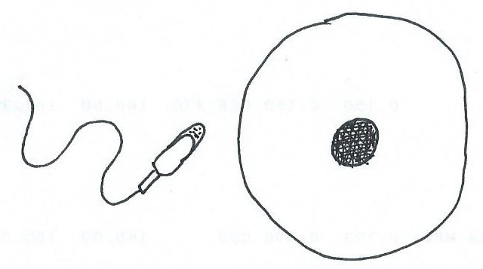
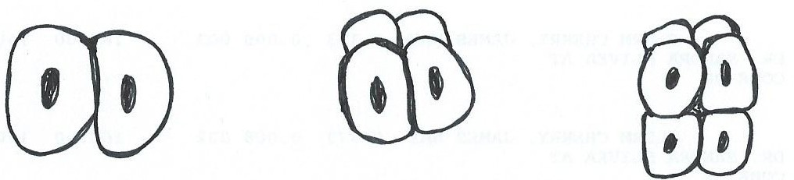
sperm cell
When the egg
cell is fertilized
= a zygote
egg cell
Then the cells begin to multiply . . .
2 cells 4 cells 8 cells

Slide 3
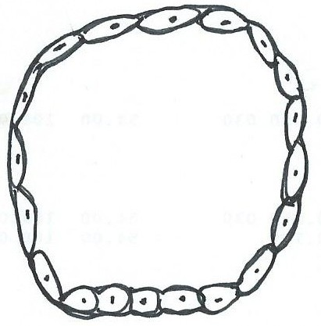
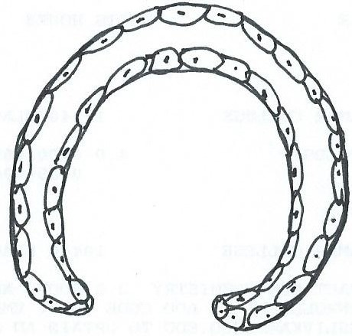
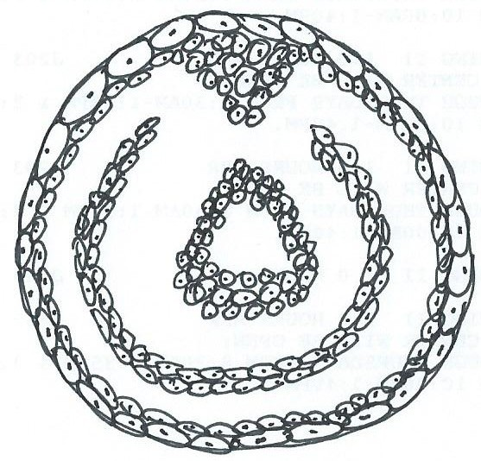
The 3 Primary Germ Layers
of the Embryo (Yolk Sac)
Blastula
Gastrula
Ectoderm
Mesoderm
Embryo
Endoderm

Slide 4
The Three Primary Germ Layers
The three primary (1º) germ layers in the body are named depending on where in embryological development they derive from. The cells in each of these layers differentiate into the cells of each of the four (4) primary tissues of the body.
Table below shows some specific tissue generated from the 3 1º Germ Layers
Endoderm | Mesoderm | Ectoderm
Entire G.I. tract, Respiratory tract (pharynx, larynx, trachea, lungs) Lining of urinary bladder, and urethra Lining of auditory canal, tonsils, thyroid, parathyroid, thymus, Liver and pancreas | All Connective tissue: (from blood to bone) Most all Muscle Tissue: Skeletal, Cardiac, Smooth Endothelium of blood vessels, lymphatic vessels, body cavities, joint cavities, Dentin of teeth Kidneys and ureters Adrenal cortex Internal reproductive organs | Epidermis of skin and epidermal derivatives: hair, nails, glands skin; Linings of oral, nasal, anal, and vaginal cavities All Nervous tissue, special sense organs Enamel of teeth Pituitary gland Adrenal medulla Lens of eye

Slide 5
Tissue = a group of cells and cell products with similar structure and function.
There are four 1º tissues in the body:
Epithelium
Connective
Muscular
Nervous

Slide 6
A. Functions of Epithelial Tissue
1) Physical Protection
Provides protective barrier of exposed surfaces, either internally or externally.
2) Regulate Exchange
Controls what enters or exits the body, ‘simple’ layers facilitate exchange.
3) Produce Secretions
Glandular epithelium produces secretions onto internal or external surfaces.
4) Provides Sensation
Epithelium is extensively innervated, for a role in detecting sensory input.

Slide 7
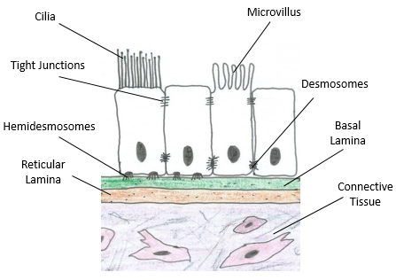
B. Characteristics of Epithelial Tissue
1) Cellularity – Most of this tissue is comprised of cells, with very little extracellular material. This tissue looks like a ‘wall of cells’.
2) Polarity – Epithelial tissue has a ‘sidedness’ to it. There is a superficial or apical surface (exposed), and a bottom or basal surface, attached to basement membrane.
Apical end specializations: a) Cilia or b) Microvilli.

Slide 8
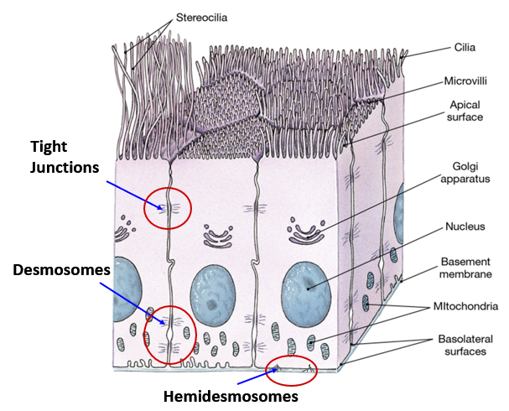
3) Attachments – Cells in epithelial tissue are physically connected to the cells adjacent to them, including above and below, as well as being attached to the basement membrane.
a) Tight Junctions
b) Desmosomes
c) Hemidesmosomes
d) Gap Junctions
4) Avascularity – Epithelial tissue does not have any blood vessels within it thus it has no direct blood supply of its own. A = without, and vascular = blood, together meaning ‘without a blood supply’. This limits how many cell layers can be living in this tissue.
5) Highly Regenerative – Epithelial tissue has a high capacity to make more of itself, in other words, it is constantly regenerating to replace itself, as it is continuously sloughed off.

Slide 9
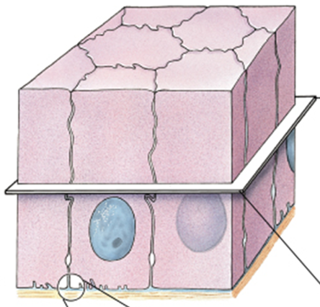
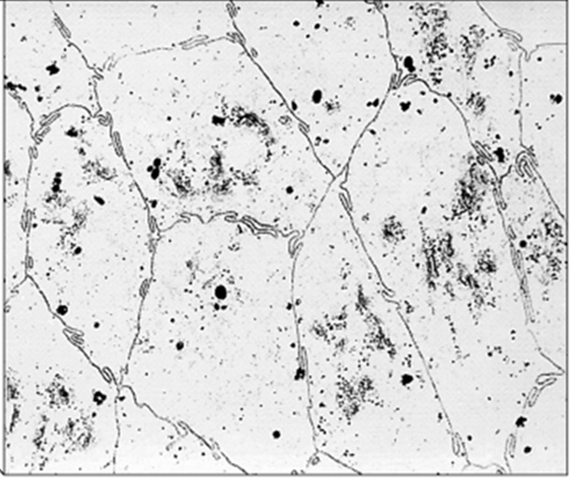
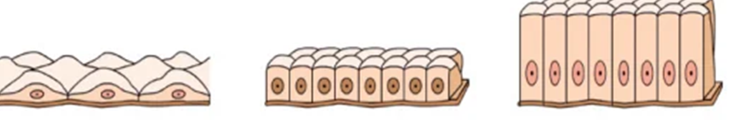
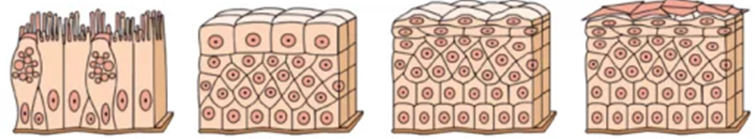
3-D Epithelial Tissue
Exposed (Apical) Surface
Epithelial histology (top view)
Anchored (Basal) Region
Types of Epithelium

Slide 10
Classification of Epithelia
1. Number of cell layers
A) Single layer of cells = Simple Epithelium
B) Several layers of cells (more than one) = Stratified Epithelium
2. Shape of Exposed (apical) cells
Squamous epithelium - Thin and flat.
Cuboidal epithelium - Short cube-shaped hexagonal boxes.
Columnar epithelium - Taller than it is wide.
Transitional epithelium - Changes shapes (from squamous to cuboidal).

Slide 11
Classification of Epithelia
Simple (only 1 cell layer)
Stratified (more than 1 cell layer)
1) Simple Squamous Epithelium
5) Stratified Squamous Epithelium
Glomerular capsule; Alveolus
Mesothelium; Endothelium
Keratinized = Epidermis of skin
Non-keratinized = esophagus, cheek
2) Simple Cuboidal Epithelium
6) Stratified Cuboidal Epithelium
Renal tubules;
Thecal follicle (thyroid gland)
Ducts of sweat glands
Ducts of salivary glands
3) Simple Columnar Epithelium
7) Stratified Columnar Epithelium
Stomach, Small and Large Intestines
Male urethra
Conjunctiva of the eye
4) Pseudostratified Ciliated
Columnar Epithelium
8) Transitional Epithelium
Ureter
Urinary bladder
Urethra
Trachea, larynx, bronchi

Slide 12
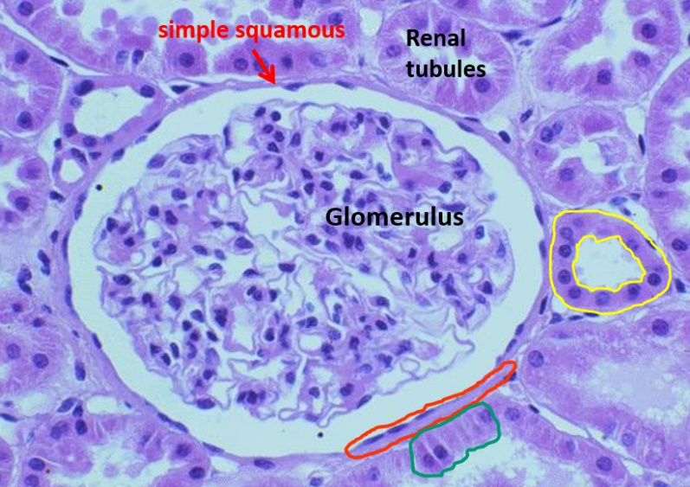
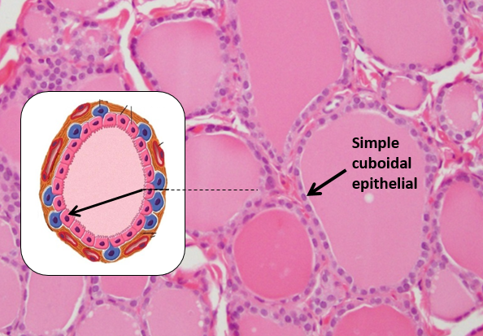
Simple Squamous Epithelium
Simple Cuboidal Epithelium

Slide 13
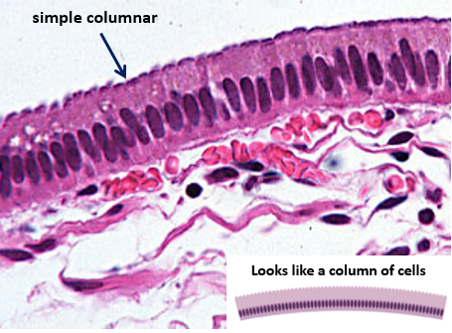
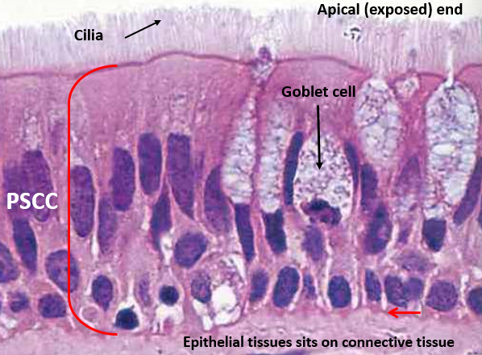
Simple Columnar Epithelium
Pseudostratified Ciliated
Columnar Epithelium

Slide 14
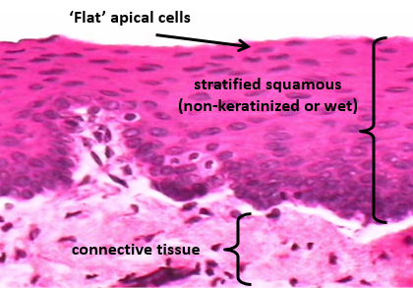
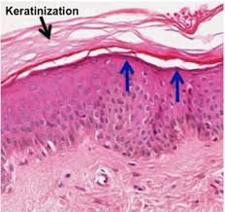
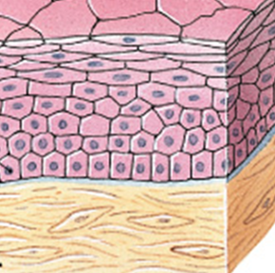
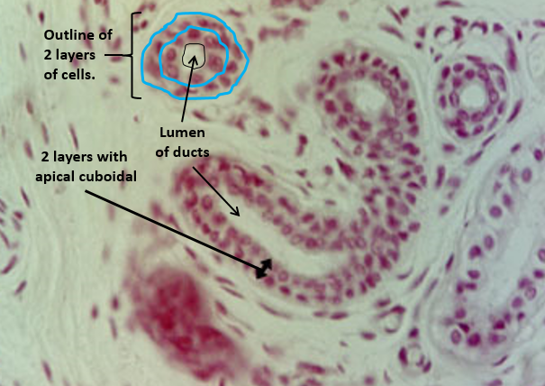
Stratified Squamous Epithelium
Wet
Dry
Stratified
Cuboidal
Epithelium

Slide 15
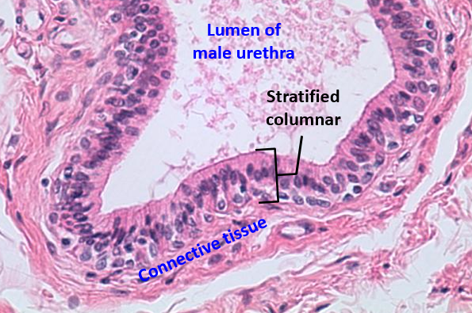
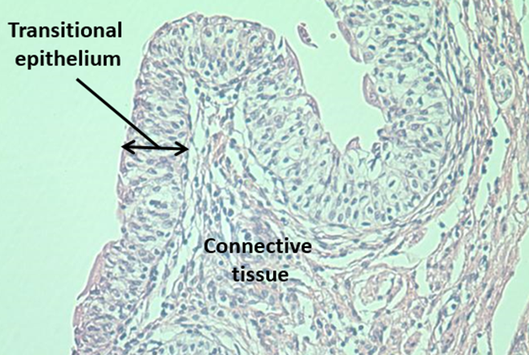
Stratified Columnar Epithelium
Transitional Epithelium

Slide 16
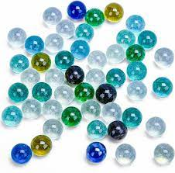
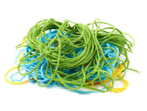
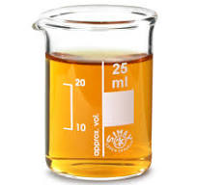
The 3 Elements of Connective Tissue
1. A variety of Cell types
2. A variety of Protein/Fibers
3. Various Ground Substances

Slide 17
1. Cells of Connective Tissue
1) Fixed cells, fibroblasts, adipocytes, chondrocytes, chondroblasts, osteocytes, osteoblast.
2) Wandering cells, like macrophages, mast cells, erythrocytes and leukocytes.
2. Fibers in Connective Tissue:
1) Collagen: thick, strong and unbranched (most common is type I collagen).
White in body, stains pink and blue in histology.
2) Reticular: very thin (type III collagen), fine, branching (‘network’) and flexible.
3) Elastic: medium thickness, from elastin, often seen in coils.
Yellow in body, stains dark in histology.
3. Ground Substance of Connective Tissue:
Most common components of connective tissue ground substance are: 1) Hyaluronic acid, and 2) Glycosaminoglycans (Mucopolysaccharides).
Plus: Chondroitin sulfate is found in all cartilage tissue, it’s responsibly for the ‘rubbery’ matrix. Also, Calcium hydroxyapatite Ca₁₀(PO₄)₆.2OH (a calcified crystalline structure) is found in bone, it makes the matrix hard (calcified).

Slide 18
Functions of Connective Tissue
1) Structural Framework – For internal interconnecting, packing, binding tissues.
2) Protection – Insulates vital organs (skull, rib cage, adipose), buffers and cushions internal organs (areolar and reticular) cover and bind many organs.
3) Storage within Body – Adipose stores energy (as triglycerides or fats). Bone stores minerals calcium and phosphate, plus many trace minerals in its calcified matrix.
4) Transportation – Blood and lymph fluids transport material through the body.
5) Repair and Healing – CT is the ultimate ‘fallback’ tissue for healing and making repairs in body. Any gap or injury is filled by CT. Scar tissue usually result of ‘back-filling’ with collagen fibers when a wound is deep or significant.
Note: The arrival of blood to any tissue signifies an increase in repair and healing potentials. Blood and lymph also serves in a defense role for the body.

Slide 19
B. Characteristics of Connective Tissue
1) Abundance of Extracellular Material – Most cells in CT are not closely packed (like epithelium). The fibers and ground substance exist in various proportions and arrangements.
Note: *The main difference between loose and dense connective tissue is how densely packed the matrix is with fibers.
2) Various Specialized Cells – The cells are versatile in size, shape and function, depending on the specific type of CT (they are not ‘consistent’ as in epithelium).
Many cell types in CT continue to differentiate (e.g., osteoblasts become…).
3) Blood Supply Varies – Some CT is richly vascularized, e.g., bone, adipose and areolar. Other tissue is moderately supplied, e.g., dense irregular and reticular CT. Some are scantly supplied, e.g., dense regular (tendons and ligaments). Finally, all cartilage (hyaline, elastic and fibrocartilage) are avascular (no direct blood supply).
4) Nervous Innervation – All CT has nervous innervation (supplied by nerves) but most connective tissue is not very richly innervated, and therefore not highly sensitive.

Slide 20
Connective Tissue
Fluid Connective Tissue
Blood
Lymph
Connective Tissue Proper
Loose
  Areolar
  Adipose
  Reticular
Dense
  Regular
  Irregular
  Elastic
Supporting Connective Tissue
Cartilage
  Hyaline
  Elastic
  Fibrocartilage
Bone
  Spongy
  Compact

Slide 21
Connective Tissue
Fluid Connective Tissue
Blood – in blood vessels and heart.
Lymph – in lymph vessels and lymph nodes.
Connective Tissue Proper
Loose
  1) Areolar - Papillary region of dermis,
  around blood vessels, C.T. of membranes.
  2) Adipose - Hypodermis, eye sockets,
  renal fat capsule.
  3) Reticular - Spleen, lymph node,
  capsule of liver and kidney.
Dense
  Regular – Tendons, ligaments.
  Irregular – Joint capsules
  Reticular region of dermis.
  3) Elastic – Elastic ligaments, walls of
  arteries, penile ligaments.
Supporting Connective Tissue
Cartilage
  Hyaline – nose, trachea, larynx,
  Costal cartilage, articular cartilage.
  Elastic – epiglottis, external ear.
  Fibrocartilage – intervertebral disc, pubic symphysis, menisci.
Bone
  Spongy – inner portion.
  Compact – outer portion.

Slide 22
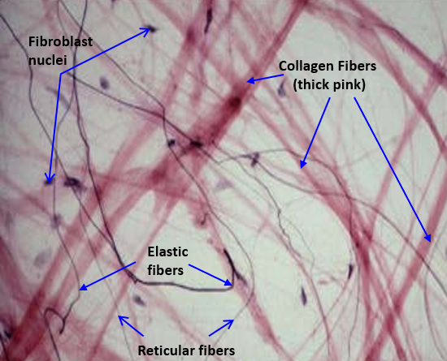
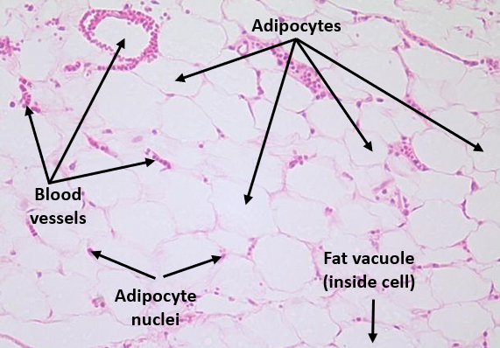
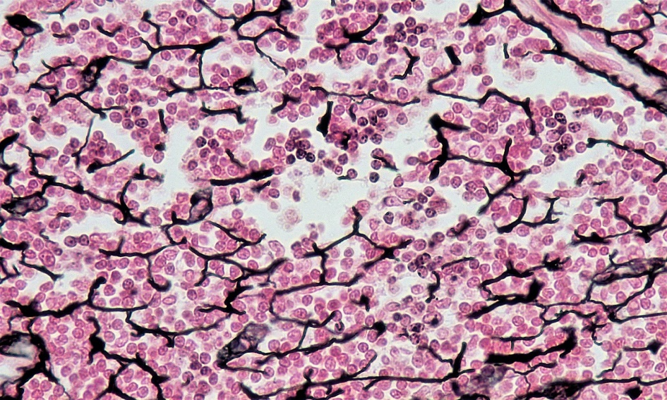
Areolar Tissue
Adipose Tissue
Reticular Tissue

Slide 23
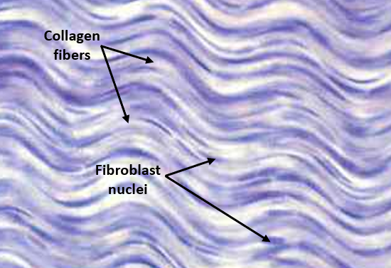
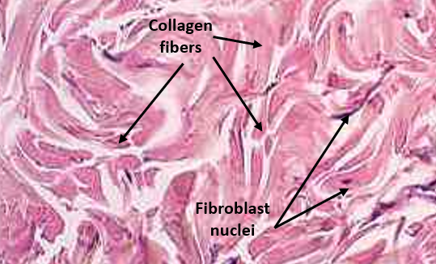
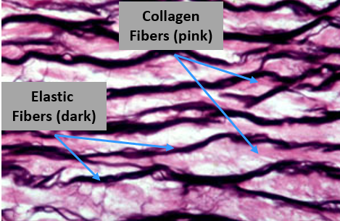
Dense Regular CT
Dense Irregular CT
Elastic Tissue

Slide 24
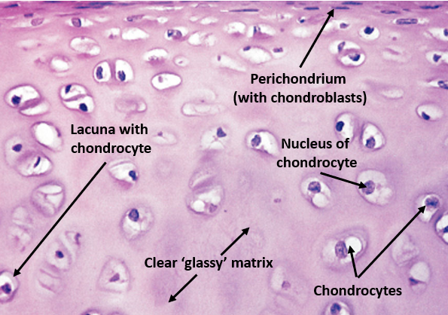
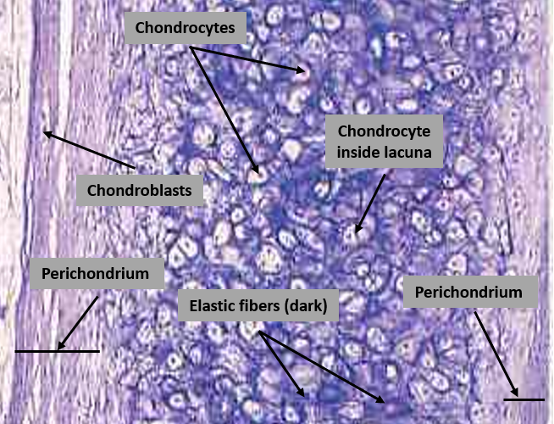
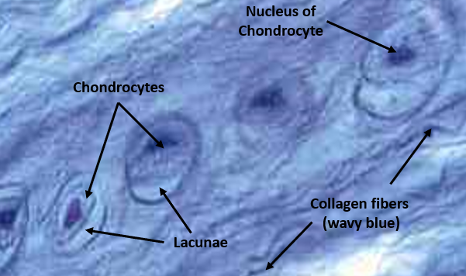
Hyaline Cartilage
Elastic Cartilage
Fibrocartilage

Slide 25
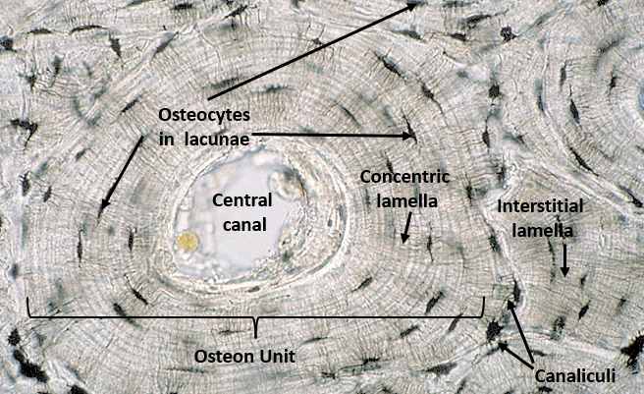
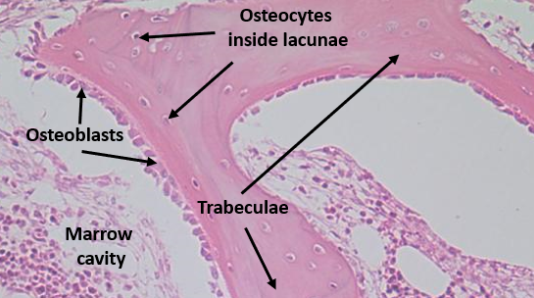
Compact Bone
Spongy Bone

Slide 26
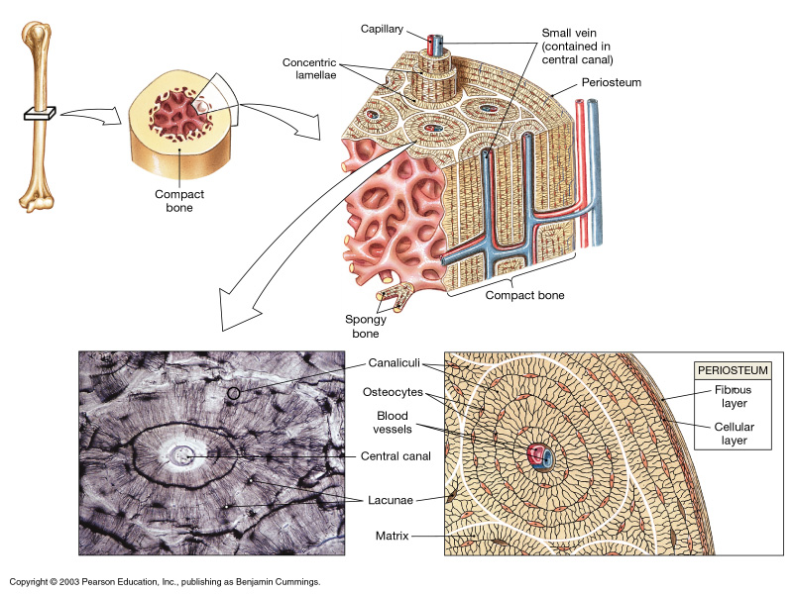
Bone Tissue
Compact Bone

Slide 27
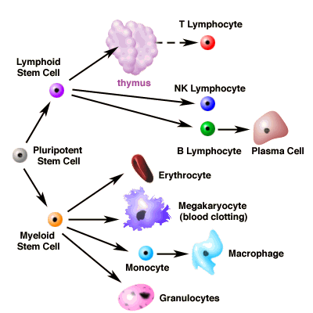
Fluid Connective Tissue
Hematopoietic stem cells produce blood and lymph cells

Slide 28
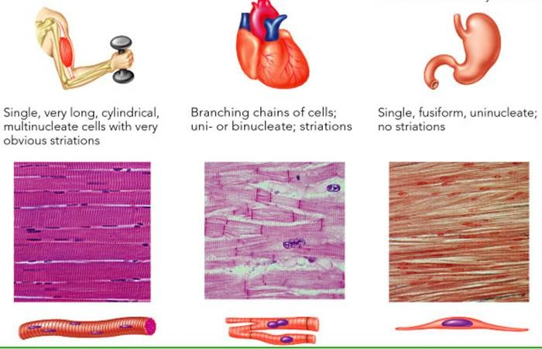
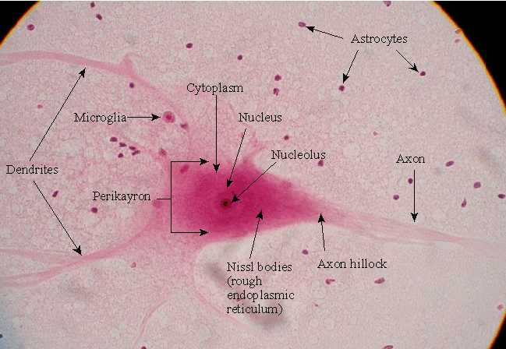
Muscle Tissue
Skeletal
Cardiac
Smooth
Nervous Tissue
Neurons
and
Glial cells

