Slide 1
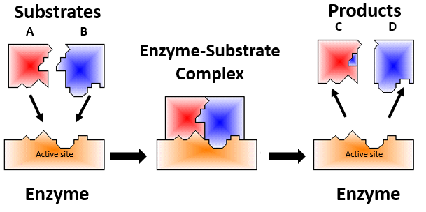
Enzymes are Proteins that act as Biological Catalyst
They speed up rate of chemical reactions w/out being consumed in process.
The active site on the enzyme is where the substrates bind.
Substrates are the reactants in a chemical reaction requiring enzymes.

Slide 2
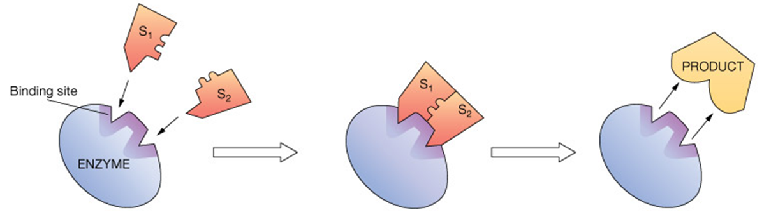
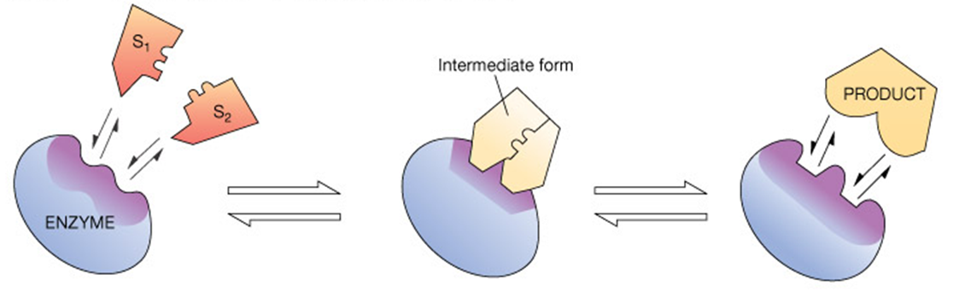
Specificity: a) Lock and Key or b) Induced Fit
a) Lock-and-Key model
Earlier model, where enzyme active binding site thought to be exact match for substrates.
b) Induced-Fit model
More recent model, where active binding site of enzyme is not a rigid shape but changes as substrates approach in order to achieve an optimal fit for the reaction to occur.

Slide 3
Naming of Enzymes
Most enzymes end with ase and typically their name indicates their function or the substrates they bind. Some important examples:
kinase - adds phosphates to molecules;
phosphotase - removes phosphates from molecules;
dehydrogenase - removes Hydrogens;
hydrolase - adds H₂O;
synthase - dehydration synthesis reactions;
carbonic anhydrase - removes H₂O from carbonic acid;
amylase - digests starch;
lipase - digests lipids;
protease - digests proteins.

Slide 4
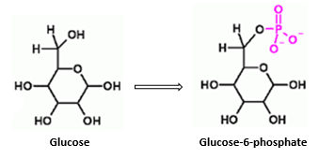
Enzyme Specificity - ability of an enzyme to catalyze only certain reactions. Some are very specific, such as glucokinase.
It catalyzes this reaction:
glucokinase
Glucose + P_{i} Glucose 6-P.
*Other enzymes have broader specificities,
e.g. peptidases break all peptide bonds.
The type and amount of enzymes in the body can vary.
e.g., alcohol dehydrogenase removes H’s from ethanol (‘alcohol’) thereby reducing its toxic effects.
Q: Is everyone’s ability to “handle” alcohol the same?

Slide 5
Enzyme Activation
Some enzymes exists in an inactive state and need to be activated.
There are 3 categories of enzyme activation
1) Proteolytic Activation:
e.g.
Pepsinogen + HCl
(inactive)
Pepsin
(active)
(longer)
(shorter)
Other Examples of Proteolytic Activation:
Fibrinogen - > becomes…
Thrombinogen - > becomes…
Angiotensinogen - > becomes …

Slide 6
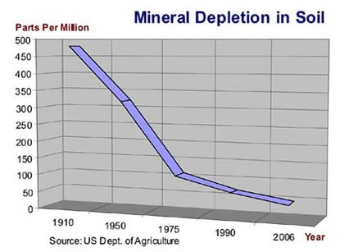
Enzyme Activation
2) Co-factors:
Inorganic components required for substrate binding at the active site.
These are usually ions, often metals like zinc and copper.
e.g., Zn²⁺, Cu²⁺,Ca²⁺, Mg²⁺ …
The enzymes that require them will not work without them. Cofactors induce conformational (shape) changes to allow binding of the substrate.
Cofactor | Example Enzymes
Zn²⁺ | carbonic anhydrase
Zn²⁺ | alcohol dehydrogenase
Cu²⁺ | cytochrome oxidase
K⁺ and Mg²⁺ | pyruvate phosphokinase

Slide 7
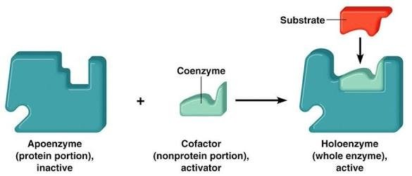
3) Co-enzymes:
Small organic molecules to accept and transfer electrons (e⁻s) from different enzymatic reactions.
Bind loosely to an enzyme at active site to help catalyze reactions. They are usually vitamins, vitamin derivatives, or from nucleotides.
e.g., Co-enzyme NAD⁺ shuttles e⁻s in glycolysis
Apoenzyme – is an inactive enzyme that requires a cofactor or coenzyme.
Holoenzyme – is a complete and catalytically active enzyme because it has its cofactor or coenzyme.

Slide 8
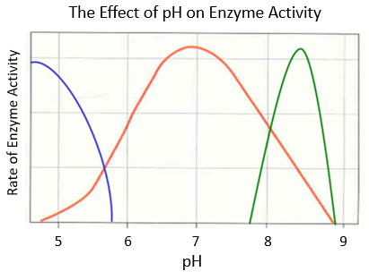
Factors that Effect Enzyme Activity
Once an enzyme is active, several factors can modulate (change) its activity.
1. pH (Acidity/Alkalinity)
Enzymes function within certain pH ranges. Changes in pH alter 3º structure. Beyond a critical level (outside its optimal pH range), the enzyme is denatured.
Compare enzymes of mouth, stomach and small intestine.
*Salivary amylase breaks down starch to maltose in the mouth, has an optimum pH 6.7 to 7.0.

Slide 9
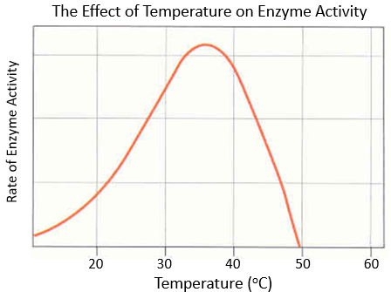
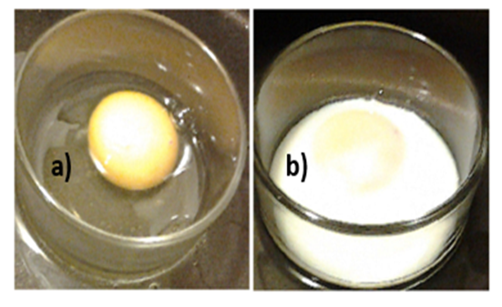
2. Temperature
Enzymes function within certain and temperature ranges. Most human enzymes are optimal at ~ 37ºC. Again, beyond a critical level, enzymes are denatured.
Think of the effects of a fever on enzymes in the body.

Slide 10
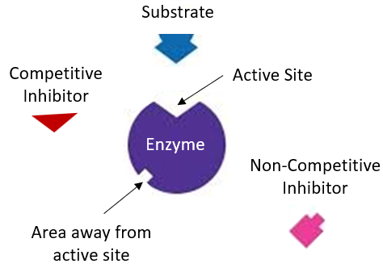
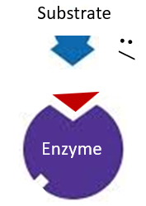

3. Inhibitors - Molecules that bind to enzymes and inhibit the true substrate from binding: There are two categories:
Competitive Inhibitors
Non-Competitive Inhibitors
a) Competitive Inhibitors bind to the active site without being acted on, thus reducing reaction rate of true substrate(s). In some cases, the competing molecule is acted on by the enzyme, but again, inhibits reaction with natural substrate.
Reaction Inhibited!

Slide 11
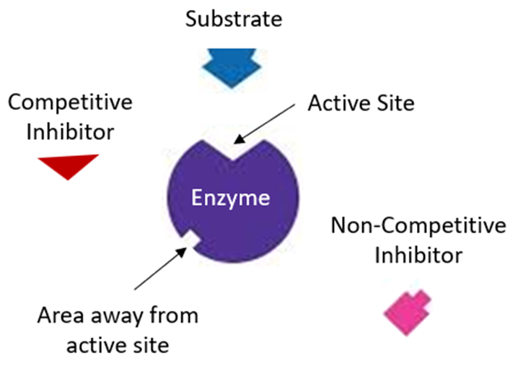
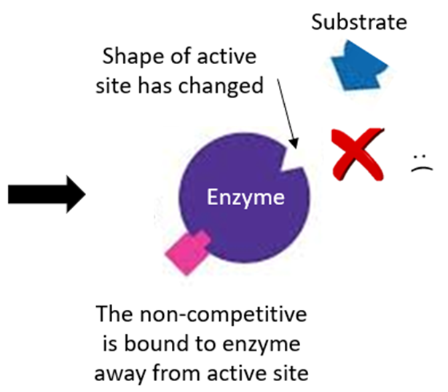
b) Non-Competitive Inhibitors bind at some site other than the active site. They do not directly interfere with enzyme-substrate binding but inhibit the enzyme from catalyzing the reaction. Some act by binding to enzyme cofactors.
Reaction Inhibited!
This is also called Allosteric Inhibition, not to be confused with Allosteric Modulation

Slide 12
Enzymes Control Metabolic Pathways:
e₁
e₂
e₃
A
B
C
D
Substrate
(initial reactant)
e₄
Intermediates
(within pathways)
End Products
(can inhibit the start of the pathway)
An end product can inhibit first enzyme
e₅
E
F
This is called End Product Inhibition
When the end of a pathway controls the start of it.
An end product inhibiting one enzyme can stop multiple pathways!

Slide 13
*Allosteric Modulators - these bind away from active site but in doing so alter the shape of the active site. This can increase or decrease enzyme affinity for substrates.
Covalent Modulators - bind covalently to enzyme away from the active site, change the shape, thus function of the enzyme.
e.g., Phosphate groups are one of the most common and important covalent modulators in the human body.
P
Active
Sites
Changes in Active Sites
Enzyme
Enzyme
Allosteric inhibitors (like ‘end-product inhibition’) only inhibit, but allosteric modulators can turn enzyme activity up or down!

Slide 14
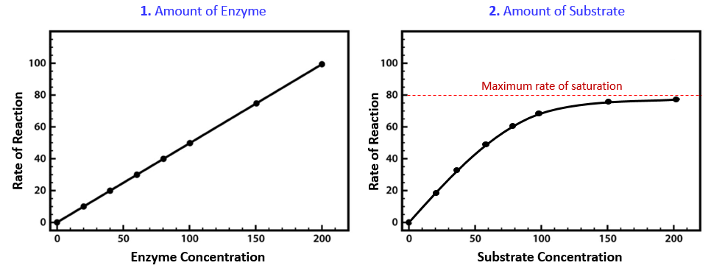
Enzyme and Substrate Concentration Affect Reaction Rate
The rate of enzymatically catalyzed reactions assessed by measuring product synthesis (or substrate consumption).
Reaction Rate is:
1. Directly Related to the Amount of Enzyme Present.
If the substrate concentration ([substrate]) is kept constant, then the more enzyme that is present, the greater the rate of the reaction (i.e., the more product is produced).

Slide 15
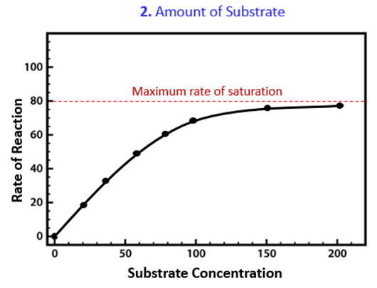
2. Related to the Amount of Substrate Present and can Reach a Maximum.
If the enzyme concentration ([enzyme]) is held constant, the reaction rate will increase as [substrate] increases but there is a limit to how fast a reaction can go.

Slide 16
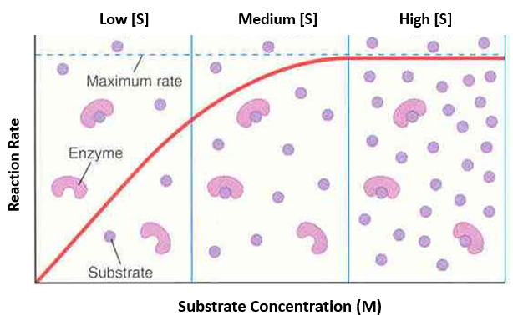
Visualization of enzyme to substrate ratios, the reaction rate can increase up to a point where all enzymes are occupied (saturated)

