Slide 1
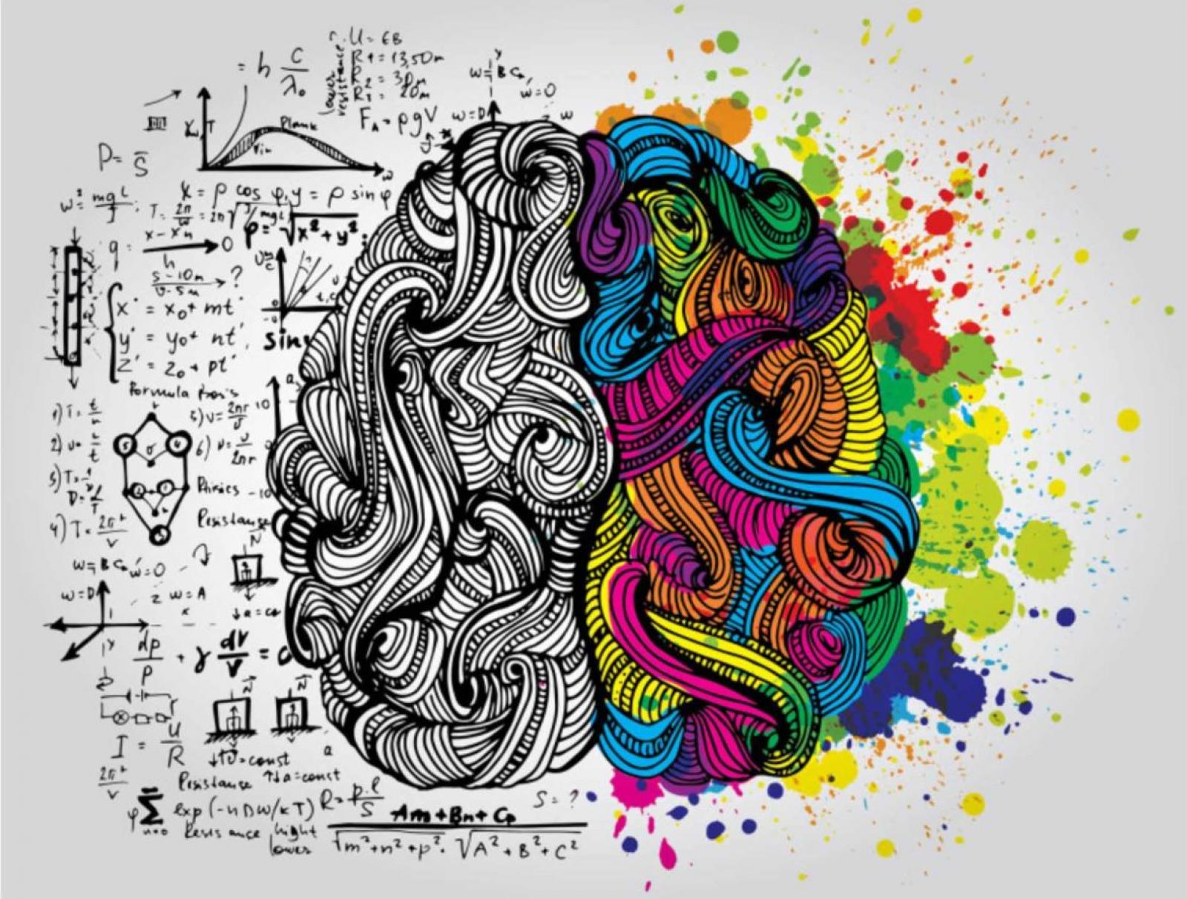
Human Physiology
Left Right

Slide 2
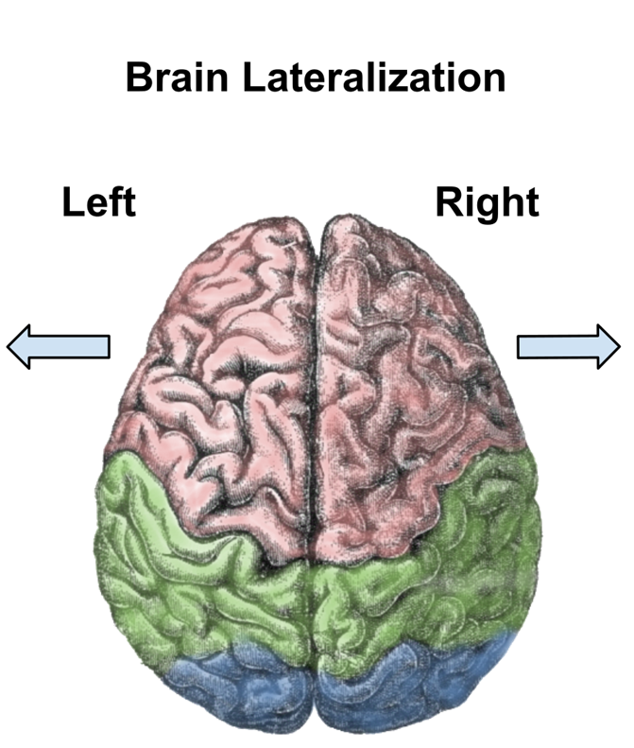
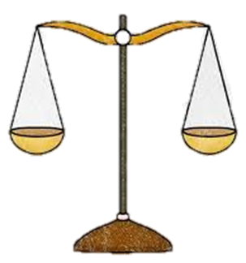
Analytical
Logical
Precise
Repetitive
Organized
Detailed
Belief
Sequential
Literal
Detached
Verbal
Creative
Imaginative
General
Intuitive
Conceptual
Holistic
Heuristic
Irregular
Figurative
Empathetic
Non-Verbal

Slide 3
Etymology (word origin; derivation of words):
Physiology
From 1560’s, French and directly from Latin physiologia.
“Study and description of natural objects, natural philosophy".
Derived from physios = "nature, natural, physical"; and logia = "study".
This gives the meaning of "science of the normal function of living things".
Anatomy
From Late 1300’s, Latin anatomia, Greek anatome.
“Study or knowledge of the structure and function of the human body“.
Derived from ana = "up"; and tomos (or temnein) = "to cut".
Together this gives "a cutting up" involving dissection.

Slide 4
Compare Function and Process in terms of Physiology
Functional Questions:
Purpose of event?
Process Questions:
How is event achieved?
Why do we breathe?
Why do RBCs transport O₂? Why do people faint?
How do we breathe?
How do RBCs transport O₂? How do people faint?
Integration of both to get the
holistic picture!

Slide 5
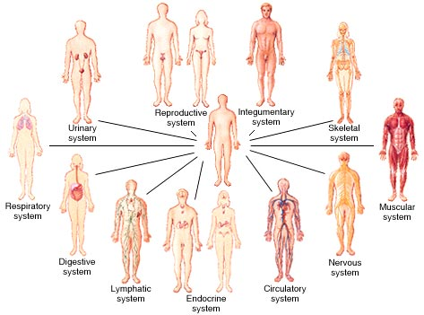
Levels of Organization: … Atoms … → …. Cells → … (starting point for Physiology)
The Systems that make up the Body in Human Physiology

Slide 6
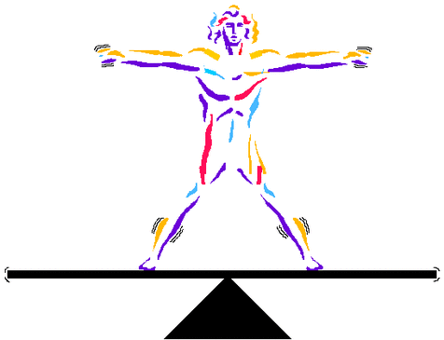
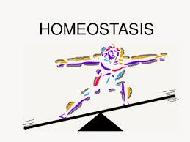
Homeostasis
Typical values of a Metabolic Blood Panel
Parameter | Blood Levels
Osmolarity | 295 to 310 mOsM
pH | 7.35 to7.45
Arterial blood gas P_{CO2} | 35 to 46 mmHg
Arterial blood gas P_{O2} | 80 to 100 mmHg
Hematocrit (HCT) | 42 to52% Male
 | 37 to 48% Female
Blood Sugar Regulation | Blood Levels
Glucose (fasting) | 70 to 100 mg/dL
Glucose - 2 hrs post prandial | 140 mg/dL
Insulin (fasting) | 5 to 25 mU/mL
Glucagon | 50 to 100 pg/mL
Ions/Minerals | Blood Levels
Sodium (Na⁺) | 135 to 145 mM
Potassium (K⁺) | 3 to 5 mM
Calcium (Ca²⁺) | 1.8 mM
Chloride (Cl⁻) | 106 mM
Phosphorus (i) (PO₄³⁻) | 3-4 mM

Slide 7
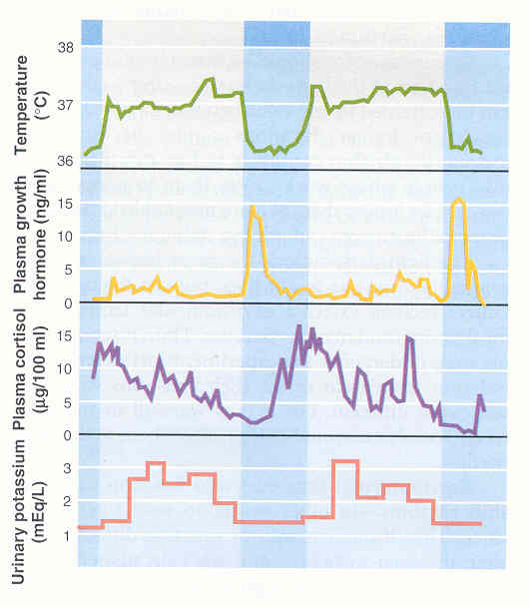
Lights on (daytime)
Lights off
38
37
36
Body
Temperature (ºC)
15
10
5
0
Plasma Growth
Hormone (ng/ml)
15
10
5
0
Plasma Cortisol
(mg/100 ml)
3
2
1
Urinary K⁺
(mEq/L)
Figure 1. Circadian rhythms with room lights on (clear bars) for 16 hrs and lights off (blue bars) for 8 hrs.

Slide 8


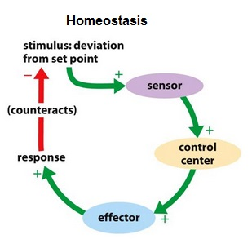
Homeostasis is maintained by
Feedback Loops

Slide 9
3
4
5
1. Stimulus
2. Receptor
3. Afferent Pathway
4. Integration Center
5. Efferent Pathway
6. Effector Tissue
7. Response
2
6
1
7

Slide 10
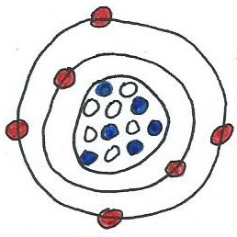
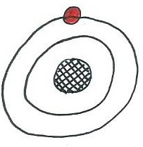
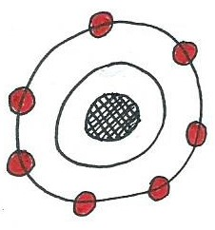
THE CHEMISTRY OF PHYSIOLOGY - REVIEW
Levels of Organization:
atoms > molecules > organelles > cells > tissues > organs > organ systems > organism
Valence e⁻ –> outer shell electrons = chemical properties of atom.

Slide 11
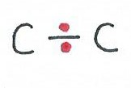
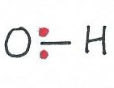
3 Types of Chemical Bonds
Covalent bonds – sharing of electrons between atoms; strong bonds.
  Non-polar = equal sharing of e⁻s e.g. lipids
  Polar = non-equal sharing of e⁻s e.g. water
2. Ionic bonds – complete transfer of electrons, relatively weak bond (though crystals are strong), break in water yielding ions (charged particles).
Yielding Na⁺ and Cl⁻
Na atom Cl atom
3. Hydrogen bonds – weak but sig attractive forces between a H atom in one molecule and an O or an N atom in another molecule.
Molecules: Inorganic molecules – e.g. H₂O.
Organic molecules – e.g. C₆H₁₂O₆.

Slide 12

Properties of Water
1) Solvency - universal solvent.
2) Cohesion – creates surface tension, and adhesion.
3) Thermostability - high heat capacity, high heat of
vaporization. Definition of calorie.
4) Reactivity - Water participates in chemical
reactions
e.g. Hydrolysis and Dehydration Synthesis

Slide 13
Organic Molecules:
Carbohydrates
Monosaccharides – simple sugars (monomers).
1. Glucose – the molecule as a source of E in the human body.
2. Fructose – a simple sugar found in fruits (fruit sugar).
3. Galactose – a component of milk sugar.
Disaccharides – 2 monosaccharides joined by a glycosydic bond.
1. Sucrose (table sugar) = glucose + fructose
2. Lactose (milk sugar) = glucose + galactose
3. Maltose (grain sugar) = glucose + glucose
Polysaccharides – complex carbohydrates – polymers of glucose.
1. Glycogen - E storage for glucose in animal cells, liver, skeletal mus.
2. Starch - E storage for glucose in plant cells, e.g., potatoes.
3. Cellulose - structural component of plant cell walls, e.g., dietary fiber.

Slide 14
Lipids
In general are non-polar molecules, not solvent in water.
Fatty Acids – fatty acids and glycerol.
Triglycerides – mono, di, tri ...
3) Phospholipids – amphiphilic (polar and non-polar)
4) Steroids – complex and important!
Proteins
Contains C, H, O, N, S. most versatile and complex Amino Acids (AA’s) are the monomers of proteins.
Levels of Structures of Proteins:
Primary (1º) –
Secondary (2º) –
Tertiary (3º) –
Quaternary (4º) –

Slide 15
THERMODYNAMICS - How Energy is converted to Work.
1st Law of Thermodynamics
2nd Law of Thermodynamics
The Human Body:
Food (PE) is used to move and operate (KE) the body.
e.g., 100 Kcal of food is consumed, ~ 60 Kcal lost as heat, ~ 40 Kcal used for movement (chemical, transport and mechanical) of the body.
i.e., conversion in our bodies is about 40% efficient.
Efficiency changes…

Slide 16
What is Energy?
What is Work?
1) Chemical Work – chemical bonds (invest, store, release E).
2) Transport Work – movement across a gradient.
3) Mechanical Work - movement of a part or 'whole‘.
Let’s examine 2 forms of Energy:
Kinetic Energy (KE) and Potential Energy (PE)
KE and PE can be converted from one form to the other but it is never a 100% efficient conversion.
Work (chemical, transport, mechanical) in body involves inter-conversion of these 2 forms of E.

Slide 17
Chemical Reaction in Body - to Store, Release, or Transfer E.
Metabolism = Anabolism + Catabolism
1) Endergonic Reactions – Require Energy (E) input
e.g. A + B + E → C
Dehydration Synthesis:
Anabolic Reactions –synthesizing something, building a more complex, larger molecule from simpler, smaller molecules, require input of E.
2) Exergonic Reactions – Release Energy (E)
e.g. C → A + B + E
Hydrolysis:
Catabolic Reactions – they are breaking chemical bonds. Large molecules are broken down to produce smaller molecules, release E that can be used for physiological work.

