Slide 1
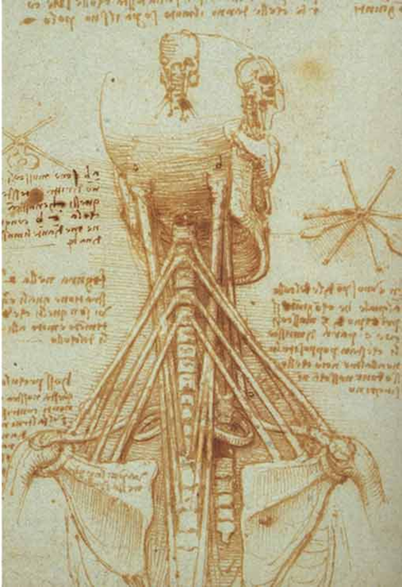
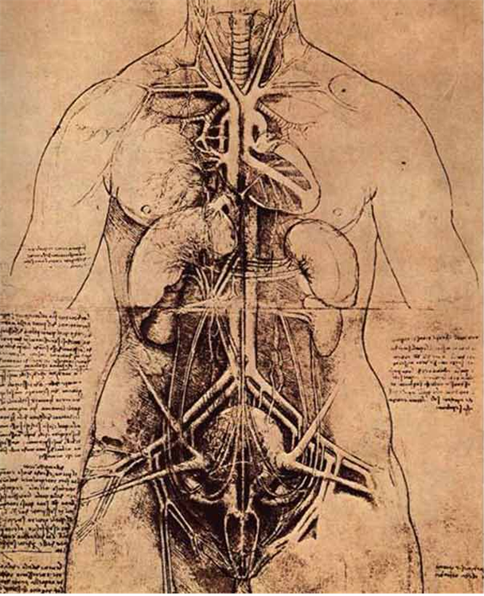
Human Anatomy
The Study of Human Form and Structures

Slide 2
The term Anatomy comes from Late 1300’s:
Anatomia (Latin) and Anatome (Greek)
ana meaning "up"
tomos (or temnein) which means "to cut"
Together this gives "a cutting up“ (Dissection).
Anatomy is considered the “Study or knowledge of the structure (form) and function of the human body“.
Etymology (word origin ) is very important is understanding anatomical terms

Slide 3
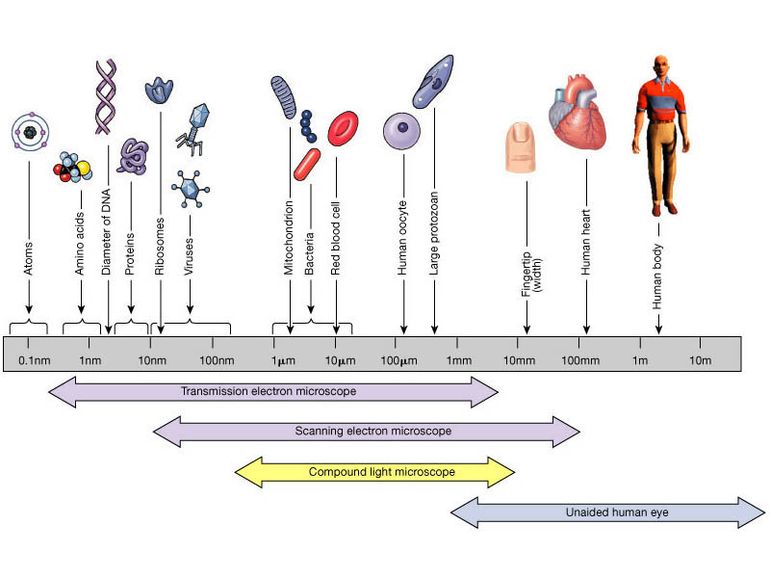
Microscopic Anatomy
Gross Anatomy

Slide 4
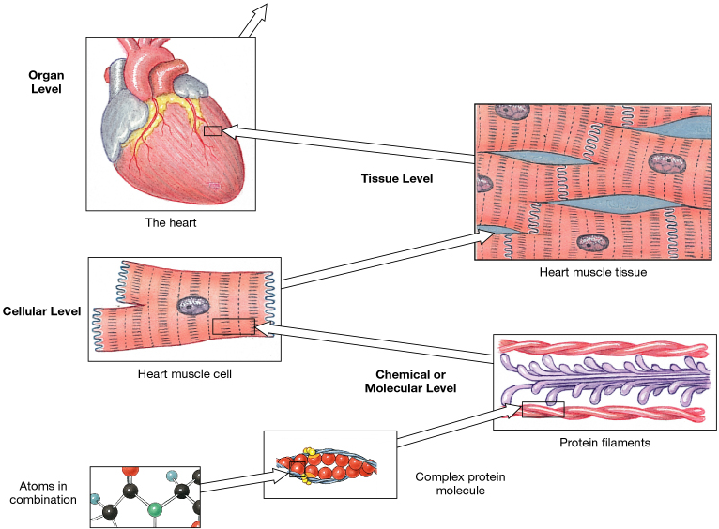
Levels of Organization
in Human Anatomy

Slide 5
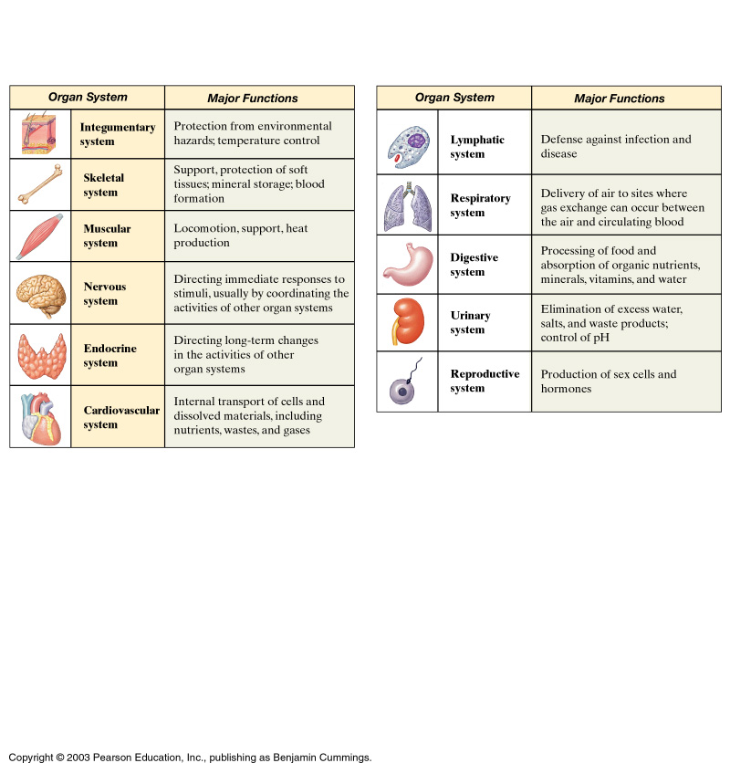
Organ Systems of the Body

Slide 6
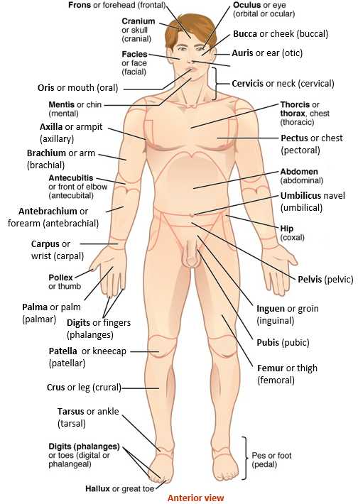
Anatomical Regional Terms

Slide 7
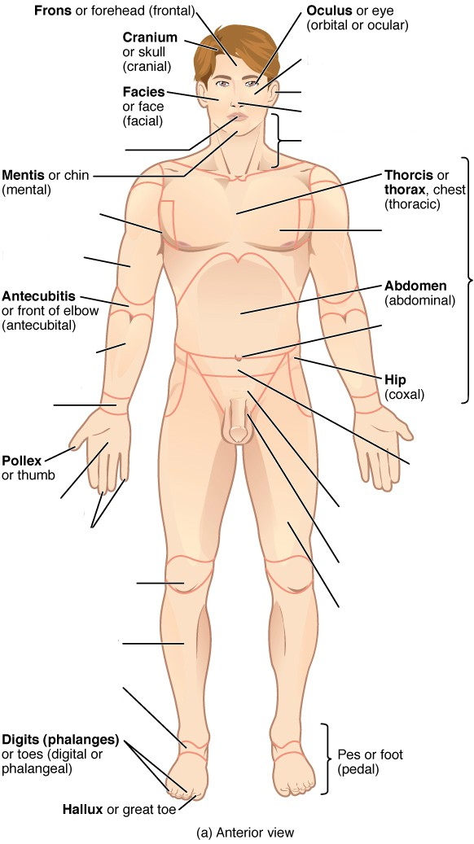
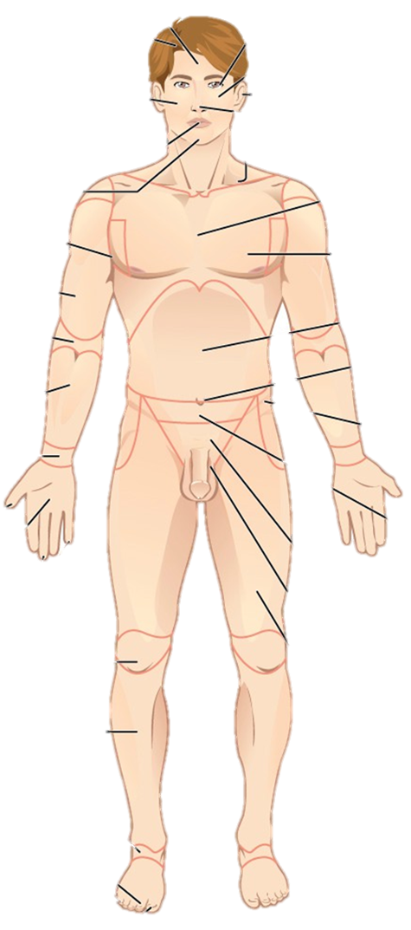
1
31
Bucca or cheek (buccal)
30
Auris or ear (otic)
2
29
Cervicis or neck (cervical)
3
28
Oris or mouth (oral)
27
4
26
Axilla or armpit
(axillary)
5
Pectus or chest (pectoral)
25
Brachium or arm (brachial)
6
24
7
Umbilicus navel (umbilical)
23
Antebrachium or forearm (antebrachial)
8
Carpus or wrist (carpal)
9
22
Pelvis (pelvic)
10
21
Palma or palm (palmar)
Inguen or groin (inguinal)
Digits or fingers (phalanges)
11
12
20
Patella or kneecap (patellar)
Pubis (pubic)
Femur or thigh (femoral)
13
19
Crus or leg (crural)
14
18
Tarsus or ankle (tarsal)
15
16
Anterior view
17

Slide 8
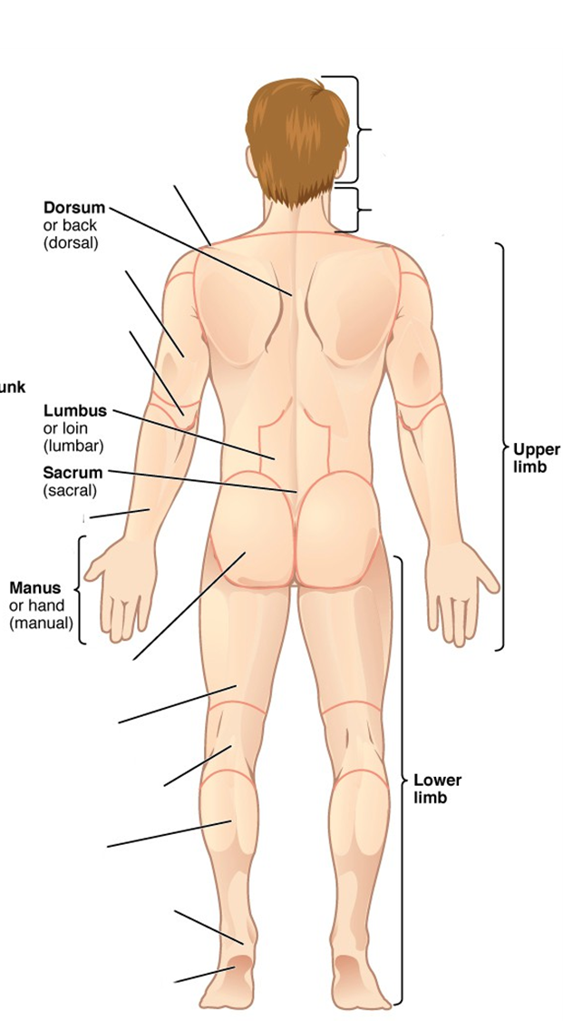
Shoulder
(acromial)
Cephalon or head (cephalic)
40
32
Dorsum or back
(dorsal)
Cervicis or neck
(cervical)
33
27
Brachium or arm (brachial)
6
Olecranon or back of elbow (olecranal)
34
Lumbus or loin (lumbar)
35
Upper
limb
44
Sacrum (sacral)
36
Antebrachium or forearm (antebrachial)
8
Manus or hand (manual)
37
Gluteus or buttock (gluteal)
38
Femur or thigh (femoral)
18
Popliteus or back of knee (popliteal)
Lower
limb
39
43
Sura or calf
(sural)
40
Calcaneus or heel of foot (calcaneal)
41
Planta or sole of foot (plantar)
42
Posterior view
Posterior view

Slide 9
Selected anatomical regions and commonly
used “layperson’s” terminology.
Anatomical Landmarks | Common Term
1. Cranial | Skull
2. Cervical | Neck
3. Acromial | Shoulder
4. Thoracic | Chest
5. Abdominal | Belly
6. Gluteal | Buttock
7. Inguinal | Groin
8. Axillary | Armpit
9. Brachial | Arm
10. Olecranon / Antecubital | Elbow (back) / Fossa (front)
11. Antebrachium | Forearm
12. Carpal | Wrist
13. Manual | Hand
14. Digits (Phalanges) | Fingers
15. Femoral | Thigh
16. Patellar | Knee (front)
17. Popliteal | Back of knee
18. Crural | Leg (front)
19. Sural | Calf (back)
20. Tarsal | Ankle

Slide 10
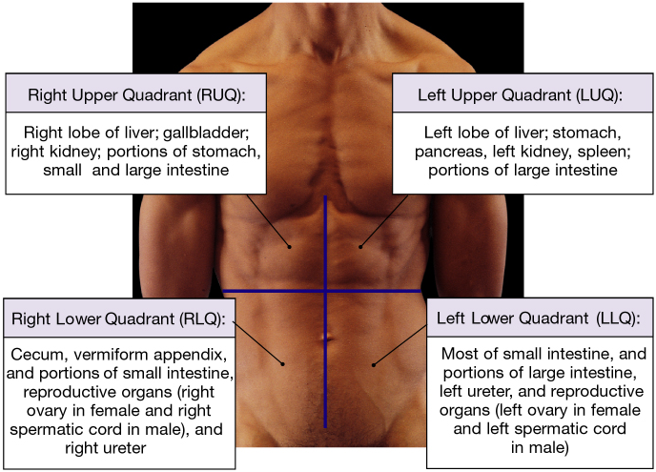
Abdominopelvic Quadrants and Regions

Slide 11
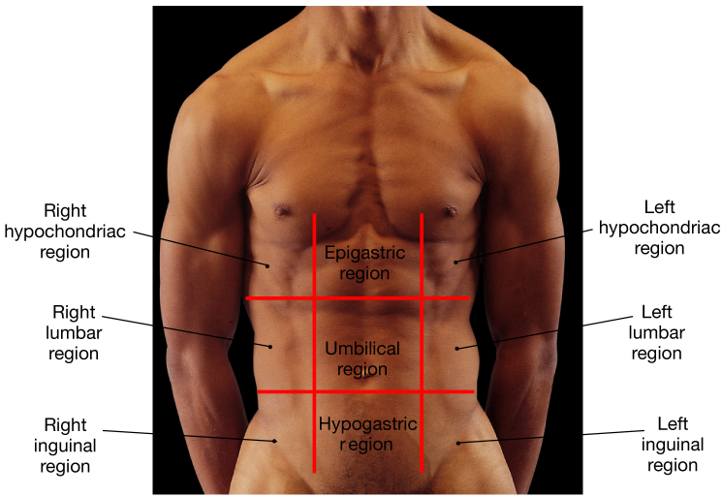
9 Quadrants

Slide 12
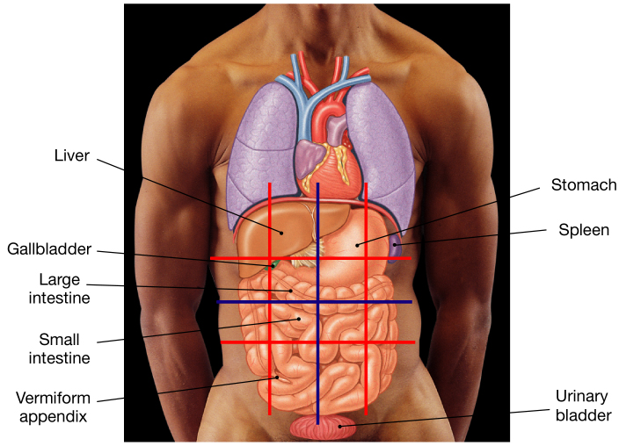
Structures in these Regions

Slide 13
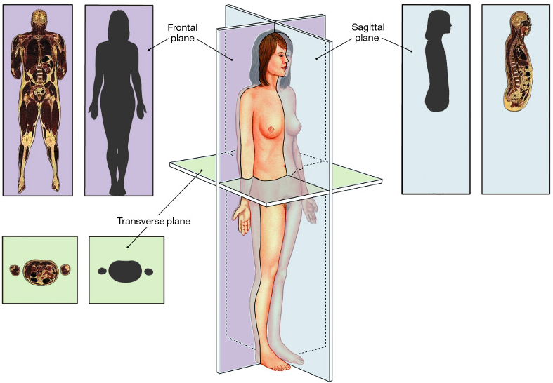
Sectional Planes

Slide 14
Sectional Anatomy
Three sectional planes of the body
1. Frontal (Coronal) plane
Longitudinal
2. Sagittal plane (mid- and para-)
3. Transverse (Horizontal) plane

Slide 15
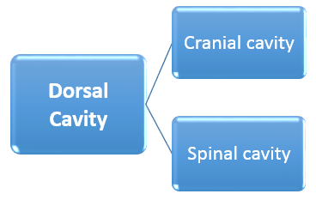
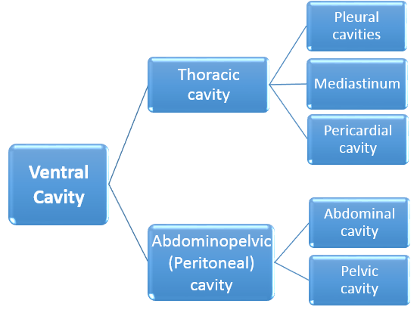
The Body Cavities
Dorsal (back) and Ventral (front)
Brain protected by bones of the skull. Also covered by meningeal layers and bathed in cerebrospinal fluid (CSF).
Spinal cord protected by the vertebrae of the spinal column. Further protected by the spinal meninges and CSF.
Two cavities, containing the R and L lungs, surrounded by pleural fluid.
The area in between the two lungs, contains the heart, thymus gland, trachea, esophagus, aorta, great veins & nerves.
Contains the heart, bathed in pericardial fluid.
Stomach, small intestine, liver, gallbladder, pancreas, spleen, and the colon.
Bladder, rectum, lower colon and reproductive organs.

Slide 16
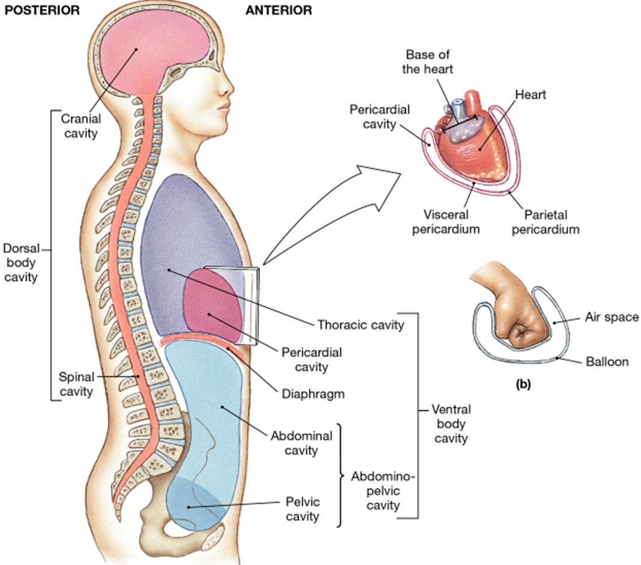
Posterior
(Dorsal)
Anterior
(Ventral)

Slide 17
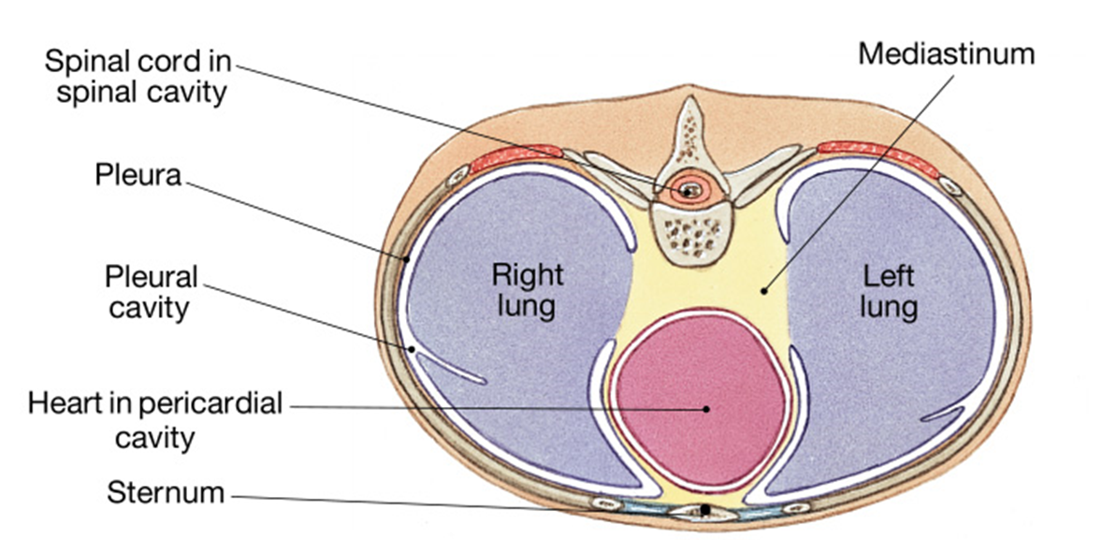
Sectional View
What kind of sectional view (plane) is shown in the diagram above?
Can you identify anterior and posterior regions?
What general body cavity is being shown in the diagram above?

Slide 18
Dorsal Body Cavity
1. Cranial Cavity
    Contains the brain and CSF.
    Protects this delicate tissue.
2. Spinal Cavity
    Contains the spinal cord and CSF.
    Protects this delicate tissue.

Slide 19
Ventral Body Cavity
1. Thoracic Cavity
    Contains:
    a) Plural cavities (lungs inside).
    b) Mediastinum
    i) Pericardial cavity (heart).
2. Abdominopelvic Cavity
    Contains: stomach, intestines, gallbladder,
    liver, spleen, bladder, reproductive organs.

Slide 20
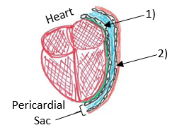
  Mediastinum (=area between the 2 lungs)
  Contains: Heart, thymus, trachea, esophagus, vessels (aorta, vena cavae), nerves.
Serous Membranes - line ventral body cavities, they always have 2 portions:
Visceral
Parietal
Pleura - membrane lining the pleural cavities.
Pericardium - lines the pericardial cavity.

Slide 21
The Abdominopelvic cavity contains the Peritoneal cavity
Peritoneum - lines the peritoneal cavity (this is a region/area inside the abdominal cavity).
Note: This lining is also a serous membrane.
Mesenteries – a double layered serous membrane that supports and stabilizes the digestive organs in abdominal cavity.

Slide 22
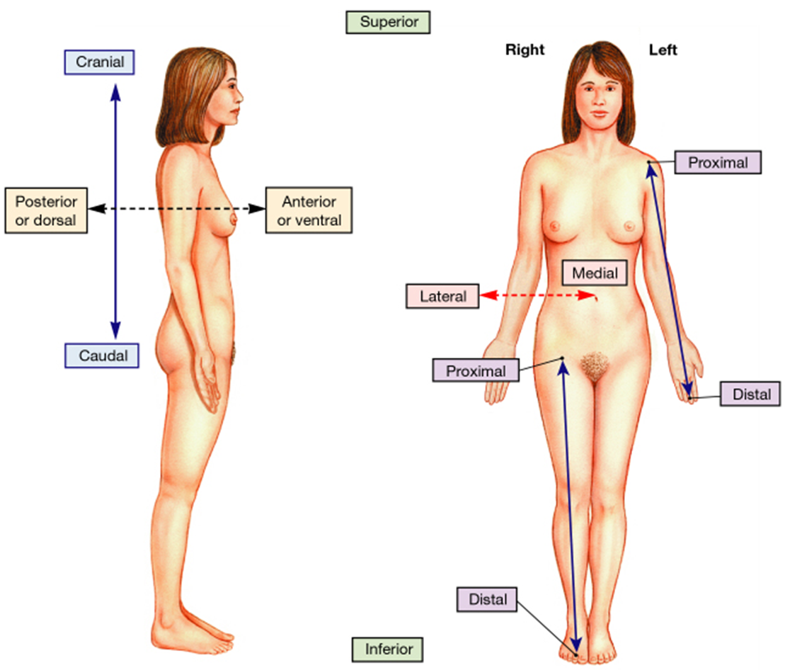
Directional References
Practice using the
correct directional terms listed when describing the
various organs and
structures within
the body.

Slide 23
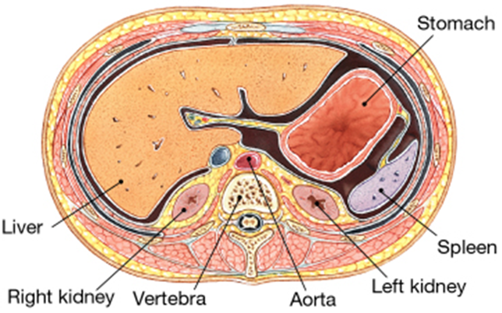
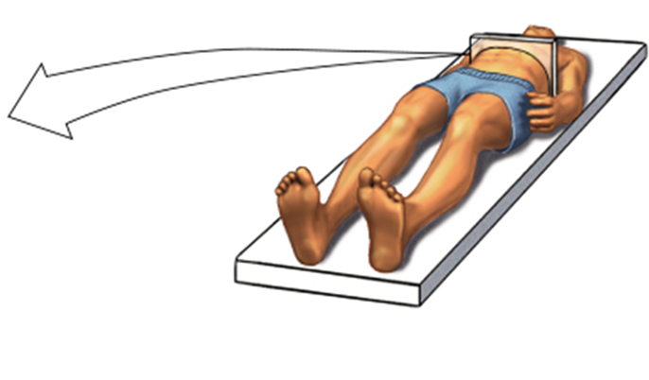
Example of relative position and orientation of
a body scan for clinical purposes.
Can you identify the body cavity and orientation shown below?

