Slide 1
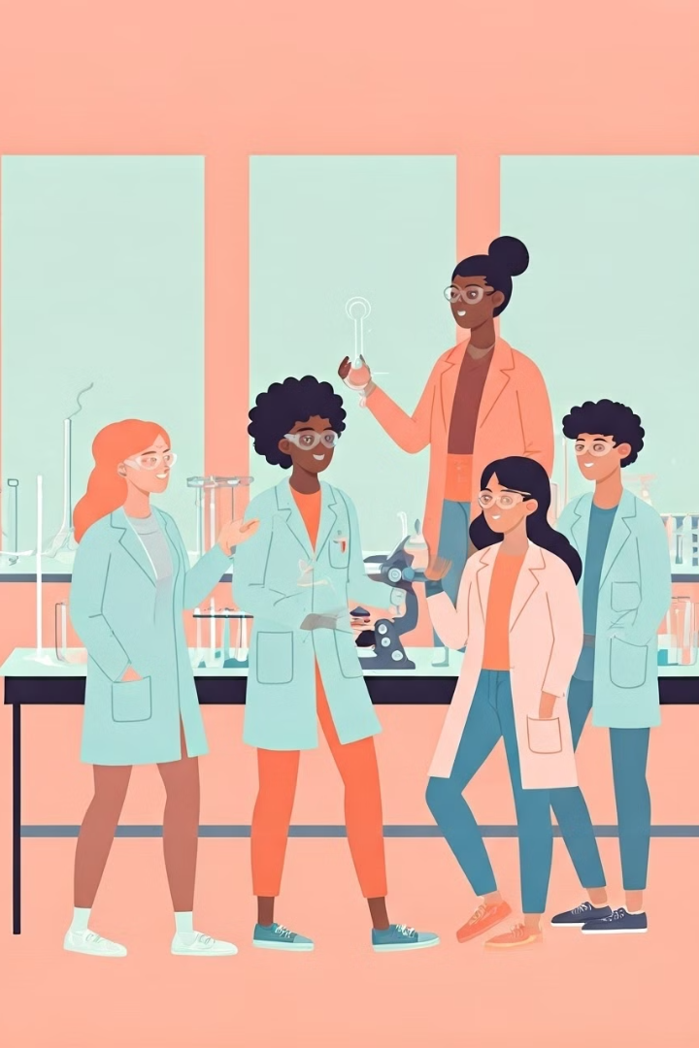
The next generation of STEM.
SPRING 2025
Notes:
https://gamma.app/docs/Miramar-MESA-Presentation-s4h5spkjrhh9m1q
Prelude with comment: Hola buenas tardes, good afternoon everyone my name is Damaris Garduno and I am excited to introduce you to MiraCosta's Math, Engineering, Science, Achievement Program AKA MESA. My Pronouns are she/her/hers/ella and I am the MESA Program Academic Services Coordinator. Let’s start off with a quick question that we will be answering "waterfall" style in the chat. I am going to ask the question and as you think of the response feel free to throw it in the chat but don't hit submit until I say GO, I will make sure to read the words as they fall like water all at once. Here is the question: When I say the phrase "The next generation of STEM" what words come to mind? Let's take 30 seconds to think and type the first words that come to mind but not yet submit... FAST FORWARD 30 seconds arighty the 30 seconds are up so READY set GO, please hit submit. I'm loving this flow! I see robots, AI, space, revolutionary ideas, advanced technology, genius, Tesla, clean energy, problem solvers, out of the box thinking WOW these are great . Thanks for sharing! You know what I think of? I think of our MESA students, I think of YOU, a unique group of STEM leaders with strong stories and ganas to make a difference in this world. So why do I think of MESA students? In order for you to understand why we must learn what MESA is.

Slide 2
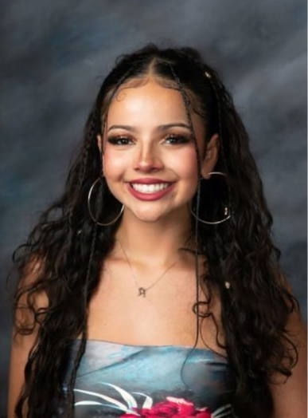
My Positionality
Jacqueline Blanco
She/Her(s)/Ella
MESA Program Student Ambassador
Intended Major: Biology
Top transfer school: University of California, Los Angeles
Career goal: Neurosurgeon with a PhD in Neuroscience/Neurobiology
Recent STEM Experience: Certified Nursing Assistant (CNA)
Hobbies: Violin, Dancing, Reading
Notes:
MESA is a statewide award-winning program that supports students from underserved and underrepresented communities to excel in STEM fields. By joining a cohort of peers with similar aspirations, students build a strong community of encouragement and mentorship, fostering their academic and personal growth. We're going to watch a quick video that shows MESA in action.
***SELECT small part, 1 min of video*** "FAST FORWARD to the end of the video". Orale, that video always gives me the chills - as you saw students, alumni, and even company employers believe in the power of MESA to create the next generation of STEM leaders that reflects California's diverse population.

Slide 3
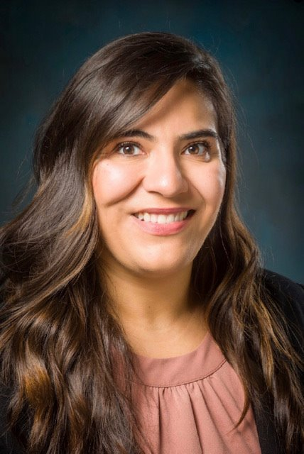
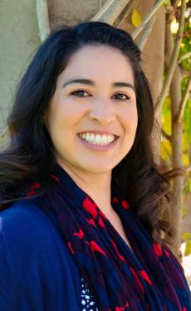
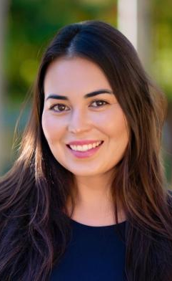
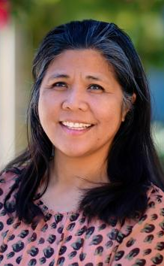
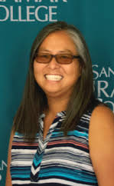
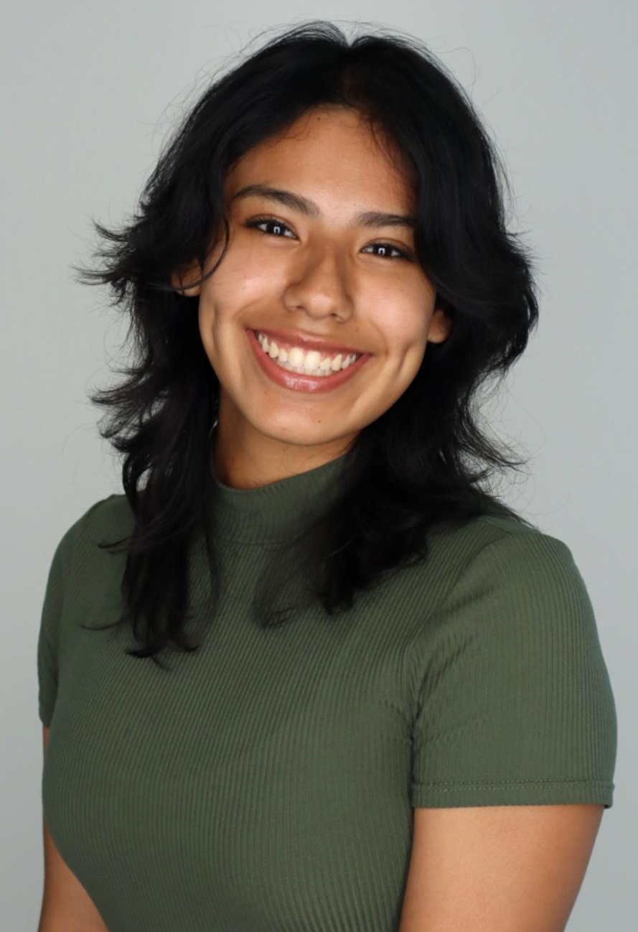
MESA & HSI STEM Exito Administrative Assistant III
Maribel Flores
MESA Program Coordinator/Counselor
Damaris Bravo
MESA Program
Counselor
Ericka Banda
MESA Project Assistant
Melissa Cayetano
MESA Tutor
Hieu Le
MESA Program Director & MBEPS Dean
Linda Woods
The New MESA Team
MESA Ambassadors
Jacqueline Blanco
Danna Aguilar
Jannet Aguilar
Notes:
MESA is a statewide award-winning program that supports students from underserved and underrepresented communities to excel in STEM fields. By joining a cohort of peers with similar aspirations, students build a strong community of encouragement and mentorship, fostering their academic and personal growth. We're going to watch a quick video that shows MESA in action.
***SELECT small part, 1 min of video*** "FAST FORWARD to the end of the video". Orale, that video always gives me the chills - as you saw students, alumni, and even company employers believe in the power of MESA to create the next generation of STEM leaders that reflects California's diverse population.

Slide 4
What is MESA?
MESA is a statewide award-winning program that supports students from underserved and underrepresented communities to excel in STEM fields. By joining a cohort of peers with similar aspirations, students build a strong community of encouragement and mentorship, fostering their academic and personal growth.
Notes:
MESA is a statewide award-winning program that supports students from underserved and underrepresented communities to excel in STEM fields. By joining a cohort of peers with similar aspirations, students build a strong community of encouragement and mentorship, fostering their academic and personal growth. We're going to watch a quick video that shows MESA in action.
***SELECT small part, 1 min of video*** "FAST FORWARD to the end of the video". Orale, that video always gives me the chills - as you saw students, alumni, and even company employers believe in the power of MESA to create the next generation of STEM leaders that reflects California's diverse population.

Slide 5
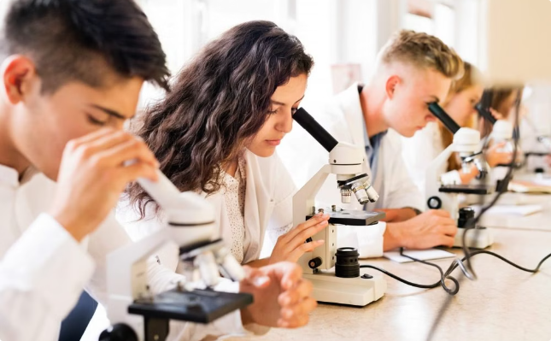
Problem? MESA is the 50+ year solution.
The #s don't lie
~ 25,000 CA MESA student/alumni network
80% MESA vs 67% non-MESA CA student UC admittance rate
19 universities + 91 community colleges
Notes:
So how many people are in the MESA family? I know you are STEMers so you love #s. So let me share some with you. The program has been around for more than 50 years so there are ~ 25,000 CA MESA student/alumni network The UC admittance rate for MESA students is 80% vs 67% for non-MESA CA students and there are 19 universities + 91 community colleges that have a MESA program Not to mention, we have ALOT of industry partners including Google, the other companies on this slide and more

Slide 6
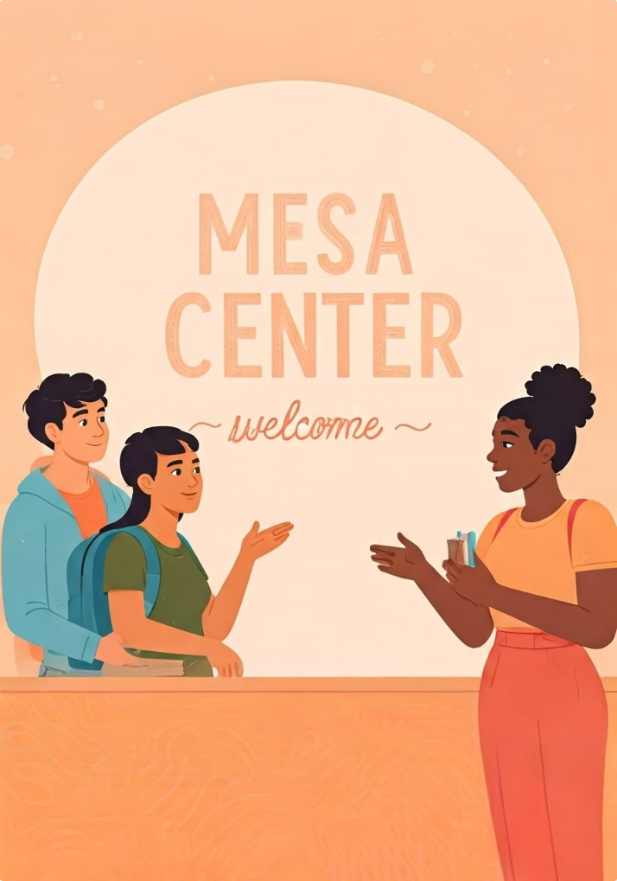
MESA's Magic Formula & Benefits
1
Smooth Transfer Pathway
MESA Team Check Ins (Classes, Transfer Apps, PR, Personal, etc.)
Tutoring & Cluster Courses (coming Fall 2025)
FREE Laptops, Calculator, Lab Gear Loans
Maximizing Financial Support : Scholarships, Gas/Grocery Cards
2
Employment Readiness
MESA Alumni Professionals Panels & Shadow Day
Industry Job/Intern Opportunities $$$
REUs : Including PAID Miramar Summer Research Positions
SWE, Robotics, SACNAS, STEM Conference Fees covered
On Campus Job Opportunities
3
A Lasting Community
MESA Center (coming Fall 2025)
MESA Ambassadors/Mentors
CA MESA space online community
VIP Events/Trips (University trips, SDSU MESA partnership)
Notes:
So how does MESA make such a big impact? Like any good scientist, we have our fine tuned Magic Formula that our MESA scholars benefit from. FIRSTLY, as community college student we make sure you are taking the right steps in your transfer pathway. Our students love meeting with our MESA Team counselor, director, coordinator, and staff since we have been trained to guide you academically with choosing your classes to help you transfer, University applications, Scholarships, Personally, and with so much more. Most importantly, when you feel lost or confused, our team is here for you. You have MESA Peer Tutors and MESA professors who understand or may even be from a similar background as you as first generation and low income students. We purposefully ensure that you and other MESA scholars are clustered together in the same courses so you don't feel alone and can get help with your STEM classes. You won’t have to worry about not having enough money to buy a laptop, calculator and even textbooks since MESA has them for you. More importantly, we help you maximize, understand and apply for different financial aid options or scholarships so that you feel comfortable knowing that you CAN afford your education. Out team works wonders and organizes events and trips with love for our MESA scholars to attend. So you are the VIP guest for things such as our University Roadtrip all the way to northern CA, Conferences such as the MESA SLC, SHPE, SWE, and our MESA Scholar Graduation Ceremony where you get a distinction sash to wear when you cross the stage at graduation. EVEN BEFORE YOUR GRADUATE and TRANSFER we ensure that employers will be eager to hire you! How? We have a Career chisme series where MESA alumni break bread with you and give you the chisme or inside scoop on what it takes to make it through college and into different STEM jobs. We have partnerships with different companies like General Atomics, Qualcomm, Solar Turbines and Space Force that have flexible paid internships for our students. We even help you apply for REUs at different institutions state, nationwide and even internationally! & my favorite of all is that you have an entire COMMUNITY that you can count on beyond your time here at MiraCosta College. We have the MESA Center that gives the familia vibes b/c you can study there, chill there, eat, nap, do what you need and access all of our services in one spot. The MESA peers you meet here often end up transferring with you and if not MESA is also at the 4 yr universities so before transferring you know you will have a group of people to count on. As soon as you join the program you will have access to ALL CA MESA student, alumni, staff and industry partners through the online MESA SPACE who are rooting for you and work hard to make sure we’re doing all we can to help you achieve your dream!

Slide 7
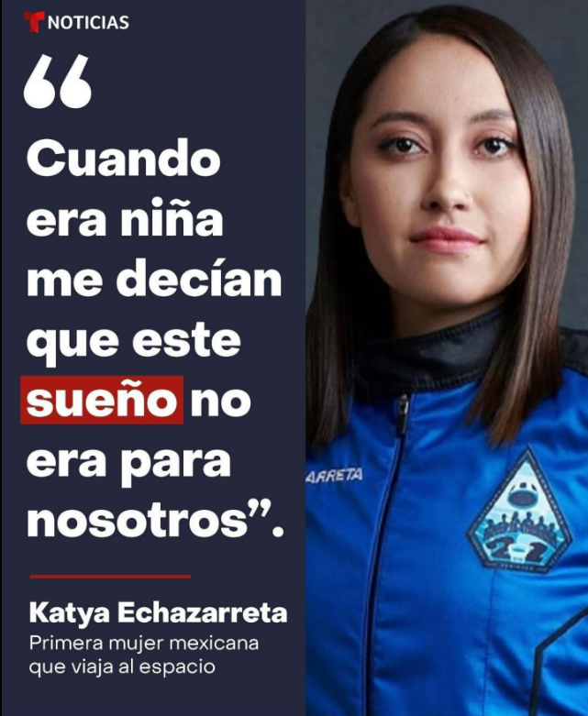
Join the Fam: MESA Eligibility
1
STEM Transfer Goals
Pursuing a calculus-based STEM field degree w/ intent to transfer to a 4-year institution. MATH 150 or MATH 121.
2
No Previous Bachelor's Degree
You have not yet graduated with a Bachelor's degree
3
Financial Need
Demonstrated through FAFSA or CADAA.
4
Complete Application
We verify eligibility upon application submission.
Notes:
One notable MESA alumnuis is Katya Echazarreta, An Electrical Engineer, the 1st Mexican-Born and One of the Youngest Women to Fly into Space. Ok, so now that you have fallen in love with MESA, you can join our family by meeting the eligibility requirements listed on this slide and I will place the link to this information in the chat for you () to access later but the quick highlights are....

Slide 8
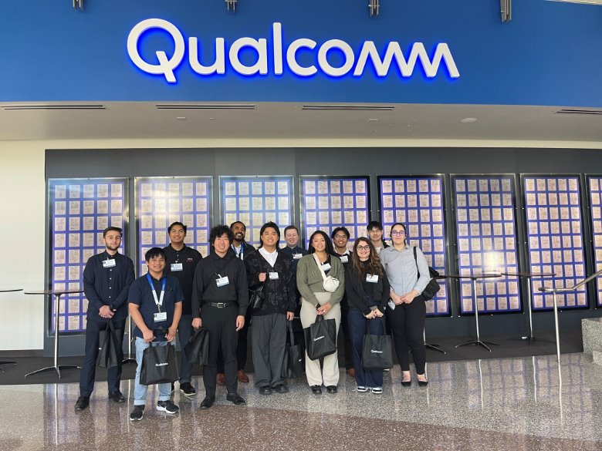
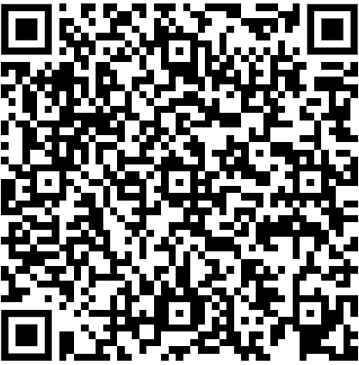
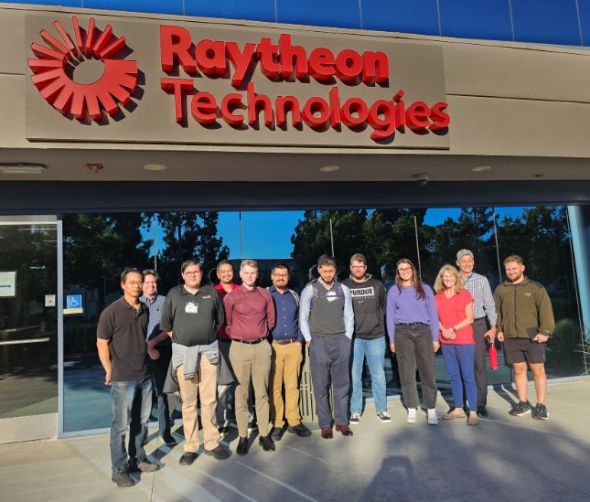
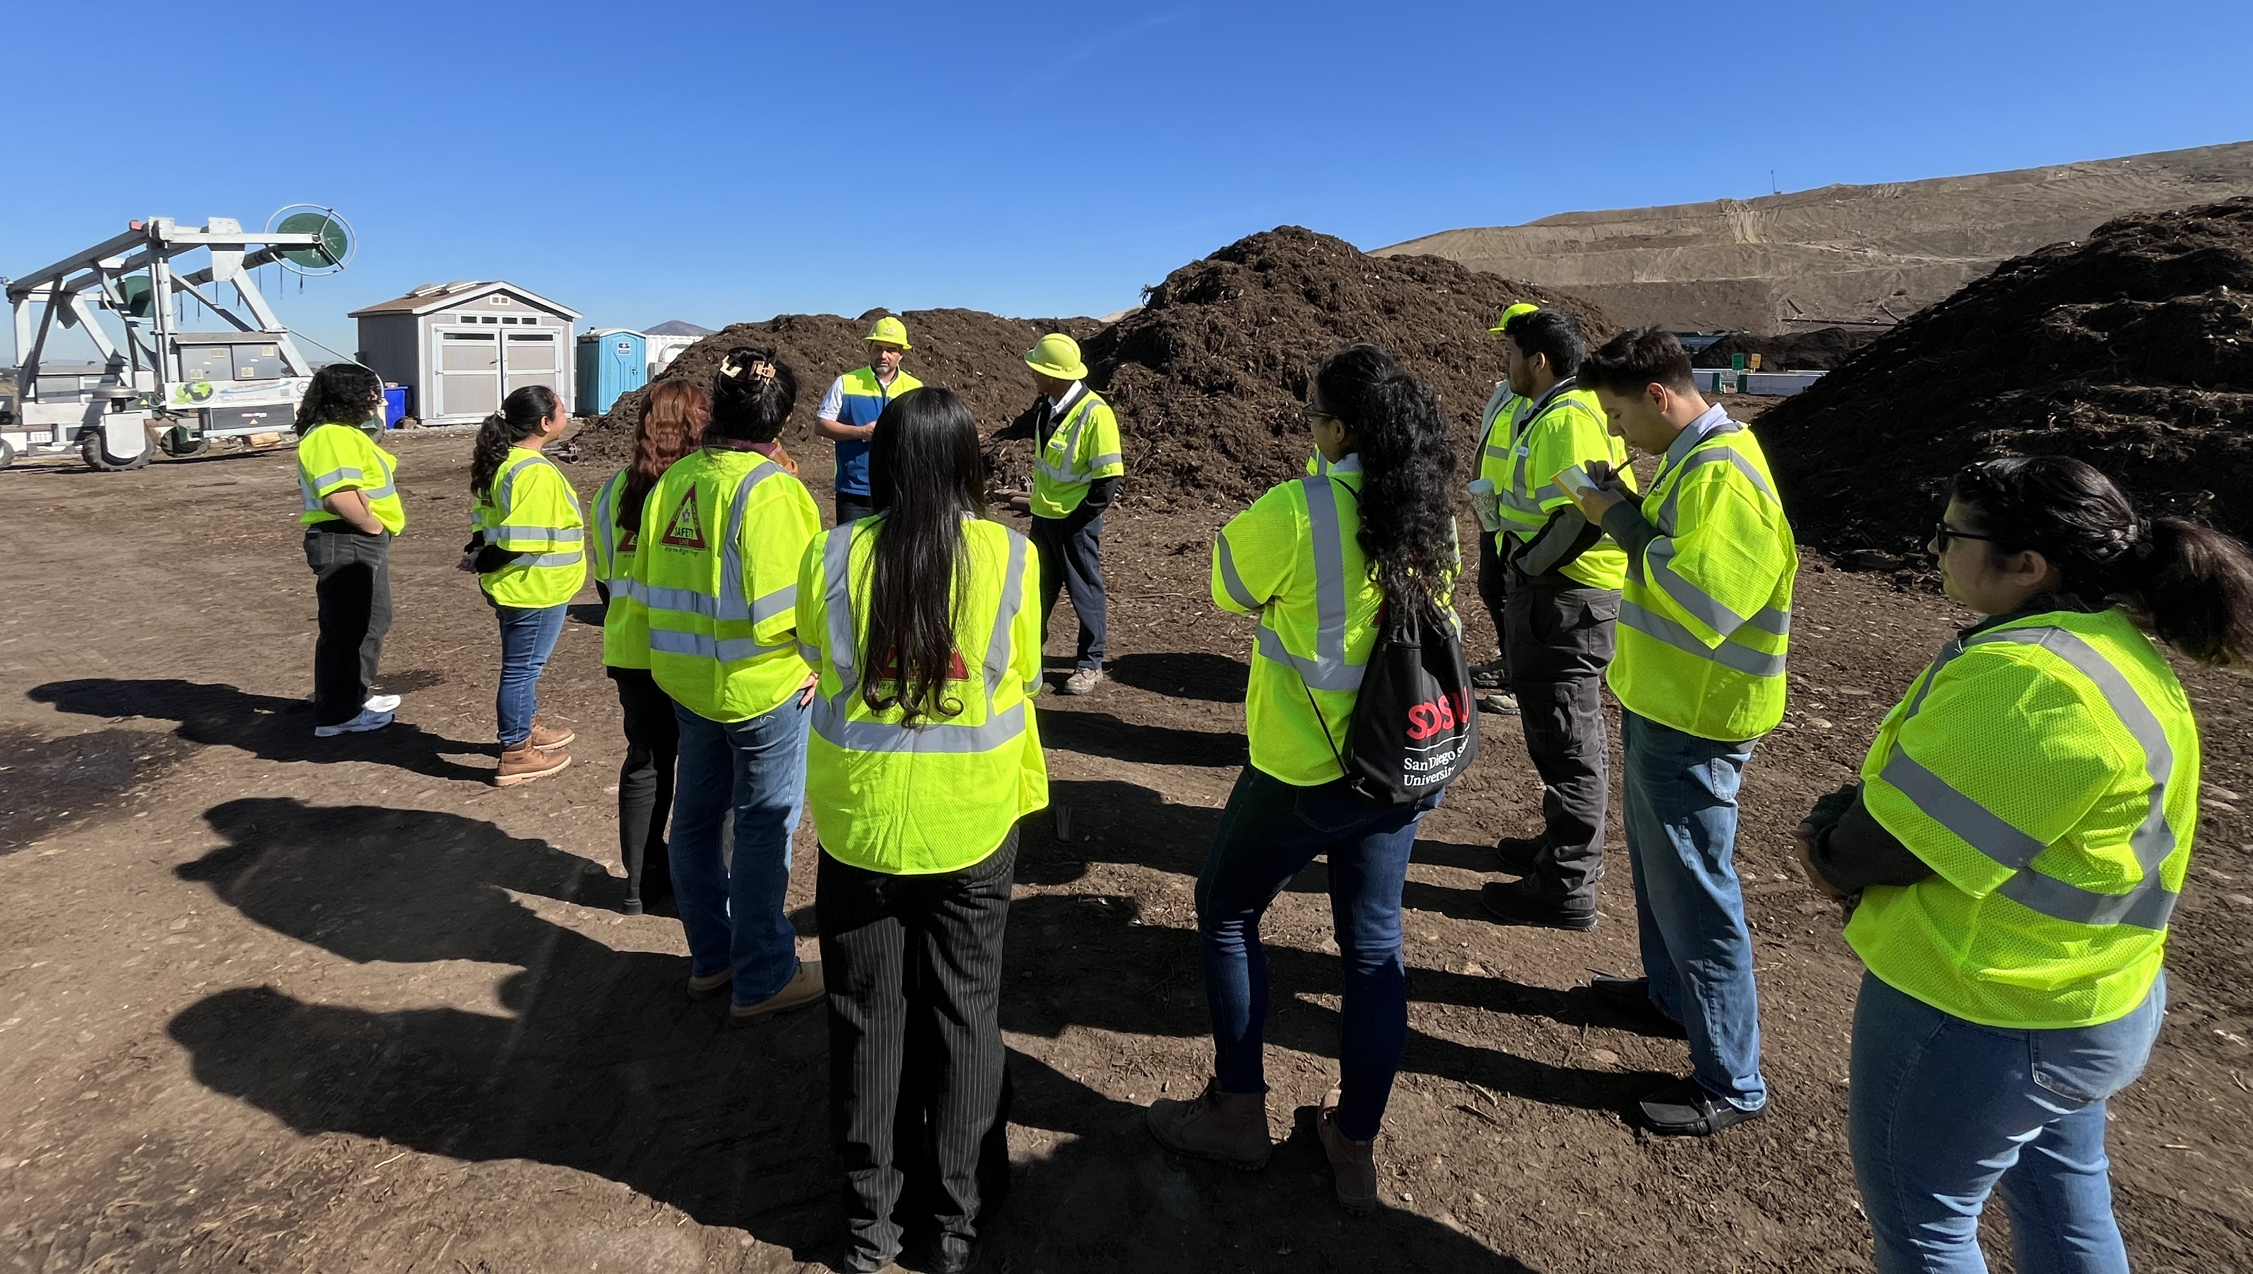
Questions?
Application Form:
Contact Us
Reach out via email or phone.
Miramarmesa@sdccd.edu
+1 619-388-5662 (temporary)
Visit STEM Center
Stop by the STEM Center
Monday - Thursday ( 9:00 am to 5:00 pm )
Friday ( 9 am to 1:00 pm )
Apply!
Complete via Miramar MESA Program Website
Notes:
& fast forward, let’s pretend the game is over. Now if you have any questions you can feel free to stick around and ask me or if you need to head out, you can contact us via email, phone, or you can always come visit us at the MESA Center! Our application is currently closed for FALL but at the start of SPRING will be available at our website linked in the presentation. Thank you for being such a great audience and remember, you’ve got this!

