Slide 1
SAN DIEGO MIRAMAR COLLEGE
“I.D.E.A. PODCAST”
PROPOSAL

Slide 2
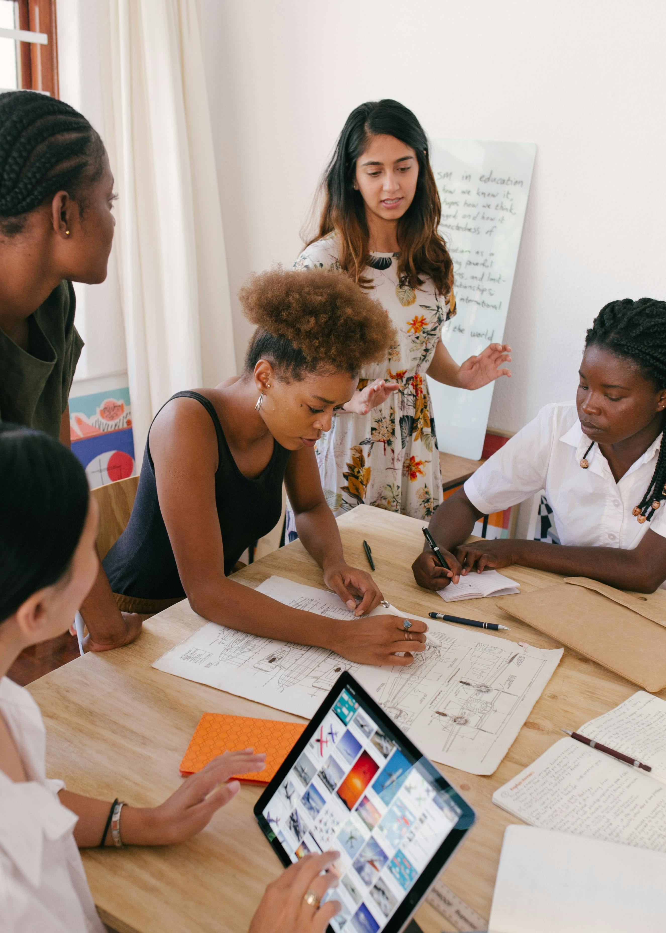
The I.D.E.A Mission
The I.D.E.A. (Inclusion, Diversity, Equity and Anti-Racism) Committee is committed to promote understanding, engagement and appreciation throughout the College and District for all aspects of diversity, equity, and inclusion.
In this aim lies the task of educating and informing students of what these words/concepts mean, as well as what they look like in action.
How can we unpack these ideas and model productive interaction for students?

Slide 3
Why a Podcast?
How might this serve the SD Miramar academic, student, and greater communities?
Long-form podcast episodes allow ample time for addressing an idea and/or concept completely.
Easily accessible and free when uploaded to YouTube.
Can serve to directly model productive, informed dialogue on important ideas.
Can feature direct student-to-professor dialogue on issues, concepts, and ideas (models rapport and trust between students and instructors).

Slide 4
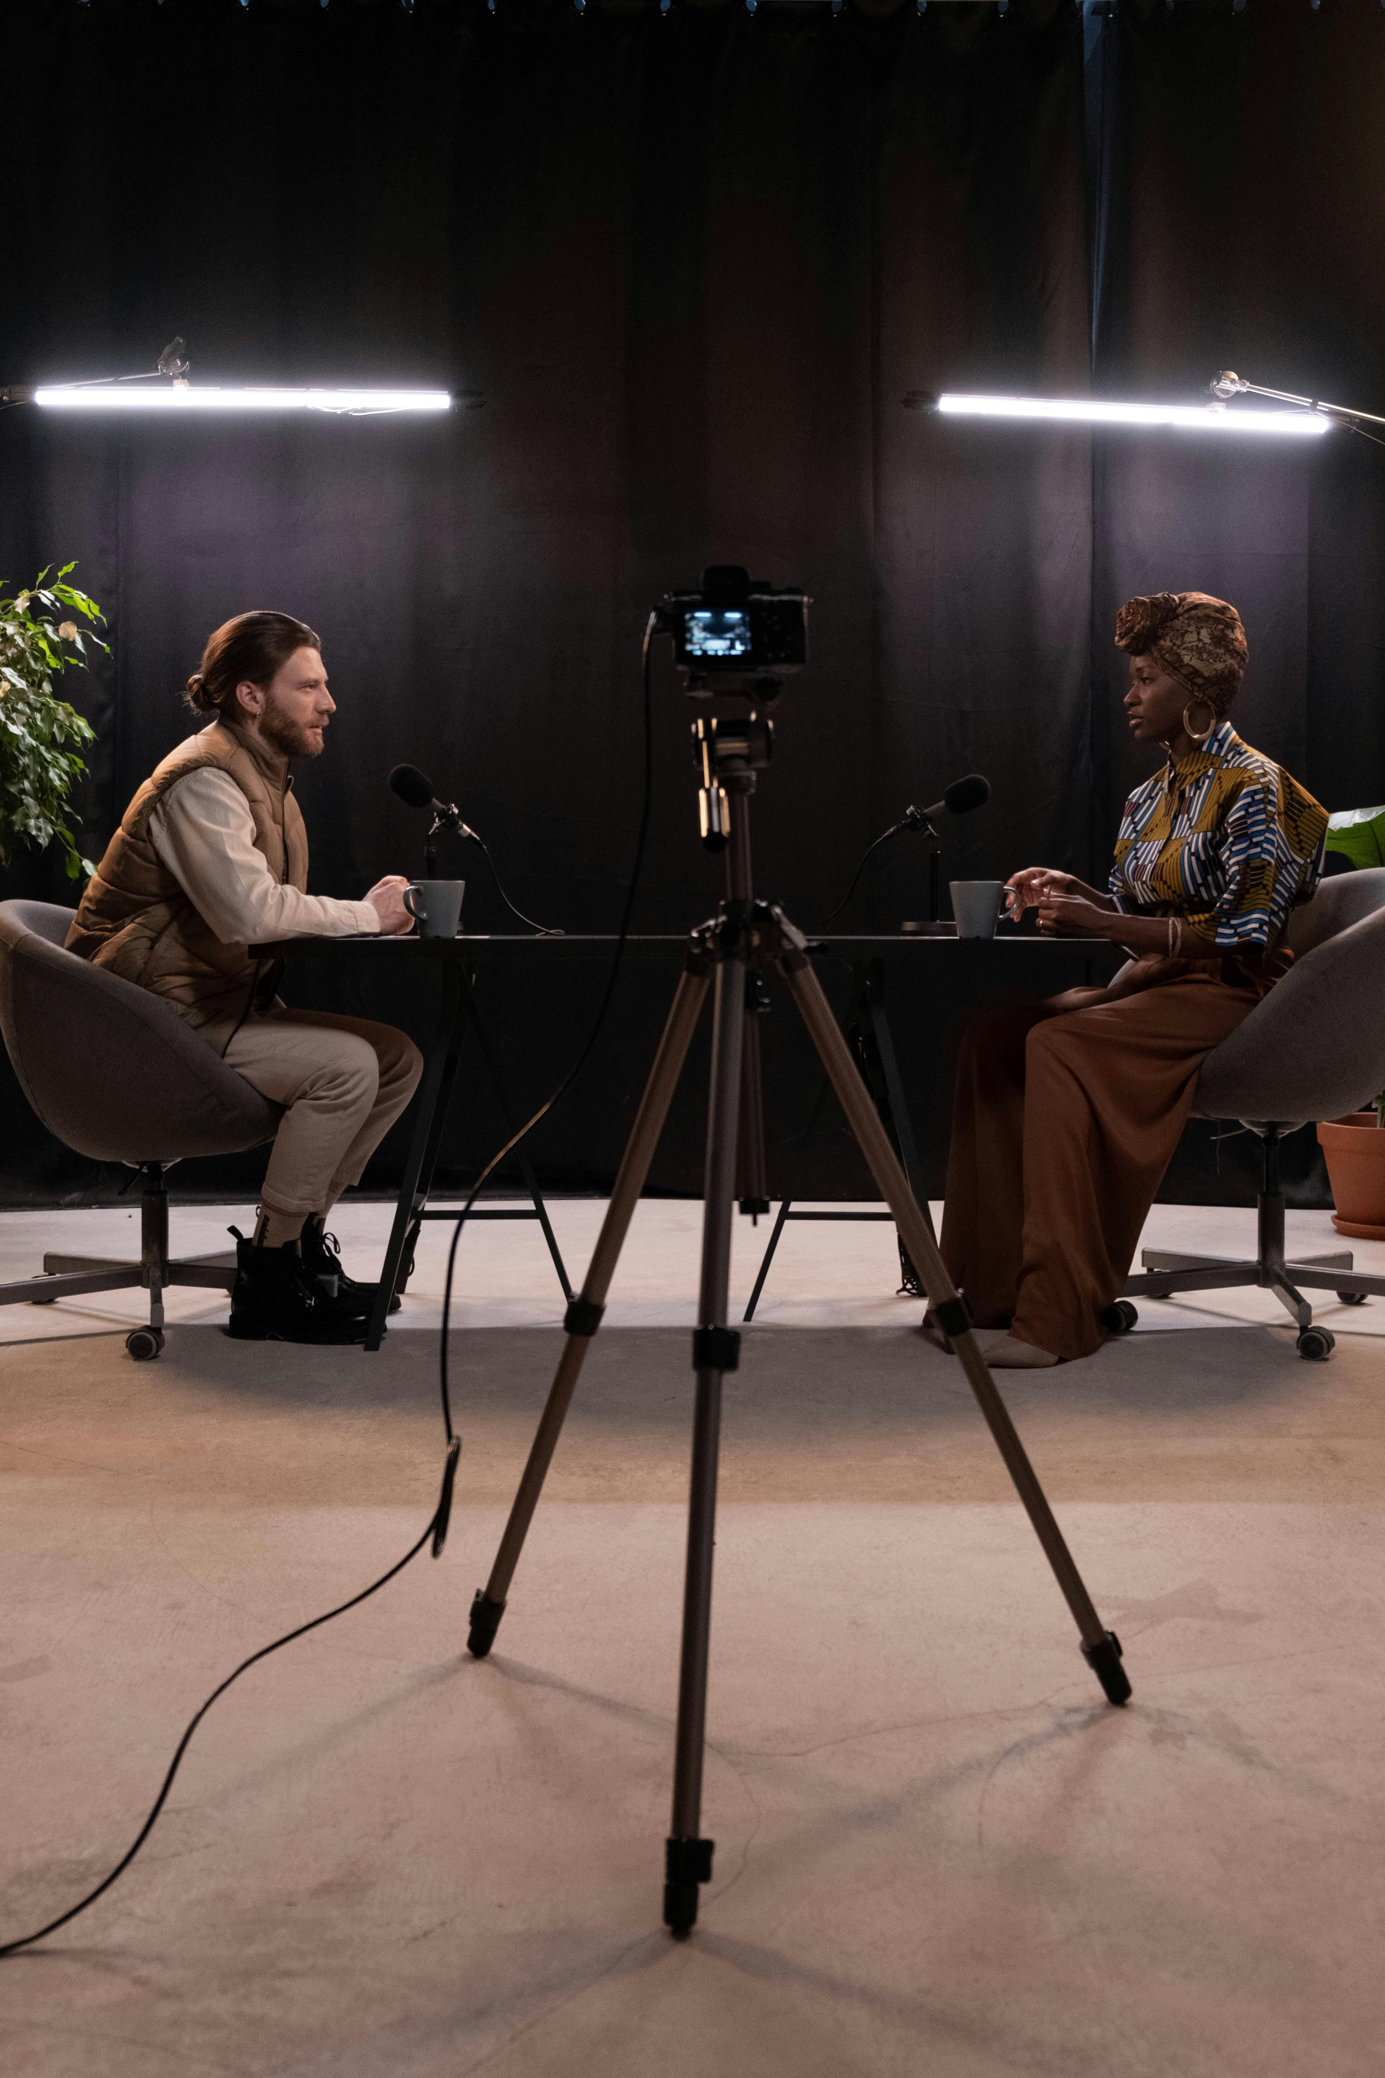
What would an “IDEA Podcast” look like?
Location & Workflow
H-216 recording studio; great lighting and sound, along with ample microphones needed for 1-10 interview guests.
The SD Miramar Music Club owns a GoPro, which is capable of shooting 5k video.
Either a student or myself will combine the audio and video and upload to YouTube. Editing and sending drafts to interview guests or supervisors for approval can included in the workflow easily at this step.
YouTube video can be posted and shared easily.

Slide 5
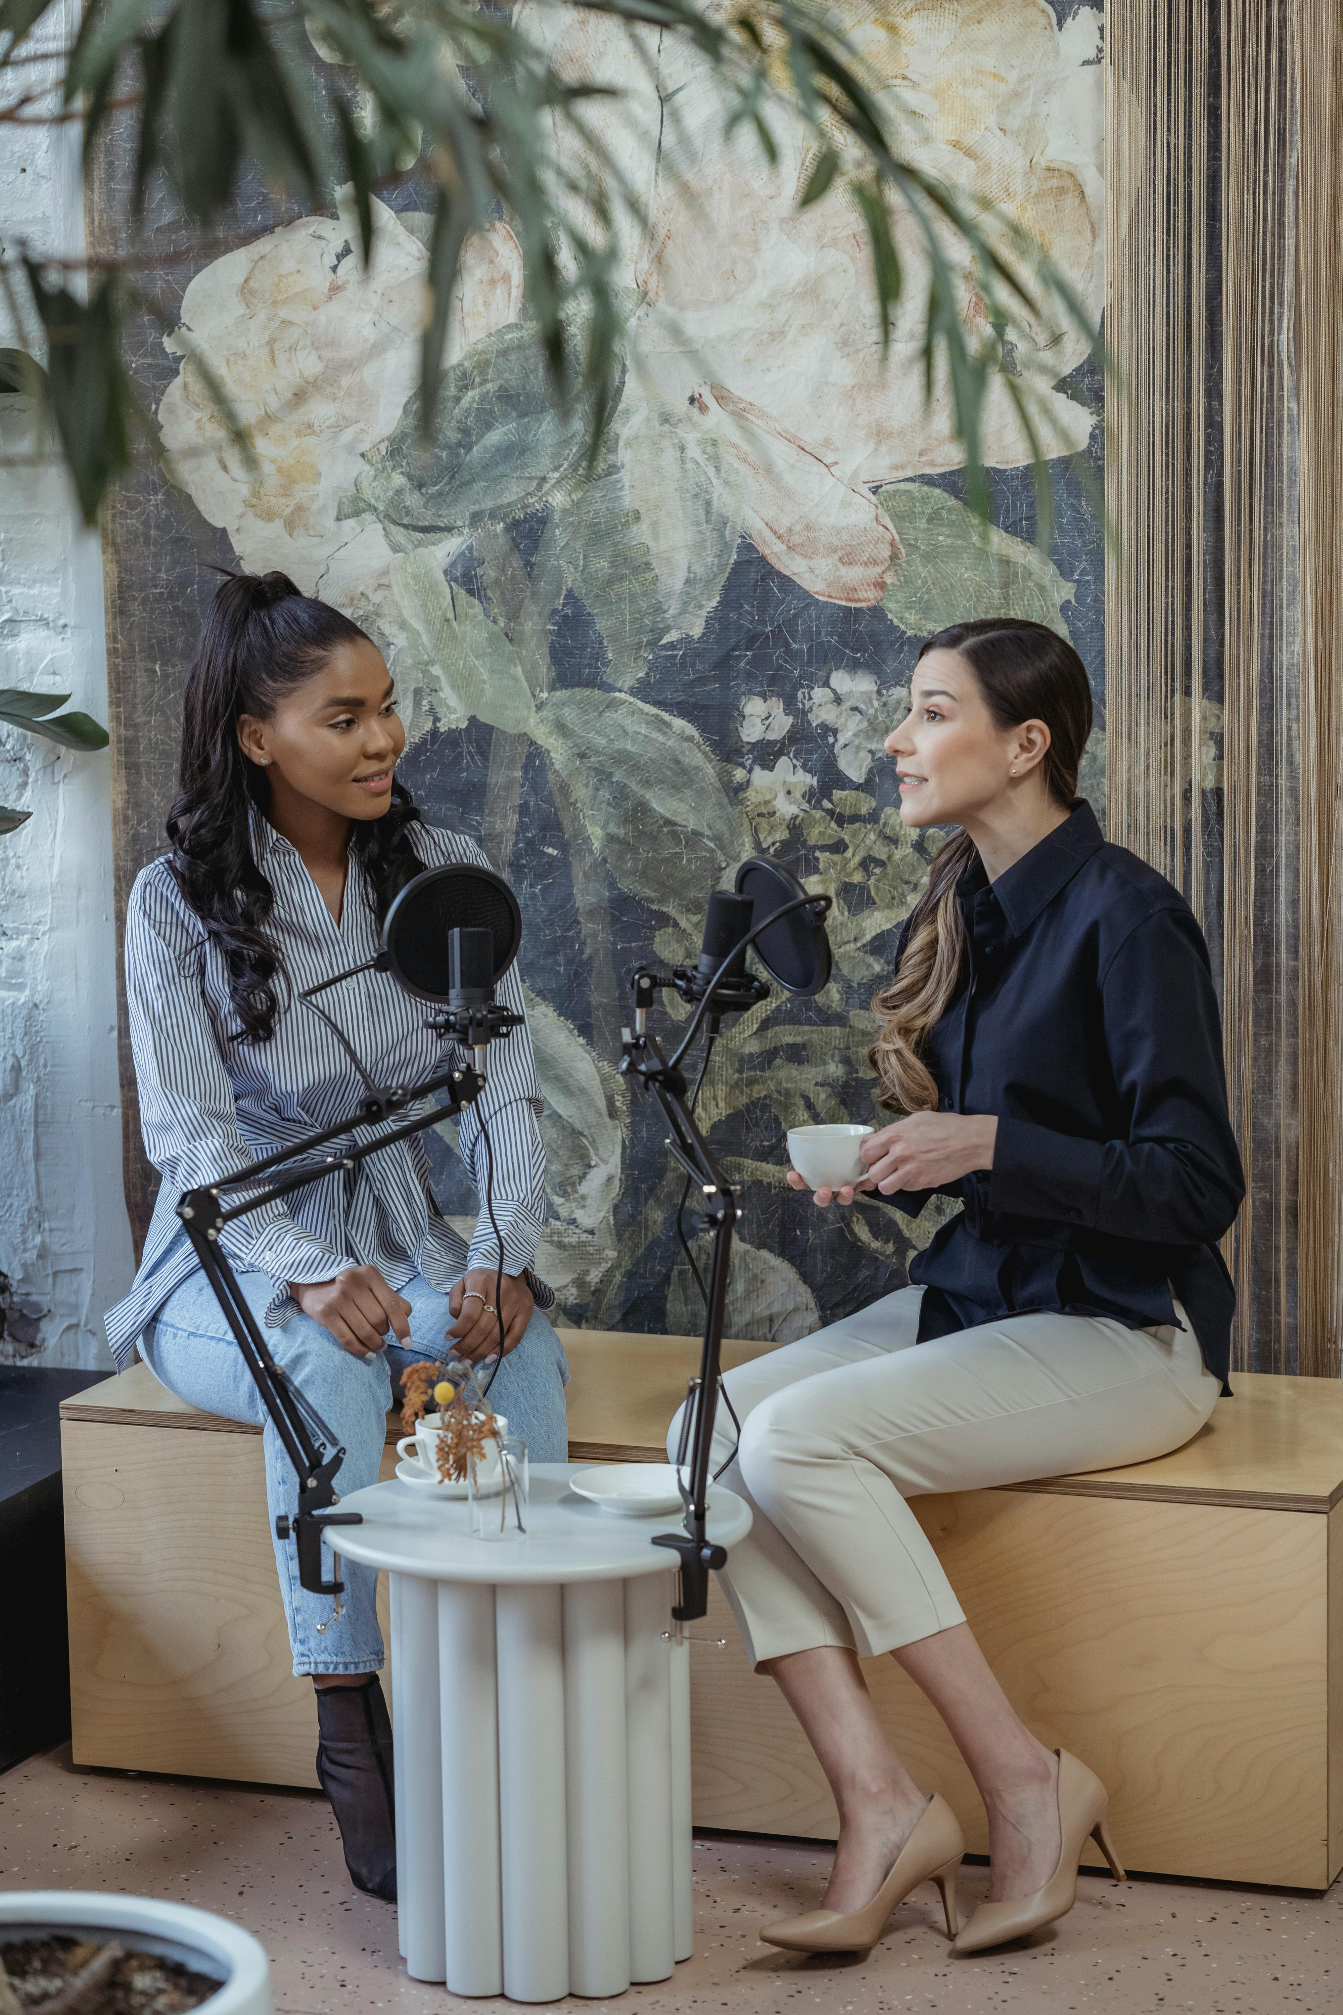
What would an “IDEA Podcast” look like? (Cont.)
Format & Style
A Host
Interview guest(s)
Student Representative(s)
It would be imperative for the podcast style to be interactive between all involved, allowing for the host to shape a dialogue that features the interviewee’s expertise. The student representative(s) would be free to pose questions that reflect the students’ interests, concerns as questions for both the host and interviewee.

Slide 6
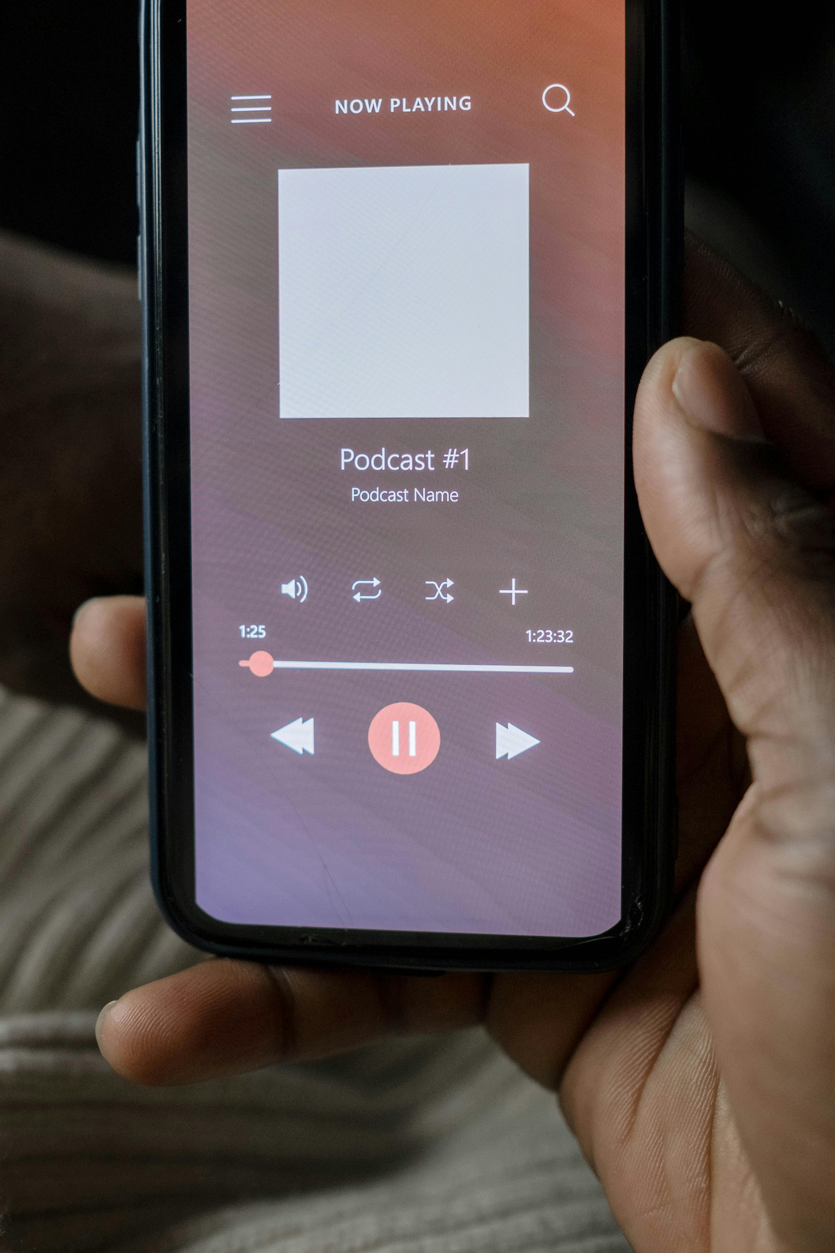
“IDEA Podcast” for the Miramar Community
The podcast can also serve to promote other IDEA—and SD Miramar/SDCCD—events.
Any other important conversations meant for dissemination across the SD Miramar/SDCCCD community can be shared via the podcast as video and/or audio only.
Low-cost podcast hosting services (such as Podbean) are available if enabling RSS feeds (i.e., accessing via Apple Podcast, Google Play, Spotify, etc.) is desired.

Slide 7
Thank you!

