Slide 1
Jet Fuel Resource Center Meeting the basic needs of our students
Shelly Parks, LCSW, Basic Needs Coordinator

Slide 2
Mission
Our mission is to ensure that every student has access to equitable basic needs, such as healthy food, stable housing, and financial wellness, so that they are better able to persist at Miramar College and meet their educational goals.
We are committed to providing an educational environment that fosters compassion and respect, welcomes diversity and supports students in various circumstances, including students experiencing basic needs insecurities.

Slide 3
Service Model

Slide 4
Jet Fuel Resource Center Jet Fuel Resource Center
Jet Fuel Food Pantry
The Flight Suit (clothing, outerwear)
Pantry Pickup Program
Food Packs
Period Packs
Special Request Clothing (blankets, ponchos, socks, winter hats & gloves)
Household Items: Paper Products, Laundry & Dish Soap
CalFresh Application Assistance
Counseling
1-to-1 Case Management leveraging TBH platform & staff
Financial Wellness
Cal Coast Credit Union Workshops
Impact Grants*
Digital Access: Calculator, Laptop Loans (Miramar College Library)
Outreach & Engagement
Classroom Visits
Eat with Us Events
Tabling
Really, Really FREE Farmers Market*
Baby Care (diapers & wipes)
Pilot Program: Financial Intervention
Pilot: Identified, high-need student cohorts + targeted financial intervention
Locker Assignments & Shower Facilities (Hourglass Field)
Hygiene & Shave Kits
Diesel Technology
Dreamers Support Program
Pride Program
Fire / EMT
*The Really, Really FREE Farmers Market is open to the public. All other programs are limited to currently enrolled Miramar College students (excludes CCE-Miramar) due to funding allocations.

Slide 5
Jet Fuel Resource Center Jet Fuel Resource Center
Jet Fuel Food Pantry
The Flight Suit (clothing, outerwear)
Pantry Pickup Program
Food Packs
Period Packs
Special Request Clothing (blankets, ponchos, socks, winter hats & gloves)
Household Items: Paper Products, Laundry & Dish Soap
CalFresh Application Assistance
Counseling
1-to-1 Case Management leveraging TBH platform & staff
Financial Wellness
Cal Coast Credit Union Workshops
Impact Grants*
Digital Access: Calculator, Laptop Loans (Miramar College Library)
Outreach & Engagement
Classroom Visits
Eat with Us Events
Tabling
Really, Really FREE Farmers Market*
Baby Care (diapers & wipes)
Pilot Program: Financial Intervention
Pilot: Identified, high-need student cohorts + targeted financial intervention
Locker Assignments & Shower Facilities (Hourglass Field)
Hygiene & Shave Kits
Diesel Technology
Dreamers Support Program
Pride Program
Fire / EMT
*Impact Grants are only available to students who meet eligibility criteria and have met with a Basic Needs Counselor to discuss their situation.
Grants are intended to prevent a student from failing or dropping out due to an acute, unforeseen financial hardship.
Granting of funds can take up to a week (or more, depending on when the request is made) and are therefore not intended for immediate relief.

Slide 6
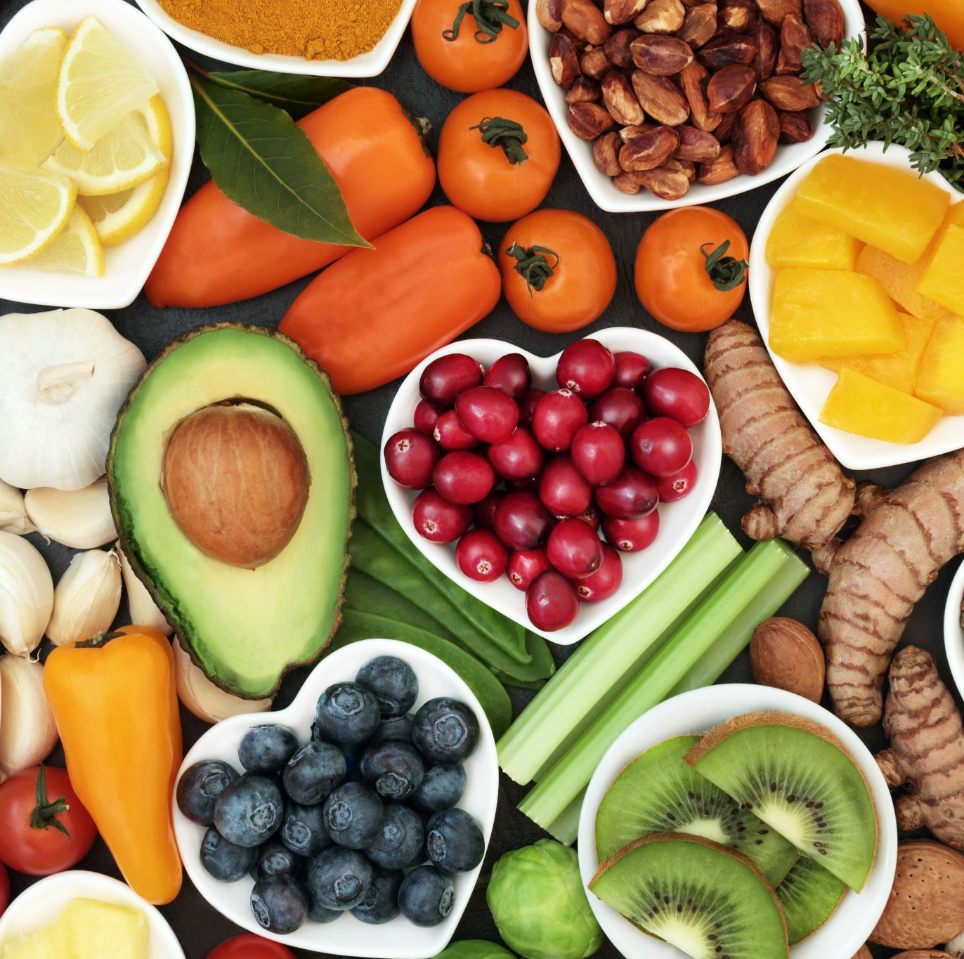
Food Security
95 Store Pick-ups that resulted in 30,117 pounds of rescued food
47,546 pounds of total food provided—that’s equivalent to 39,622 meals!
5,355 pantry visits from 461 unique students
9 Farmer’s Market distributions serving 645 unique visitors
Timeframe: Fall 2024 data

Slide 7
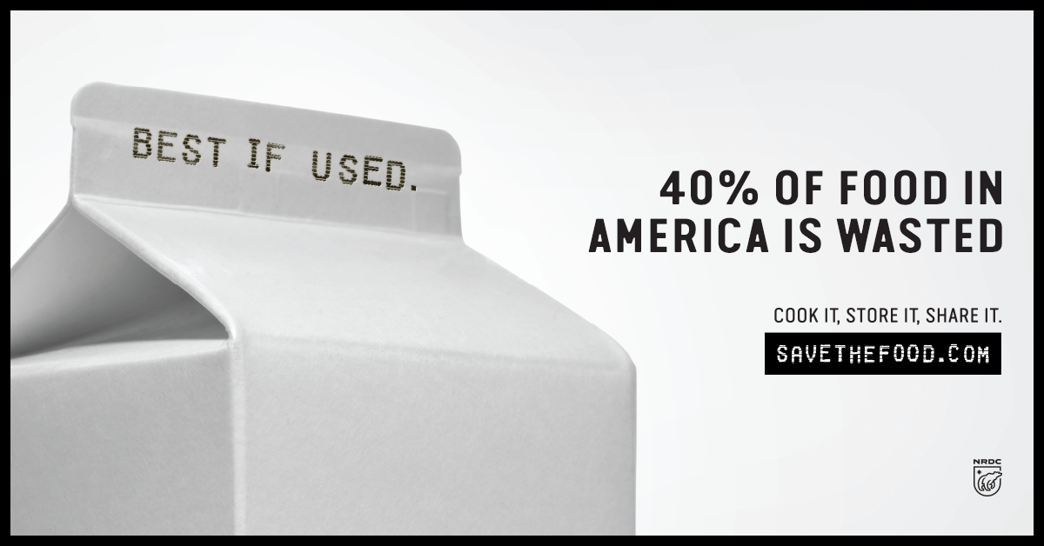

Slide 8
Food Safety
Best if Used By/Before Date
Indicates when a product will be of best flavor or quality. It is NOT a purchase or safety date.
Sell-By Date
Tells the store how long to display the product for sale for inventory management. It is NOT a safety date.
Freeze-By Date
Indicates when a product should be frozen to maintain peak quality. It is NOT a purchase or safety date.
Use-By Date
The last date recommended for the use of the product while at peak quality. It is NOT a safety date when used on food.
However, when used on infant formula, then it IS a safety date.
Source: USDA Food Safety and Inspection Service (FSIS)

Slide 9
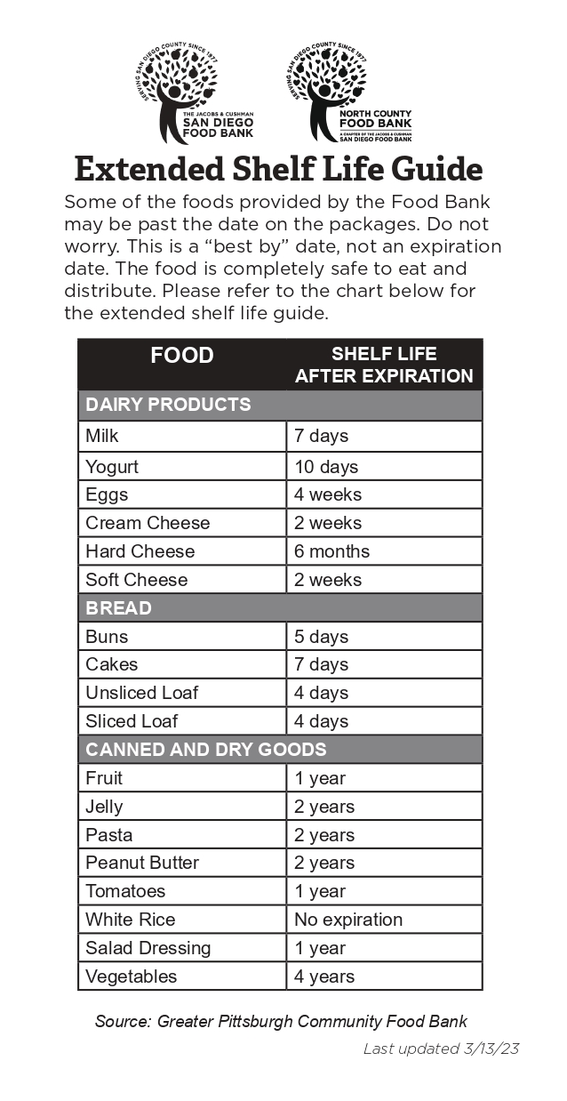
Product Dating Labels
Because much of the food offered in the pantry is donated or “rescued,” many foods appear to be “expired” based on product dating labels.
However, these foods are completely safe to eat.
See the Extended Shelf Life Guide
Source: Greater Pittsburgh Community Food Bank

Slide 10
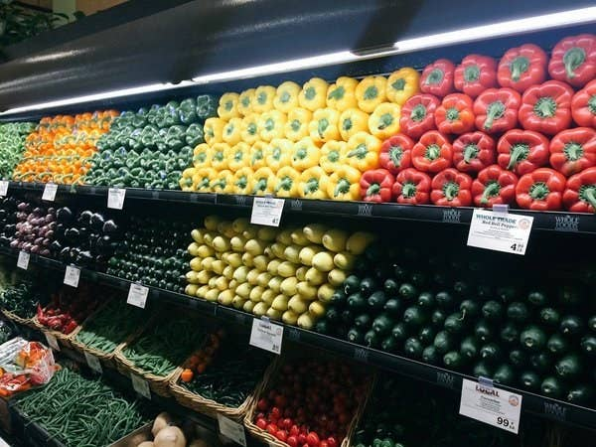
USDA Grades & Standards
U.S. No. 1: Uniform in size, shape, and color
U.S. No. 2: Inconsistent size, shape, or color
U.S. No. 2 fruits and vegetables are completely safe to eat.
Source: ams.usda.gov/grades-standards

Slide 11
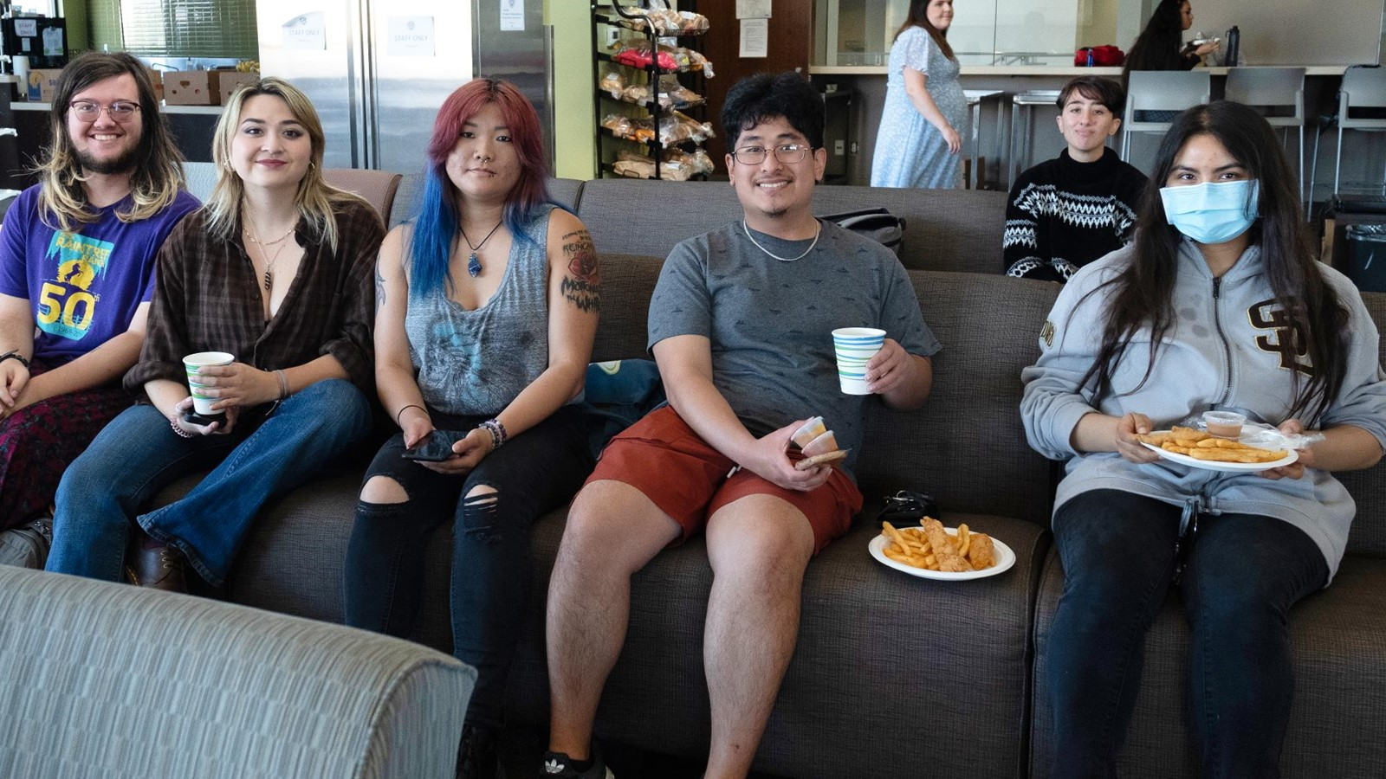
Our Students

Slide 12
Student Demographics
*0% due to rounding; two students have self-identified as being Transgender.
Source: Spring 2025 Pantry Use Form (N = 424)

Slide 13
Student Demographics
Source: Spring 2025 Pantry Use Form (N = 424)

Slide 14
Lived Experiences
13%
Identify as belonging to the LGBTQ+ community
4%
Have been impacted by the justice system
15%
Are active duty, a veteran, or a military dependent
73%
Have submitted a FAFSA® or CADAA for financial aid
19% of students preferred not to answer whether they do or do not identify as LGBTQ+.
13% of students declined to state if they are/have been justice-impacted.
Source: Spring 2025 Pantry Use Form (N = 424)

Slide 15
Support Services
25%
Are currently in the Promise Program
14%
Utilize Disability Support Program & Services (DSPS)
26%
Receive assistance through EOPS, CalWORKs, CARE, or NextUP
94%
Of basic needs students participate in at least one affinity group, academic support, or student services program
Source: Spring 2025 Pantry Use Form (N = 424)

Slide 16
ACP Representation
5%
15%
17%
7%
3%
30%
8%
15% of students have reported that they are undecided or do not know which ACP their major falls under.
Source: Spring 2025 Pantry Use Form (N = 424)

Slide 17
Impact & Outcomes

Slide 18
Where students obtain their food
Students were asked where they plan to obtain the majority of their meals this semester.
Students could select up to four (4) primary food sources.
*1% represents 7 students. "Found Foods" are defined as "Search for something that wasn't meant to be eaten (dumpster-dive, found foods, etc.)"
Source: Spring 2025 Pantry Use Form (N = 424).

Slide 19
Pantry Usage
57%
Report that they want to save money for other expenses
15%
Cite helping support their family or others who rely on them
54%
Say they can’t afford to buy enough groceries most weeks
16%
Cite not having enough time to cook due to their work and/or class schedule
Students could select up to three (3) reasons for utilizing the pantry.
Source: Spring 2025 Pantry Use Form (N = 424)

Slide 20
Pantry Satisfaction Survey
95%
Satisfaction with the variety of items offered in the pantry
91%
Satisfaction with the quality of items offered in the pantry
79%
97%
Satisfaction with customer service offered by pantry staff
Of respondents are happy with current operating hours
During the last week of the Fall 2024 semester, all pantry visitors were invited to complete a satisfaction survey and entered in an opportunity drawing for a $500 Smart & Final grocery gift card.
Source: Fall 2024 Pantry Usage Survey (survey responses = 57, n = 167, N = 461)

Slide 21
Measuring Stigma
Students were asked how often they feel a variety of emotions after utilizing the pantry.
Source: Fall 2024 Pantry Usage Survey (survey responses = 57, n = 167, N = 461)

Slide 22
Measuring Stigma
*Pride defined as “feeling positive about taking care of yourself of others.
Students were asked how often they feel a variety of emotions after utilizing the pantry.
Source: Fall 2024 Pantry Usage Survey (survey responses = 57, n = 167, N = 461)

Slide 23
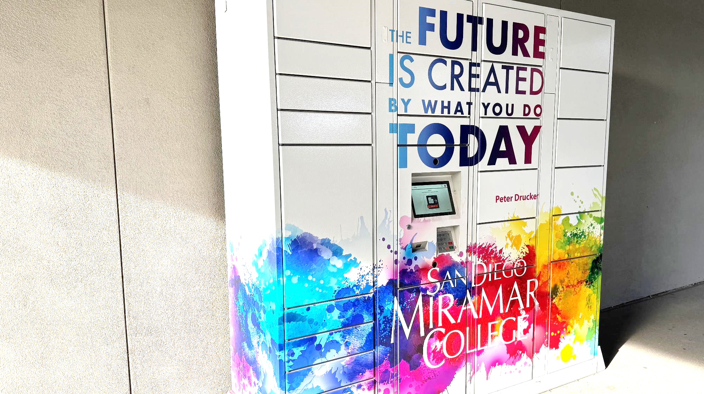
Looking Forward

Slide 24
18-month Action Plan
Making data-driven decisions to:
Enhance existing operations.
Evaluate current data platforms and define future data collection strategy.
Expand community and government referrals, build strategic relationships, and engage partners for on-site service delivery.
Foster and institutionalize cross-departmental collaboration.

Slide 25
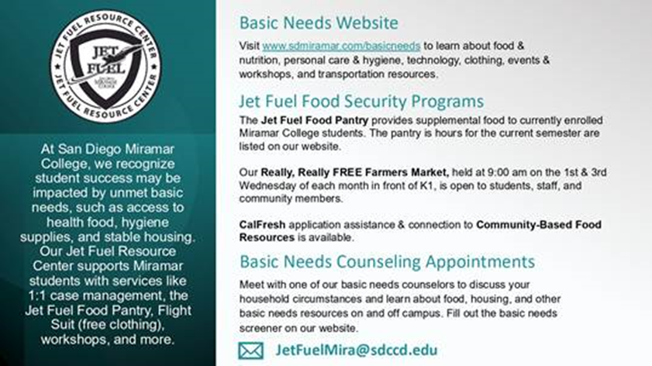
Coming Soon...
Basic Needs Flex Workshop
Coming Fall 2025
Syllabus Statement & Slide
Being able to meet your basic needs is foundational to your success as a student at Miramar College. If you are having difficulty affording food, lack a stable place to live, or are struggling to meet another need, the campus has resources for you. Our Jet Fuel Resource Center supports Miramar students with services like 1:1 case management, the Jet Fuel Food Pantry, Flight Suit (free clothing), workshops, and more.
Please contact the Basic Needs Team JetFuelMira@sdccd.edu for information on how to get support or view more information at https://sdmiramar.edu/basicneeds.

Slide 26
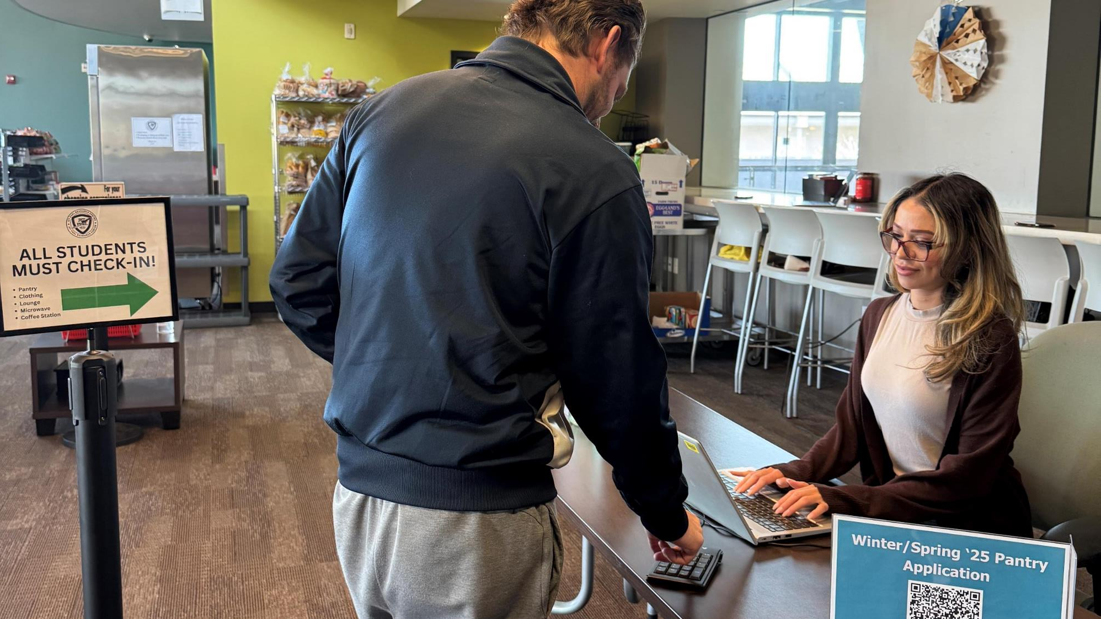
Closing & Q&A

