Slide 1
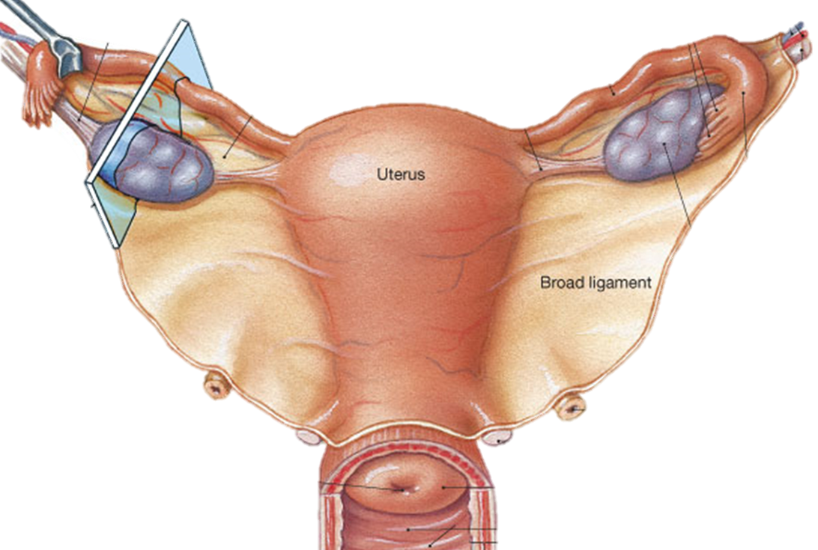
The Female Reproductive System
Ovaries
Uterine tubes
All 3 enclosed within broad ligament.
Uterus
Vulva
External Female Genitalia:
Mons pubis, Labia majora, Labia minora, Clitoris, Vaginal orifice.

Slide 2
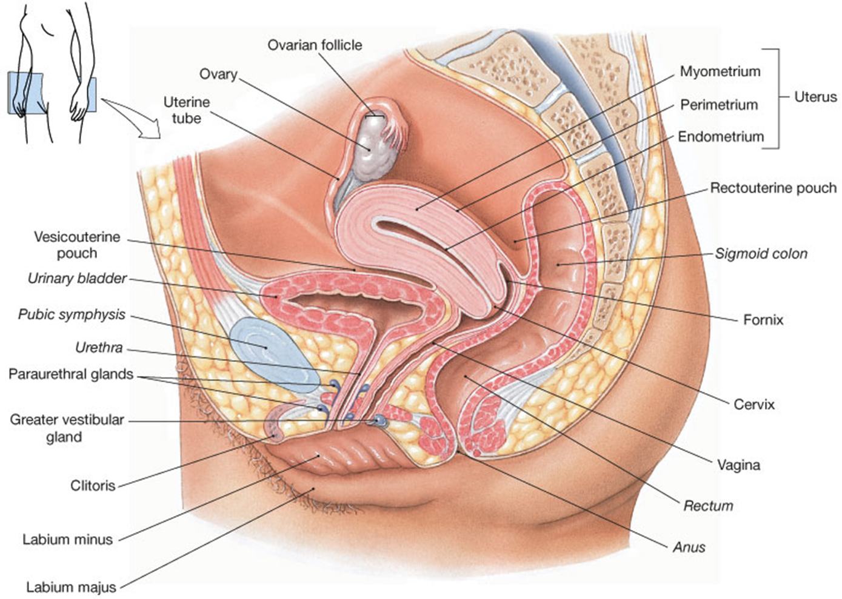
Female Reproductive System
Midsagittal Section

Slide 3
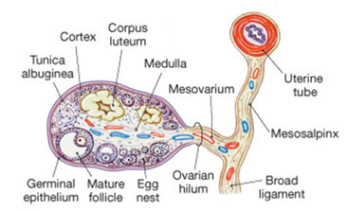
The Ovaries
Ovaries -> eggs, estrogen and progesterone.
Held in position by ovarian ligament and suspensory ligaments.
Ovarian artery and vein enter at ovarian hilus.
Has tunica albuginea.
Ovarian cycle and follicular development.
(dictates uterine cycle)

Slide 4
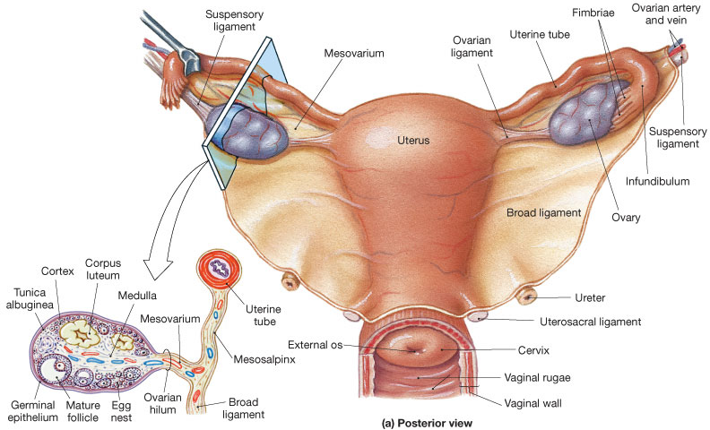
ciliated and
non-ciliated
simple columnar
epithelium

Slide 5
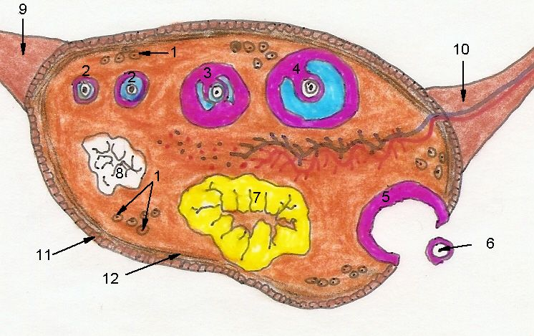
Frontal section of the Ovary
Process of Oogenesis
When an oocyte (immature egg cell) becomes an ovum (mature egg cell).

Slide 6
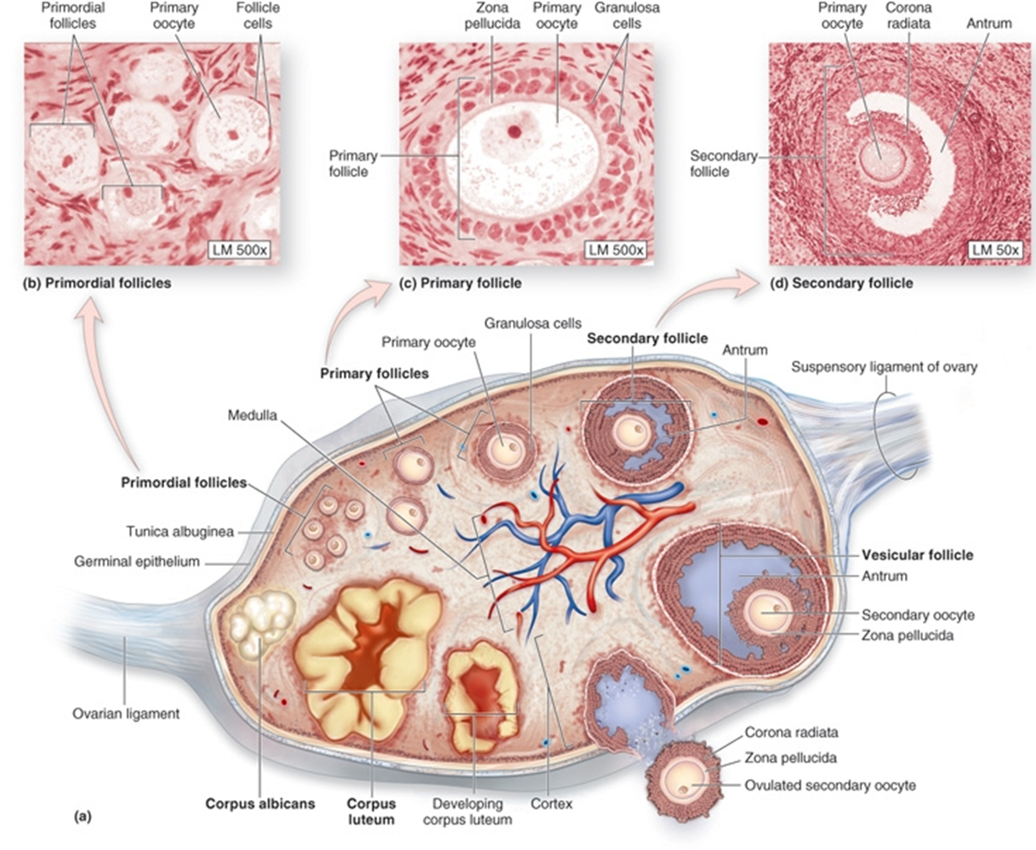

Slide 7
The Uterine Tubes
Infundibulum with fimbriae
Ampulla
Isthmus
Opens into uterine cavity
Lined with ciliated and non-ciliated simple columnar epithelium - aids in transport

Slide 8
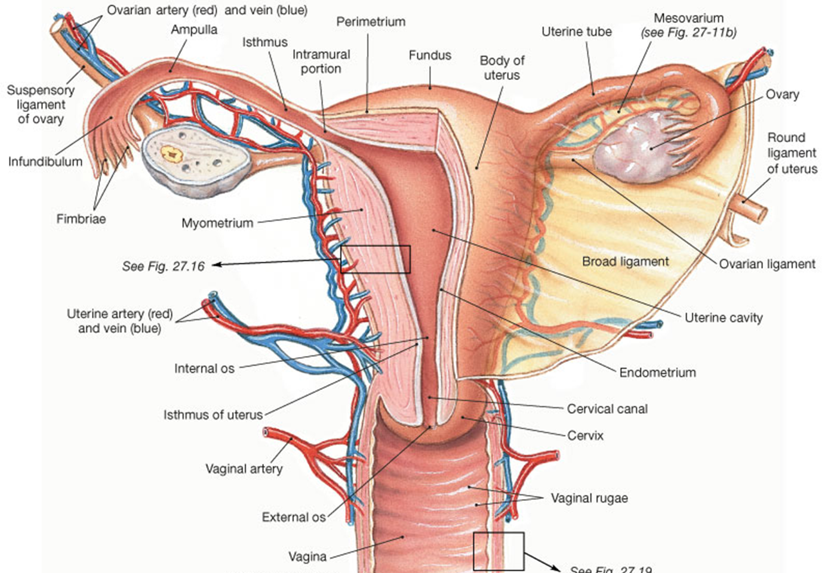
Histology of Uterus
Histology:
Uterine tube has ciliated and non-ciliated simple columnar epithelium
Histology:
Vaginal canal has stratified squamous epithelium
Histology of Vaginal canal

Slide 9
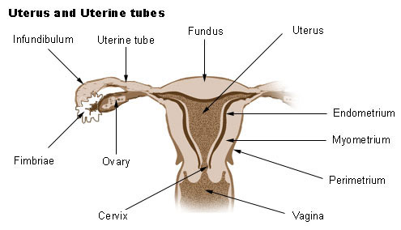
Gross Divisions of the Uterus
Fundus
Body (largest portion)
Uterine cavity
Cervix
Internal os
Cervical canal
External os

Slide 10
Uterine Wall (Layers)
Endometrium - innermost layer
Contains endometrial (uterine) glands.
Functional layer, top 2/3 (sheds).
Basal Layer, bottom 1/3 (remains).
Myometrium – muscular (thickest ~90%).
Perimetrium – outermost (superficial).

Slide 11
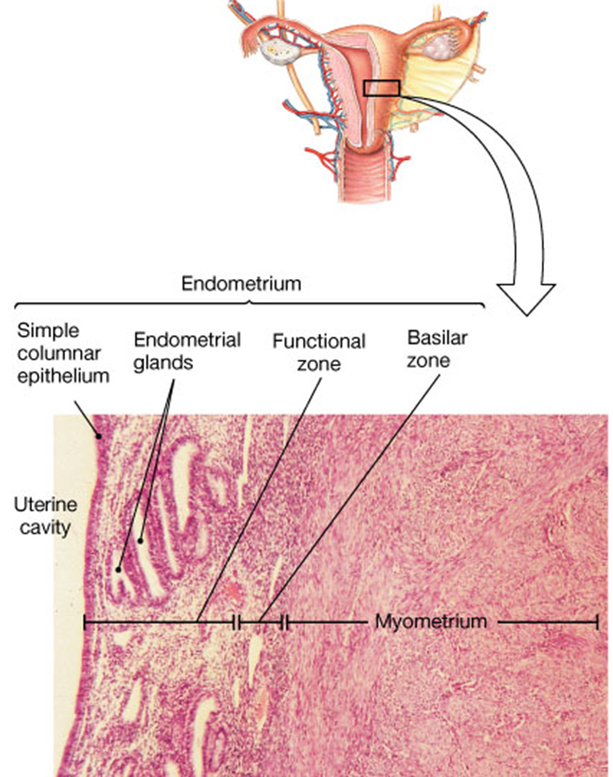
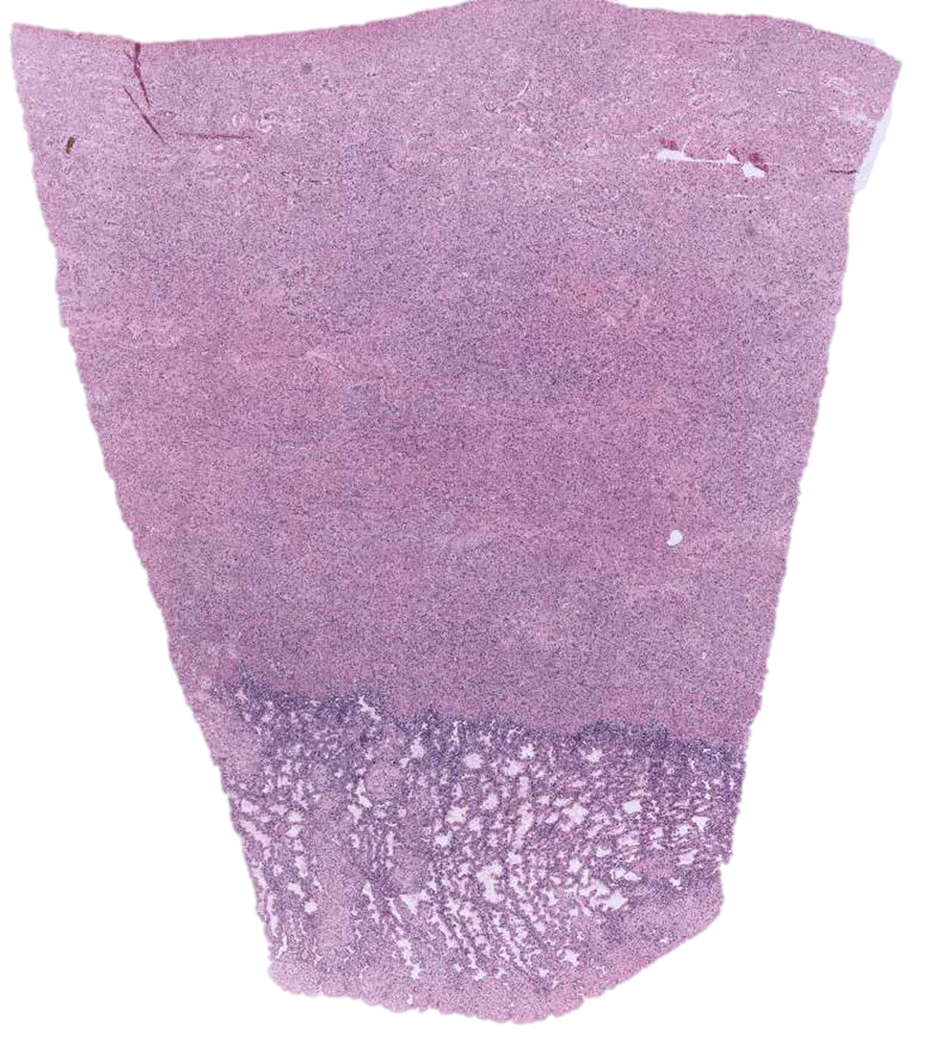
Histology of the
Uterine Wall

Slide 12
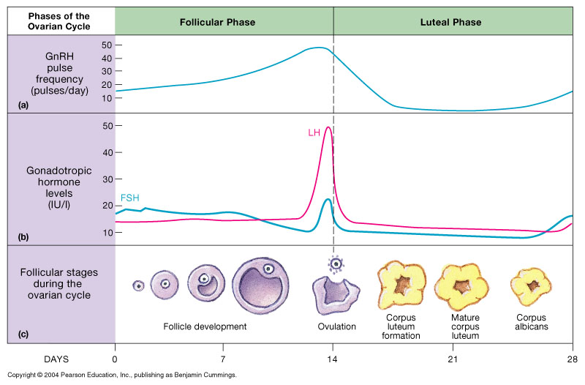
Ovarian Cycle

Slide 13
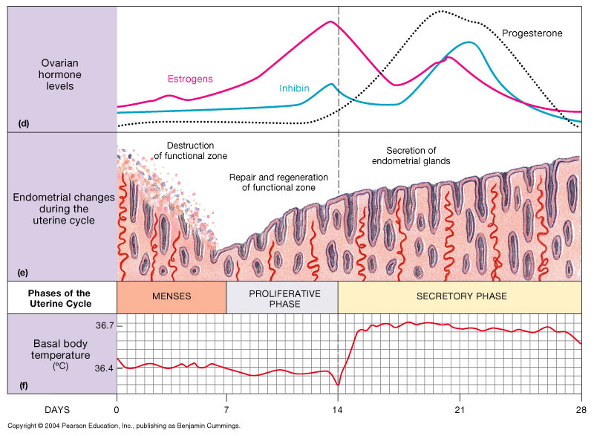
Uterine Cycle

Slide 14
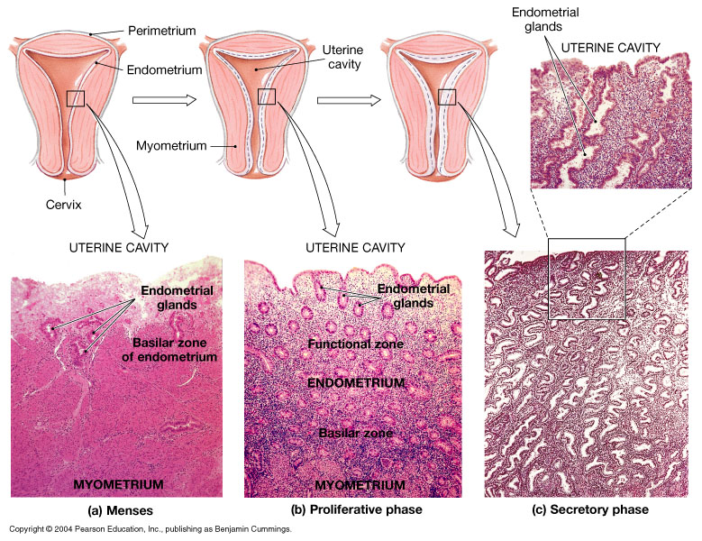

Slide 15
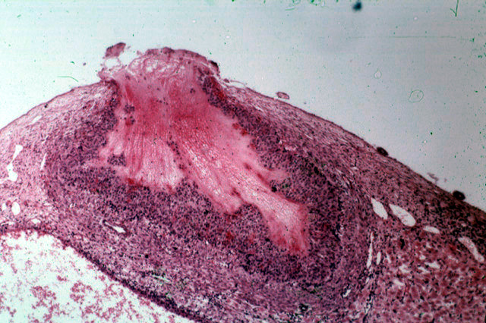
Ovulation of Mature Follicle

Slide 16
The Vagina
Elastic muscular tube from uterus to external genitalia (has rugae).
Passageway.
Forms lower portion of birth canal.
Lined by stratified squamous epithelium.

Slide 17
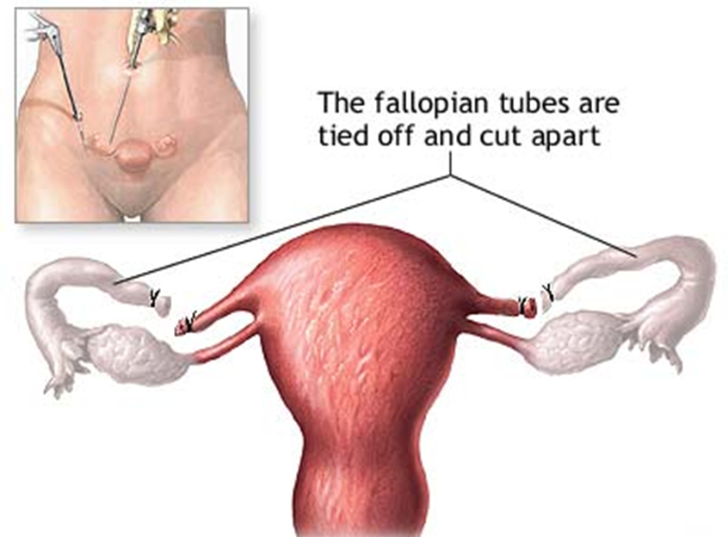
Tubal Ligation

Slide 18
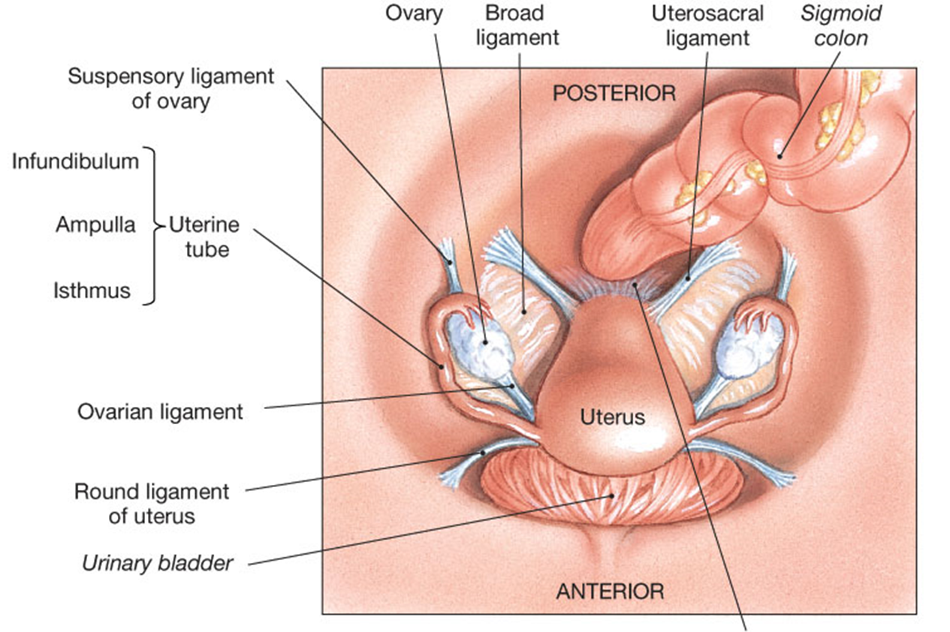
Superior View of Female
Reproductive System Ligaments
Lateral (cardinal) ligaments

Slide 19
The External Genitalia
Vulva (pudendum)
Labia majora – outer (larger)
Labia minora – inner (smaller)
Clitoris – erectile tissue (spongiosum)
- Prepuce (hood, foreskin of clitoris)
Vestibule (created by labia minora)
Greater vestibular (Bartholin’s) gland.
Mons pubis

Slide 20
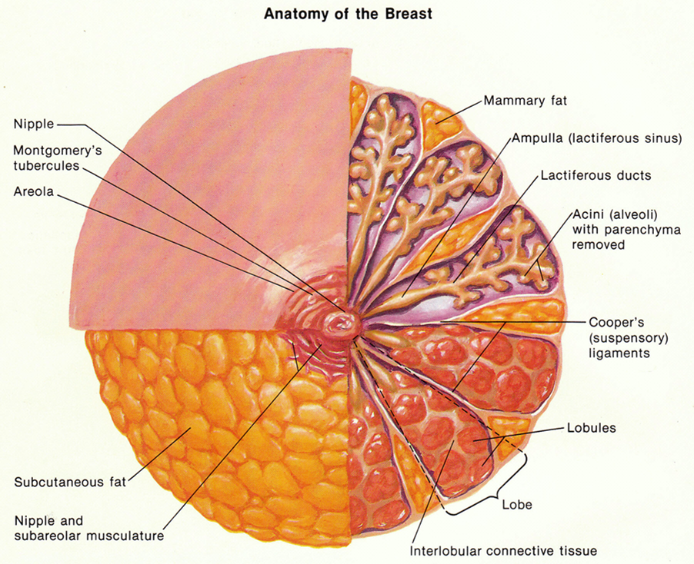
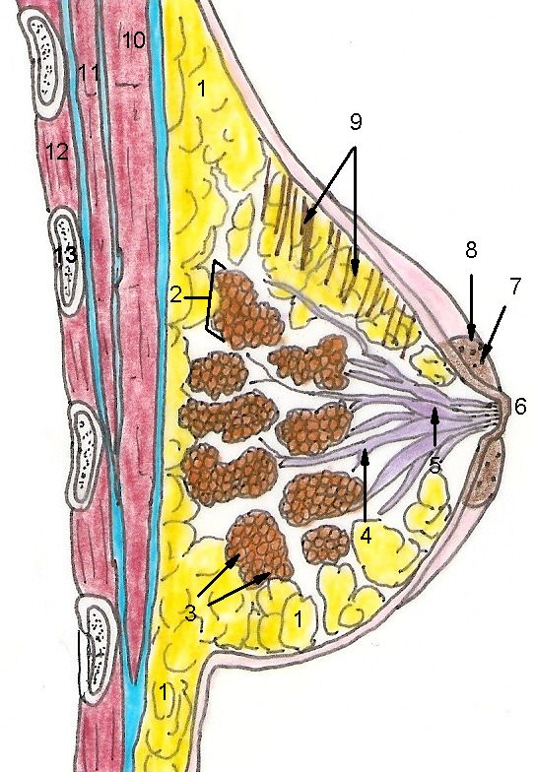
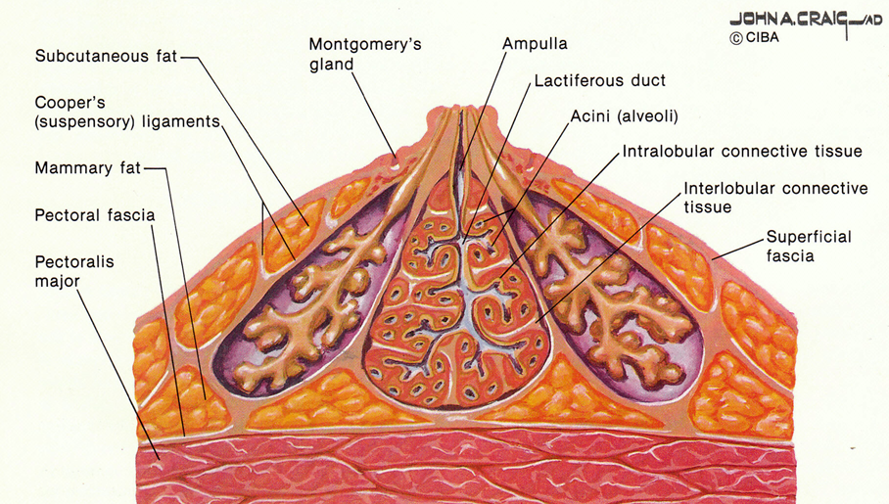
The Breast and
Mammary Gland

Slide 21
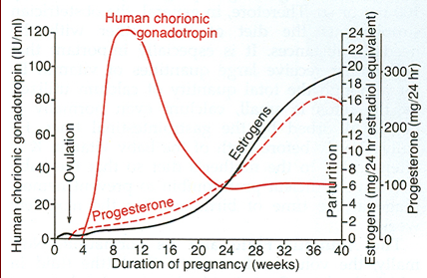
Implantation of Fertilized Egg Cell into
Endometrium Triggers Signal to Ovaries

Slide 22
2º Sexual Characteristic
Differences in anatomy and physiology between males and females
= sexual dimorphism. Determined by genotype (XX and XY) and by phenotype (mostly directed by testosterone levels).
Characteristic | Males | Females
Bone mass/density | More massive and dense, thicker, more prominent. | Less massive and dense, less prominent features.
- Pubic Angle - Q Angle - Finger digit ratio | - Smaller: acute, less than 90º - Smaller: Q = ~12º - 4th longer than 2nd | - Larger, obtuse, greater than 90º - larger: Q = ~18º - 4th same/shorter to 2nd
Muscle mass | More muscle mass, higher % average of 40% body Wt. | Less muscle mass, lower % average of 32% body Wt.
Hair growth pattern | More hairy, facial hair, male pattern baldness. | Less hairy, no facial hair.
Distribution of body fat | Less body fat, 14% body Wt. Visceral fat stores. | More body fat, 24% body Wt. Subcutaneous fat stores.
Larynx Voice (pitch) | Larger Larynx, longer, thicker vocal folds – deeper pitch. | Smaller larynx, shorted, thinner vocal folds – higher pitch.

