Slide 1
Human Reproductive System
Produces, stores, nourishes and transports functional gametes (egg and sperm).
Fertilization - union of sperm and egg = zygote.
Structures
Gonads – make gametes + Sex Hormones
Ducts – gametes and fluid travel through.
Accessory Organs and Glands
External Genitalia

Slide 2
Male Gonads = Testes
Produce Sperm (male gametes)
Testosterone
Female Gonads = Ovaries
Eggs (female gametes)
Estrogen and Progesterone

Slide 3
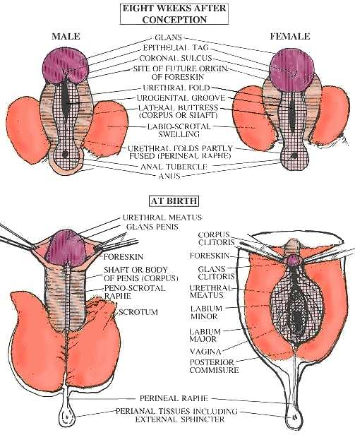

Slide 4
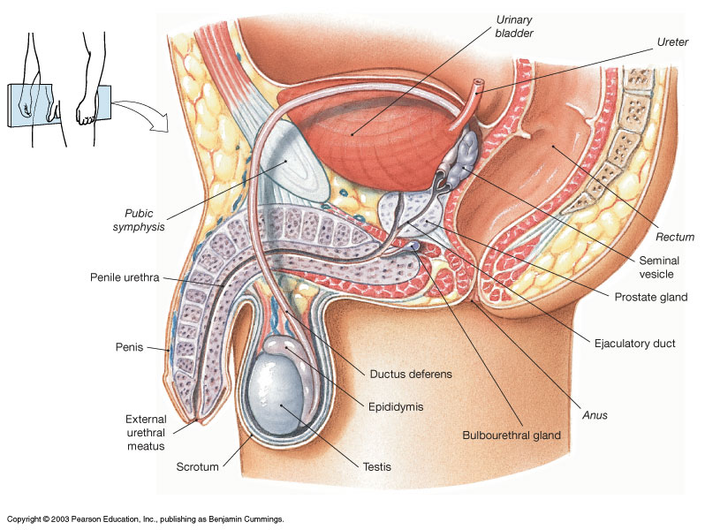
Male Reproductive Structures

Slide 5
Male Reproductive Structures
1º Reproductive organ: Testes
Scrotum - encloses testes.
Dartos muscle:
Cremaster muscle:
Sperm must be 2-3º F cooler than rest of body, hence kept ‘outside’ in scrotum.

Slide 6
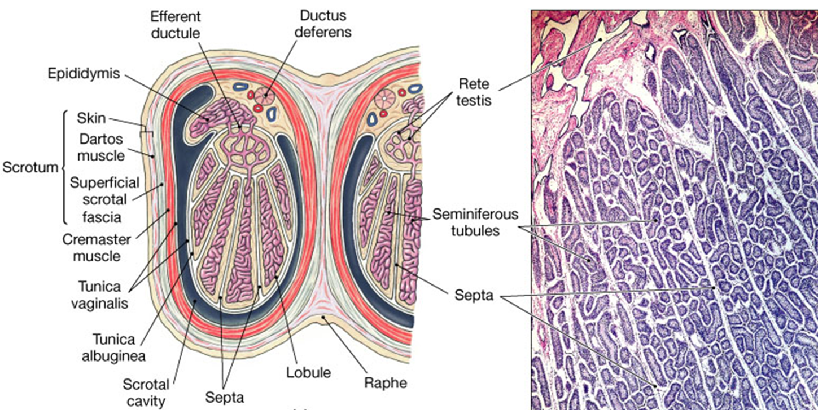
Structures of the Testes
Figure 27.4a

Slide 7
Seminiferous Tubules
Site of sperm cell production - spermatogonia (stem cells)
Interstitial cells - make and secrete testosterone.

Slide 8
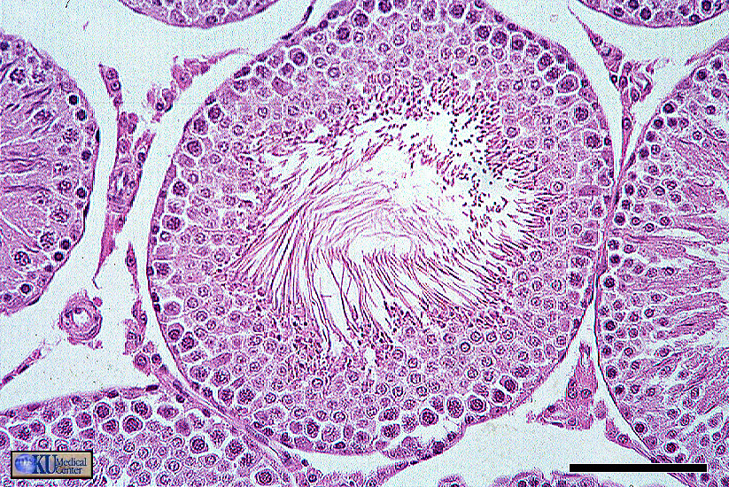
Seminiferous Tubules of the Testes
Interstitial Cells in between them

Slide 9
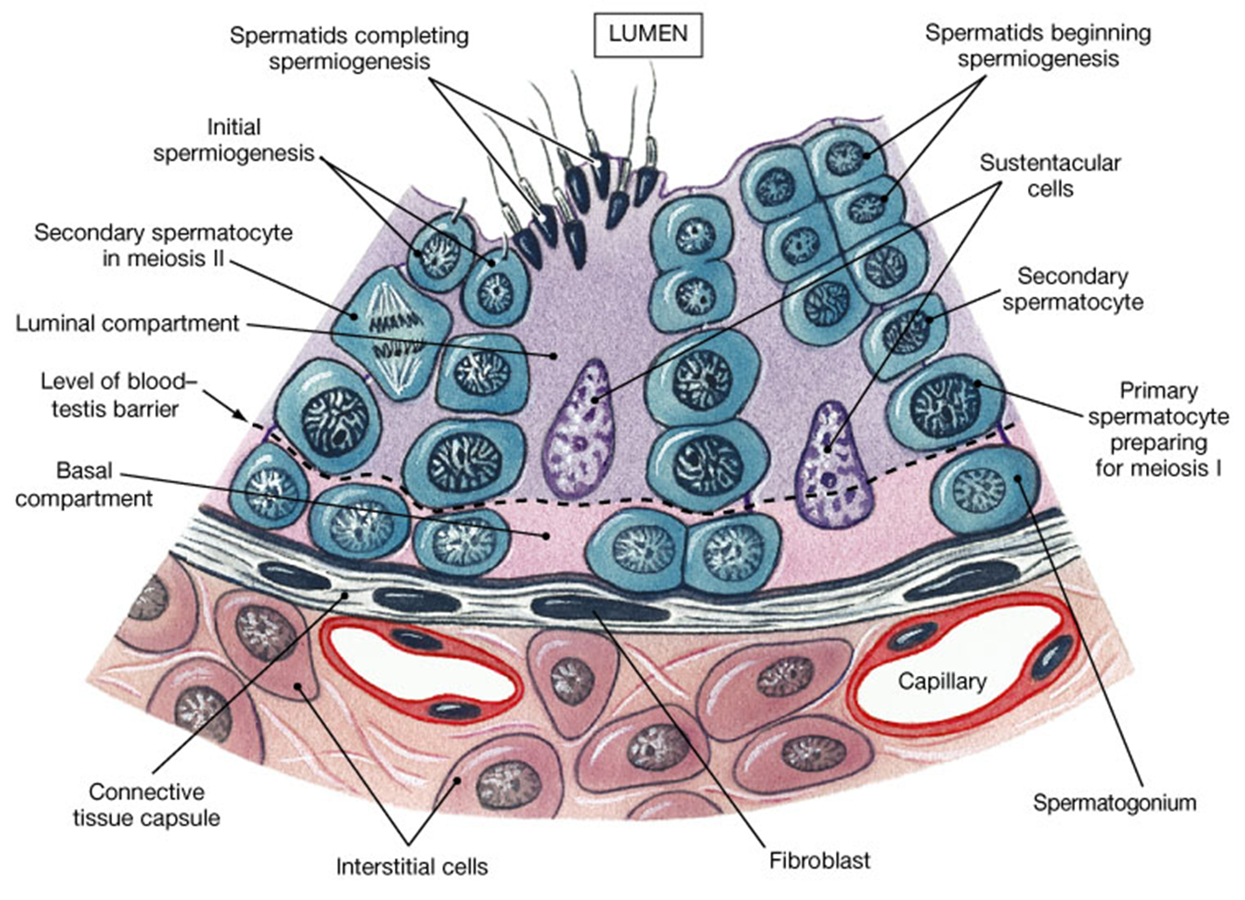
Spermatogenesis
The stem cell of mature spermatozoa

Slide 10
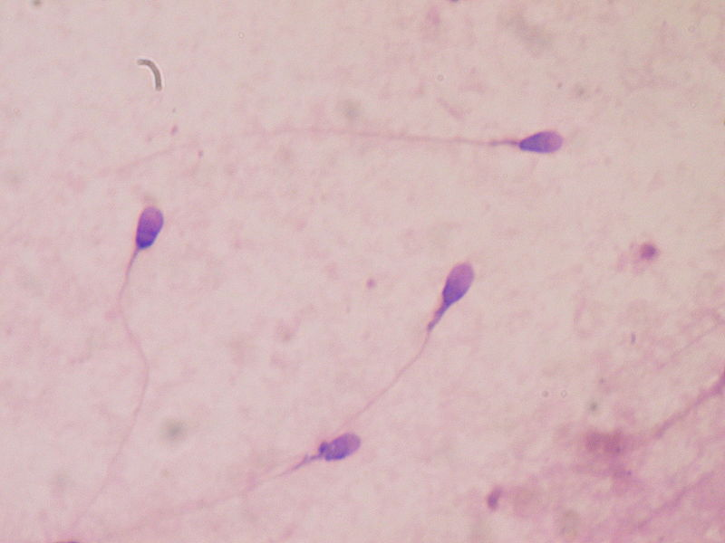
Spermatozoa Cells

Slide 11
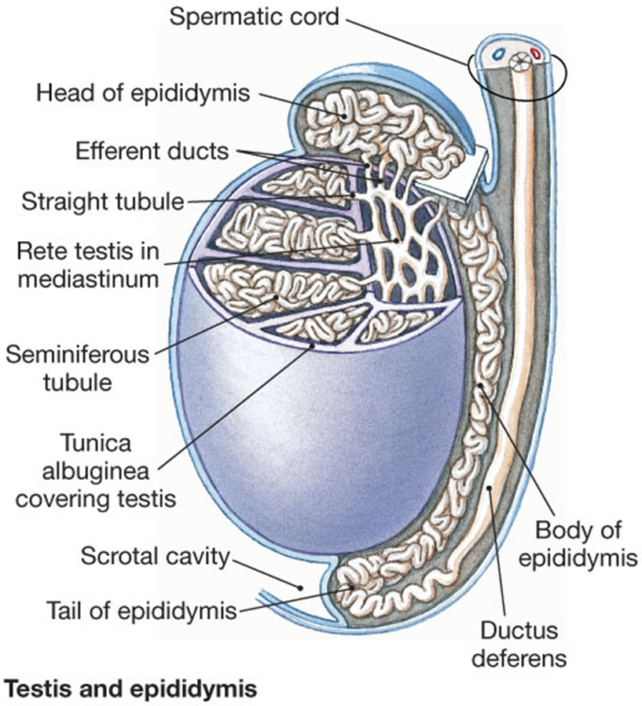
Epididymis – about 18 feet long (3 weeks).
- Head
- Body
- Tail
Transport &
Maturation
of Sperm cells
and culling
Ductus deferens

Slide 12
Ductus Deferens
Muscular tube transports/stores sperm.
Passes through inguinal canal to Abdomen.
Fuses into ejaculatory duct (see upcoming figure).
Empties into urethra (3 parts in male).

Slide 13
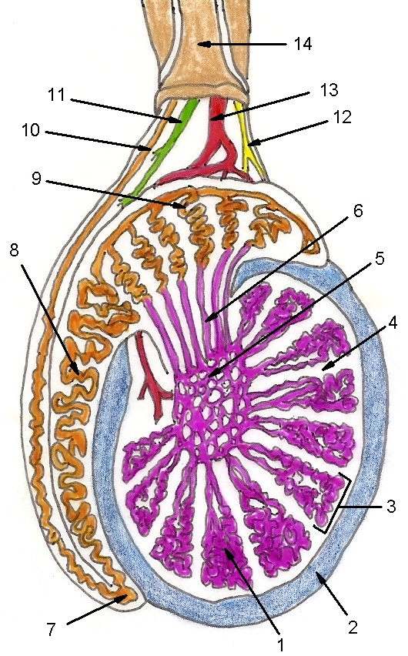
1. Seminiferous tubules
2. Tunica albuginea
3. Lobule of testis
4. Testicular septum
5. Rete testis
6. Efferent ductule
7. Tail of epididymis
8. Body of epididymis
9. Head of epididymis
10. Ductus deferens
11. Lymphatic vessel
12. Testicular nerve
13. Testicular artery
14. Spermatic cord

Slide 14
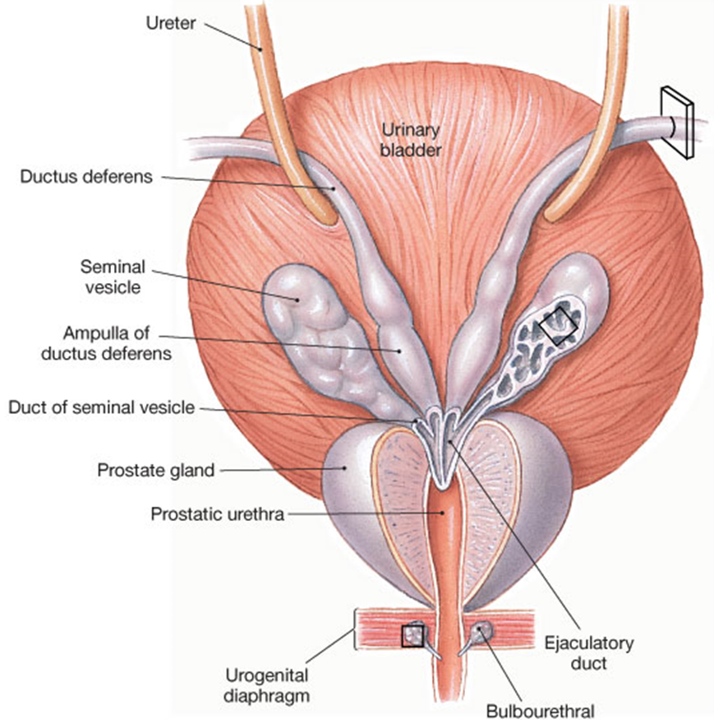
The Accessory Glands
1
2
3
Bulbourethral gland
Posterior View

Slide 15
Accessory Organs of the Male
1. Seminal vesicles (paired)
2. Prostate gland (single)
Secrete semen
into urethra
3. Bulbourethral glands (paired)

Slide 16
Seminal Vesicles
Paired glands – secretes 60% semen volume.
Fibrinogen – converts to fibrin.
Fructose – a sugar for energy!
Prostaglandins – contract female tract.
pH of fluid is from 7.2 to 7.8 (basic or alkaline).

Slide 17
Prostate Gland
Single gland - secretes 30% semen volume.
Clotting enzymes – to cause initial clots.
Fibrolysin – to liquefy clots.
The pH of this fluid is 6.9 to 9.5 (highly basic).
Bulbourethral Glands
Paired glands (~5% semen volume).
Alkaline (pH 7.2 to 8.0) mucus secretion, helps neutralize male urethra and vaginal canal.
Lubricating properties.

Slide 18
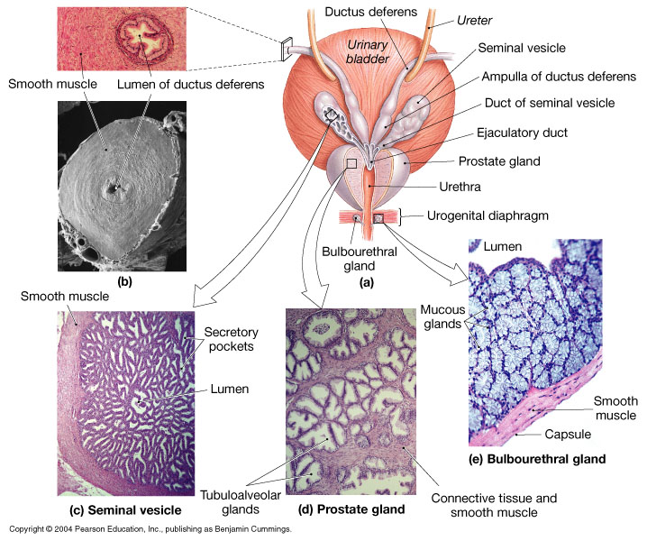

Slide 19
Semen
Typical ejaculation releases 2-5 ml.
Sperm count typically 50 – 100 million per ml.
Sperm count below 20 million/ml = “infertile”.
Typical pH range from 7.2 to 7.8 (alkaline or basic).

Slide 20
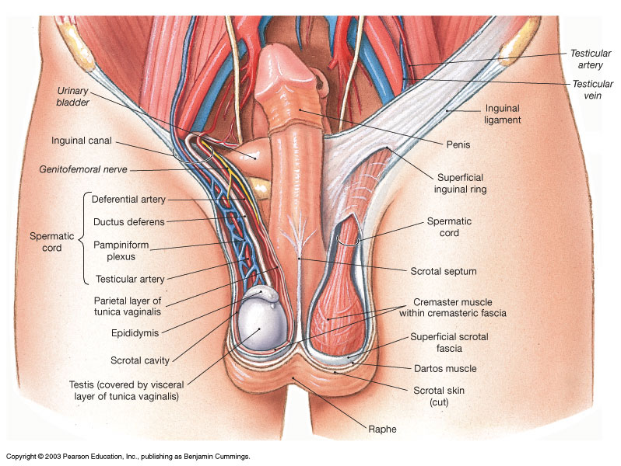

Slide 21
The Spermatic Cord
Structure of connective tissue, fascia and muscle.
Encloses these structures:
ductus deferens, testicular artery,
testicular vein, cremaster muscle.
Pampiniform plexus, lymphatics and nerves.
All these travel through inguinal canal.

Slide 22
Male Urethra
Urinary bladder to tip of penis
Three regions
Prostatic urethra
Membranous urethra
Penile urethra
Lined with stratified columnar and transitional epithelium.

Slide 23
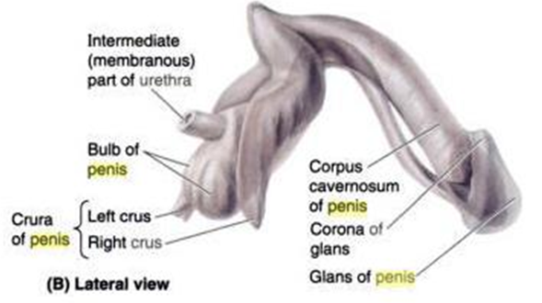
The Anatomy of the Penis
Root, body (shaft) and glans.
Prepuce (foreskin)
surrounds tip (glans).
Erectile tissue (3 masses)
Two corpora cavernosa
One corpus spongiosum
(surrounds penile urethra)
Erection –
Caused by dilation of arterial smooth muscles.

Slide 24
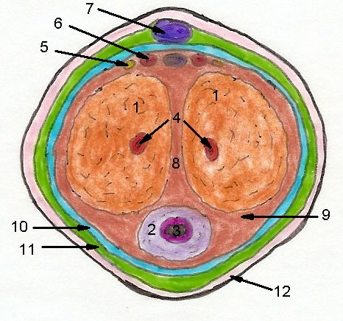
Cross Section of the Penis
Structures
1 Corpora cavernosa
2 Corpus spongiosum
3 Penile urethra
4 Deep artery
5 Doral nerve
6 Doral artery
7 Superficial dorsal vein
8 Septum of penis
9 Tunica albuginea
10 Deep fascia
11 Loose areolar CT
12 Skin of penis

Slide 25
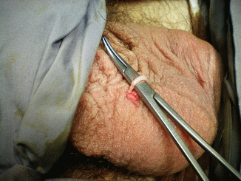
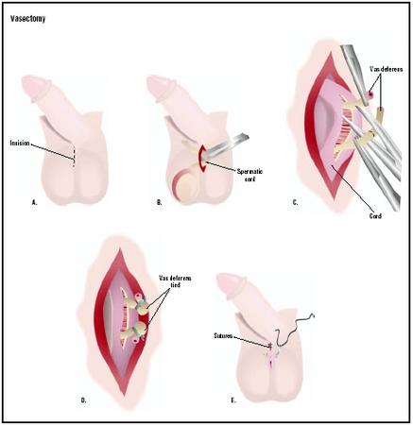
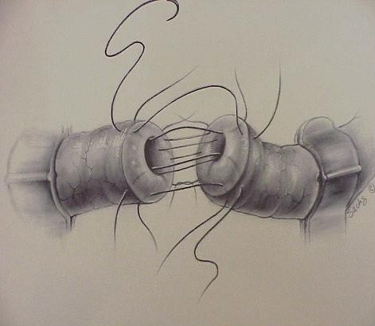
Vasectomy

