Slide 1
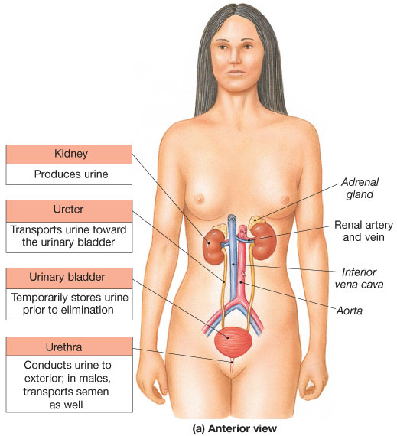
The Renal System
2 Kidneys
Produces urine
2 Ureters
Transports urine
1 Urinary bladder
Stores urine
1 Urethra
Excretes urine to outside

Slide 2
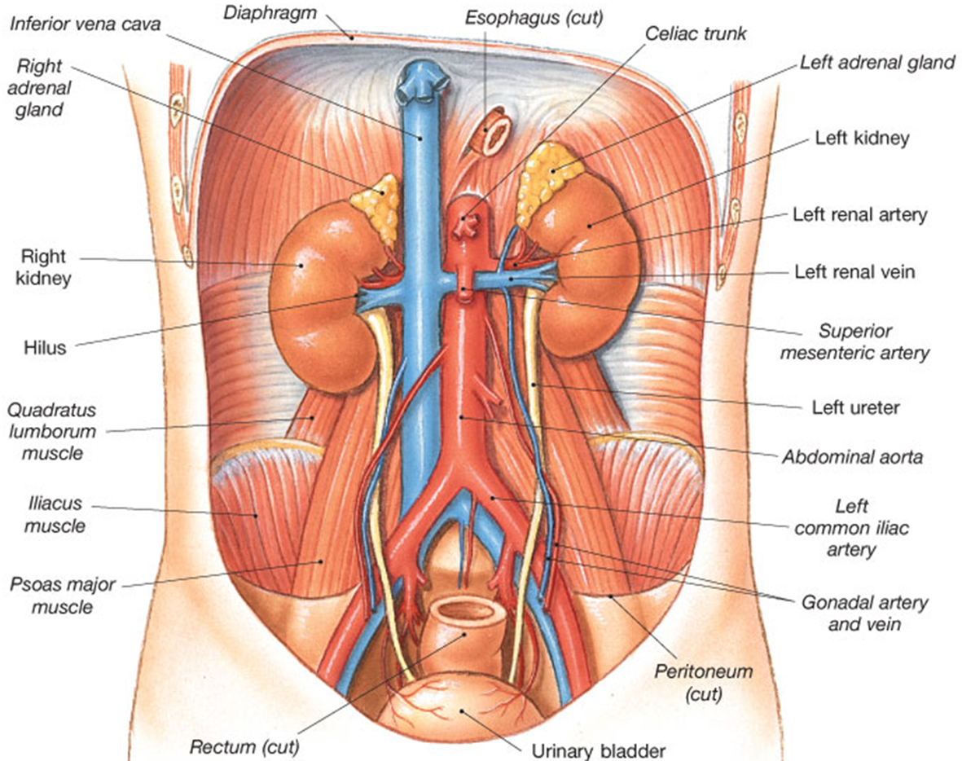
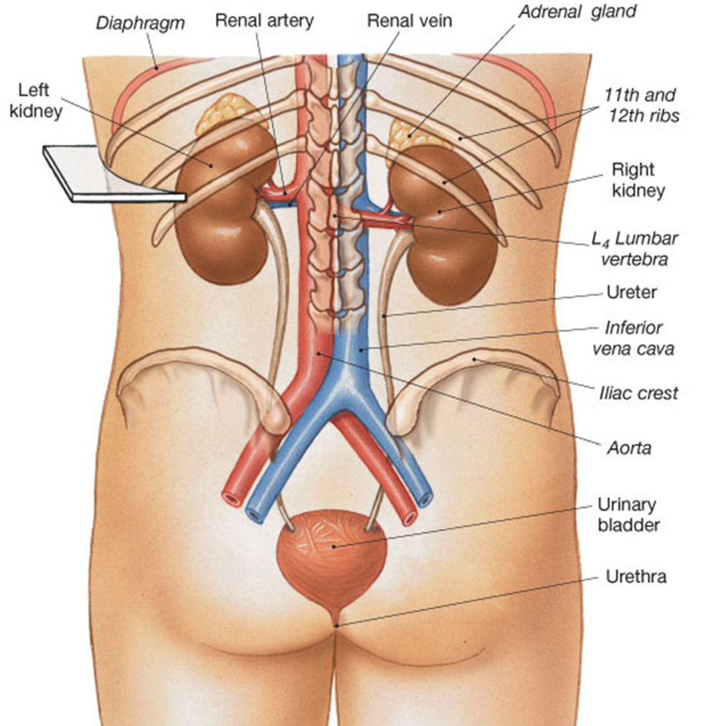
Located on posterior wall of abdominal cavity, they are ‘retroperitoneal’ = located in the space behind the peritoneal cavity.
Covered partially by ribs 11 and 12.
Usually positioned between 12th thoracic and 3rd lumbar vertebrae. The right kidney is generally slightly lower than the left due to liver.

Slide 3
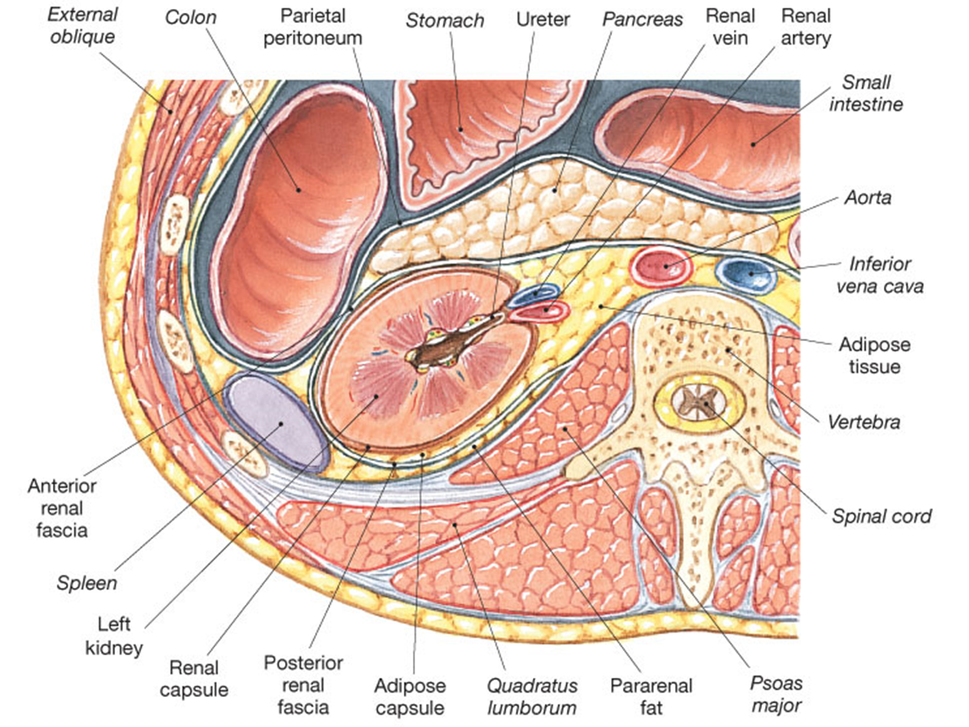
Transverse Section of Abdomen

Slide 4
3 Layers Surrounding the Kidney
Renal Capsule
- inner layer (outer surface of kidney)
Adipose Capsule
- fat padding around kidney
Renal Fascia
- outermost layer

Slide 5
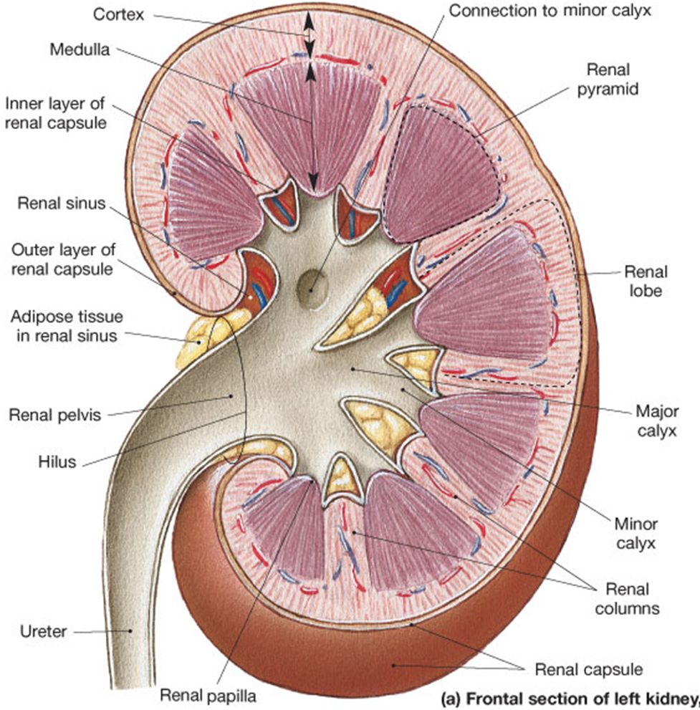
Outer renal cortex
Inner renal medulla
Renal pyramid
Renal columns
Renal papilla
Minor calyx
Major calyx
Renal pelvis
Ureter

Slide 6
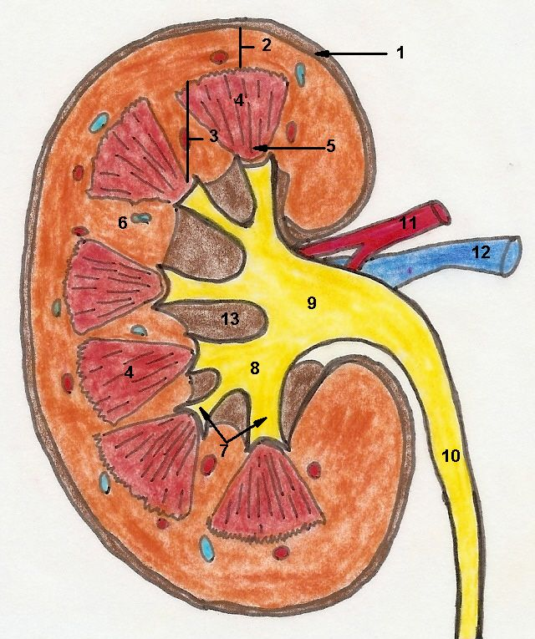
13

Slide 7
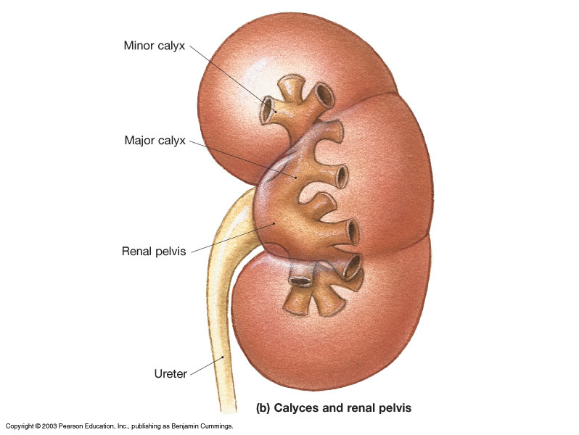
Collection of Urine in the Renal Systems
Calyx – ‘cup’
Pelvis = basin
Calyx - singular
Calicies - plural
to Bladder

Slide 8
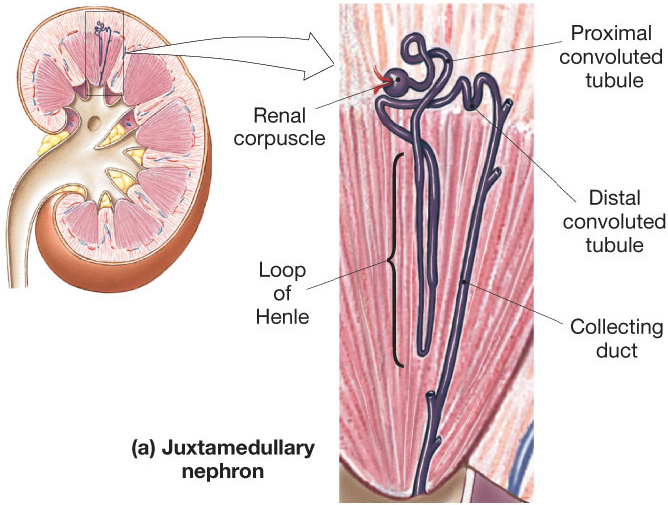
The Nephron – Functional Unit
1.25 million/kidney

Slide 9
The Nephron has 2 parts:
1. Renal Corpuscle
a) Glomerulus
b) Bowman’s Space
c) Bowman’s Capsule
2. Renal Tubule
a) Proximal convoluted tubule (PCT)
b) Loop of Henle (nephron loop)
c) Distal convoluted tubule (DCT)

Slide 10
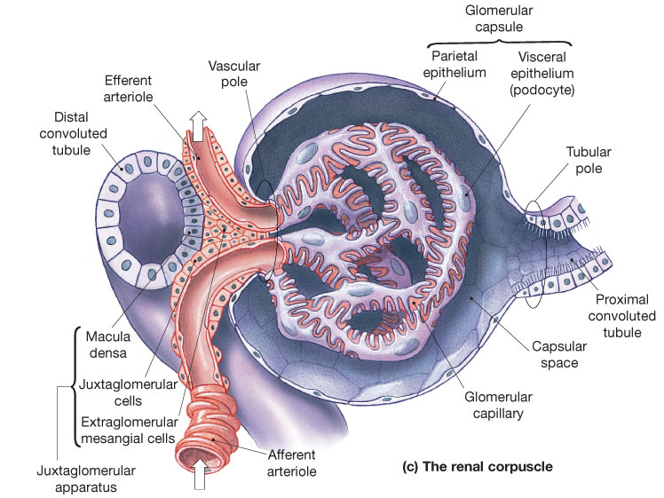
Glomerulus Details

Slide 11
Juxtaglomerular Apparatus
Macula Densa – specialized portion of DCT.
Sits in between afferent and efferent arteriole
– for communication regarding renal function.
Juxtaglomerular (JG) Cells – specialized
cells, mostly surrounding afferent arteriole.
Purpose: For changing diameter of afferent arteriole.

Slide 12
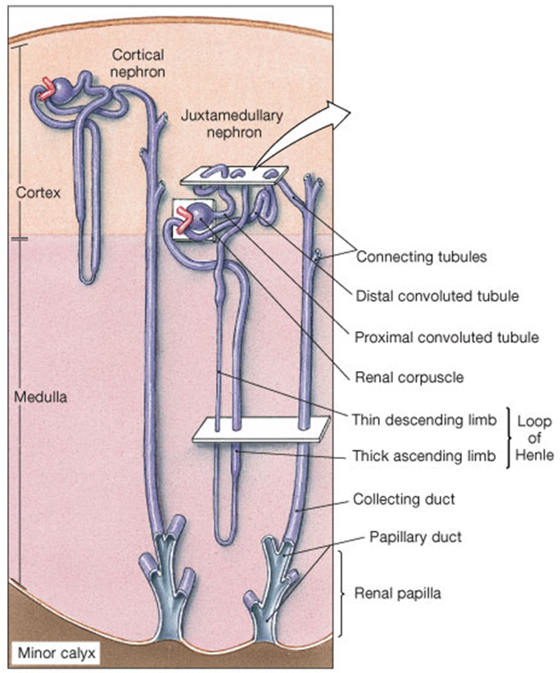
~85% Cortical Nephrons
Short loop of Henle.
Efferent arteriole
becomes peritubular
capillaries.
15% Juxtamedullary
Closer to medulla.
Loop of Henle deeper.
Efferent arteriole
becomes vasa recta.

Slide 13
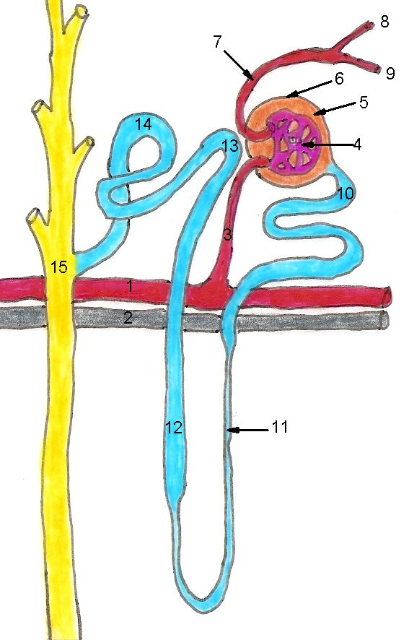

Slide 14
Renal Blood Supply
Renal a.
Segmental a.
Interlobar a.
Arcuate a.
Cortical radiate a.
Afferent
arteriole

Slide 15
Blood arrives at afferent arteriole.
Filtrate is “filtered” at Glomerulus.
(a fenestrated capillary bed)
Blood departs via efferent arteriole.
a) Peritubular or b) Vasa recta
capillaries capillaries
(cortical nephrons)
(juxtamedullary nephrons)
Veunles

Slide 16
Venules
Interlobular v.
Arcuate v.
Interlobar v.
Renal v.

Slide 17
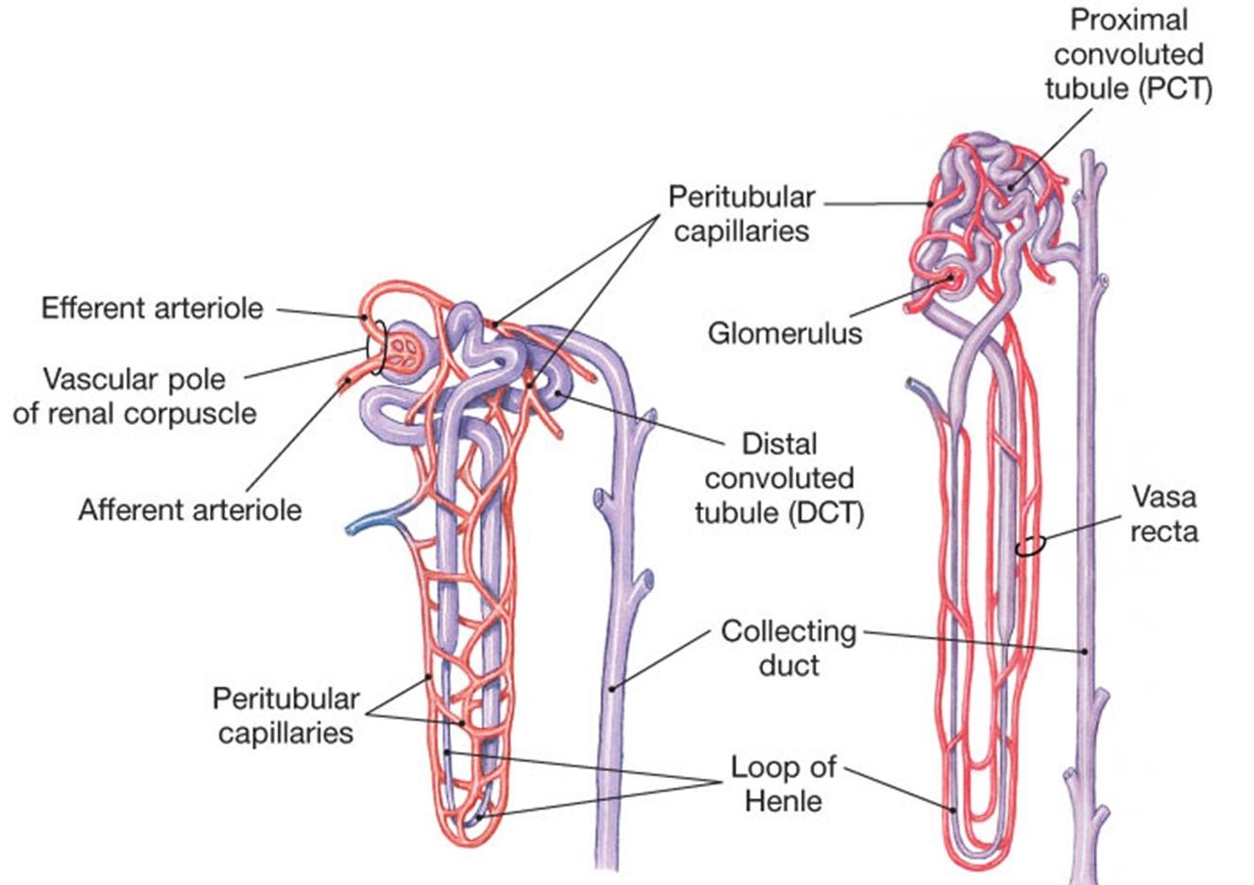
Nephrons with:
peritubular capillaries (cortical)
b) vasa recta (juxtamedullary)

Slide 18
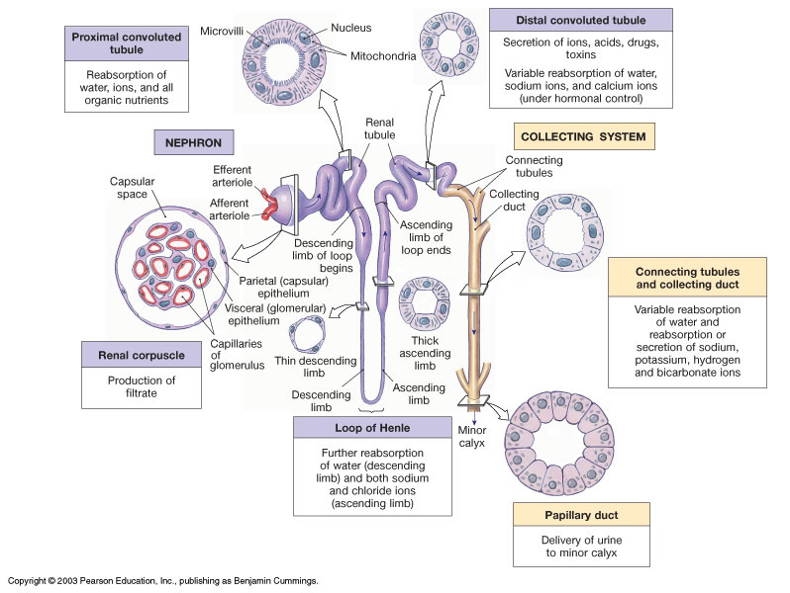
The Renal Tubules

Slide 19
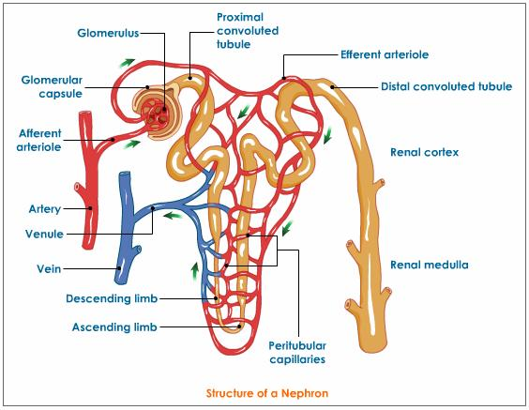
The Renal Tubules
a) Proximal Convoluted
Tubule
Actively reabsorbs most of filtrate
Nutrients (glucose, amino acids)
Ions (Na⁺, Ca²⁺, etc.)
Line with simple cuboidal epi, microvilli (brush border) to provide a large surface area for increased reabsorption.

Slide 20
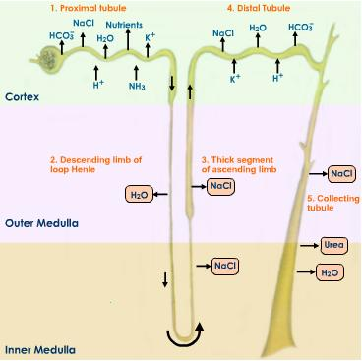
b) Loop of Henle
Descending and Ascending limb
For Water balance
Thin segment - simple squamous epi.
Thick segment - simple cuboidal epi (no microvilli)

Slide 21
c) Distal Convoluted Tubule
Actively secretes ions
and other materials
Lined with simple
cuboidal epi.

Slide 22
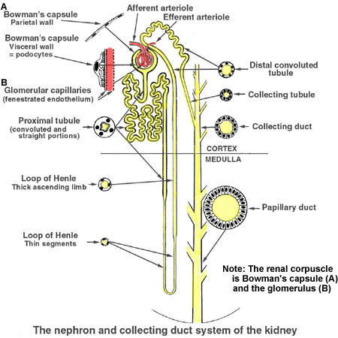
Collecting Duct
- simple cuboidal epi.
Changes to simple columnar epithelium
deeper in medulla.
AntiDiuretic Hormone
(ADH) acts here to
conserves H₂O

Slide 23
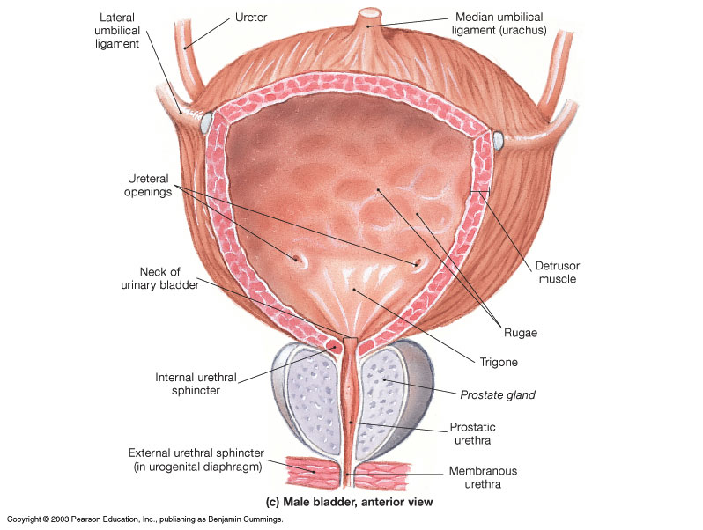
Bladder is lined with . . .
Transitional epithelium

Slide 24
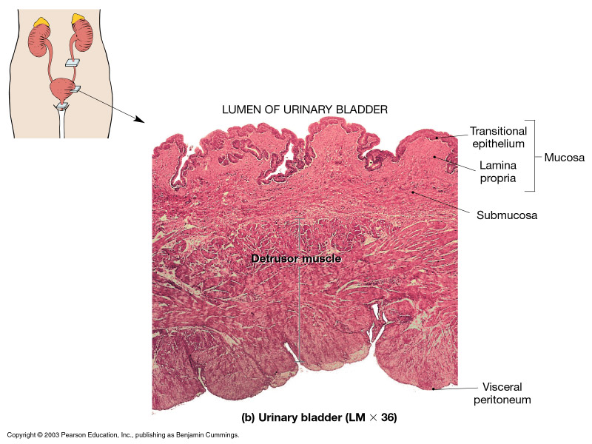

Slide 25
There are 4 Processes in the kidneys:
1. Filtration: at Glomerulus – net movement of substances from glomerulus to Bowman’s space.
2. Resabsorption: – net movement of substances from renal tubules and collecting duct into peritubular & vasa recta capillaries.
3. Secretion: – net movement of substances from peritubular & vasa recta capillaries into renal tubules.
4. Excretion: – elimination of urine from body.

Slide 26
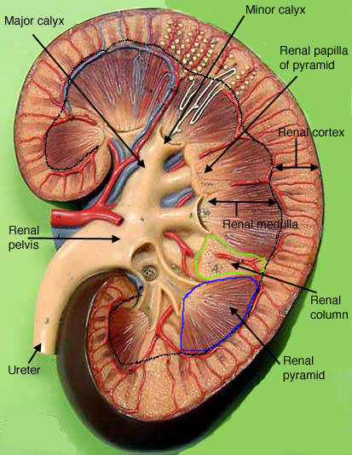

Slide 27
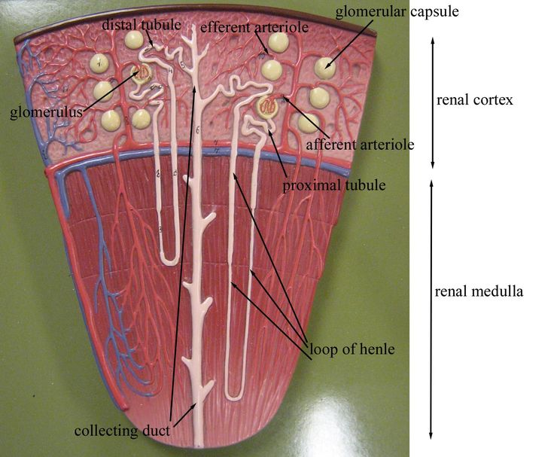

Slide 28
