Slide 1
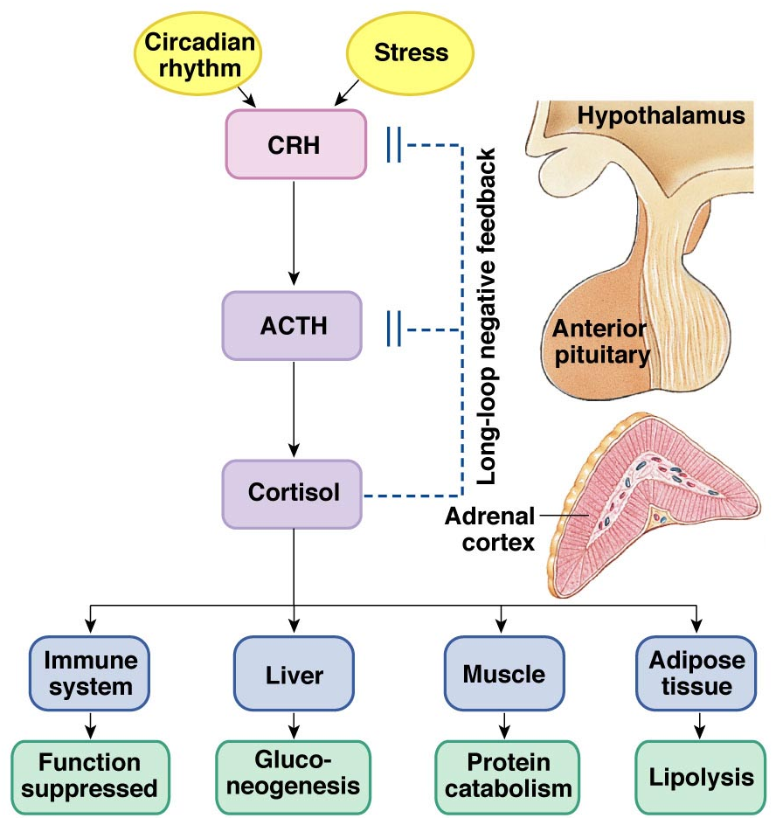
The Pituitary Gland
The hypothalamus significantly influences the pituitary gland
Posterior
pituitary
Hypothalamic releasing
and inhibiting hormones
are delivered to the
anterior pituitary
The hypothalamus makes
and releases the hormones
of the posterior pituitary

Slide 2
Pituitary (Hypophysis)
Posterior Pituitary – “neurohypophysis”
Anterior Pituitary – “adenohypophysis”
Posterior Pituitary – 2 hormones
①
Oxytocin
②
Antidiuretic Hormone (ADH)
①
②

Slide 3
Anterior Pituitary – synthesizes 6 hormones.
①
Growth Hormone (hGH)
(also called Somatotropin)
②
Adrenocorticotropic Hormone (ACTH)
(also called corticotropin)
③
Thyroid Stimulating Hormone (TSH)
③④⑤
⑥⑦⑧
④
Follicle Stimulating Hormone (FSH)
⑤
Luteinizing Hormone (LH)
⑥
Prolactin (PRL)

Slide 4
①
hGH – is the primary hormone that regulates overall body growth, also important in general metabolism. Stimulates growth of bone, cartilage, muscle, glands, vessels, …
This hormone is also known as somatotropin.
②
ACTH – stimulates cortisol secretion from the adrenal cortex
(known as the stress hormone). Also promotes growth
of the adrenal cortex.
③
TSH – stimulates thyroid gland to secrete thyroxine (T₃ and T₄) and growth of the thyroid gland. An important regulator of metabolic activity in entire body (basal metabolic rate).

Slide 5
④
FSH – a) Females: stimulates growth and development of
ovarian follicles and thus development of the egg cell. Also
promotes estrogen secretion.
b) Males: it is required for spermatogenesis, the
production of sperm cells (spermatozoa).
⑤
LH – a) Females: responsible for ovulation, and luteinization. Regulates estrogen and progesterone levels.
b) Males:* stimulates interstitial cells (in testes) to
secrete testosterone.
*Called interstitial cell stimulating hormone (ICSH)
⑥
PRL – a) Females: enhances breast development & milk production
for the process of lactation.
b) Males: it enhance LH- receptors in interstitial cells increasing (testosterone) thus increasing spermatogenesis.

Slide 6
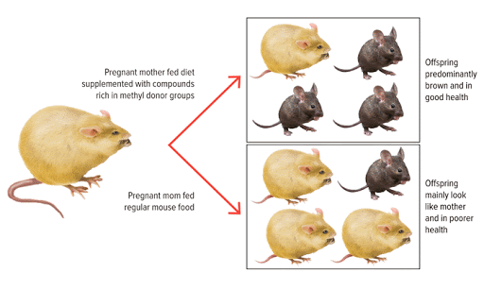
For Normal Growth and Repair
Need adequate levels of growth hormone, and other hormones
An adequate diet (vitamins/minerals)
Absence of Stress
Agouti Mice
Genetics
  - Genotype
  - Phenotype

Slide 7
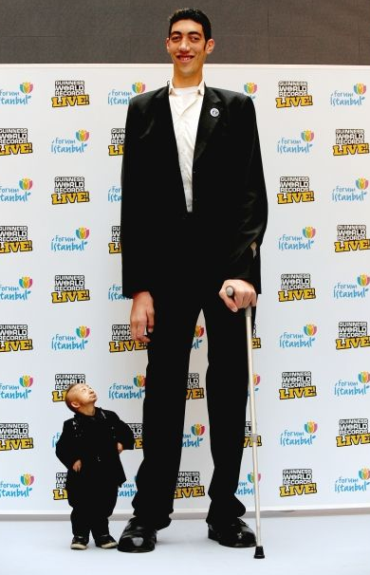
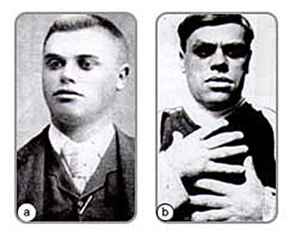
Growth Hormone
Severe GH deficiency
leads to dwarfism
(2 ft, 5.4 in)
Over secretion of GH in children leads to gigantism
(8 ft, 1 in)
Over secretion of hGH in adults leads to acromegaly

Slide 8
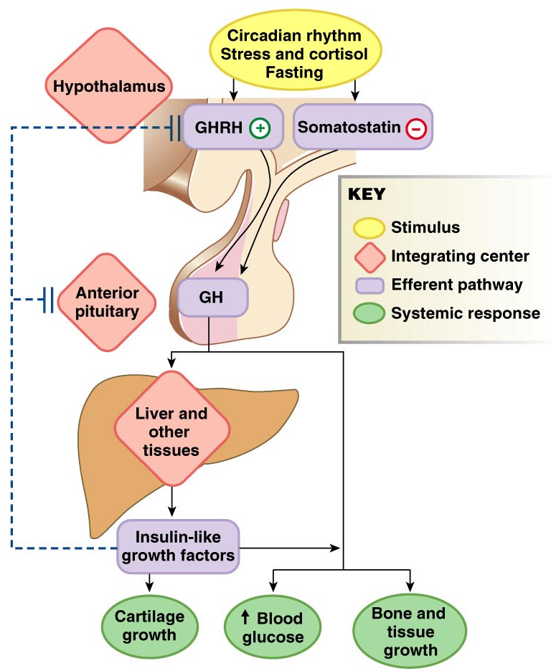
Pathway of Growth Hormone Control

Slide 9
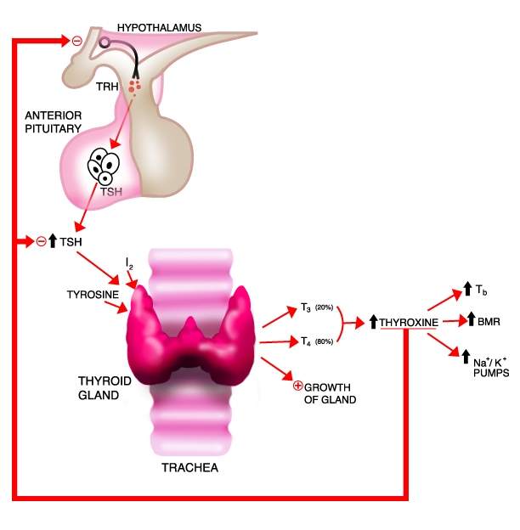
Negative Feedback Loop of
Hypothalmic-Adenohypophysis
and the Thyroid Gland
Hypothyroidism
Hyperthyroidism

Slide 10
The
Cortisol
Connection
The Hypothalamus-Pituitary-Adrenal Axis
(HPA)

Slide 11
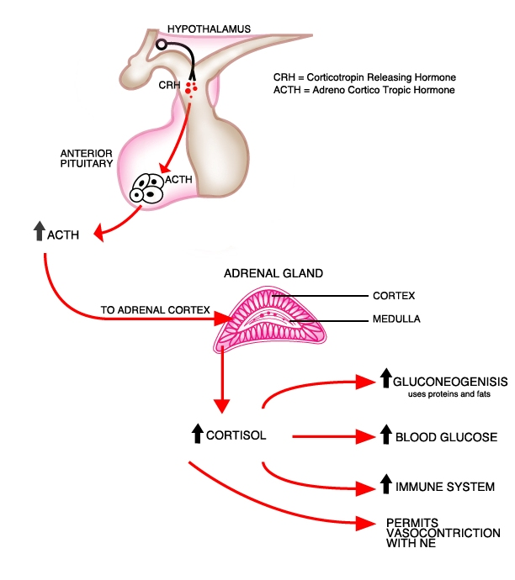

CRH = Corticotropin Releasing Hormone
ACTH = Adrenocorticotropic Hormone
GLYCOGENOLYSIS
The many functions of cortisol in the body

Slide 12
Cortisol
Promotes Gluconeogenesis
  Breakdown of skeletal muscle proteins
  Enhances lipolysis (prevents glucose use)
Promotes Glycogenolysis
Elevates Blood Glucose
Permissive – needed for NE vasoconstriction
Suppresses the immune response
Response to stressors – protective?

Slide 13
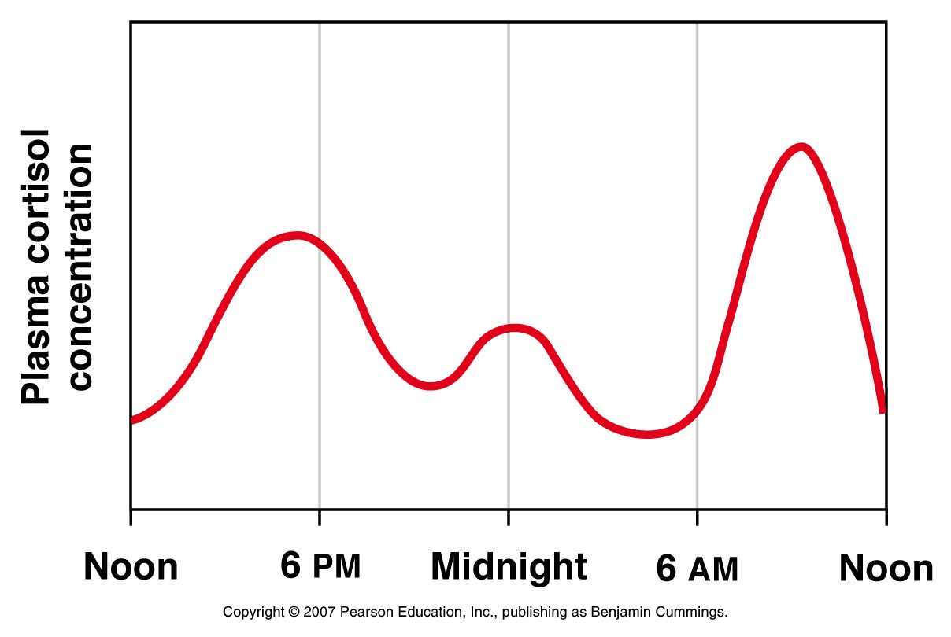
Circadian Rhythm of Cortisol Secretion

Slide 14
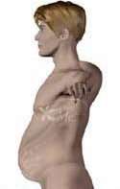
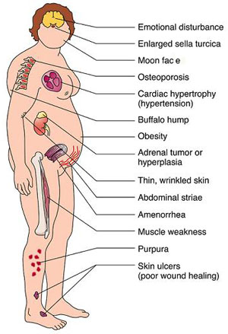
Hyper-Cortisolism
Over secretion of cortisol or ACTH.
Pituitary disorder = ↑ ACTH
Adrenal disorder = ↑ cortisol
Called Cushing’s Disease
Characterized by:
↑ Glucose and ↓ Protein
Loss of Muscle mass
Characteristic Fat deposits

Slide 15
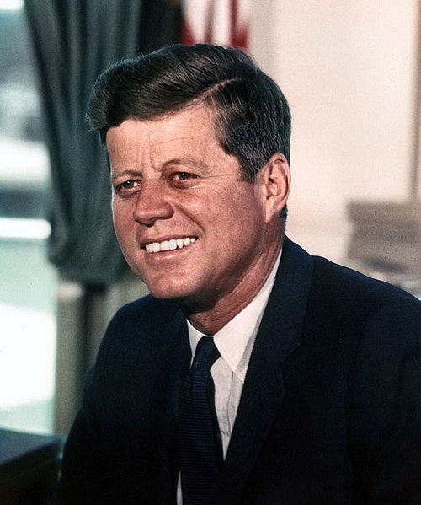
Hypo-Cortisolism
  Under secretion of adrenal steroid hormones
  e.g., Autoimmune destruction of adrenal cortex
Called Addison’s Disease
Characterized by:
↓ Glucose (hypoglycemia)
Lack of Vasoconstriction
Causes Low Blood Pressure
(Orthostatic Hypotension)
Poor response to stress
Fatigue and muscle weakness
Increased Melanocyte-Stimulating Hormone (MSH)
(darkens specific areas skin)

Slide 16
Hormone Interactions
Antagonistic – one hormone having the opposite effect of another.
e.g. Insulin and glucagon
Parathyroid Hormone and Calcitonin
Parathyroid hormone increases blood calcium. Calcitonin (released by the thyroid gland) decreases blood calcium.
Synergistic – two or more hormones having greater effect together than their sum separately.
e.g. Testosterone and FSH
Prolactin and Oxytocin
Prolactin promotes milk production (synthesis). Oxytocin facilitates milk ejection via myoepithelial cell contractions in mammary glands, thus they work together for lactation.
Permissive – one hormone enhances the effect of another hormone secreted later.
e.g. Estrogen and Progesterone
Cortisol and Norepinephrine
Estrogen prepares the uterus by thickening the endometrium. Progesterone then further increases this thickness, making the uterus receptive to implantation.

Slide 17
Cholesterol
Vitamin D
(a hormone)
Glucocorticoids
Cortisol
Mineralcorticoids
Steroid Hormones
(testosterone, estrogen,
progesterone)
Bile Salts

