Slide 1


Umoja at Miramar College
Presented by: Judy Patacsil & Support Individuals
1

Slide 2
Action for Classified Senate
  Support the formation of a task force to review the application process to establish an Umoja Program.
  To recommend that the task force begin meetings to include Administration and Faculty to discuss guidelines provided by the Umoja Community Education Foundation
  Pass a motion of support to bring Umoja to San Diego Miramar College.
2

Slide 3
Umoja’s Mission
  Umoja, (a Kiswahili word meaning unity) is a community and critical resource dedicated to enhancing the cultural and educational experiences of African American and other students.
  We believe that when the voices and histories of students are deliberately and intentionally recognized, the opportunity for self-efficacy emerges and a foundation is formed for academic success. Umoja actively serves and promotes student success for all students through a curriculum and pedagogy responsive to the legacy of the African and African American Diasporas
Umoja Community Education Foundation Website
3

Slide 4
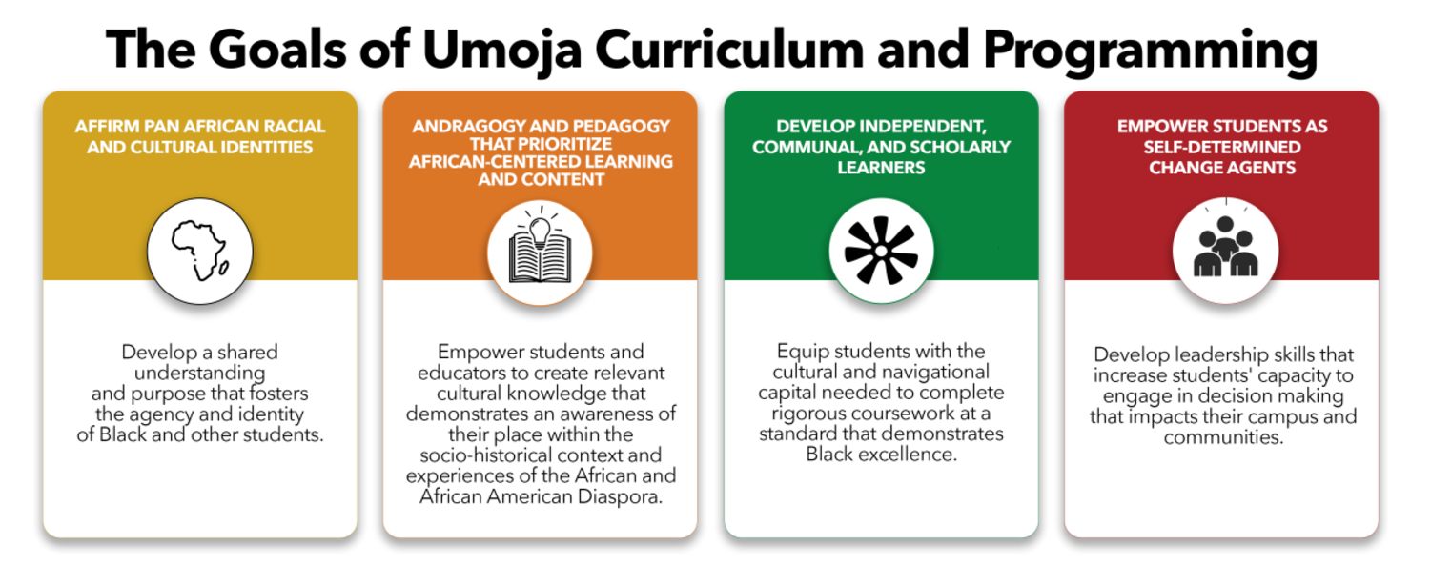
Umoja’s Curriculum: Transformative, Emancipatory, and Responsive to the African American Legacy
4

Slide 5






Umoja Statistics & Program Components in San Diego County
  74 Programs throughout CA and WA
  8,439 Students enrolled in Fall 2023 (CCCO Data Mart)
  7 Umoja programs in San Diego County - Miramar is the only community college without Umoja.
COORDINATION & CORE TEAM
VILLAGE
SPACE
ACADEMIC/UMOJA DEDICATED COURSES
STUDENT FOCUSED PROGRAMMING
REPORTING AND DATA
PROFESSIONAL AND STUDENT DEVELOPMENT
5

Slide 6
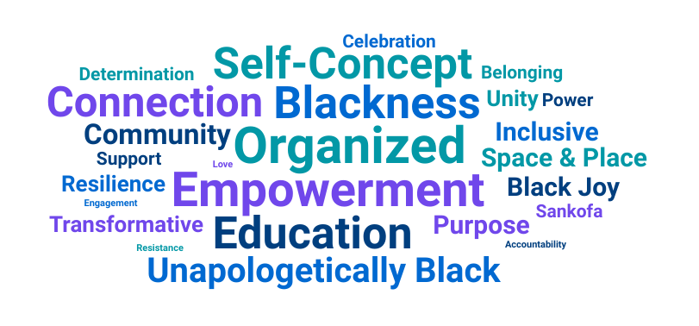
Why at Miramar?
They [community colleges] provide a pathway for adults who return to college seeking new work and career opportunities. Community colleges are first, second, and if needed, third and fourth chance institutions. They are educational settings where—if they meet their mission—people who have encountered obstacles in school and life can move towards productive futures
Umoja White Paper
6

Slide 7
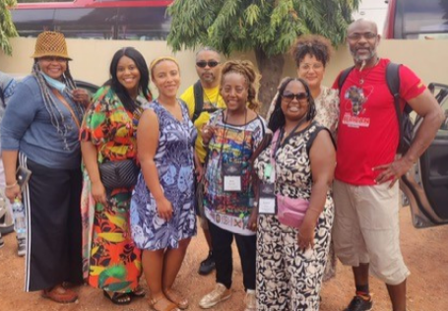
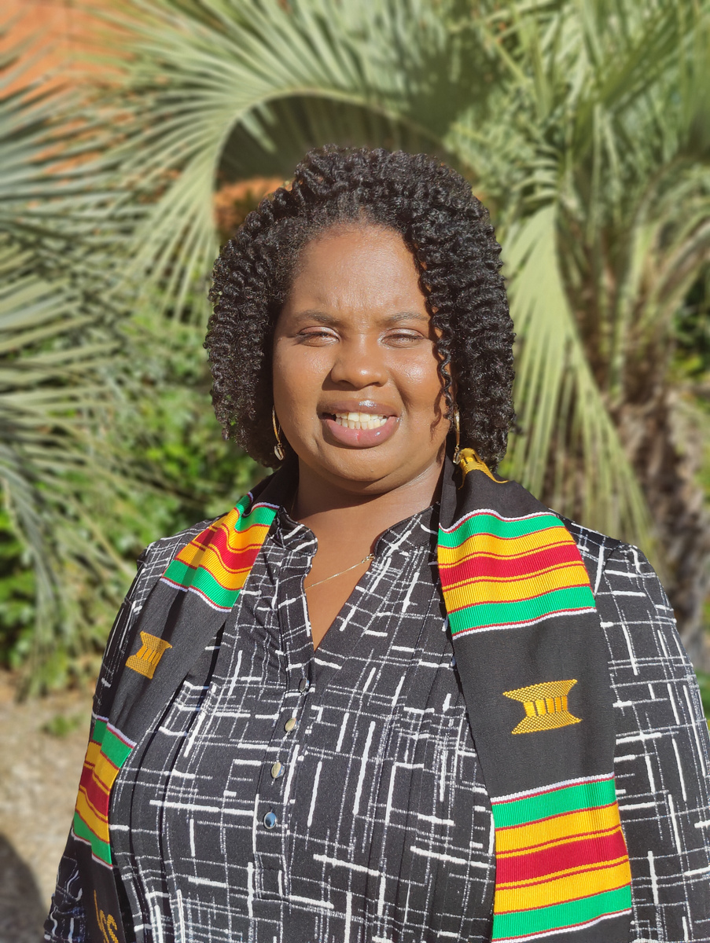
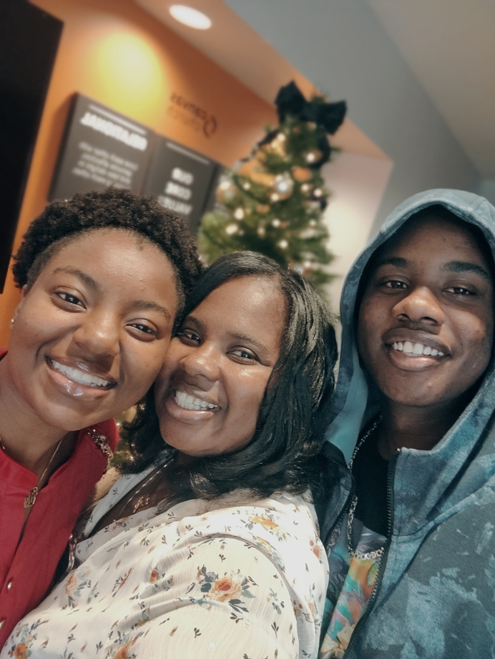
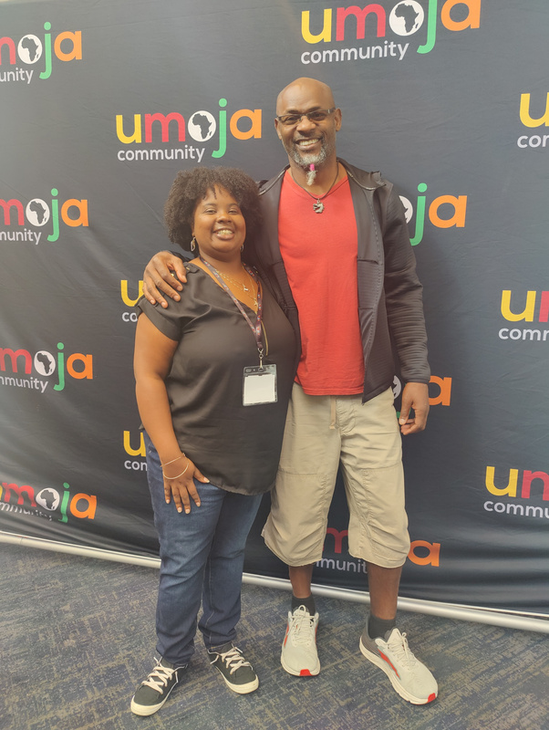
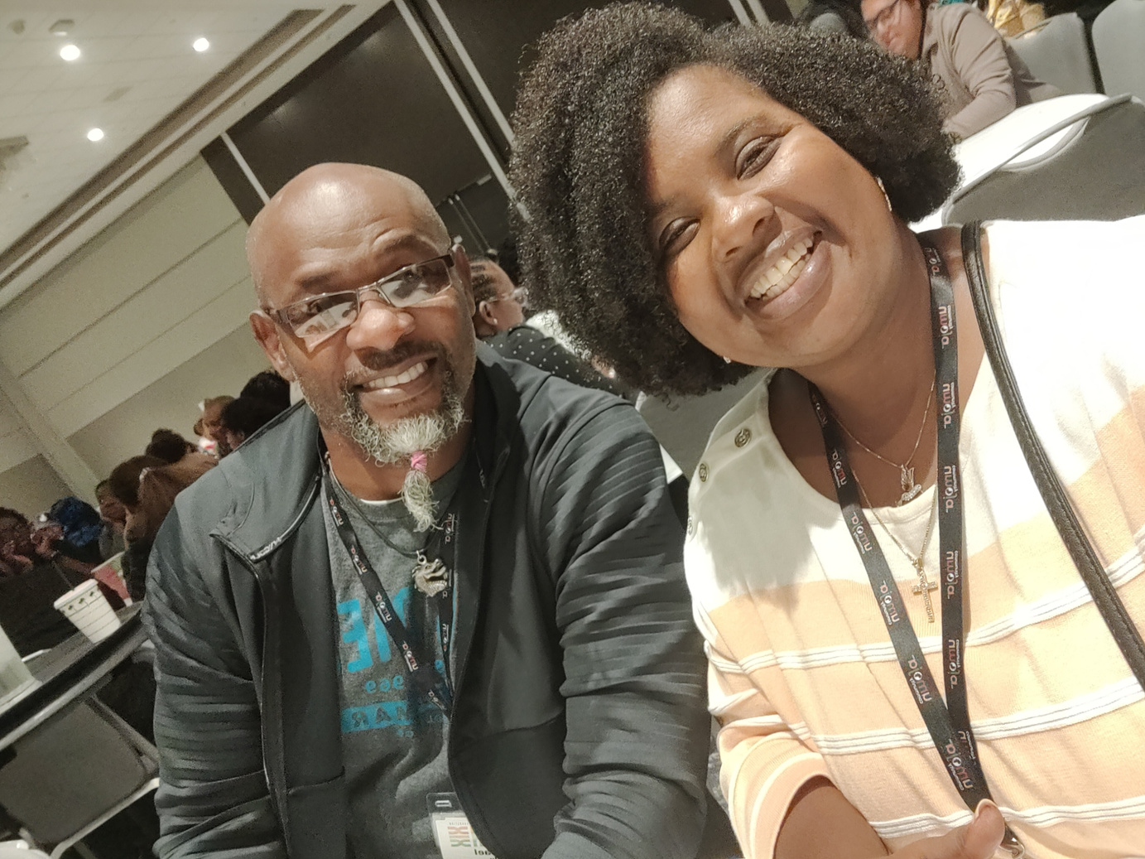
Future of the Black/African American Community @ Miramar
Student, Staff and Faculty in Ghana for Study Abroad
Tarlease and Dr. Michael Odu at the Umoja Conference in 2022

Slide 8
Thank you!
1

