Slide 1
CRM Implementation Update
Notes:
Good Morning - Today I’m here to present an update on the Element451 CRM implementation. I'll begin with a brief overview of the implementation project, followed by early feedback on efforts during Phase 1. I am happy to be here – but I have roughly 15 minutes to present about 3 years and 4 months worth of work that’s taken place so far. I have intentionally made the presentation portion of this brief so there is time for you to ask questions or provide feedback.

Slide 2
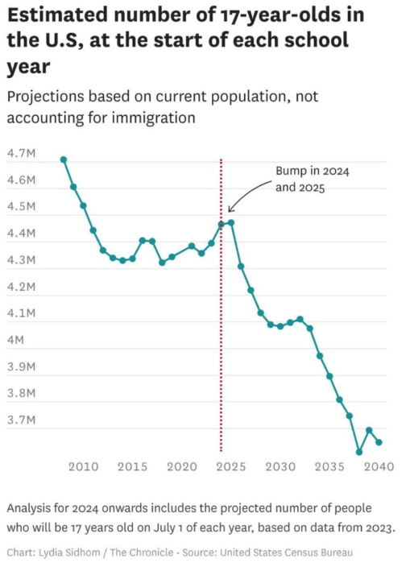
How Did We Get Here?
Largest decrease in enrollments in recent history
Demographic Cliff
HH Period Ending
Notes:
It’s not lost on me that not everyone might be aware of how the CRM Project came about or what the acronym CRM stands for…Originally, the work I have done with Jesse, then Claudia and Sonny originated from a grant funded project, the creation of a CTE Marketing plan. In it, we reviewed where the marketing for SDMC currently sat: efforts to promote our college came from folks here, folks at the district as well as the consortium. As such, we were not really aware of what was working and what wasn’t.

Slide 3
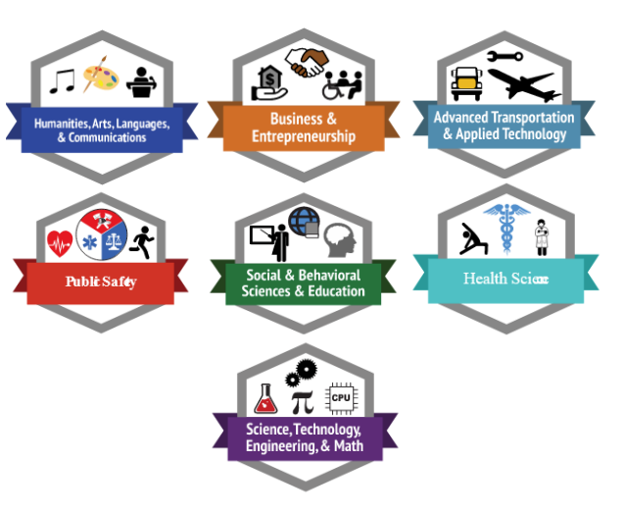
Where We Could Go…
Integrated Marketing Communications approach
Continuous Improvements with analytics and KPIs
Increased enrollment, better retention rates = better performance of SCIF
Notes:
Ultimately, we were recommending a shift to take place using an Integrated Marketing Communications approach, relying on data-driven decisions to increase enrollment and retention.

Slide 4
CTE Marketing Plan Recommendations
More emphasis on Retention
Implement SEO Strategy
Create content calendar for increased blog and social media engagement (Instagram, TikTok, YouTube)
Centralization & Infrastructure Development (Marketing Department)
Adopt CRM Platform
Interest
Desire
Action
Retention
Awareness
AIDAR Model
Notes:
The plan recommended we put more emphasis on retention, implement an SEO Strategy, create a content calendar with an increase usage of certain social media platforms like Instagram Reels, TikTok and YouTube Shorts, and adopt a CRM platform.
Can anyone tell me what CRM stands for? Client Relationship Management: Here the client is our students. This is primarily a marketing communications tool, but the features within it are robust (events, surveys, forms, and AI Agents)
And as you some of you know, we in fact have adopted a platform: Element 451, the only Higher Ed-centric on the market.

Slide 5
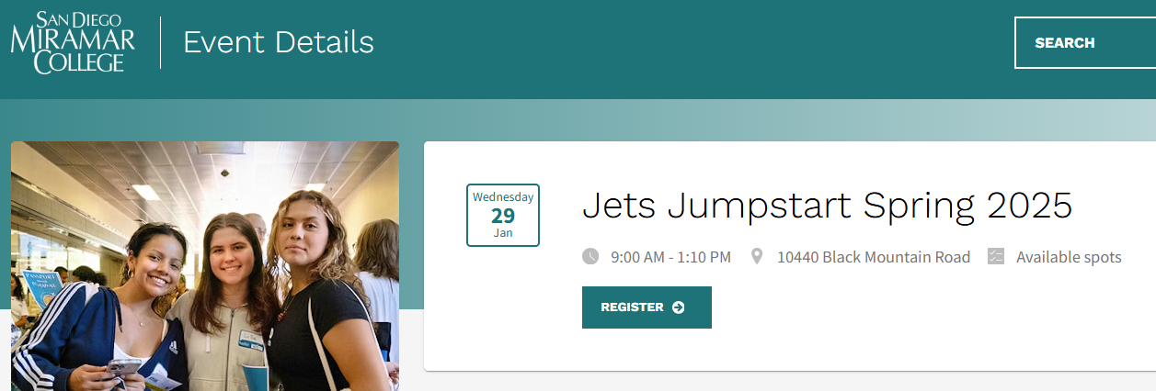
Accomplishments
SEO Strategy produced dramatic increase in traffic to 7 CTE Programs
RFI Page & Automated workflows already implemented
Events: Jets Jumpstart, Promise Giving Day, Campus Tours and more
District began uploading admitted students into CRM on a weekly basis
Dual Enrollment SMS Campaign and Discovery Series Event launch in February
Notes:
It should be noted that there have already been some key accomplishments from this work done prior to 2025:
A dramatic increase to the web pages for the 7 CTE programs as a result of the SEO strategy put into place
Within the CRM, we have built and deployed a RFI page and the related automated workflow
Also within the CRM, we are using the Events functionality for Campus Tours, Promise Giving Day, and most notably Fall 2024 JJS which had roughly 300 attendees this past Fall
As 2025 came upon us, I was brought onboard for the implementation across the college - Important to note as well – we have the support at the district level: we are getting a weekly upload of newly admitted students directly into the CRM, and have monthly standing meetings. We just recently received buy-in to have ownership over email communications to nurture admitted students through the various steps to enrollment.
Finally, we have new efforts already underway, including a new Dual Enrollment text-messaging campaign, nurturing campaign for the SDCCD Career Fair this month, and an Event and Campaign built out around our Discover Series set for this Spring

Slide 6
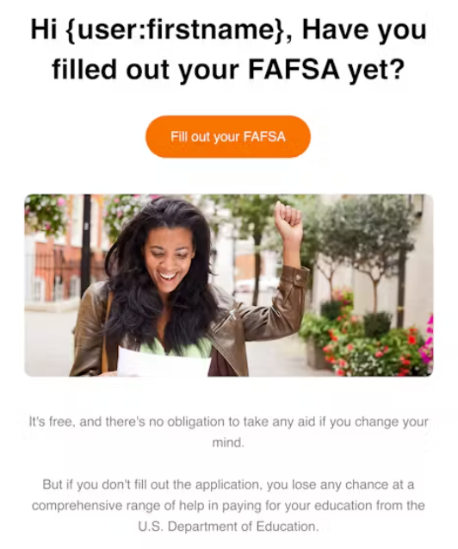
Rolling Out Element 451
Phase 1: fact finding with key stakeholders, assimilate the ACPs and Student Journey into the overall implementation, and coordinating with the district for essential support tasks
Phase 2: uses the seven CTE programs as the roadmap for implementation; builds out a strategy to re-engage Stop-Out students; identify pain points in automated messaging; create training materials for distribution
Notes:
This will be an 18-month Implementation process
Review Phase 1 and 2
If I am sitting here reviewing this, my first question is why the 7 CTE programs. I want to assure you that while we are starting with these 7 programs as a nod to how the project originated, The implementation will include everyone, not just the 7 CTE programs. This is just the first area of focus (a crawl, walk, run approach if you will).

Slide 7
Rolling Out Element 451
Phase 3: culminates in reviewing all work leading into launching efforts in Spring 2026 for the previously identified 7 CTE programs
Phase 4: Campus wide implementation and training efforts begin in earnest
Phase 5 final tasks related to implementation of CRM within remaining departments, continuous improvement opportunities, and the transition toward the institutionalization of the CRM Platform
Notes:
Review Phases 3 - 5
The big opportunities – and there are many – include what I see as obvious: enrollments, retention, engagement and a consistent, strategic communication plan. Included with that is a the opportunity to weave the student journey and our ACPs into the communication plan as well.

Slide 8
Project Timeline
Notes:
As I mentioned, this is an 18-month implementation timeline, and just into the second month of Phase 2.

Slide 9
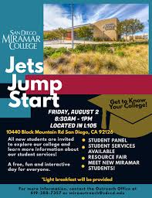
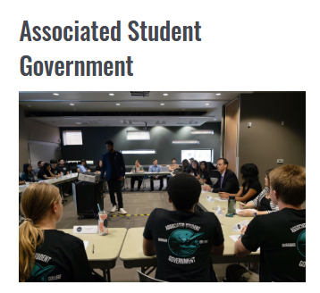
How will this help Miramar College?
“The Student Journey”
Onboarding Workflow
Notes:
Student has been admitted through CCCApply and enters into our CRM through the district weekly uploads
Immediately upon entering, the student is automatically enrolled into the Onboarding Workflow, which is a series of automated emails and text messages walking the student through the steps to enroll, how to pay for college or apply for a student support program, while also encouraging them to attend the Online Orientation and Meet with a Counselor to get an Education Plan and then register for classes.
Shortly after they have registered, the student begins to receive reminders to RSVP for Jets Jumpstart, where they can learn all about the resources and services available to them at Miramar College
Now maybe this student is seeking certificate or degree in Public Safety Management, and during their first semester we would have a workflow designed to not only provide them with an official welcome to the program from the Dean, but also a series of emails encouraging them to participate in career exploration organizations and events on campus,; meet with a counselor to build out their long-range education plan and register for the following semester all while promoting work-study or student assistance on campus.
When the following semester rolls around, we can continue to engage this student by using a workflow to promote clubs and organizations congruent with their ACP, reviewing their Ed Plan with a counselor to discuss transfer opportunities, begin the process of re-applying for Financial Aid and register for classes in the next semester.
By this point, the student is starting to think about what’s next, so a series of communications designed to apply to transfer, or explore their career options; as well as checking in with their counselor to verify progress toward their goals, as well as register for their final semester
As the student is finishing their time here at Miramar College, they will receive targeted communication to either complete their supplemental application for transfer or apply to graduate, more information and opportunities as it relates to their career and work with the career center on job Search if applicable. Also – communication to ensure that they have applied for graduation, and RSVP’d to commencement ceremonies.
The last piece is to keep in touch with our graduates & transfers.- you can create communication pieces specifically targeted to our alumni.
By the way, this may be a hypothetical student, but what’s been outlined here should sound pretty familiar to a lot of you.: I’ve heard there’s interest in welcome letters from specific schools or programs, that institutionally we are looking for ways to engage, connect, and support or uplift specific student populations, increase applications for graduation – and this entire graphic has been based on some of the work by the Student Success Committee in creating the Student Journey
The biggest piece of feedback I’ve received from students and staff alike: NOISE. My goal is to reduce the number of overall communications a student receives. If we do this correctly – the student receives the information specific to their journey at the time they need it most.

Slide 10
Dan Roberts
droberts001@sdccd.edu
https://calendly.com/droberts001/crm-feedback-meetings
Questions? Feedback?
Notes:
I want to communicate our progress regularly, and plans are underway to create a website and newsletter. I also will be presenting often across the campus throughout the entire process. I understand that there is naturally some curiosity around how much work will fall to folks that make up the classified ranks. The early answer is that it will vary based on the needs of each department. But – this system is designed to provide the college with opportunities for automated communication. The heavy lift is the next 14 months, and I predict that other than some training workshops, much of that heavy lift will – for the most part – take place at management level. I am still learning about the needs of each area, and what kind of communications will need to be built out within the system. After that initial build-out, key members of each area will be identified and trained to manage their portion of the system. If we do this right, the impact won’t be huge to your day-to-day tasks – and my prediction is that some you will even see a reduction in work because the automated communication will take some of the repetitive tasks off your plate.

