Slide 1
Structure of Arteries and Veins
Composed of 3 layers (tunics)
Tunica Intima – simple squamous epithelium
Called endothelium! (plus basement membrane C.T.)
2. Tunica Media – sheets of smooth muscle
Contraction – vasoconstriction
Relaxation – vasodilation
3. Tunica Externa – connective tissue
*Lumen – central blood-filled space of a vessel

Slide 2
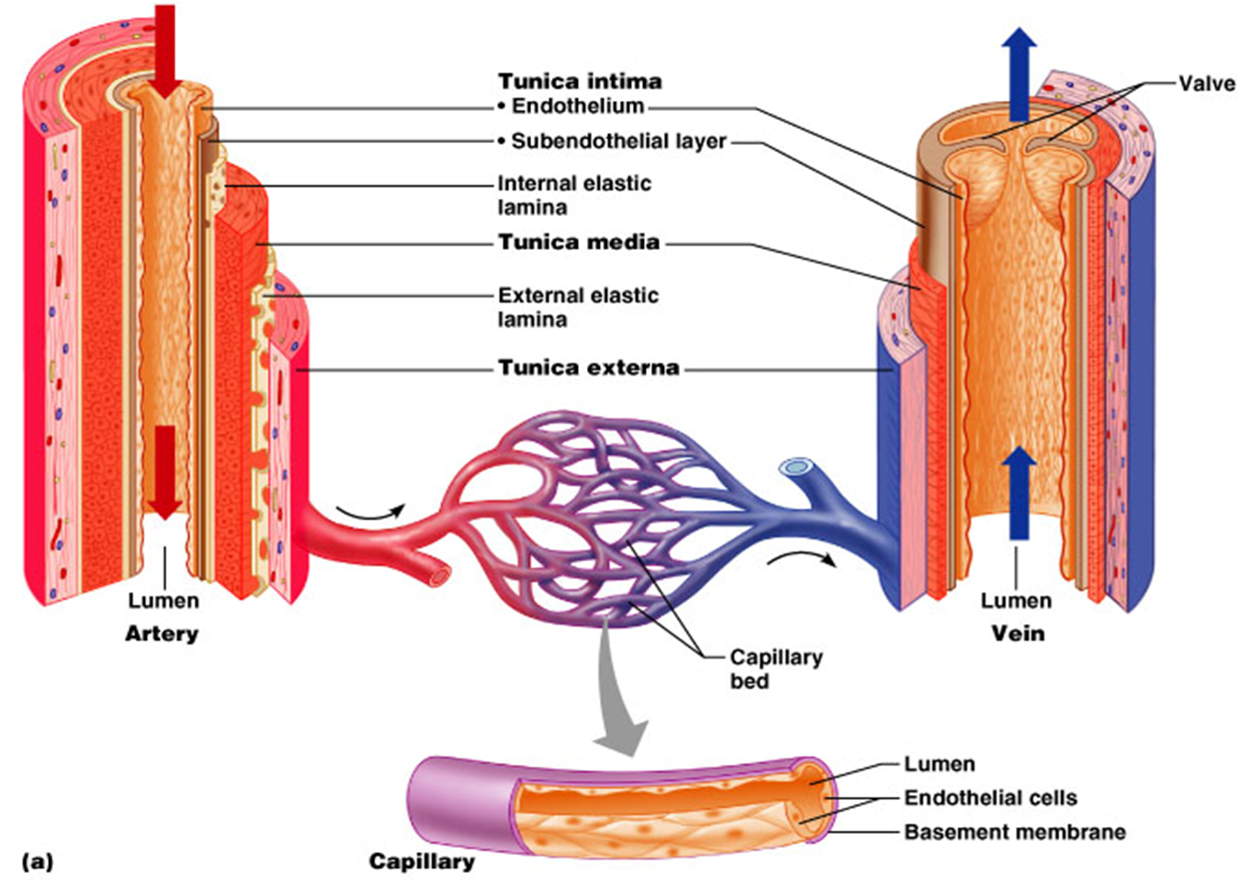

Slide 3
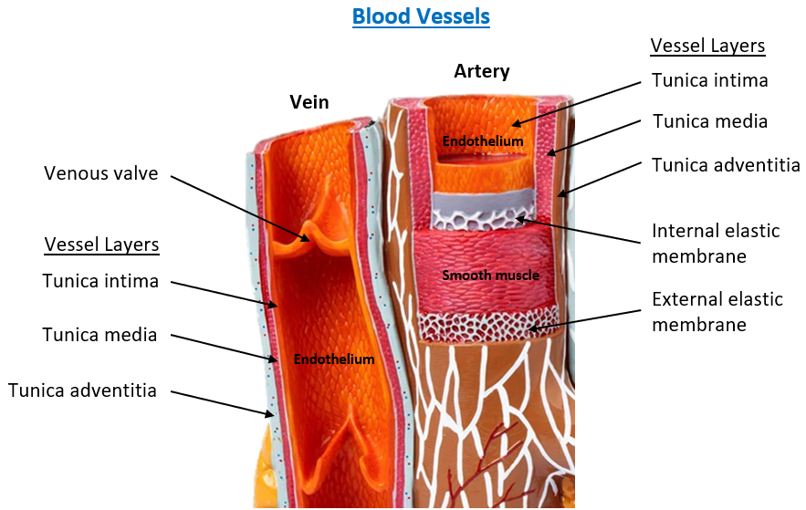
Example of how Blood Vessel Layers
are shown in Anatomical models

Slide 4
Arteries
Arterioles
Ventricles
Heart!
Capillaries
Atria
Venules
Veins

Slide 5
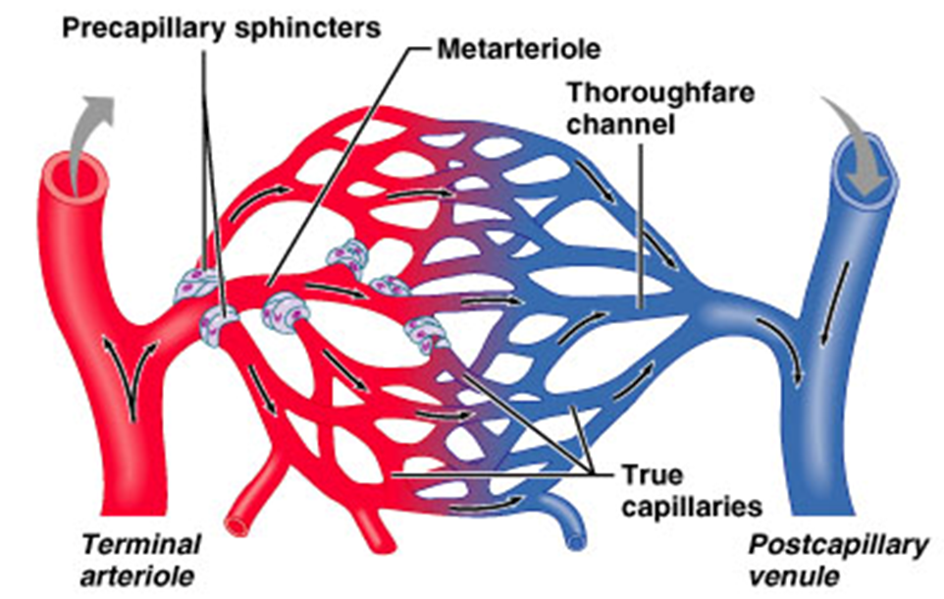

Slide 6
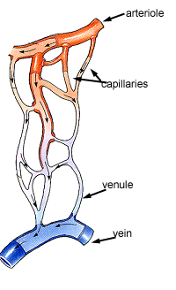
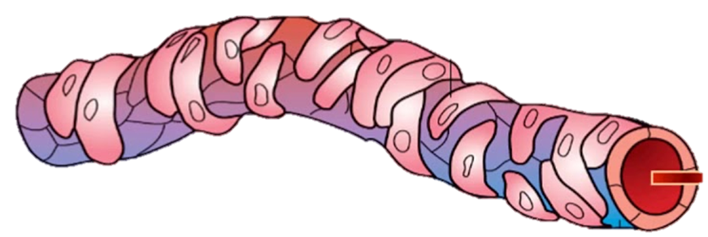
Arterioles control flow into Capillary Beds
Two layers to arterioles:
Inner endothelium
Outer smooth muscle
precapillary sphincters
Endothelial cells
Vascular Smooth Muscle (VSM)

Slide 7
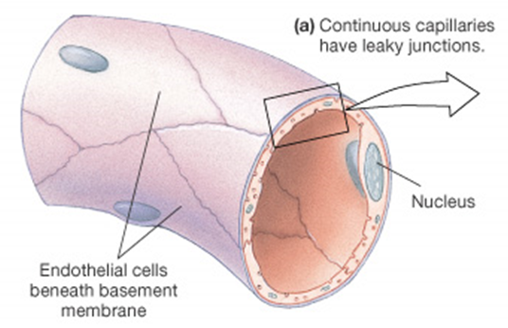
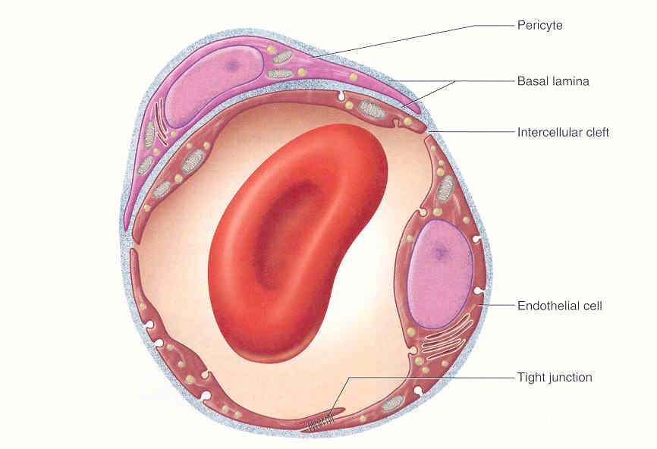
3 Types of Capillary Beds
1. Continuous Capillary Bed
- most common type in the body.
- have tight junctions
- ‘leaky’ capillaries

Slide 8
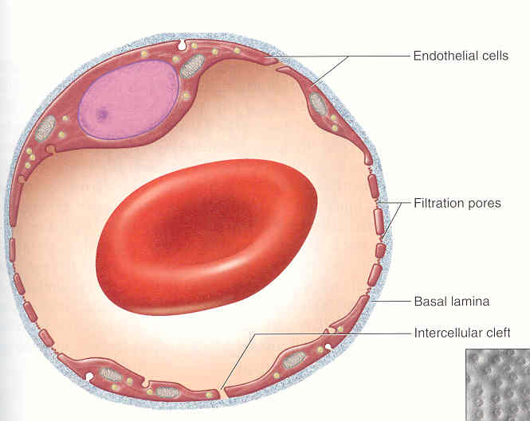
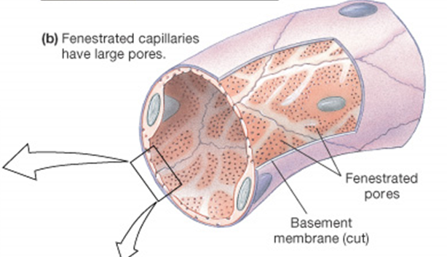
2. Fenestrated Capillary Bed
- have ‘pores’ or fenestrations.
- more ‘leaky’ than continuous.
- specific locations in body:
e.g., kidney, synovial joints,
hypothalamus.

Slide 9
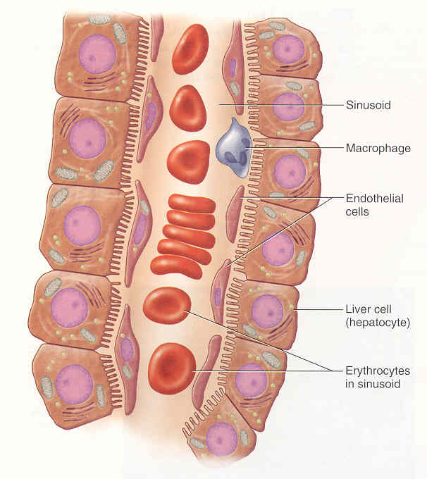
3. Sinusoidal Capillary Bed
- open ‘flaps’ in adjacent
endothelial cells.
- ‘leakiest’ capillary bed.
- high degree of exchange.
- highly convoluted (twisting).
- least common in body:
e.g., liver, spleen, and red
bone marrow.

Slide 10
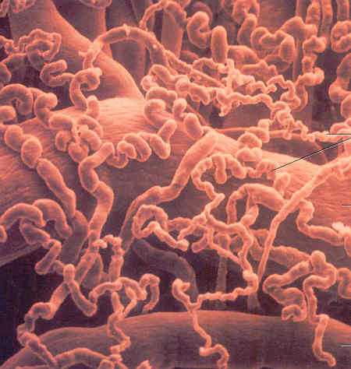
Capillaries
Venule
Ateriole

Slide 11
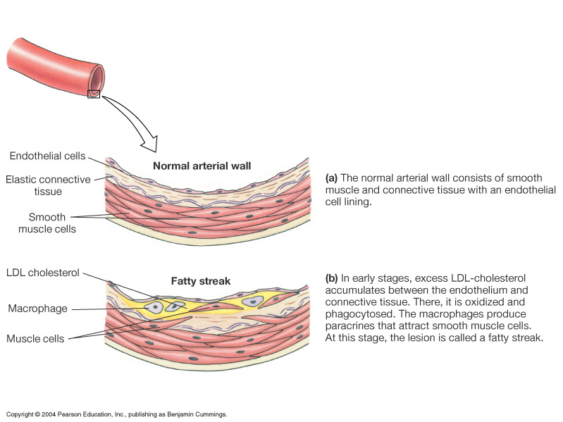
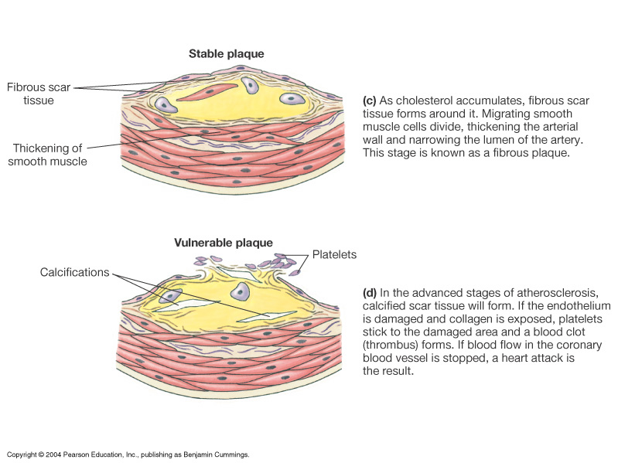
Arteriosclerosis
= hardening of vessel wall.
Atherosclerosis
= deposits of lipids in blood
vessel wall, forming a plaque.
results in hardening and
narrowing of vessel.

Slide 12
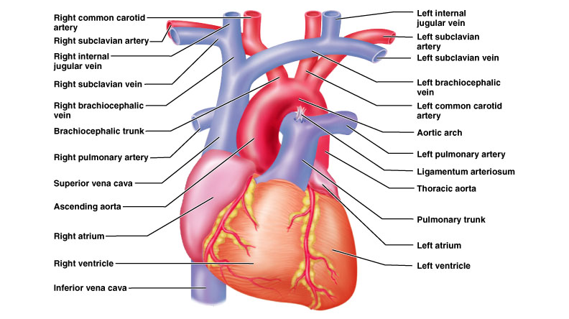
Vessels of the Heart

Slide 13
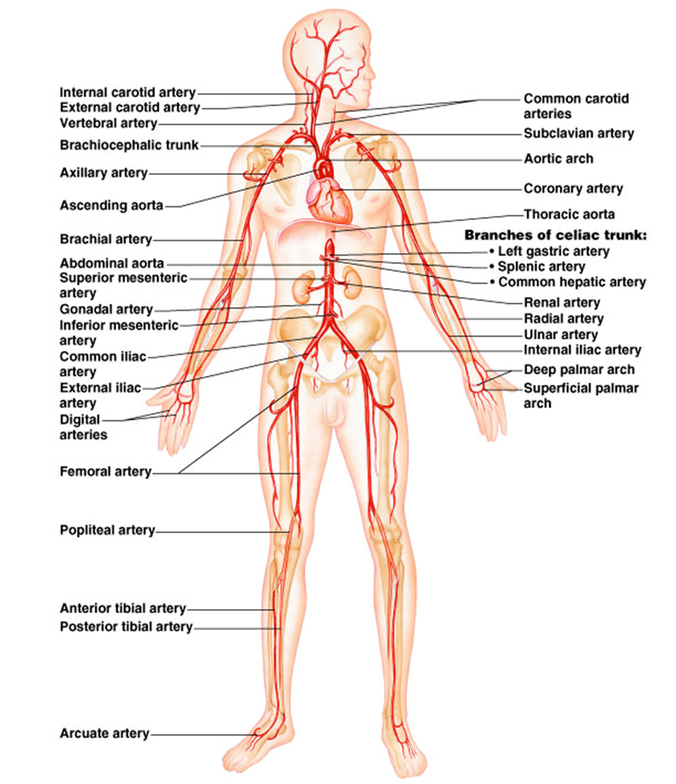
Arteries of the Systemic Circulation

Slide 14
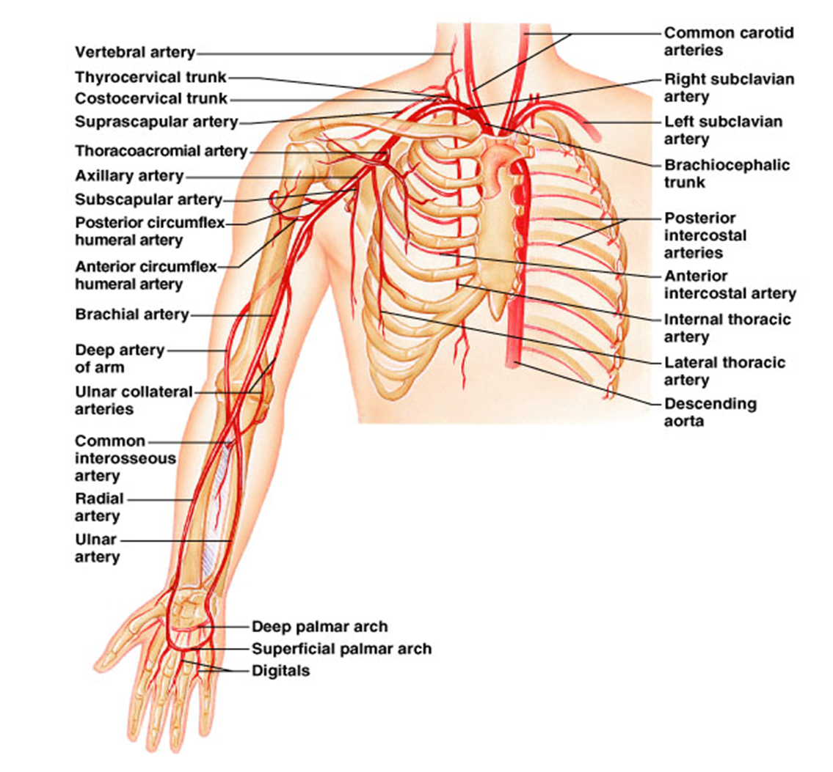
Arteries of the thorax, neck,
brachium, antebrachium and palm.

Slide 15
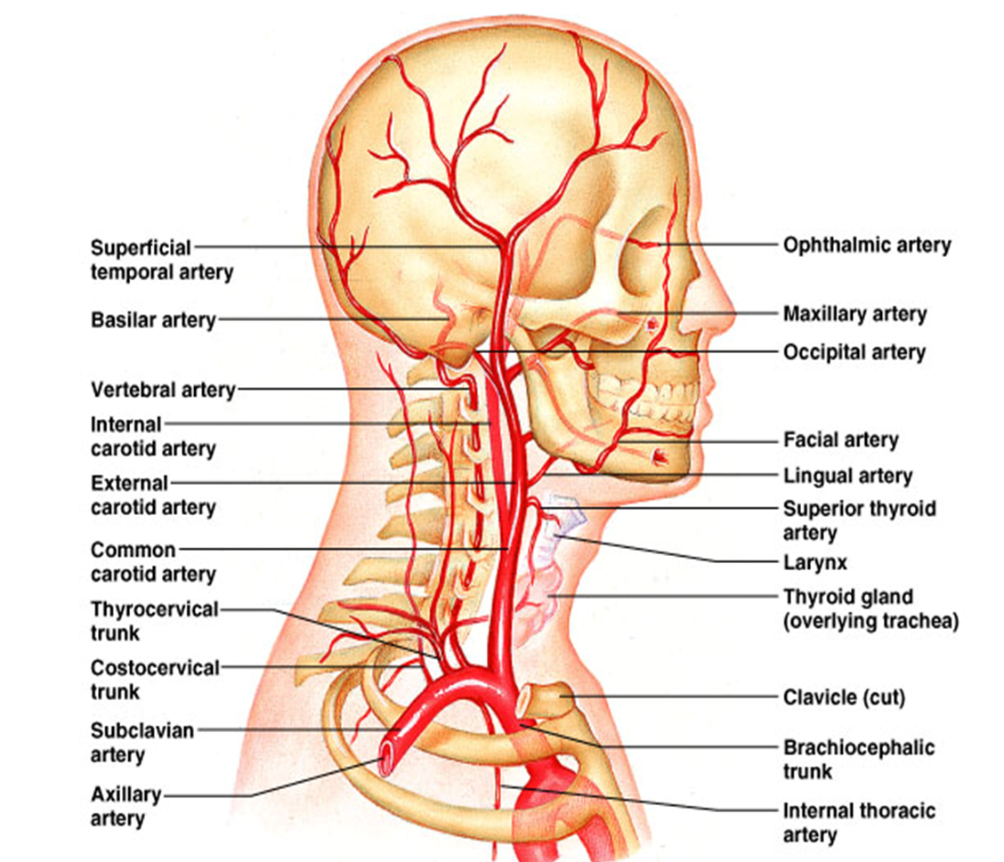
Arteries of the Head and Neck

Slide 16
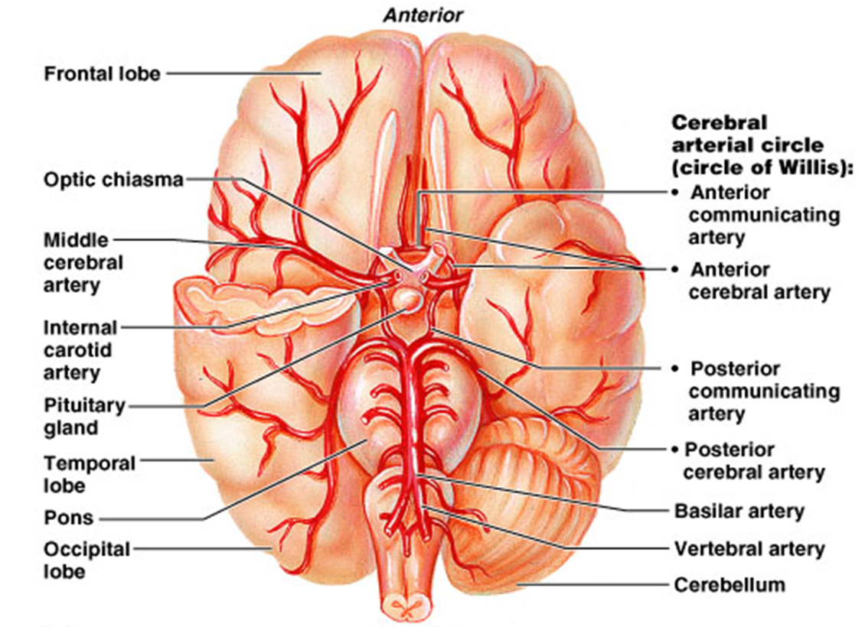
Arteries of the Brain

Slide 17
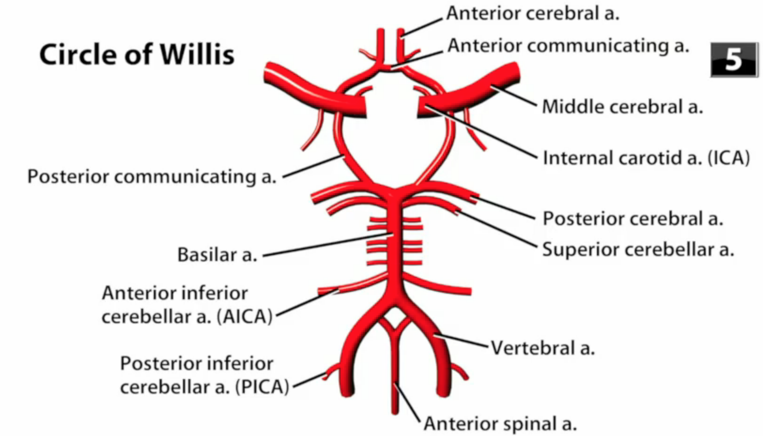
Cerebral Arterial Circle

Slide 18
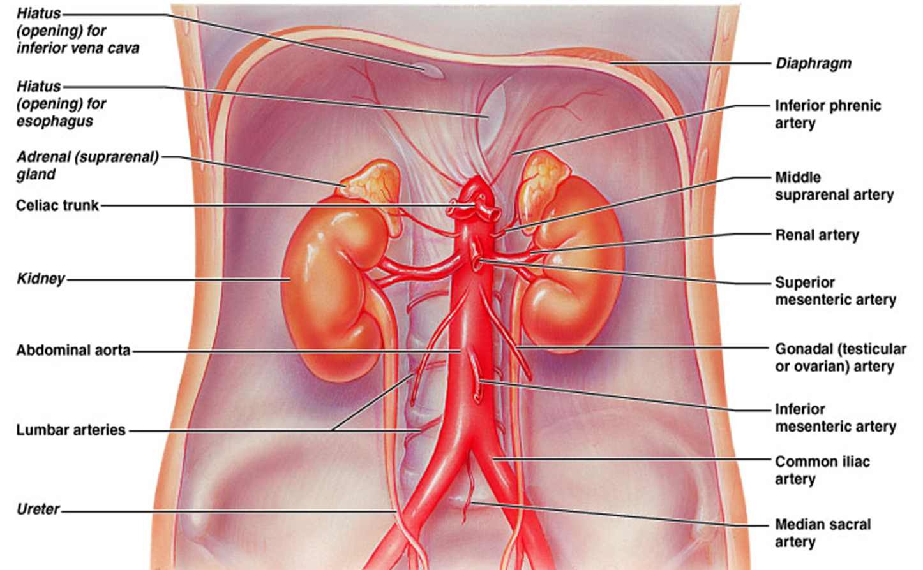
Arteries of the Abdomen

Slide 19
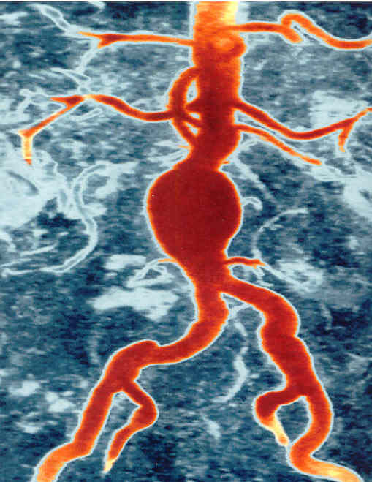
Aortic
Aneurysm
Aneurysm:
Weakening of
A vessel wall;
Results in
bulging due
to pressure in
vessel.
Poses threat of
hemorrhage.

Slide 20
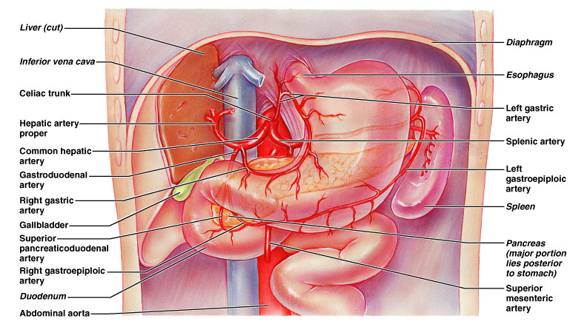
The Celiac Trunk

Slide 21
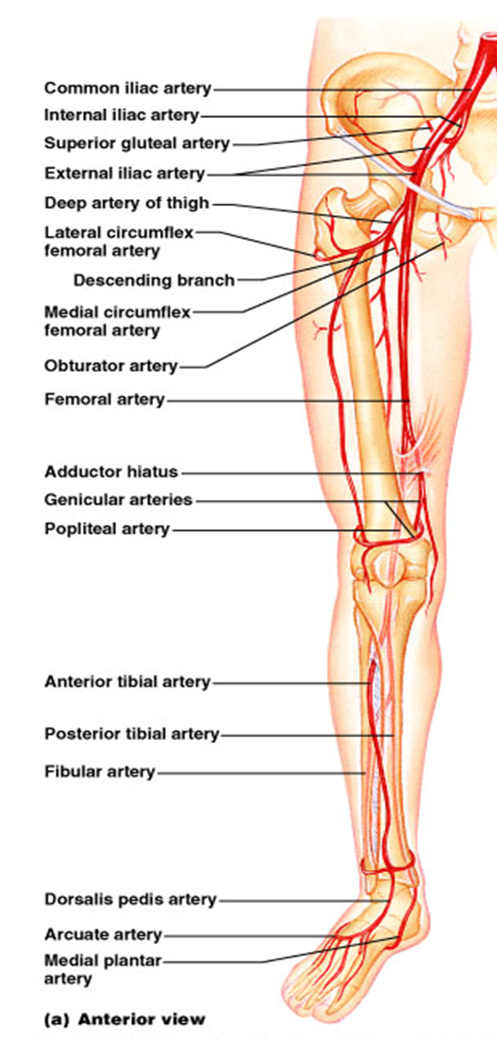
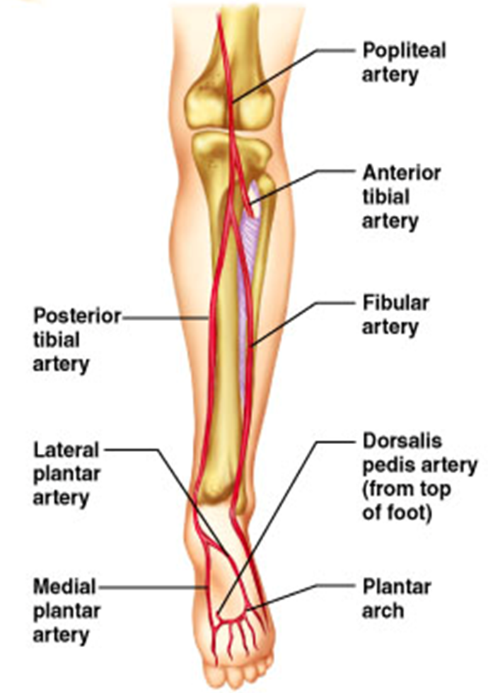
Arteries of the Hip,
Thigh, Leg and Foot
Anterior view
Posterior view

Slide 22
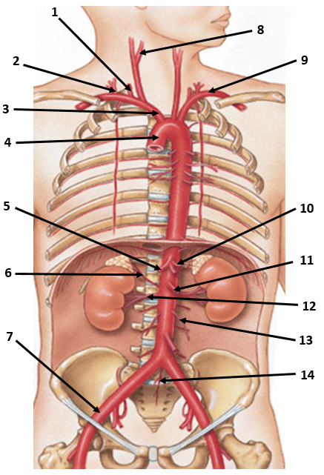
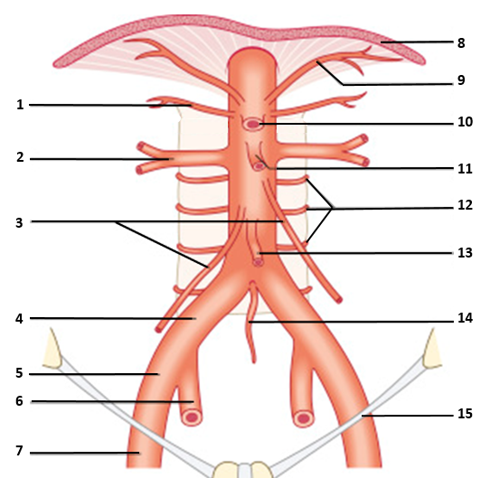
Naming Arteries of the Systemic Circuit

Slide 23
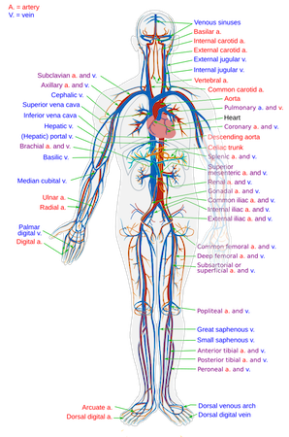
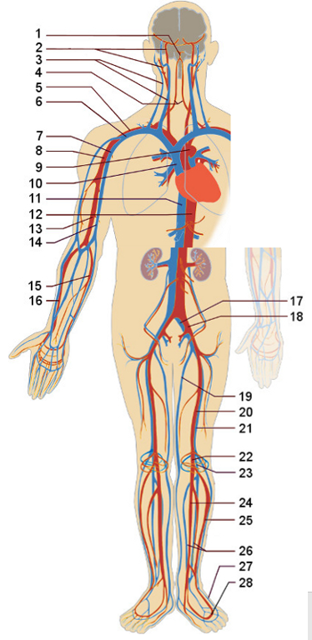
Comparison of Arterial and Venous Vasculature

Slide 24
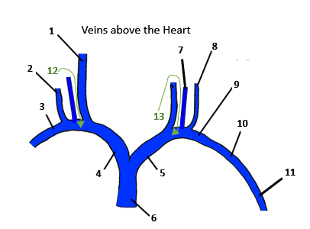
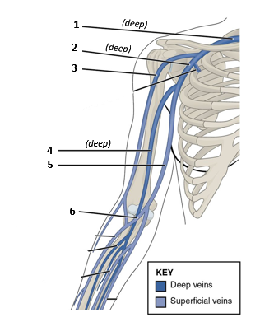
Veins of the Systemic Circuit
Upper and Lower limbs have 2 sets of veins!

Slide 25
