Slide 1
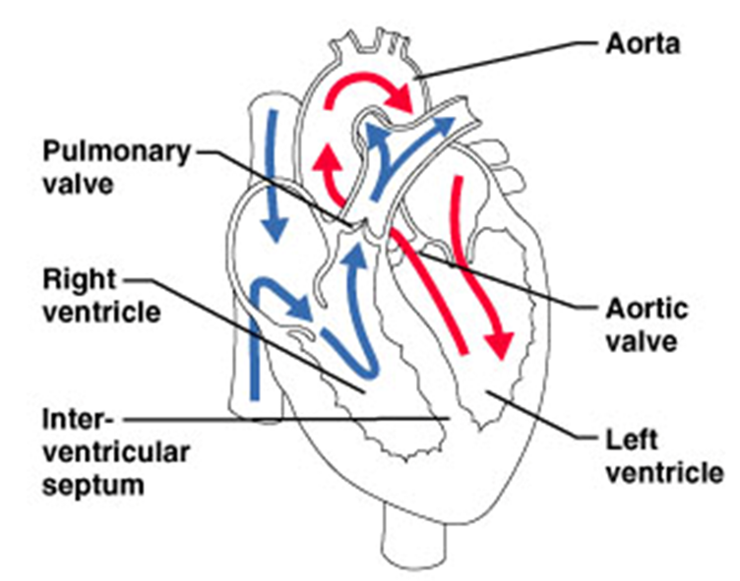
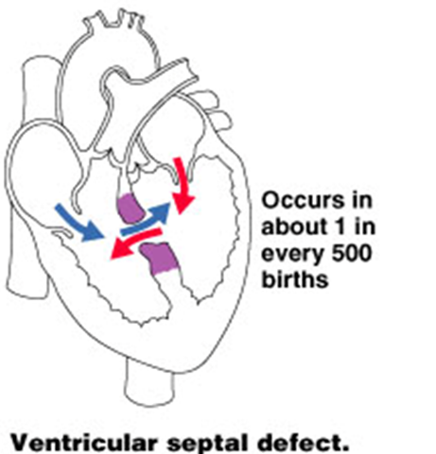
Circuits in
Normal Heart
Congenital
Heart Defects

Slide 2
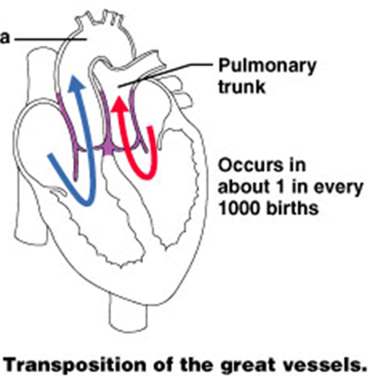
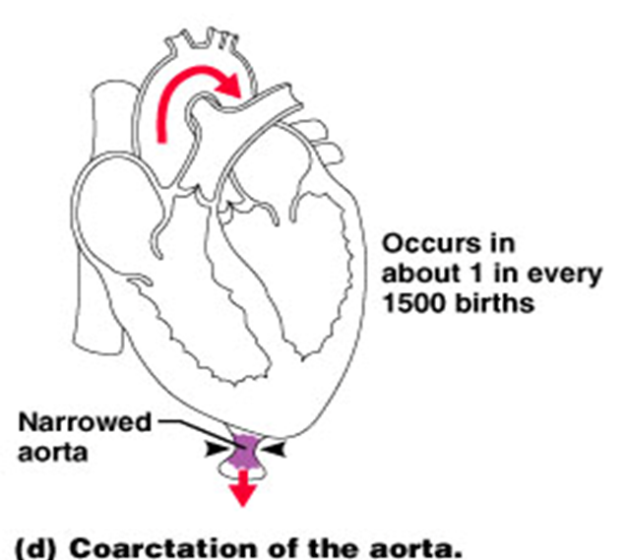
Congenital Heart Defects

Slide 3
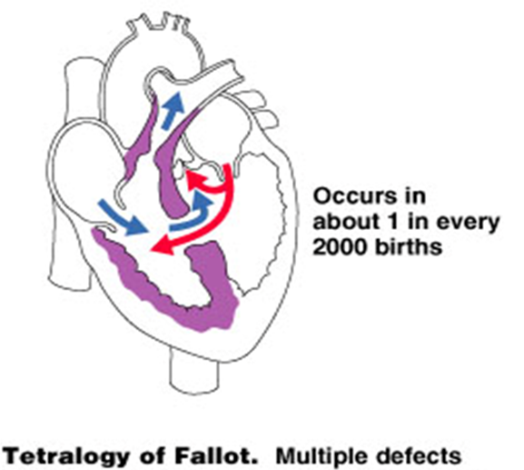
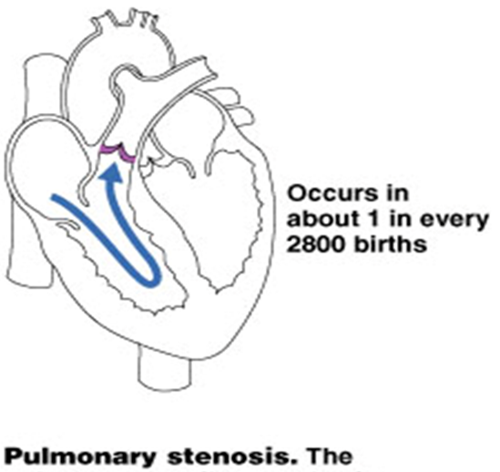
Congenital Heart Defects

Slide 4
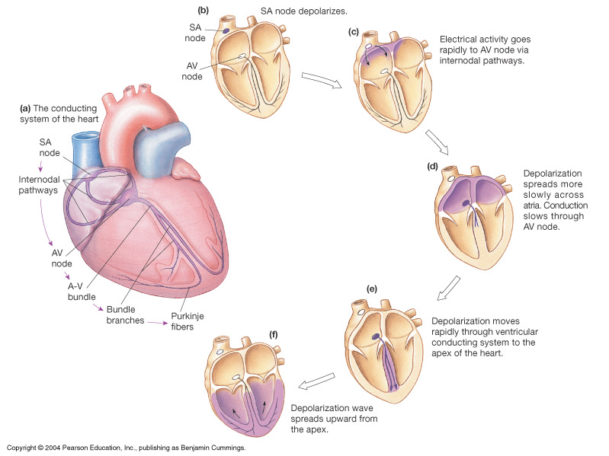
Electrical Conduction System
Sino Atrial (SA) Node – sup/post rt atrium
Atrial Ventricular (AV) Node – inf rt atrium
AV Bundle (of His) – sup IV septum
L and R Bundle Branches – IV septum
Purkinje Fibers – both ventricles

Slide 5
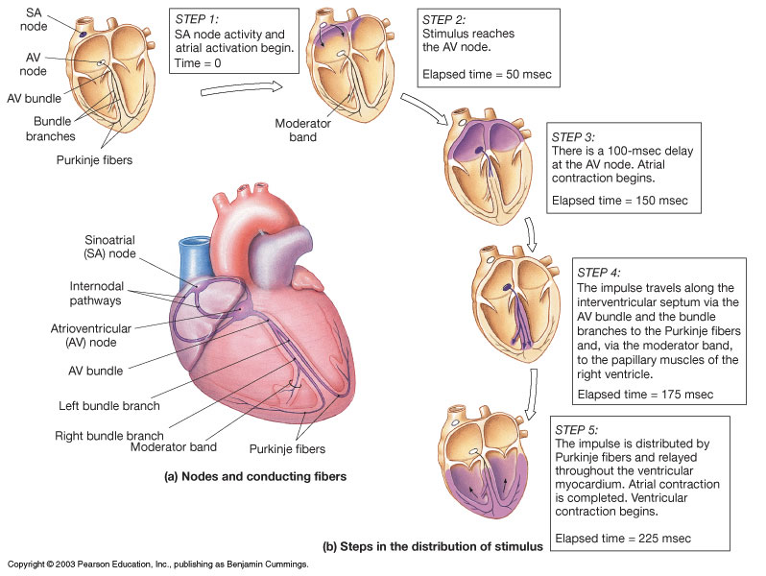
The Conducting System of the Heart

Slide 6
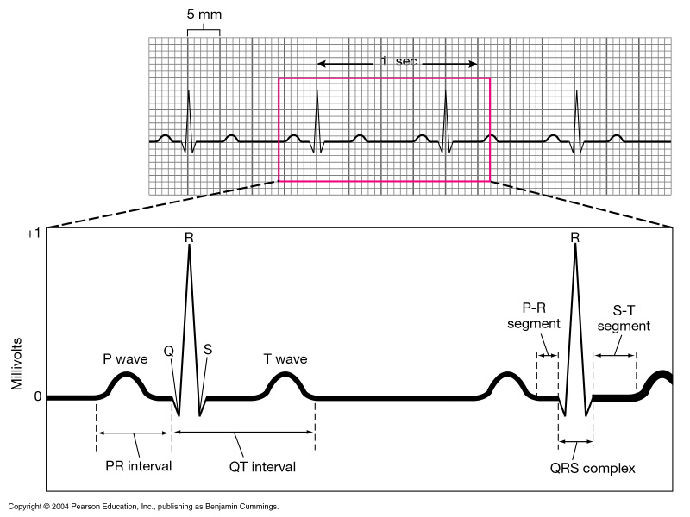
An Electrocardiogram (ECG) trace

Slide 7
The Electrocardiogram
Recording of the electrical activities in the heart
P wave
= Atrial Depolarization
QRS complex
= Ventricular Depolarization
T wave
= Ventricular Repolarization

Slide 8
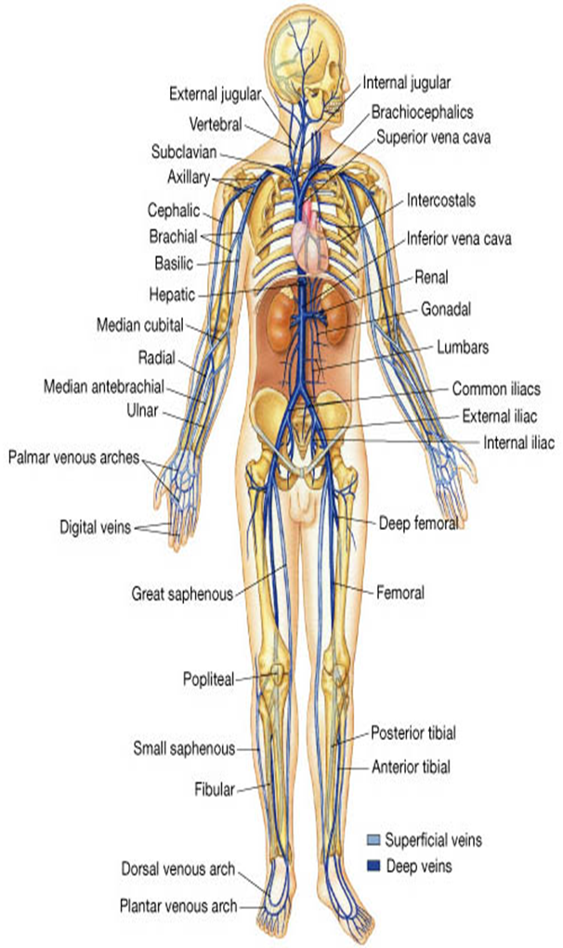
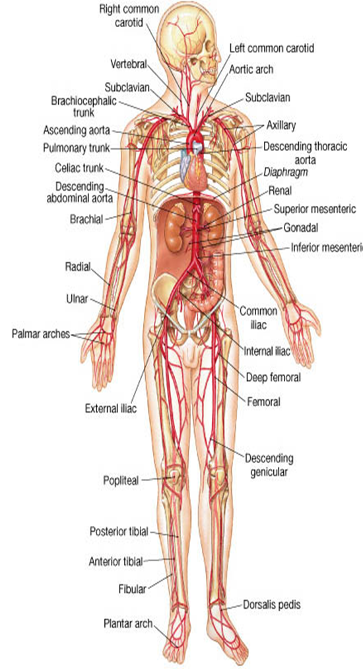
The Systemic Vessels

Slide 9
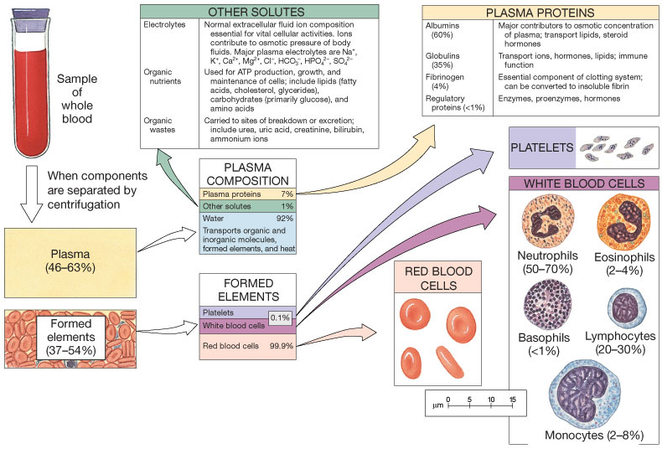
Blood

Slide 10
Blood = Plasma + Formed (Cellular) Elements
Plasma
~ 55% blood volume
~ 92% of plasma is water
High dissolved O₂ content
Dissolved proteins
Minerals, glucose, lipids, ions.
Cells
~ 45% blood volume
RBCs (~ 99% of cells)
WBCs (~ 1% of cells)

Slide 11
The Proteins in Plasma
Albumins
60% of plasma proteins.
Globulins
35% of plasma proteins.
Fibrinogen
For clotting reaction, forms Fibrin.
+ Regulatory proteins - various enzymes and hormones.
*serum = plasma without clotting proteins

Slide 12
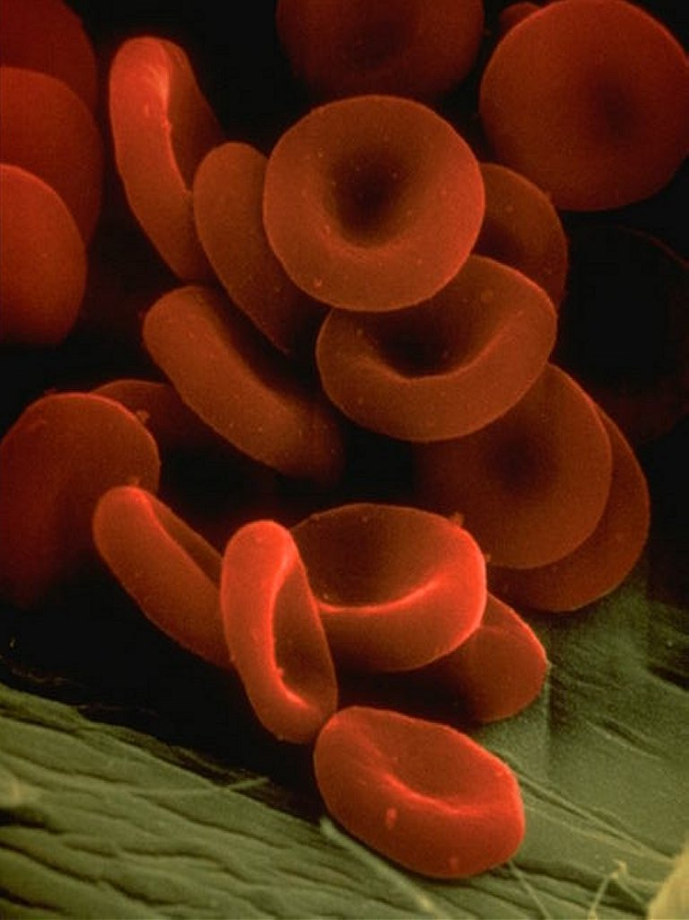

Slide 13
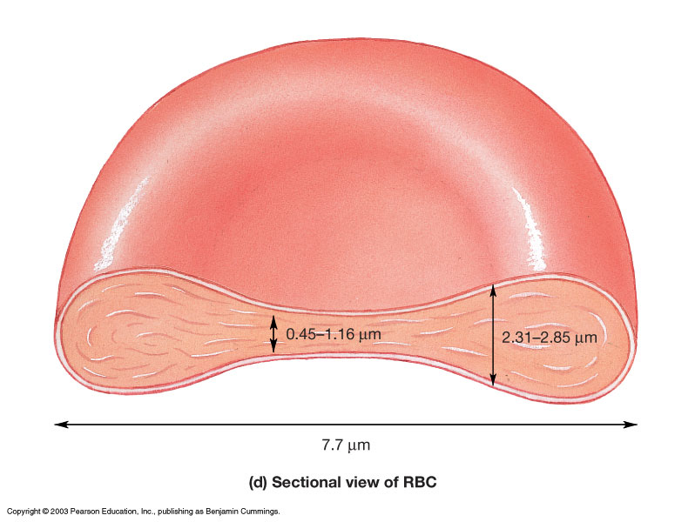
Cellular Components
RBCs (erythrocytes) ~ 99% of all cells.
Hematocrit = % of blood occupied by cellular components.
(packed RBC volume)
Lacks: nuclei,
mitochondria
and ribosomes.
Anaerobic metabolism
Life span = ~120 days

Slide 14
White Blood Cells (Leukocytes)
Granular Leukocytes
Neutrophils 70% of circulating leukocytes
Multi-lobed nucleus (3 or more), mobile phagocytes.
Eosinophils much less common
Bi-lobed nucleus with ‘orange’ staining granules.
Basophils relatively rare
Bi-lobed with dark staining granules, releases histamine and heparin.

Slide 15
Agranular Leukocytes
Lymphocytes primary cell of lymphatic system
T-cells attack foreign cells directly.
B-cells produce antibodies.
Monocytes
Large ‘dimpled’ nucleus, differentiate
into Macrophages.

Slide 16
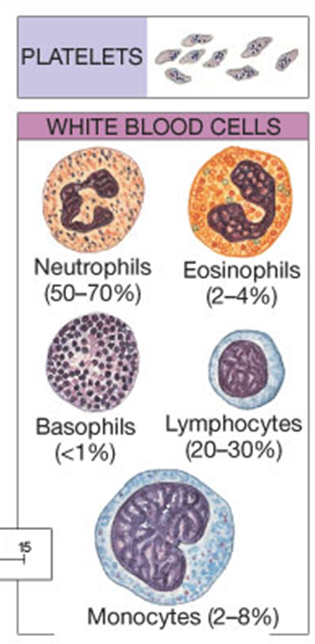
Platelet cells (Thrombocytes)
Fragments of cells (Megakaryocytes) for clotting.
Never
Let
Monkeys
Eat
Bananas

Slide 17
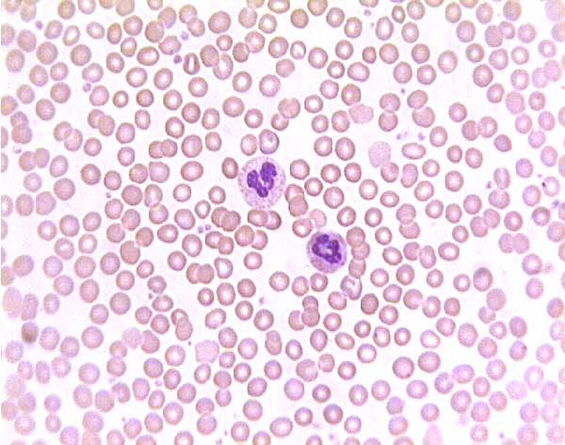
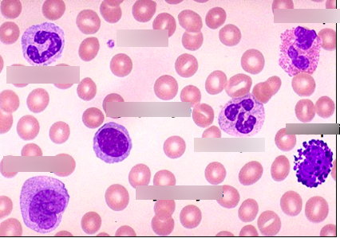
Blood Cell Histology
Zoom-in on White Blood Cells

Slide 18
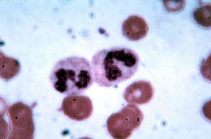
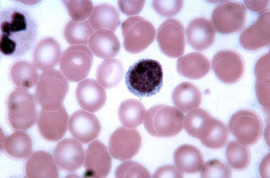
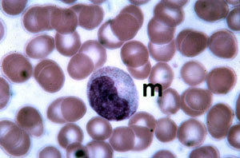
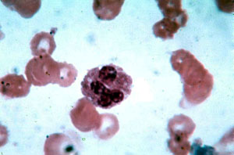
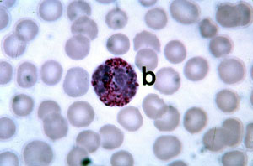

Slide 19
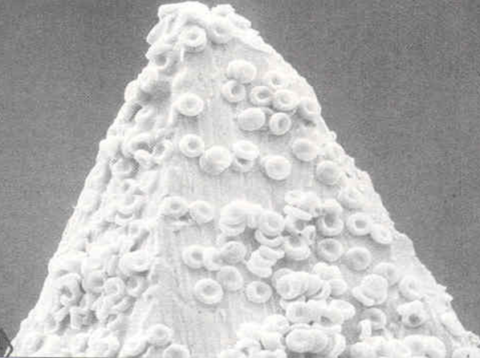
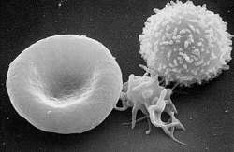

Slide 20
Arteries
Arterioles
Ventricles
Heart!
Capillaries
Atria
Venules
Veins

