Slide 1
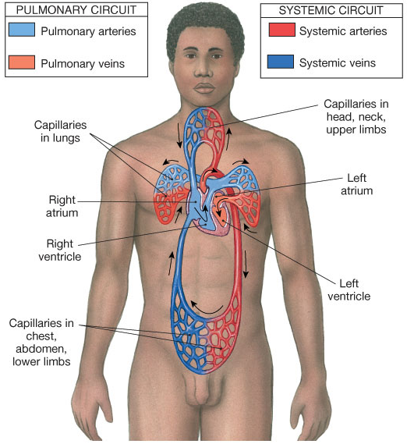
The Cardiovascular System
Heart
Central Pump
Blood Vessels
Transport Blood

Slide 2
Functions of Cardiovascular System
Transport around the body of:
O₂ from the lungs to body tissues
CO₂ from body tissues to lungs
Delivery of Nutrients to cells
Removal of Waste (+ toxins) from cells
Hormone circulation
Healing and repair of body tissues
Thermoregulation

Slide 3
The Heart has 4 Chambers
The Atria – receive blood
The Ventricles – pump blood

Slide 4
The 2 Circuits
Pulmonary
Circuit
From heart to lungs back to heart
(From RV to LA)
Purpose:
To exchange gasses with lungs
Systemic
Circuit
From heart to body back to heart
(From LV to RA)
Purpose:
To exchange gasses with tissues
Artery =
Vein =

Slide 5
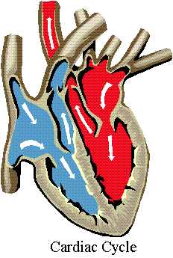
R Atrium – receives blood from body (IVC, SVC).
R Ventricle – pumps blood to Lungs (PT).
Coronary sinus
L Atrium – receives blood from lungs (L&R PV).
L Ventricle – pumps blood to Body (Aorta).

Slide 6
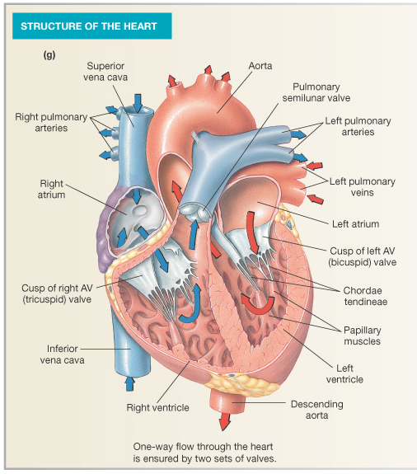
The Heart
Heart Tissue
Pericardial Sac
Fibroskeleton
Valves
Surface Structures
(one-way-flow)

Slide 7
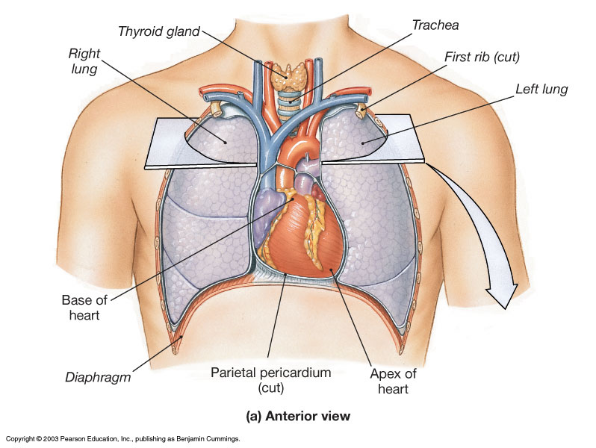

Slide 8
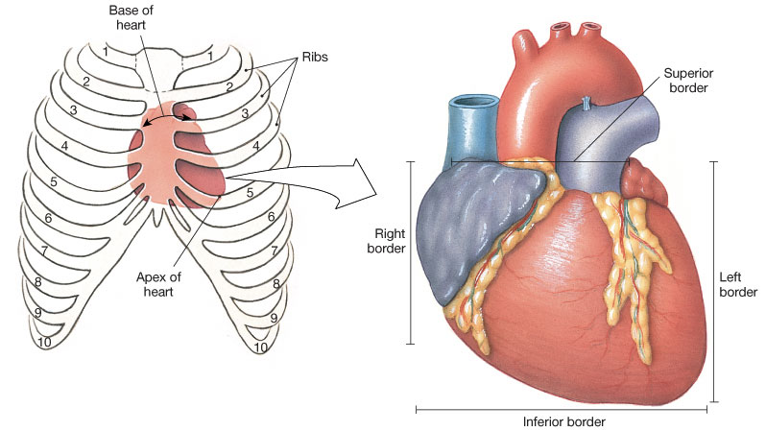
Position and Orientation of the Heart

Slide 9
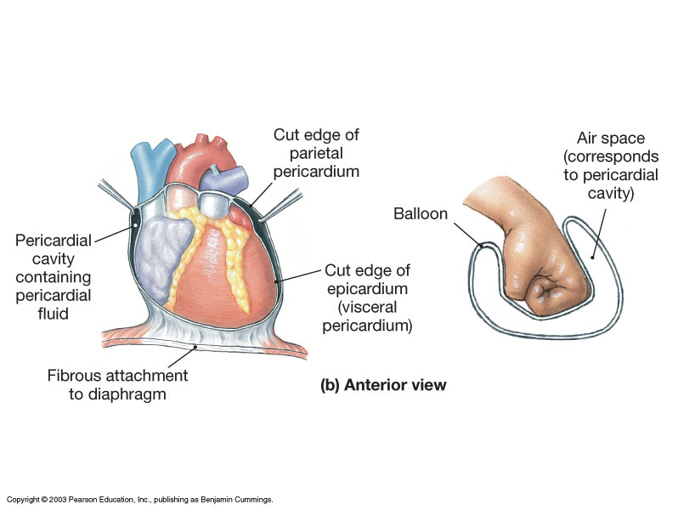
Pericardial Sac and Location of the Heart in the Thoracic Cavity

Slide 10
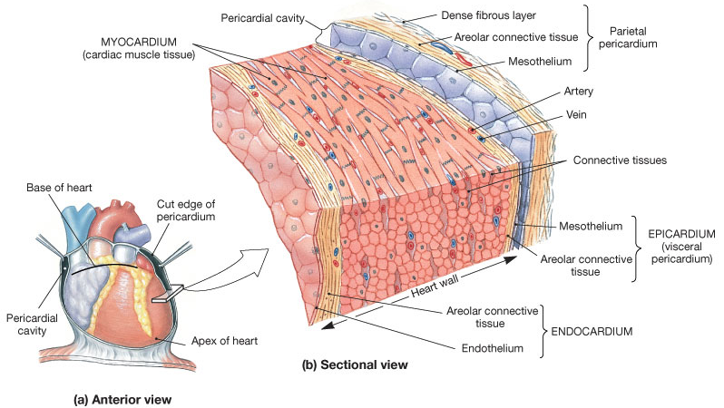
Endocardium
Endothelium
and CT of inner
surface
Myocardium
Cardiac Muscle (thickest layer of heart)
Epicardium
Visceral pericardium (a serous membrane)

Slide 11
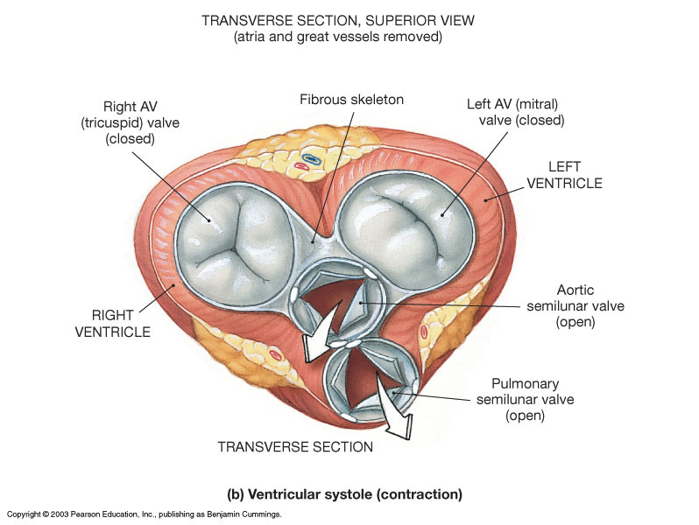

Slide 12
The Fibrous Skeleton
An internal connective tissue of the heart
1. Provides attachment for heart’s valves
2. Evenly distributes the force of contraction
3. Electrically isolates atria from ventricles

Slide 13
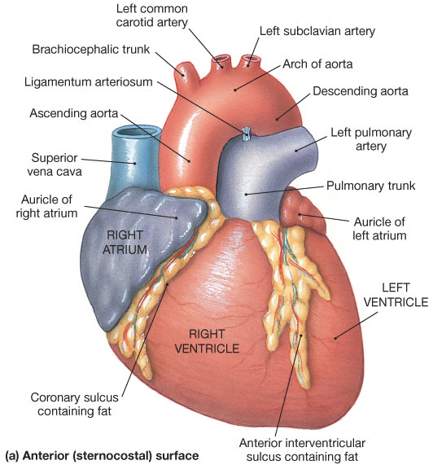
Surface Anatomy of the Heart

Slide 14
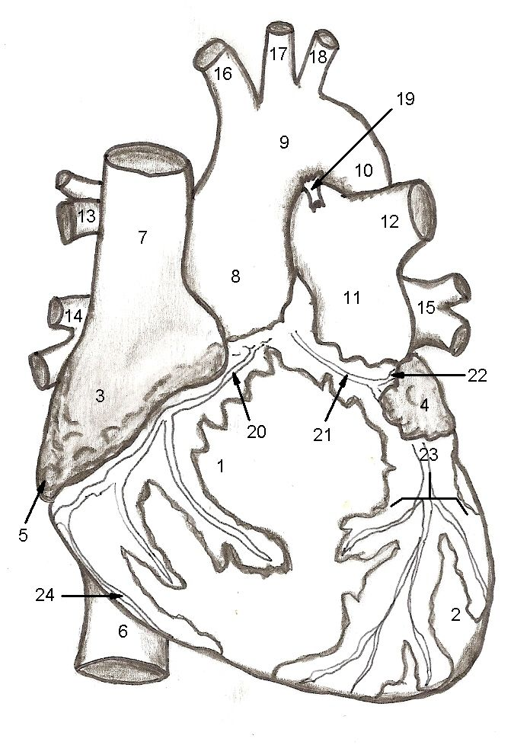
Image from
Cardiovascular
Worksheet

Slide 15
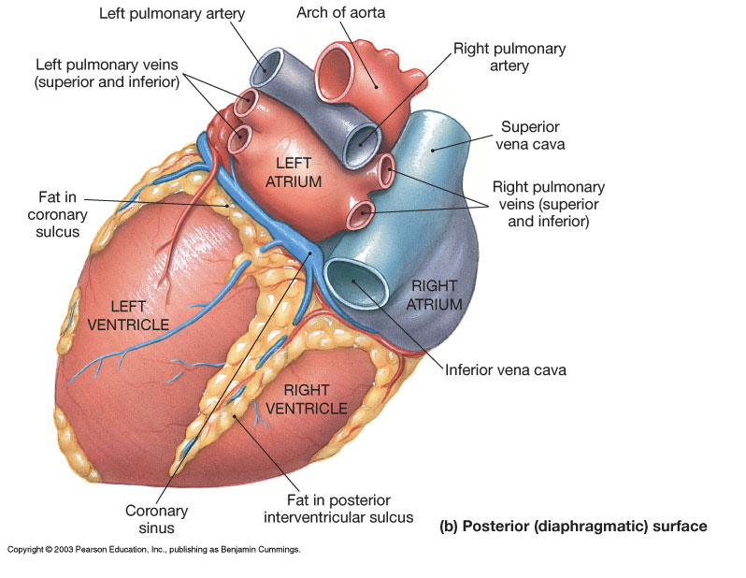

Slide 16
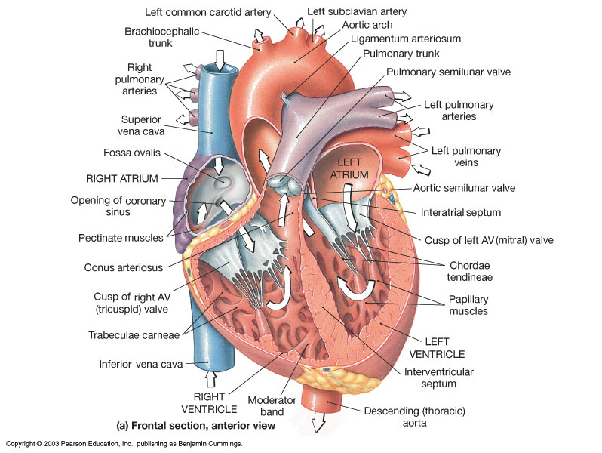
Sectional Anatomy of the Heart

Slide 17
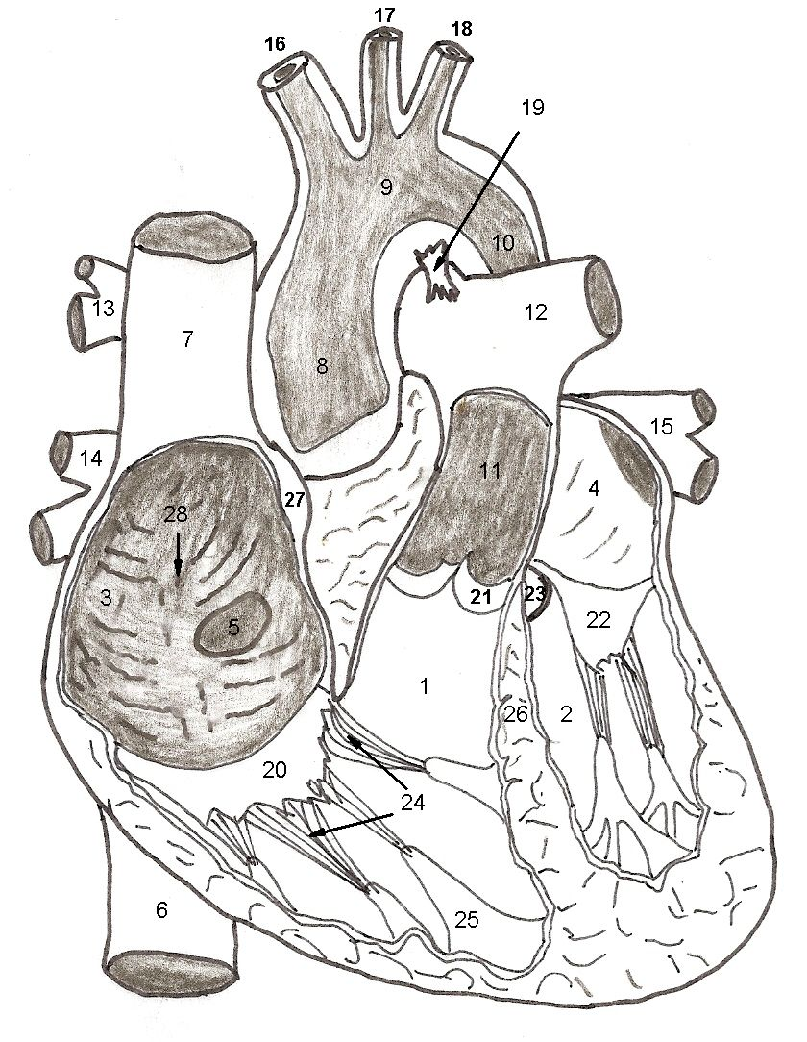

Slide 18
The Atria
Right Atrium receives blood from systemic circuit:
1) Superior vena cava
2) Inferior vena cava
3) Coronary Sinus
Left Atrium receives blood from pulmonary circuit:
From L and R Pulmonary veins.
Walls of both Atria have Pectinate muscles.
Foramen ovale open in utero –
closes to become the Fossa ovalis after birth.

Slide 19
The Ventricles
Blood from atria goes through (AV) valves:
Tricuspid AV valve (Rt)
Bicuspid AV valve (Lt)
Chordae Tendineae
Papillary Muscles
Trabeculae Carneae
Blood leaves via pulmonary trunk and aorta
Pulmonary semilunar valve (Rt)
Aortic semilunar valve (Lt)

Slide 20
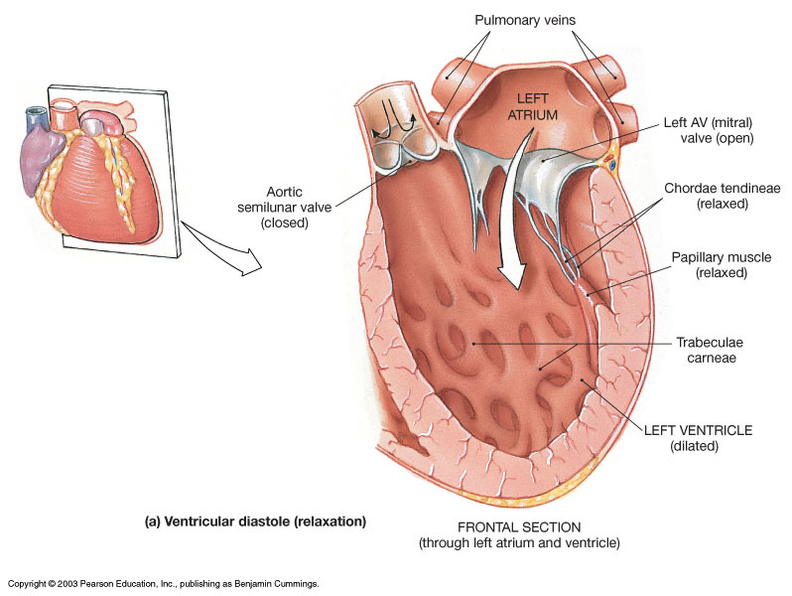
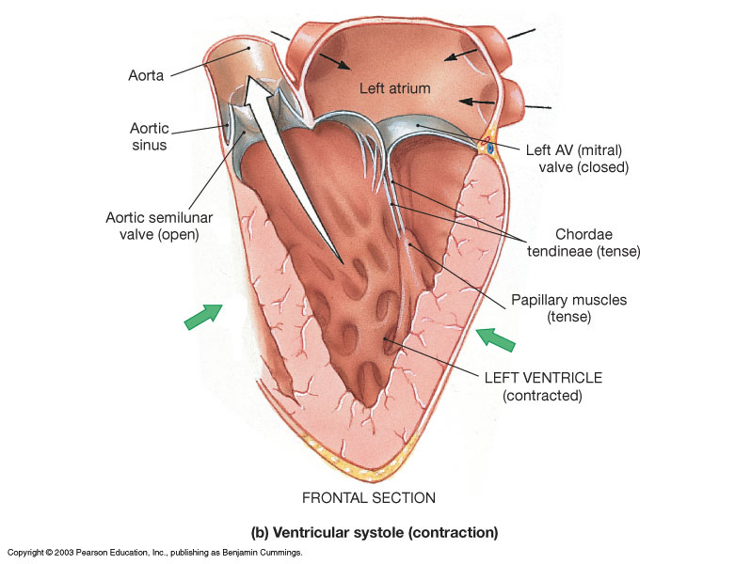
Valves of the Heart
How do papillary muscles work?

Slide 21
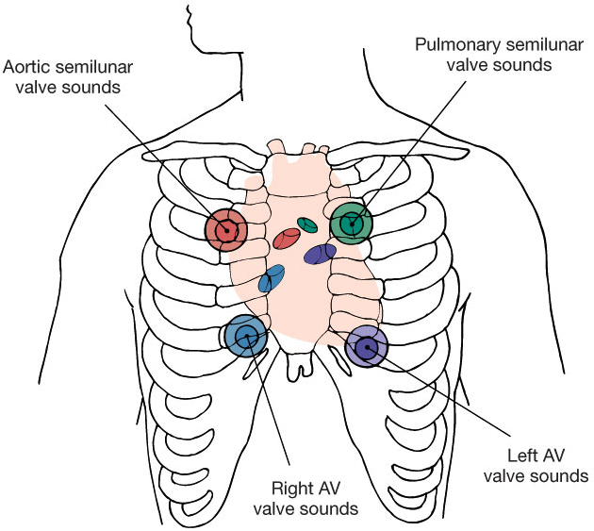
Heart Valves and Heart Sounds
Stethoscope Placement
Closure of AV valves creates 1st heart sound
‘Lub’
Closure of semilunar valves creates 2nd heart sound
‘Dupp’

Slide 22
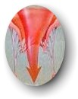
Disorders of Heart Valves
Normal
Heart Valves
Problem
Heart Valves
Problems Opening:
Stenosis – narrowing of valve,
when a valve doesn't open
completely.
Turbulence = noise = murmur.
Problems Closing:
Prolapse – overlapping or when
valve doesn't close tightly. Also
termed valvular insufficiency
(regurgitation)
Retrograde flow = noise = murmur.

Slide 23
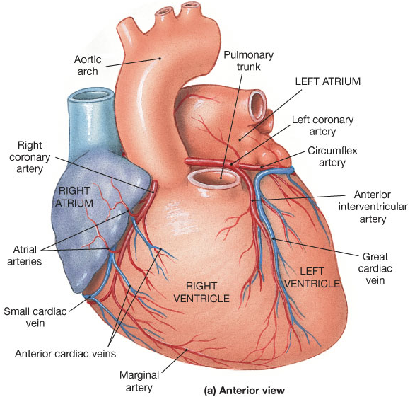
Coronary Circulation
Blood
Supply
to the
Heart!

Slide 24
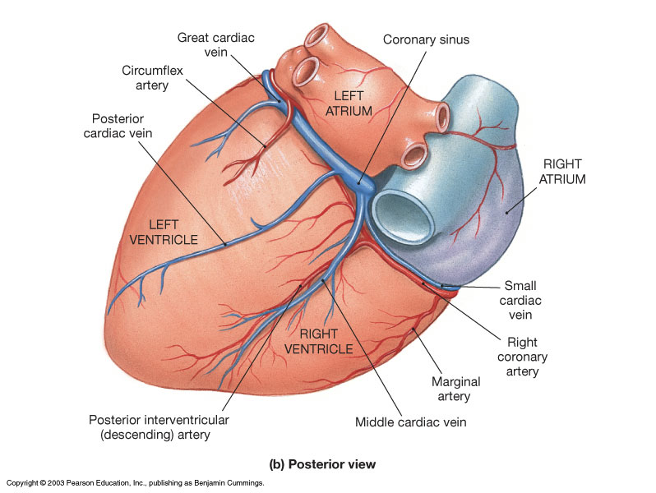

Slide 25
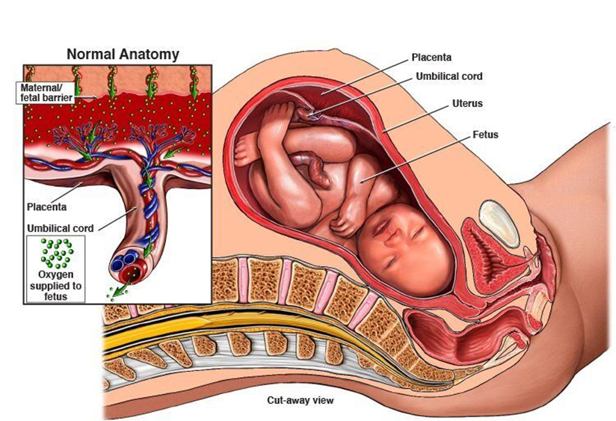
Fetal Circulation

Slide 26
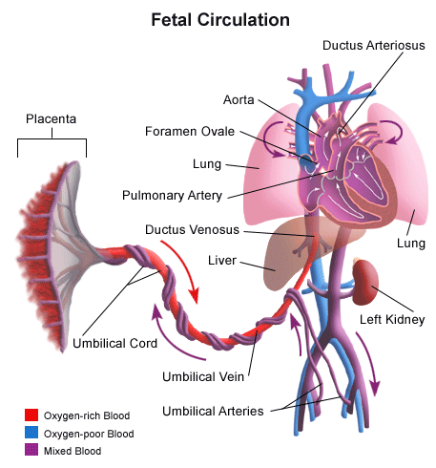
Fetal Circulation
Ligamentum
Arteriosum
Fossa Ovalis
Ligamentum Venous
Ligamentum Teres

Slide 27
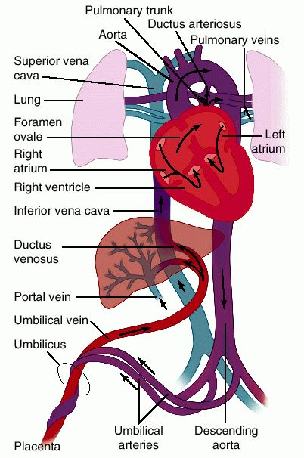
1 Umbilical Vein Delivers O₂ and nutrient rich blood from placenta to the fetus.
2 Umbilical Arteries Returns O₂ and nutrient
poor blood from the fetus to placenta.
Note:
Umbilical vein is carrying blood to fetal heart.
Umbilical arteries are carrying blood away from fetal heart.

Slide 28
Changes in Heart After Birth
1. Foramen Ovale Fossa Ovalis
2. Ductus Ligamentum
Arteriosus Arteriosum
Changes in Vessels After Birth
1. Ductus Ligamentum
Venosus Venosum
2. Umbilical Ligamentum
Vein Teres

Slide 29
Control of the Heart
Basic rate established by pacemaker cells inside heart (myocardium)
“intrinsic myogenic control”
Modified by Autonomic N.S. (ANS)
Para: decreases rate via Vagus n. X.
Sym: increases heart rate and force of contraction via cardiac accelerator n.

Slide 30
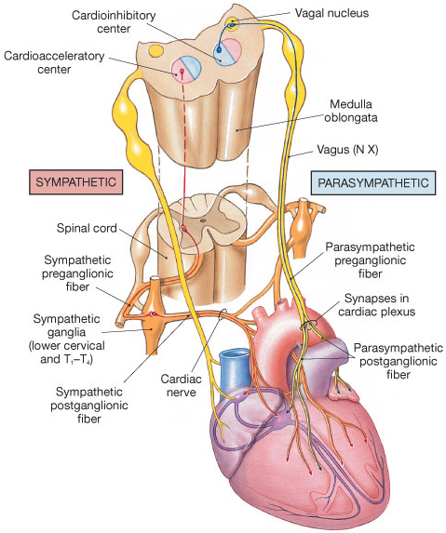
The Autonomic Innervation
of the Heart

Slide 31
Cardiac Centers in CNS (Medulla Oblongata)
Cardioacceleratory Center
M.O. activates Sympathetic neurons.
Cardioinhibitory Center
M. O. activates Parasympathetic neurons.
These centers (above) receive input from:
Higher brain centers (e.g., cerebrum).
Receptors monitoring blood pressure.
Receptors monitoring dissolved gases in blood.

