Slide 1
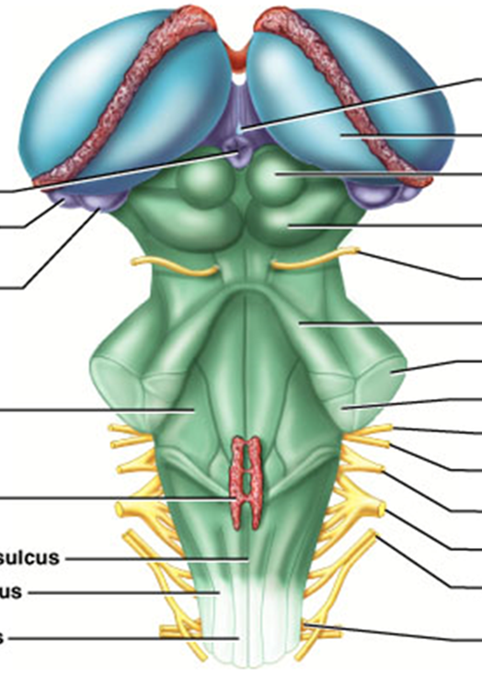
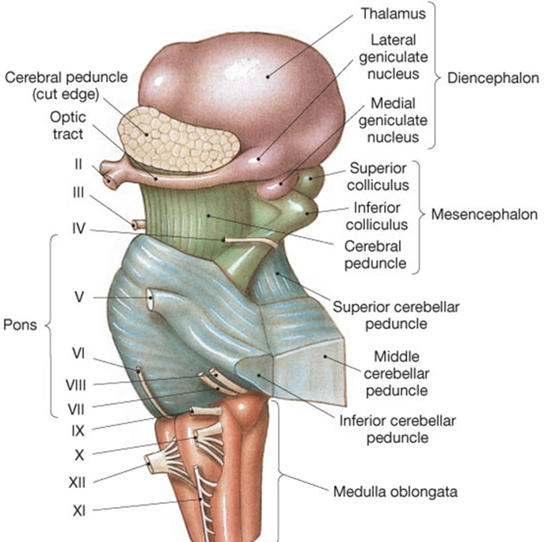
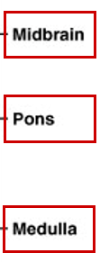
The Brain Stem
(Midbrain)
Posterior View Lateral View

Slide 2

Midbrain
Substantia nigra
= black substance
Corpora quadrigemina
= ‘four bodies’ (2 pairs)
Superior colliculi
=> nuclei that act in visual reflexes (vision).
Inferior colliculi
=> nuclei that act in auditory reflexes (sound).

Slide 3
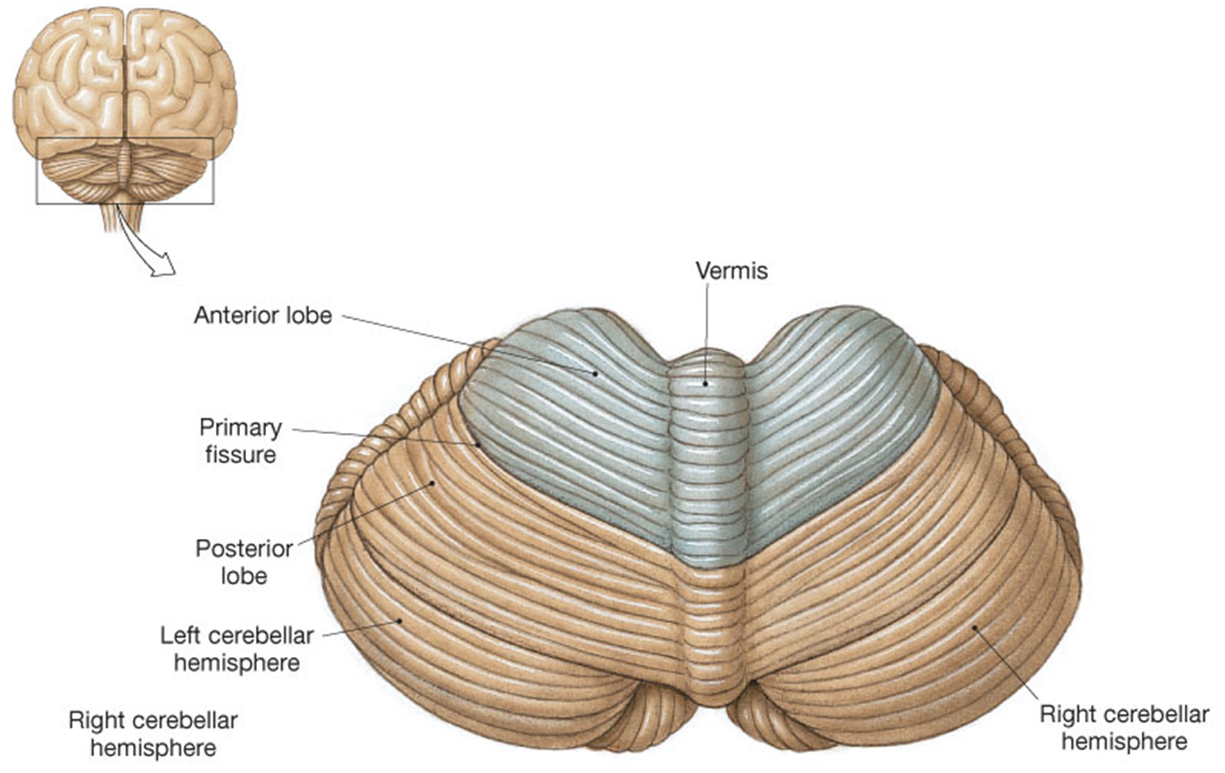

The Cerebellum – superior view
Located dorsal to the pons and medulla
Consists of two cerebellar hemispheres
Folia
Cerebellum (Superior View)

Slide 4
Functions of Cerebellum
Located dorsal to the pons and medulla
1) Controls postural reflexes:
Coordinates rapid, automatic adjustments of muscles in body to maintain equilibrium.
2) Produces skilled movements:-
Implements routines for fine tuned movements.
Refines learned routines until the action becomes routine.

Slide 5
* Thick tracts connecting the cerebellum to the brain stem
Superior, Middle and Inferior Cerebellar Peduncles
* Fibers to and from the cerebellum are ipsilateral -
run to and from the same side of the body

Slide 6
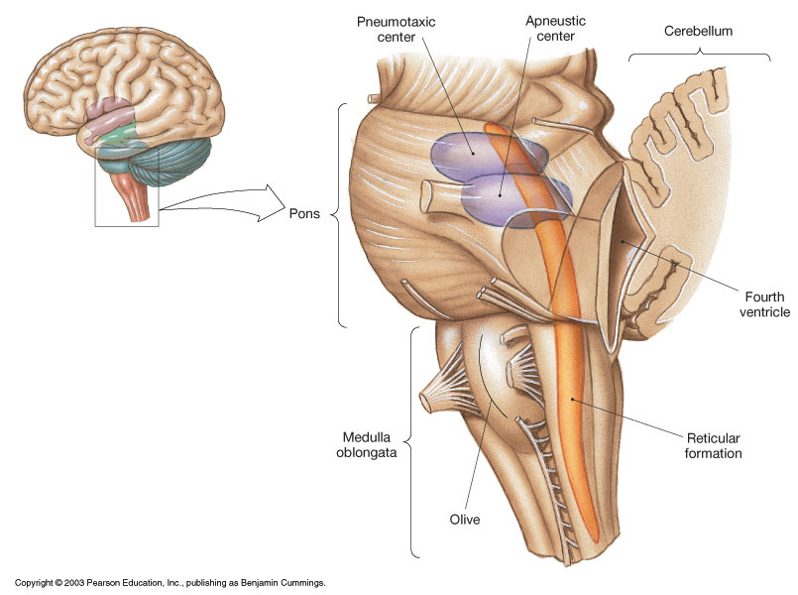
Pons
* Contains the pontine
respiratory centers.

* Contains the nuclei
of cranial nerves
V, VI, and VII

Slide 7
The Medulla contains:
Much of the reticular formation
Nuclei influence autonomic functions

Vital centers of the reticular formation:
1) Cardiac Control Center
2) Respiratory Control Center
3) Vasomotor Control Center
Also contains centers for hiccupping, sneezing,
swallowing, vomiting and coughing.

Slide 8
Protection of the Brain
The Skull
Cranial Meninges
Cerebrospinal Fluid
Blood-Brain Barrier

Slide 9
Cranial Meninges - 3-layer protective membrane
1. Dura Mater - Composed of two layers:
a) Periosteal (Endosteal) – outer layer attaches to bone.
b) Meningeal – inner layer, closer to brain.
(These two layers fused, except to enclose the dural sinuses)
Composed of dense irregular connective tissue.
2. Arachnoid Layer - ‘spider’ web-like layer.
Composed of loose/fibrous connective tissue.
3. Pia Mater - delicate, follows convolutions.
Composed of an outer collagen layer, & inner epithelial elastic and reticular fiber layer.

Slide 10
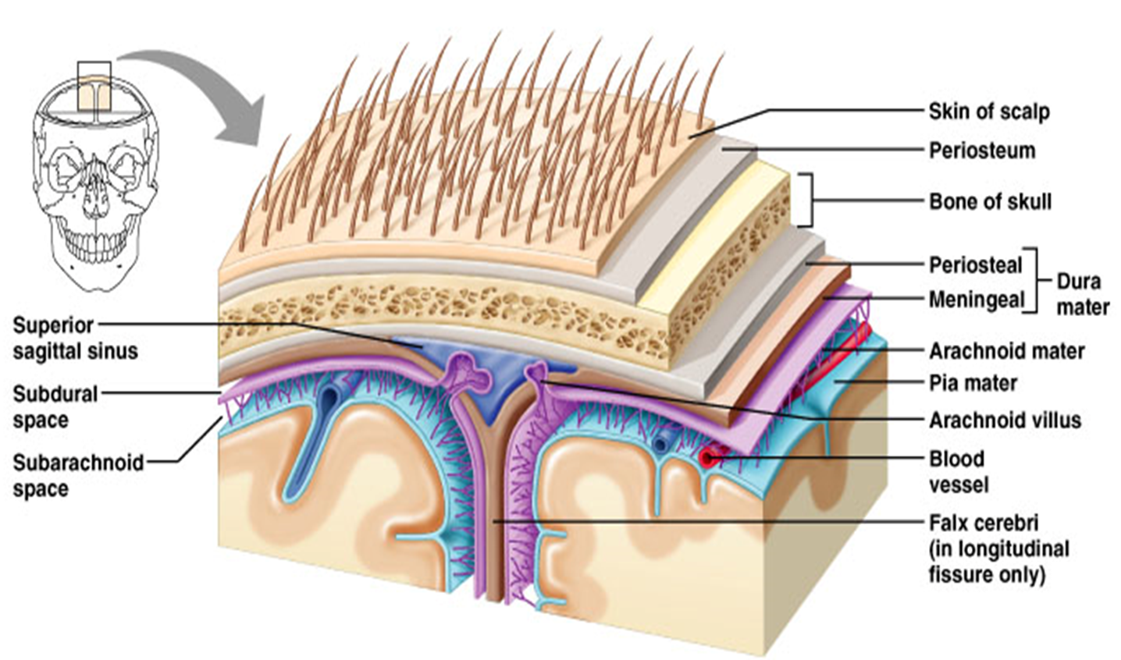
The Arrangement of the Cranial Meningeal

Slide 11
Cranial Meningeal Spaces
Epidural space
Potential space superior to dura mater.
Subdural space
Potential space between dura & arachnoid mater.
Subarachnoid space
Filled with CSF
Contains the blood vessels supplying brain.

Slide 12
The Sinuses = Large Veins (in cardiovascular system)

Slide 13
Cerebrospinal Fluid (CSF)
Roles of CSF:
1. Cushions and insulates delicate nervous tissue.
2. Gives Buoyancy to the brain (“floats” in CSF).
3. Exchange of gases (O₂ and CO₂), nutrients and
wastes.
*CSF formed in the choroid plexuses in ventricles of brain

Slide 14
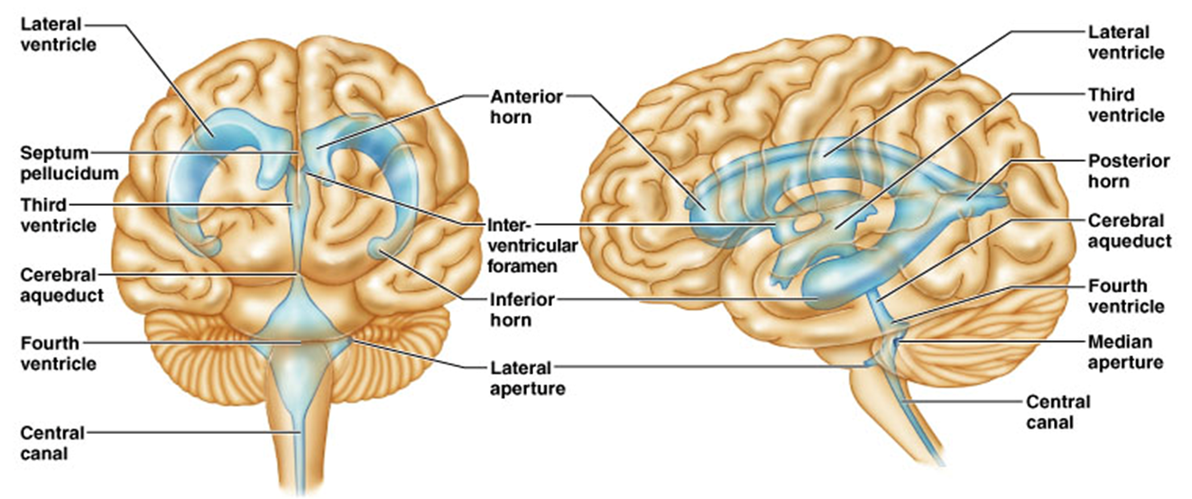
CSF Circulates in:
Chambers, Spaces, and the Central Canal.
Anterior view of Ventricles
Lateral view of Ventricles

Slide 15
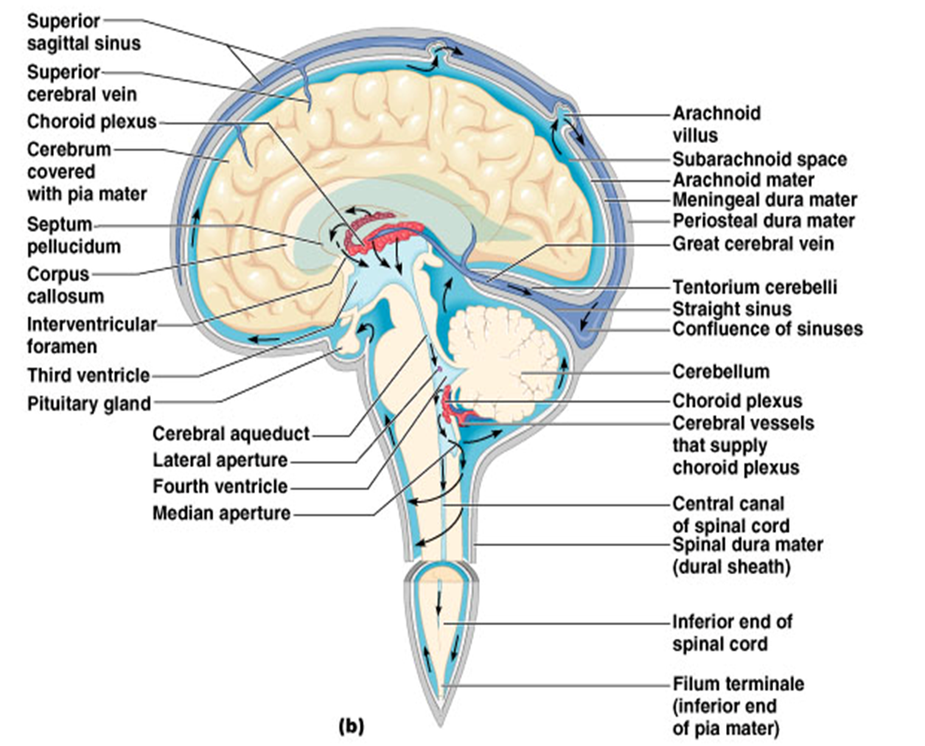
The Flow of CSF

Slide 16
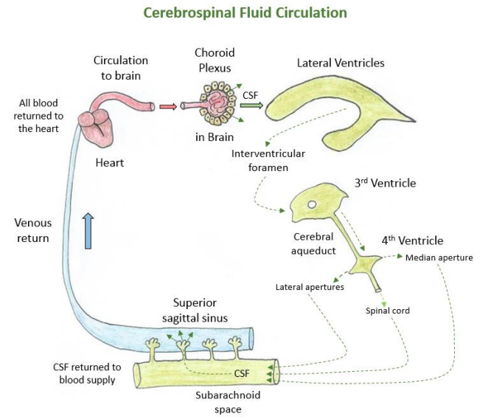
Arachnoid
villi

Slide 17
CSF Circulation

Slide 18
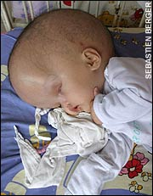
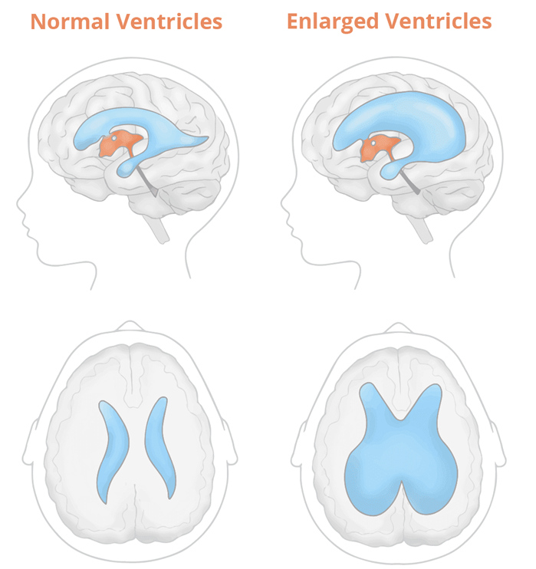
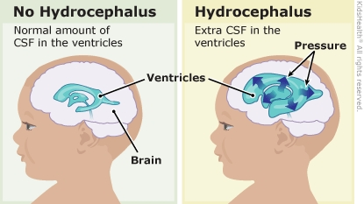
Hydrocephalus

Slide 19
Blood Brain Barrier (BBB)
A restrictive barrier around blood vessels in the brain (created by astrocytes).
Prevents most blood-borne toxins from entering the brain but not an absolute barrier.
Nutrients such as O₂, and glucose can pass. Plus CO₂, alcohol, nicotine, and anesthetics.
Dopamine? L-Dopa?

Slide 20
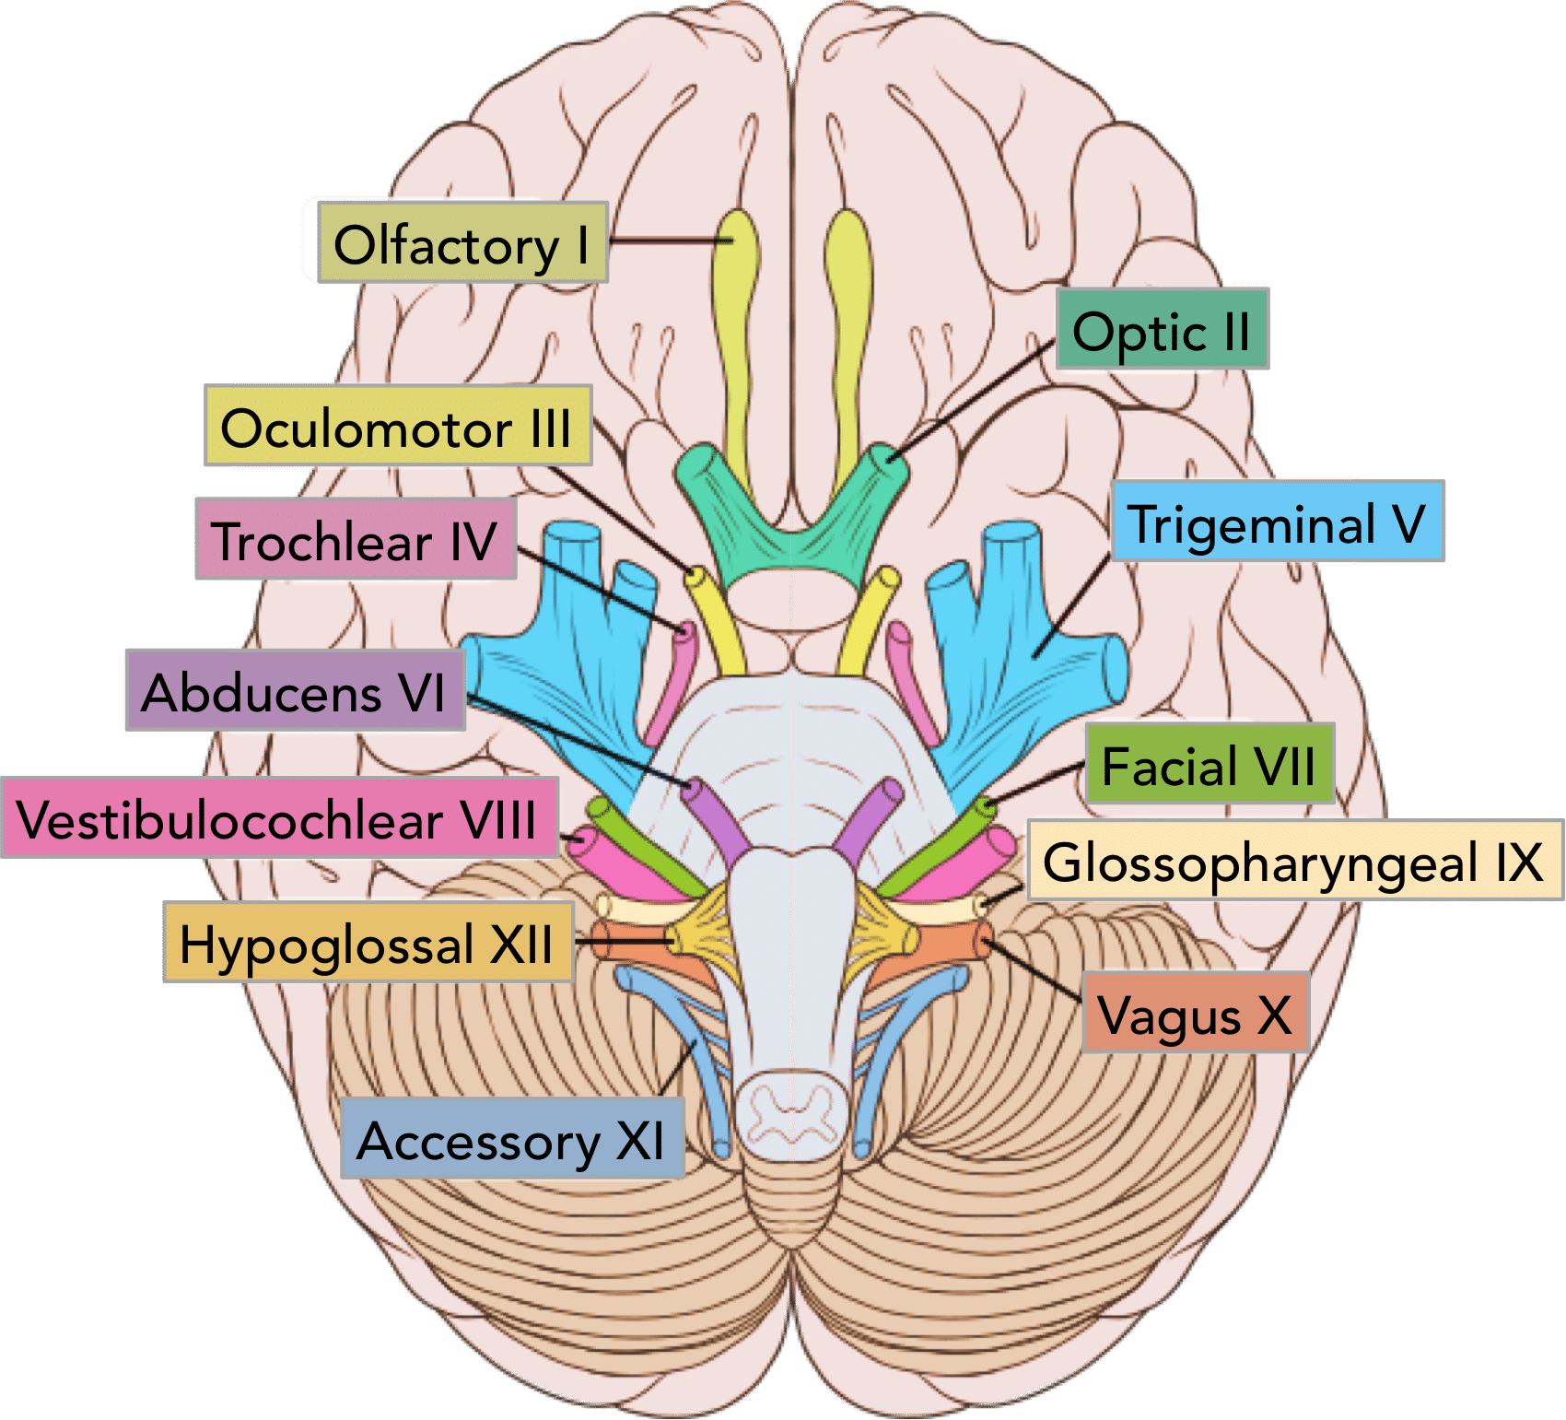
The 12 Pairs of Cranial Nerves
Descriptive Numeric Names

Slide 21
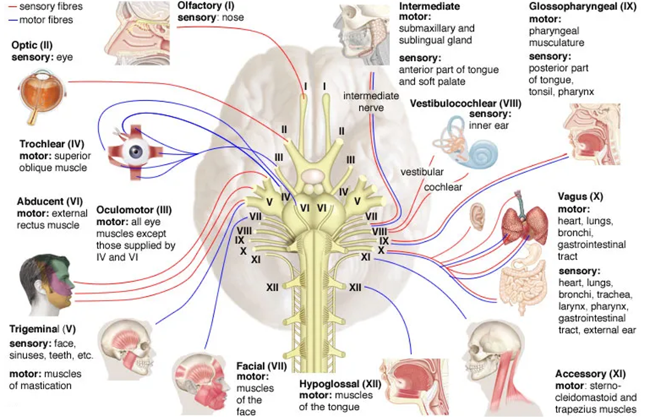

Slide 22
Cranial Nerves | Origins | Innervation | General Functions
Olfactory N. I (s) | Cerebrum, olfactory tract and bulb. From nasal mucosa through the olfactory foramina into olfactory bulb. | The nasal mucosa. | Sense of smell (from nose) to the Temporal lobe for perception.
Optic N. I II (s) | From optic disc enters the skull via optic canal on way to optic chiasm. | Photoreceptors Rods and Cones of Retina. | Transmits visual information from the eyes to occipital lobe for perception.
Oculomotor N. III (m) | From midbrain exits skull and enters orbit via superior orbital fissure. | 4 extrinsic ocular muscles; ciliary muscle, sphincter pupillae muscle. | Controls movement of eyeball. Constriction of pupil. Controls levator palpebrae superioris, and lens.
Trochlear N. IV (m) | From midbrain exits skull and enters the orbit via superior orbital fissure. | Superior oblique muscle of the eye. | For inferolateral rotation (down and out) movement of eyeball.
Trigeminal N. V (b) | From pons, has 3 branches: Ophthalmic N. superior orbital fissure Maxillary N. foramen rotundum Mandibular N. foramen ovale | Muscles and tissues of the head, and face, sinuses, and teeth. | Sensations of forehead, orbits and nose; cheek, upper lip; lower lip, buccal and mandible. Muscles of mastication (chewing).
Abducens N. VI (m) | From pons, exits skull via the superior orbital fissure. | Lateral rectus muscle of the eye. | Abducts the eyeball (looking laterally).

Slide 23
Cranial Nerves | Origins | Innervation | General Functions
Facial N. VII (b) | From pons, leaves brain via stylomastoid foramen. Part of Parasympathetic division. | Facial muscles. Tastebuds, lacrimal and sublingual, submandibular salivary glands. | Muscles of facial expression. Taste for anterior 2/3 of tongue. Generates tears and saliva.
Vestibulocochlear N. VIII (s) | Pons and medulla oblongata, it is incoming from the internal auditory canal. | The inner ear, both the vestibular complex (utricle and saccule); and the cochlear for hearing. | Vestibular branch: Conveys info to the vestibular complex regarding relative position of the head with the body to maintain balance (equilibrium). Cochlear branch: Sends sound info from the inner ear (cochlea) to auditory cortex temporal lobe.
Glossopharyngeal N. IX (b) | Leaves brain from medulla oblongata via jugular foramen. Part of the Parasympathetic division. | Laryngeal and pharyngeal muscles for swallowing; parotid salivary gland. Posterior one-third of tongue. Carotid bodies within the carotid sinus. | Elevates larynx and pharynx when swallowing, dilates pharynx during swallowing and speech. Responsible for ‘gag reflex’. For taste sensation posterior 1/3 of tongue. Detects dissolved gas levels in carotid bodies of carotid sinus.
Vagus N. X (b) | Leave brain from medulla oblongata, exits skull via jugular foramen. Significant (75%) part of the Parasympathetic division. | Acts on the tongue, pharynx, laryngeal muscles that control the voice, the heart, and gastrointestinal system. | Controls thoracic abdominal viscera, laryngeal and pharyngeal muscles. Sensation of epiglottis; regulates heart and digestive tract. Also has gag reflex.
Accessory N. XI (m) | From medulla oblongata and from spinal cord. Exits the skull via jugular foramen. | Sternocleidomastoid and trapezius muscles. Small laryngeal muscles. | For head rotation, flexion, lateral flexion, and extension of head. Plus, elevation of shoulders.
Hypoglossal N. XII (m) | From medulla oblongata, exits brain via hypoglossal foramen. | Intrinsic and extrinsic tongue muscles. | Controls muscles of food mixing, swallowing and muscles of speech, and sound creations in mouth.

Slide 24
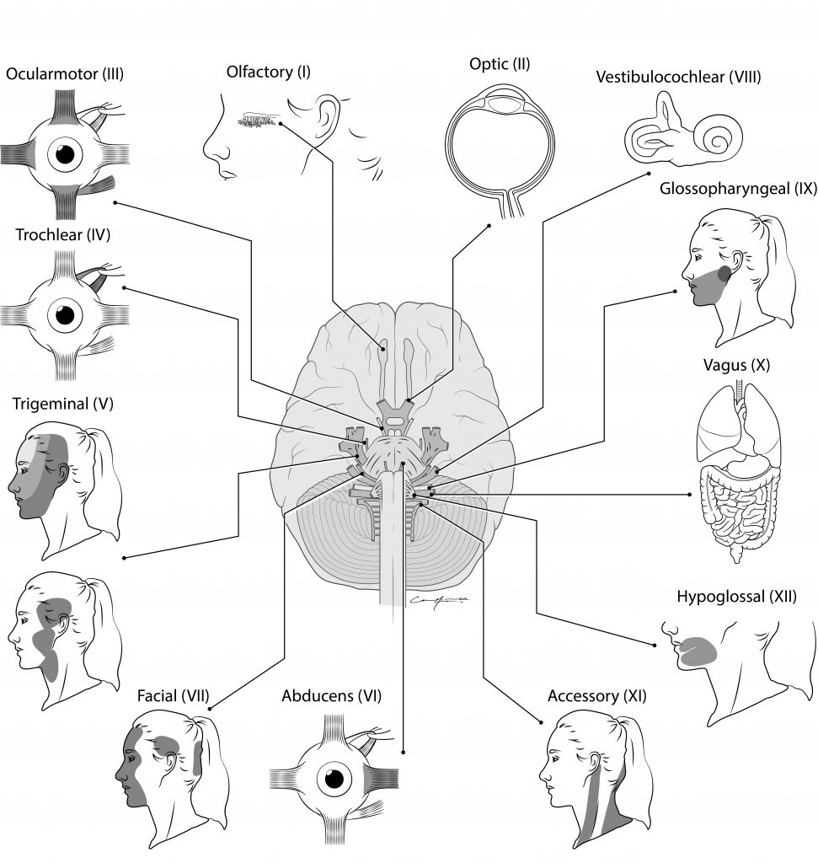
Testing the 12 Cranial Nerves

