Slide 1
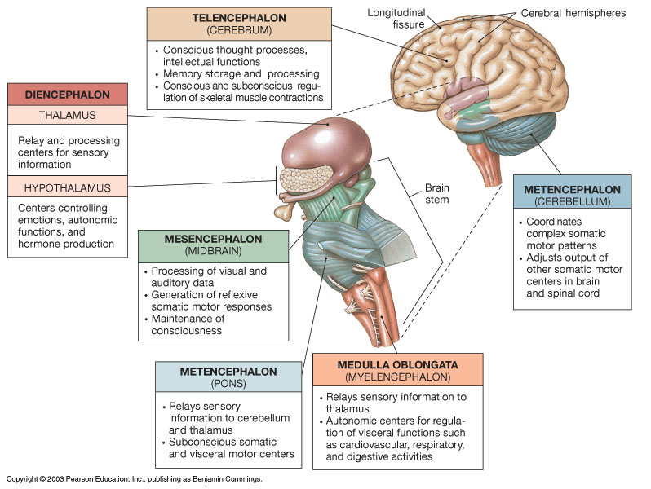
The Brain and
its Regions

Slide 2
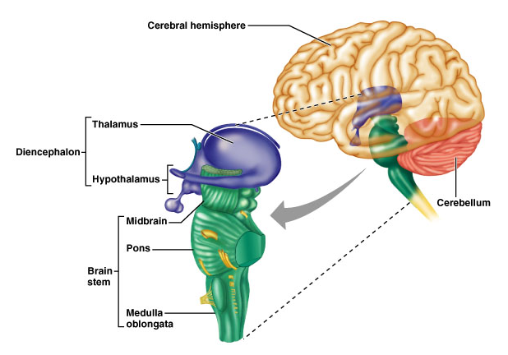
The 6 Divisions of the Brain
①
(Cerebrum)
Epithalamus
②
④
③
⑤
⑥

Slide 3
Sulci (sulcus) – grooves on surface of cerebrum.
Gyri (gyrus) – fold of brain tissue between sulci.
Fissure - deep groove, separating hemispheres.
Three kinds of cerebral functional area:
1) Sensory areas
2) Association areas
3) Motor areas

Slide 4
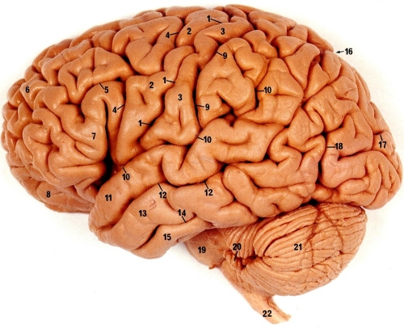
Surface Structures of the Brain

Slide 6
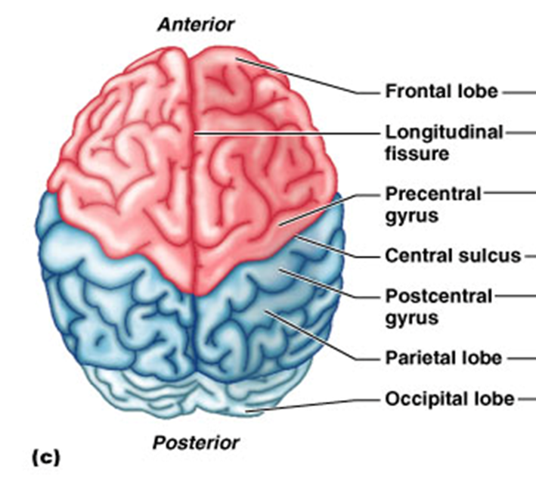
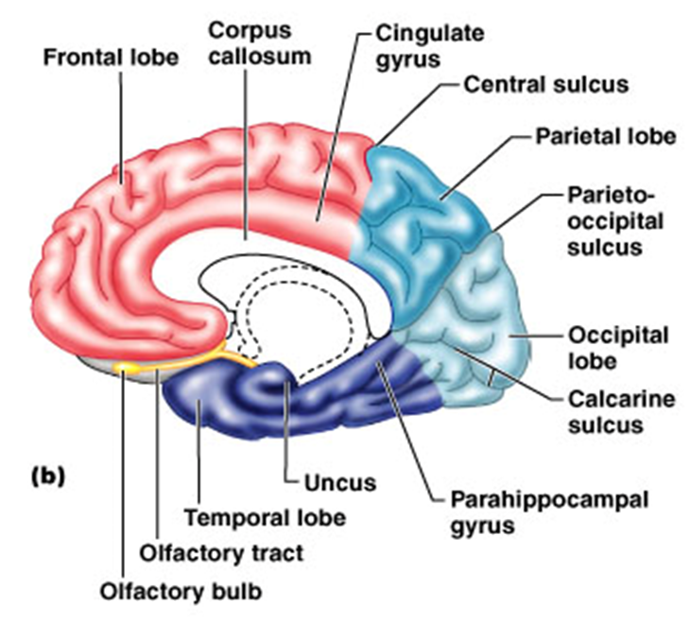
General Anatomy of Cerebrum
Two Hemispheres - Left and Right.
Two significant gyri: Precentral gyrus (motor).
Postcentral gyrus (sensory).

Slide 7
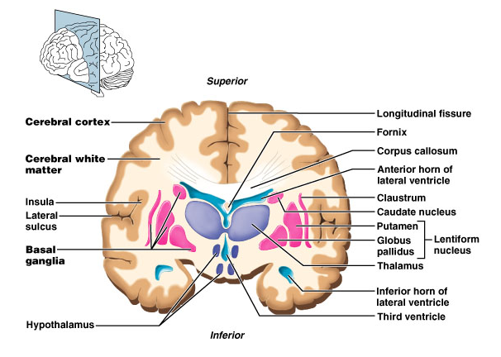
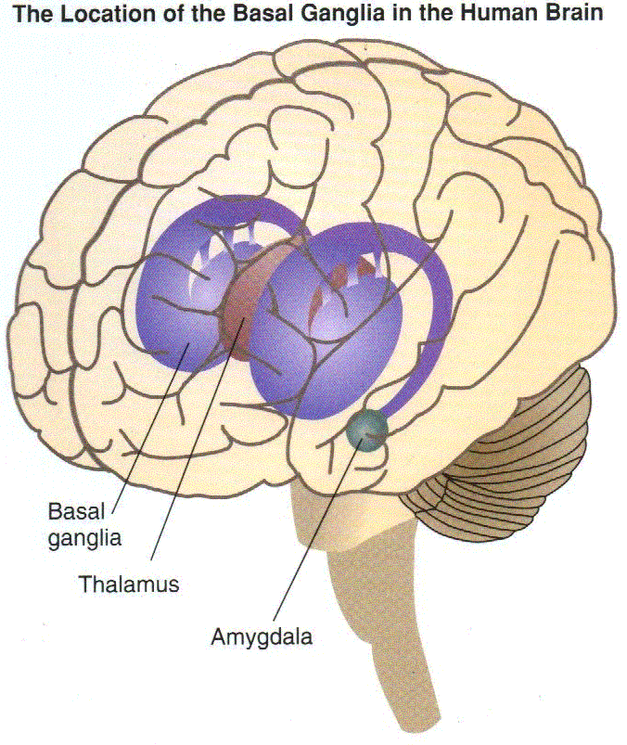
Cerebral (Basal) Nuclei
Consists of 5 pairs of Nuclei
1. Caudate nucleus
2. Putamen
3. Globus pallidus
4. Subthalamic nucleus
5. Substantia nigra
The cerebral (basal) nuclei are groups of subcortical nerve cell bodies (nuclei)
deep within white matter of the brain.
Role: Primarily to fine-tune voluntary body movements.
To process and signal from cerebral cortex (for movement), then to convey instructions to thalamus, which then relays this back to cortex, and finally sends to skeletal muscles via the tracts of the pyramidal motor system. Other higher cortical functions also mediated via the basal ganglia.

Slide 8
Functions of the Cerebrum
In General - our conscious mind, enables us to:
Be aware of ourselves and sensations.
Initiate and control voluntary movements.
Communicate, remember, predict and understand.
Cerebrum has 5 Lobes
Frontal Lobe - memory, behavior, personality, movement.
Parietal Lobe - somatic sensory perception.
Temporal Lobe - auditory and olfactory perception.
Occipital Lobe - visual perception.
Insula Lobe - visceral perception, gustatory cortex.

Slide 9
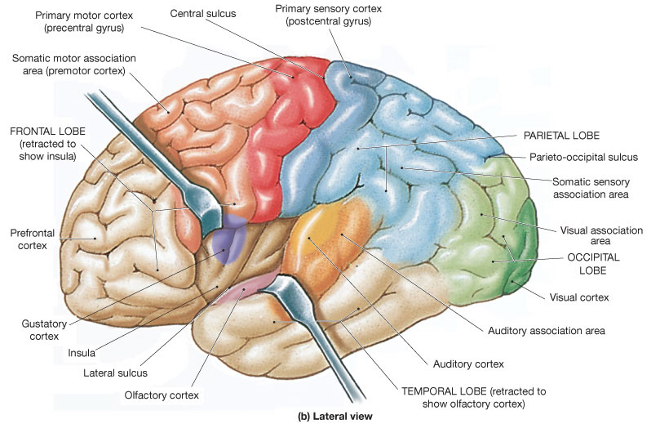
Cerebral Lobes

Slide 10
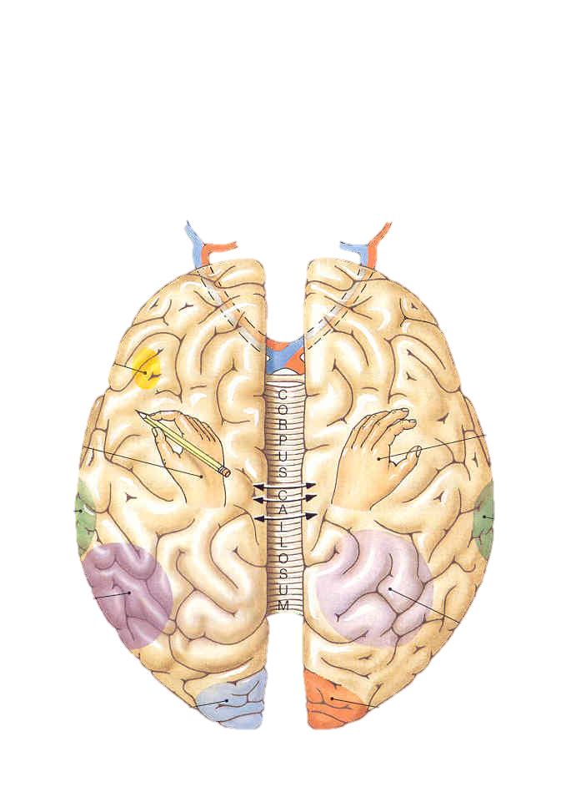
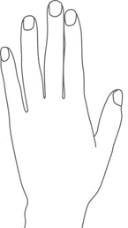
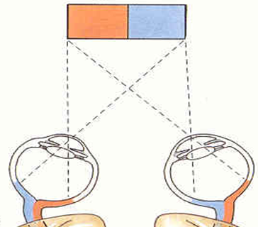
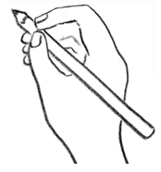
Broca’s area
Prefrontal cortex
Prefrontal cortex
Speech
center
Writing
(right-handed)
Analysis
by touch
Auditory cortex
(right ear)
Auditory cortex
(left ear)
Wernike’s area
General interpretive center (language and math)
Spatial visualization
and analysis
Visual cortex
(right visual field)
Visual cortex
(left visual field)
Left
Hemisphere
Right
Hemisphere
Decussation: A crossing of nerve fibers from one side of the CNS to the other.

Slide 11
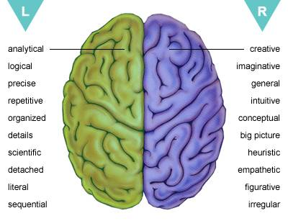
R
R
L
Analytical
Precise
Logical
Repetitive
Organized
Details
Scientific
Detached
Literal
Sequential
Creative
General
Imaginative
Intuitive
Conceptual
Holistic
Heuristic
Empathetic
Figurative
Irregular

Slide 12
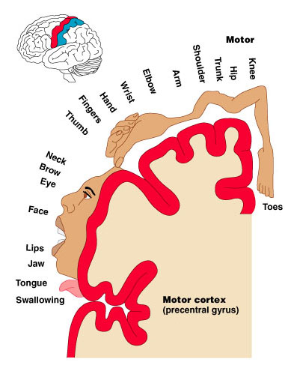
Homunculus - Motor and Sensory

Slide 13
The Limbic System = “Emotional Brain”
Anatomical Location:
Medial aspect of cerebral hemispheres.
Also within the diencephalon.
Composed of:
Septal nuclei, cingulate gyrus, hippocampus and amygdala.
The fornix links the limbic system together.

Slide 14
Structures of the Limbic System
Cingulate gyrus
Allows us to shift between thoughts.
Interprets pain as unpleasant.
Amygdala
Detects menacing glances from others.
Emotional recognition of faces.
Hippocampus
Consolidation of new memories (storage & retrieving)
Navigation and Spatial Orientation.
Septal Nuclei
Role in reward and reinforcement.

Slide 15
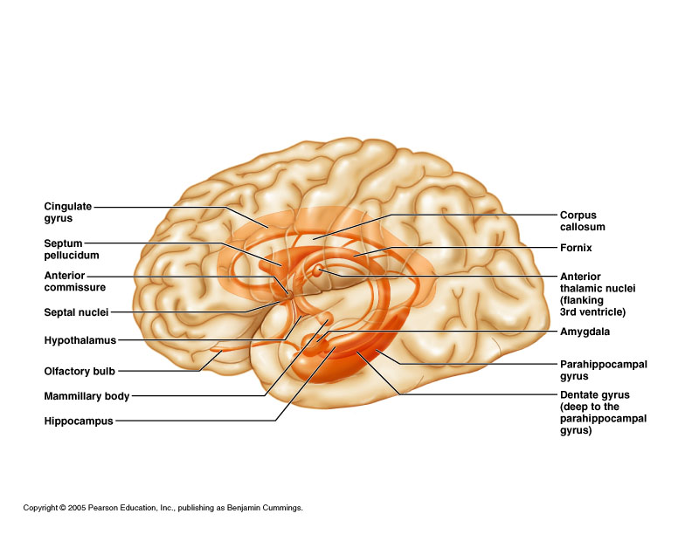
Anatomical Structures of the Limbic System

Slide 16
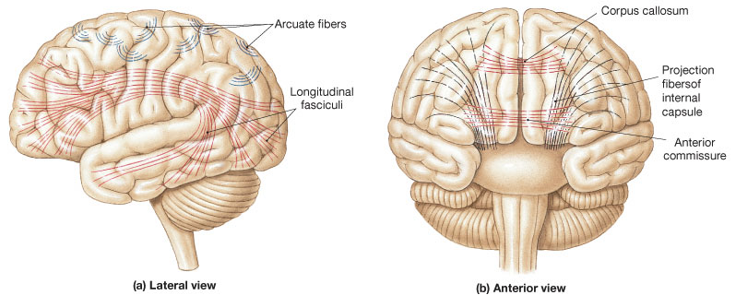
The major groups of axon fibers and tracts
of the central white matter.
a) Association Fibers
b) Commissural Fibers
c) Projection Fibers

Slide 17
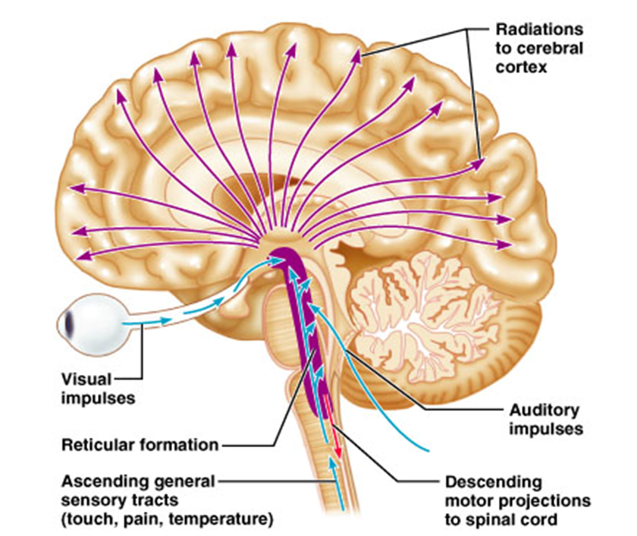
The Reticular System - widespread connections, ideal for arousal of the brain as a whole.
The Reticular
Activating
System (RAS)
Maintains consciousness
and alertness.
Functions in sleep and
arousal from sleep.
Pons and MO

Slide 18
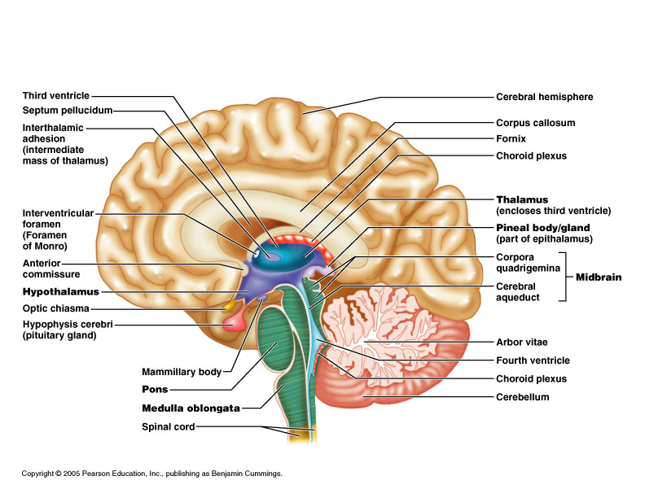
Regions below the Cerebrum
②
③
⑤
④
⑥

Slide 19
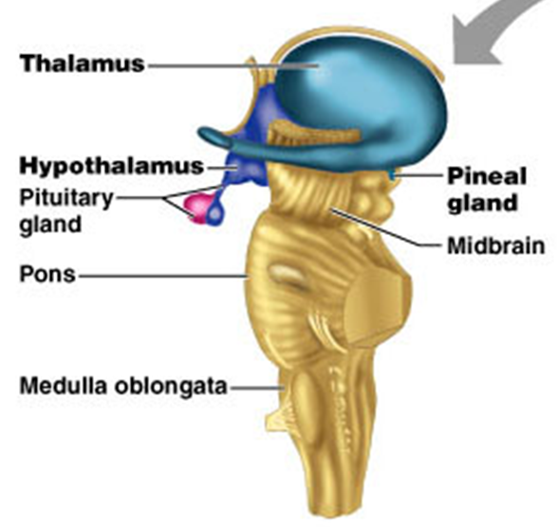
②
Diencephalon
= 1) Epithalamus, 2) Thalamus and 3) Hypothalamus
1) Epithalamus
- Includes the pineal gland (body).
Secretes hormone melatonin, under
influence of the hypothalamus.
* Dimethyl-tryptamine (DMT) is also released from Pineal gland.

Slide 20
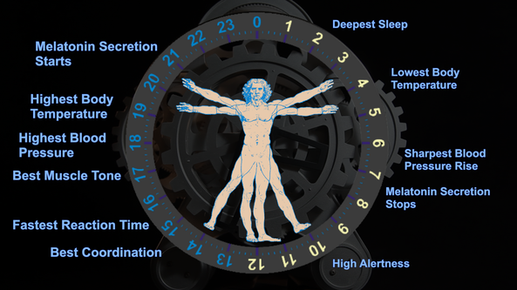
Note: The significant Blue Light emitted from tv, computer and phone screens blocks the hormone melatonin, therefore suppresses your body's ability to prepare for sleep.

Slide 21
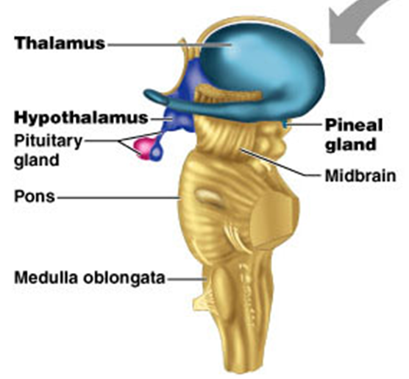
2) Thalamus
* Makes up 80% of
the diencephalon.
* Contains ~ a dozen major
nuclei which act as the
“gateway” to cerebral cortex.
* Afferent impulses
converge on thalamus.
* Nuclei organize and amplify
or tone down signals.

Slide 22
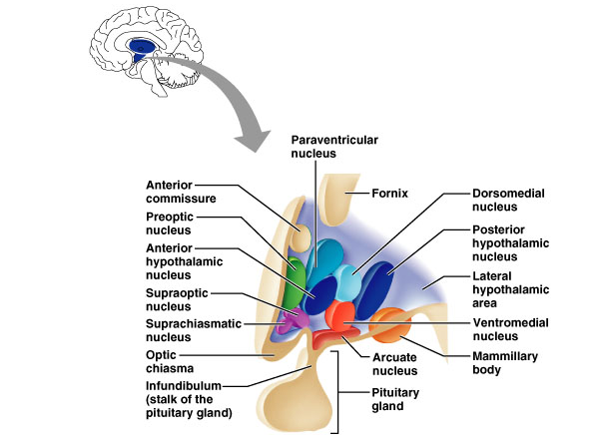
3) Hypothalamus
Main visceral control center of the body
Adrenal gland
T_{b} and Sexual
Dimorphism
Heart Rate and BP
Shivering
Sweating
Thirst and
Hunger
Posterior
Pituitary
Satiety
Circadian
rhythms
Olfaction and
Memory
Feeding

Slide 23
Functions of the Hypothalamus:
1. Controls autonomic nervous system (ANS)
2. Control of the endocrine system
3. Regulation of body temperature (T_{b})
4. Regulation of hunger and thirst sensations
5. Regulation of sleep-wake cycles
Overall: Controls many important behaviors via emotional
responses (Limbic system) and the ANS - Formation of memory

