Slide 1
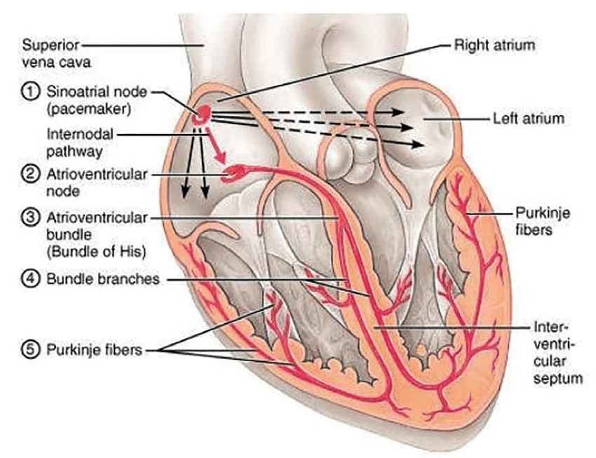
Electrical Conduction System of the Heart
Note: The internodal pathway (a)
Note: The interatrial band (b) (Bachmann’s bundle)
(b)
The 5 main components of this conduction system (with location):
1) Sinoatrial (SA) node
2) Atrioventricular (AV) node
3) AV Bundle (of His)
4) Left and Right bundle branches
5) Purkinje fibers
(a)
Sinus rhythm = the normal contractile pattern of the heart.
Electrical Conduction Region | Spontaneous Rate of Action Potentials/min
SA Node (sets the pace) | 70 - 80
AV Node | --------
AV Bundle | 40 - 60
R and L Bundle Branches | --------
Purkinje Fibers | 20 - 40

Slide 2
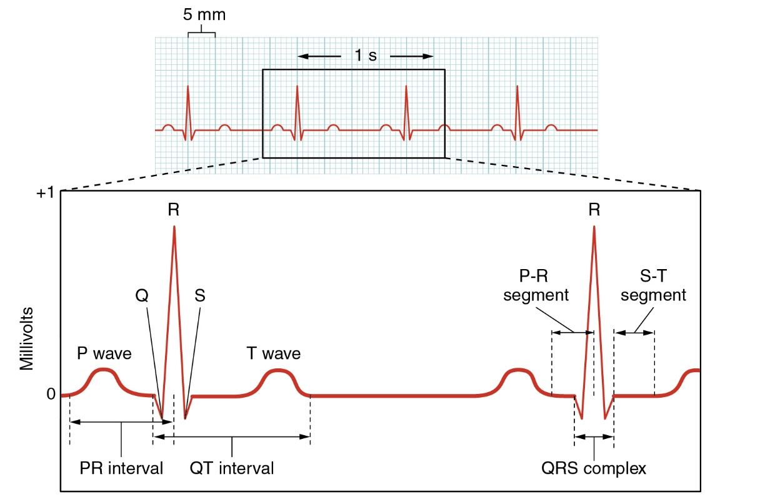
Trace of an ElectroCardioGram (ECG)

Slide 3
ECG Waves
P wave: Depolarization of the atria (R and L at same time). *Signal to contract.
QRS Complex: Depolarization of ventricles (R and L at same time).
Note: atrial repolarization occurs here, usually masked by this large signal on ECG.
T wave: Repolarization of the ventricles. *Signal to relax.
ECG Segments
P-R Interval: Time from onset of P wave to start of QRS complex.
Reflects conduction through AV node = time delay between atrial and ventricular activation, called the ‘AV nodal delay’.
S-T Segment: Portion between the QRS complex and the T wave. Represents early part of repolarization of ventricles.
T-P Segment: Flat line, no net electrical events = time of ventricular diastole (filling).

Slide 4
Segment, Wave or Interval | Electrical Event | Mechanical Event
P-Wave | Depolarization of the atria. | Late ventricular diastole (relaxation). Passive filling of the ventricles (AV valves open).
PR Interval | Reflects delayed conduction through AV node, or the ‘AV nodal delay’. | Atrial systole (contraction), top off of ventricular volume (AV valves still open).
QRS Complex | Depolarization of ventricles | Early ventricular systole (contraction). Closure of AV Valves (1st heart sound). Increased ventricular pressure
ST Segment | No net electrical events. | Late ventricular systole. Opening of semilunar valves. Ejection of blood from ventricles into arteries.
T-Wave | Repolarization of the ventricles. | Early ventricular diastole (relaxation). Decreasing pressure, closure of semilunar valves (2nd heart sound).
TP Segment | No net electrical events. | Ventricles continue to relax as pressure falls even lower, AV valves open.

Slide 5
Cardiac Output
Cardiac Output (C.O.) = volume of blood ejected by ventricles per unit time.
(expressed as minute volume, or liters of blood per minute or L/min)
C.O. is set to meet metabolic needs, i.e., is proportional to the tissues need for oxygen (O₂) and nutrients, and removal of carbon dioxide (CO₂) and waste.
C.O. changes with changes in body position.
e.g., from recumbent (lying down) to an upright -> HR and SV increase.
At rest, healthy adult basal C.O. is about 5 L/min.
C.O. can increase 50-100% by anxiety/excitement, and up to 500% by exercise.

Slide 6
Calculating Cardiac Output: CO = HR x SV
Factors Affecting Heart Rate
ANS
Hormones
Physical Activity
Emotional State
Factors Affecting Stroke Volume
Amount of Ca²⁺
Preload (EDV) and Afterload (Resistance)
ANS (Sym)
Physical Activity
Emotional State
Heart Rate
(beats/min)
Stroke Volume
(volume/beat)
Example Calculations:
Below are values for at rest and during exercise.
Let’s calculate the C.O., including units, showing all work!
*SV= EDV-ESV
1) At Rest:
HR = 72
EDV = 135
ESV = 65
2) During Exercise:
HR = 121
EDV = 178
ESV = 42

Slide 7
Cardiac Output = Heart Rate and Force (Contractility) is Modified by ANS
Para activity decreases heart rate and force of contraction.
Sym activity increases heart rate and force of contraction.
Remember… Force is indicated by stroke volume (SV), and SV = EDV - ESV
Multiple Factors Influence Stroke Vole (SV), it’s homeostatically regulated.
SV directly related to the force generated by cardiac muscle during contraction.
Greater force of contraction means greater SV, and lesser force means lower SV.

Slide 8
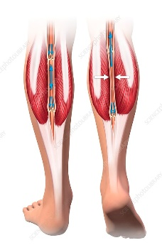
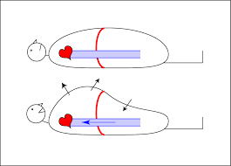
Things that Influence SV:
Length-Tension or Stretch-Force Relationships
As cardiac muscle sarcomere length increases, tension generated contracting muscle increases = SV.
More force, greater amount of blood ejected.
b) Venous Return or Cardiovascular Preload
Blood returning to the heart is termed 'venous return’.
Increased venous return = stretch cardiac muscle, and they contract more forcefully.
Venous return determines EDV, and this determines stroke volume (SV)!
Several factors affecting venous return:
The ‘Skeletal Muscle Pump’.
The ‘Respiratory Pump’.
Sympathetic Activity.
Preload = another way of expressing EDV. The greater the EDV = Greater preload = Greater SV.
Note: Decreased EDV = Decreased preload = Decreased SV.
Afterload = the force ventricles must generate to pump blood against resistance in vascular system. Any increased resistance requires a greater afterload to force open the semilunar valves and pump the blood into the arteries. Increased afterload decreases SV; decreased afterload increases SV.

Slide 9
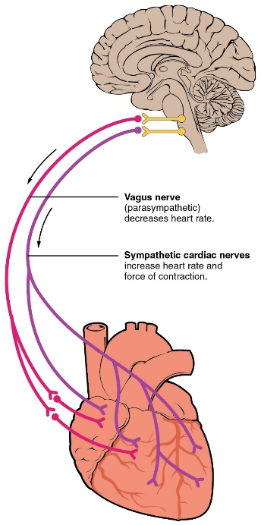
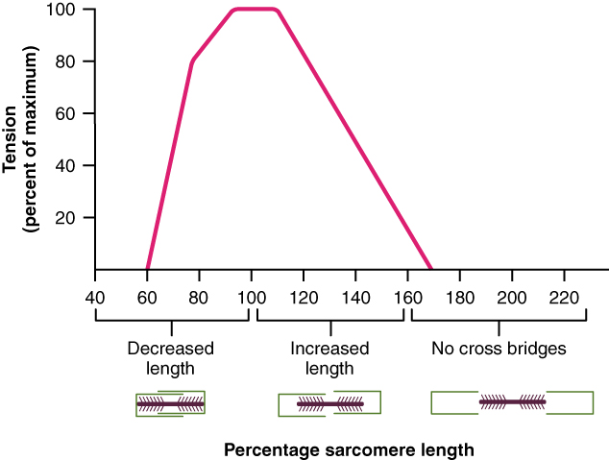
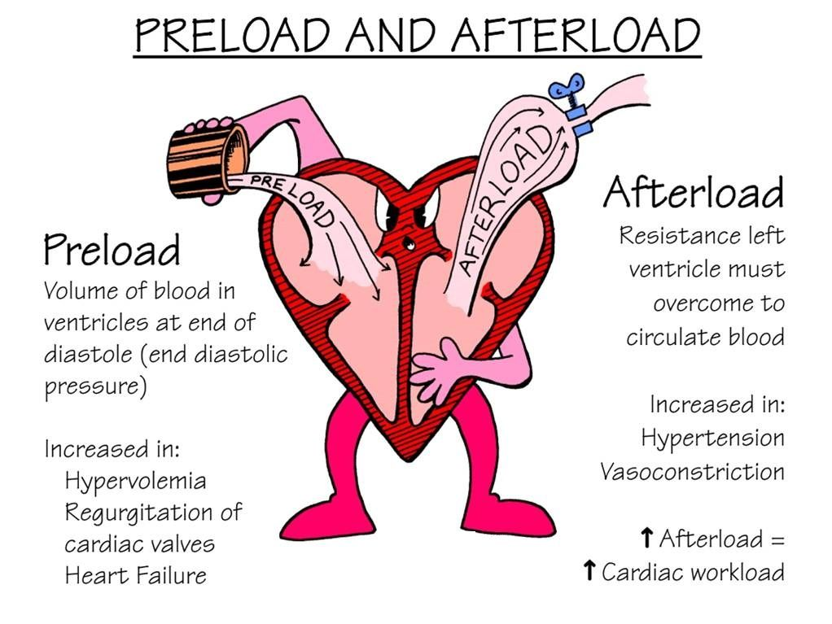
Summary of Impacts on Cardiac Output
❶
❶
Parasympathetic activity decreases heart rate and force of contraction.
Sympathetic activity increases heart rate and force of contraction.
❷
Optimal Length of Sarcomere = Most Force
Note: At rest, cardiac sarcomeres are short, thus stretching heart chambers (with increased volume) makes heart contract with more force, this will increase SV.
❸
Preload and Afterload effect Stroke Volume!
❷
❸

Slide 10
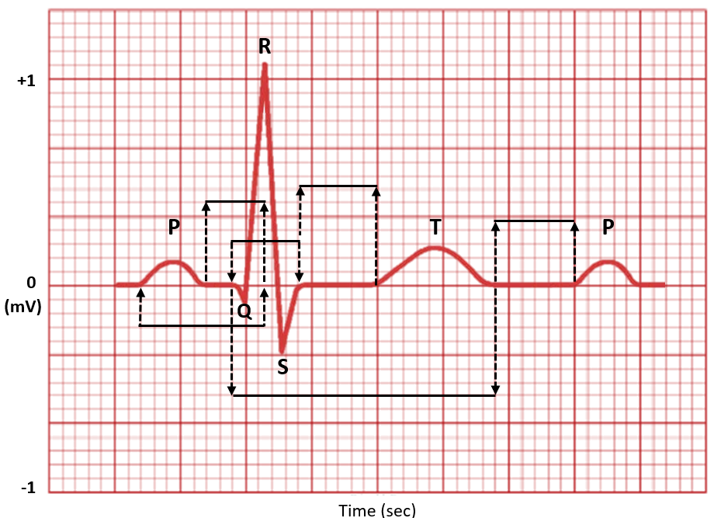
Components of the ECG
General Features of ECG
Wave – Deflection from baseline (+ or - direction).
Segment - A line between waveforms.
Interval - A waveform and a segment.
Complex - Consists of several waveforms.
Take a look at these links…
https://www.youtube.com/watch?v=RYZ4daFwMa8
http://ekginterpretation.weebly.com/cardiac-cycle.html
Specific Intervals and Segments
S-T Segment, T-P Segment
PR Segment, P-R Interval
QT Interval
Specific Waves and Complexes
P Wave -
QRS Complex -
T Wave -

Slide 11
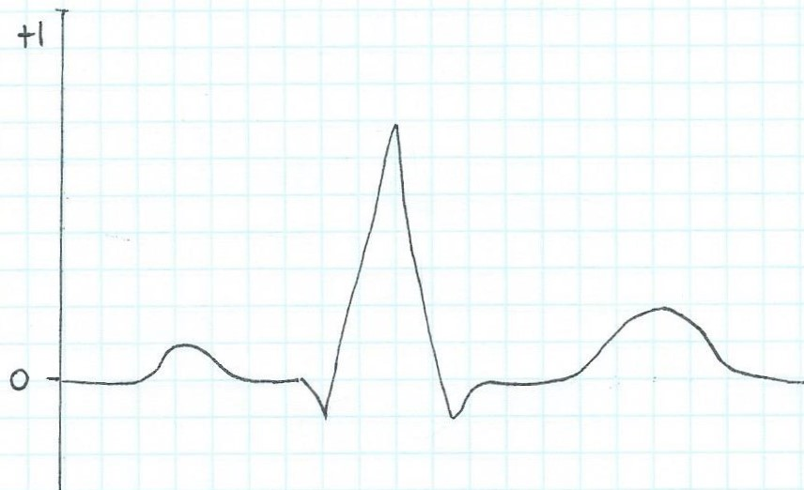
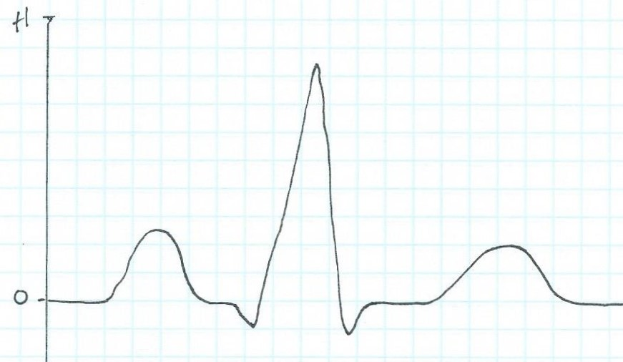
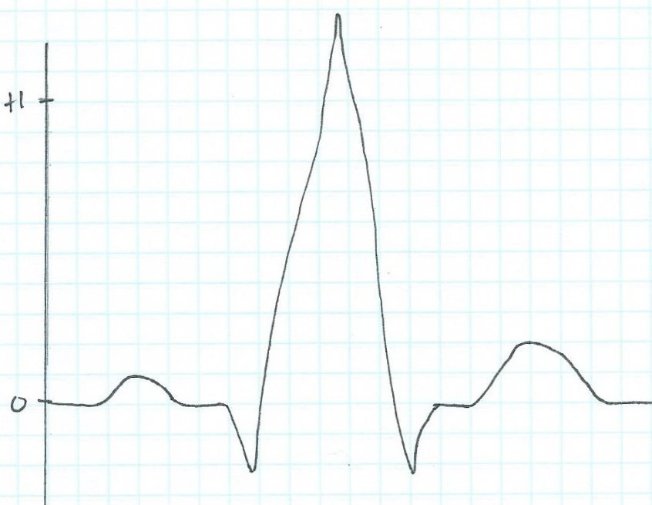
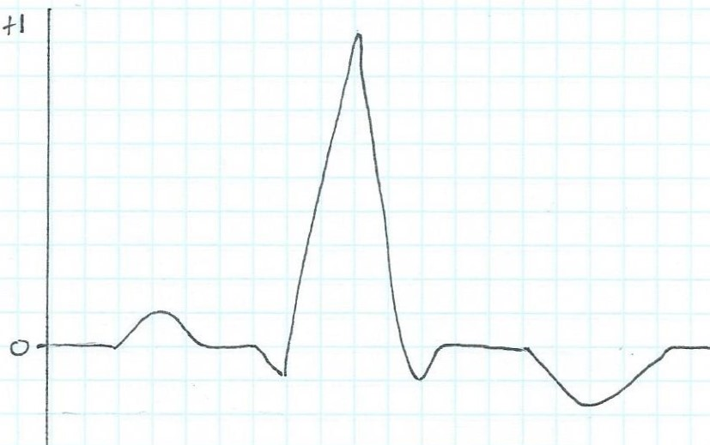
Examine the ECG traces below. Use the Normal ECG trace as a guide. Identify the waves and complexes and state what they indicate. Then find the abnormal component on each of these ECG traces a), b) and c) and suggest what they might indicate:
Normal ECG trace
a)
b)
c)

Slide 12
Diastole
Systole
The Cardiac Cycle:
Mechanical Events of the Heart
Late Diastole: “Heart at rest” all chambers relaxed filling with blood (passive filling ~ 80% full).
2. Atrial Systole: atria contract, adds the last 20% of blood to ventricles (top off ventricles)
Occurs after P-wave on EKG
End Diastolic Volume (EDV) = Maximum ventricular volume*

Slide 13
3. Ventricular Systole (part 1):
Ventricular contraction begins - ↑Pressure (P).
Closure of AV valves = 1st heart sound ("lub")
Sealed Compartment – all valves are closed.
Isovolumetric ventricular contraction:
=> pressure builds as volume stays the same.

Slide 14
4. Ventricular Systole (part 2):
Ejection phase: ↑P pushes open semilunar valves, blood forced out into artery leaving ventricle.
Pulmonary Semilunar => 25 mmHg (minimum pressure)
Aortic Semilunar => 80 mmHg (minimum pressure)
End Systolic Volume (ESV) = volume remaining in
heart after ejection (~½)*.
Stroke Volume = EDV - ESV (ml/beat)

Slide 15
5. Ventricular Diastole:
Relaxation of ventricles, artery back flow slams semilunar valves shut = 2nd heart sound ("dup").
Sealed Compartment again – all valves are closed.
Isovolumetric ventricular relaxation:
=> ↓ pressure as volume stays the same.
The AV valves then open, refilling starts –
back to start of cycle.

Slide 16
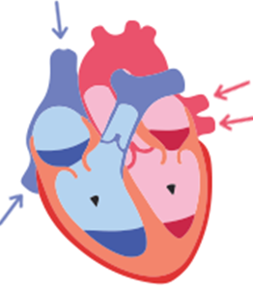
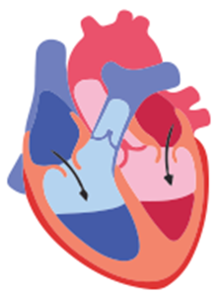
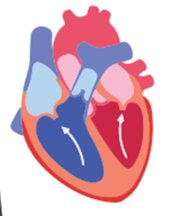
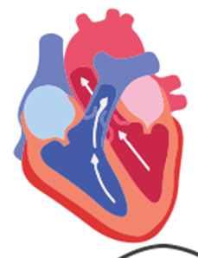
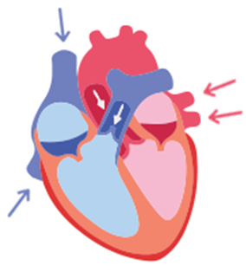
Late Diastole
The Cardiac Cycle
❶
❷
Atrial Systole
❸
Vent. Systole (part 1)
❹
Vent. Systole (part 2)
❺
Vent. Diastole

