Slide 1
Budget & Resource Development Subcommittee
March 12, 2025
TREY research

Slide 2
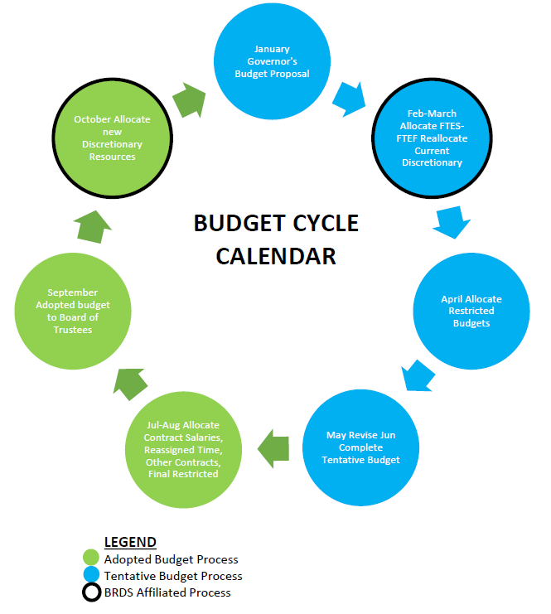

Slide 3
2025-26 Tentative Budget Development – Discretionary Reallocation
Worksheets distributed to Managers February 4, 2025
Worksheets due back to Business Office March 4, 2025
Total Discretionary budget remains at 2024-25 amount
Allocated by formula - FTES Target X $100
$1,006,657
Opportunity to reallocate current resources to meet budget objectives for the 2025-26 fiscal year
All worksheets have been completed
BRDS budget process has been completed

Slide 4
2025-26 Tentative Budget Development – Discretionary Reallocation
Areas completing worksheets
Administrative Services - Bell
Academic Services – Odu
Communications/PIO – Quis
College Technology Services – Hill
Institutional Effectiveness and Planning – Miramontez
Instruction - Odu
LEAD/Equity – Julian
President – Lundburg
Student Services - Gonzalez

Slide 5
Process Review – Request for New Resources, Adopted Budget
Export request for resources from Nueventive
Sort for ONGOING requests
Sort for Type of Request = DEPARTMENT DISCRETIONARY BUDGET INCREASE
Remove Title Duplicates caused by Unit Goal Alignment
Sort for PROGRAM combine and send to Dean/Manager/Director
Dean/Manager/Director rank prioritize with Dept Chair / Lead
Dean/Manager/Director send worksheet to Executive Cabinet
Executive Cabinet will allocate available resources
Dean/Manager/Director select resource request and Executive Cabinet will transfer to Request for New Resource form and report out
Example

Slide 6
2025-26 Budget Update
2023-24 Recalculation Apportionment
SDCCD met its SCFF financial targets
SDCCD generated 903 Unfunded FTES = $6.6M
2024-25 First Principal Apportionment
State Dept of Finance projecting a current 6.5% deficit due to lagging property tax collection
This translates to a 7.1% deficit factor to SDCCD
Expectation is that this will resolve as tax receipts are collected throughout the year
SDCCD is currently on track to generate 569 Unfunded FTES = $3M
2025-26 Budget Development
Modest increases continue to be considered
COLA is still projected
Next State update will be May 15, 2025
Miramar’s Tentative Budget Development is underway and due to be finalized May 30

Slide 7
Questions ?

