Slide 1
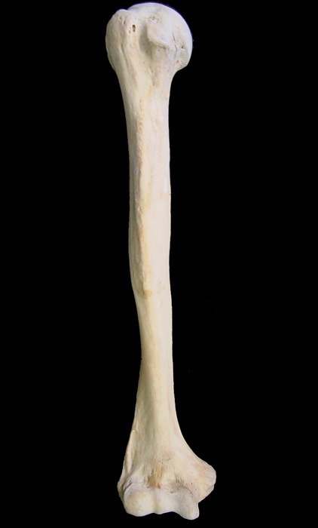
BONES
Of the
Appendicular
Skeleton

Slide 2
Bony Landmarks
Articulations
condyle -
facet -
head -
Depressions
alveolus -
fossa -
fovea -
sulcus or groove -
Extensions & Projections
crest -
epicondyle -
line -
process -
trochanter -
tubercle -
tuberosity -
spine -
Passages
canal or meatus -
foramen (foramina) -
fissure -

Slide 3
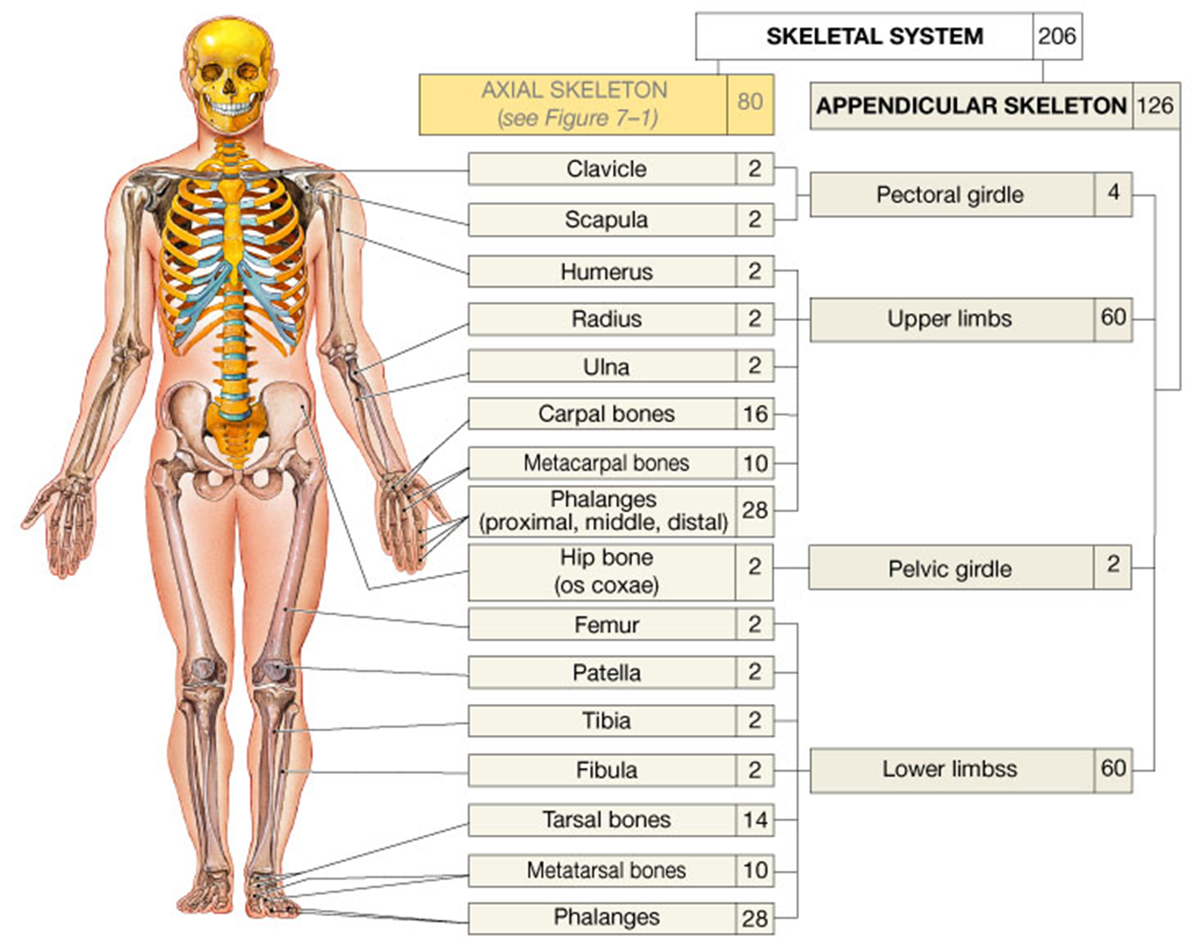

Slide 4
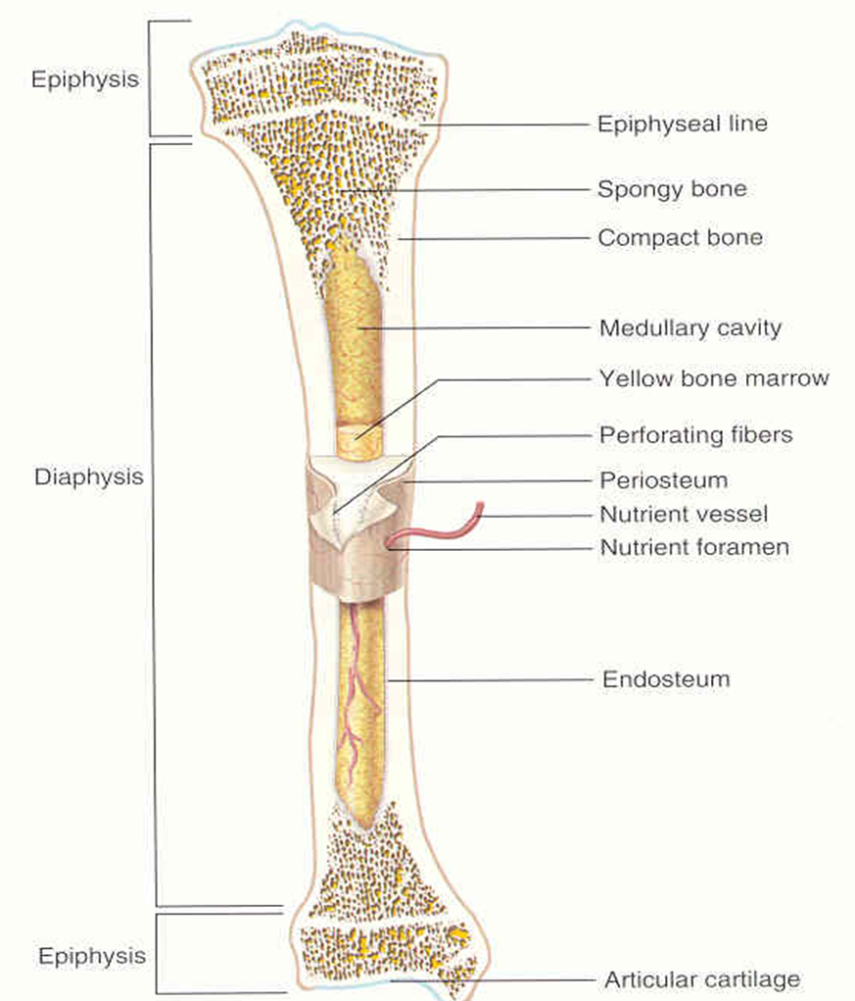
Anatomy of a Long Bone

Slide 5
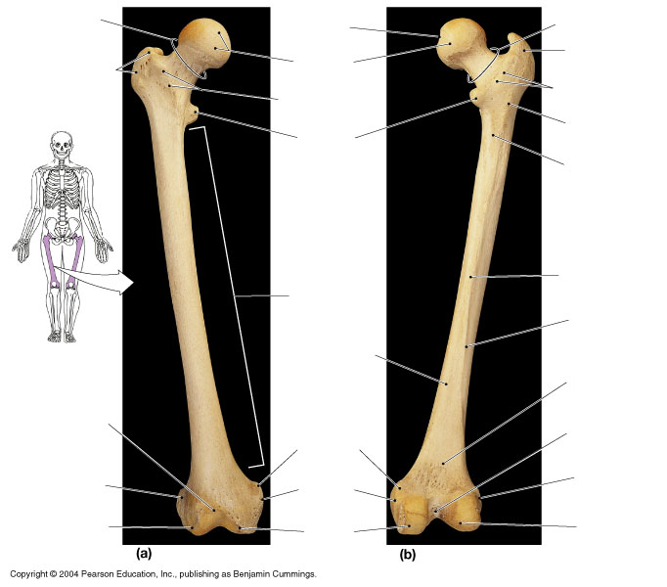
What are
the bony
landmarks
indicated on
each aspect
of this bone?

Slide 6
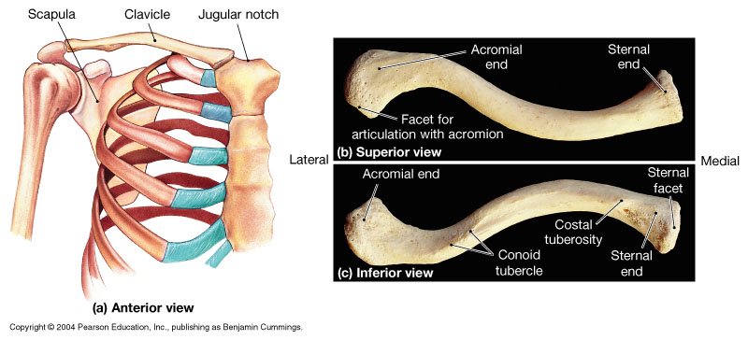
The Appendicular Skeleton
= The Pectoral and Pelvic Girdles

Slide 7
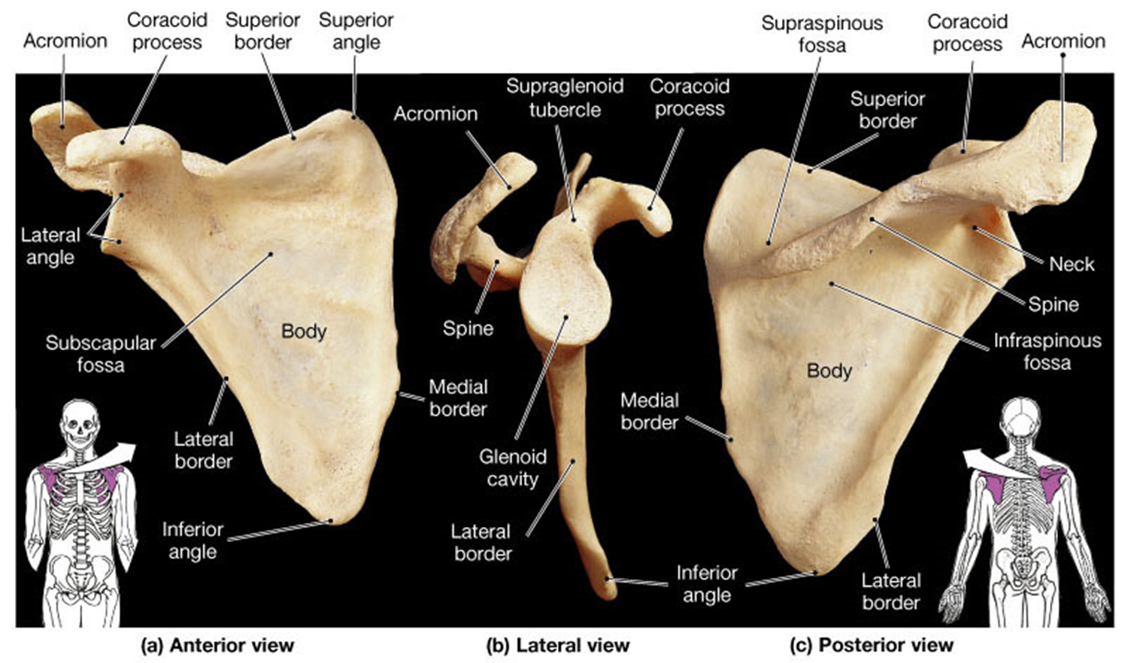
The Scapula

Slide 8
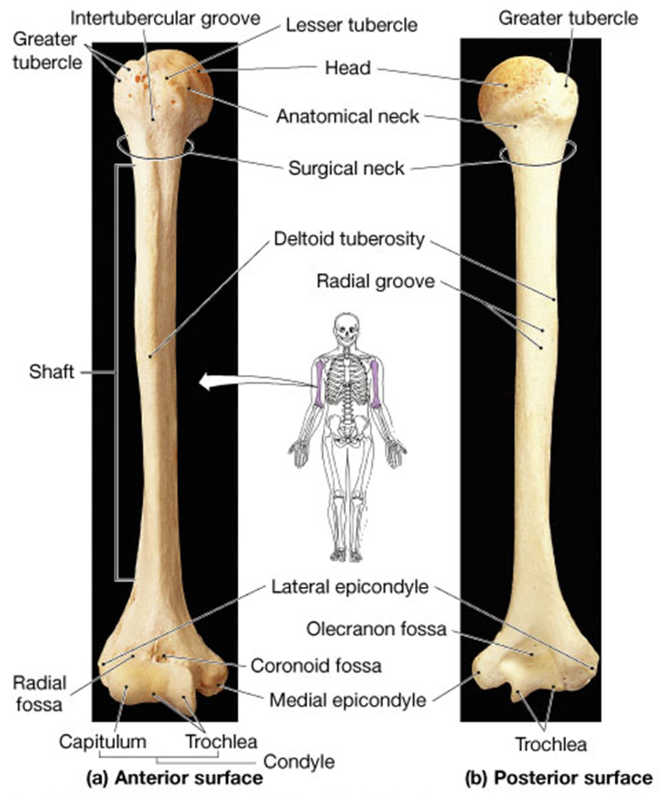
The
H
U
M
E
R
U
S

Slide 9
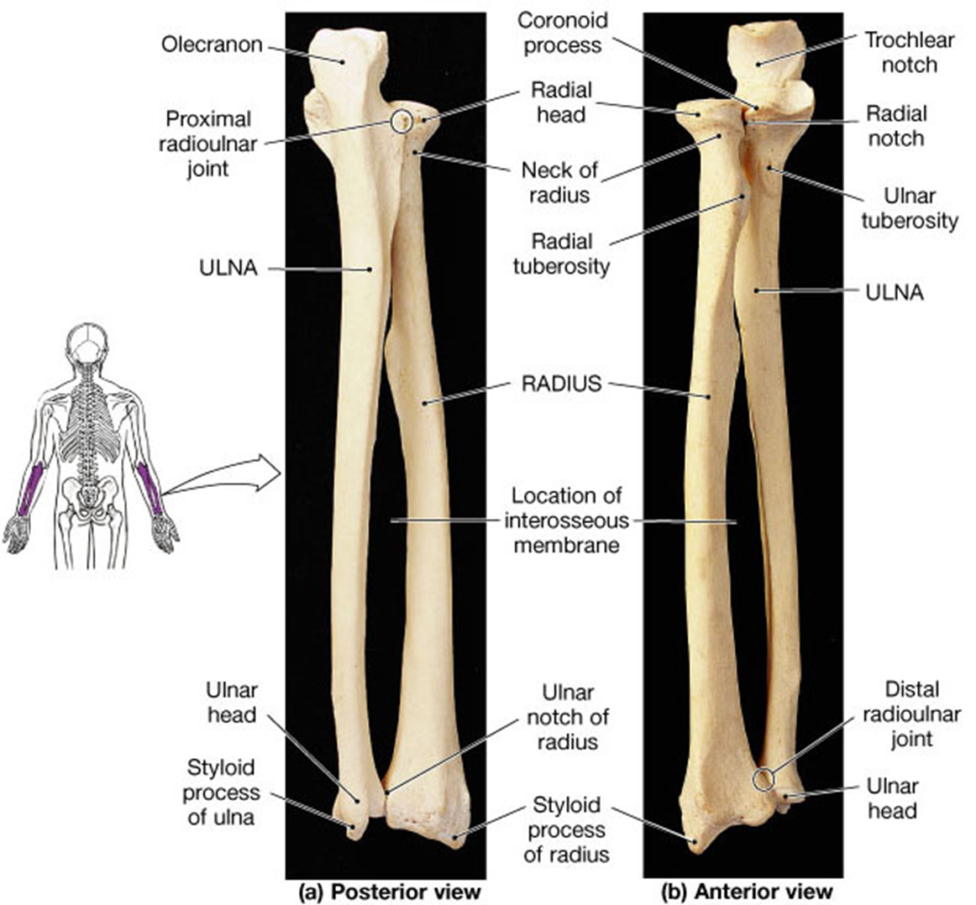
The
Ulna
The
Radius

Slide 10
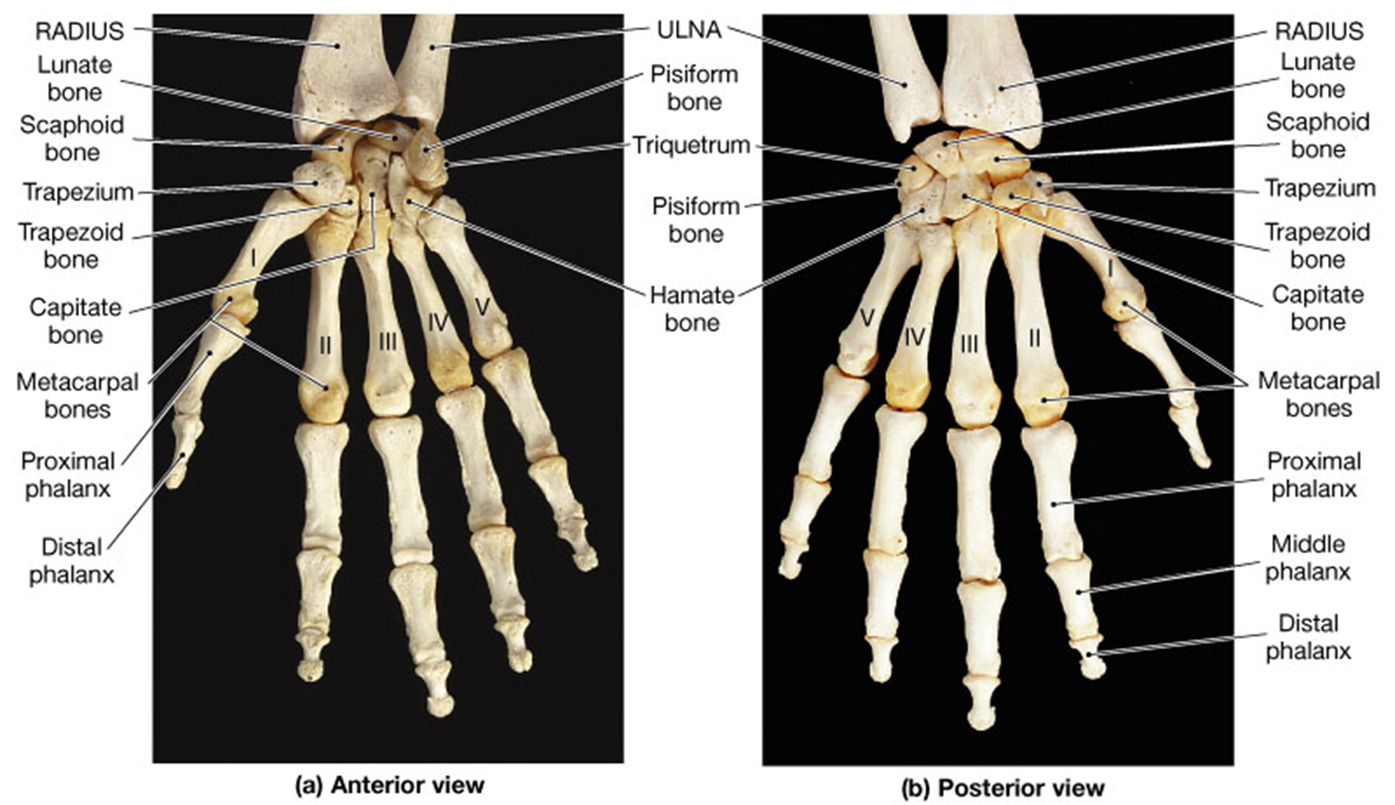
The Wrist and Hand

Slide 11
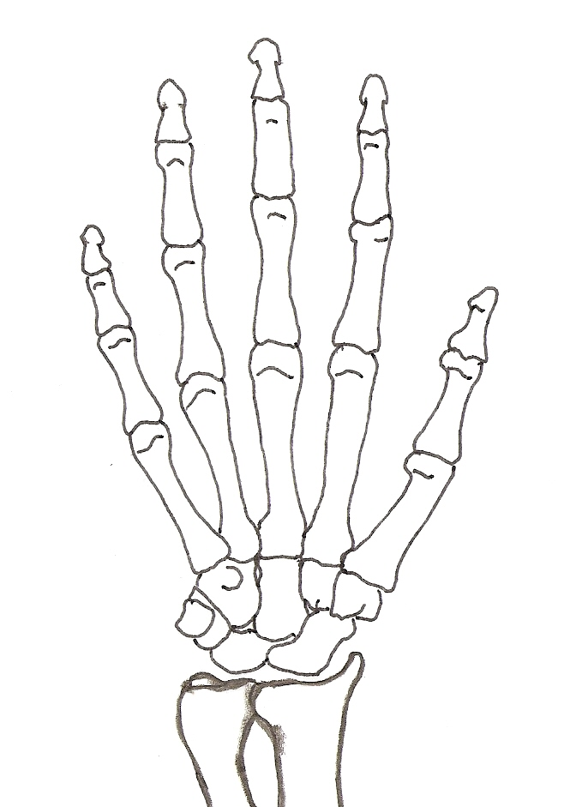
View the Carpal bones of the wrist as 2 rows of 4 bones
7
6
5
Distal (2nd) row
8
Ulna
4
3
2
1
Proximal (1st) row
Radius

Slide 12
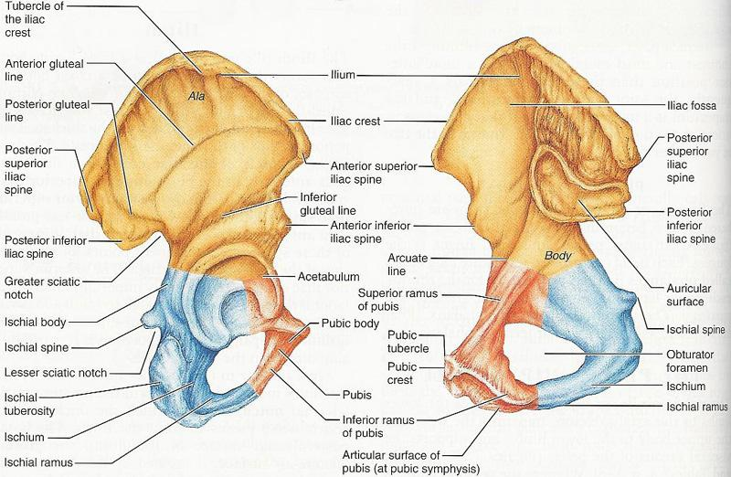
The Os Coxa is made of 3 bones:
1) Ilium; 2) Ischium; and 3) Pubis

Slide 13
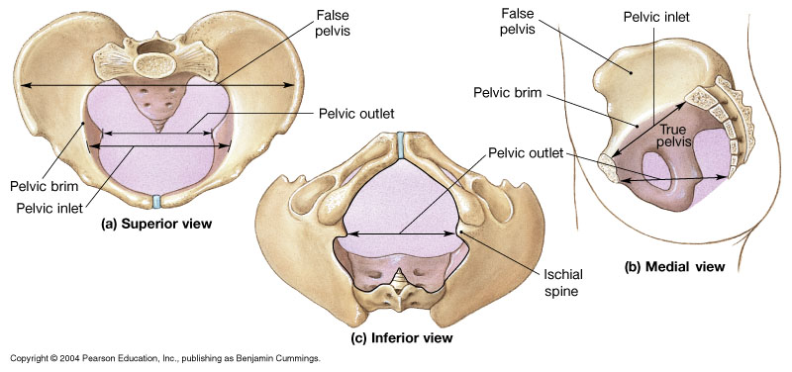
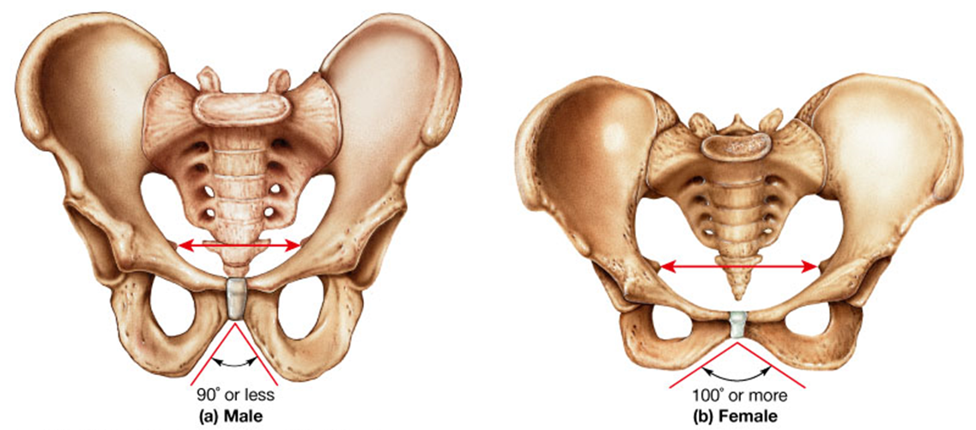

Slide 14
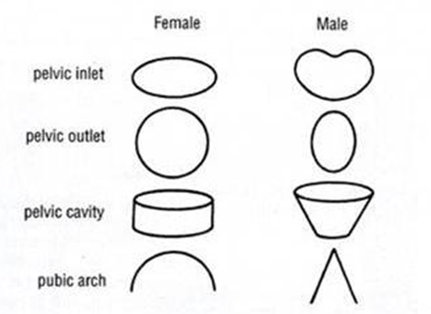
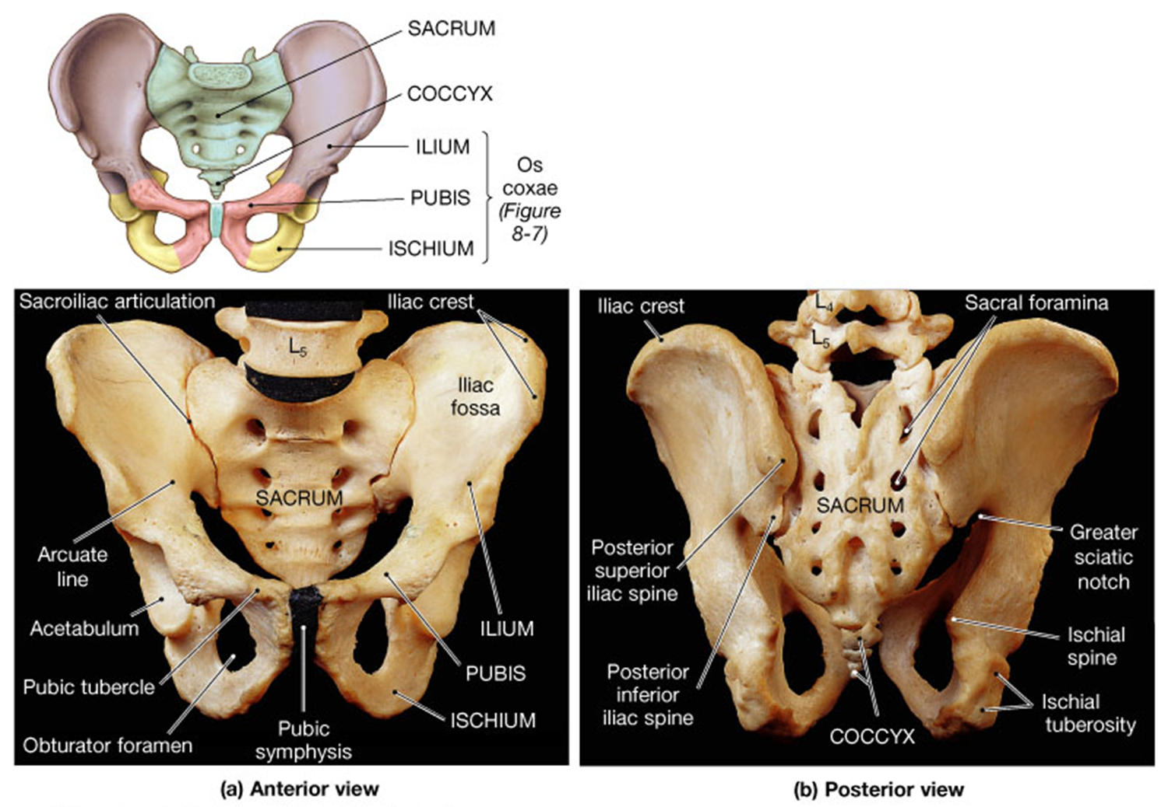

Slide 15
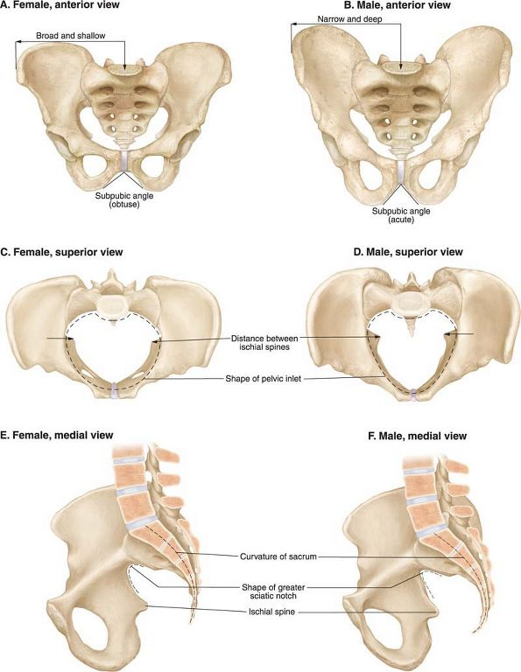

Slide 16
Table with information regarding sexual dimorphism of the pelvis.
Characteristics | Female | Male
General Appearance | Less massive, smaller, thinner | More massive, larger, thicker
Ischial Spine | More vertical, Projected laterally (outward) | Projected more medially (inwardly)
Sacrum | Shorter, more broad less curved anteriorly | Taller, more narrow more curved anteriorly
Coccyx | less curved anteriorly | more curved anteriorly
Width of Pelvis | Wider (shallow) (distance across ASIS’s) | Narrower (deep) (distance across ASIS’s)
Pelvic Inlet | More wide, oval shaped | More narrow, heart shaped
Pelvic Outlet | More open | More narrow
Pubic Symphysis | Shorter | Longer
Pubic Arch (Angle) | Broader, more open (obtuse) Angle 100º or greater | Narrower, less open (acute) Angle 90º or less
Greater Sciatic Notch | More wide | More narrow
Obturator Foramen | More oval shaped | More round shaped
Acetabulum | More shallow, and angled toward the anterior | More deep, and angled more toward the lateral

Slide 17
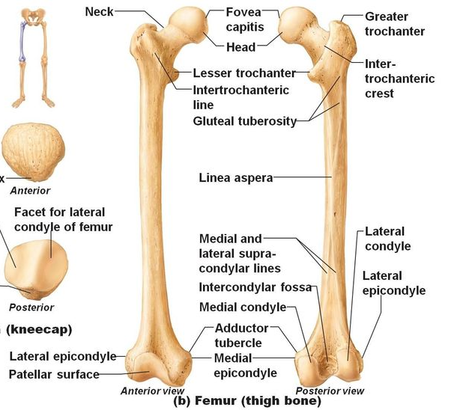
The Femur

Slide 18
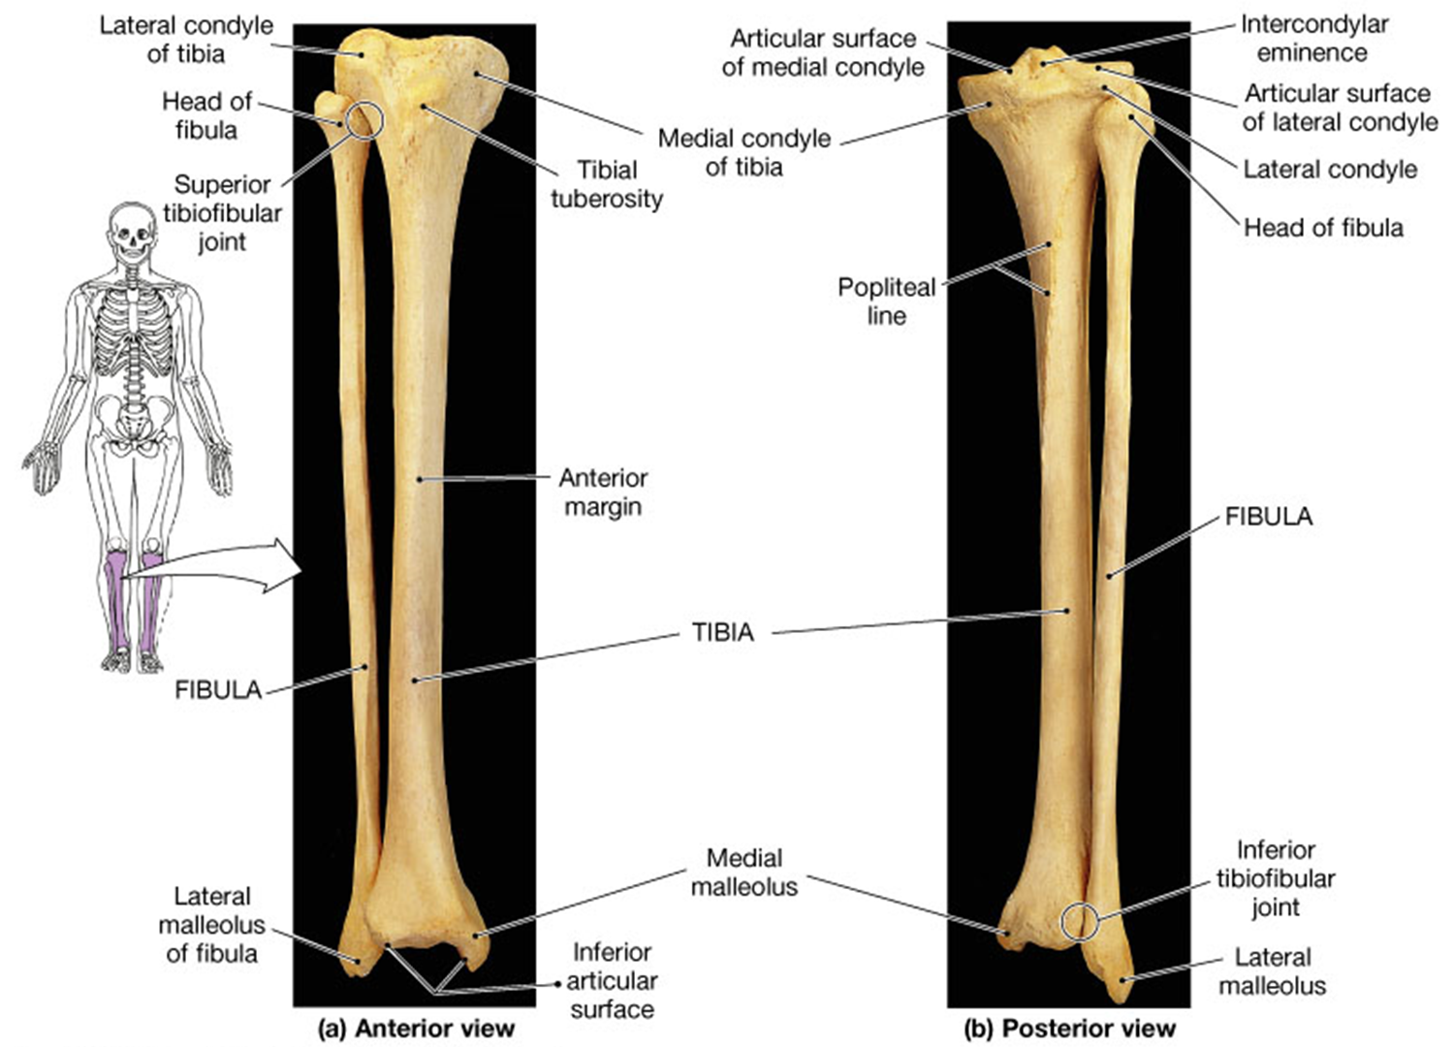
The Tibia and Fibula

Slide 19
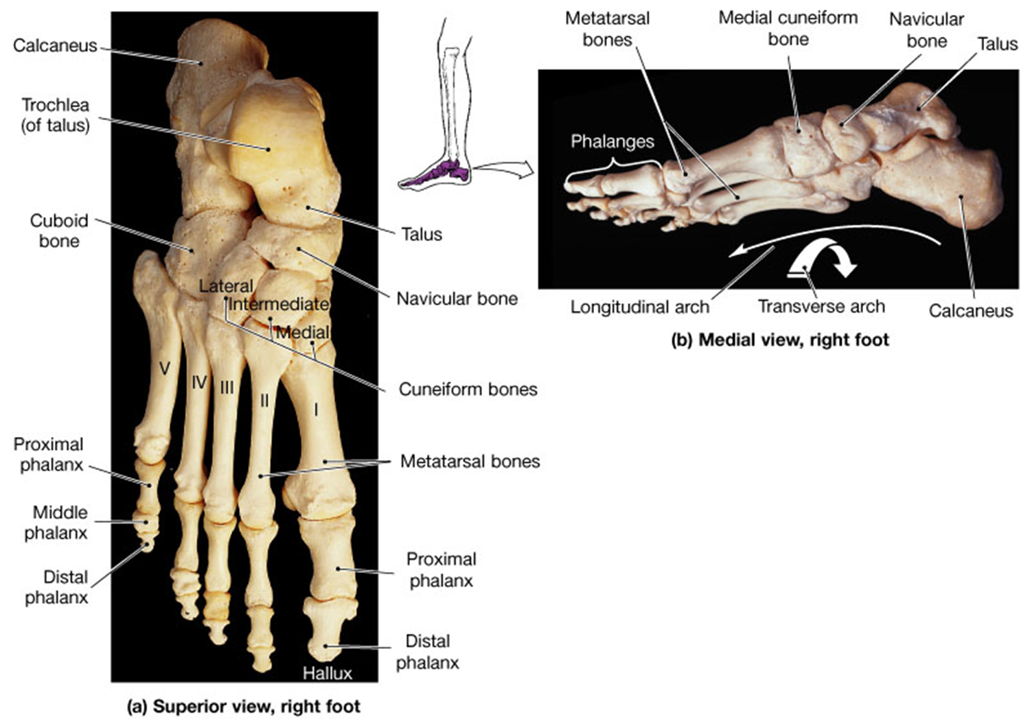
The
Foot

Slide 20
