Slide 1
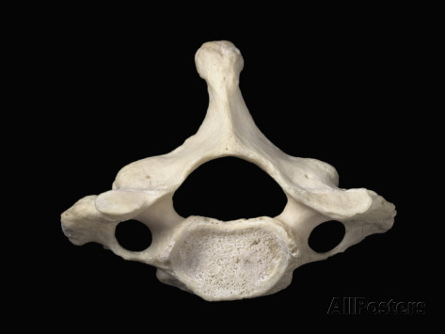
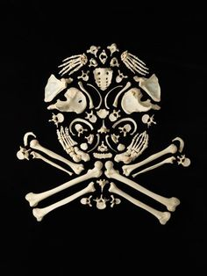
BONES
Axial
Skeleton

Slide 3
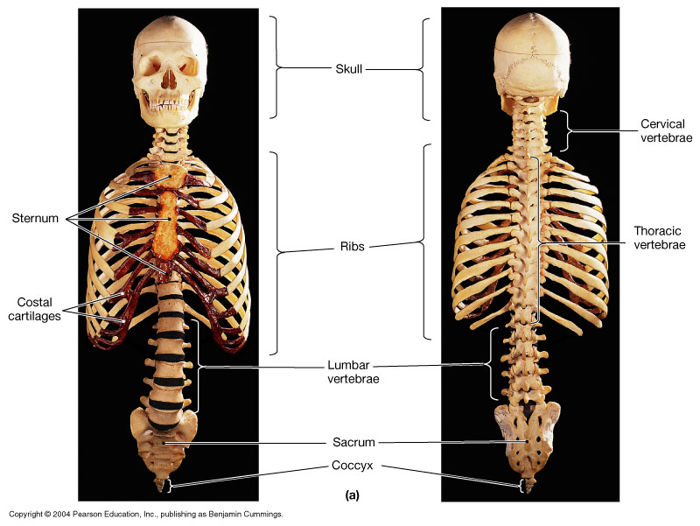

Slide 4
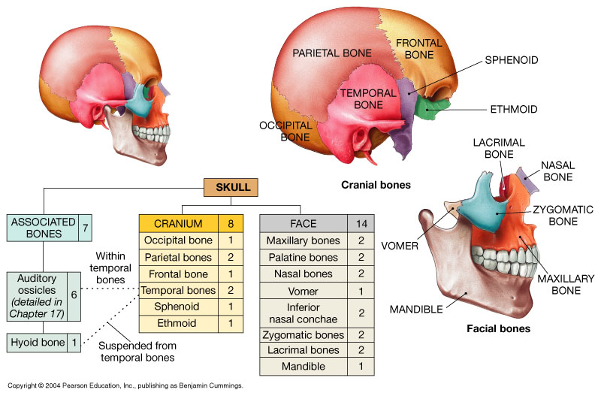
Cranial Bones
Facial Bones

Slide 5
Cranial Bones
Cranial bones create the cranial cavity.
Brain in direct contact with protective
membrane in between bones and brain
called the meninges.
1 frontal bone 1 occipital bone
2 parietal bones 1 sphenoid bone
2 temporal bones 1 ethmoid bone

Slide 6
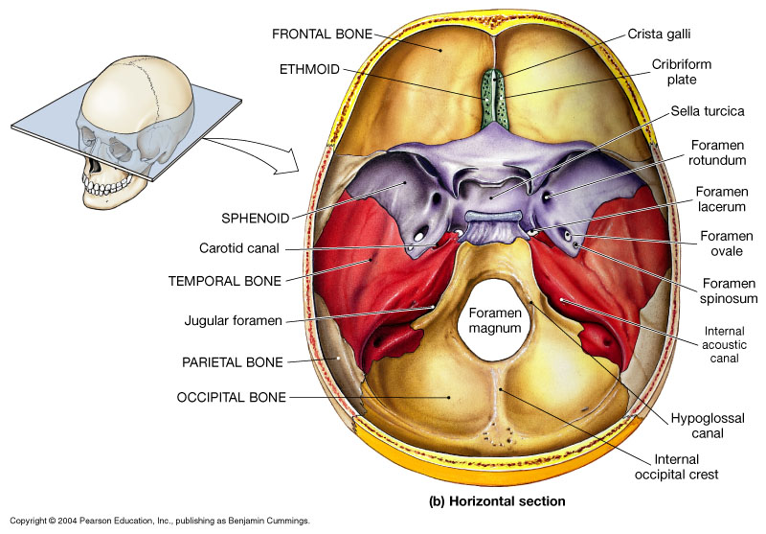

Slide 7
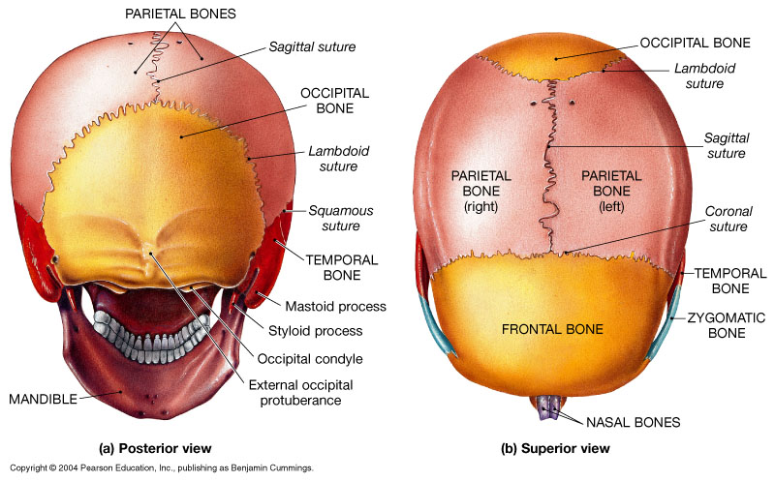

Slide 8
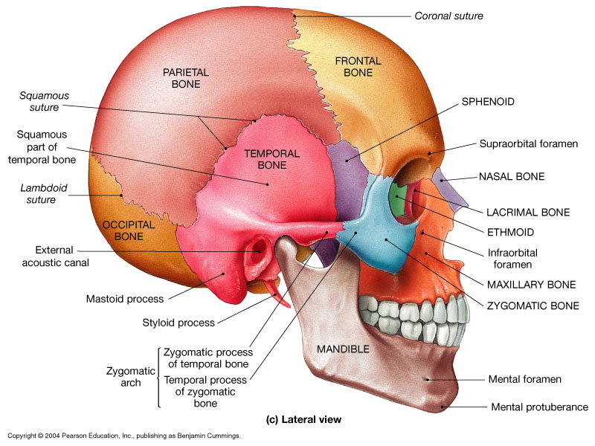

Slide 9
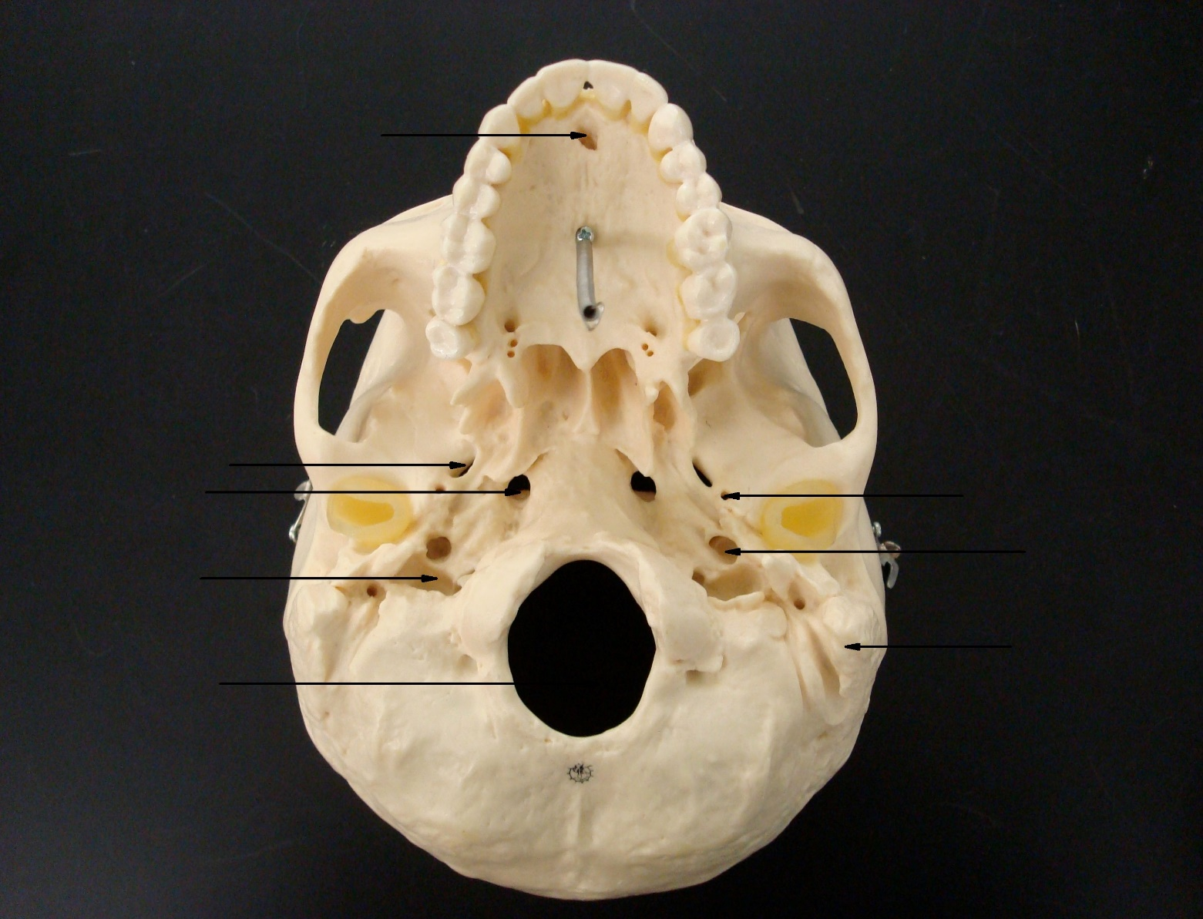
Intermaxillary suture
Incisive fossa
Palatine process
Inferior View
of
The Skull
Palatine bone
Zygomatic arch
Foramen ovale
Foramen lacerum
Foramen spinosum
Jugular foramen
Carotid canal
Mastoid process
Foramen magnum
Occipital condyle
External occipital crest

Slide 10
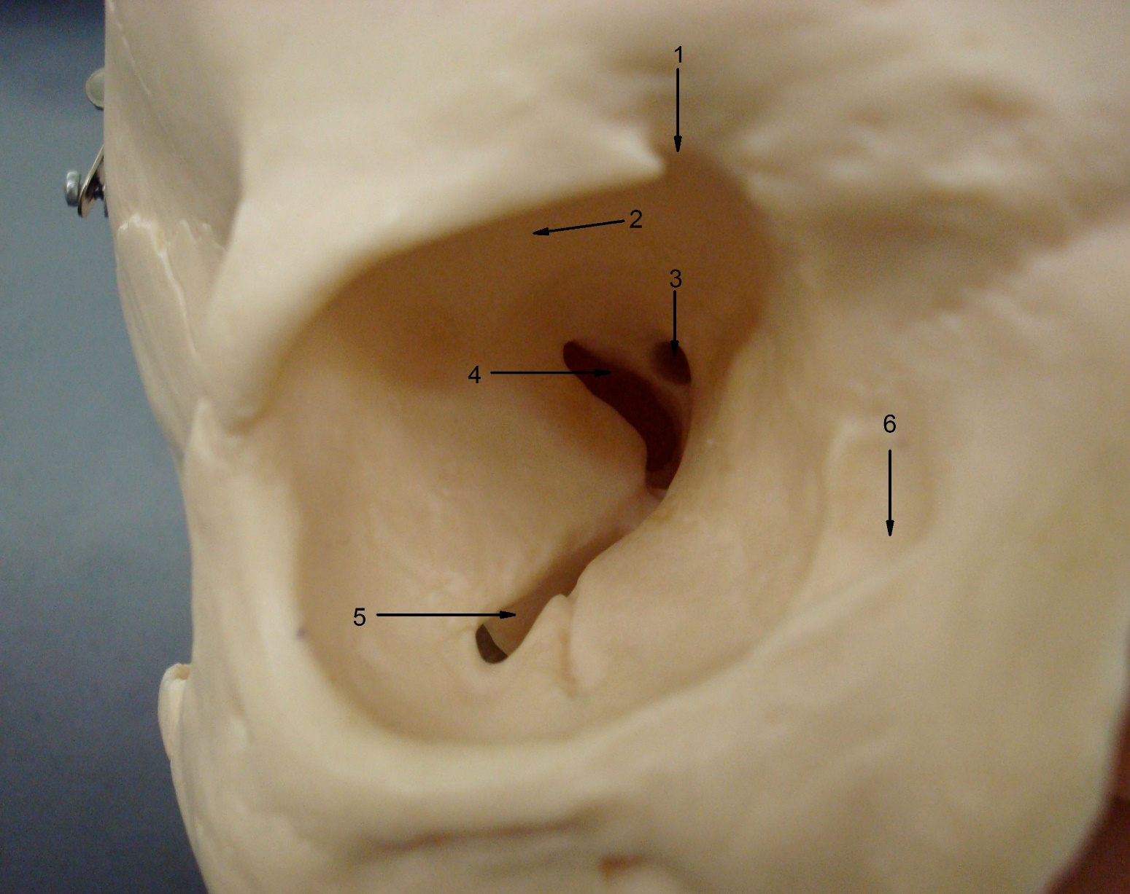
Structures:
1. supraorbital notch
2. orbital surface*
3. optic canal
4. superior orbital fissure
5. inferior orbital fissure
6. lacrimal canal
7. zygomatic process*
8. infraorbital foramen
9. zygomatic process**
10. supraorbital margin
* of frontal bone
** of maxillary bone
10
7
9
8

Slide 11
Facial Bones
Facial bones have no direct contact with the brain or meninges.
2 maxillae bones 2 nasal bones
2 palatine bones 2 inferior nasal conchae
2 zygomatic bones 1 vomer
2 lacrimal bones 1 mandible

Slide 12
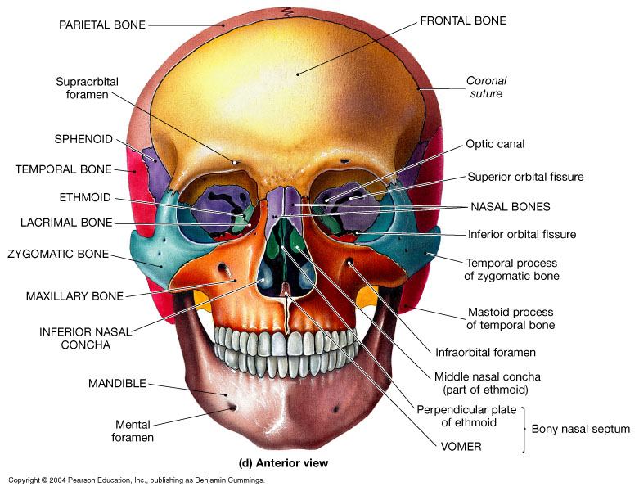

Slide 13
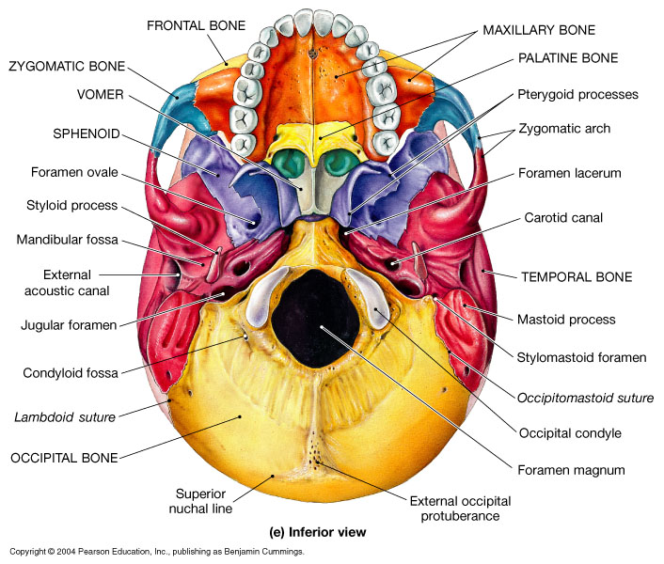

Slide 14
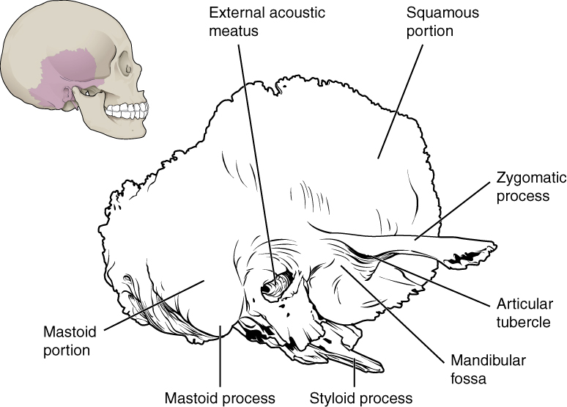
Temporal Bone

Slide 15
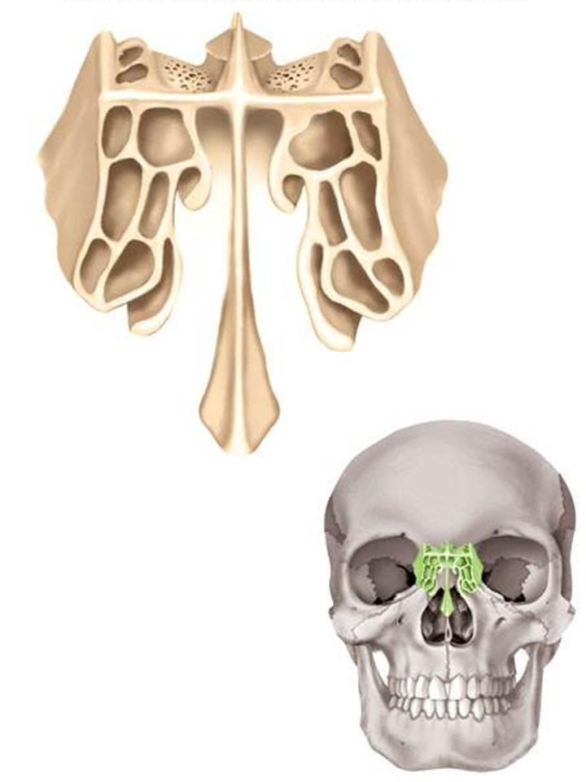
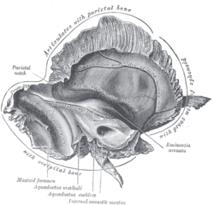
Ethmoid Bone
Temporal Bone

Slide 16
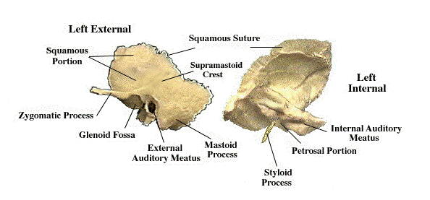
Temporal Bone

Slide 17
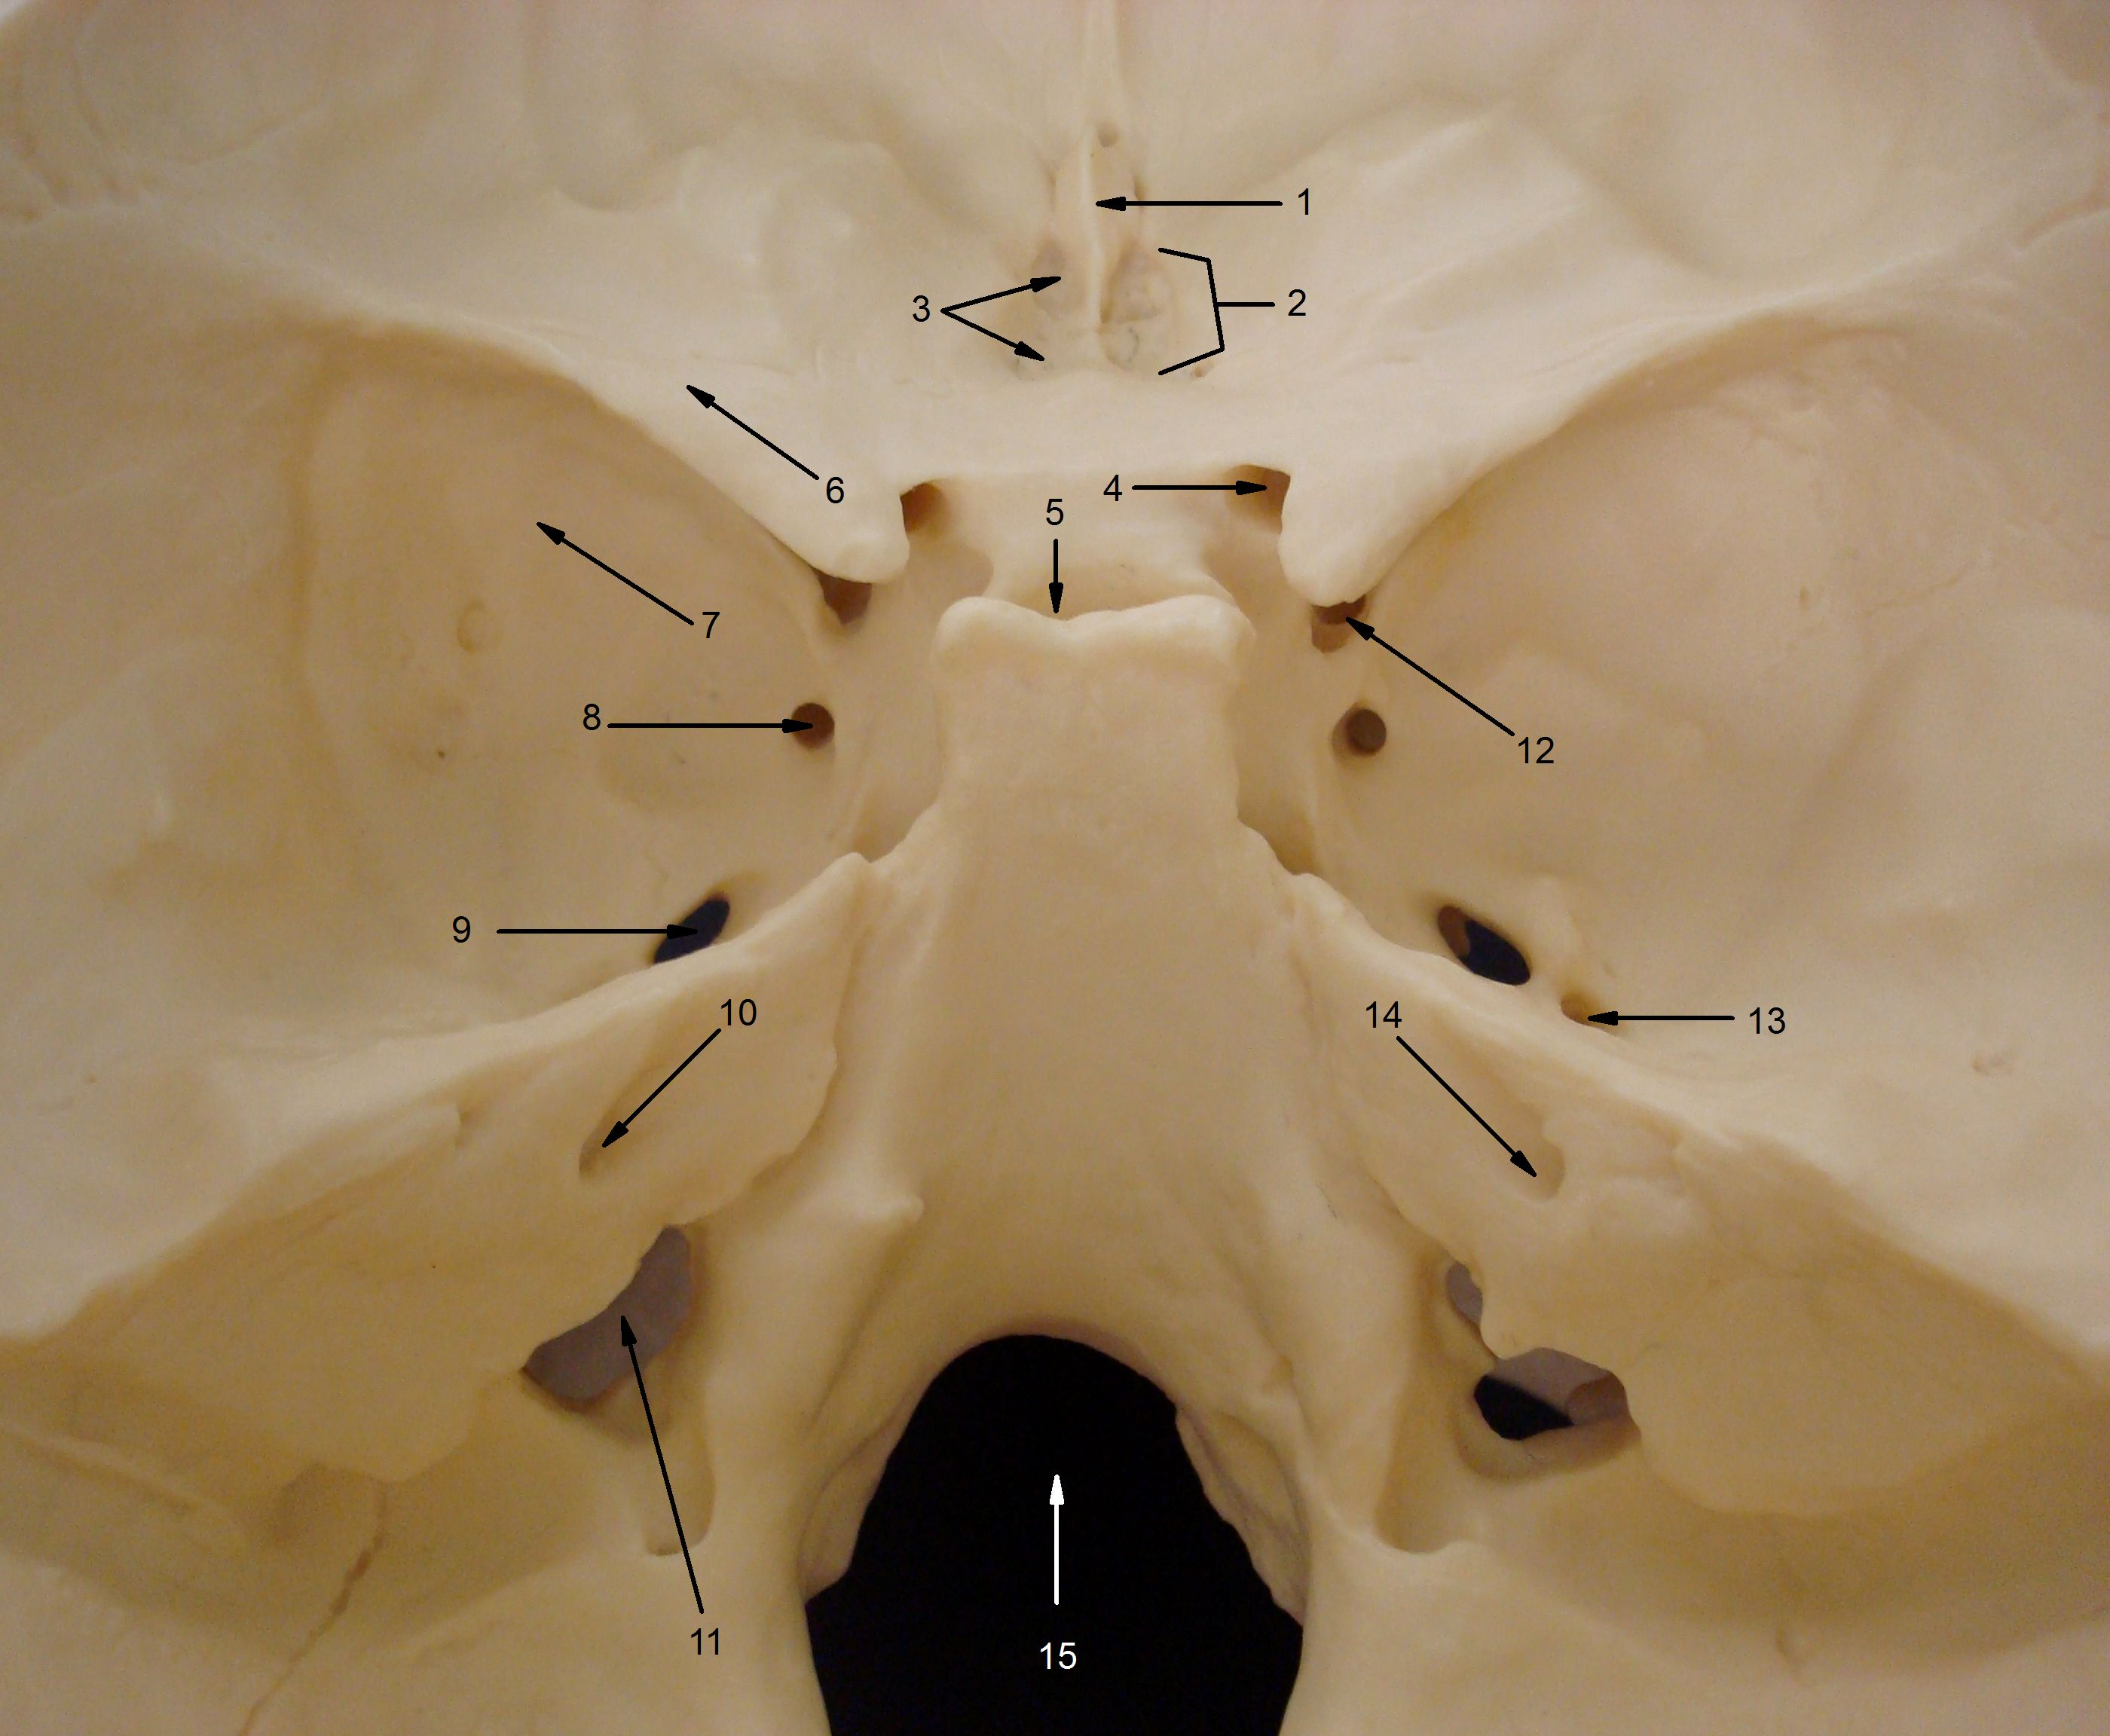
The Holes in the Skull!

Slide 18
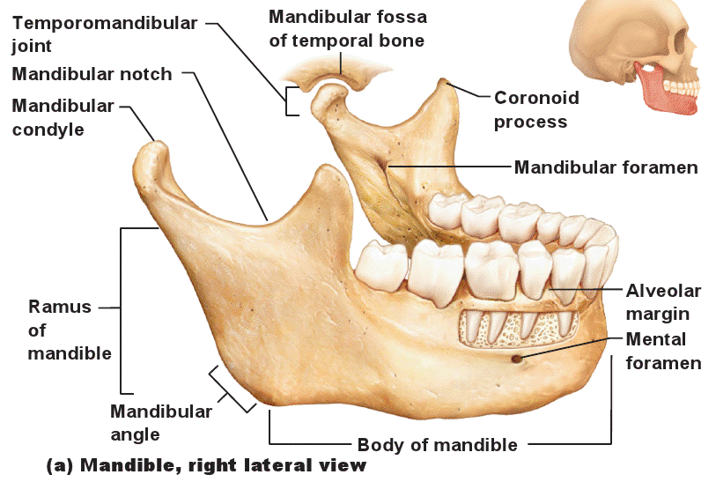
Mandible Bone

Slide 19
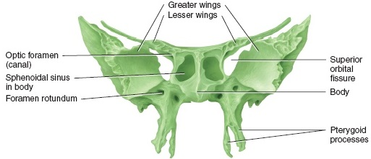
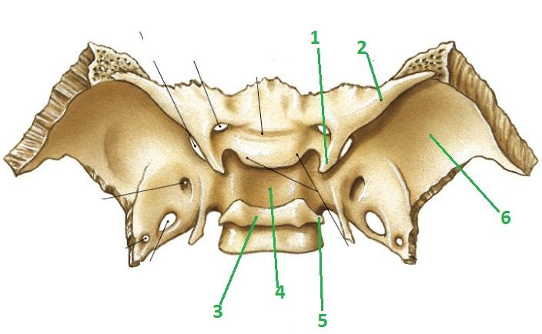
Sphenoid
Bone

Slide 20
Sinuses in the skeletal system are cavities or chambers in bone.
Roles:
*
Lighten weight of skull
*
Produce mucus
*
Sound resonation
There are 4 paranasal sinuses
Frontal sinus
Maxillary sinus
Sphenoidal sinus
Ethmoidal sinus (air cells)

Slide 21
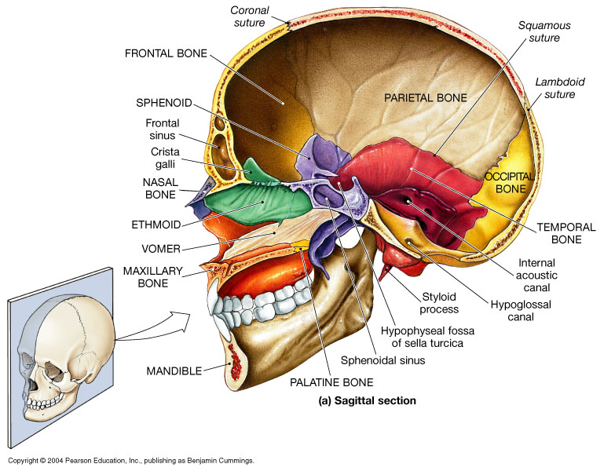

Slide 22
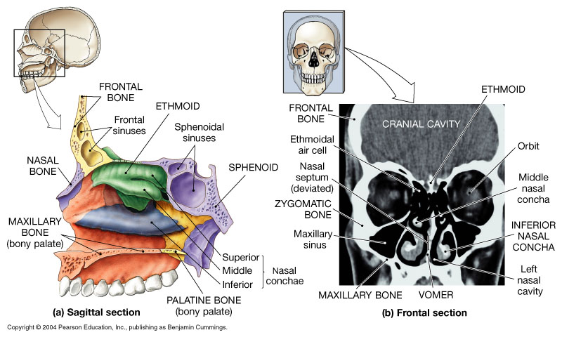

Slide 23
Fontanels are the fibrous regions between the cranial bones of a developing skull.
Provide flexibility for growing brain.
Allows distortion of skull during birth.
Most fontanels are fully fused by 12 months.
Anterior fontanel does not close for 18 to 20 months of age = “soft spot” on baby head!

Slide 24
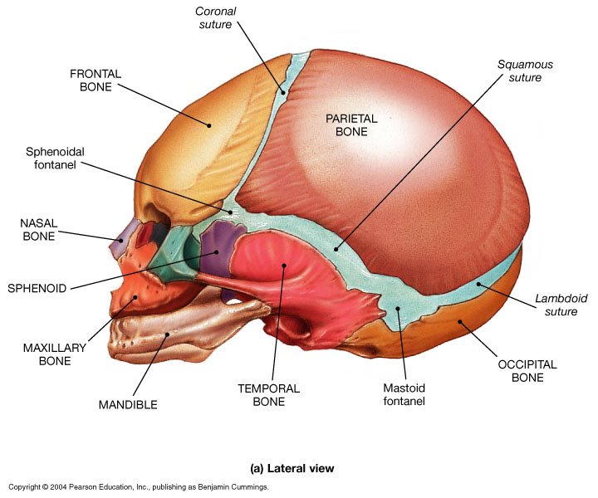

Slide 25
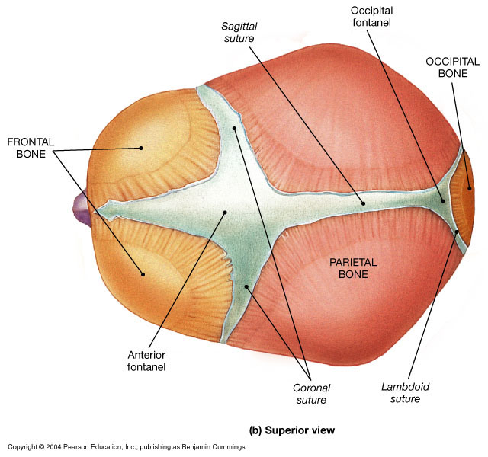

Slide 26
Bones of the vertebral column
Curvatures:
Cervical, the top 7
The Cervical Curvature
is a secondary curvature
Thoracic, attach to ribs, there
are 12, cause there are 12
pairs of ribs!
The Thoracic Curvature
is a primary curvature
The Lumbar Curvature
is a secondary curvature
Lumbar, big bottom ones!
Sacral and coccyx ,
these babies are all fused!
The Sacral Curvature
is a primary curvature

Slide 27
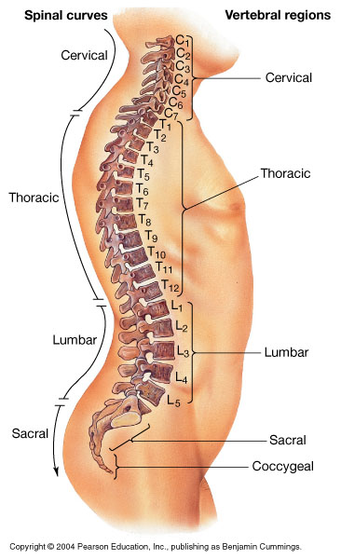
Normal Spinal Curvature
2º
1º
2º
1º

Slide 28
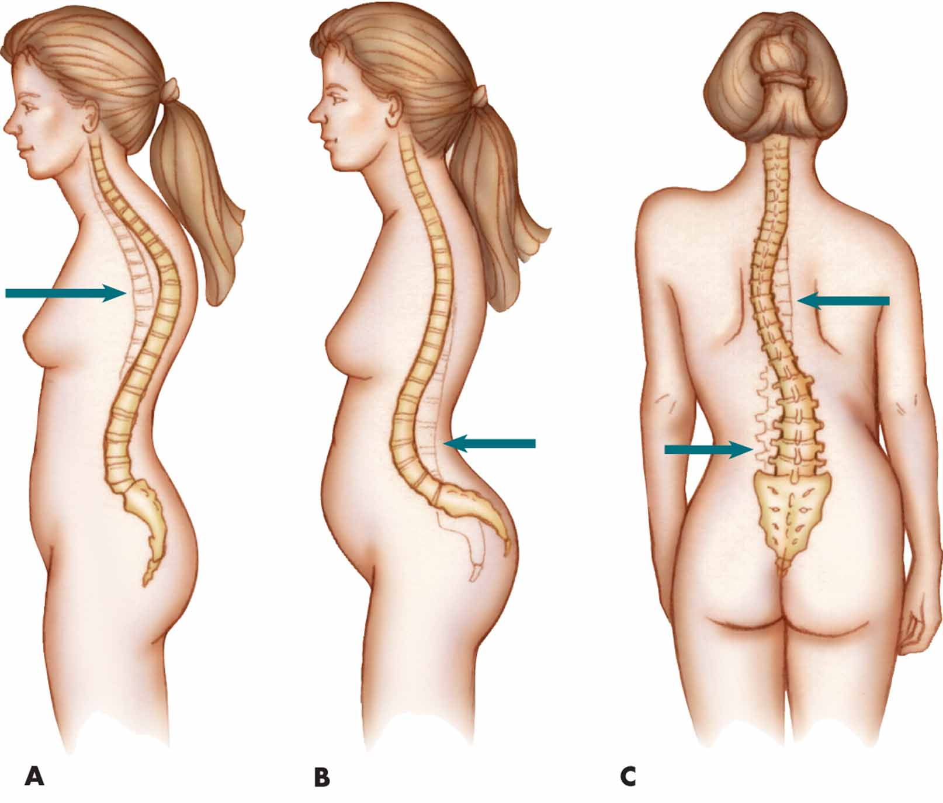
Abnormal Curvatures of the Spinal Column

Slide 29
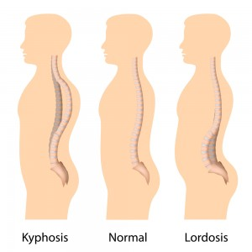

Slide 30
Vertebrae – The bones of the vertebral column.
There are a total of 33 total bones in the 4 regions:
24 separate vertebrae
+ sacrum (5 fused vertebrae)
+ coccyx (4 fused vertebrae)
Cervical vertebrae = 7 bones, (C₁, C₂, C₃ etc.)
Thoracic vertebrae = 12 bones, (T₁, T₂, etc.)
Lumbar vertebrae = 5 bones, (L₁, L₂, etc.)
.
Total = 24 individual bones

Slide 31
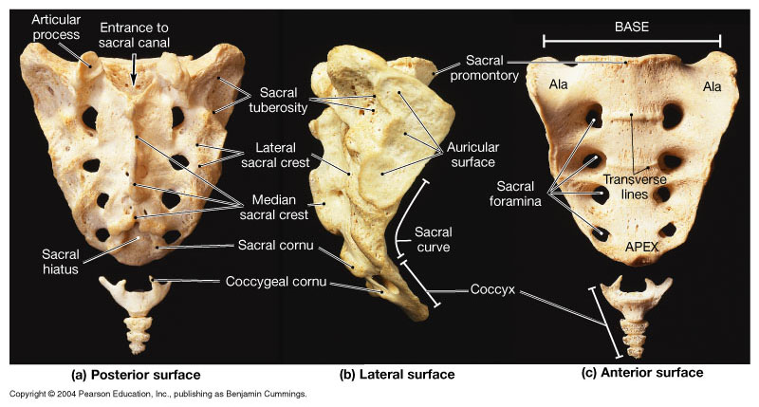
Sacral vertebrae – 5 fused bones, (S₁, S₂, etc.)
Coccygeal vertebrae – 4 fused bones, (Co₁, Co₂, etc.)

Slide 32
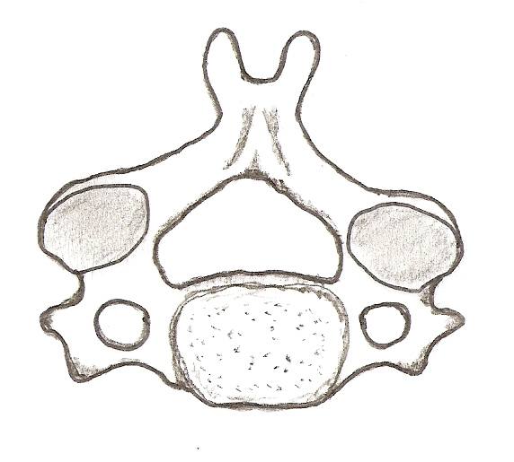
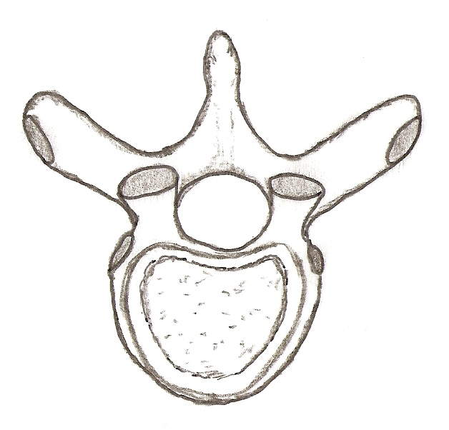
1. Unique Features of Cervical Vertebrae
Bifid spinous process
Transverse foramen
These ones are instantly recognizable due
to the ‘holes’ in the transverse processes!
2. Unique Features of Thoracic Vertebrae
Sharp, downward angle of spine
Costal facets on transverse process
Superior articulating processes are like
‘two hands up’ in orientation
Costal facets on body
Only ones with attachments for ribs!

Slide 33
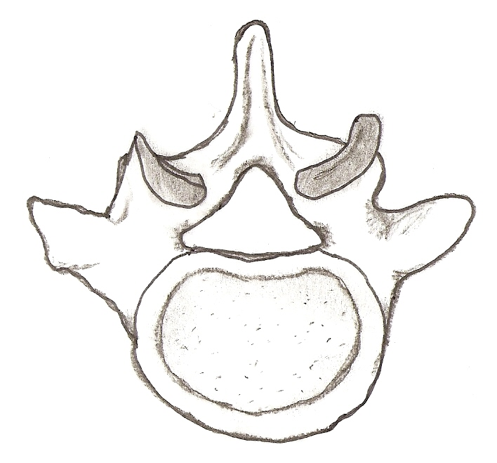
3. Unique Features of Lumbar Vertebrae
Short, blunt spine
Superior articulating processes are like
‘two hands clapping’ in orientation!
Large body

Slide 34
Cervical Vertebrae - 7 bones, (C₁, C₂, C₃ etc.)
C₁ - called the Atlas.
- Articulates with occipital condyles.
- Has a ‘ring’ like structure (no body).
C₂ - called the Axis.
- Articulates with the atlas.
- Has odontoid process (dens).

Slide 35
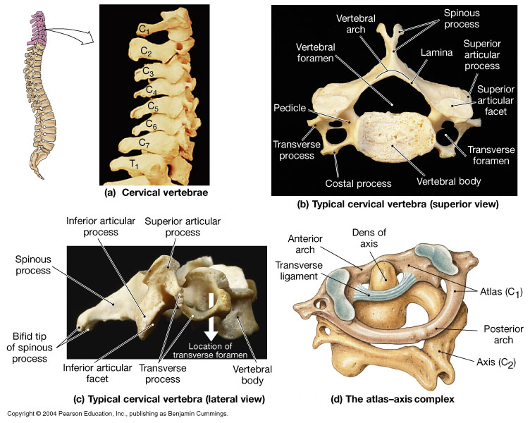

Slide 36
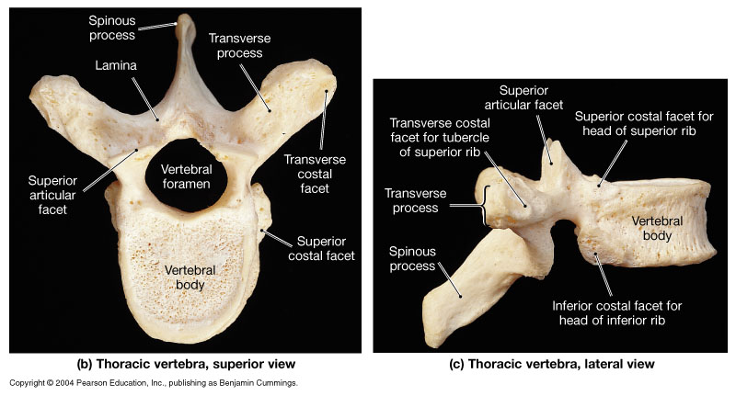
Thoracic vertebrae – 12 bones, (T₁, T₂, etc.)
- Have costal facets for attachment of ribs.

Slide 37
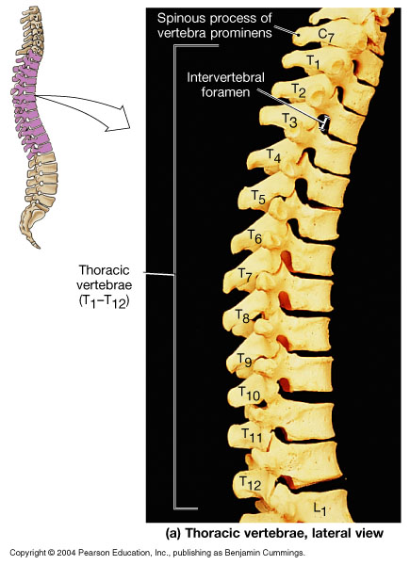

Slide 38
Thoracic Vertebrae – 12 bones, (T₁, T₂, etc.)
Lumbar Vertebrae – 5 bones, (L₁, L₂, etc.)

Slide 39
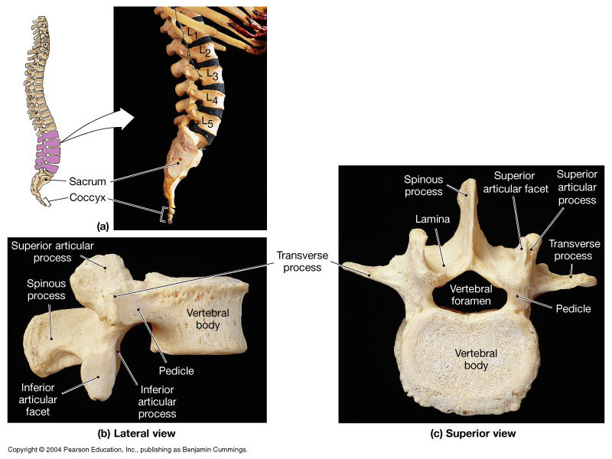
Lumbar
Vertebrae

Slide 40
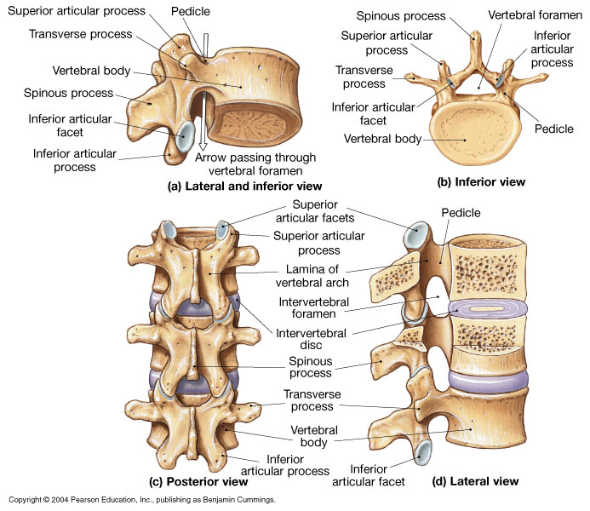

Slide 41
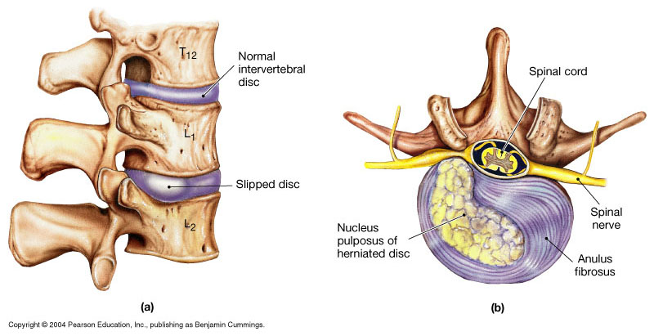

Slide 42
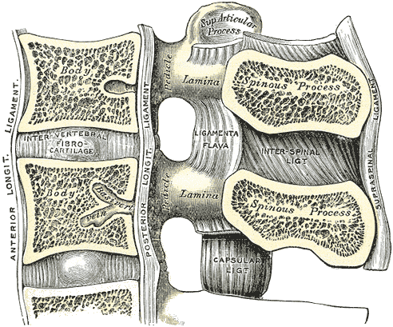
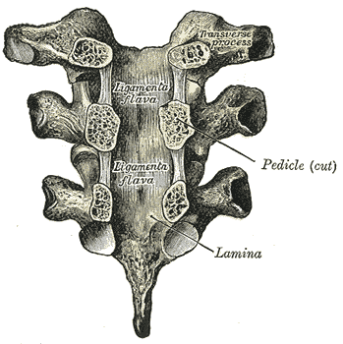
Ligaments of the Vertebral Column

Slide 43
Thoracic Vertebrae – 12 bones, (T₁, T₂, etc.)
Lumbar Vertebrae – 5 bones, (L₁, L₂, etc.)
Sacral Vertebrae – 5 bones, (S₁, S₂, etc.)
Coccygeal Vertebrae – 4 bones, (Co₁, Co₂, etc.)

Slide 44
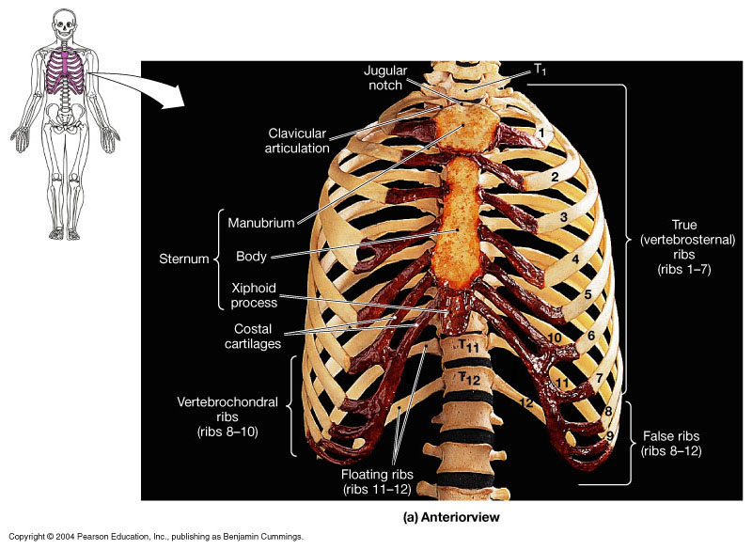

Slide 45
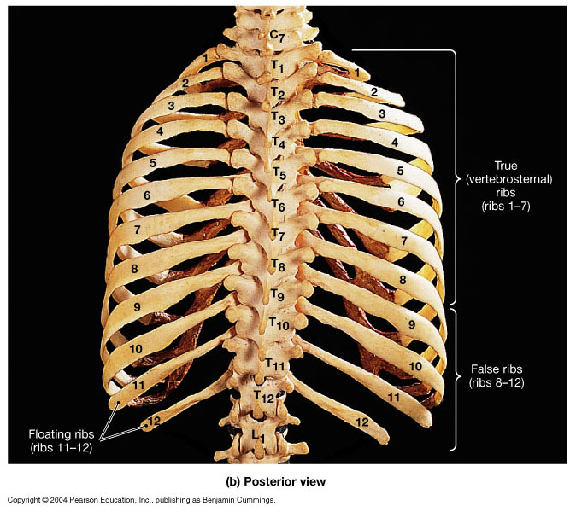

Slide 46
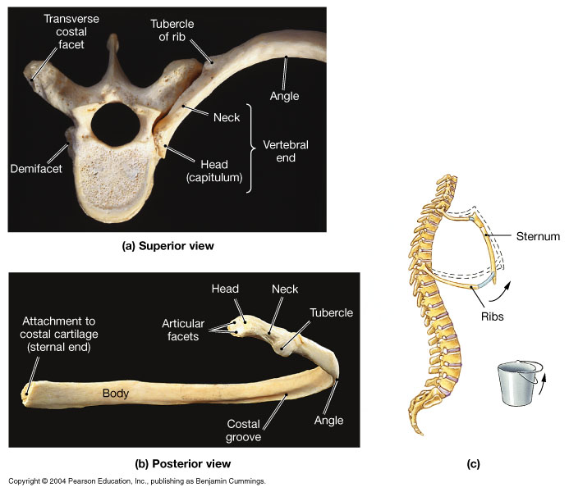
There are 3 types of ribs:
Vertebrosternal (true) rib 7
Vertebrocostal (false) rib 3
Vertebral (floating) rib 2

Slide 47
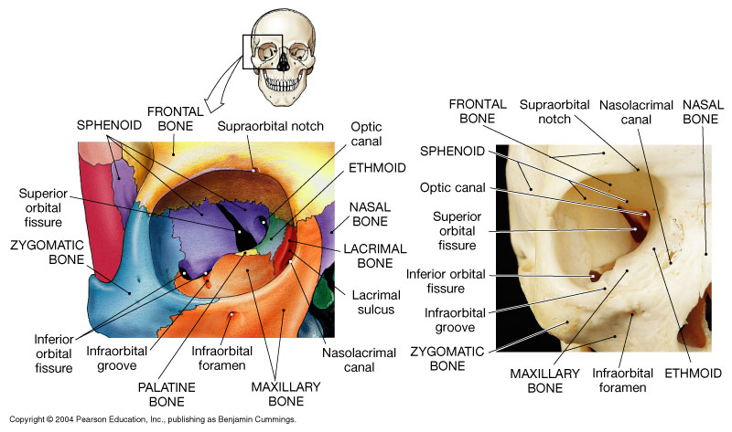
How many bones make up the orbit?
What are they?

Slide 48
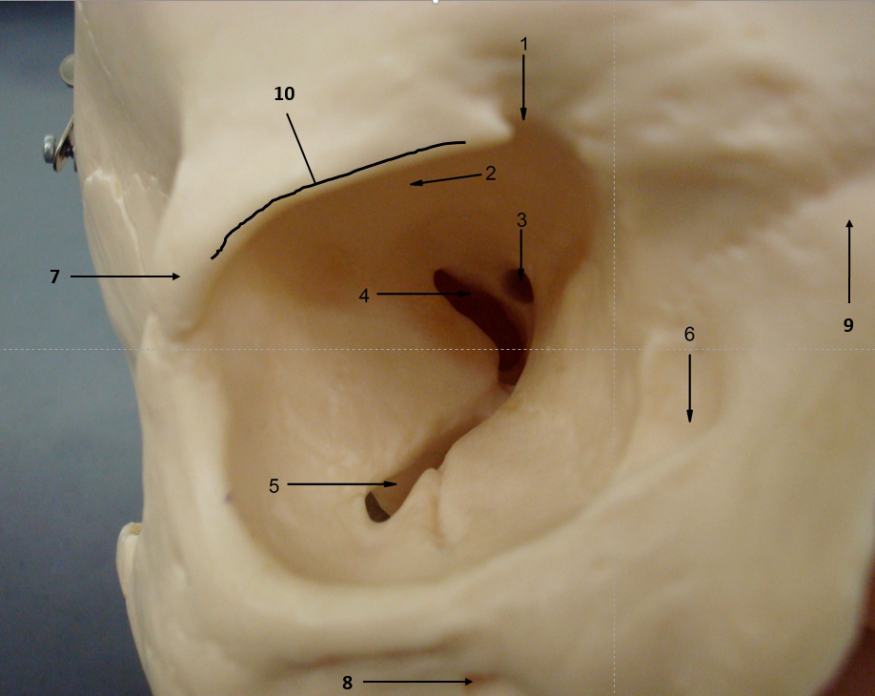
Structures:
1. supraorbital notch
2. orbital surface*
3. optic canal
4. superior orbital fissure
5. inferior orbital fissure
6. lacrimal canal
7. zygomatic process*
8. infraorbital foramen
9. zygomatic process**
10. supraorbital margin
* of frontal bone
** of maxillary bone

Slide 49
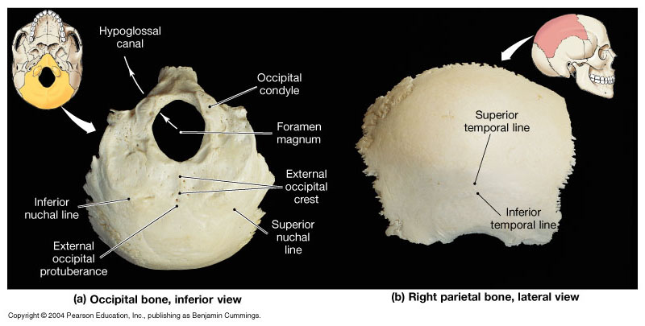

Slide 50
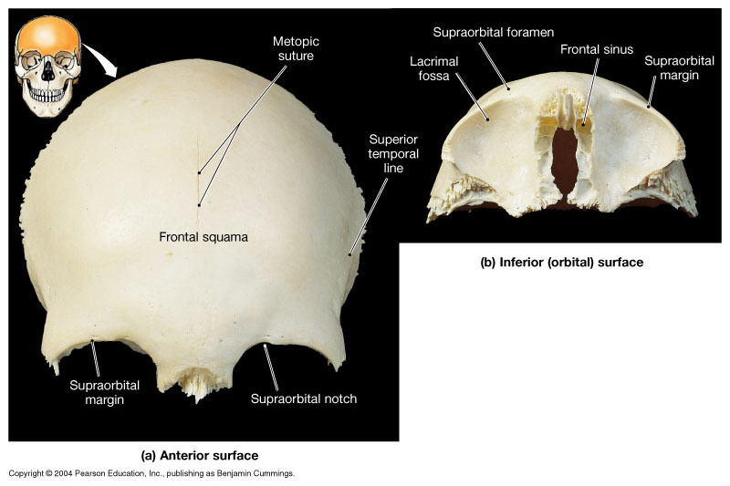

Slide 51
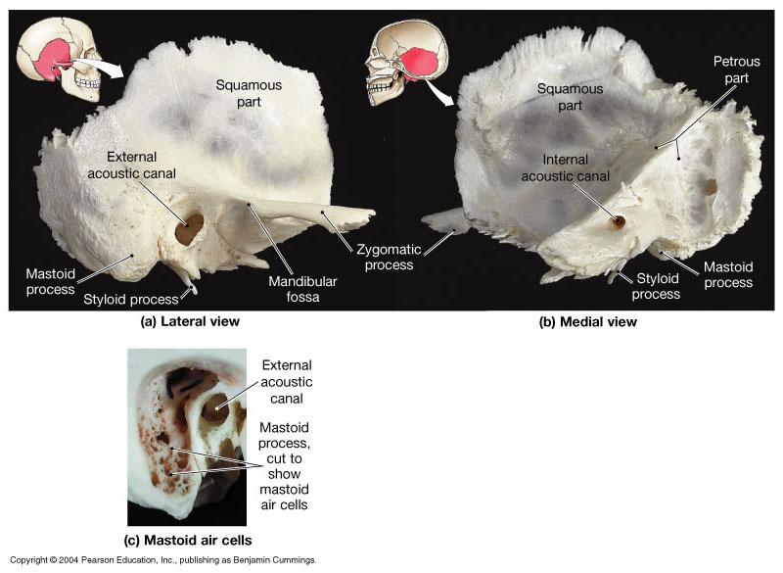

Slide 52
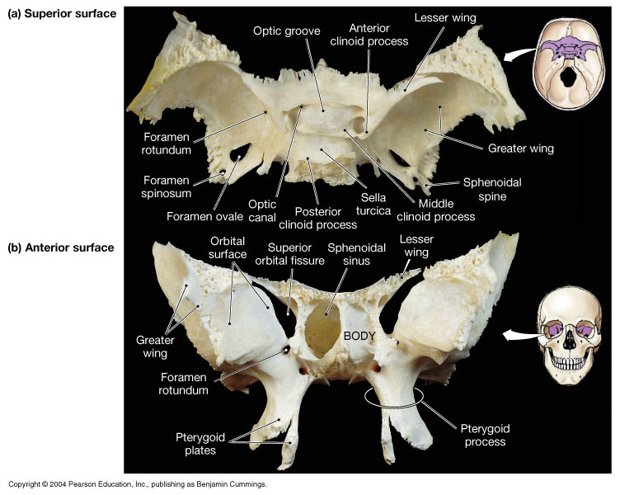

Slide 53
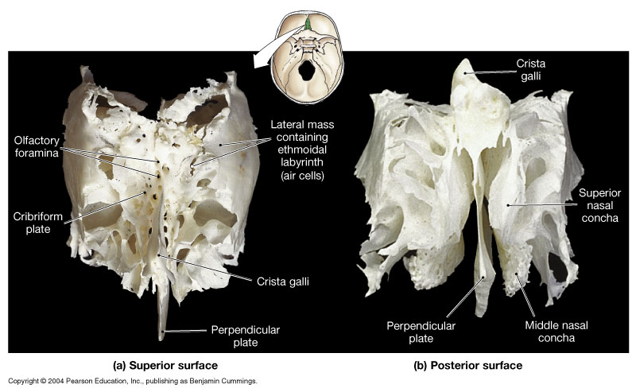

Slide 54
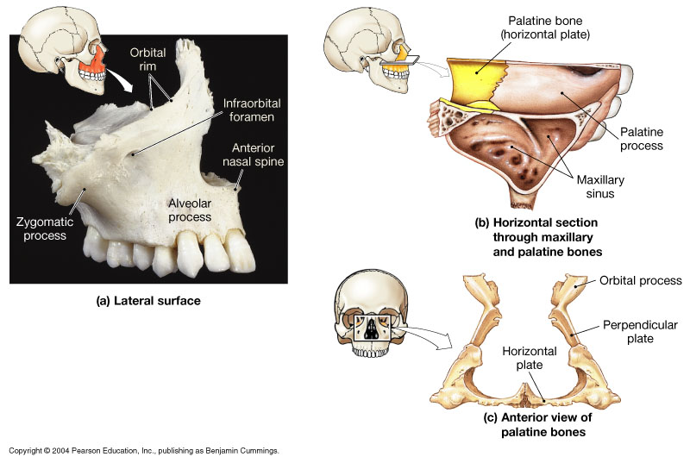

Slide 55
