Slide 1
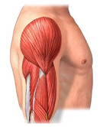
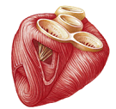
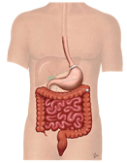
3 Types of Muscle Tissue
Properties of
Muscle Tissue
Skeletal – attached to bone
Contractility
Cardiac – the heart
Excitability
Extensibility
Elasticity
Smooth – internal organs
blood vessels

Slide 2
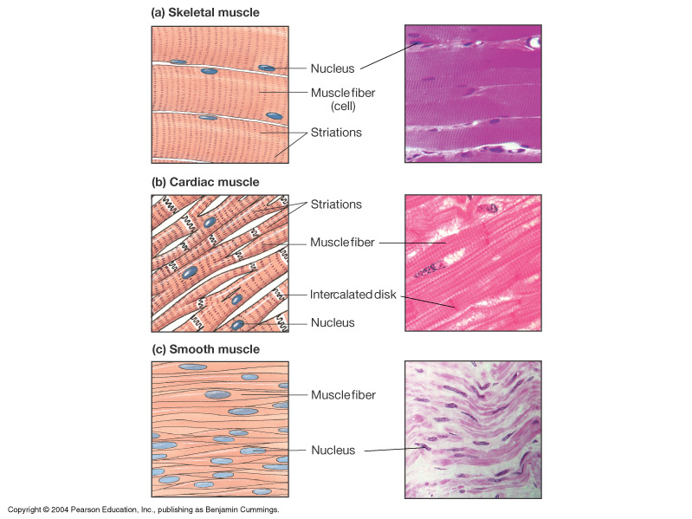
Skeletal muscle
Skeletal muscle
Control
- Long & cylindrical
- Multinucleated
SNS
- Striated
- Voluntary
Cardiac muscle
Cardiac muscle
- Shorter & branched
- Uninucleated
- Striated
Intrinsic
Myogenic
- Involuntary
- Intercalated disks
Smooth muscle
Smooth muscle
- Spindle-shaped
- Uninucleated
ANS
Paracrine
Endocrine
- Non-striated
- Involuntary

Slide 3
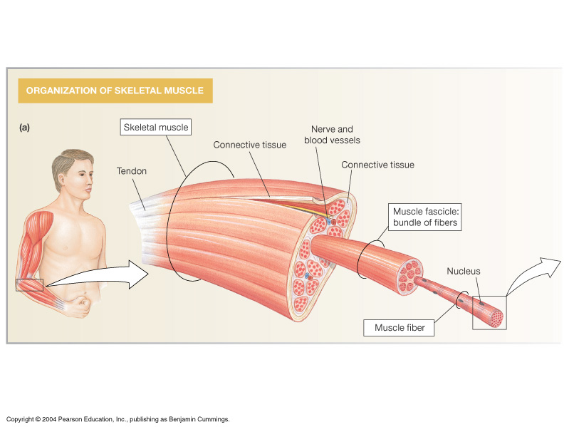
Facts and Functions of Skeletal Muscle
Movement of Body & Posture
Heat Production (T_{b})
Protection of Body
Controls Entrances/Exits
About 40% body mass
Muscle fiber = Muscle cell
One muscle cell
(see next slide)

Slide 4
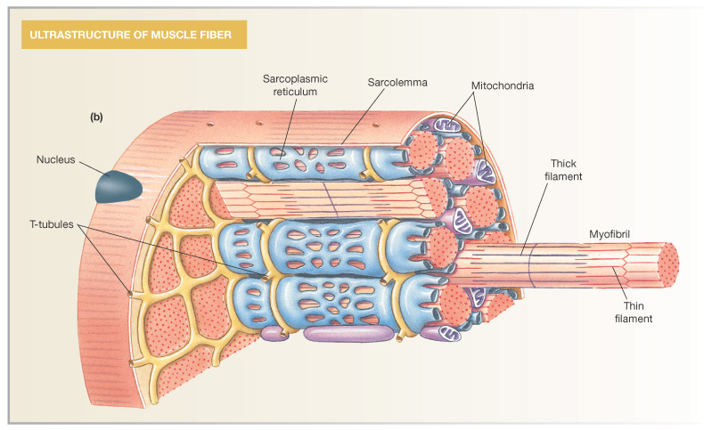
A Muscle Fiber (= A Muscle Cell)
Sarcoplasm

Slide 5
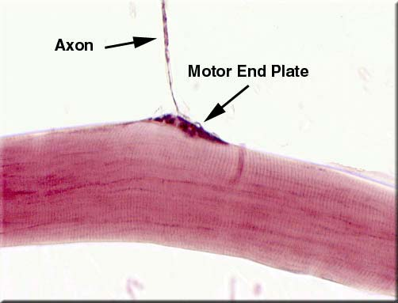
Neuromuscular Junction
of Skeletal Muscle
(under end bulb)
single skeletal muscle fiber
(notice the striations)

Slide 6
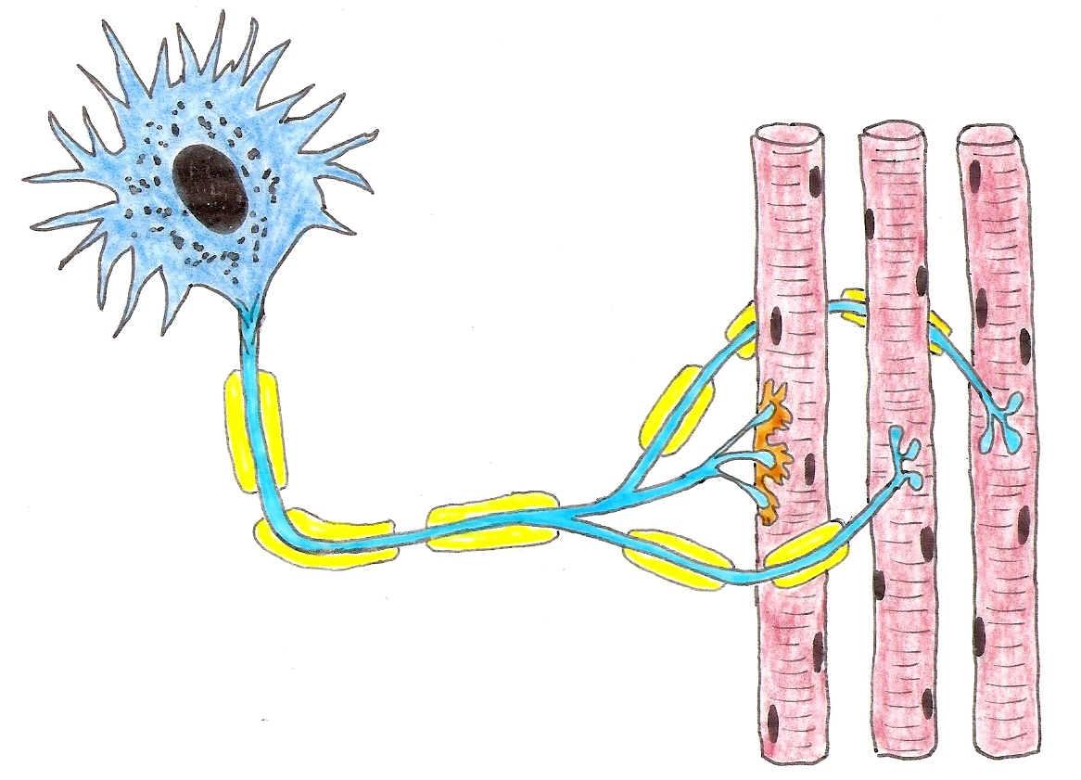
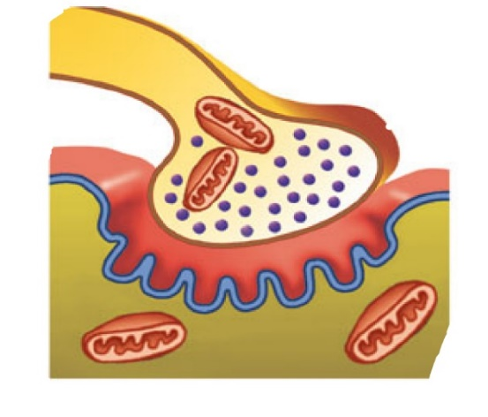
Diagrammatic Neuromuscular Junctions

Slide 7
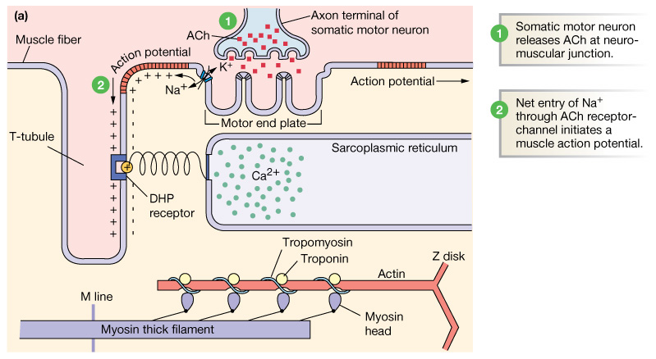
Excitation - Contraction in Skeletal Muscle

Slide 8
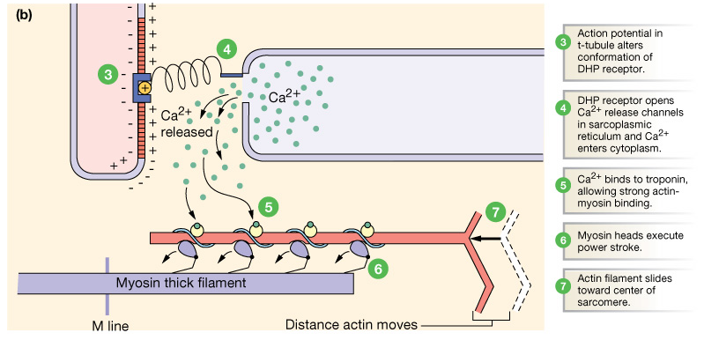
Releases of intracellular Ca²⁺ triggers contraction

Slide 9
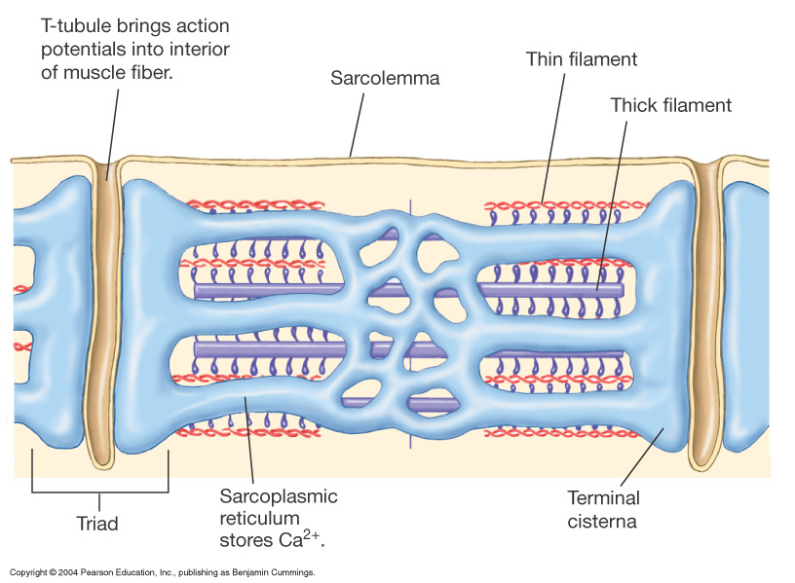
Lateral
sacs

Slide 10
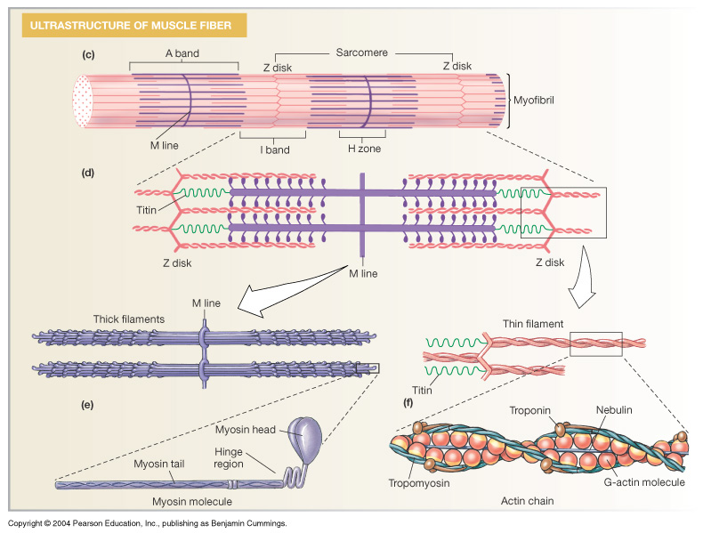
The Sarcomere – ‘Functional Unit’

Slide 11
Contractile Proteins
Regulatory Proteins
Actin – “thin filaments”
  2 regulatory proteins associated with actin

Tropomyosin
- guards active site on actin

Troponin
- binds Ca²⁺
Myosin – “thick filaments”
– ATPase site on head
– Actin binding site on head

Slide 12
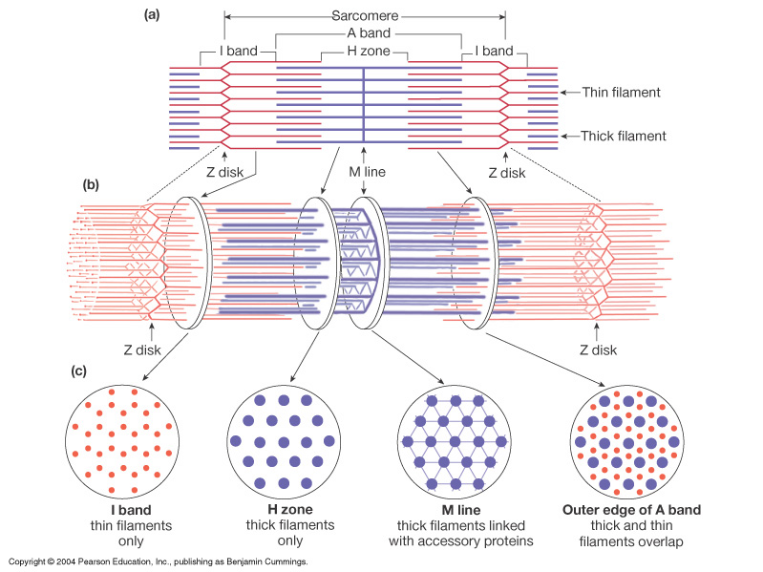
Structures of the Sarcomere
Z disks
H-band
I-band
A-band
M line
H-band = myosin only
I-band = actin only
A-band = all of the myosin

Slide 13
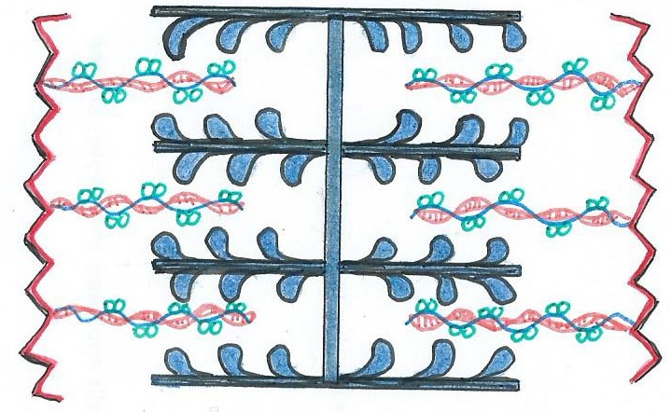
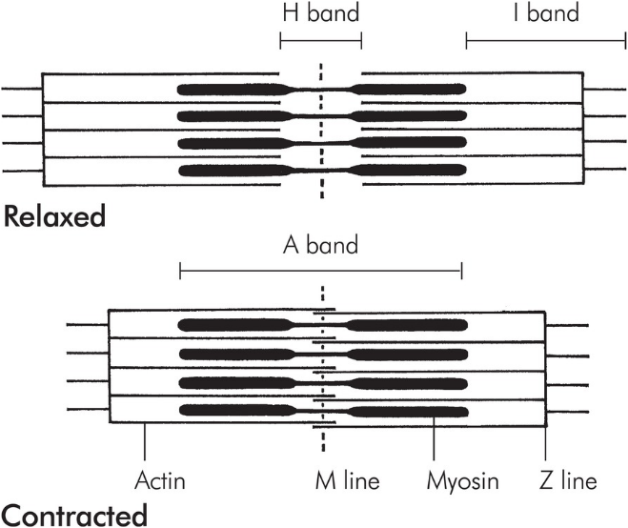
M line
H-Band
A-Band
I-Band
I-Band
Which Bands Shorten
During Contraction?
Which Bands Lengthen
During Stretching?

Slide 14
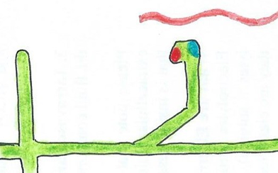
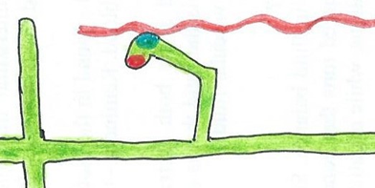
(a) High Energy state of Myosin Head
The Myosin Head
High E State: Myosin head cocked back and ready to bind Actin and pull it toward the M-line.
The myosin head got into this High E state by binding ATP, and hydrolyzing it to ADP and Pi, which remains in the ATP binding site.
Only when myosin binds with actin is ADP and Pi expelled from binding site, allowing myosin to spring toward M-line pulling actin with it
= the Power Stroke.
After pulling to its limit, the myosin is now in its Low E state (b).
If ATP is available - it binds with myosin head and breaks the crossbridge, then cocks myosin back into the High E state
Actin
M-line
Actin binding
site
ATP binding
site
Myosin
(b) Low Energy state of Myosin Head
Contraction can continue if there is: Continued stimulus (Ca²⁺) and ATP.

Slide 15
Muscle Relaxation
1) Stop signal from Somatic Motor Neuron*
2) Re-sequester Ca²⁺ into SR
3) Break remaining Crossbridges
* Degradtive Enzyme

Slide 16
Where is ATP used in Muscle Tissue
1) Re-sequestering Ca²⁺ into the SR
e.g., requires __ ATP for every __ Ca²⁺ imported to SR
2) Breaking the Crossbridge
(Myosin-Actin bond)
*Needed for relaxation or continuation of contraction

Slide 17
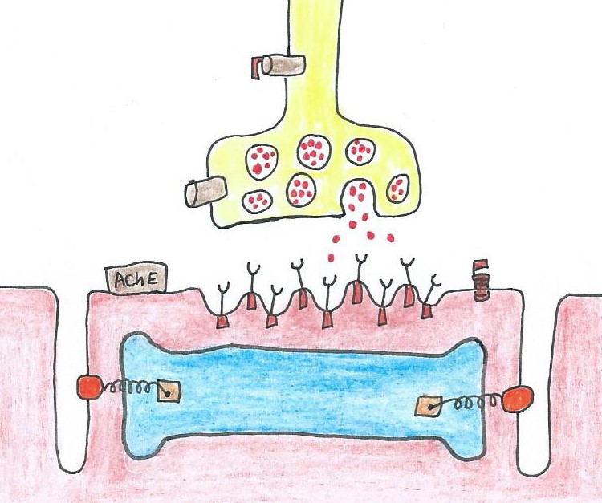
Things that can Effect Muscle Contraction at the Neuromuscular Junction
Botulism toxin:
Curare:
Organophosphates:

Slide 18
Sources of ATP in Muscle Tissue
(Skeletal Muscle Metabolism)
1) Immediate – Creatine Phosphate
2) Short Term – Glycolysis (Lactic Acid)
3) Long Term – Oxidative Phosphorylation

Slide 19
1) Immediate Source: Creatine Phosphate (CP)
Takes P from CP and sticks it on ADP to make ATP
(High at rest)
P
CP
ADP
What
Enzyme?
P
C
ATP
(High at work)
Makes ATP fast, but CP is very limited!
(~6 to 15 seconds)

Slide 20
2) Glycolysis
1 Glucose (C₆H₁₂O₆)
2 ADP
Glycolysis
+ Lactic Acid
2 x pyruvate
2 ATP
Have O₂
No O₂
(30-40 sec)
Krebs Cycle
3) Oxidative Phosphorylation
ETC
36 ATP

Slide 21
Muscle Fatigue -
Depletion of O₂ - decrease in ATP available.
Depletion of glucose or glycogen - decrease in ATP available.
Slows Na⁺/K⁺ pumps, decreases RMP excitability.
Lactic Acid Build-Up.
Motor neuron exhaust ACh: "junctional fatigue".
CNS (origin) "central fatigue", mentally exhausted.

Slide 22
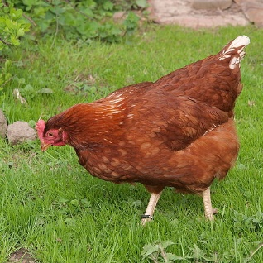
1. Slow Twitch: Aerobic
2. Fast Twitch: Anaerobic
- Slow onset of contraction
- Fast onset of contraction
- Slower to fatigue
- Faster to fatigue
  - Smaller diameter
  - Larger diameter
  - More mitochondria
  - Fewer mitochondria
- More capillaries
  - Fewer capillaries
  - Myoglobin
  - High glycogen stores
  - Posture, Endurance
- Power lifting, Sprinting

Slide 23
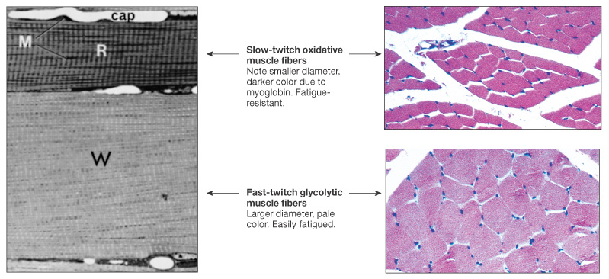

Comparison of Slow and Fast Twitch Muscle Fibers

Slide 24
Varying the Force of Contraction
(Graded Skeletal Muscle Contraction)
1) Temporal Summation
2) Spatial Summation
3) Length of Resting Sarcomere

Slide 25
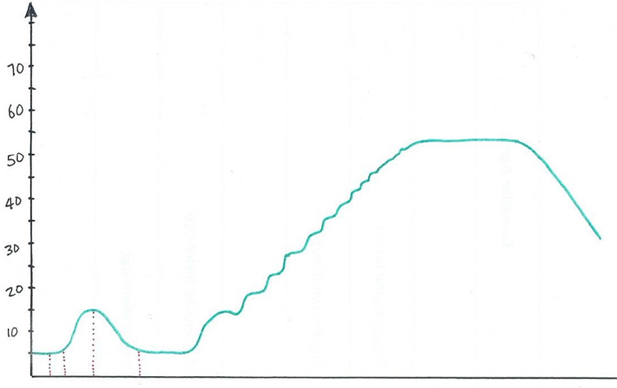
Temporal Summation of Muscle Tension
Complete Tetanus
Muscle Fatigue
Incomplete Tetanus
Muscle Force
(g)
Muscle Twitch
1 2 3

Slide 26
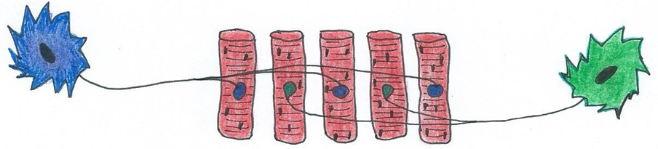
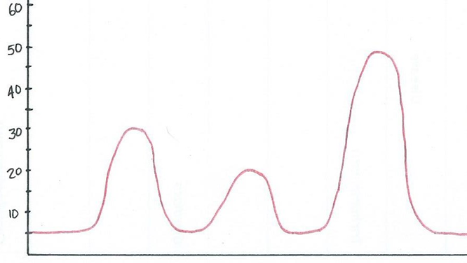
Spatial Summation of Muscle Tension (force)
1 2 3 4 5
Motor Unit A is: Motor Neuron A and muscle fibers 1, 3 and 5.
Motor Unit B is: Motor Neuron B and muscle fibers 2 and 4.
Muscle Force
(g)
A B A and B

Slide 27
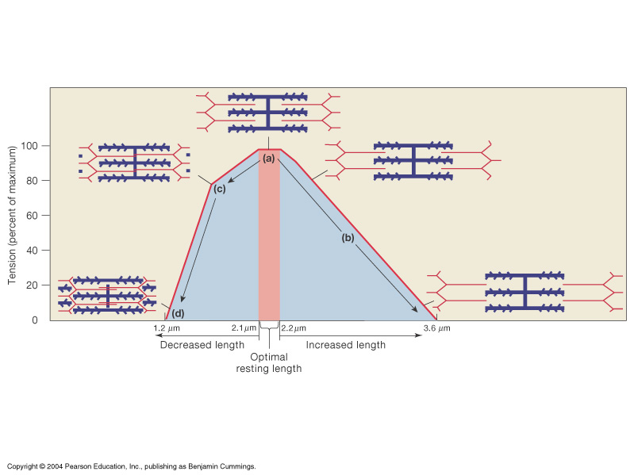
Length of Sarcomere and Tension Generation

