Slide 1
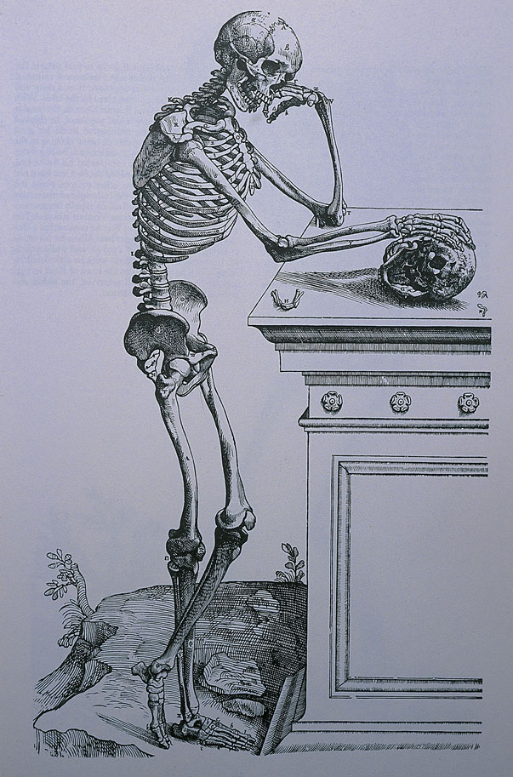
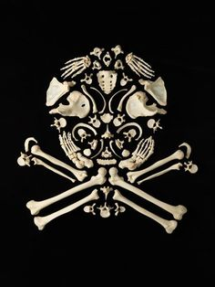
The
BONES

Slide 2
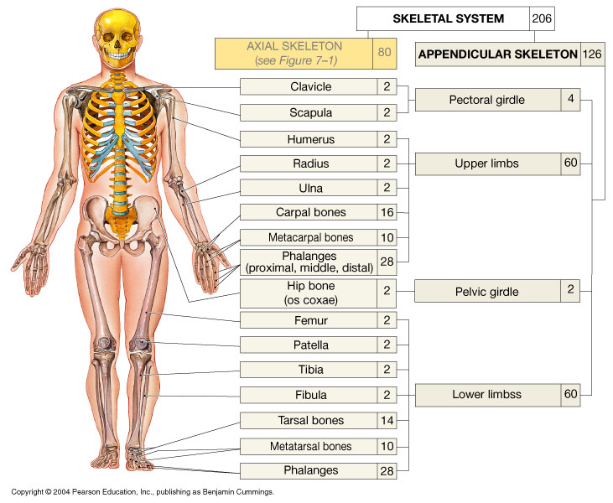
The
BONES
of the
SKELETON
AXIAL SKELETON
80

Slide 3
Functions of Bone (Osseous Tissue)
Structural Support:
Protection:
Storage: 1) minerals and 2) lipids
Blood Cell Production:
Body Movement:
Detoxification:

Slide 4
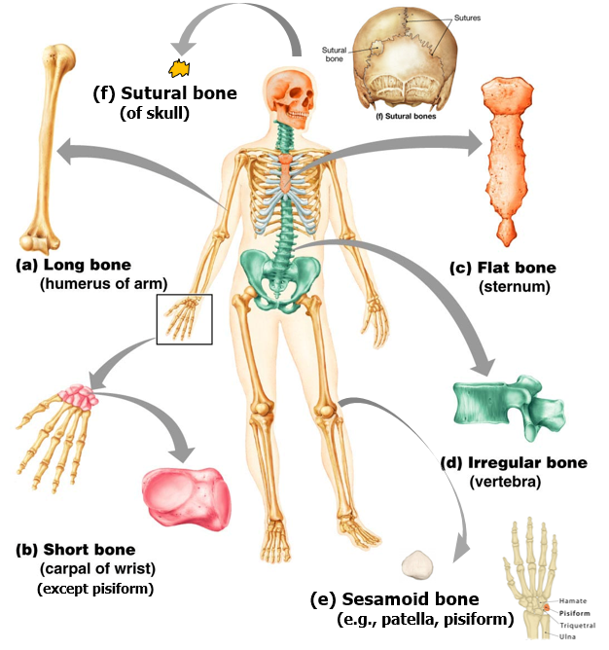
Classification of Bone by Shape
There are
6
categories
a) Long –
b) Short –
c) Flat –
d) Irregular –
e) Sesamoid –
f) Sutural –

Slide 5
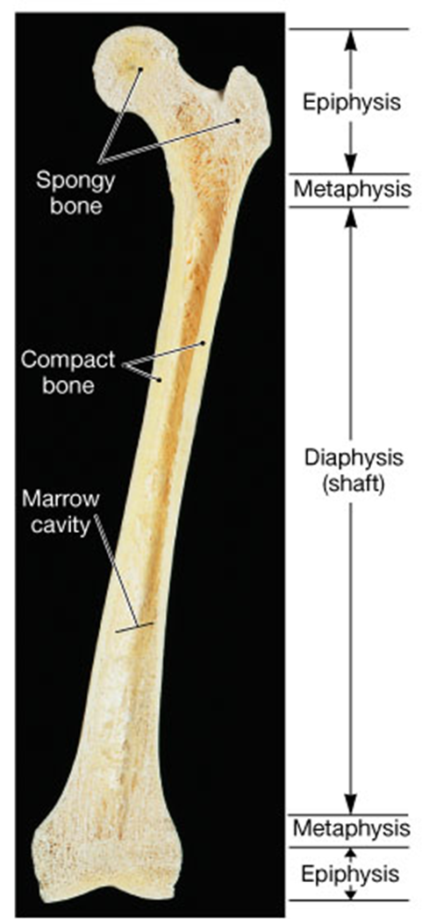
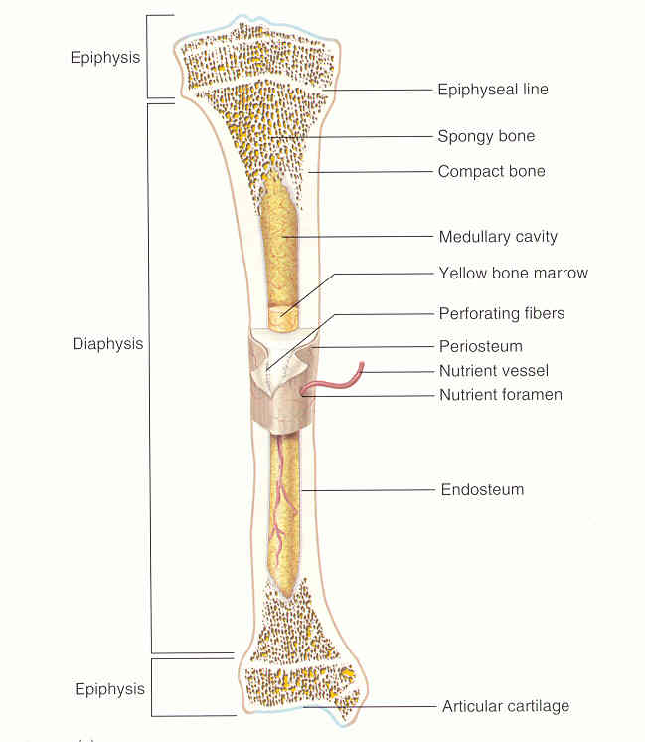
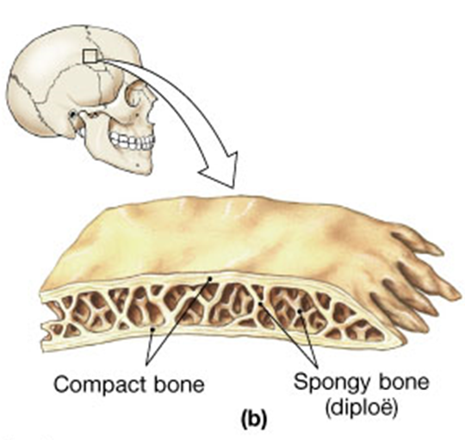
Anatomy of a Long Bone
Anatomy of a Flat Bone

Slide 6
Constituents of Bone
Organic (~1/3)
Inorganic (~2/3)
Collagen
(and some other proteins)
80%
Calcium
Hydroxyapatite
Ca₃(PO₄)₂.(OH)₂
Specialized Bone Cells (4)
15%
Calcium Carbonate
CaCO₃
Glycosaminoglycans
(GAGs)
5%
Other Minerals:
Mg, SO₄, Na, K, Zn, Cu …
Gives Bone Flexibility!
Gives Bone Rigidity!

Slide 7
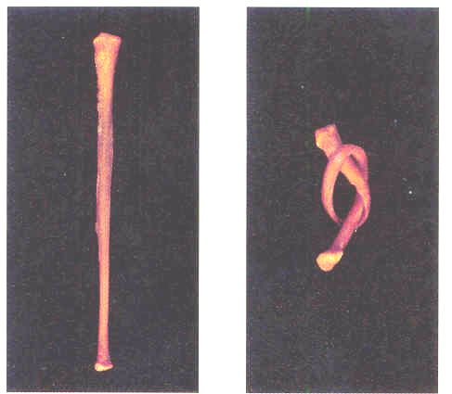
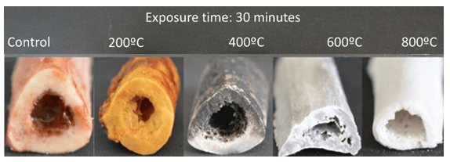
Bone soaked in acetic acid to de-mineralize it…
Heating bone
destroys proteins in it…
Makes it very brittle

Slide 8
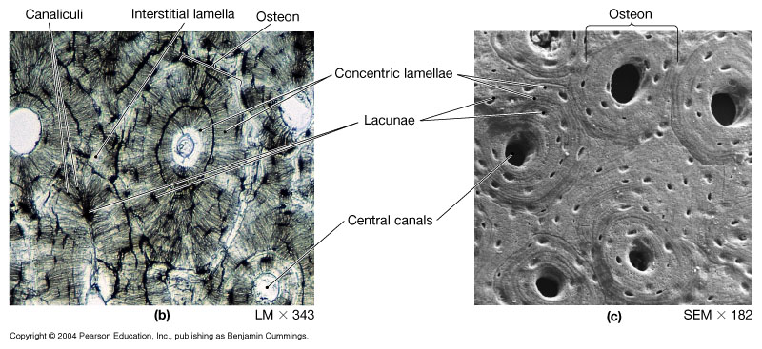
Compact Bone

Slide 9
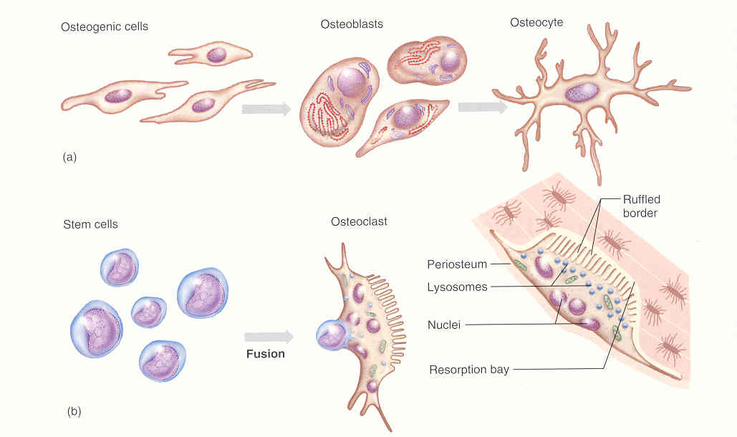
Specialized Bone Cells
Osteoprogenitor cells Osteoblasts Osteocytes
Osseo Lineage
Stem cells Osteoclasts
Myeloid Lineage

Slide 11
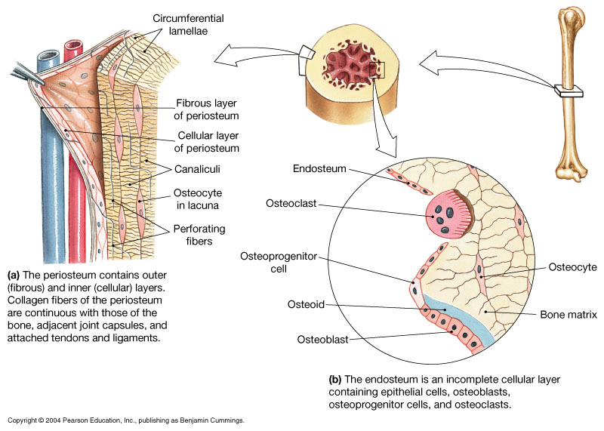

Slide 12
Hormonal Control of Bone Tissue
Human Growth Hormone (hGH):
(Pituitary gland)
Thyroxine:
(Thyroid gland)
Stimulate
Osteoblasts
Sex Hormones:
(estrogen, progesterone, testosterone)
(Ovaries and Testes)
Calcitonin:
(Thyroid gland)
Inhibits Osteoclasts
Parathyroid Hormone:
(Parathyroid
gland)
Stimulates Osteoclasts
Calcitriol:
Increases Ca²⁺ absorption from intestine,
Decreases Ca²⁺ loss in urine.
(Skin to kidneys)

Slide 13
2 Types of Ossification
1. Intramembranous Ossification
Mesoderm
Mesenchymal cells
Osteoprogenitor cells
Osteoblast
Osteocytes in bone tissue

Slide 14
2. Endochondral Ossification - most bones formed this way
Bone replaces a cartilage model of bone .
Blood vessels arrive at center cavity left by dying chondrocytes.
Mesenchymal cells from blood differentiate into Osteoprogenitor cells and then Osteoblasts.
Osteoblasts replace cartilage with spongy bone => becomes primary ossification center.
Spongy bone remodeled by Osteoclasts into a marrow cavity. Outer becomes compact bone.
The Secondary ossification center begins at epiphyses. Leaving cartilage band at metaphysis - called the epiphyseal plate (growth plate).
Length-wise growth of long bones occurs at epiphyseal plate as chondrocytes enlarge and become more active then ossify creating the epiphyseal line, ceasing bone growth.
Cartilage is left at articulating ends = Articular Cartilage.

Slide 15
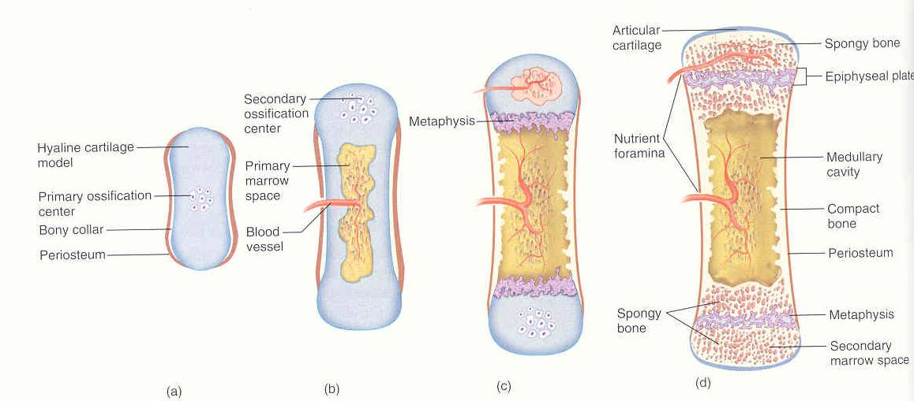
2. ENDOCHONRAL OSSIFICATION
Starts as a cartilage
model of bone

Slide 16
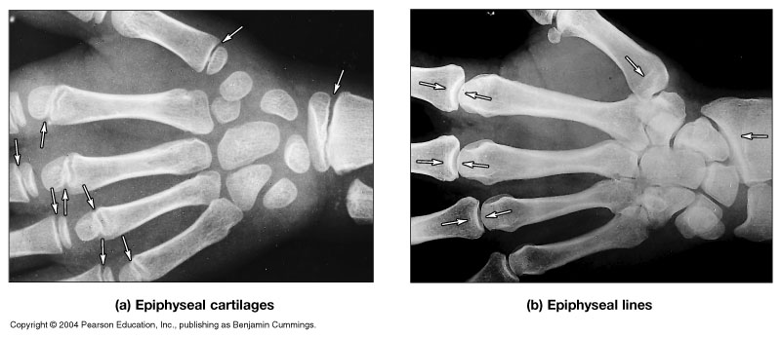

Slide 17
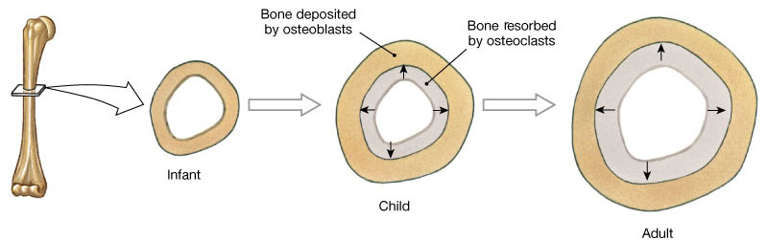
Appositional Bone Growth
Bones can increase in thickness after length-wise growth stops = Appositional Bone Growth.
Process by which old bone lining medullary cavity is reabsorbed and new bone produced beneath the periosteum, increasing the bone diameter.
Bone Remodeling:
Depositing and removing bone tissue!

Slide 18
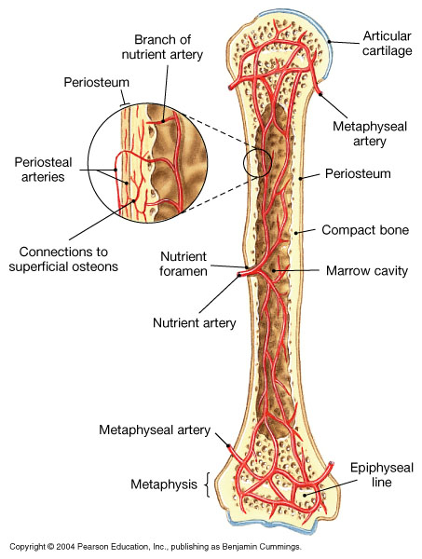
Notice all of the features and terms used for the elements of a bone in the body

Slide 19
Bone Fractures
Simple (Closed):
Skin remains intact.
Compound (Open):
Skin is broken exposing the
bone and deep tissues to the exterior.
Compound Fractures have:
Risk of infection.
Greater risk of blood loss if fracture lacerates blood vessels.

Slide 20
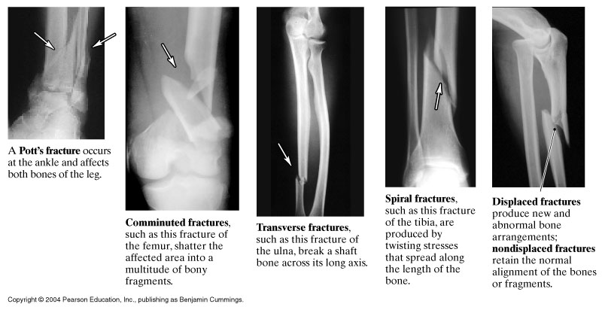

Slide 21
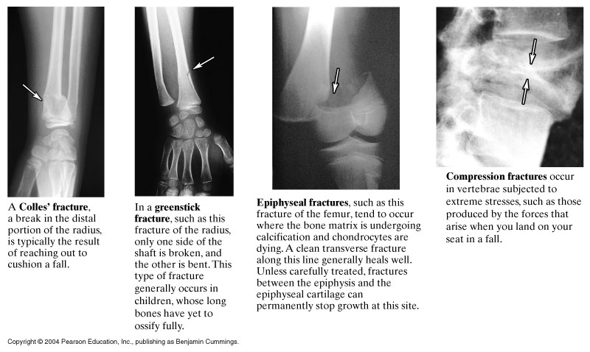

Slide 22
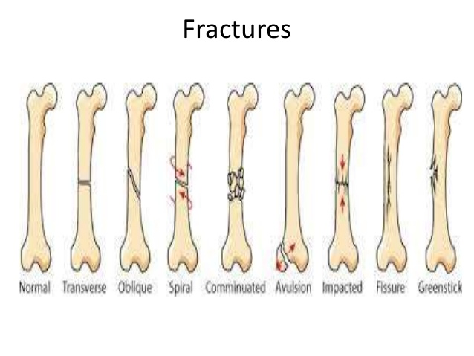
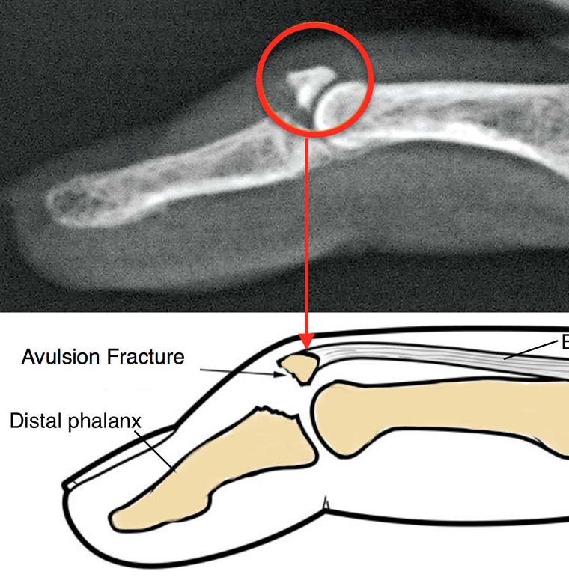
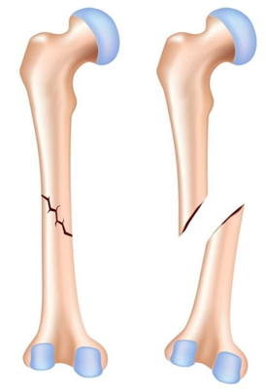
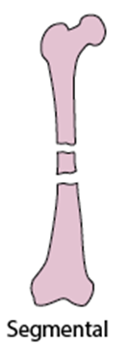
Review Typical Bone Fractures
Comminuted
Transverse
Greenstick
Hairline
Avulsion
Oblique
Spiral
Segmental
Compression
Impacted
Longitudinal
Stress
Torus (Buckle)
Colle’s
Pott’s
Fissure
Normal Transverse Oblique Spiral Comminuted Avulsion Impacted Fissure Greenstick

Slide 23
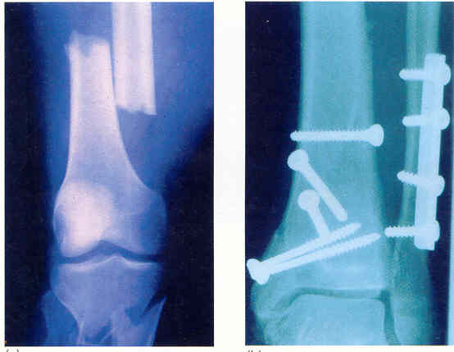
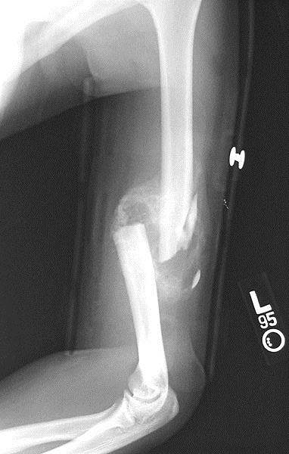

Slide 24
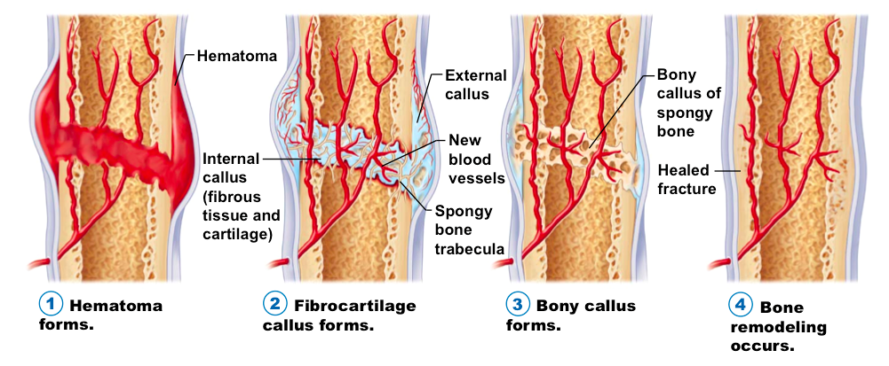
Bone Fracture Repair

Slide 25
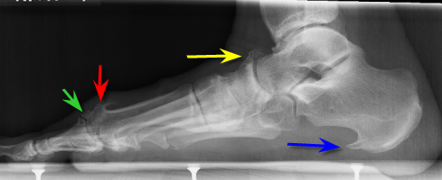
Disorders of Bone Tissue
Osteopenia: A reduction in bone mass with age.
Osteomalacia (called ‘Rickets’ in children): Defective mineralization of bone, resulting in too much flexibility, bone cannot bear weight sufficiently.
Osteophyte: also called a bone spur, is an outgrowth of bone occurring along the edges of a bone. Can form in any bone but most commonly found in joints and where ligaments or tendons attach to the bone.

Slide 26
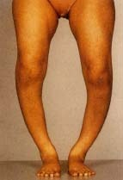
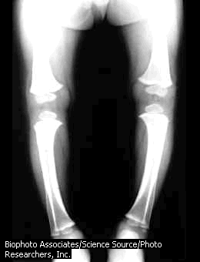

Slide 27
Osteoporosis: A significant reduction in bone mass that impairs function.
Too little mineralization of bones can be caused by:
1) Decrease in hormone levels (less mass of bones).
2) Deficiency of minerals in youth, thus too little bone mass to begin with.
3) Imbalance of osteoblasts and osteoclasts activity that impairs normal bone mass.

Slide 28
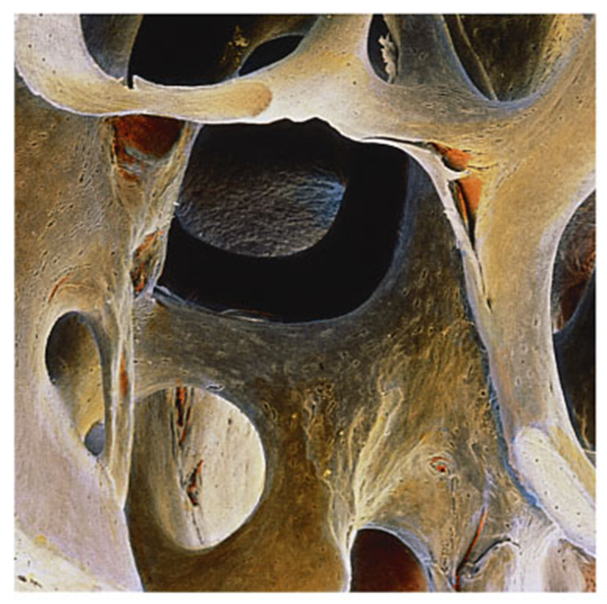
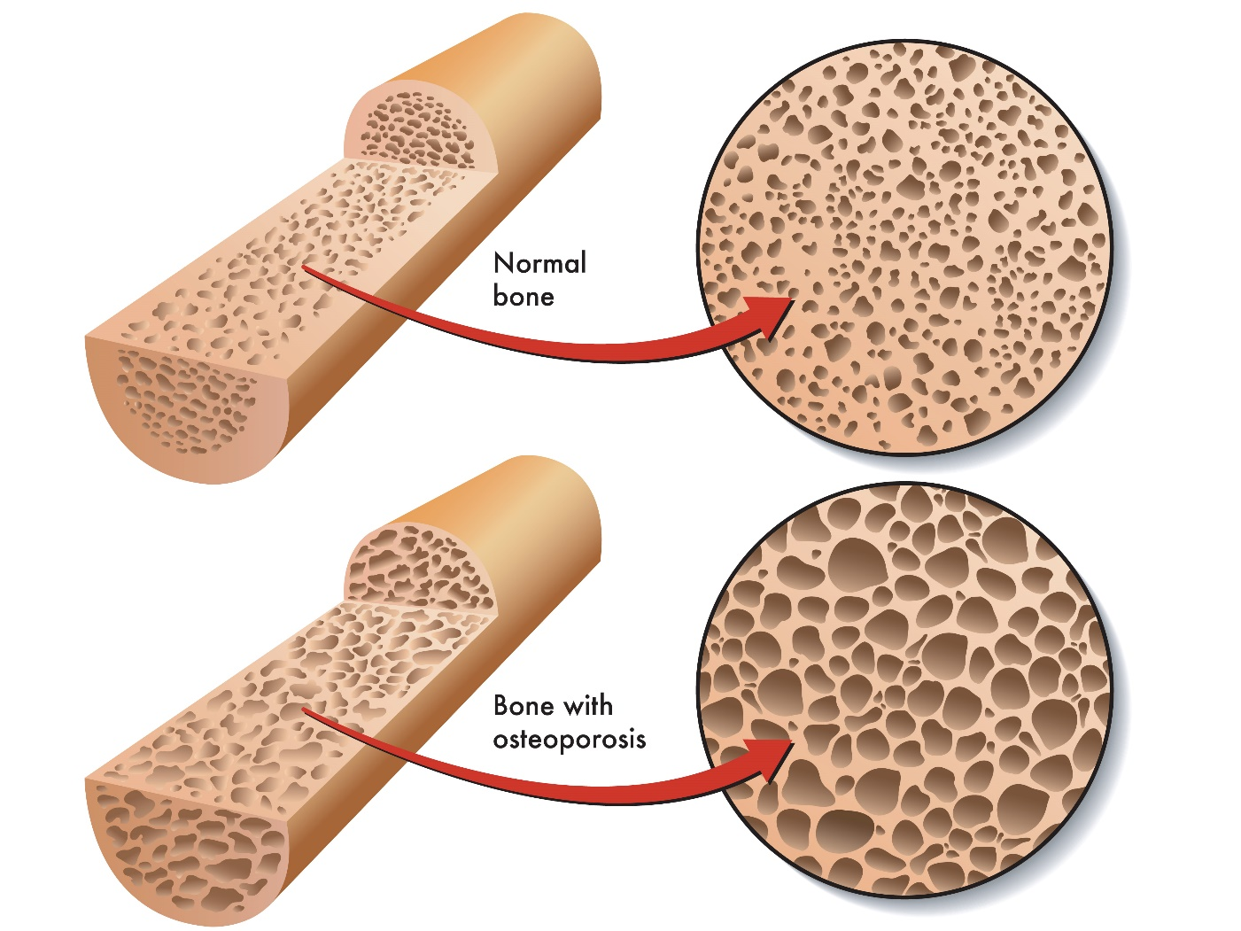
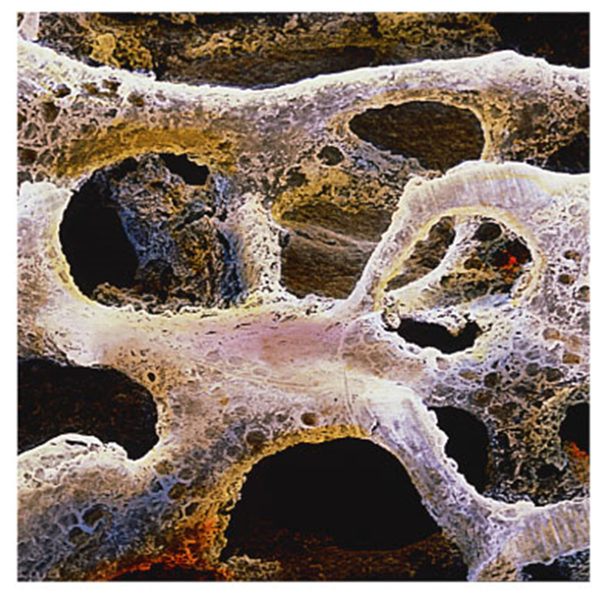
Osteoporosis:
Normal Spongy Bone (SEM x 25)
Spongy Bone with Osteoporosis (SEM x 21)

Slide 29
The 4 Essential things required for
Normal Bone Growth, Repair and Remodeling …
1) Adequate Minerals:
Plenty of Ca²⁺ and PO₄²⁻. Also extremely important are the trace minerals (~80 of them).
2) Adequate Vitamins:
Vitamin D, Vitamin K2, Vitamin C, and Vitamin A.
3) Appropriate Hormone Levels:
Human Growth Hormone (hGH), Thyroxine, Calcitriol, Parathyroid Hormone, Calcitonin, and Sex Hormones.
4) Weight Bearing Exercise:
Bone is very dynamic tissue, responds quickly to use or disuse (Atrophy vs Hypertrophy).

