Slide 1
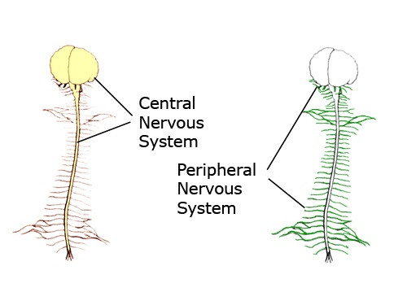
The Nervous System
Spotlight on the Peripheral Nervous System

Slide 2
Central Nervous System
Peripheral Nervous System
Somatic N.S.
Autonomic N.S.
Voluntary*
Involuntary*
(has 2 divisions)
Effector Tissue is:
Skeletal
Muscle
only
Parasympathetic
Sympathetic
Effector Tissues are:
1. Cardiac Muscle
2. Smooth Muscle
3. Glands

Slide 3
The Somatic Nervous System (SNS)
This one is simple and easy – so let it be!
CNS
NT = ______
One Somatic Motor Neuron
to a single effector tissue:
Effector Tissue
Skeletal Muscle
R = ___________
These are always ___________
All that happens is a Somatic Motor Neuron ‘fires’ a signal to
skeletal muscle (at the NMJ) and then the muscle contracts!
If these neurons do not send a signal, the muscle stays relaxed!
e.g., the radial nerve sends a signal and presto, the triceps brachii contract!
Easy, right

Slide 4
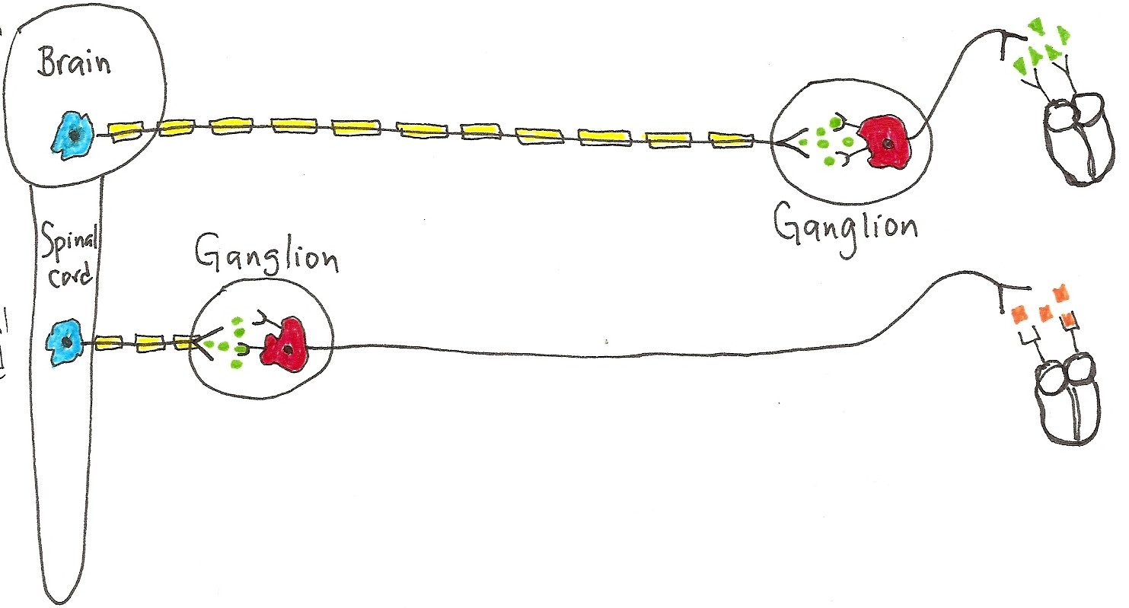
The Autonomic Nervous System
Effector Tissue
(the ANS is more complex than the SNS!)
The ANS is mostly involuntary and involves
2 Motor Neurons to 3 types of Effector Tissue

Slide 5
Notes:
The Autonomic Nervous System (ANS) is complex.
It involves two motor neurons; one neuron from the CNS to a ganglion (the preganglionic neuron) and the second neuron from the ganglion to the effector tissue (the postganglionic neuron).
It has 2 divisions: Parasympathetic and Sympathetic. There are 3 basic effector tissues in the ANS:  cardiac muscle,  smooth muscle and  glandular tissue. Both divisions have the same effector tissues, but often have antagonistic effects.
A ganglion is a cluster of nerve cell bodies in the PNS. A nerve fiber is a single axon, whereas a nerve is a bundle of axons in the PNS.
In the detailed drawings, please notice how the ganglion in the Para are close to the effector tissue, but in the Sym, they are close to the CNS.
Also note that the nerve fibers for the preganglionic neurons in the Para are very long and the nerve fibers for the postganglionic are very short. It is the opposite arrangement for the Sym division!

Slide 6
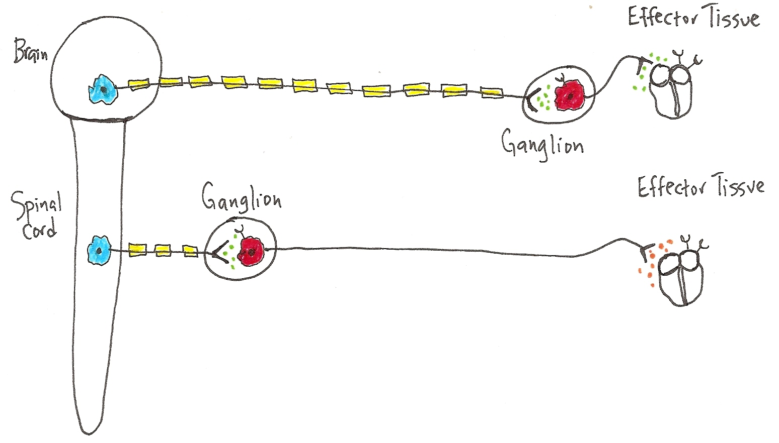
CNS
PNS
Tissue
Preganglionic Neurons
PARA
NT = ______
R = _______
NT = ______
R = _______
SYM
NT = ______
Postganglionic Neurons
R = _______
In CNS: Preganglionic Neurons
Para = Craniosacral Origin
Sym = Thoracolumbar Origin
At Ganglion:
Postganglionic
Nerve cell bodies
Effector Tissue:
Cardiac, Smooth Muscle
and Glands

Slide 7
Notes:
In general, Para is for ‘housekeeping’ activities (“Rest & Digest”), storing needed things, getting rid of things and doing the chores!
e.g., after lunch, as you decide to sit and read - Para is at work! Heart rate is low, saliva and G.I. tract activity is up high, bronchiole (airways) diameter down no need for much air, everything is fine, there’s no hurry, you’ve got all day. Pupil diameter is small, enabling that fine focus to get all the details!
In general, Sym is for emergency situations (“Fight or Flight”)! You may fight or run – either way it takes a lot of energy.
e.g., imagine as you sit down to read, a big scary creature enters the room. Presto - immediately the Sym is at work. Heart rate skyrockets (to pump more blood to body to get you out of danger), your G.I. activity comes to a halt, and bronchioles diameter gets larger, as you need more air flow to either fight or run. Sweat? Yep. Dry mouth? Yes. Pupil diameter becomes larger too, enabling distant focus so you can see an escape route!

Slide 8
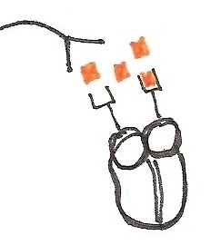
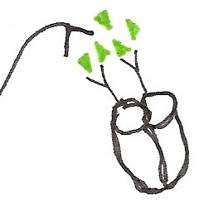
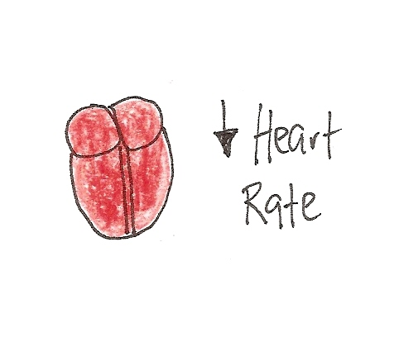
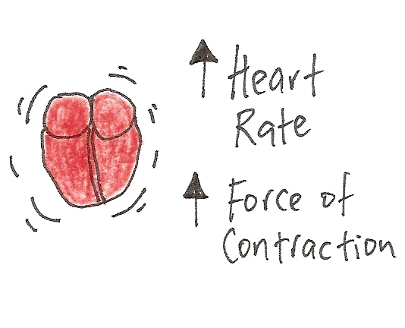
PARA
SYM
Lets compare how the 2 –‘s of the ANS Effect
the Heart.
. .
ACh released from Postganglionic
Parasympathetic neurons
NE released from Postganglionic
Sympathetic neurons
Effect?
Effect?
PARA = “Rest and Digest”
SYM = “Fight or Flight”

Slide 9
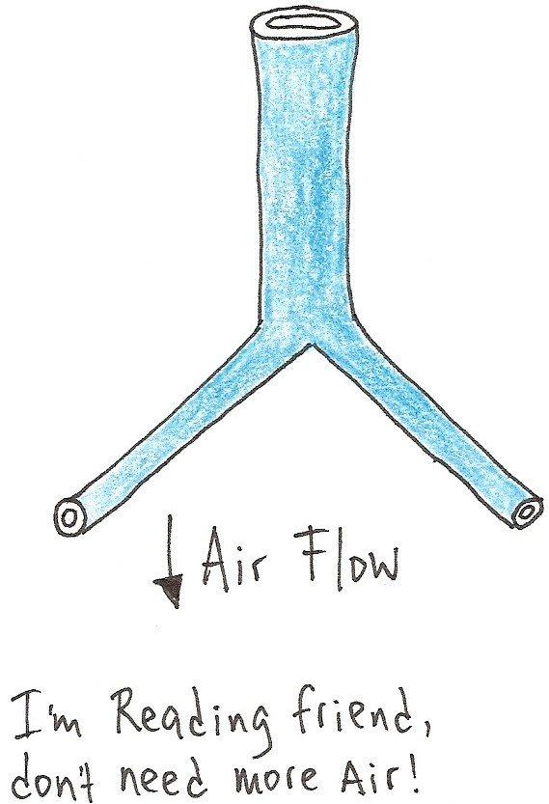
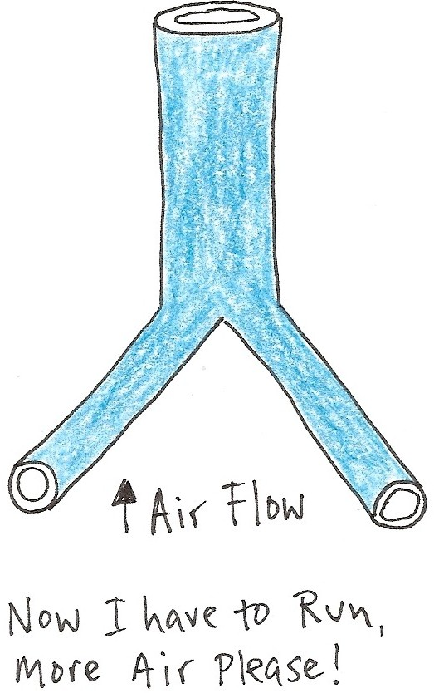
PARA
SYM
The
Lungs?
(Bronchioles)
Diameter of
Bronchioles
Diameter of
Bronchioles
What is the direct effector tissue for the bronchioles?
Remember, basically, you only have 3 choices!

Slide 10
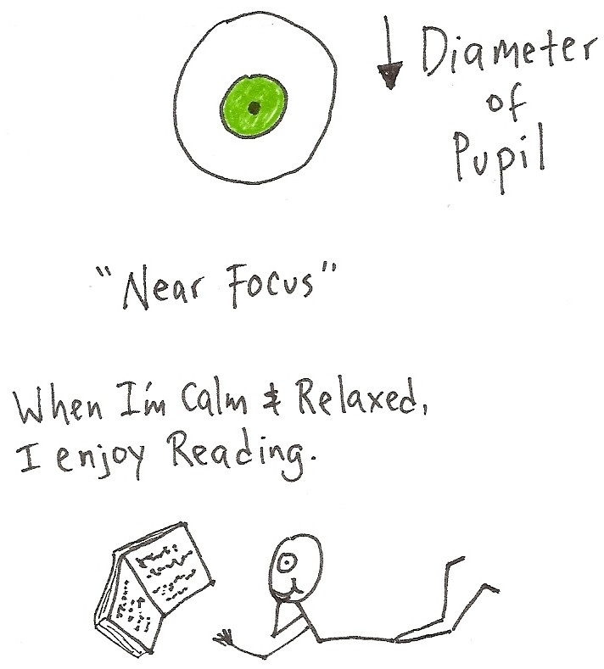
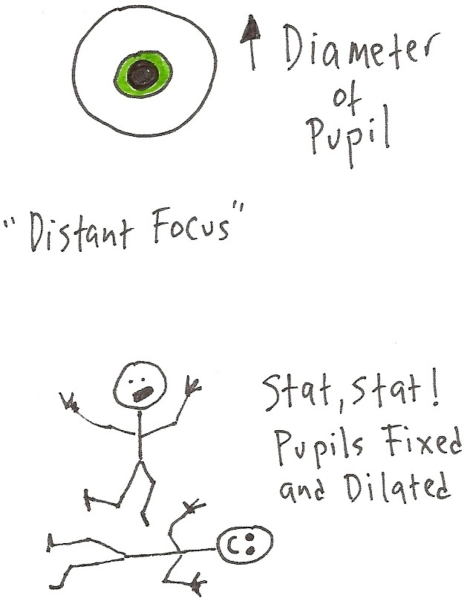
PARA
SYM
Vision?
Hmmm, did you know coconut oil is a natural saturated fat with medium chain fatty acids and is excellent for human health?
Good thing I read …
Note: Similar effects to Sympathetic stimulation found from being in Love – seriously!

Slide 11
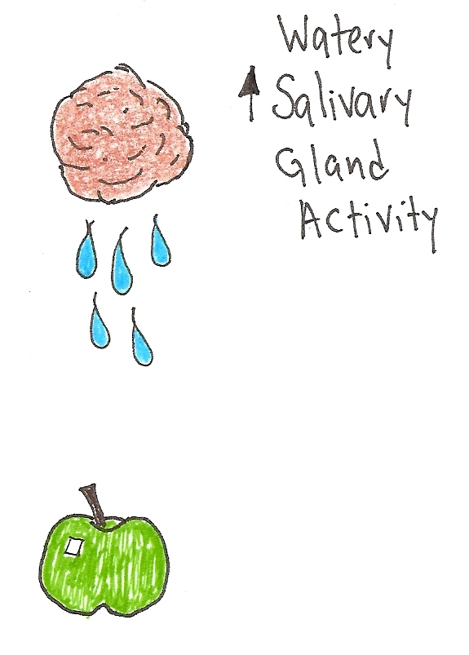
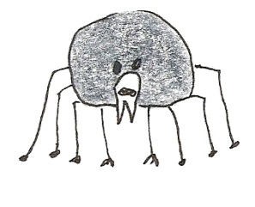

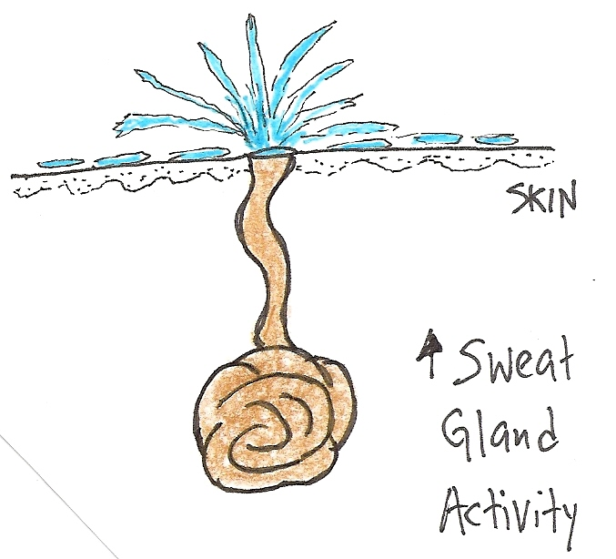
PARA
SYM
Saliva & Sweat?
“What a tangled web
we weave, when our
aim is to deceive!”
Yum, I can just
Imagine how nice
this will taste!
Make sure it’s Organic, salvesterols are good for you.
Note: Not telling the truth
can also make you sweat!

Slide 12
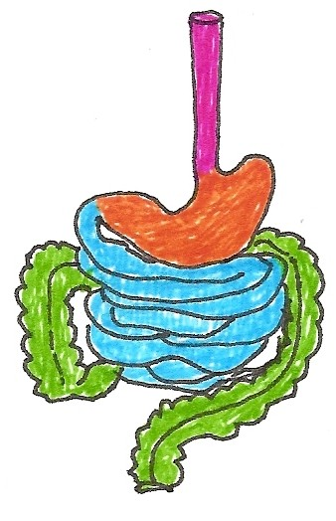
PARA
SYM
Rest and DIGEST
Emergency - no time to digest!
Alimentary Canal
In G. I. Tract Motility
In G. I. Tract Motility
In G. I. Tract Secretions
In G. I. Tract Secretions

Slide 13
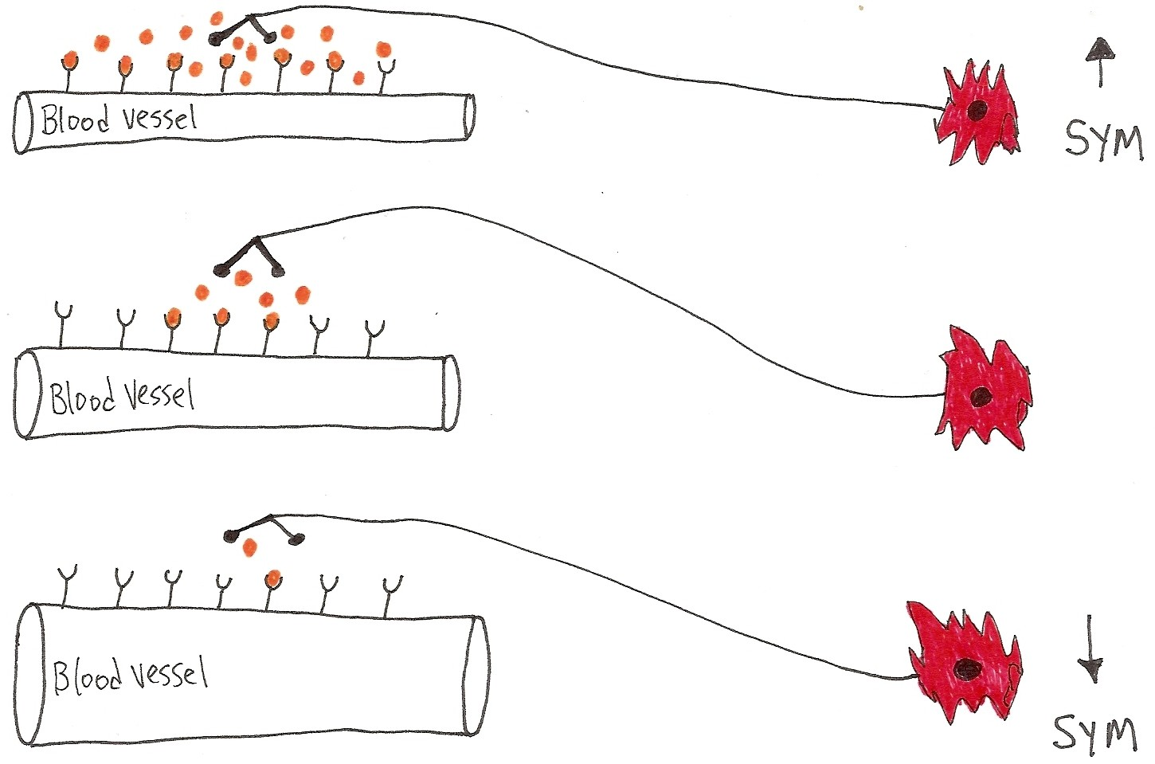
Blood Vessel Diameter: SYM
↓r -> ↑R -> ↑BP -> ↓flow
These are
the α receptors
and NE is binding
to them, big time!
Sympathetic Innervation
These are
the α receptors
and NE is not
binding to
all of them!
↑r -> ↓R -> ↓BP ->↑flow
α’s = constriction; β’s = dilation. The vessel above must have which receptors? Alpha?

Slide 14
Notes:
Vascular Smooth Muscle (VSM) is around blood vessels walls and is predominantly controlled by the Sym division of the ANS.
Sym postganglionic neurons release norepinephrine (NE):
a) if α (alpha) receptors present = vasoconstriction = ↓flow, ↑ Blood Pressure
b) if β (beta) receptors present = vasodilation = ↑flow, ↓ Blood Pressure
The rule of thumb is: the more Sym stimulation, the more constriction of blood vessels (except to skeletal muscle!). So this means your blood pressure will go up when you get excited!!!
Please Note: Skeletal muscle is controlled by the Somatic (soma = body) nervous system (SNS), not the Autonomic nervous system (ANS). However, the SNS and the ANS work together. The blood vessels supplying skeletal muscles have β receptors on them, and when NE binds to these receptors it causes vasodilation – this then increase blood flow to muscles so you can run faster and swing your arms harder!

Slide 15
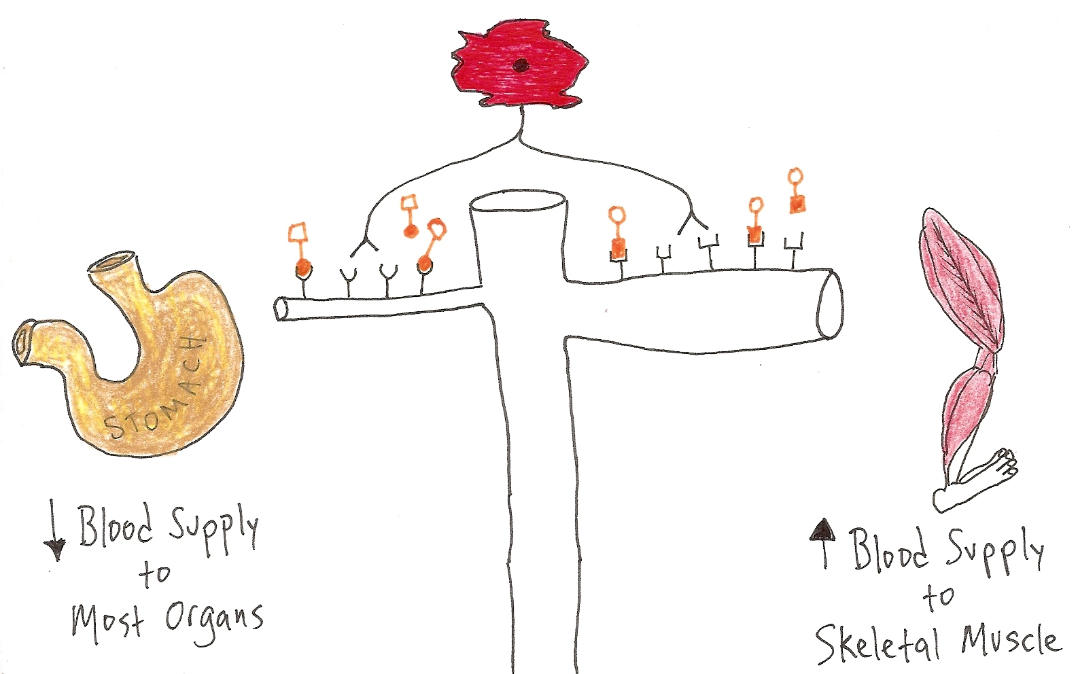
Diverting Blood Flow: SYM
In times of Emergency!
α R’s = Vasoconstriction
β R’s = Vasodilation
α = alpha receptors
β = beta receptors
b
l
o
o
d
v
e
s
What’s the Effector Tissue for blood vessels?
NB: The ANS does not innervate Skeletal Muscle!

Slide 16
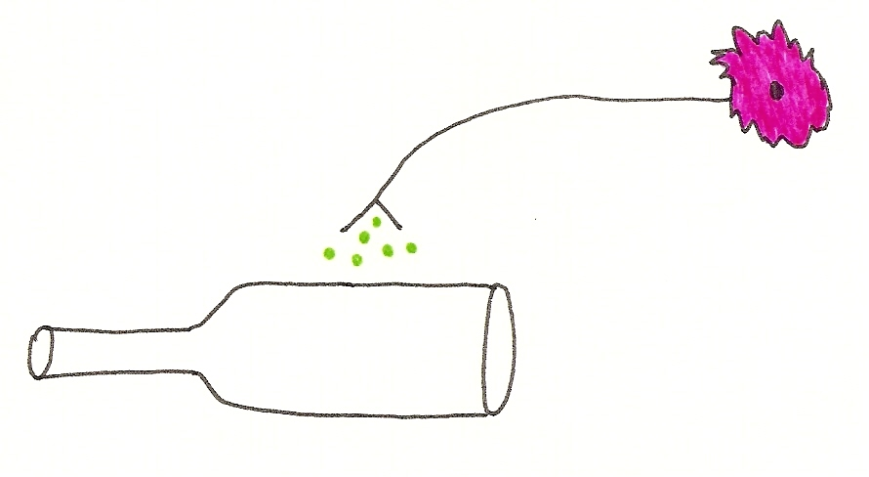
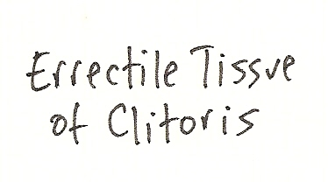
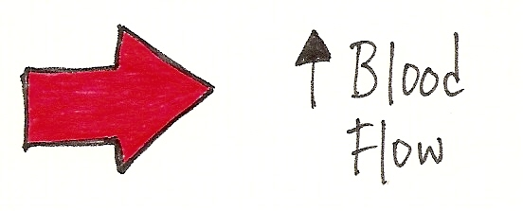
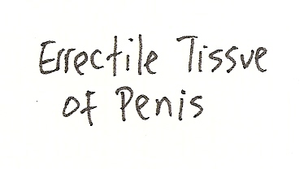
PARASYMPATHETIC
*Para has no effect on blood
Flow except to erectile tissue!
Females
to
vasodilation
blood vessels to erectile tissue
Yep –> Engorged and Tingly
vasodilation
to
Males

Slide 17
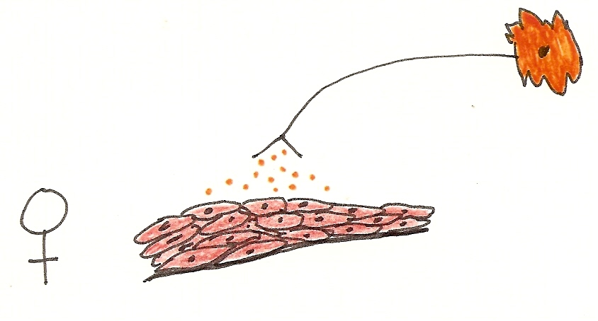
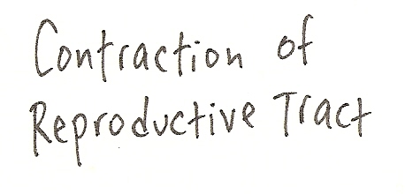
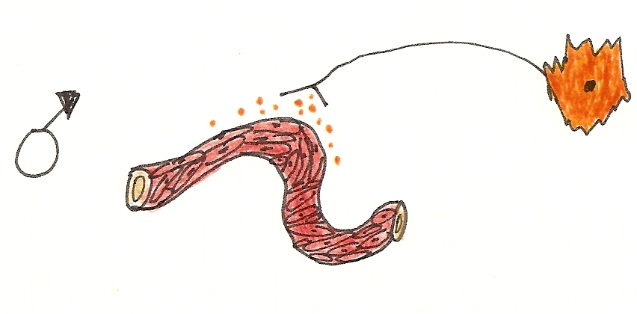
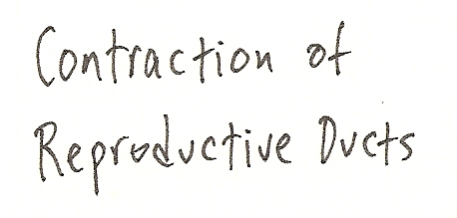
SYMPATHETIC
Lining of Repro tract
Yep –> Ejection of Fluids
Lining of Repro duct
Q: What’s the Effector Tissue?

Slide 18
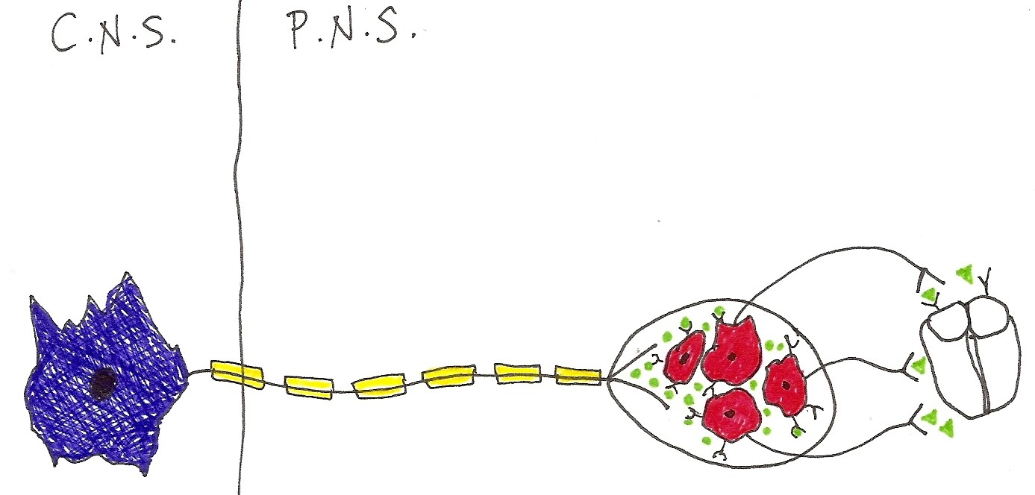
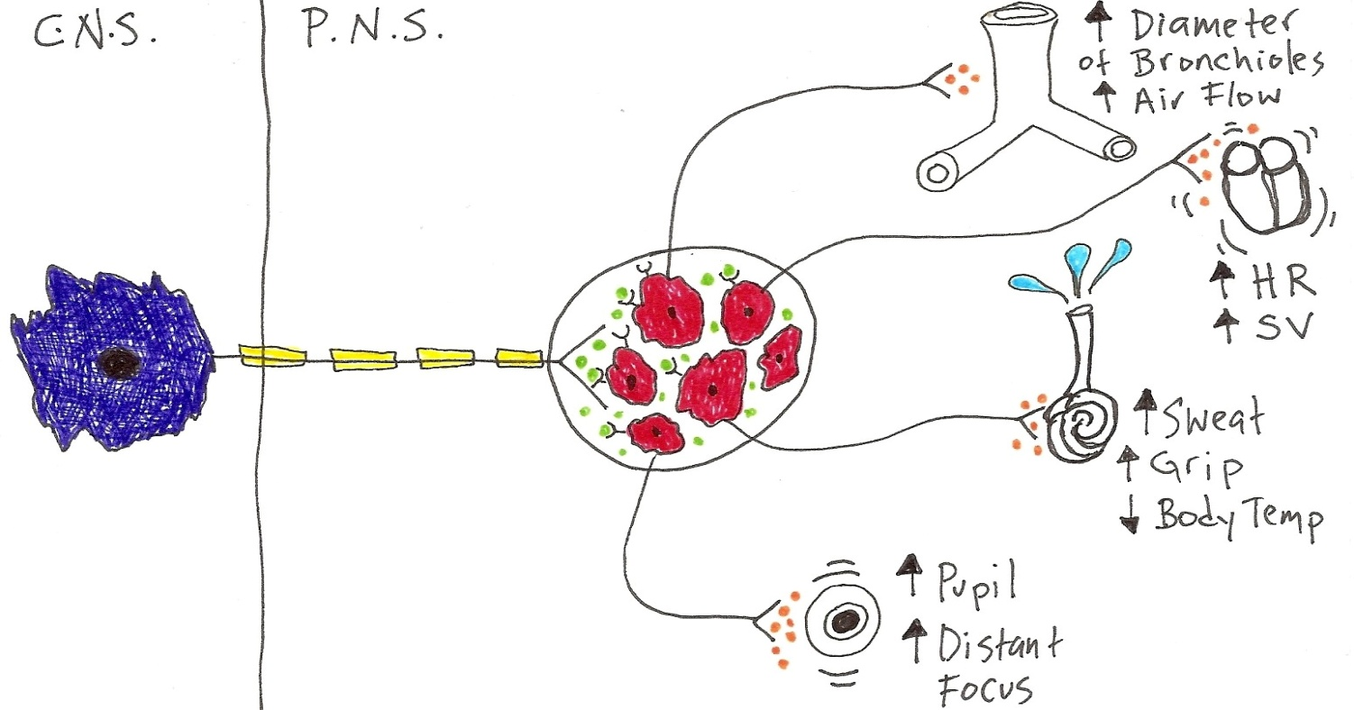
Anatomical Arrangement of ANS
Para
is
CONVERGENT
Ganglion
Effector
Tissue
Sym
is
DIVERGENT
Ganglion
Effector
Tissue

Slide 19
Notes:
The Anatomical arrangement of two divisions is indicative of their function.
Para is more Convergent, such that it often focuses on one thing at a time. Usually the ganglion is on the effector tissue, so it is a focused response, not wide-spread.
Sym is more Divergent, such that it can signal multiple tissues at once. With the ganglion so close to the spinal cord, this allows the response to spread out in many directions at once (simultaneously).
Note how the 2 divisions seem to cooperate more with reproductive issues?
In matters of Reproduction…
Para relaxes VSM* and increases blood flow to erectile tissue = the “point” factor.
Sym causes the smooth muscle of reproductive ducts to contract = the “shoot” factor.
*VSM = vascular smooth muscle (the muscle around blood vessels)

Slide 20
Effector Tissue | PARA | SYM
Heart
Bronchioles
Pupil
Salivary Glands
Sweat Glands
Digestive Activity
Blood Vessels
Erectile Tissue
Reproductive Ducts/Tracts
“point”
“shoot”

Slide 21
Effector Tissue | Parasympathetic Stimulation | Sympathetic Stimulation
Iris (Eye Muscles) | Sphincter Muscle | Radial Muscle
Eye Lens Focus | ___________ focus | ____________ focus
Lacrimal Gland | ___________ sections (tears) | XXXXXXXX
Sweat Glands | XXXXXXXX | ___________ sections
Arector Pili | XXXXXXXX | ___________ hair muscle
Lung Bronchioles | Bronchial ______________ | Bronchial __________
Heart | Heart rate __________ Force of beat __________ | Heart rate __________ Force of beat __________
Visceral Blood vessels | XXXXXXXX | ___________________ ___________________
Systemic Veins | XXXXXXXX | ___________________
Skeletal Muscle Blood vessels | XXXXXXXX | ___________________
Salivary Glands | ___________________ | ___________________
G. I. Tract Activity | Motility ___________________ Secretions ___________________ | Motility ___________________ Secretions ___________________
Liver | Glycogen ___________________ | Glycogen___________________
Kidney | ____________ urine output | _____________urine output
Bladder Wall |  | XXXXXXXX
Internal Urethral Sphincter
Adrenal Medulla | XXXXXXXX
Erectile tissue |  | XXXXXXXX
Reproductive tract | XXXXXXXX

