Slide 1
3 Types of
Muscle Tissue
Properties of
Muscle Tissue
Contractility
Skeletal – attached to bone
Excitability
Cardiac – the heart
Extensibility
Smooth – internal organs
blood vessels
Elasticity

Slide 2
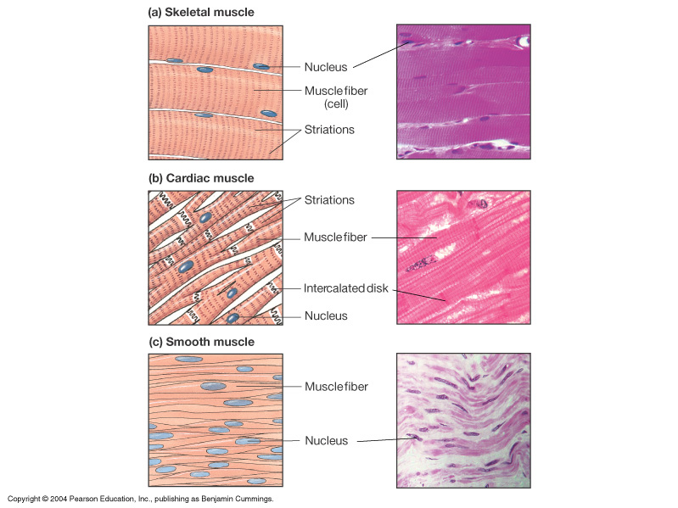
Skeletal muscle
Skeletal muscle
- Long & cylindrical
- Multinucleated
- Striated
- Voluntary
Cardiac muscle
Cardiac muscle
- Shorter & branched
- Uninucleated
- Striated
- Involuntary
- Intercalated discs
Smooth muscle
Smooth muscle
- Spindle-shaped
- Uninucleated
- Non-striated
- Involuntary

Slide 3
Functions of Skeletal Muscle
Movement of Body (with Levers and Joints)
Protection of other Structures
Heat Production
Controls Entrances and Exits to Body

Slide 4
Micro-Anatomy of Skeletal Muscle
Muscle cell = muscle fiber
Fascicle = bundle of muscle fibers
Whole muscle = bundle of fascicles

Slide 5
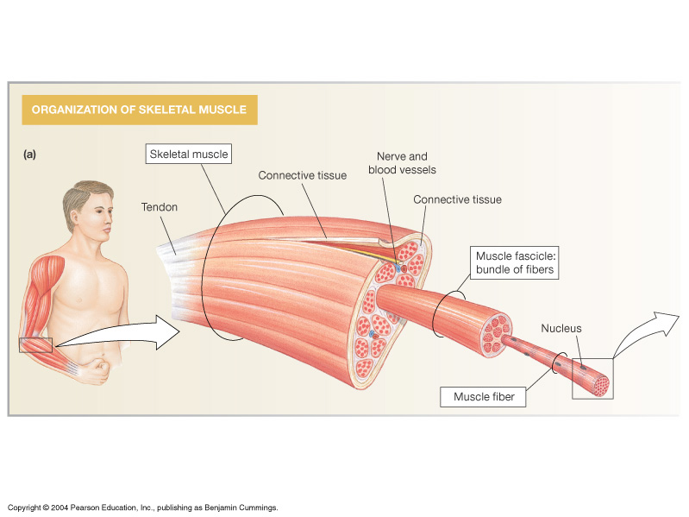
Anatomy of Skeletal Muscle

Slide 6
Connective Tissue of Skeletal Muscle
Endomysium => covers a muscle fiber
Perimysium => covers fascicles
Epimysium => covers whole muscle

Slide 7
Naming of Skeletal Muscle
Size
Maximus
Minimus
Major
Minor
Longus
Brevis
Shape
Deltoid (triangle)
Teres (round, cylindrical)
Trapezius (trapezoidal)
Rhomboideus (rhomboidal)

Slide 8
Location
Abdominis
Femoris
Brachii
Capitis
Pectoralis
Intercostal
Digitorum
Relative Position
Lateral
Medial
Internal
External
Superficialis
Profundis
Action
Abductor
Adductor
Flexor
Extensor
Pronator
Supinator
Levetor
Depressor

Slide 9
Number of Heads
Biceps
Triceps
Quadriceps
Orientation of Muscle
Rectus
Transversus
Oblique
Origin and Insertion
sternocleidomastoid
coracobrachialis
Brachioradialis

Slide 10
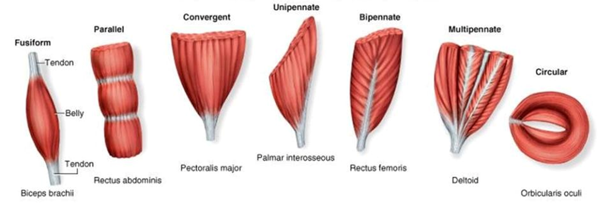
Classification of Skeletal Muscle by Fascicular Orientation

Slide 11
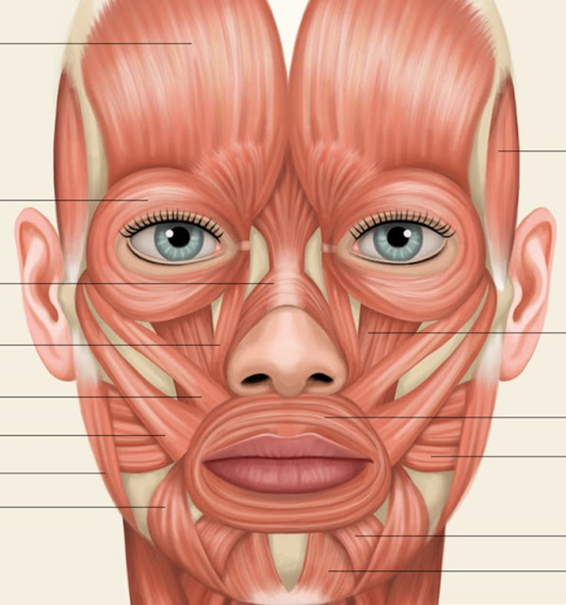
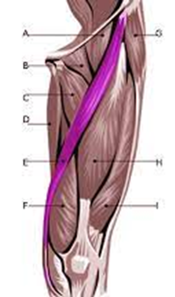
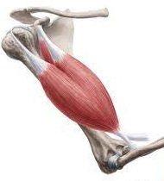
Classification by Orientation of Fascicles (Presented in the order from weakest to greatest force generated)
e.g. orbicularis oculi
e.g. orbicularis oris
1) Circular:
2) Parallel:
a) Strap-like:
- e.g. sartorius, rectus abdominis
b) Fusiform (Spindle-shaped):
e.g. biceps brachii

Slide 12
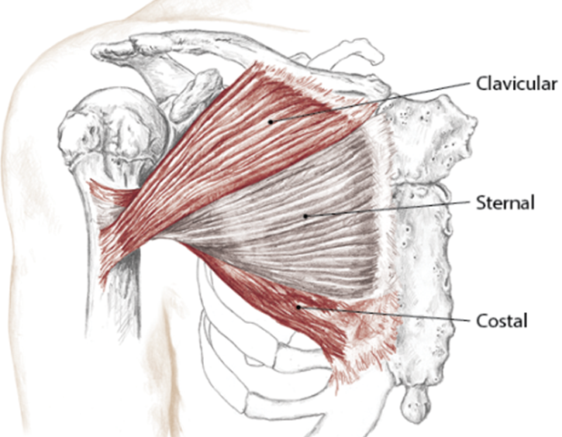
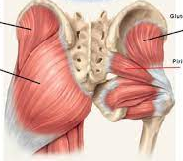
Classification by Orientation of Fascicles
3) Convergent:
e.g. pectoralis major
e.g. piriformis
(+ other gluteal muscles)

Slide 13
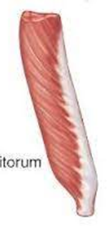
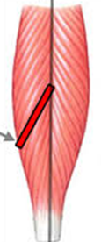
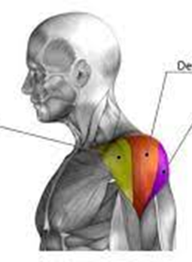
4) Pennate Muscles:
Central tendon
a) Unipennate:
- e.g. extensor digitorum
b) Bipennate:
- e.g. rectus femoris
c) Multipennate:
- e.g. deltoid

Slide 14
A Lever System can:
Increase the force applied to the movement.
OR
Increase speed or distance of body part moved.
But never both!

Slide 15
Levers are elongated rigid structures that move on a fixed point,
called a fulcrum (F).
The role of Lever Systems is
to Confer Advantage
to Body Movement.

Slide 16
In the body Bones act as levers.
Movable Joints act as the fulcrum (F).
The Effort (E) arm is powered by muscular
contraction.
The Resistance (R) is the weight of the body
part being moved.
Each Lever System needs a:
Fulcrum, Effort arm and Resistance.

Slide 17
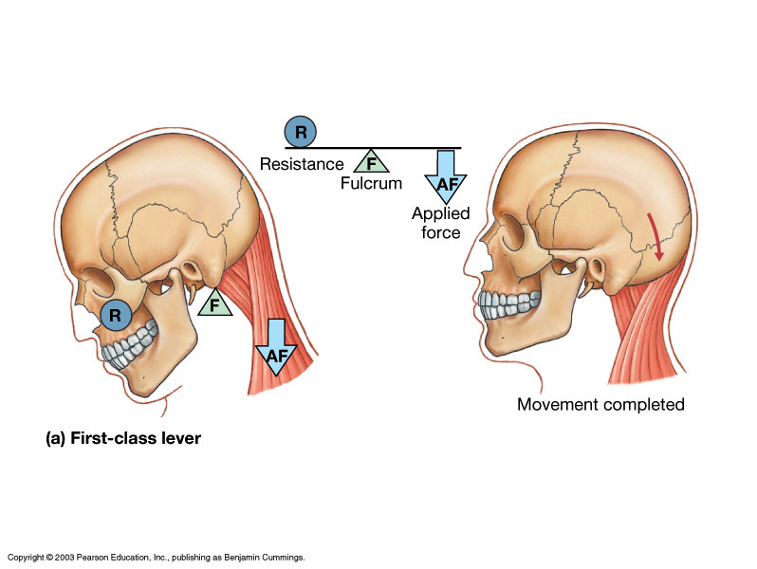
1st Class Lever: EFR
E
Effort
Arm
E

Slide 18
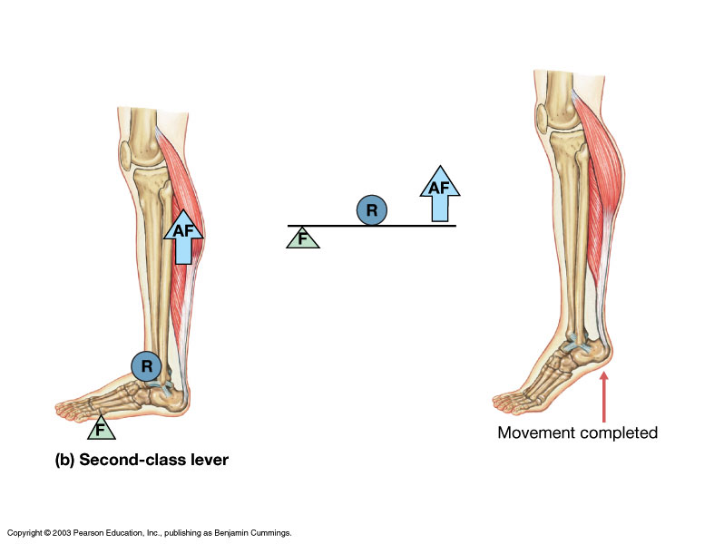
2nd Class Lever: FRE
E
E

Slide 19
3rd Class Lever: FER
E
E

Slide 20
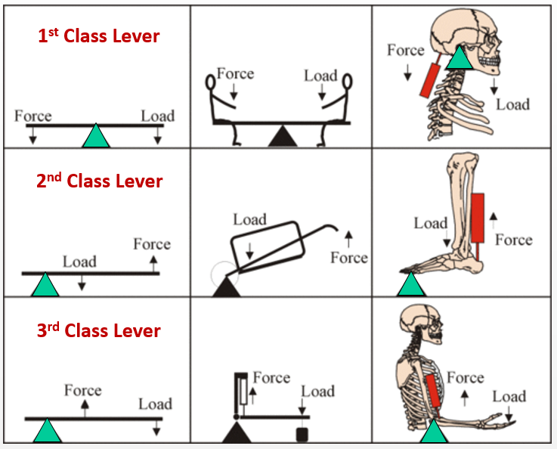
The Mechanics of Levers in the Body

Slide 21
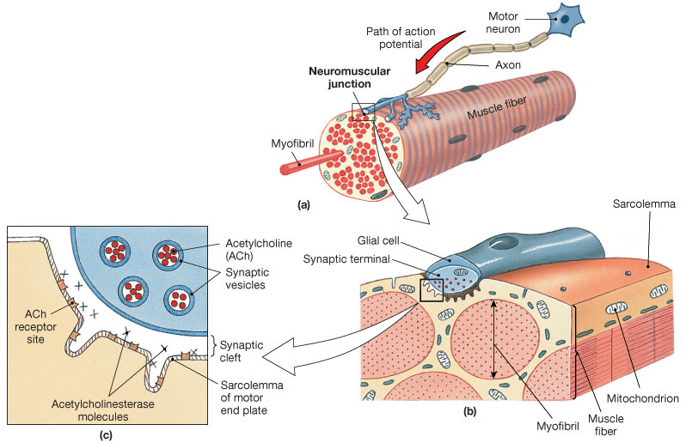
The Neuromuscular Junction
Skeletal Muscle is controlled by
Somatic
Motor
Neurons

Slide 22
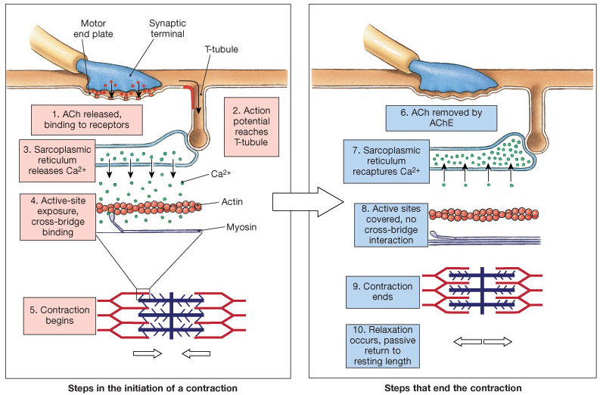

Slide 23
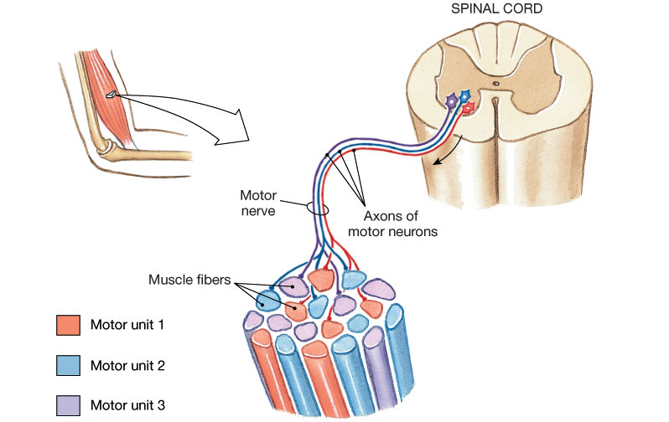
Motor Unit Recruitment

