Slide 1
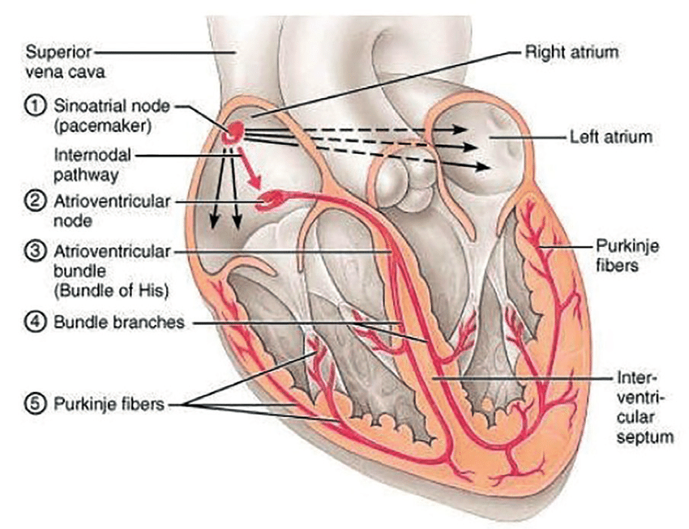
Electrical Conduction System of the Heart
(b)
Note: The internodal pathway (a)
Note: The interatrial band (b) (Bachmann’s bundle)
(a)
There are 5 main components (with location) of this conduction system:
1) Sinoatrial (SA) node
2) Atrioventricular (AV) node
3) AV Bundle (of His)
4) Left and Right bundle branches
5) Purkinje fibers
Sinus rhythm = the normal contractile pattern of the heart.
Electrical Conduction Region | Spontaneous Rate of Action Potentials/min
SA Node (sets the pace) | 70 - 80
AV Node | --------
AV Bundle | 40 - 60
R and L Bundle Branches | --------
Purkinje Fibers | 20 - 40

Slide 2
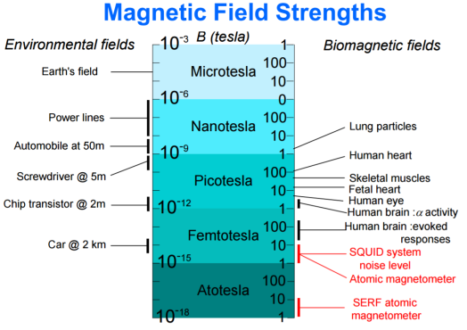
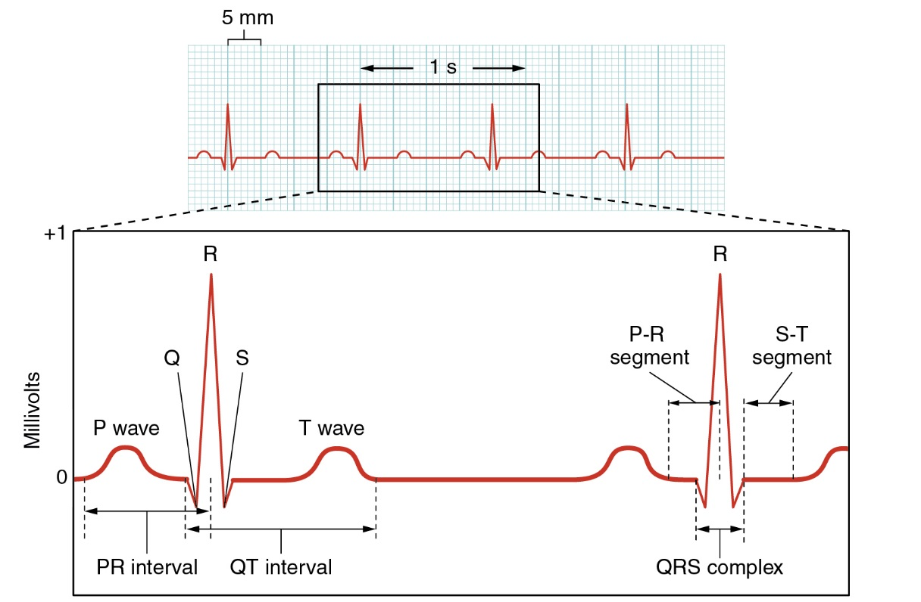
Trace of an ElectroCardioGram (ECG)

Slide 3
Cardiac Output
Cardiac Output (C.O.) is the volume of blood ejected by ventricles per unit time.
Expressed as minute volume, or liters of blood per minute (L/min)
C.O. is set to meet metabolic needs, i.e., is proportional to the tissues need for oxygen (O₂) and nutrients, and removal of carbon dioxide (CO₂) and waste.
C.O. changes with changes in body position.
  e.g., from recumbent (lying down) to an upright -> HR and SV increase.
At rest healthy adult basal C.O. about 5 L/min.
C.O. can increase 50-100% by anxiety/excitement, to 500% by exercise.

Slide 4
Calculating Cardiac Output: CO = HR x SV
Factors Affecting Heart Rate
ANS
Hormones
Physical Activity
Emotional State
Factors Affecting Stroke Volume
Amount of Ca²⁺
Preload (EDV) and Afterload (Resistance)
Sym Innervation
Physical Activity
Emotional State
Heart Rate
(beats/min)
Stroke Volume
(volume/beat)
Example Calculations:
Below are values for at rest and during exercise.
Let’s calculate the C.O., including units, showing all work!
*SV= EDV-ESV
1) At Rest:
HR = 72
EDV = 135
ESV = 65
2) During Exercise:
HR = 121
EDV = 178
ESV = 42

Slide 5
Cardiac Output = Heart Rate and Force (Contractility) is Modified by ANS
Para activity decreases heart rate and force of contraction.
Sym activity increases heart rate and force of contraction.
Multiple Factors Influence Stroke Vole (SV), it’s homeostatically regulated.
SV directly related to the force generated by cardiac muscle during contraction.
Greater force of contraction means greater SV, and lesser force means lower SV.

Slide 6
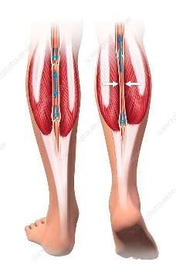
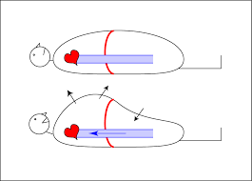
Things that Influence SV:
Length-Tension or Stretch-Force Relationships
As cardiac muscle sarcomere length increases, tension generated contracting muscle increases = SV.
More force, greater amount of blood ejected.
b) Venous Return or Cardiovascular Preload
Blood returning to the heart is termed 'venous return'.
Greater venous return = stretch cardiac muscle, and they contract more forcefully.
Venous return determines EDV and this determines stroke volume (SV)!
Several factors affecting venous return:
    The ‘Skeletal Muscle Pump’.
    The ‘Respiratory Pump’.
    Sympathetic Activity.
Preload = another way of expressing EDV. The greater the EDV = Greater preload = Greater SV.
Note: Decreased EDV = Decreased preload = Decreased SV.
Afterload = the force ventricles must generate to pump blood against resistance in vascular system. Any increased resistance requires a greater afterload to force open the semilunar valves and pump the blood into the arteries. Increased afterload decreases SV; decreased afterload increases SV.

Slide 7
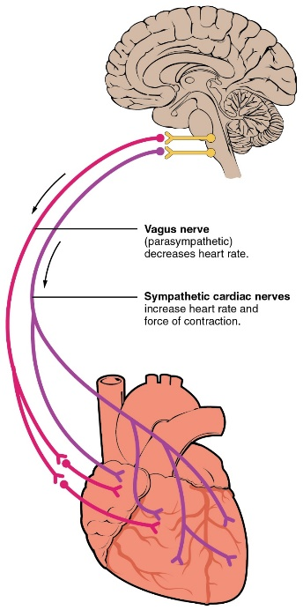

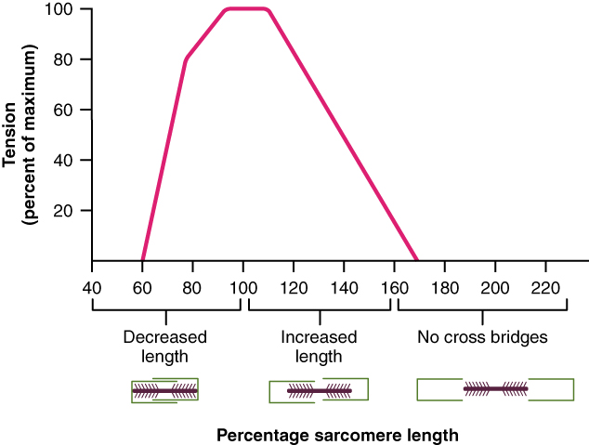
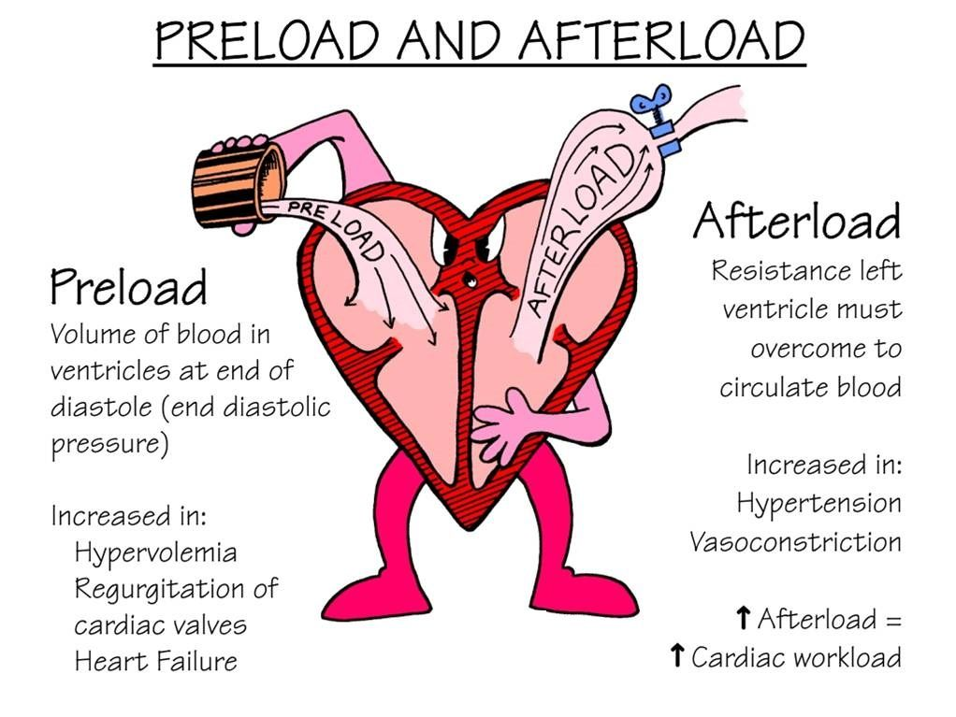
Summary of Impacts on Cardiac Output
❶
❶
Parasympathetic activity decreases heart rate and force of contraction.
Sympathetic activity increases heart rate and force of contraction.
❷
Optimal Length of Sarcomere = Most Force
Note: At rest, cardiac sarcomeres are short, thus stretching heart chambers (with increased volume) makes heart contract with more force, this will increase SV.
❸
Preload and Afterload effect Stroke Volume!
❷
❸

Slide 8
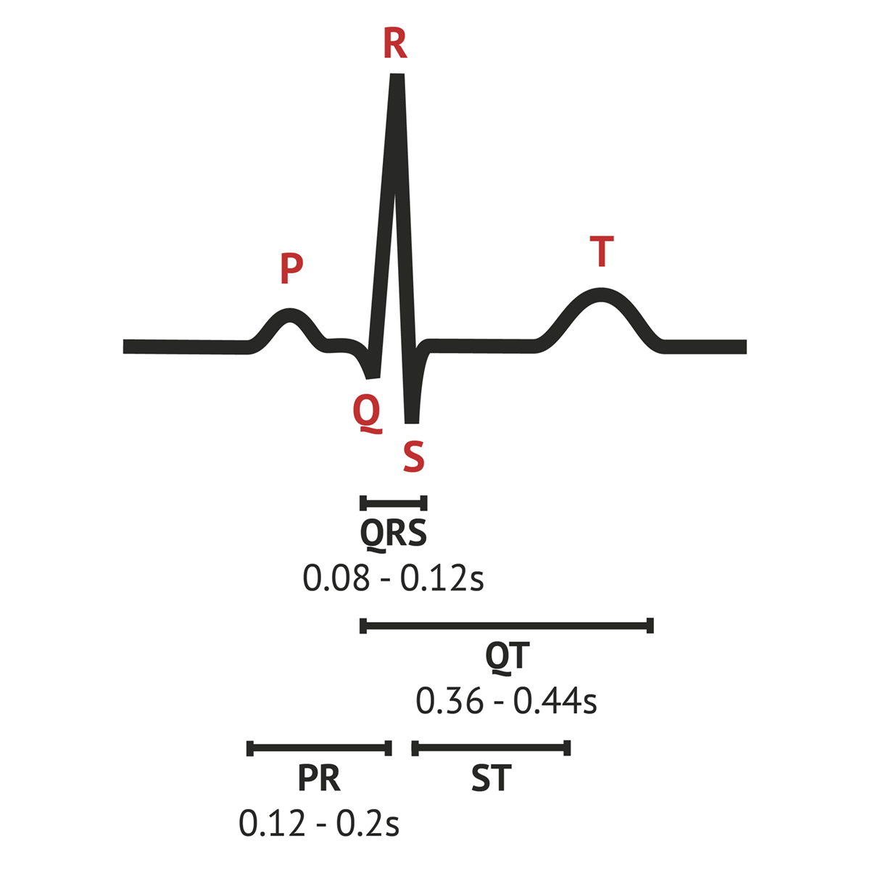
Components of the ECG
General Features of ECG
Wave – Deflection from baseline (+ or - direction).
Segment - A line between waveforms.
Interval - A waveform and a segment.
Complex - Consists of several waveforms.
Take a look at these links…
https://www.youtube.com/watch?v=RYZ4daFwMa8
http://ekginterpretation.weebly.com/cardiac-cycle.html
Specific Waves and Complexes
P Wave -
QRS Complex -
T Wave -
Specific Intervals and Segments
S-T Segment, T-P Segment
PR Segment, P-R Interval
QT Interval

Slide 9
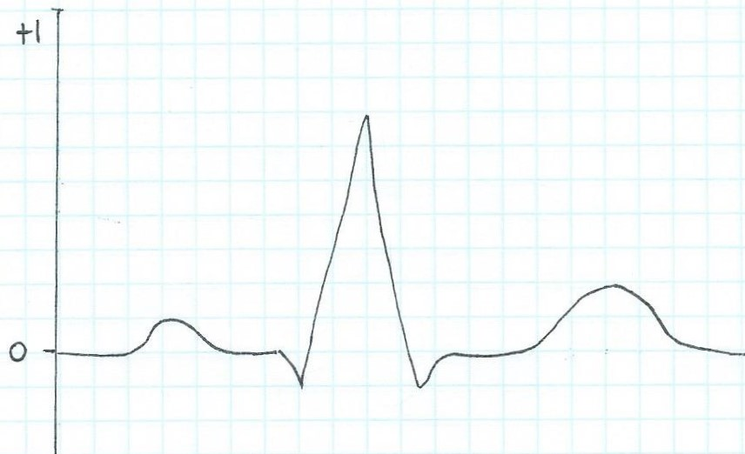
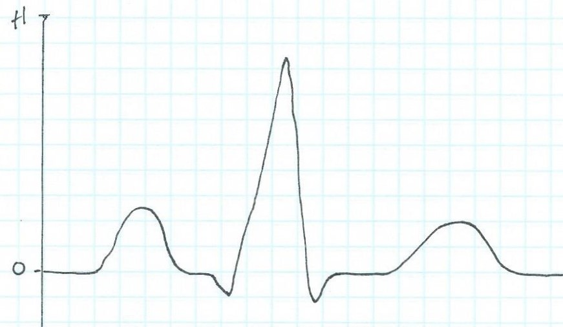
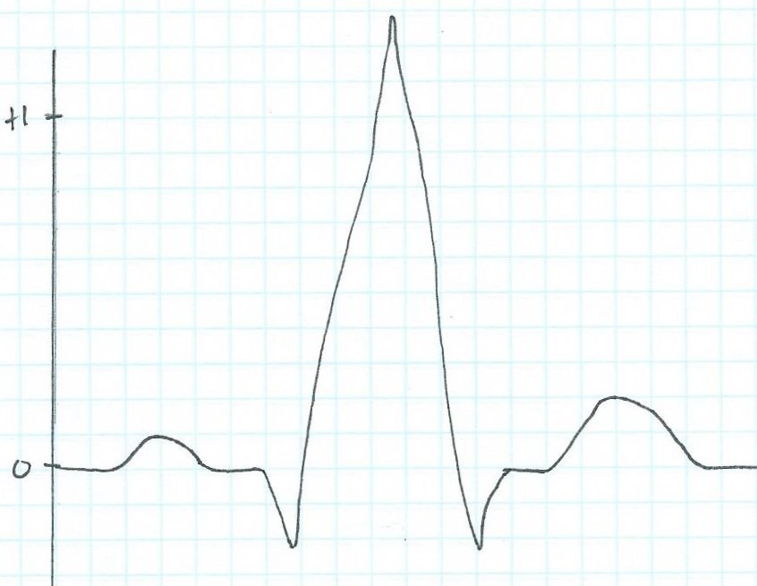
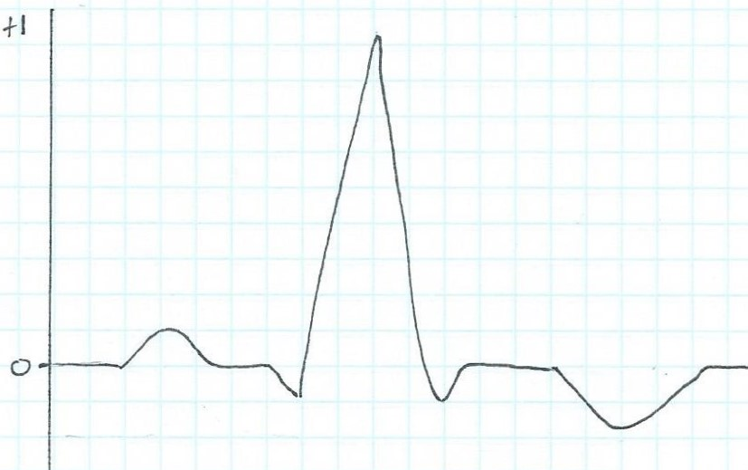
Examine the ECG traces below. Use the Normal ECG trace as a guide. Identify the waves and complexes and state what they indicate. Then find the abnormal component on each of these ECG traces a), b) and c) and suggest what they might indicate:
Normal ECG trace
a)
b)
c)

Slide 10
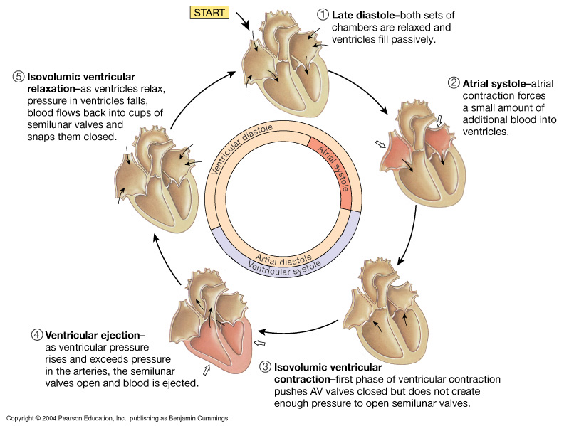
Diastole
Systole
The Cardiac Cycle
http://www.youtube.com/watch?v=rguztY8aqpk

Slide 11
The Cardiac Cycle:
Mechanical Events of the Heart
Late Diastole: “Heart at rest” all chambers relaxed filling with blood (passive filling ~ 80% full).
2. Atrial Systole: atria contract, adds the last 20% of blood to ventricles (top off ventricles)
Occurs after P-wave on EKG
End Diastolic Volume (EDV) = Maximum ventricular volume*

Slide 12
3. Ventricular Systole (part 1):
Ventricular contraction begins - ↑Pressure (P).
Closure of AV valves = 1st heart sound ("lub")
Sealed Compartment – all valves are closed.
Isovolumetric ventricular contraction:
=> pressure builds as volume stays the same.

Slide 13
4. Ventricular Systole (part 2):
Ejection phase: ↑P pushes open semilunar valves, blood forced out into artery leaving ventricle.
Pulmonary Semilunar => 25 mmHg (minimum pressure)
Aortic Semilunar => 80 mmHg (minimum pressure)
End Systolic Volume (ESV) = volume remaining in
heart after ejection (~½)*.
Stroke Volume = EDV - ESV (ml/beat)

Slide 14
5. Ventricular Diastole:
Relaxation of ventricles, artery back flow slams semilunar valves shut = 2nd heart sound ("dup").
Sealed Compartment again – all valves are closed.
Isovolumetric ventricular relaxation:
=> ↓ pressure as volume stays the same.
The AV valves then open, refilling starts –
back to start of cycle.

Slide 15
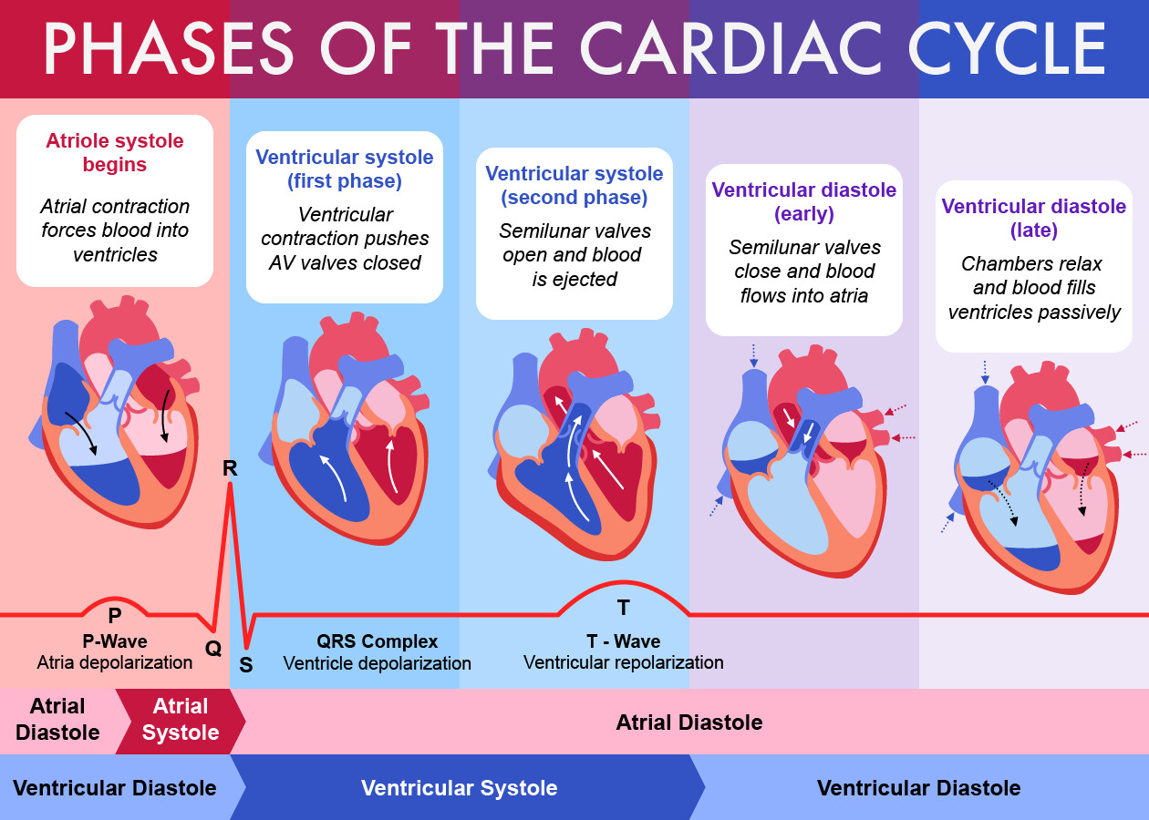
The Cardiac Cycle Summary
❷
❸
❹
❺
❶
Note: For our 5 phases we started here!
This image is nice as it shows chamber blood volumes and major ECG activity. The way we have numbered the phases is different but that does not matter since the titles of the phases are always the same. It’s a ‘cycle’ (circle) so we can start anywhere!

