Slide 1
Articulations
Bone-bone; Bone-cartilage; Bone-teeth
Structural Classification of Articulations
The structural material that brings bones together.
Fibrous – bones brought together by fibers.
Cartilaginous – bones brought together by cartilage.
Synovial – bones joined by an enclosed fluid filled cavity.

Slide 2
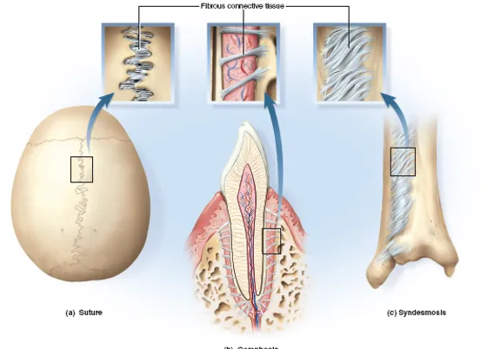
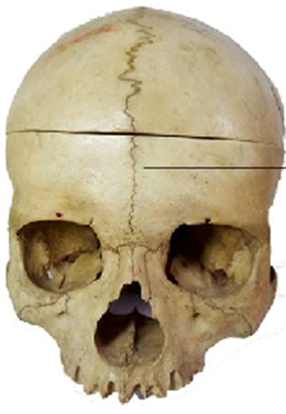
Fibrous Joints
Synostosis
Suture
Syndesmosis
Gomphosis

Slide 3
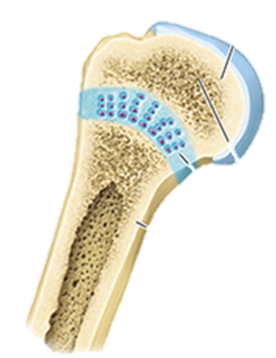
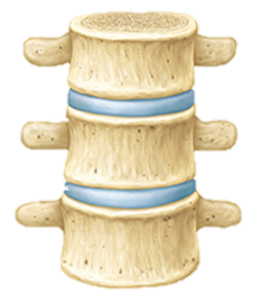
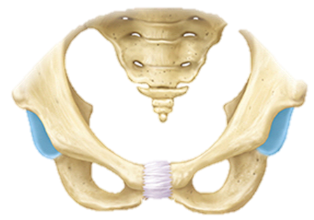
Cartilaginous Joints
Synchondrosis – joined by hyaline cartilage.
Symphysis – joined by Fibrocartilage
Epiphysis
Diaphysis
Epiphyseal plate
intervertebral joints
1st sternocostal joint
Pubic symphysis

Slide 4
Synovial Joints
Generalized Synovial Joint
Articular (joint) Capsule
Outer ‘fibrous’ layer
(dense irregular c.t.)
Inner ‘cellular’ layer
(synovial membrane)

Slide 5
Functional Classification of Articulations
Degree of movement permitted at articulation:
Ranges from: None, to a little bit, to highly movable.
Synarthrosis – no movement possible at these joints.
Amphiarthrosis – slight movement possible at joint.
Diarthrosis – highly moveable at these joints.

Slide 6
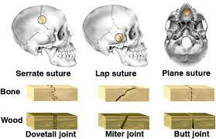
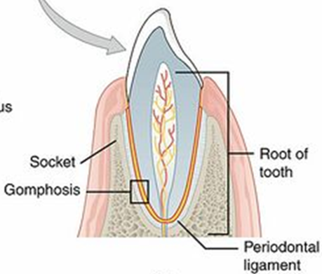
Synarthroses
Sutures – immovable joints of the skull
Gomphoses – tooth in socket

Slide 7
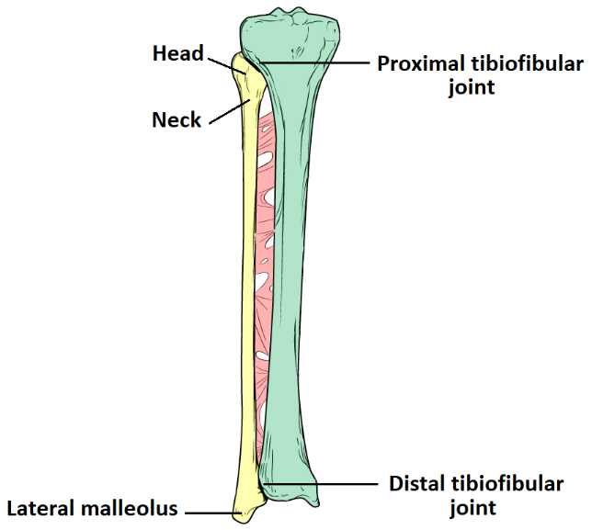
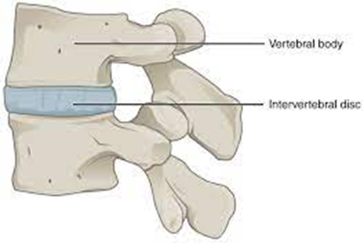
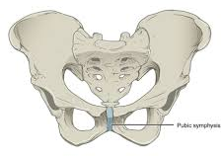
Amphiarthroses
Syndesmosis
Slightly movable fibrous joint.
Symphysis
Slight movement with fibrocartilage
①
①
Interosseous
membrane
Cartilaginous joint uniting bodies
of adjacent vertebrae
②
②
Pubic symphysis of pelvic girdle

Slide 8
Diarthroses
Joints characterized by their high mobility and having a joint cavity within a synovial membrane encased in the joint capsule.
Diarthrotic joints are also known as Synovial joint
Gliding (Planar)
Hinge
6 Types of
Synovial
Joints
Pivot
Ellipsoidal/Condyloid
Saddle
Ball and Socket

Slide 9
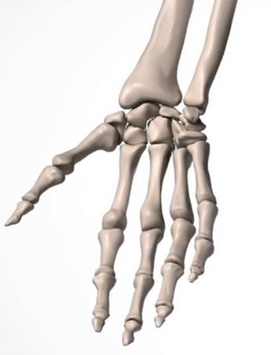
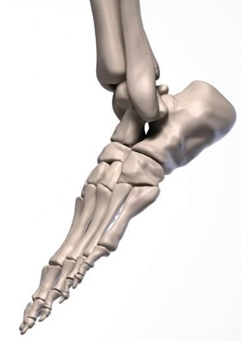
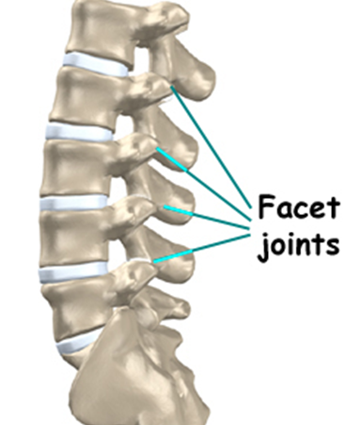
Gliding Joints
These joints occur as short boxy bone surfaces move past each other. See at wrist, ankles, and spine.
1) Carpals of the hand Intercarpal joints
2) Tarsal joints of foot
(navicular w/ 2 cuneiforms)
Intertarsal joints
3) Vertebral Column
Facets of intervertebral joints

Slide 10
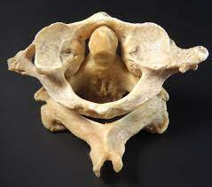
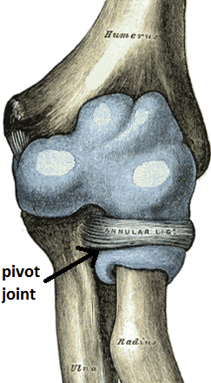
Pivot Joints
1) Atlantoaxial joint
Formed between the atlas (C₁) and the axis (C₂) cervical vertebrae of neck.
For the “no” gesture,
Shaking head left to right.
2) Proximal radioulnar joint
Consists of the radial head articulating with the radial notch of the ulna. The disc-like head of radius tightly bound by the annular ligament securing it in place.
Allows the pivot action of pronation/supination.

Slide 11
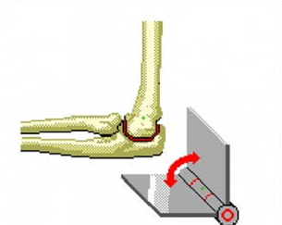
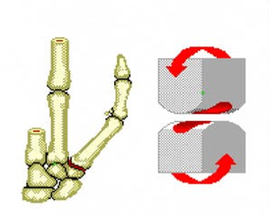
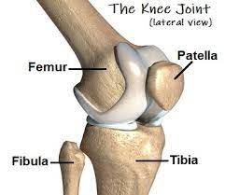
Hinge Joints
1) Humeroulnar joint of the elbow.
2) Interphalangeal joints of the hand.
3) Tibiofemoral join of the knee.

Slide 12
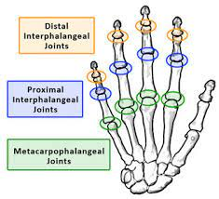
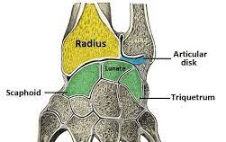
Condyloid/Ellipsoid Joints
1) Metacarpophalangeal joints II through V.
Large convex heads of distal aspect of metacarpals articulate with concave-shaped proximal aspect phalanges
2) Distal radiocarpal joint of the wrist

Slide 13
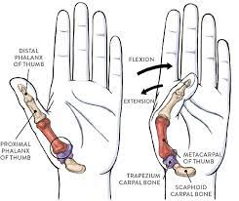
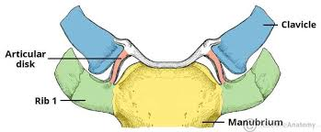
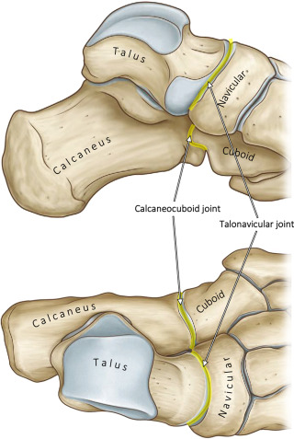
Saddle Joints
1) 1st Carpometacarpal joint – the thumb joint (trapeziometacarpal)
2) Sternoclavicular joint of the thorax
3) Calcaneocuboid
joint of the heel
Note: The most compelling example of a saddle joint in the body is the thumb (trapeziometacarpal) joint!

Slide 14
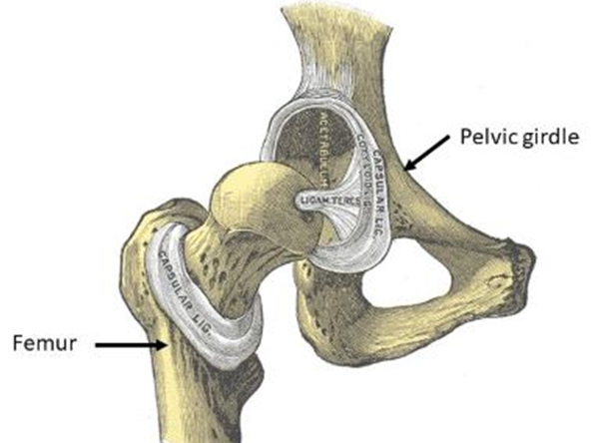
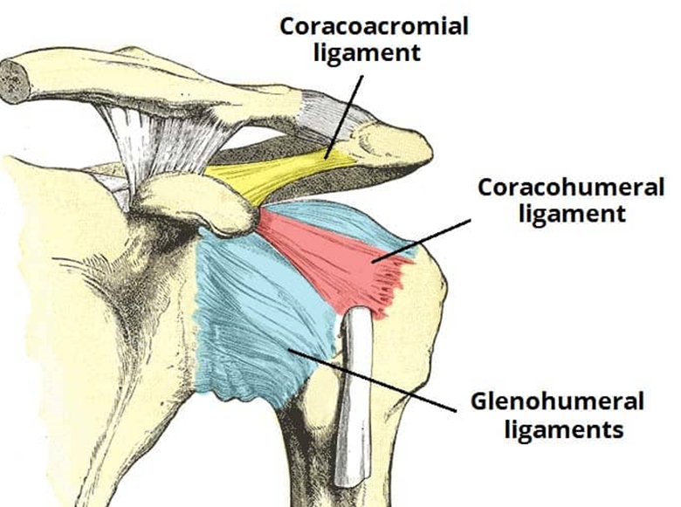
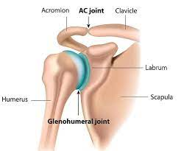
Ball and Socket Joints
1) Hip joint of the pelvic girdle.
Articulation of head of femur
and acetabulum of pelvis
2) Shoulder joint of pectoral girdle.
the glenohumeral joint. Articulation of head of humerus with glenoid cavity.

Slide 15
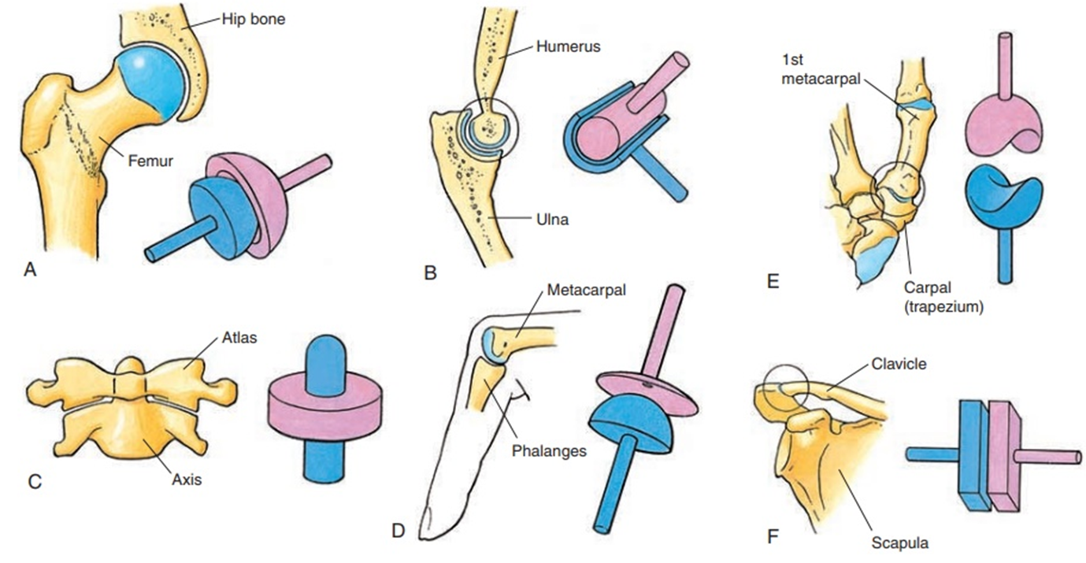
The 6 Types of Synovial Joints
a)
b)
c)
d)
e)
f)
a) Ball and Socket; b) Hinge; c) Saddle;
d) Pivot; e) Ellipsoidal/Condyloid; f) Gliding (Planar).

Slide 16
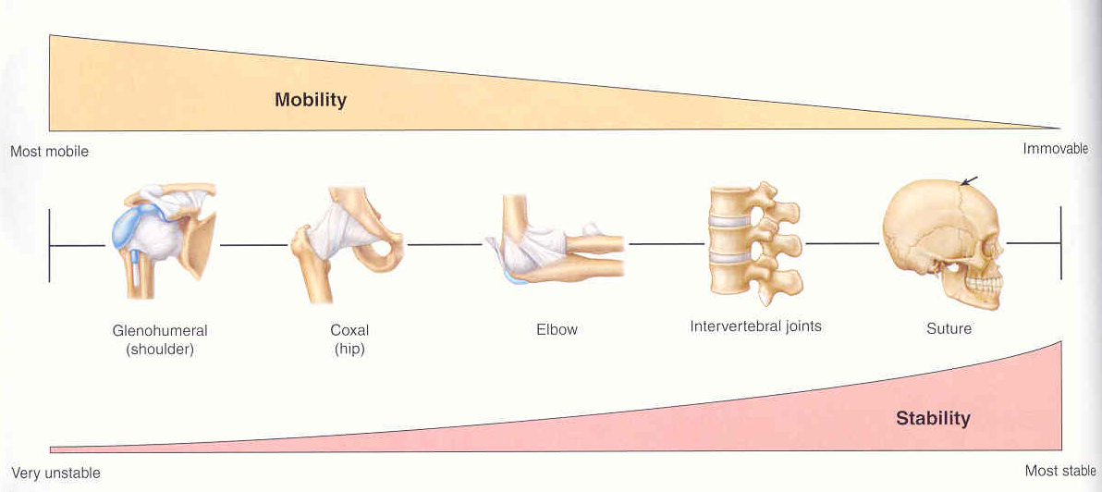

Slide 17
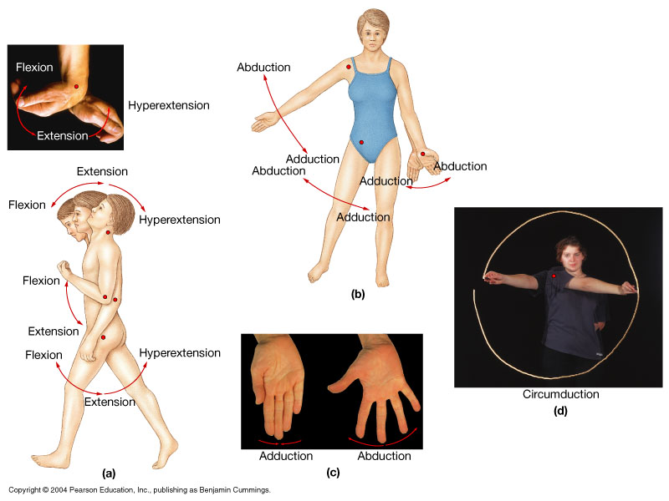
Movements (Actions) at Articulations

Slide 18
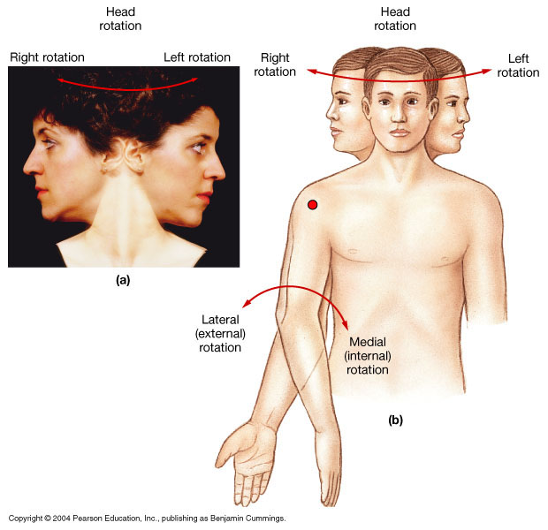

Slide 19
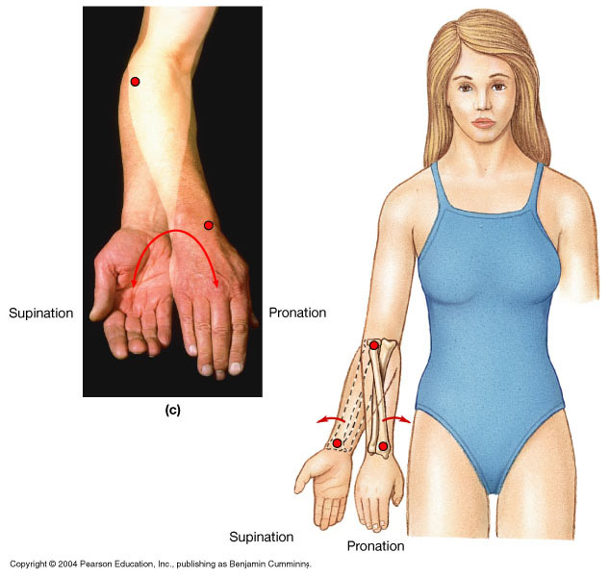

Slide 20
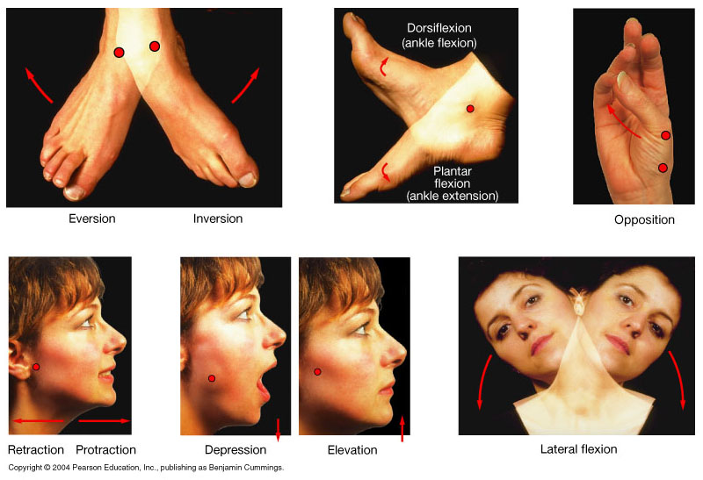

Slide 21
Structures that Stabilize
Synovial Joints
Ligaments
Menisci
Bursae
Fat pads
Tendons

Slide 22
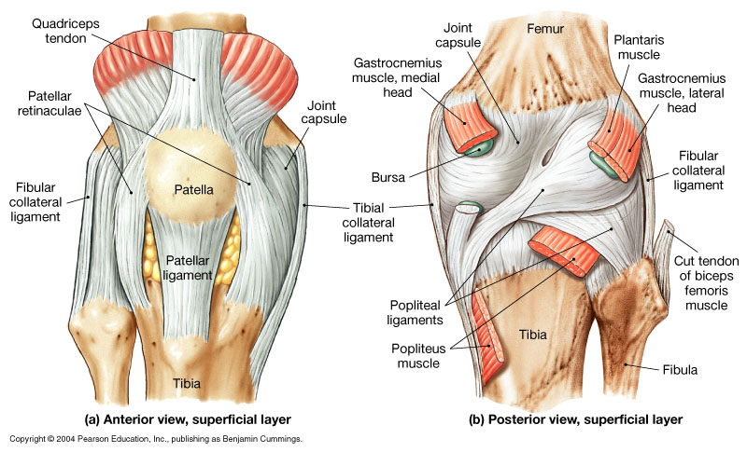
Diagrammatic Knee Joint

Slide 23
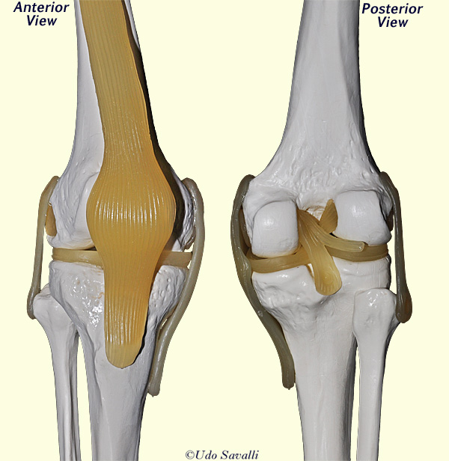
The Knee Joint

Slide 24
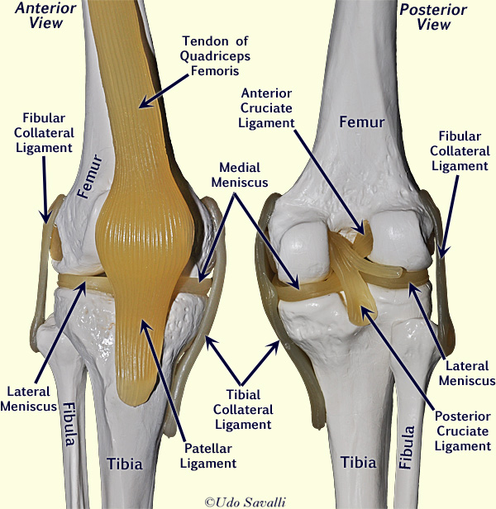
The Knee Joint

Slide 25
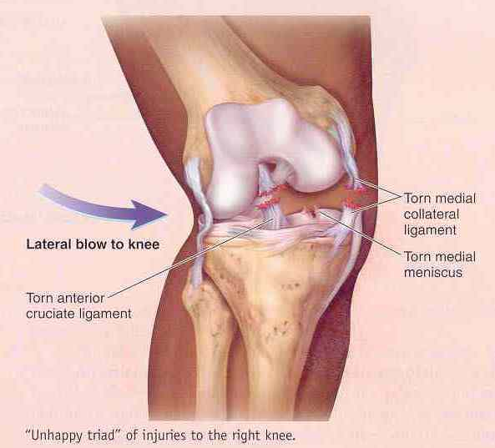

Slide 26
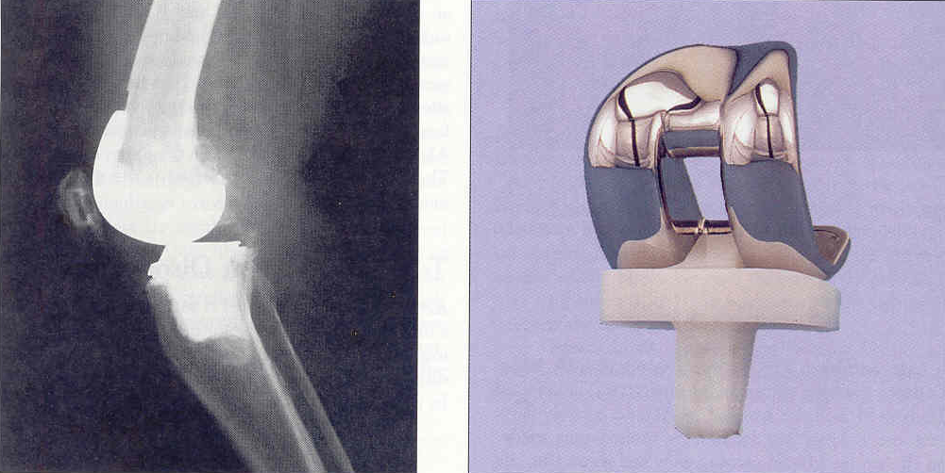

Slide 27
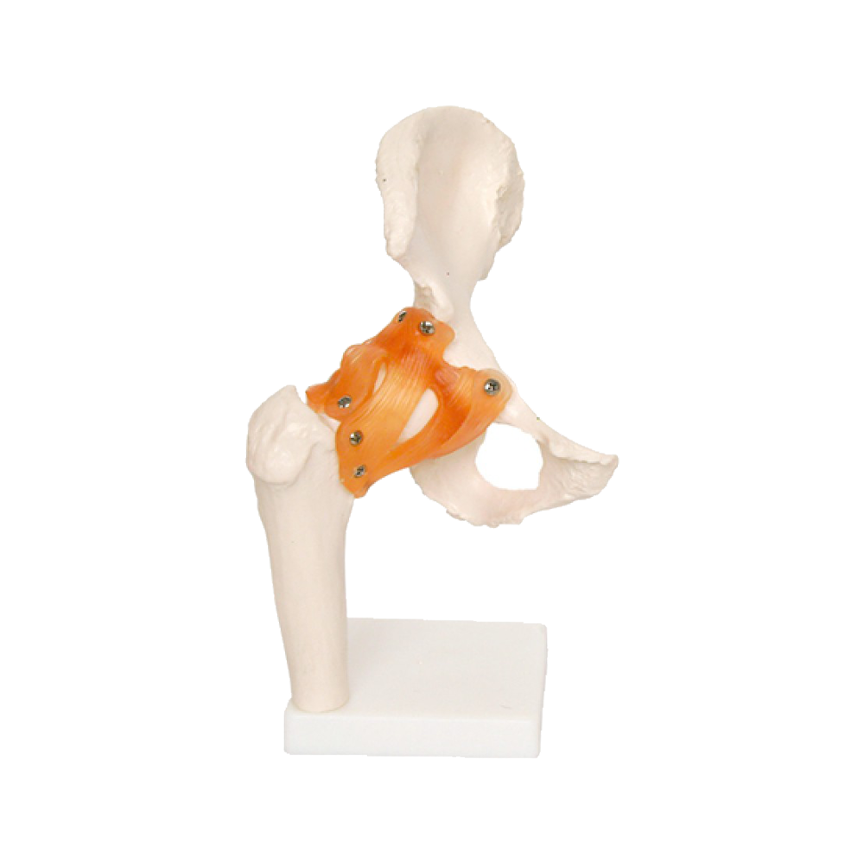
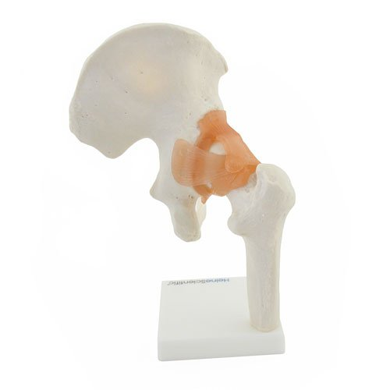
The
Hip
Joint
Plus the don’t forget the ligamentum teres connecting the fovea capitis to the acetabulum
Iliofemoral
ligaments (n=2)
Ischiofemoral
ligament
Pubofemoral
ligament
Pattern: 1st part = name of bone ligament is coming from on os coxa (3 choices).
2nd part = femoral.

Slide 28
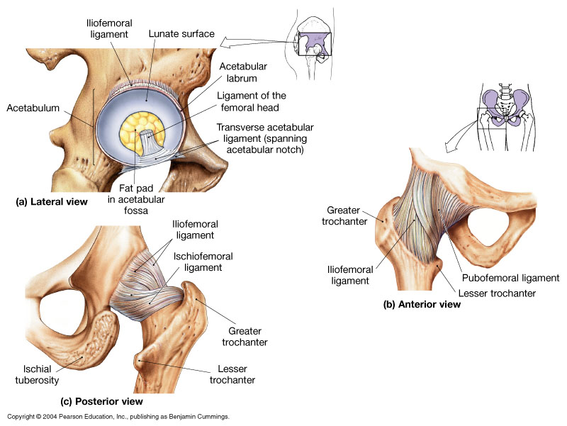
Hip Joint

Slide 29
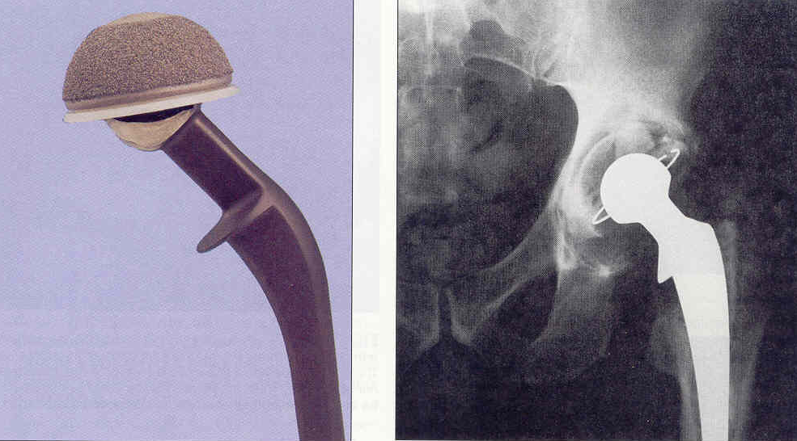
A ‘Hip Fracture’ is the breaking of which structure? ______________
Hip Replacement Procedure

Slide 30
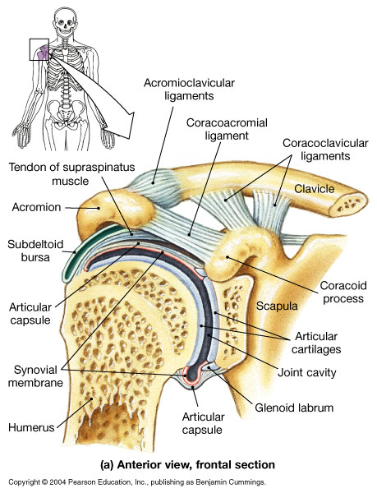
Shoulder Joint

Slide 31
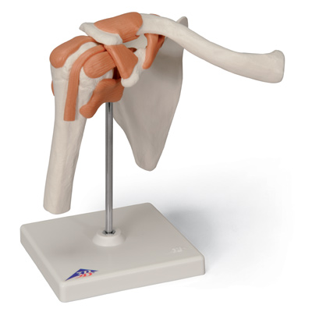
Acromioclavicular ligament
The Ligaments of the
Shoulder
Joint
Coracoclavicular ligaments
(n =2)
Coracoacromial ligament
Segments of articular (joint) capsule
Pattern: The coracoid is a big shot and always gets named 1st ; then the acromion; the poor clavicle is always last.
Tendon for long head of biceps brachii

Slide 32
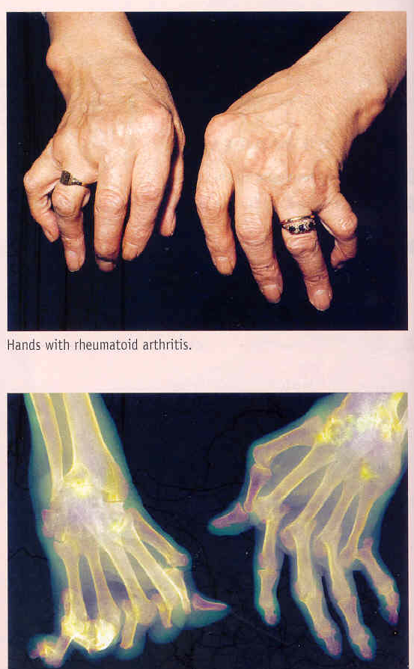

Slide 33
Disorders of Articulations
Arthritis: Inflammation of a synovial joint, that is often painful and restricts movement at that joint.
Osteoarthritis: “Wear and tear” age-related arthritis, due to use of the joint.
Rheumatoid Arthritis: Autoimmune disease, in which the body’s defense cells attack synovial joints.
Ankylosis: Abnormal fusion of a joint, restricting normal movement.

Slide 34
Disorders of Articulations
Bursitis: Inflammation of a bursa, causing pain when ever the associated ligament or tendon moves.
Gout (Gouty Arthritis): Uric acid deposits in synovial joints and crystallizes there, causing pain and restricting movement.
Sprain: When a ligament is stretched beyond normal, to where some collagen fibers are torn.
Luxation: Dislocation, when articulating surfaces are forced out of anatomical position.

