Slide 1
Campus Safety: A Shared Responsibility
Miramar's Inaugural
Women’s Empowerment Week
March 24-28, 2025

Slide 2
Collaborative Planning Efforts
1st Event | 2nd Event | 3rd Event | 4th Event
3/24 | 3/25 | 3/26 | 3/27
Opening Day Zine-making Workshop (Session 1) Self-defense class (Session 1) | Title IX Presentation "How To Be Safer on Campus During These Difficult Times" | Self-defense class (Session 2) Women in STEM Girls Who Code Club Spectrum Zine-making Workshop (Session 2) | Film and discussion A Focus on Mental and Physical Health

Slide 3
The Crew
Amy Alsup
Elaina Taylor
Jeanette Moore
Heather Paulson
Sharilyn Wilson
Anchal Verma
Marcy Sawyer
Angela Romero
Anne Gloag
Mardi Parelman
Xtopher Ruiz
Valerie Chau
Jennifer Aase
Joseph Hankinson
Michael Tiong
Laura T. Gonzalez
Olivia Flores
Carmen Carrasquillo

Slide 4
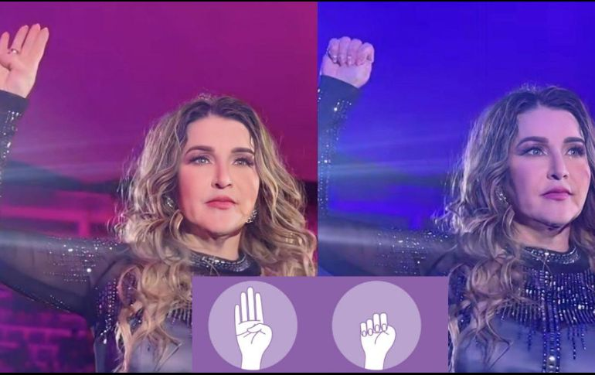
Thank you!
Campus safety is a shared responsibility...
Join us!
Ideas or support you can offer?
GAIA Feedback Form

