Slide 1
Budget & Resource Development Subcommittee
February 12, 2025
TREY research

Slide 2
2025-26 Governor's January Budget – January 10, 2025
California State Budget has a proposed increase of 8% to $322.2B
The proposed state budget is balanced with a modest surplus of $363M
California Community College system has proposed increased spending in
Apportionment COLA of 2.43% - $230.4M
Targeted Categorical COLA – $28.7M
EOPS, DSPS, CalWORKs, Apprenticeship, CARE
Systemwide enrollment growth of 0.5% - 30.4M
One-time and ongoing funding to establish a Systemwide Common Data Platform and scaling up Credit for Prior Learning policies
Scale up CPL - $93M one-time, $7M ongoing
Base increase to Rising Scholars - $30M
Allocation to Nursing Infrastructure Grant of $60M will continue to impact SWP
One-time funding for 3 years for LGBTQ+ Student Support pilot - $10M
Categorical with no proposed COLA or increase
SWP, California Promise, NextUP, Basic Needs Centers, MESA
Next budget update will be May 15
Final budget by June 30

Slide 3
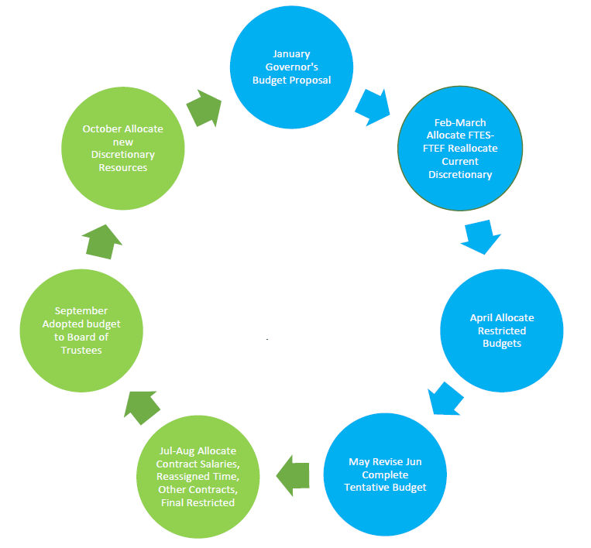

Slide 4
2025-26 Tentative Budget Development – Discretionary Reallocation
Worksheets distributed to Managers February 4, 2025
Worksheets due back to Business Office March 4, 2025
Total Discretionary budget remains at 2024-25 amount
Allocated by formula - FTES Target X $100
$1,006,657
Opportunity to reallocate current resources to meet budget objectives for the 2025-26 fiscal year
New Discretionary resources, if any, will be allocated in October

Slide 5
2025-26 Tentative Budget Development – Discretionary Reallocation

Slide 6
Process Review – Request for New Resources, Adopted Budget
Export request for resources from Nueventive
Sort for ONGOING requests
Sort for Type of Request = DEPARTMENT DISCRETIONARY BUDGET INCREASE
Remove Title Duplicates caused by Unit Goal Alignment
Sort for PROGRAM combine and send to Dean/Manager/Director
Dean/Manager/Director rank prioritize with Dept Chair / Lead
Dean/Manager/Director select resource request and transfer to Request for New Resource form
Title
Amount
Unit Goal Alignment
Priority/Rank
Example

Slide 7
Questions ?

