Slide 1
Integumentary* System
*From Latin integumentum "a covering," from integere "to cover over“.
Superficial Epidermis (epithelial tissue)
Cutaneous
Membrane
(Skin)
Deeper Dermis (connective tissue)
Accessory Structures
Hair and Hair Follicles
Exocrine Glands
Nails

Slide 2
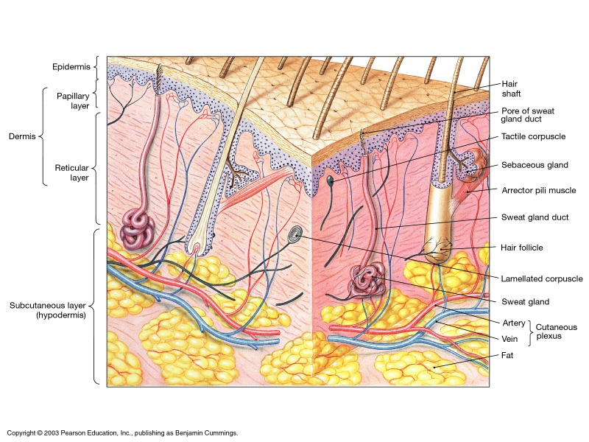
The Integumentary System

Slide 3
Functions of the Integumentary System
1) Physical Barrier from Environment
2) Regulation of Body Temperature (T_{b})
3) Secretions and Excretions
4) Vitamin D Synthesis
5) Sensations (receive sensory info)
6) Immunological Defense

Slide 4
Integument
Cutaneous Membrane
+
Accessory
Structures
=
1. Epidermis
2. Dermis
Hair and Follicles
1. Stratified squamous
- Protection
- 4 or 5 layers
2. Exocrine Glands
Sebaceous
Sweat (2 types)
2. Areolar and Dense Irreg
Papillary – superficial 1/5
Reticular – deep 4/5
3. Finger and Toe Nails

Slide 5
Epidermis = Stratified Squamous Epithelium.
The thickness of the epidermis varies.
Thin skin = ?
Thick skin = ?

Slide 6
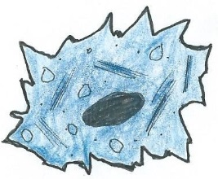
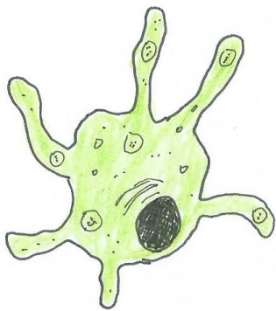
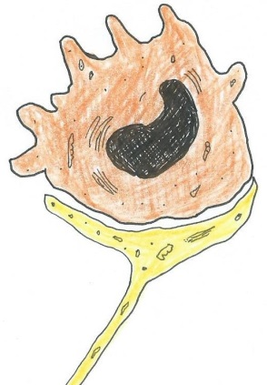
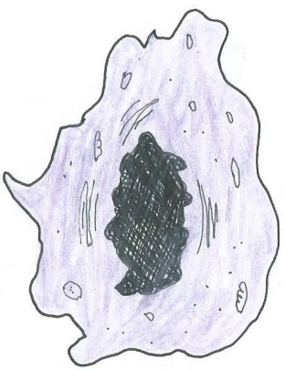
Cells of the Epidermis
1. Keratinocytes
Most abundant cell (80-90 % of cells in epidermis).
Produces keratin, a hydrophobic lipoprotein,
guards against water loss.
2. Melanocytes
Produce the dark pigment melanin.
For protection against UVA rays
(10-20% of cells in epidermis).
3. Merkel cells
Cells for nervous sensation in the epidermis
Coupled with ‘nerve ending’ discs.
4. Langerhans cells
Large defense cells in the epidermis;
phagocytose substances.

Slide 7
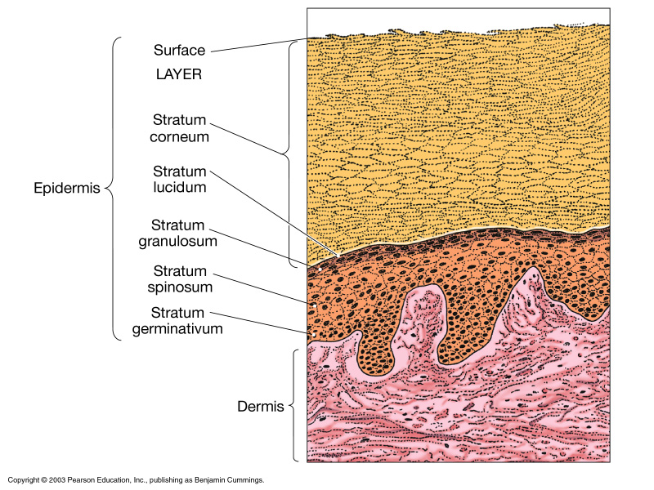
The Epidermis
Stratum Corneum:
Most superficial layer,
many layers of dead cells.
Stratum Lucidum:
Translucent layer,
only in thick skin.
Stratum Granulosum:
Has dark staining granules.
Stratum Spinosum:
Can appear “spiny”.
Stratum Basale or Germinativum:
Division of basal cells, produces new keratinocytes (+ the other cells).
The Dermis

Slide 8
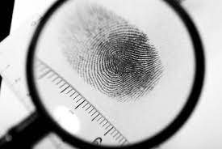
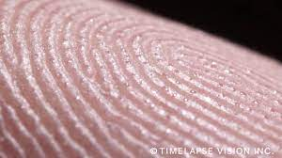
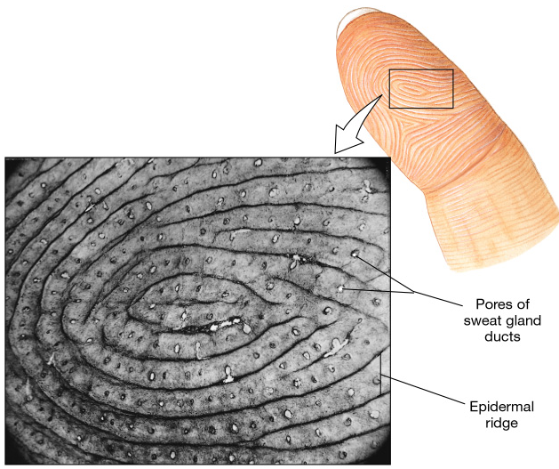
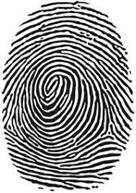
Role of Fingerprints?

Slide 9
The Dermis
Papillary Layer (areolar C.T.)
– nourishes and supports the epidermis.
Reticular Layer (Dense Irreg C.T.)
– attaches skin to deeper tissues.
– restrict spread of pathogens (defense).
– sensory perception (touch, pressure, pain).
– thermoregulation via blood vessels.
– many accessory structures located here.

Slide 10
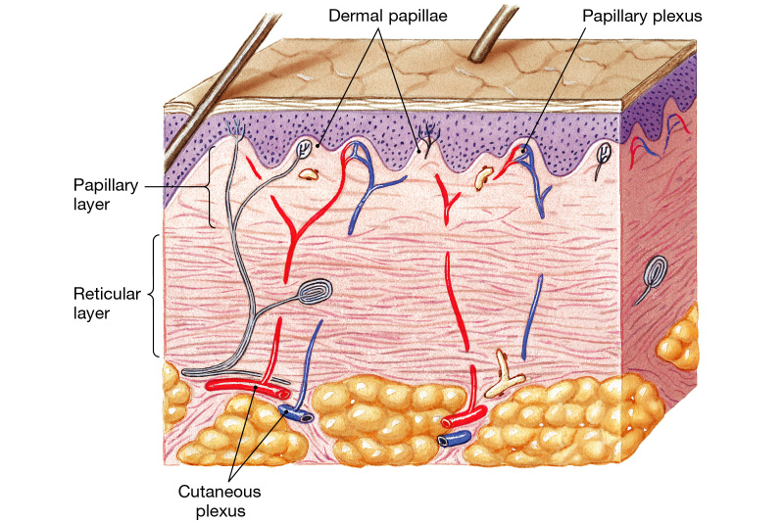
The Dermis

Slide 11
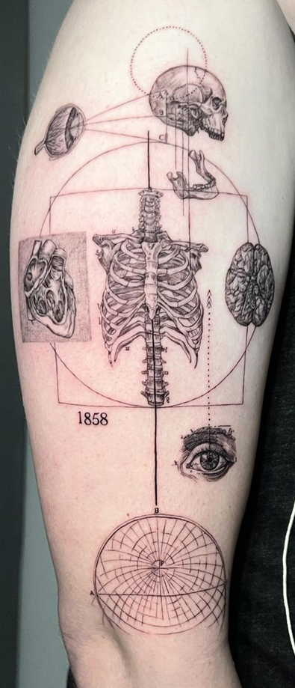
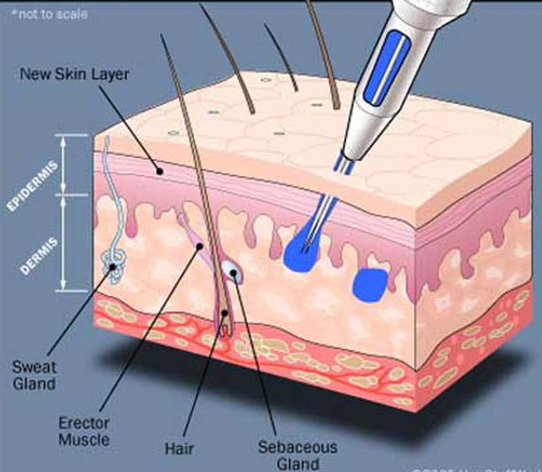
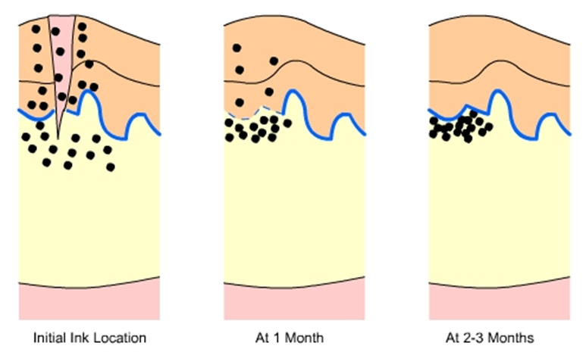
Anatomy of a Tattoo

Slide 12
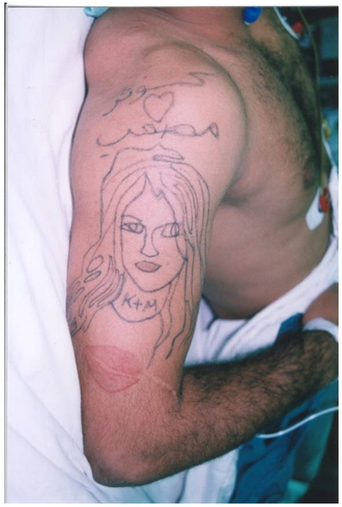
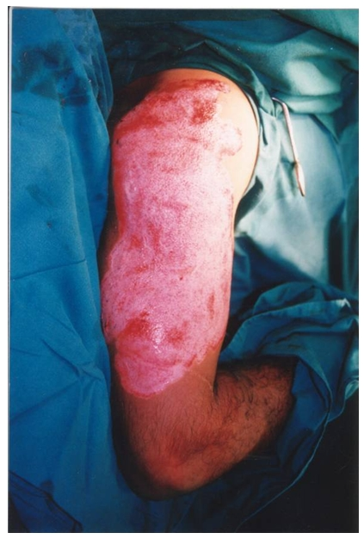
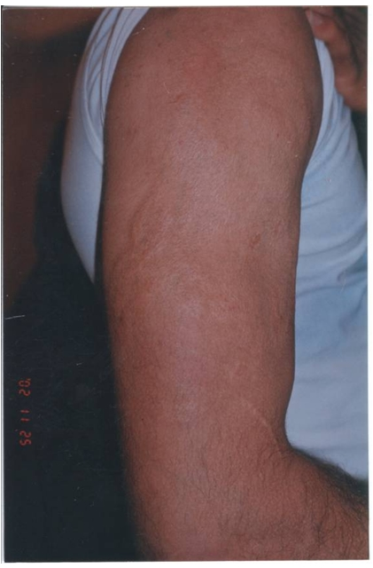

Slide 13
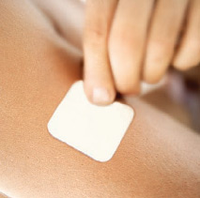
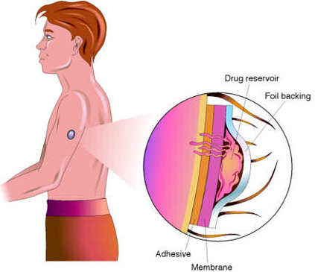
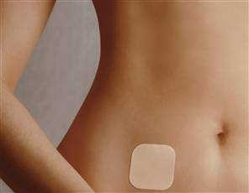
Do substances get into your bloodstream
from being in contact with your skin?
What factors would be important?
What are some examples?

Slide 14
The Subcutaneous Layer
Hypodermis
Superficial Fascia
Roles
Stabilizes skin’s position.
- Permits limited independent movement.
Provides insulation and protection.

Slide 15
Skin Color
Depends on 3 Things:
1. Melanin: amount = darkness.
2. Carotene: from diet.
3. Hemoglobin (Hb) + amount of blood:
HbO₂ = red
Hb without O₂ = blue/purple
*If skin is thin, blood supply deep to it can be seen.
Jaundice, Pallor, Cyanosis, Albinism, Erythemia, Hematoma

Slide 16
Accessory Structures of the Skin
Shaft
a) Hair
b) Hair Follicle
- medulla
- cortex
Root
Bulb
Roles of Hair:
- Protection
- Insulation
- Sensation?
Hair Root
Cross Section (x.s.)
Hair shaft
Longitudinal Section (l.s.)

Slide 17
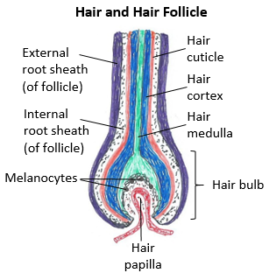
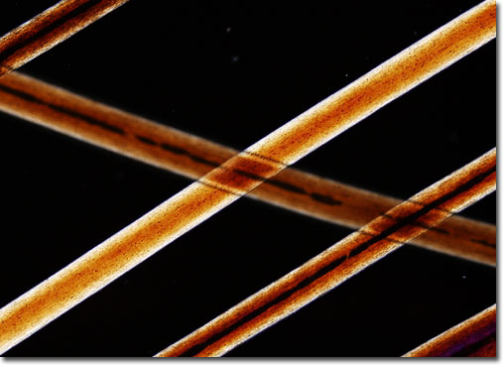
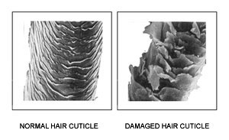
Hair and the Hair Follicle
The Hair shaft has 3 layers:
Medulla - innermost layer, has large cells.
Cortex - layer between cuticle and medulla, contains keratin and pigment, the bulk of hair.
Cuticle - the outermost layer; transparent and protects the inner layers. A healthy cuticle can give hair a shiny appearance.

Slide 18
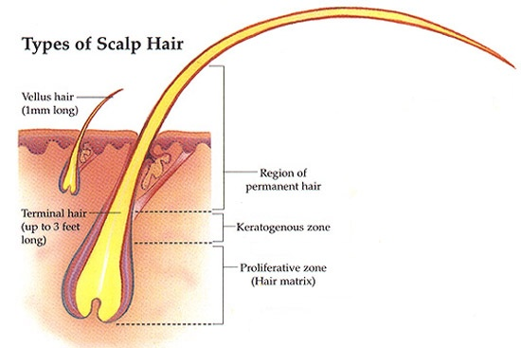
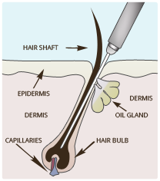
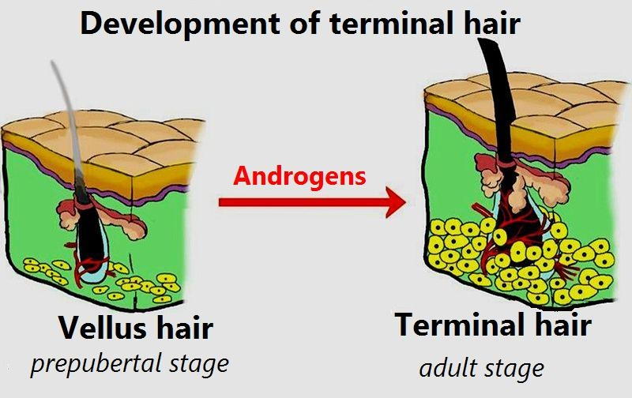
Basic types of Hair
Vellus Hair - short, fine, lightly-colored hairs on a large % of body as a child. This hair helps regulate T_{b}. Only 0.5 cm long.
Terminal Hair - thick, long, darker hair, e.g. scalp hair. Can be many feet long.
Lanugo Hair – thin, soft, unpigmented baby hair covering unborn and newborn babies.
Hair Removal
by Electrolysis

Slide 19
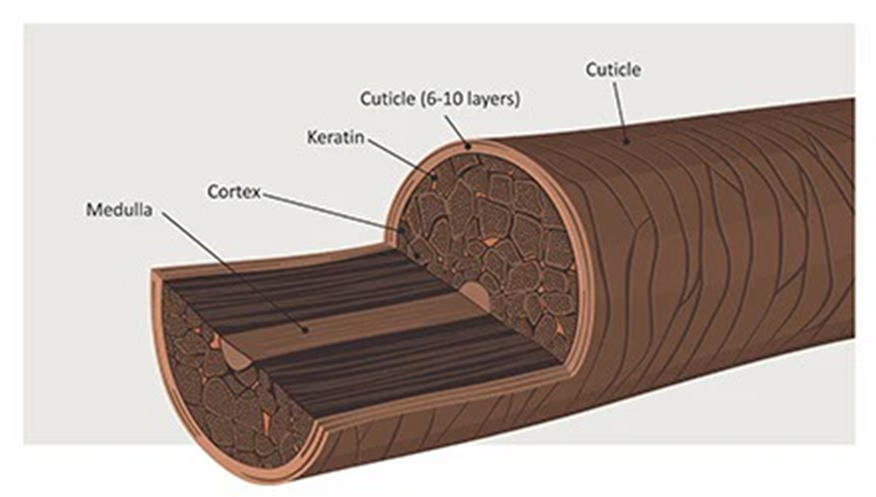
Hair Color and Texture
Hair Color:
Determined by the amount of melanin in hair bulb.
More Melanin – Darker Hair
Less Melanin – Lighter Hair
Air Bubbles in Medulla – White Hair!
*If hair is Red, this is another iron (Fe) containing pigment,
called trichosiderin.

Slide 20
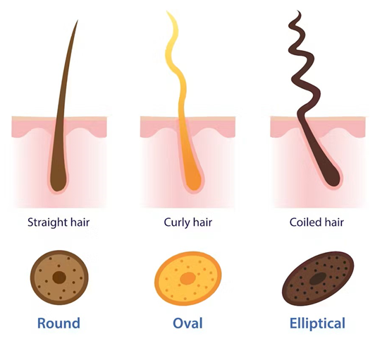
Hair Color and Texture
Hair Texture:
Mostly determined by cross section of hair shaft.
Round – Straight Hair.
Oval – Curly Hair.
Flat (Elliptical) – Kinky Hair.

Slide 21
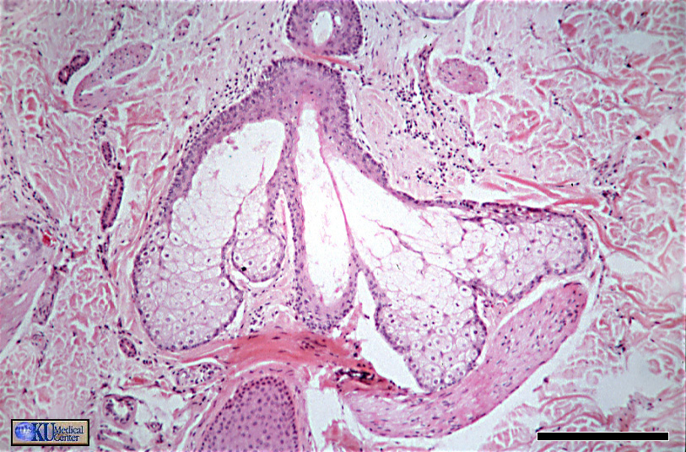
2. Exocrine Glands
Sebaceous (Oil) Glands
- Sebaceous Glands secret sebum onto hairs.
Sebaceous Follicles are large sebaceous glands not
associated with hair.

Slide 22
Sebaceous Glands

Slide 23
Sudoriferous (Sweat) Glands
1) Merocrine Sweat Glands
Thin, watery, sensible perspiration, more numerous than apocrine, highest density on palms and soles.
2) Apocrine Sweat Glands
Thicker, lipid rich secretion, only in specific regions of the body, e.g., axillary and inguinal regions.
Modified Apocrine Sweat Glands
Mammary Glands
Large, complex apocrine sweat glands, produce milk as nourishment for babies.
Ceruminous Glands
Produces waxy cerumen (ear wax), found in ear canal to keep eardrum protection and pliable.

Slide 24
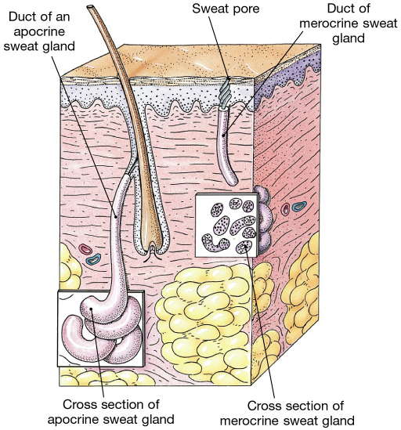

Slide 25
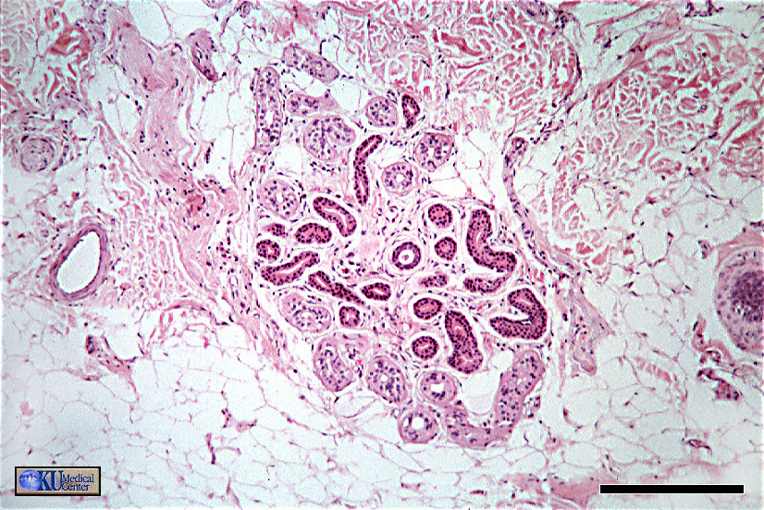
Sudoriferous (Sweat) Gland

Slide 26
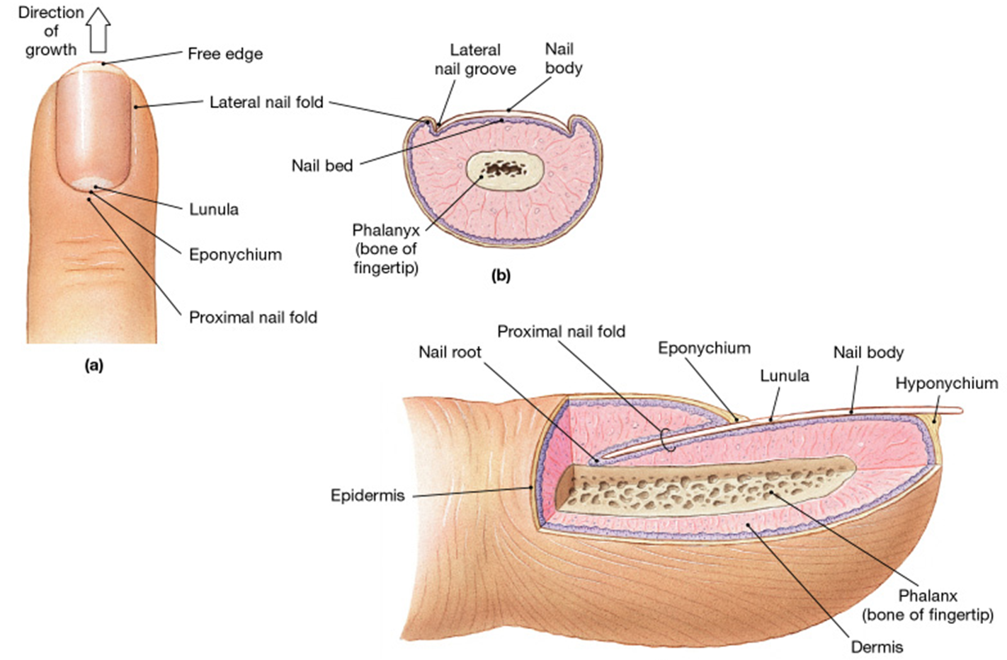
3. Finger and Toe Nails

Slide 27
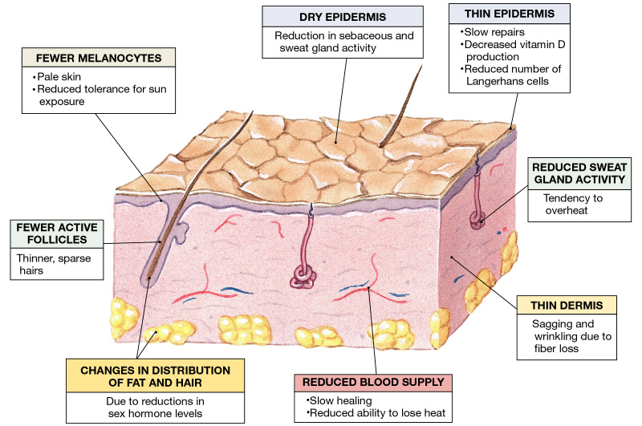
Aging of the Integumentary

Slide 28
Burns and the Integument
Tissue
Damage
Tissue
Appearance
Recovery
and Risks
1st Degree
Epidermis is
Damaged (or destroyed)
Red in color
2-3 days
Painful (tender)
Papillary of Dermis
May be damaged
Skin cancer from
Repeated burn
Mild edema
2nd Degree
Epidermis is
Destroyed
Blister
1-2 weeks
Painful
Typically don’t pop
blister (infection)
Dermis is Damaged
+ assoc. structures (=?)
Edema
3rd Degree
Epi & Dermis are
both Destroyed
Charred, black or
white in color
6 months
- Infection
Deeper tissue
Damage (e.g. ?)
May not be
painful
- Dehydration

Slide 29
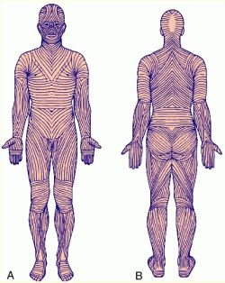
Lines of cleavage follow lines of tension in the skin.
Created by fiber patterns within the skin.

Slide 30
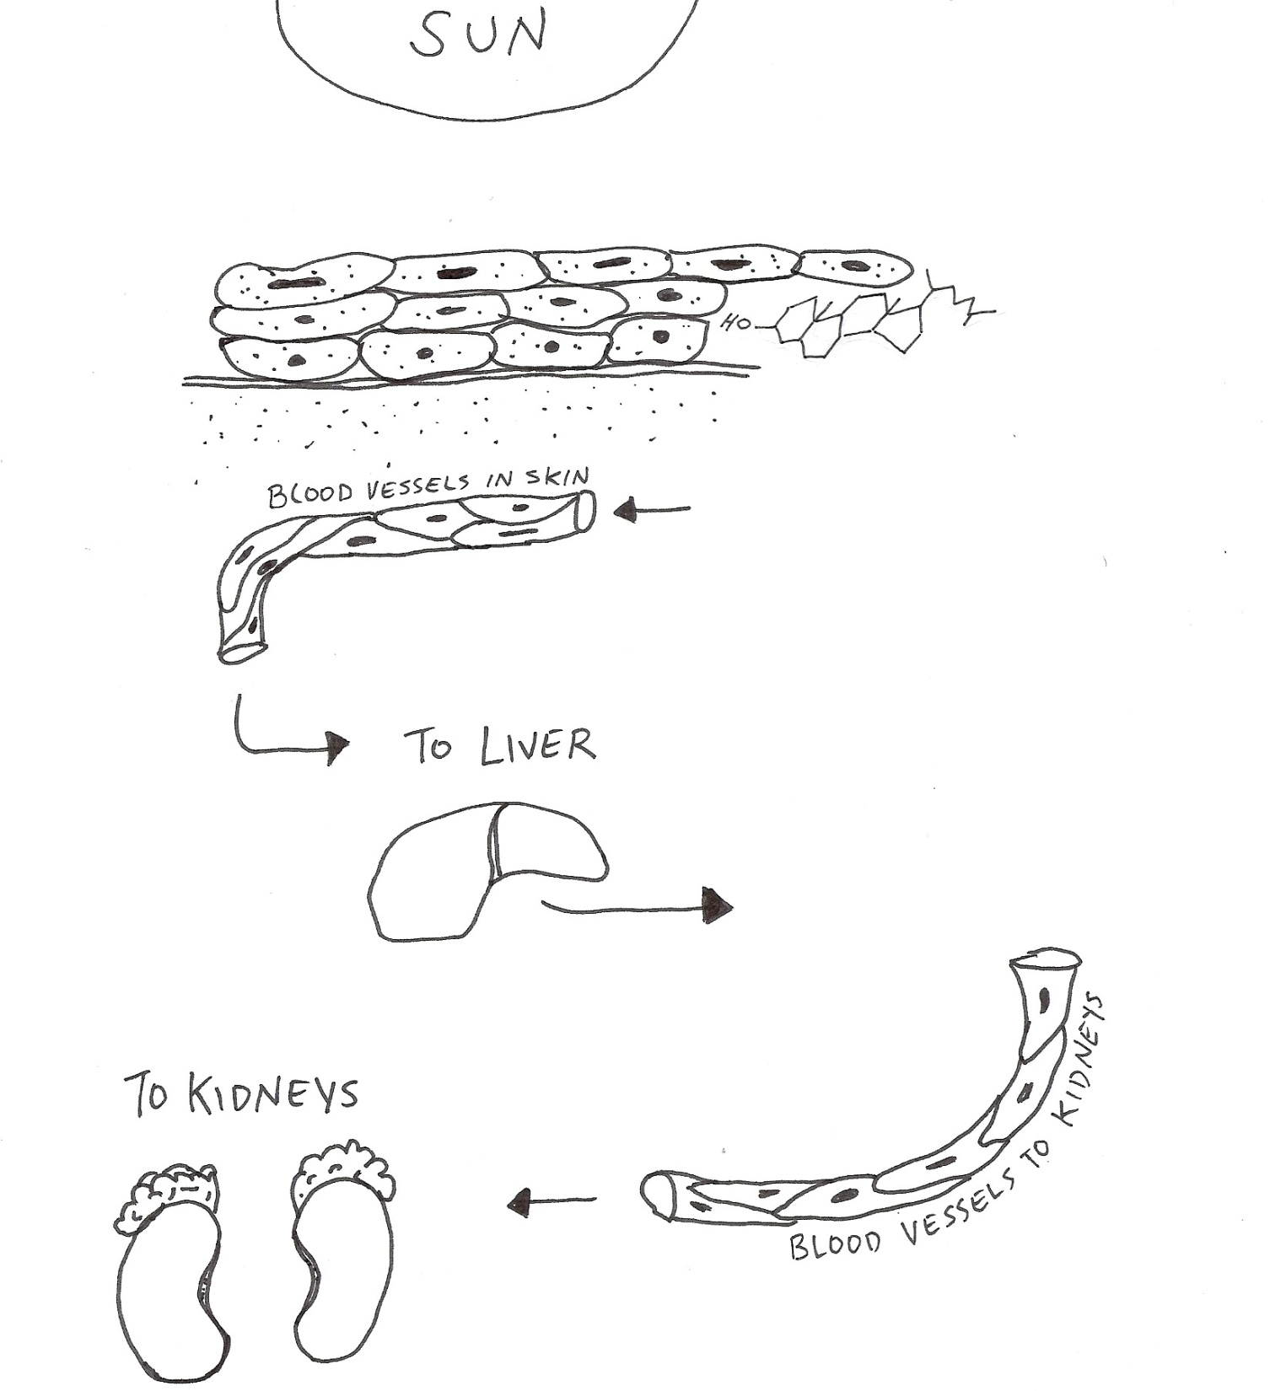
The story
of Vitamin D
UVB
Light
UVB
Light
UVB Light
+
Epidermis of Skin
7-dehydrocholesterol
Dermis of Skin
Cholecalciferol
(Vit D₃)
Your cells only make Vitamin D if UV stimulation is adequate (~20 min/day)
“Calcidiol”
25-Hydroxycholecalciferol
(25-Hydroxy Vit D₃)
Allow your healthy Liver to process Vit D₃ into Calcidiol.
Allow your healthy Kidneys to process Calcidiol into the
most active form, Calcitriol.
ACTIVE FORM
“Calcitriol”
1,25-Hydroxycholecalciferol
(1,25-Hydroxy Vit D₃)

