Slide 1
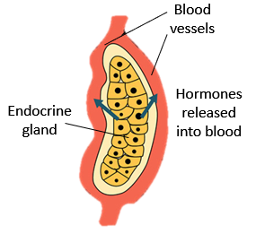
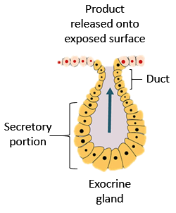
Glandular Epithelia
Endocrine Glands
Secretes hormones directly into interstitium then into blood stream. These glands have no ducts. Hormones travel via blood stream all over body, only have effect on tissues with receptors for that hormone = “target tissue”.
Exocrine Glands
Secretions made by cells and discharged through ducts onto an exposed surface.
Exocrine Glands can be Classified by:
Structure of gland
Type of secretion produced
Mode of secretion

Slide 2
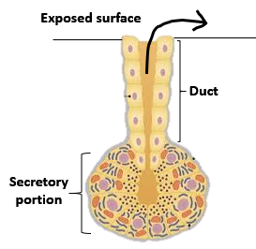
Classifications of Exocrine Glands
How many cells? One cell = Unicellular. Many cells = Multicellular.
1. Structure (of multicellular) glands:
1) Simple (one duct) or Compound (many ducts).
2) Shape od Secretory portion:
Tubular (tube shaped) or Acinar (Alveolar) (bag shaped).
2. Mode of Secretion:
1) Merocrine
2) Apocrine
3) Holocrine
3. Type of Secretion:
1) Serous – sweat glands, parotid salivary gland
2) Mucous – sublingual salivary gland
3) Mixed – submandibular salivary gland
*Sebum
*Apocrine sweat
*Cerumen
*Milk

Slide 3
Structural Classification
of Simple and Compound Exocrine Glands
a) Unicellular
(goblets cells of GI, respiratory tract
b) Simple tubular
(stomach, colon)
c) Simple branched tubular (stomach)
d) Simple coiled tubular (merocrine, apocrine sweat glands)
e) Simple acinar
f) Simple branched acinar (sebaceous glands)
g) Compound tubular (mucous glands duodenum)
h) Compound acinar (mammary glands)
i) Compound tubuloacinar (pancreas)

Slide 4
Modes of Secretion from Exocrine Glands
Merocrine (eccrine) Secretion
Exocytosis (vesicles fuse with PM and release contents from cell.
Most common mode of secretion.
Apocrine Secretion
Exocytosis but lipid rich content and can function as pheromones (‘scent glands’).
Holocrine Secretion
Involves entire cell, fills with vesicles and bursts, destroys the cell. Cell debris part of product.

Slide 5
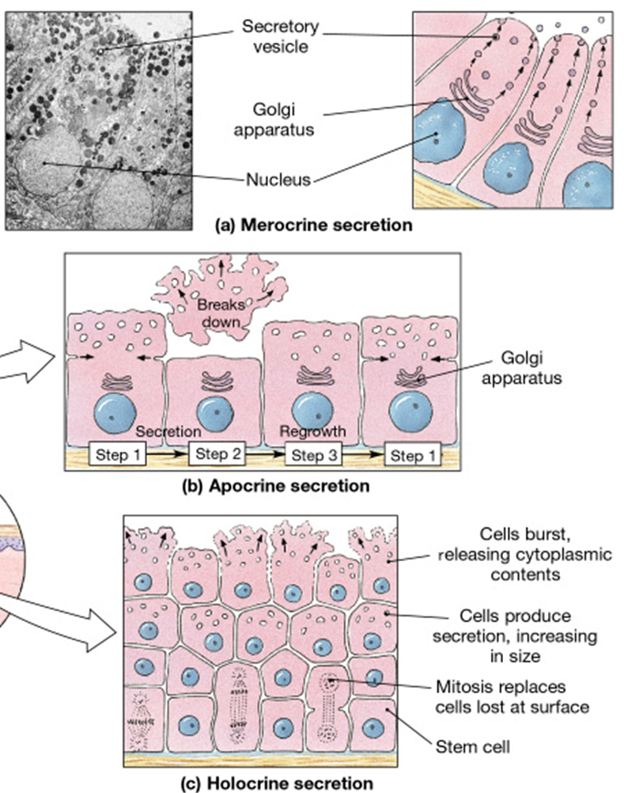
Modes of Secretion
1) Merocrine secretion
2) Apocrine secretion
3) Holocrine secretion

Slide 6
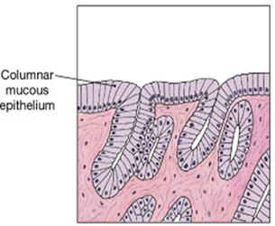
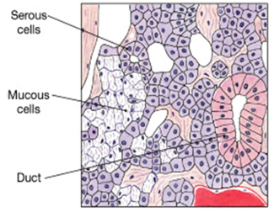
Types of Secretion
Mucous – thick, sticky, viscous solution.
Serous – watery, slippery, thin solution.
Mixed – contains elements of both mucous and serous solutions.

Slide 7
Tissue Membranes
= Epithelial Tissue
Connective Tissue
Membranes function to cover and protect body.
3 Types of Epithelial Membranes
Cutaneous
Mucous
Serous

Slide 8
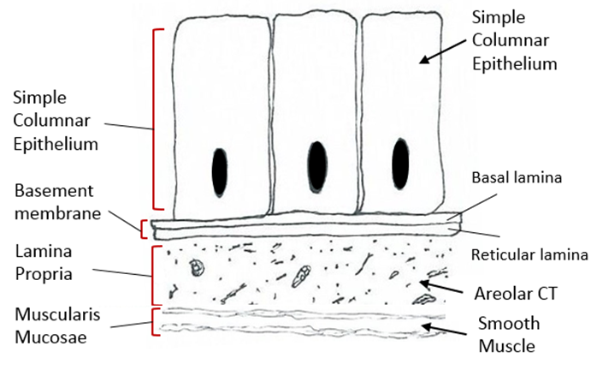
Mucous Membranes
Line passageways that open to exterior.
Moistened by mucous (mucin + H₂O).
3 Layers:
Epithelium (simple or stratified)
Areolar CT called ‘Lamina Propria’
Smooth Muscle called ‘Muscularis Mucosae’
Roles
Protection
Absorption
Secretion

Slide 9
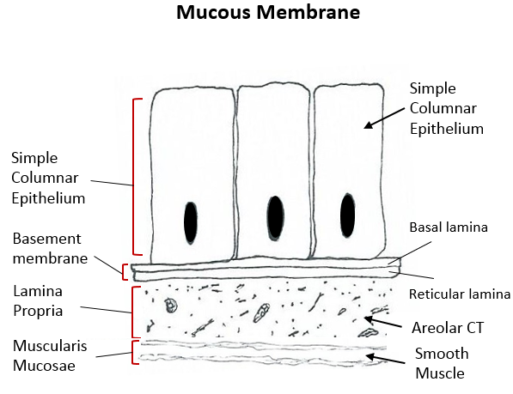

Slide 10
Serous Membranes
Lines internal body cavities.
Thin, watery, serous fluid (transduate).
2 layers:
Simple Squamous Epithelium (Mesothelium).
Thin areolar C.T. (subserous fascia).
Role:
Reduce friction of two surfaces moving across
each other.
1) Pleura, 2) Pericardium and 3) Peritoneum

Slide 11
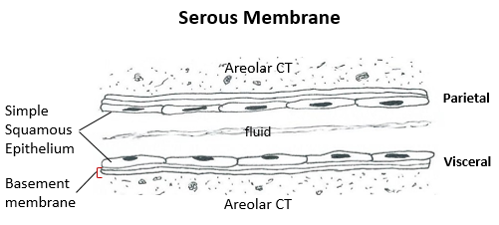

Slide 12
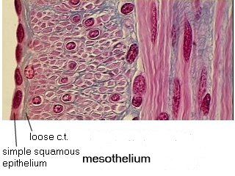
Serous Membranes
Internal body cavities are lined with membranes that produce serous secretions.
Areolar C.T.
Various
deeper tissue
Simple
Squamous
Epithelium

Slide 13
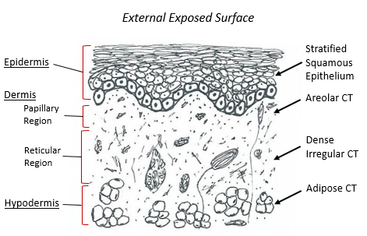
Cutaneous Membranes
Covers external surface of body.
A “dry” membrane, preventing dehydration.
2 Main Layers:
Epithelium (Keratinized Stratified Squamous), this is called the Epidermis.
Areolar and Dense Irregular CT make up the Dermis.
Roles
Physical protection
Prevents water loss
Detection of sensations
Thermoregulation
Production of vitamin D

Slide 14
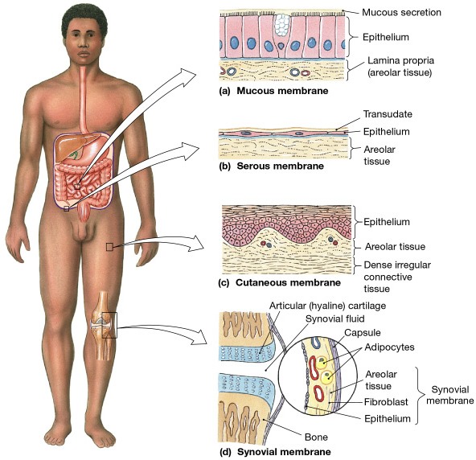
Mucous
Serous
Cutaneous
Connective Tissue
Synovial
Membrane

Slide 15
Fasciae
Composed of Layers of fibrous C.T. in between various tissues.
Roles:
1) Provides stability, maintains relative positions of organs.
2) Allows for distribution of blood, lymph vessels and nerves.

Slide 16
All organ systems are interconnected
There are 3 types of Fasciae
1. Superficial Fascia
2. Deep Fascia
3. Subserous Fascia

Slide 17
Superficial Fascia (hypodermis)
Subcutaneous layer (adipose and dense irreg).
Insulation, padding, allows movement.
Deep Fascia
Dense connective tissue, lots of collagen.
Many layers with varying orientations.
Subserous Fascia
Areolar connective tissue.
In between deep fascia and serous membrane.

Slide 18
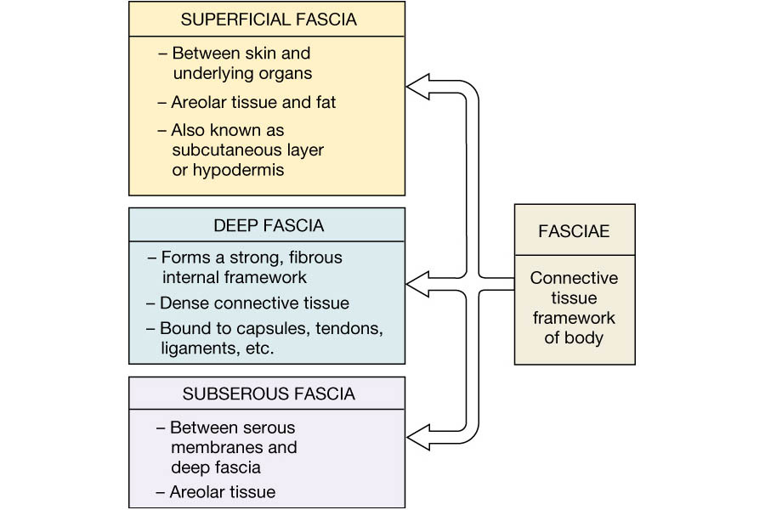
Fasciae

Slide 19
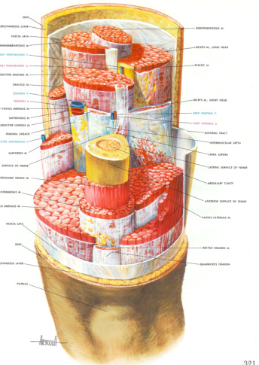

Slide 20
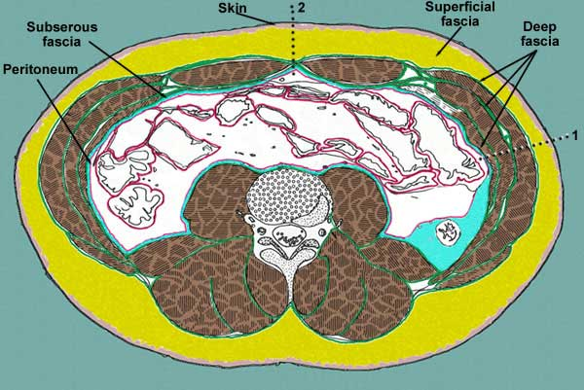
Locations of the 3 Fasciae

