Slide 1
Primary Germ Layers
Germ layer - a collection of cells formed during embryogenesis (reproductive) development.
Humans have 3 primary germ layers called the endoderm, mesoderm and ectoderm (triploblastic).
They are named from where they derive from.
Germ layers give rise to all tissues and organs.

Slide 2
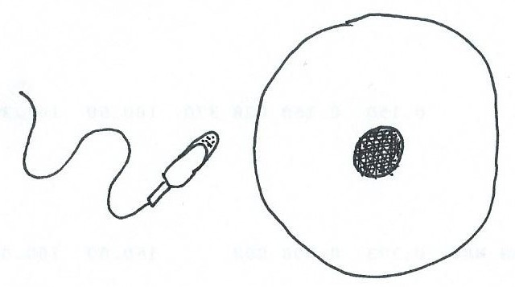
sperm cell
When the egg
cell is fertilized
= a zygote
egg cell
Then the cells begin to multiply . . .
2 cells 4 cells 8 cells

Slide 3
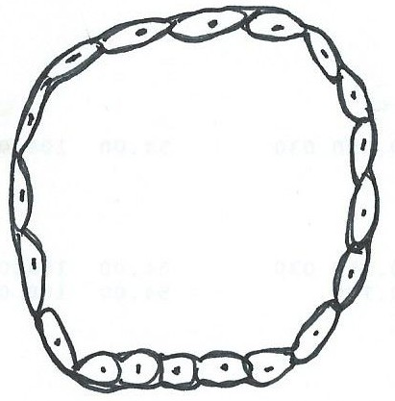
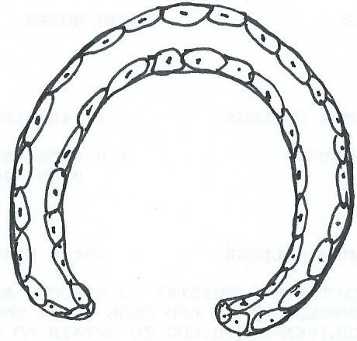
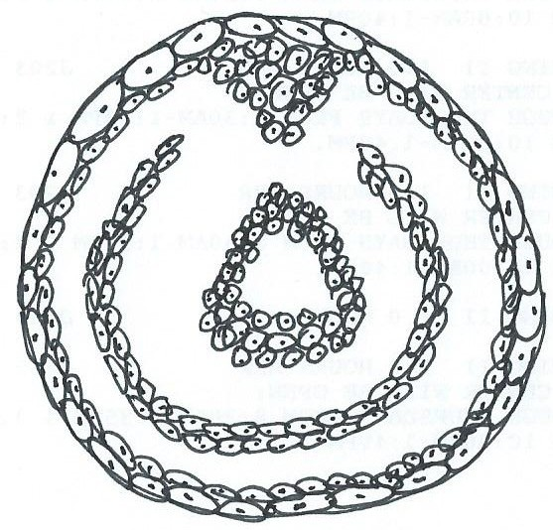
The 3 Primary Germ Layers
of the Embryo (Yolk Sac)
Blastula
Gastrula
Ectoderm
Mesoderm
Embryo
Endoderm

Slide 4
The Three Primary Germ Layers
The three primary (1º) germ layers in the body are named depending on where in embryological development they derive from. The cells in each of these layers differentiate into the cells of each of the four (4) primary tissues of the body.
Table below shows some specific tissue generated from the 3 1º Germ Layers
Endoderm | Mesoderm | Ectoderm
Entire G.I. tract, Respiratory tract (pharynx, larynx, trachea, lungs) Lining of urinary bladder, and urethra Lining of auditory canal, tonsils, thyroid, parathyroid, thymus, Liver and pancreas | All Connective tissue: (from blood to bone) Most all Muscle Tissue: Skeletal, Cardiac, Smooth Endothelium of blood vessels, lymphatic vessels, body cavities, joint cavities, Dentin of teeth Kidneys and ureters Adrenal cortex Internal reproductive organs | Epidermis of skin and epidermal derivatives: hair, nails, glands skin; Linings of oral, nasal, anal, and vaginal cavities All Nervous tissue, special sense organs Enamel of teeth Pituitary gland Adrenal medulla Lens of eye

Slide 5
Tissue = a group of cells and cell products with similar structure and function.
There are four 1º tissues in the body:
Epithelium
Connective
Muscular
Nervous

Slide 6
Functions of Epithelial Tissue
Physical Protection
Regulate Exchange
Provides Sensation
Produce Secretions

Slide 7
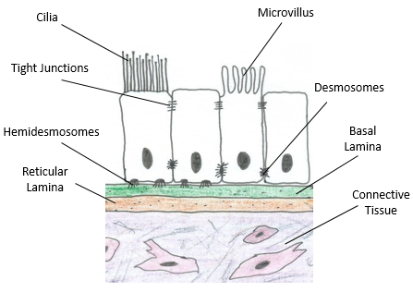
Characteristics of Epithelial Tissue
1) Cellularity – Most of this tissue is comprised of cells, with very little extracellular material. This tissue looks like a ‘wall of cells’.
2) Polarity – Epithelial tissue has a ‘sidedness’ to it. There is a superficial or apical surface (exposed), and a bottom or basal surface, attached to basement membrane.
Apical end specializations: a) Cilia or b) Microvilli.

Slide 8
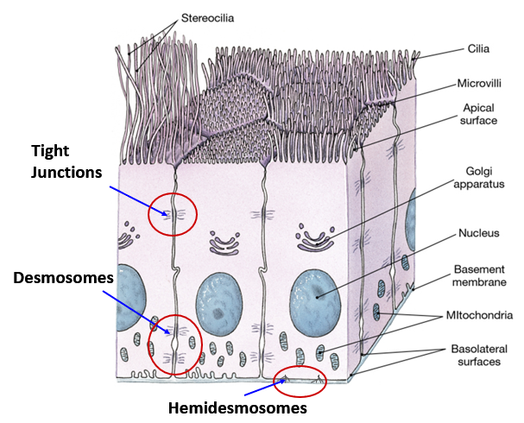
3) Attachments – Cells in epithelial tissue are physically connected to the cells adjacent to them, including above and below, as well as being attached to the basement membrane.
a) Tight Junctions
b) Desmosomes
c) Hemidesmosomes
d) Gap Junctions
4) Avascularity – Epithelial tissue does not have any blood vessels within it, thus it has no direct blood supply of its own. A = without, and vascular = blood, together meaning ‘without a blood supply’. This limits how many cell layers can living in this tissue.
5) Highly Regenerative – Epithelial tissue has a high capacity to make more of itself, in other words, it is constantly regenerating to replace itself, as it is continuously sloughed off.

Slide 9
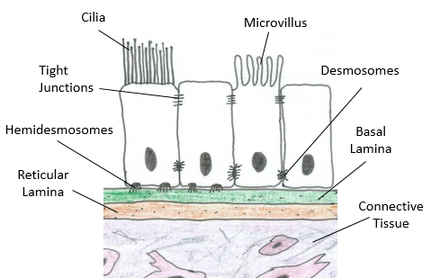
Exposed (Apical) Surface
Basement Membrane
Anchored (Basal) Region

Slide 10
Classification of Epithelia
1. Number of cell layers
A) Single layer of cells = Simple Epithelium
B) Several layers of cells (more than one) = Stratified Epithelium
2. Shape of Exposed (apical) cells
Squamous epithelium - Thin and flat.
Cuboidal epithelium - Short cube-shaped hexagonal boxes.
Columnar epithelium - Taller than it is wide.
Transitional epithelium - Changes shapes (from squamous to cuboidal).

Slide 11
Classification of Epithelia
Simple (only 1 cell layer)
Stratified (more than 1 cell layer)
1) Simple Squamous Epithelium
5) Stratified Squamous Epithelium
Glomerular capsule; Alveolus
Mesothelium; Endothelium
Keratinized = Epidermis of skin
Non-keratinized = esophagus, cheek
2) Simple Cuboidal Epithelium
6) Stratified Cuboidal Epithelium
Renal tubules;
Thecal follicle (thyroid gland)
Ducts of sweat glands
Ducts of salivary glands
3) Simple Columnar Epithelium
7) Stratified Columnar Epithelium
Stomach, Small and Large Intestines
Male urethra
Conjunctiva of the eye
4) Pseudostratified Ciliated
Columnar Epithelium
8) Transitional Epithelium
Ureter
Urinary bladder
Urethra
Trachea, larynx, bronchi

Slide 12
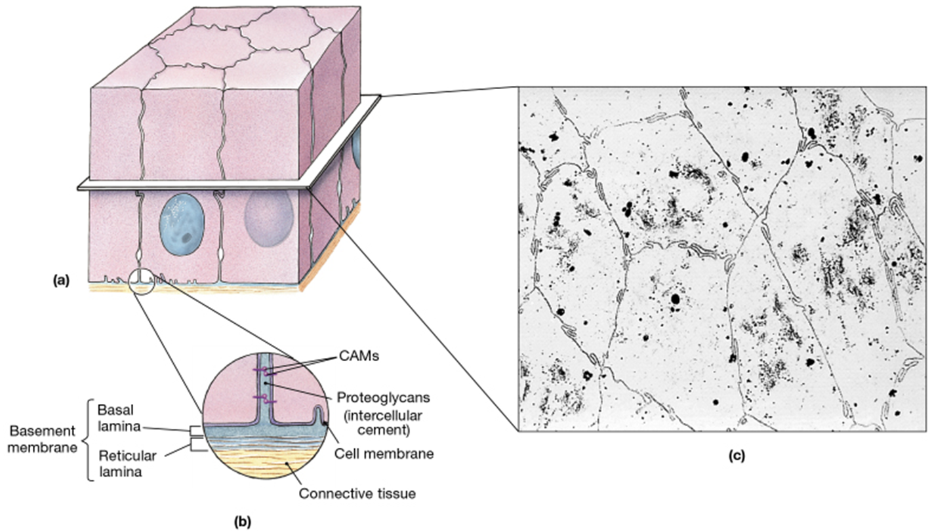
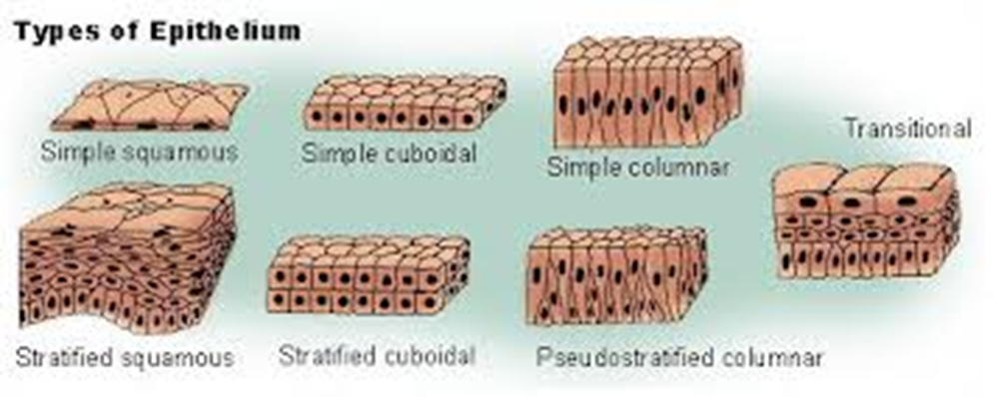
3-D Epithelial Tissue
Epithelial histology (top View)
Types of Epithelium

Slide 13
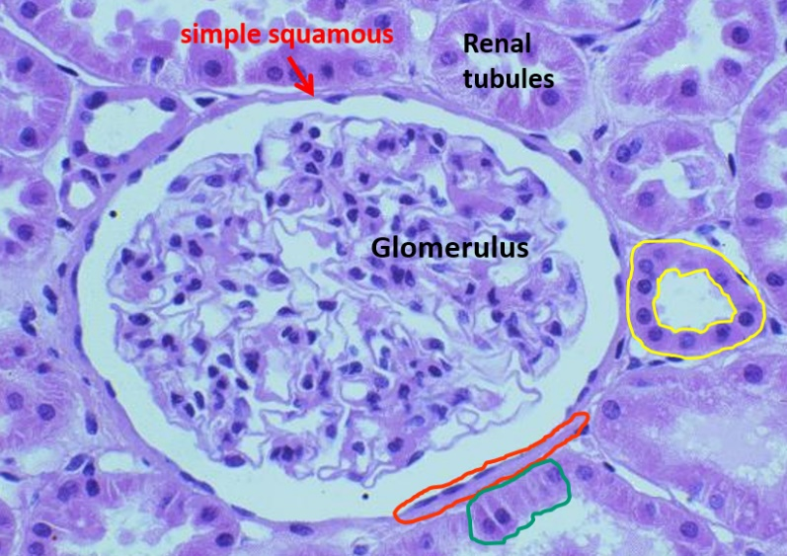
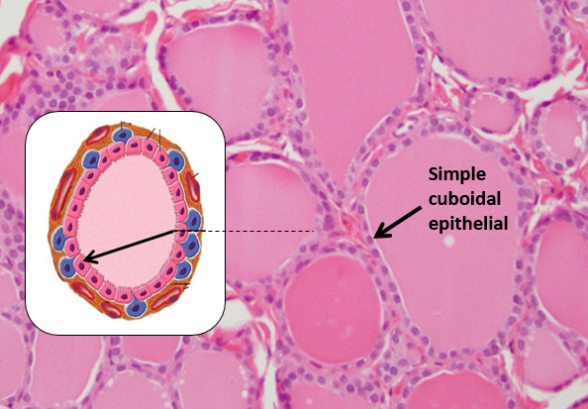
Simple Squamous Epithelium
Simple Cuboidal Epithelium

Slide 14
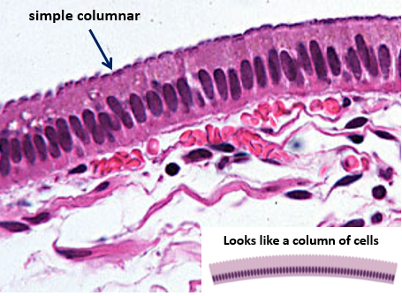
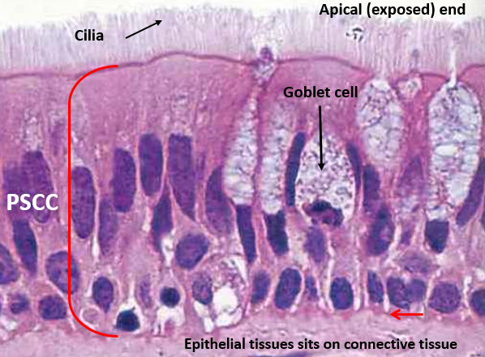
Simple Columnar Epithelium
Pseudostratified Ciliated
Columnar Epithelium

Slide 15
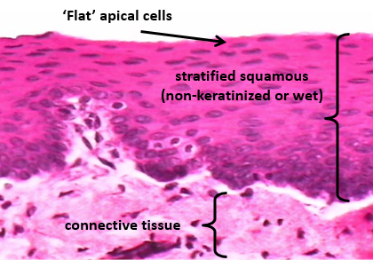
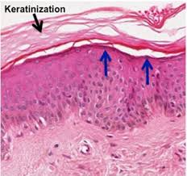
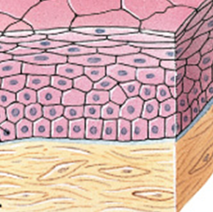
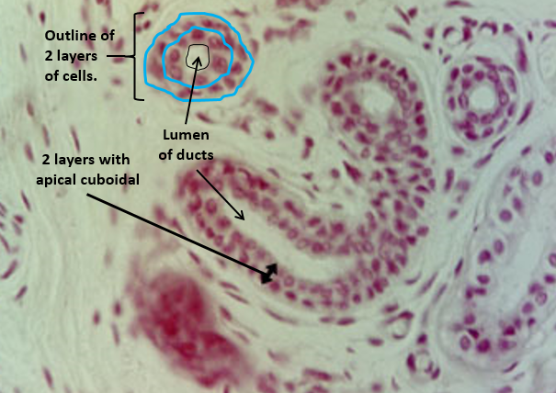
Stratified Squamous Epithelium
Wet
Dry
Stratified
Cuboidal
Epithelium

Slide 16
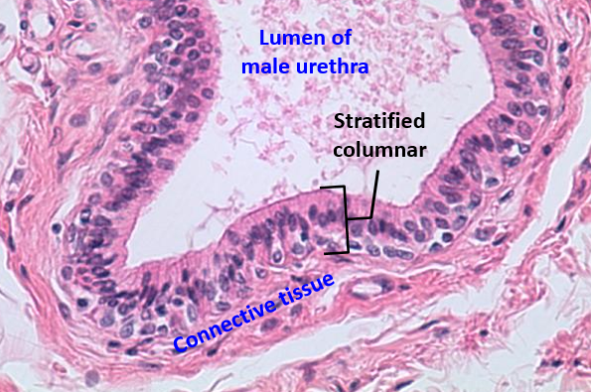
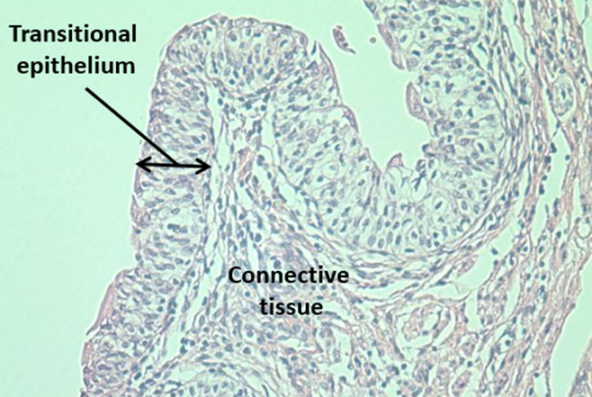
Stratified Columnar Epithelium
Transitional Epithelium

Slide 17
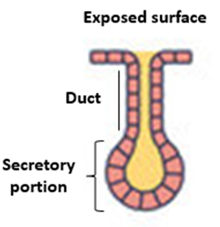
Classifications of Exocrine Glands
How many cells? One cell = Unicellular. Many cells = Multicellular.
1. Structure (of multicellular) glands:
1) Simple (one duct) or Compound (many ducts).
2) Tubular (tube shaped) or Acinar (Alveolar) (bag shaped).
2. Mode of Secretion:
1) Merocrine
2) Apocrine
3) Holocrine
3. Type of Secretion:
1) Serous – sweat glands, parotid salivary gland
2) Mucous – sublingual salivary gland
3) Mixed – submandibular salivary gland
*Sebum
*Apocrine sweat
*Cerumen
*Milk

Slide 18
Structural Classification
of Simple and Compound Exocrine Glands
a) Unicellular
(goblets cells of GI, respiratory tract
b) Simple tubular
(stomach, colon)
c) Simple branched tubular (stomach)
d) Simple coiled tubular (merocrine, apocrine sweat glands)
e) Simple acinar
f) Simple branched acinar (sebaceous glands)
g) Compound tubular (mucous glands duodenum)
h) Compound acinar (mammary glands)
i) Compound tubuloacinar (pancreas)

Slide 19
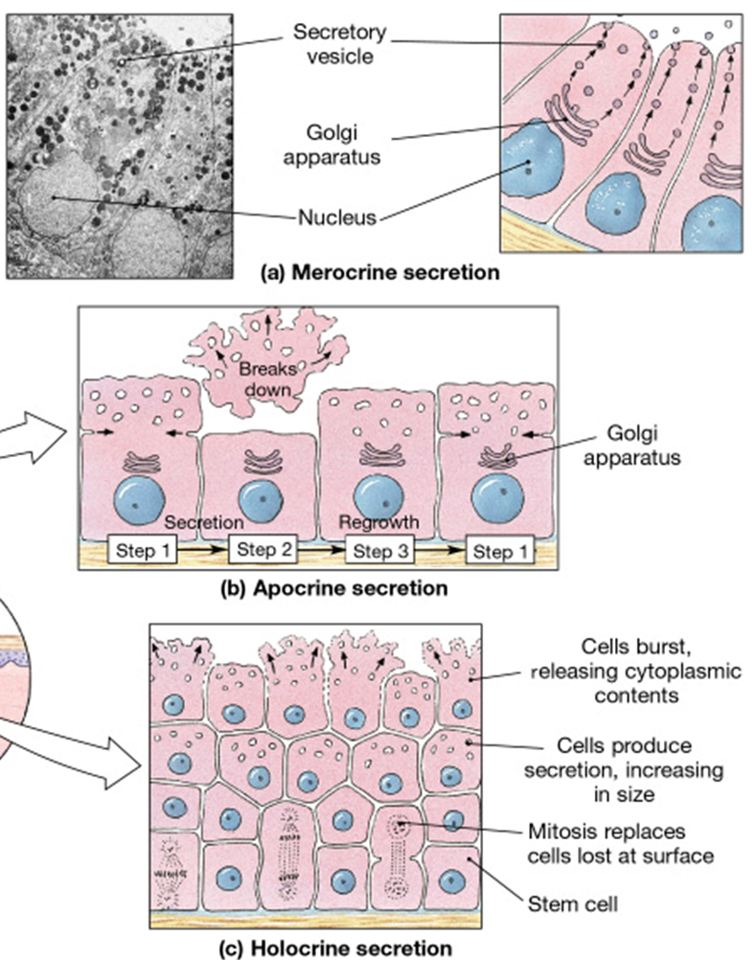
Modes of Secretion
1) Merocrine secretion
2) Apocrine secretion
3) Holocrine secretion

Slide 20
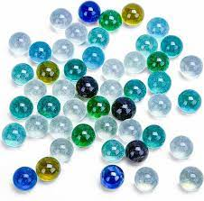
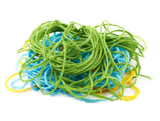
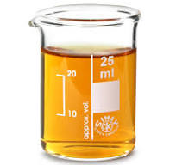
The 3 Elements of Connective Tissue
1. A variety of Cell types
2. A variety of Protein/Fibers
3. Various Ground Substances

Slide 21
1. Cells of Connective Tissue
1) Fixed cells, fibroblasts, adipocytes, chondrocytes, chondroblasts, osteocytes, osteoblast.
2) Wandering cells, like macrophages, mast cells, erythrocytes and leukocytes.
2. Fibers in Connective Tissue:
1) Collagen: thick, strong and unbranched (most common is type I collagen).
White in body, stains pink and blue in histology.
2) Reticular: very thin (type III collagen), fine, branching (‘network’) and flexible.
3) Elastic: medium thickness, from elastin, often seen in coils.
Yellow in body, stains dark in histology.
3. Ground Substance of Connective Tissue:
Most common components of connective tissue ground substance are: 1) Hyaluronic acid, and 2) Glycosaminoglycans (Mucopolysaccharides). Chondroitin sulfate is also found in cartilage, it is the substance that is responsible for the ‘rubbery’ quality of cartilage.

Slide 22
Connective Tissue
Fluid Connective Tissue
Blood
Lymph
Connective Tissue Proper
Loose
Areolar
Adipose
Reticular
Dense
Regular
Irregular
Elastic
Supporting Connective Tissue
Cartilage
Hyaline
Elastic
Fibrocartilage
Bone
Spongy
Compact

Slide 23
Connective Tissue
Fluid Connective Tissue
Blood – in blood vessels and heart.
Lymph – in lymph vessels and lymph nodes.
Connective Tissue Proper
Loose
1) Areolar - Papillary region of dermis,
around blood vessels, C.T. of membranes.
2) Adipose - Hypodermis, eye sockets,
renal fat capsule.
3) Reticular - Spleen, lymph node,
capsule of liver and kidney.
Dense
Regular – Tendons, ligaments.
Irregular – Joint capsules
Reticular region of dermis.
3) Elastic – Elastic ligaments, walls of
arteries, penile ligaments.
Supporting Connective Tissue
Cartilage
Hyaline – nose, trachea, larynx,
Costal cartilage, articular cartilage.
Elastic – epiglottis, external ear.
Fibrocartilage – intervertebral disc, pubic symphysis, menisci.
Bone
Spongy – inner portion.
Compact – outer portion.

Slide 24
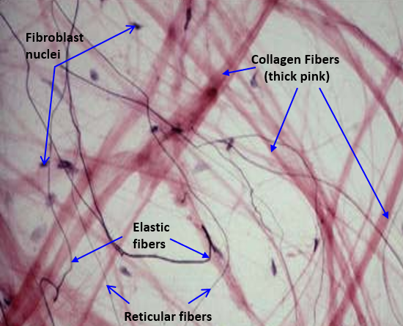
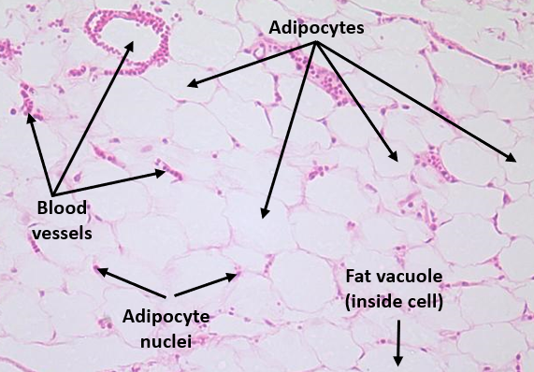
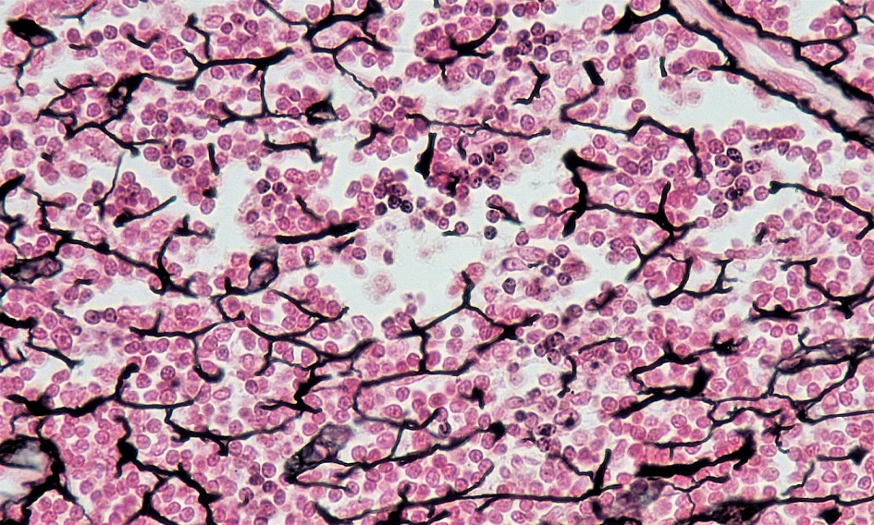
Areolar Tissue
Adipose Tissue
Reticular Tissue

Slide 25
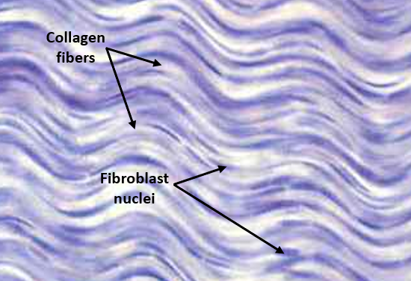
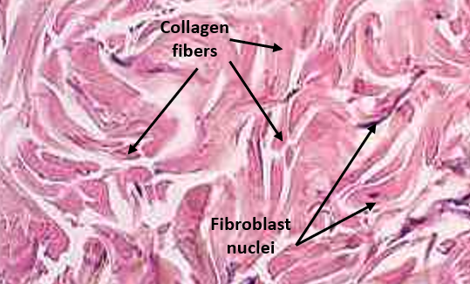
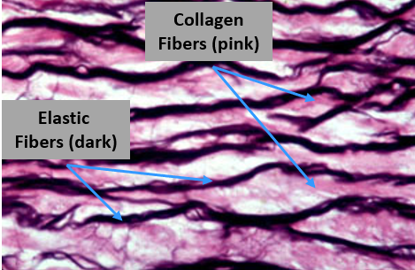
Dense Regular CT
Dense Irregular CT
Elastic Tissue

Slide 26
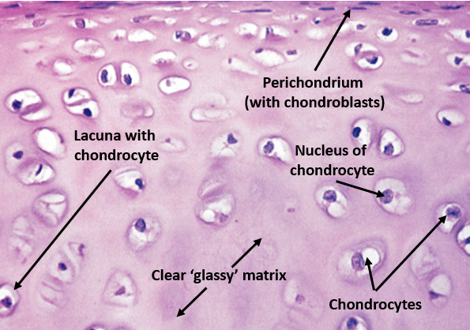
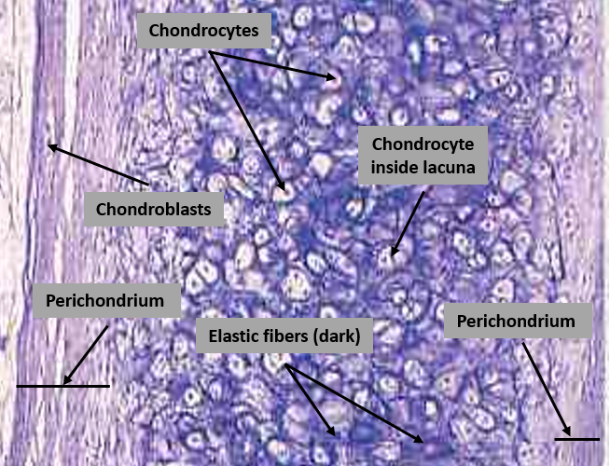
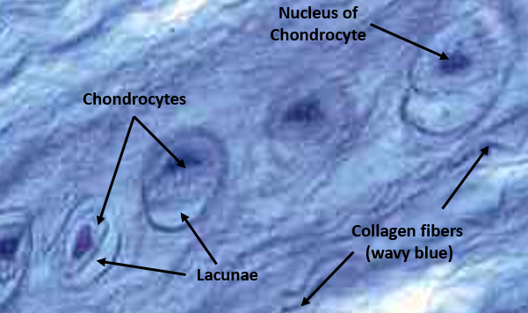
Hyaline Cartilage
Elastic Cartilage
Fibrocartilage

Slide 27
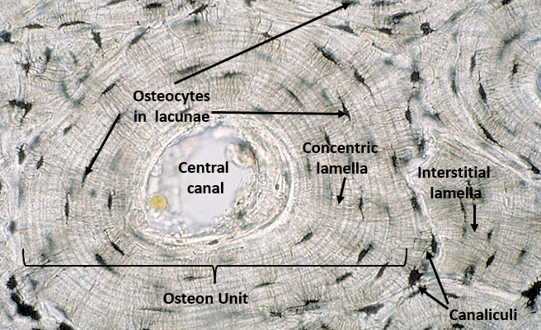
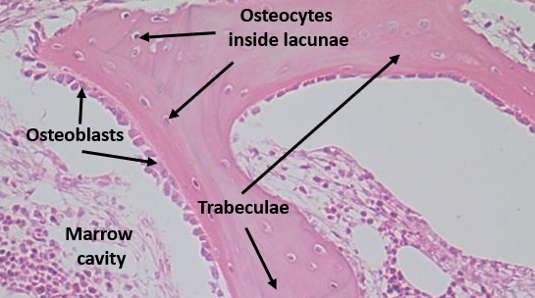
Compact Bone
Spongy Bone

Slide 28
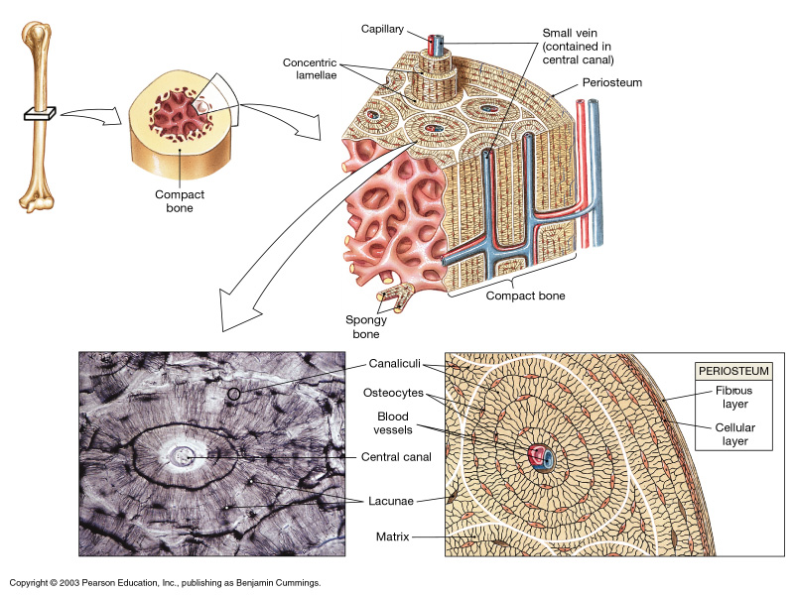
Bone Tissue
Compact Bone

Slide 29
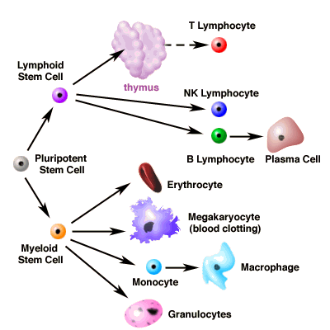
Fluid Connective Tissue
Hematopoietic stem cells produce blood and lymph cells

Slide 30
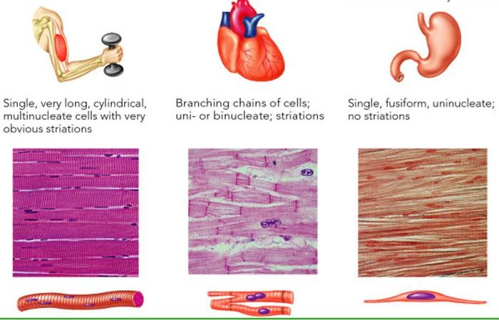
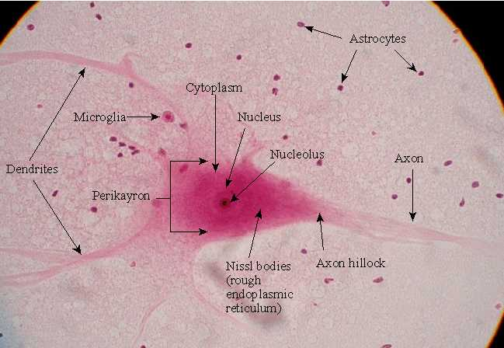
Muscle Tissue
Skeletal
Cardiac
Smooth
Nervous Tissue
Neurons
and
Glial cells

