Slide 1
The term Anatomy comes from Late 1300’s:
Anatomia (Latin) and Anatome (Greek)
ana meaning "up"
tomos (or temnein) which means "to cut"
Together this gives "a cutting up“ (Dissection).
Anatomy is considered the “Study or knowledge of the structure (form) and function of the human body“.
Etymology (word origin ) is very important is understanding anatomical terms

Slide 2
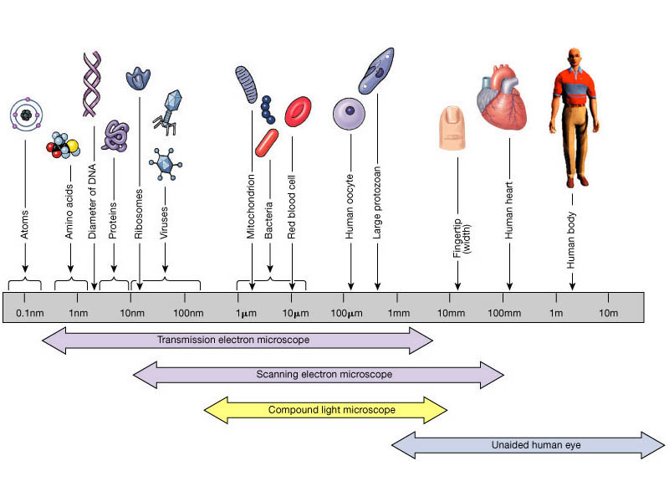
Microscopic Anatomy
Gross Anatomy

Slide 3
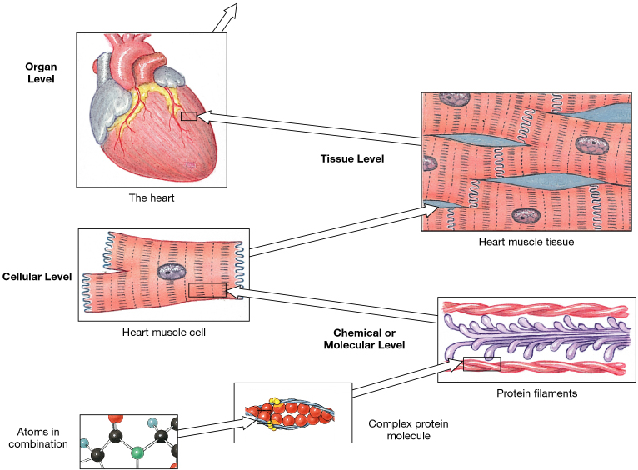
Levels of Organization
in Human Anatomy

Slide 4
Organ Systems of the Body

Slide 5
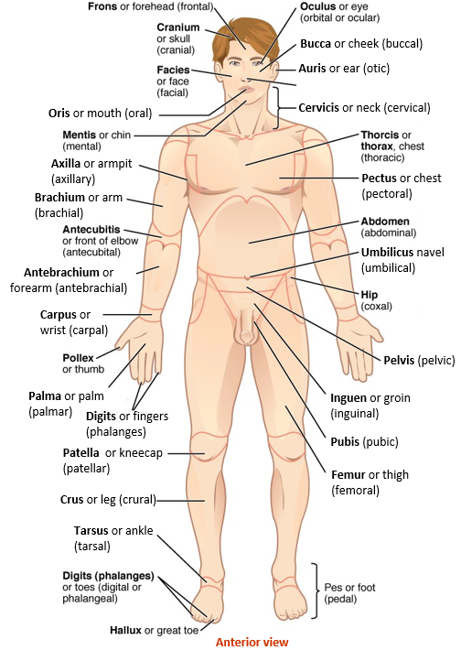
Anatomical Regional Terms

Slide 6
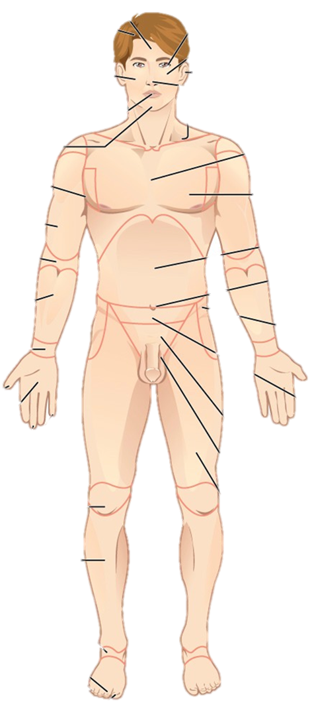
1
31
Bucca or cheek (buccal)
30
Auris or ear (otic)
2
29
Cervicis or neck (cervical)
3
28
Oris or mouth (oral)
27
4
26
Axilla or armpit
(axillary)
5
Pectus or chest (pectoral)
25
Brachium or arm (brachial)
6
24
7
Umbilicus navel (umbilical)
23
Antebrachium or forearm (antebrachial)
8
Carpus or wrist (carpal)
9
22
Pelvis (pelvic)
10
21
Palma or palm (palmar)
Inguen or groin (inguinal)
Digits or fingers (phalanges)
11
12
20
Patella or kneecap (patellar)
Pubis (pubic)
Femur or thigh (femoral)
13
19
Crus or leg (crural)
14
18
Tarsus or ankle (tarsal)
15
16
Anterior view
17

Slide 7
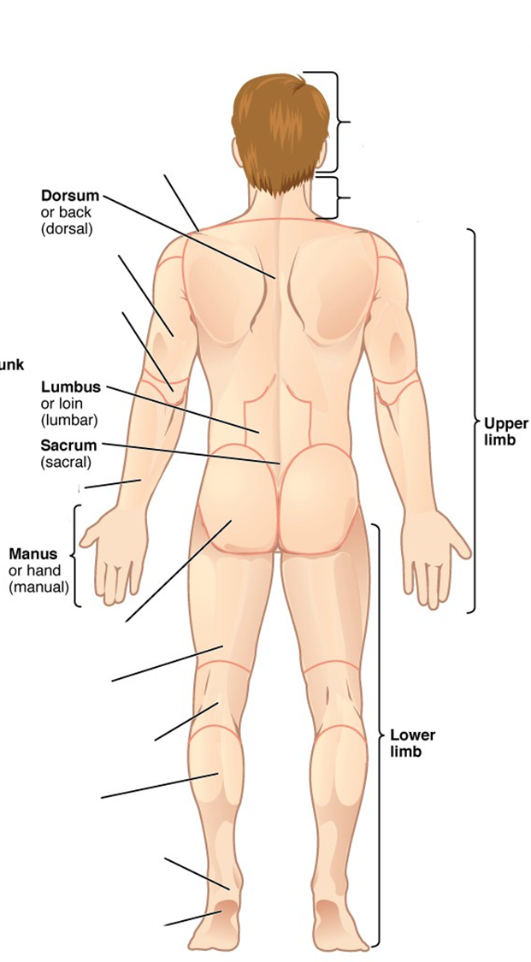
Shoulder
(acromial)
Cephalon or head (cephalic)
40
32
Dorsum or back
(dorsal)
Cervicis or neck
(cervical)
33
27
Brachium or arm (brachial)
6
Olecranon or back of elbow (olecranal)
34
Lumbus or loin (lumbar)
35
Upper
limb
44
Sacrum (sacral)
36
Antebrachium or forearm (antebrachial)
8
Manus or hand (manual)
37
Gluteus or buttock (gluteal)
38
Femur or thigh (femoral)
18
Popliteus or back of knee (popliteal)
Lower
limb
39
43
Sura or calf
(sural)
40
Calcaneus or heel of foot (calcaneal)
41
Planta or sole of foot (plantar)
42
Posterior view
Posterior view

Slide 8
Selected anatomical regions and commonly
used “layperson’s” terminology.
Anatomical Landmarks | Common Term
1. Cranial | Skull
2. Cervical | Neck
3. Acromial | Shoulder
4. Thoracic | Chest
5. Abdominal | Belly
6. Gluteal | Buttock
7. Inguinal | Groin
8. Axillary | Armpit
9. Brachial | Arm
10. Olecranon / Antecubital | Elbow (back) / Fossa (front)
11. Antebrachium | Forearm
12. Carpal | Wrist
13. Manual | Hand
14. Digits (Phalanges) | Fingers
15. Femoral | Thigh
16. Patellar | Knee (front)
17. Popliteal | Back of knee
18. Crural | Leg (front)
19. Sural | Calf (back)
20. Tarsal | Ankle

Slide 9
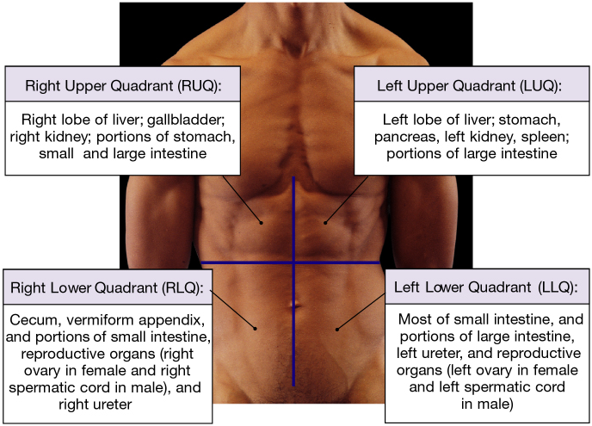
Abdominopelvic Quadrants and Regions

Slide 10
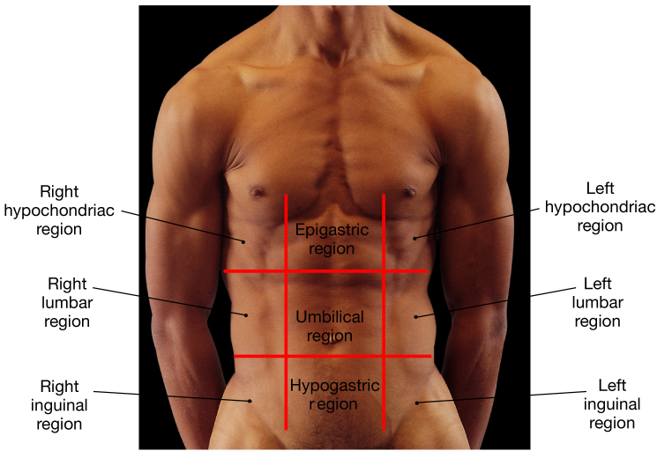
9 Quadrants

Slide 11
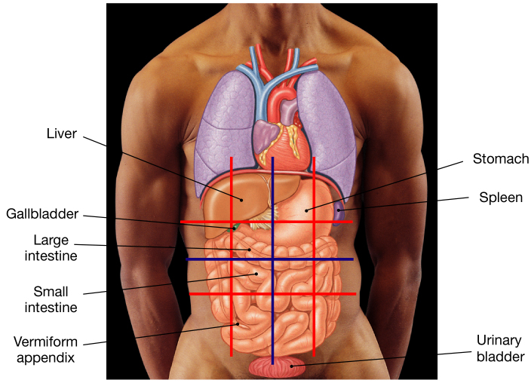
Structures in these Regions

Slide 12
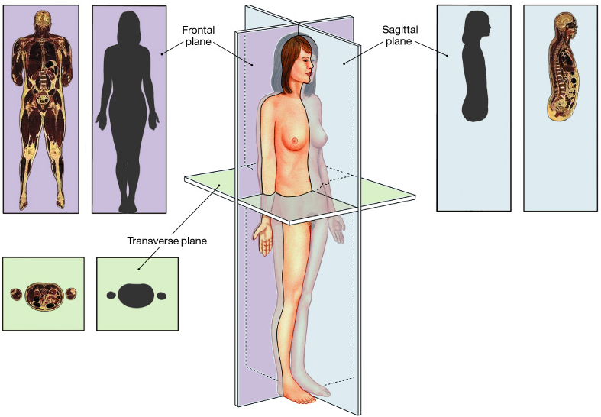
Sectional Planes

Slide 13
Sectional Anatomy
Three sectional planes
1. Frontal (Coronal) plane
Longitudinal
2. Sagittal plane (mid- and para-)
3. Transverse (Horizontal) plane

Slide 14
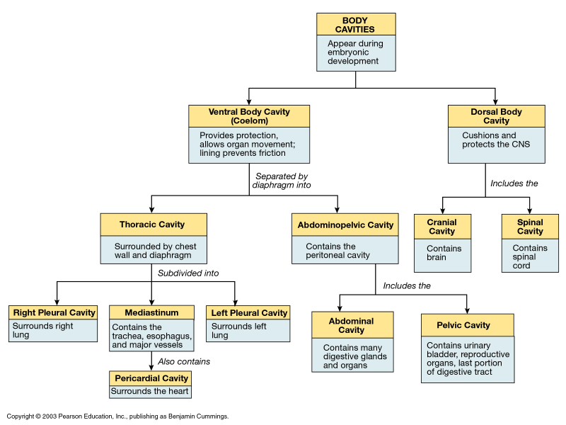
Body Cavities

Slide 15
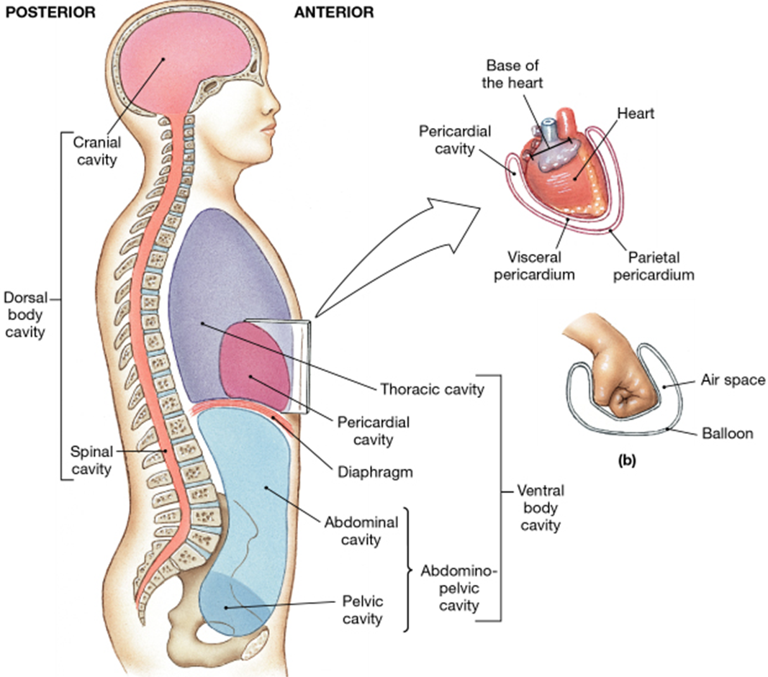
Posterior
(Dorsal)
Anterior
(Ventral)

Slide 16
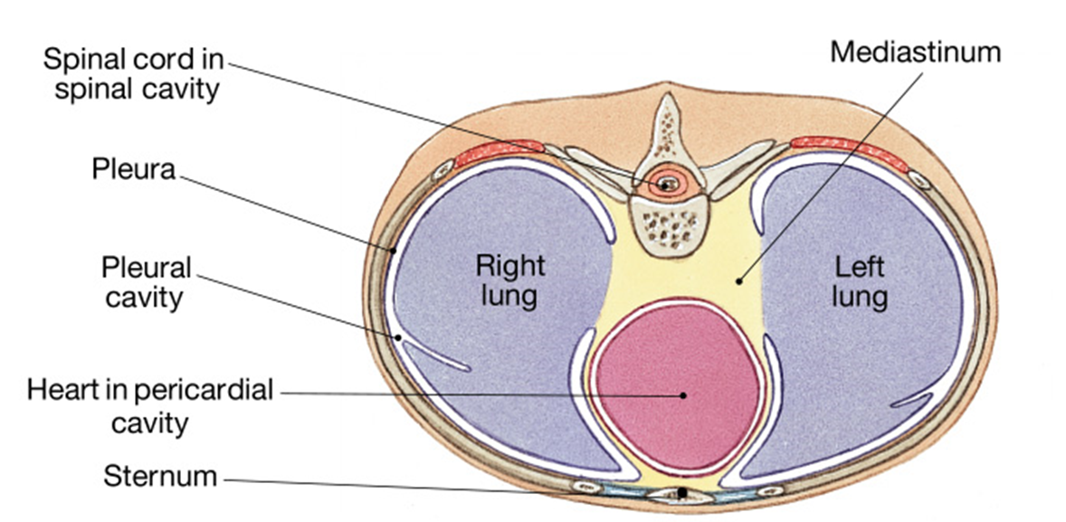
Sectional View
What kind of sectional view (plane) could you call the diagram above?

Slide 17
Dorsal Body Cavity
1. Cranial Cavity
Contains the brain and CSF.
Protects this delicate tissue.
2. Spinal Cavity
Contains the spinal cord and CSF.
Protects this delicate tissue.

Slide 18
Ventral Body Cavity
1. Thoracic Cavity
Contains:
a) Plural cavities (lungs inside).
b) Mediastinum
i) Pericardial cavity (heart).
2. Abdominopelvic Cavity
Contains: stomach, intestines, gallbladder,
liver, spleen, bladder, reproductive organs.

Slide 19
Mediastinum
Contains: Heart, thymus, trachea, esophagus, vessels (aorta), nerves.
Serous Membranes - line ventral body cavities, has 2 portions:
Visceral Parietal
A. Pleura - membrane lining the pleural cavities.
B. Pericardium - lines the pericardial cavity.

Slide 20
The Abdominopelvic cavity contains the Peritoneal cavity
Peritoneum - lines the peritoneal cavity (this is inside the abdominal cavity).
Mesenteries - support and stabilize the
digestive organs in abdominal cavity.

Slide 21
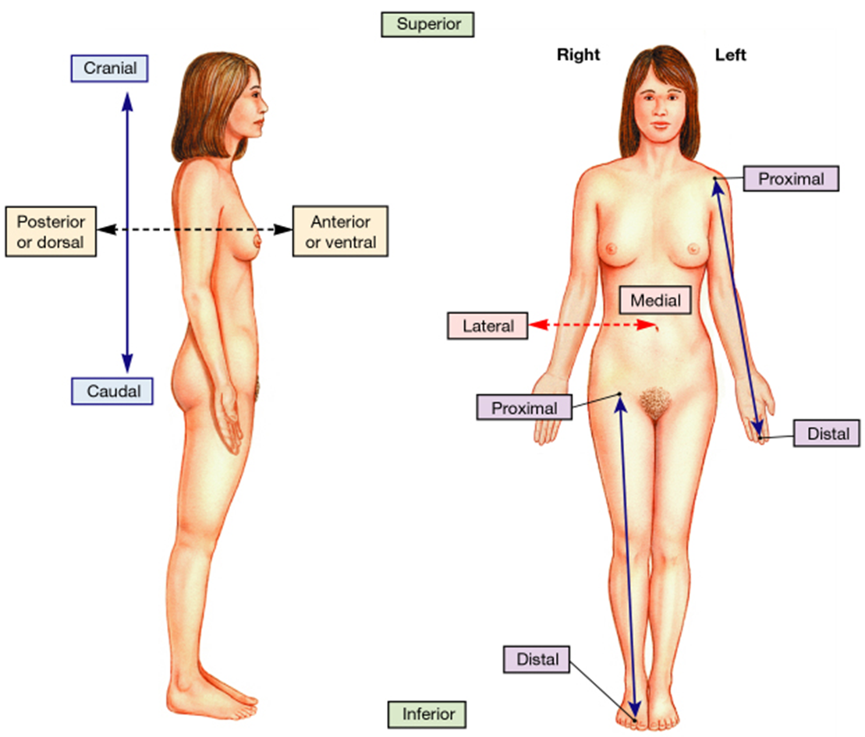
Directional References
Practice using the
terms listed in
reference to the
Various organs and
structures within
the body.

Slide 22
Example of relative position and orientation of
a scan for clinical purposes.
Can you identify the structures shown below?

