Slide 1
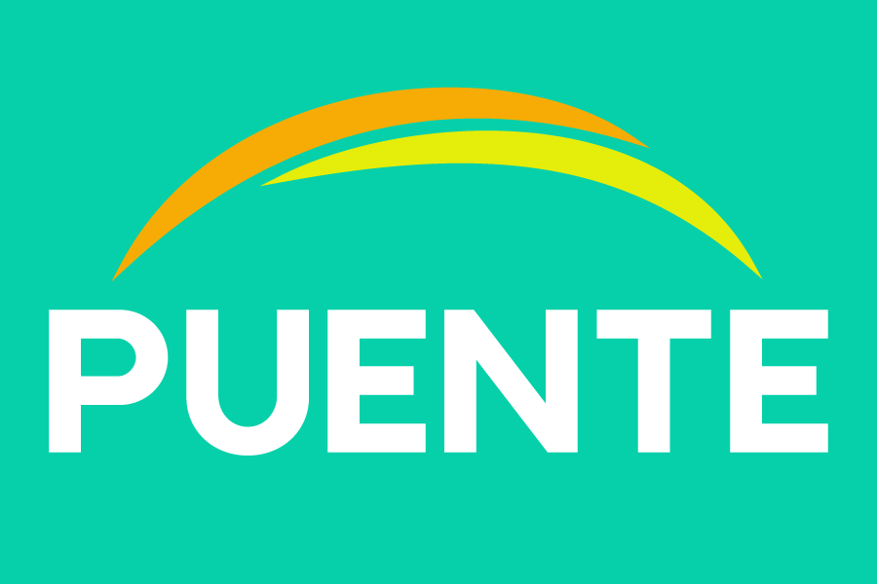
Pathway to Puente: San Diego Miramar College
Presented by Ali X. Gonzalez, Ed.D. (EOPS Counseling Faculty) & Martin Gonzalez, M.S. (Gen. Counseling Faculty)
Classified Senate

Slide 2
Action for C.S.
Support to begin the work group between English, Counseling and Administration to form a work group to bring Puente to Miramar College (overall general support for the program)

Slide 3
Puente Project History
Established 1981
Currently, at 65 California Community Colleges
Sponsored by the University of California (UC) and the California Community Colleges (CCC) systems
Grassroots initiative established to address the low rate of academic achievement for Latino students (retention, transfer rates, etc.)
Student Support Program

Slide 4
The Puente Model
English Instruction
Counseling
Mentorship

Slide 5
Why Puente at San Diego Miramar College?
San Diego Miramar College is a Hispanic Serving Institution (HSI) (waiver)
An HSI is defined as, "A campuses commitment to expanding the educational opportunities and improve the academic achievement attainment of Latinx/Chicanx and low-income students and to expand and enhance the academic offerings, program quality and institutional stability of colleges and universities that are educating the majority of Hispanic college students."
Latinos are 40% of California's population, 52% of Californians under the age of 24 are Latinx, and 46% of the students enrolled in California Community Colleges are Latinx
Latinx students are D.I. population
Out of District campuses, Miramar is the only site that does not have Puente

Slide 6
Latinx Students at San Diego Miramar College
Completion
Persistence
Utilization of student services
Counseling Interventions
Financial Aid

Slide 7
Puente Logistics
Coordinators (Counselor and English faculty member) commit to the program for 3-4 years
The program must have a full-time writing instructor and counselor who meet the criteria for participating in this program
The college is willing to provide financial support for program operation, and ideally this is a line-item budget allocation shared between the two divisions

Slide 8
Common Questions/Concerns
Program Costs versus Return on Investment (cohort has about 25-30 students)
Available staffing to provide release support for the counselor and instructor
Committing to program for 2-3 years with funding and individuals coordinating the program (English Instructor and Counselor) from departments and institution as a whole
Source: https://www.thepuenteproject.org/
Contact: Grace Ebron ebron@berkeley.edu

