Slide 1

Improving Campus Safety
Dr. Carmen Carrasquillo & Professor Amy Alsup

Slide 2
Campus Safety
The Higher Education Act of 1965 (HEA) was implemented to provide various resources and financial assistance for students in higher education institutions (The American Association of Collegiate Registrars and Admissions Officers (AACRAO, n.d.).
In 1990, the Act was amended with Title II: the Crime Awareness and Campus Security Act (CACSA), which requires higher education institutions to disclose crime statistics from the last three years and current institutional security policies (United States Department of Education, 2016).

Slide 3
Campus Safety
In 1994, the Violence Against Women Reauthorization Act (VAWA) was first enacted, which renews every five years (The National Network to End Domestic Violence, 2024).
In 1998, the Crime Awareness and Campus Security Act (CACSA) was renamed the Jeanne Clery Disclosure of Campus Security Policy and Campus Crime Statistics Act (the Clery Act) to memorialize a student who was tragically murdered while in her dorm room (United States Department of Education, 2020).

Slide 4
Campus Safety
“Under VAWA, colleges and universities are required to:
Report domestic violence, dating violence, and stalking, beyond crime categories the Clery Act already mandates
Adopt certain student discipline procedures, such as for notifying purported victims of their rights
Adopt certain institutional policies to address and prevent campus sexual violence, such as to train in particular respects pertinent institutional personnel”
(American Council on Education, 2014).

Slide 5
Campus Safety
Despite all these federal efforts, and other important state-wide legislative moves, a 2024 California Assembly Higher Education Committee report detailed widescale distrust and resentment of the way their institutions handle Title IX cases (Smith, 2024).
“The prevailing message from students, staff and faculty is that current policies of the CCC, CSU, and UC do not protect survivors" of discrimination and sexual harassment appropriately (Smith, 2024, para. 4).

Slide 6
Campus Safety
The organization Student Affairs Administrators in Higher Education (NASPA) released a 2024 report after asking senior leaders in student affairs to indicate what they view as most important to their institutions.
The top ten concerns revolved around preserving student well-being on campus. “83% identified the need for health, safety, and well-being education, and 80% emphasized increased campus-wide collaboration in these areas” (Student Affairs Administrators in Higher Education, 2024, para. 1).
Experts in the field agree that improving campus safety requires transparency and collaboration among different sectors of a campuses and districtwide efforts.

Slide 7
Improving Campus Safety: A Shared Responsibility
Recommended Actions from GAIA
Gender Advocacy, Inclusion and Advancement
Educate
Protect
Improve

Slide 8
Improving Campus Safety: A Shared Responsibility
Recommended Action #1: EDUCATE
  Bystander intervention training for all
  Campus-wide Safety Fair to teach about policies, processes, resources
  Campus Safety Forum (guests –SDCCD Campus Police; Title IX Coordinator; VC People, Culture & Technology)
  Syllabus statements
  Safety presentations to classes, departments, clubs and programs
  Elevated communication: Agendize campus safety at ASG, Senates, College Council to increase awareness and collaborate on actionable strategies.
  Outreach: Post flyers that include emergency phone numbers and a QR code to a reporting form.
  Embedded Anti-stalking Awareness Campaign

Slide 9
Improving Campus Safety: A Shared Responsibility
Recommended Action #1: EDUCATE
Review broadly the SDCCD Annual Security Report (Safe and Sound), 2021-2023
24-hour College Police Communications Center at 619-388-6405. From campus building phones, press the college police button for immediate assistance.
Criminal action and any other incidents may also be reported via email to the SDCCD Police Department at police@sdccd.edu.
When a sexual assault, dating violence, domestic violence or stalking incident is reported to College Police, staff on the scene, including College Police, will offer the victim a variety of District and other local resources.

Slide 10
Improving Campus Safety: A Shared Responsibility
Recommended Action #1: EDUCATE
SDCCD Annual Security Report, Campus Security Authority (CSA)
Faculty members who do not have responsibility for student and campus life beyond the classroom, clerical staff, cafeteria staff, facilities staff, and maintenance staff are not considered CSA’s; however, they are not prohibited from reporting crimes and are encouraged to do so for accurate record keeping by the District.
The District will issue Timely Warning Notices whenever a Clery Crime is committed on District property or on adjoining public property and the District believes that there may be a serious or continuing threat to students and employees.
District employees and students are automatically registered on the RAVE Alert platform.

Slide 11
Improving Campus Safety: A Shared Responsibility
Recommended Action #2: PROTECT
  Safe Walk Service
  Community Safety Patrols
  Designated Safety Ambassador for each School/Area
  More support for womxn's organizations and clubs: leadership conferences and retreats to collaborate on solving issues affecting womxn on campus
  Designated Womxn's Resource Center
  Womxn's Empowerment Week
    Resource fair, films, art, guest speakers
“If students feel unsafe walking alone, they can call our communication center, and we will send an officer to escort them.”
              Lt. Nelson, SDCCD Police Department

Slide 12
Improving Campus Safety: A Shared Responsibility
Recommended Action #2: PROTECT
Post-election Considerations: The Influence of Political Actors
  “.....a blistering series of attacks on refugees, immigrants, the environment, public health, women, workers, people of color, LGBTQIA+ people, and the middle-class" (Oxfam).
  How can we proactively protect our most vulnerable communities going forward?

Slide 13
Improving Campus Safety: A Shared Responsibility
Recommended Action #2: PROTECT
UndocuLiaisons are located on California community college campuses to provide answers and support for undocumented students of all nationalities and backgrounds. These resources provide a safe community for UndocuScholars and a judgement free place that makes it easier for students to focus on school and know they have support.
Find your nearest UndocuLiaison
San Diego Miramar College 619.388.7800 10440 Black Mountain Road, San Diego, 92126 www.sdmiramar.edu | 0.9 | Cheryl Barnard, Ph.D. 619-388-7485 cbarnard@sdccd.edu Undocumented student resources & support services

Slide 14
Improving Campus Safety: A Shared Responsibility
Recommendation #2: PROTECT
Post election considerations
  Offer a more visible protection campaign through cross-group dialogue and unity events.
  Collect, disaggregate and analyze new data on campus safety perceptions through multiple measures to implement intervention strategies.
  Re-visit the Reimagining Campus Policing Recommendations
    Students should be seen as equal partners in ensuring campus safety and leading campus change. This means acknowledging the power dynamics that may prevent students from fully participating.

Slide 15
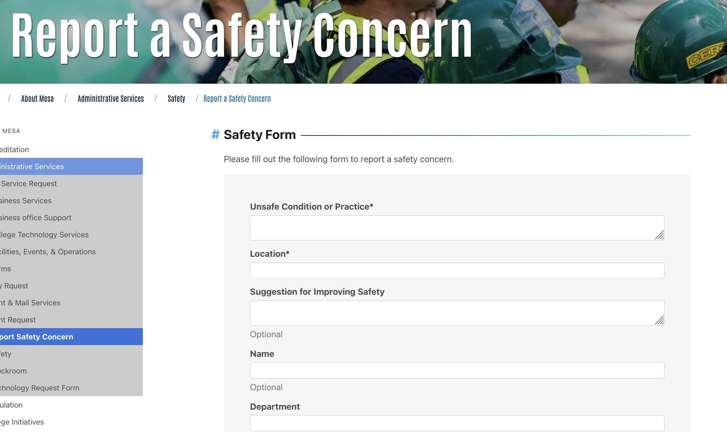
Improving Campus Safety: A Shared Responsibility
Recommended Action #3: IMPROVE
  Audit our campus justice process.
  Put a reporting form on the website and share widely.

Slide 16
Improving Campus Safety: A Shared Responsibility
Recommendation #3: IMPROVE
  Anti-violence and anti-harassment policies, incident reporting, investigation protocols, and potential actions need to be clearer and more transparent.
  Shorten the time frame for implementing identified interventions.
  Encourage open communication and thoughtful responses for the common good.

Slide 17
References
American Council on Education. (2014). New Requirements Imposed by the Violence Against Women Reauthorization Act. https://www.acenet.edu/Documents/VAWA-Summary.pdf
National Network to End Domestic Violence (NNEDV). (2024). Violence Against Women Act. (https://nnedv.org/content/violence-against-women-act/
Smith, A.A. (2024, February 6). Students, faculty, staff distrust state college systems’ handling of Title IX cases. EdSource. https://edsource.org/2024/students-and-faculty-distrust-state-college-systems-handling-of-title-ix-cases/705360
Student Affairs Administrators in Higher Education (NASPA). Addressing Critical Campus Issues in 2024: How NASPA’s Culture of Respect Collective is Leading the Charge on Sexual Violence Prevention and Student Well-being. https://www.naspa.org/blog/addressing-critical-campus-issues-in-2024-how-naspa-s-culture-of-respect-collective-is-leading-the-charge-on-sexual-violence-prevention-and-student-well-being
The American Association of Collegiate Registrars and Admissions Officers (AACRAO) (n.d.) Higher Education Act. https://www.aacrao.org/advocacy/issues/higher-education-act
United States Department of Education (2016). The Handbook for Campus Safety and Security Reporting 2016 Edition. https://www.ed.gov/sites/ed/files/admins/lead/safety/handbookfsa.pdf

