Slide 1
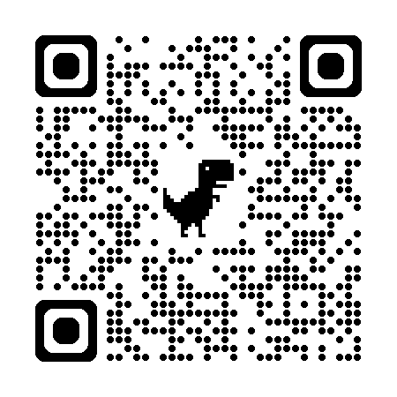
SDMC Classified Senate Meeting
October 15th, 2024
2024-2025 Academic Year
(QR Code for CSEN Webpage)
Cultivating Community: Making the Invisible, Visible

Slide 2
Agenda Overview
Call to Order
Approval of Agenda
Approval of Minutes
Public Comment
Old Business
New Business
Review of Action Items
Announcements
Adjourn
Next Scheduled Meeting
Committee Reports/Other

Slide 3
Public Comment

Slide 4
Old Business
Shared Governance Committee Updates (standing item) (Sampaga)
Installation of Sam's Brick in Leave a Legacy Plaza (Kunst)
POSTPONED
Brown Act Implementation (standing item) (Kunst)
Recording Meetings and AI Recorded Meetings
EEO Representation in the District – update from IDEA Committee (Pacheco)
Defining Equity and Professional Development (Standing Item) (Kunst/All)
Video Project Idea – Promotional Video of the Classified Senate (Kunst)

Slide 5
New Business
Discussion on adoption of 4CS 9+1 (Kunst)
Explore adding AFT and SPAA Rep Seats (Kunst/Sampaga)
Classified Contract – 32 Hour Work Week (McGill)
Discuss a potential recommendation on behalf of the Classified Senate
Review of BP/APs (Kunst)
Halloween Party & Costume Contest (Neff)
Classified Senate Scholarship (Kunst)
Student Success Committee CGH Change Request (Kunst)
HOLD: Puente Program Presentation (TBD)

Slide 6
Committee Reports/Other
District Committees:
District Governance Council – Reviewed draft Board agenda. Fall 2024 BP/AP Updated schedule. First read of BP/AP 3410 and BP 3510. Preliminary review of Facts on File for 23-24. Election planning. AI Note taking considerations. Annual Security Report 21-23. Late PASS and Time Reporting. Open enrollment period for health benefits.
Next Scheduled Meeting: Wednesday, November 6th from 3:00 pm – 5:00 pm at Miramar College
District Budget Planning and Development Council – Met on 10/2. Reviewed 24-25 Advance Apportionment, September 2024 Revision. Reviewed updates to the District Governance Handbook page. Update on Enrollment. Travel Authorization process. Miramar’s resource page.
Next Scheduled Meeting: Wednesday, November 6th from 1:00 pm – 2:30 pm at Miramar College
District Strategic Planning Committee – N/A
Next Scheduled Meeting: Monday, November 18th from 2:00 pm – 3:30 pm via Zoom
Board of Trustees – Met on 10/10. TBD.
Next meeting: Thursday, November 7th at 4:00 pm at Mesa College

Slide 7
Committee Reports/Other Cont.
College Council - Met on 10/8
Campus Safety: District is hosting Elections-Preparedness workshops at each of the colleges. Student Affairs is planning events, integrating this into other events, and tying to college-hour programing. Additionally, we are updating free speech signage. Weekly announcements at ASG.
Public Art Procedure: Intro to Public Art Procedure, some initial feedback from CC, which will go back to FHSC to address. It will come back to CC and will then go to constituencies for review/approval.
Next Scheduled Meeting: Tuesday, October 22nd from 1:00 pm – 2:30 pm in M-110 and Zoom
Student Success Committee - Met on 10/9
Reviewed Action Planning Template/Tools. Discussed focuses for the year: Communication, Collaboration, and Retention. Voted/Approved Hybrid format. CGH Change Expedited. Overview of Student Success Model. At next meeting, will breakout into groups and review Strategic Goals, SEM Plan, and Student Equity Plan.
Next Scheduled Meeting: Wednesday, October 23rd from 3:00 pm – 4:30 pm in K1-107
Others?

Slide 8
Review of Action Items

Slide 9
Announcements

Slide 10
Upcoming Events
October 14th
October 15th
October 16th
October 17th
October 18th
ASG Meeting, 9-11am, K1-107
Classified Senate, 10:30 am, L-108
Really, Really Free Farmer's Market, 9-11am, Compass Point
Healthy Relationships Workshop, 12:30 pm
Undocu-Ally Training, 10 am – 11am, Virtual – register for link
Indigenous Peoples Day, 12-2pm, Compass Point
Undocu-Hustle, 12-2pm, Counseling Classroom
Career Explorations in STEM & Health Sciences, 9:30 am – 11:00 am, K1-107
Undocu-Circles, 12-2pm, K1-211
Women’s Soccer vs. MiraCosta College, 1pm, Hourglass Field
Donut Moments, 1:30 pm – 2:30 pm, K1-107
Library Workshop, 12:00 pm, L-208
Coffee & Crafts: Butterfly Origami, 12:30 pm, K1-211
Curriculum, 2:30 pm, Building R Conference Room
Men’s Water Polo vs. Mesa, 5pm, Pool
Women’s Volleyball vs. Grossmont, 6pm, Hourglass Gym
Enrollment Management, 2pm, M-110

Slide 11
Upcoming Events
October 21st
October 22nd
October 23rd
October 24th
October 25th
HALC Job Fair, 12 – 2pm, L-104
Library Workshop, 12:00 pm, L-208
ASG, 9am, K1-107
PIER, 10:30 am, L-108
IDEA, 12:30 pm, Zoom
Women's Volleyball vs. Imperial Valley, 5pm, Hourglass Gym
Student Success Committee, 3pm, K1-107
PROA, 3pm, L-108
Yoga & Sound Healing, 12:30 pm, Compass Point
College Council, 1 – 2:30 pm, M-110
Filipino History Celebration, 12 – 2pm, Compass Point
BRDS, 1:30 pm, L-108
Women’s Soccer vs. Cuyamaca, 1 pm, Hourglass Field
PDC, 1pm, Zoom

Slide 12
Please join us for Invest in Success!
Tickets still available and can be purchased, here.

Slide 13
Adjourn
The next meeting of the SDMC Classified Senate: Tuesday, November 5th from 10:30 am – 12:00 pm in L-108 and on Zoom.
If you are unable to make it, please designate a proxy. Here is the form.

