Slide 1
EEO Data Analyses Presentation
Gregory Smith
Chancellor
October 1, 2024

Slide 2
Mission
The San Diego Community College District uplifts diverse individuals and communities through culturally affirming teaching, learning, and work environments.

Slide 3
Vision
Every member of our community experiences inclusive excellence. We create spaces where access, belonging, success, and the exchange of ideas and learning are paramount for our diverse community of students, faculty, and employees. We increase the prosperity and well-being of our local communities and the state of California.

Slide 4
Be. Belong. Become.

Slide 5
EEO Data Analyses Overview
Quantitative measure for workforce diversity
Current workforce diversity
Underutilization / underrepresentation
Longitudinal hiring outcomes
Longitudinal selection process outcomes

Slide 6
Workforce Diversity – Quantitative Assessment
Historically defined by race, ethnicity, and sex characteristics in law (Title VII of the Civil Rights Act; California Fair Employment and Housing Act)
Limited analytic requirements based on ability status and veteran status
SDCCD expanded employee and applicant data collection to include SOGI characteristics for future analyses

Slide 7
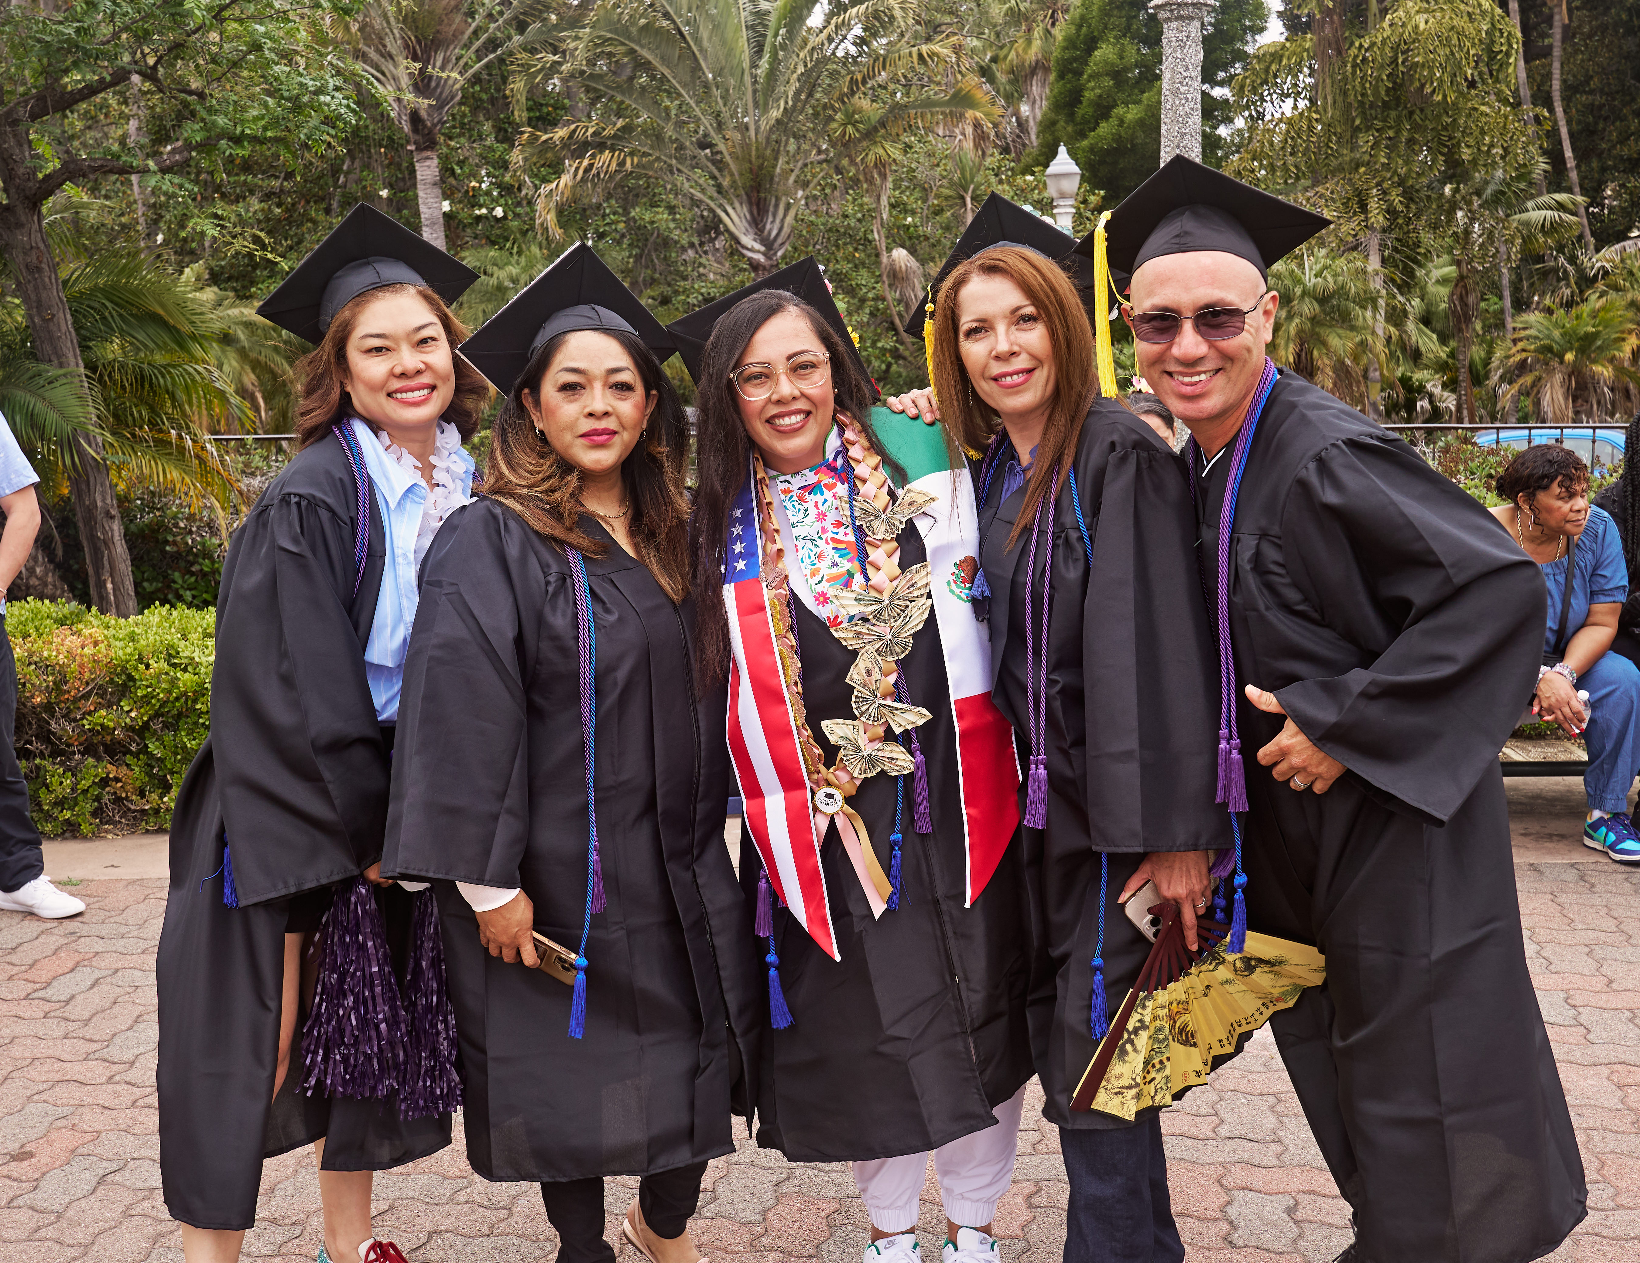
Workforce Diversity Metrics
Composite measure of race, ethnicity, and gender diversity using five measures:
SDCCD student demographics
San Diego County population estimates
California population estimates
United States population estimates
Recent graduate degrees awarded demographics

Slide 8
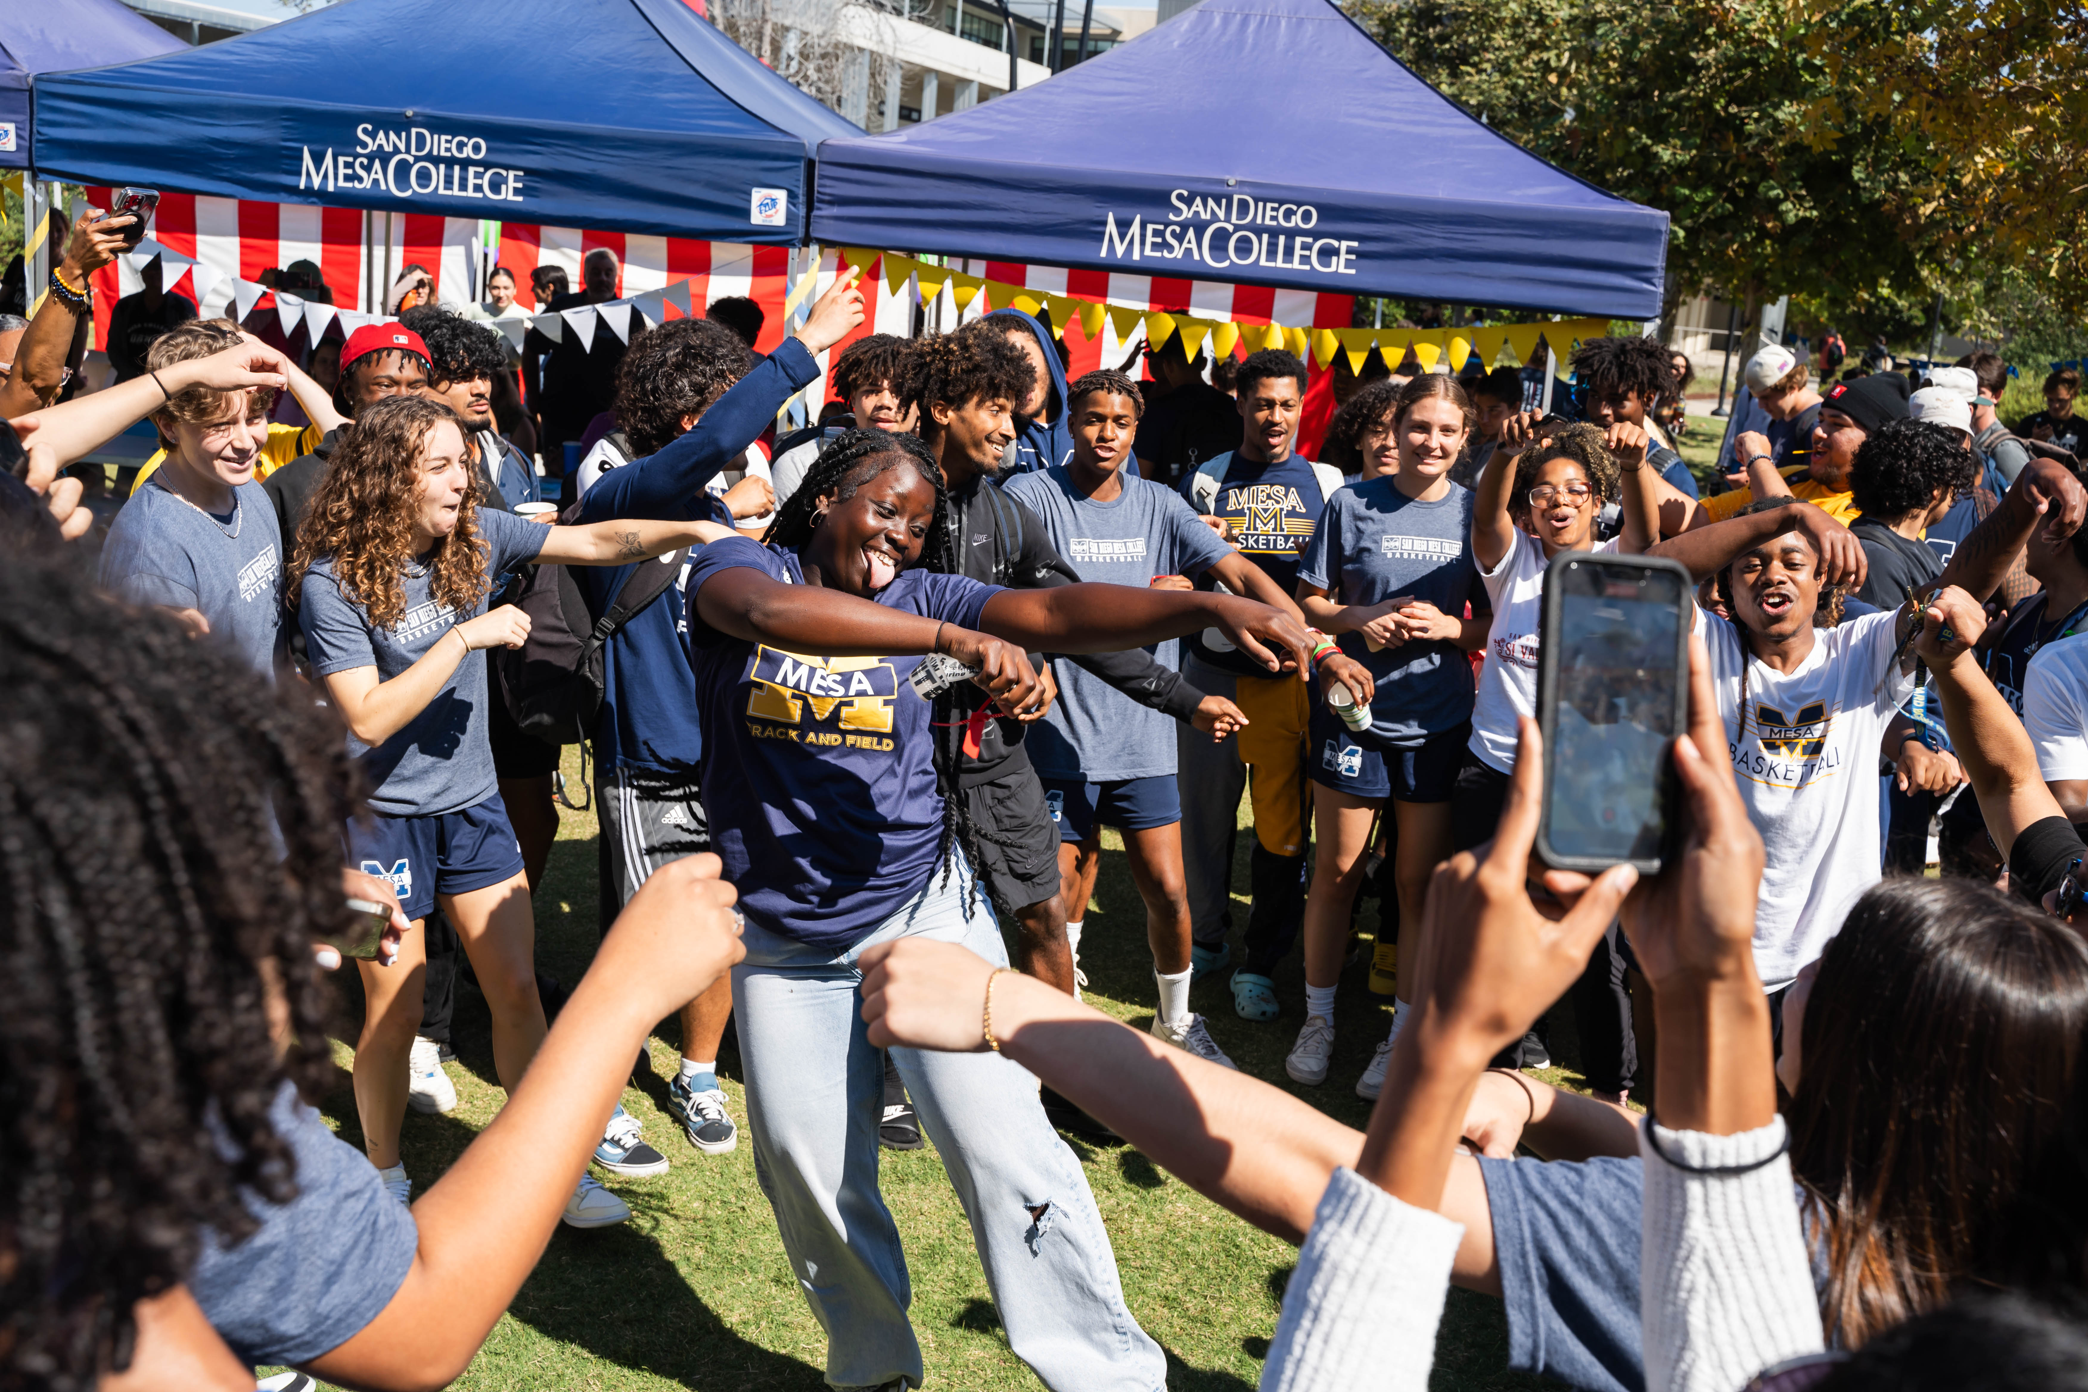
Workforce Diversity Metrics
Asian/PI 12.9%
Black 6.7%
Indigenous/Native American 0.3%
Latine/Hispanic 30.8%
White 42.9%
Female 51.9%
Male 48%

Slide 9
Current Workforce Districtwide All Job Categories
Asian/PI 15.3%
Black 7.7%
Indigenous/Native American 0.6%
Latine/Hispanic 22.4%
White 38.6%
Female 54.5%
Male 44.4%
Data as of June 30, 2024

Slide 10
Districtwide Utilization Analysis Key Findings
Latine/Hispanic
Diversity Metric 30.8%
Current Workforce 22.4%

Slide 11
Districtwide Utilization Analysis Management Key Findings
Race / Gender | Current Workforce | Diversity Metric | Focus Area
Asian / PI | 12.4% | 12.7% | Yes
Black | 11.1% | 6.9%
Indigenous / NA | 0% | 0.3% | Yes
Latine / Hispanic | 24.8% | 29.6% | Yes
White | 34% | 44.1%
Female | 58.2% | 52%
Male | 41.8% | 47.8%

Slide 12
Districtwide Utilization Analysis Supervisors Key Findings
Race / Gender | Current Workforce | Diversity Metric | Focus Area
Asian / PI | 19% | 12.7%
Black | 7.1% | 6.9%
Indigenous / NA | 0% | 0.3% | Yes
Latine / Hispanic | 23.8% | 29.6% | Yes
White | 33.3% | 44.1%
Female | 50% | 52% | Yes
Male | 50% | 47.8%

Slide 13
Districtwide Utilization Analysis Contract Faculty Key Findings
Race / Gender | Current Workforce | Diversity Metric | Focus Area
Asian / PI | 11% | 12.7% | Yes
Black | 7.1% | 6.9%
Indigenous / NA | 0.8% | 0.3% | Yes
Latine / Hispanic | 19.5% | 29.6% | Yes
White | 47.4% | 44.1%
Female | 59.2% | 52%
Male | 40.6% | 47.8%

Slide 14
Districtwide Utilization Analysis Adjunct Faculty Key Findings
Race / Gender | Current Workforce | Diversity Metric | Focus Area
Asian / PI | 11.9% | 12.7% | Yes
Black | 6.1% | 6.9% | Yes
Indigenous / NA | 0.8% | 0.3% | Yes
Latine / Hispanic | 15.1% | 29.6% | Yes
White | 51% | 44.1%
Female | 51.3% | 52%
Male | 48.2% | 47.8%

Slide 15
Districtwide Utilization Analysis Classified Professionals / Confidential Key Findings
Race / Gender | Current Workforce | Diversity Metric | Focus Area
Asian / PI | 18.4% | 12.4%
Black | 9.7% | 6.9%
Indigenous / NA | 0.8% | 0.3% | Yes
Latine / Hispanic | 34% | 31.3%
White | 22.8% | 43.1%
Female | 50.9% | 51.8%
Male | 48.8% | 48.1%

Slide 16
Districtwide Utilization Analysis College Police Key Findings
Race / Gender | Current Workforce | Diversity Metric | Focus Area
Asian / PI | 12.9% | 12.2%
Black | 6.5% | 7% | Yes
Indigenous / NA | 0% | 0.4% | Yes
Latine / Hispanic | 25.8% | 31.6% | Yes
White | 35.5% | 43%
Female | 29% | 49% | Yes
Male | 71% | 50.9%

Slide 17
Miramar College Utilization Analysis All Job Categories Key Findings
Race / Gender | Current Workforce | Diversity Metric | Focus Area
Asian / PI | 17.5% | 12.2%
Black | 3.8% | 7% | Yes
Indigenous / NA | 0.9% | 0.4% | Yes
Latine / Hispanic | 16.6% | 31.6% | Yes
White | 45% | 43%
Female | 45.9% | 49% | Yes
Male | 53.4% | 50.9%

Slide 18
Miramar College Utilization Analysis Management Key Findings
Race / Gender | Current Workforce | Diversity Metric | Focus Area
Asian / PI | 18.2% | 12.7%
Black | 9.1% | 6.9%
Indigenous / NA | 0% | 0.3% | Yes
Latine / Hispanic | 18.2% | 29.6% | Yes
White | 36.4% | 44.1%
Female | 50% | 52%
Male | 50% | 47.8%

Slide 19
Miramar College Utilization Analysis Supervisors Key Findings
Race / Gender | Current Workforce | Diversity Metric | Focus Area
Asian / PI | 26.7% | 12.7%
Black | 13.3% | 6.9%
Indigenous / NA | 0% | 0.3% | Yes
Latine / Hispanic | 6.7% | 29.6% | Yes
White | 33.3% | 44.1%
Female | 60% | 52%
Male | 40% | 47.8%

Slide 20
Miramar College Utilization Analysis Contract Faculty Key Findings
Race / Gender | Current Workforce | Diversity Metric | Focus Area
Asian / PI | 11.6% | 12.7% | Yes
Black | 0.8% | 6.9% | Yes
Indigenous / NA | 0.8% | 0.3% | Yes
Latine / Hispanic | 15.5% | 29.6% | Yes
White | 54.3% | 44.1%
Female | 50.4% | 52% | Yes
Male | 48.8% | 47.8%

Slide 21
Miramar College Utilization Analysis Adjunct Faculty Key Findings
Race / Gender | Current Workforce | Diversity Metric | Focus Area
Asian / PI | 12.9% | 12.7%
Black | 3.7% | 6.9% | Yes
Indigenous / NA | 0.8% | 0.3% | Yes
Latine / Hispanic | 16.2% | 29.6% | Yes
White | 49.9% | 44.1%
Female | 41.8% | 52% | Yes
Male | 58% | 47.8%

Slide 22
Miramar College Utilization Analysis Classified Professionals / Confidential Key Findings
Race / Gender | Current Workforce | Diversity Metric | Focus Area
Asian / PI | 28.9% | 12.4%
Black | 6% | 6.9% | Yes
Indigenous / NA | 1.2% | 0.3% | Yes
Latine / Hispanic | 21.7% | 31.3%
White | 27.7% | 43.1%
Female | 55.4% | 51.8%
Male | 44.6% | 48.1%

Slide 23
Districtwide Longitudinal Hiring Outcomes All Job Categories Key Findings
Race / Gender | Diversity Metric | % of Applicants | % of Hires | Selection Phase Focus
Asian / PI | 12.9% | 14.3% | 18%
Black | 6.7% | 12.1% | 9.8% | Selection for Interview
Latine / Hispanic | 30.8% | 35.5% | 41.8%
White | 42.9% | 38.1% | 30.5%
Female | 51.9% | 57.2% | 59%
Male | 48% | 42.8% | 41%

Slide 24
Miramar College Longitudinal Hiring Outcomes All Job Categories Key Findings
Race / Gender | Diversity Metric | % of Applicants | % of Hires | Selection Phase Focus
Asian / PI | 12.9% | 17.6% | 25.6%
Black | 6.7% | 10% | 4.1% | Selection for Interview
Latine / Hispanic | 30.8% | 28.8% | 26.4% | Selection for Interview
White | 42.9% | 43.6% | 43.8%
Female | 51.9% | 57.9% | 61.8%
Male | 48% | 42.1% | 38.2%

Slide 25
Miramar College Longitudinal Hiring Outcomes Mgmt/Supv Key Findings
Race / Gender | Diversity Metric | % of Applicants | % of Hires | Selection Phase Focus
Asian / PI | 12.7% | 12.3% | 22.7%
Black | 6.9% | 17.2% | 13.6% | Selection for Interview
Latine / Hispanic | 29.6% | 26% | 31.8%
White | 44.1% | 44.6% | 31.8%
Female | 52% | 47.4% | 47.8%
Male | 47.8% | 52.6% | 52.2%

Slide 26
Miramar College Longitudinal Hiring Outcomes Instructional Faculty Key Findings
Race / Gender | Diversity Metric | % of Applicants | % of Hires | Selection Phase Focus
Asian / PI | 12.7% | 17.6% | 22.2%
Black | 6.9% | 5.3% | 0% | Selection for Interview
Latine / Hispanic | 29.6% | 18.3% | 14.8% | Selection for Interview
White | 44.1% | 58.9% | 63%
Female | 52% | 45.6% | 63.3%
Male | 47.8% | 54.4% | 36.7%

Slide 27
Miramar College Longitudinal Hiring Outcomes Non-Instructional Faculty Key Findings
Race / Gender | Diversity Metric | % of Applicants | % of Hires | Selection Phase Focus
Asian / PI | 12.7% | 15.2% | 25%
Black | 6.9% | 12.6% | 8.3%
Latine / Hispanic | 29.6% | 42.6% | 58.3%
White | 44.1% | 29.7% | 8.3%
Female | 52% | 71.8% | 83.3%
Male | 47.8% | 28.3% | 16.7%
There were only 11 hires during the five-year analysis period

Slide 28
Miramar College Longitudinal Hiring Outcomes Classified Professionals Key Findings
Race / Gender | Diversity Metric | % of Applicants | % of Hires | Selection Phase Focus
Asian / PI | 12.4% | 21% | 28.3%
Black | 6.9% | 9.2% | 1.7% | Selection for Interview
Latine / Hispanic | 31.3% | 32.2% | 23.3% | Selection for Interview
White | 43.1% | 37.6% | 46.7%
Female | 51.8% | 66.6% | 62.1%
Male | 48.1% | 33.4% | 37.9%

Slide 29
Key Findings
Persistent differences in selection for interview across all job categories primarily impacting applicants identifying as Black or Latine/Hispanic
Limited selections in noninstructional faculty prevent robust quantitative findings; districtwide findings show more parity in diverse hiring outcomes than other categories

Slide 30
Historical Context
Social norms have defined professional roles within race, gender/SOGI, ability status and other stereotypes
Standard hiring practices in American were developed primarily in the early 1900s
Discrimination in education and employment was legal, encouraged, and expected based on race, ethnicity, gender, religion, ability status, etc.

Slide 31
Historical Context
Cover letters, resumes, CVs, reference letters, etc. are framed by socioeconomic status markers, access to and inclusion in networks, and biases strongly correlated with cultural identities
Name, prior employers, schools attended, and writing style indicate social class, race/ethnicity, gender, etc.
Decisions based on the assumption prior experience and education are objective predictors of job-related KSAs and future performance

Slide 32
Current Context
Cultural diversity as an organizational benefit is undervalued and often discouraged or perceived to be an EEO violation (“reverse” discrimination)
Communication, engagement, and behaviors are often more impactful than technical competencies on performance and undervalued in selection decisions

Slide 33
Predicting Job Performance
Interpersonal - Will they interact and communicate effectively within our values?
Cultural - Will their behaviors and relationships contribute to our desired environment?
Technical - Do they have the required competencies?
Skills - Will they perform key duties well?

Slide 34
EEO Law Restriction
Illegal: selection decisions based on protected characteristics (race, ethnicity, gender, gender identity, sexual orientation, religion, ability status, etc.)
Legal: selection decisions based on ability to serve / work effectively with diverse communities

Slide 35
Reframing Employment and Engagement
Invite
Initiate
Include
Invest

Slide 36
Invite
Our mission, vision, and values must be evident everywhere

Slide 37
Invite
We must convince people we value their authenticity

Slide 38
Invite
Employment Marketing
Success of our diverse student communities
Dynamic content
Individuals feel a cultural connection to the content

Slide 39
Invite New Employment Website Design

Slide 40
Invite
Expressing Interest
Specific questions about engagement and using technical KSAs to facilitate success of diverse communities
Eliminate information which perpetuates biases and barriers
Anonymous Screening

Slide 41
Assess
Community Engagement
Redefining committee participation to require DEIA-focused assessments
Redefine technical KSAs within successful engagement with diverse communities
Align decision-making tools with desired outcomes
Behaviors and outcomes, not philosophies

Slide 42
Our Future
Intentional Design
Who would we welcome into our community if we were redesigning to specifically ensure the success of underserved communities
How will we identify the behaviors and competencies necessary to meet our mission, vision, and values
How will we align individual actions, culture, and formal structures to hold ourselves accountable for student outcomes?
Community Building
How do individuals experience our culture and formal structures?
How do we validate and value the lived experiences of individuals within our culture and formal structures
How do we create opportunities for personal and professional growth aligned with our mission, vision, and values

Slide 43
Let’s Talk
Gregory Smith, Chancellor
(619) 388-6957
gsmith@sdccd.edu

