Slide 1
Special Senses
The Ears
(Equilibrium and Hearing)
The Eyes
(Vision)

Slide 2
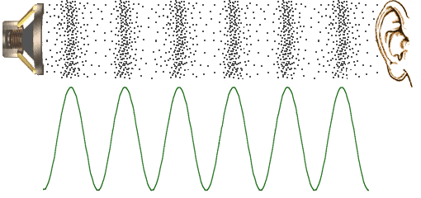
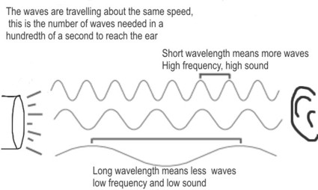
Sound Waves
1. Frequency = wavelength -> pitch of sound
2. Amplitude = height of wave -> volume of sound

Slide 3
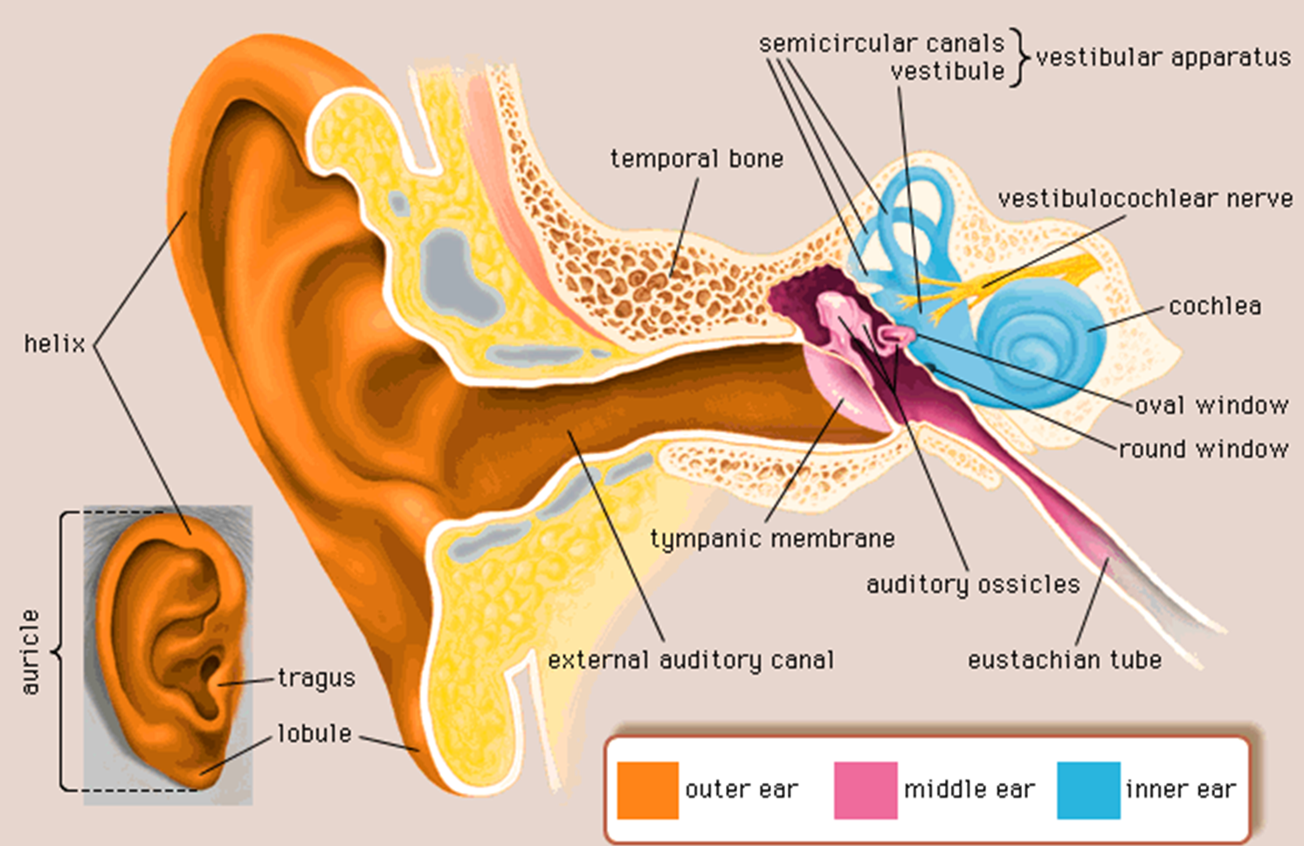

Slide 4
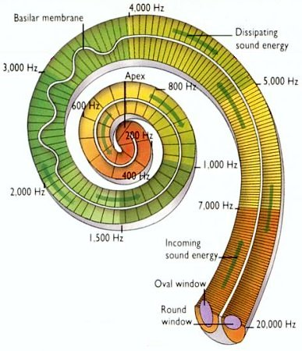
Inner cochlea

Slide 5
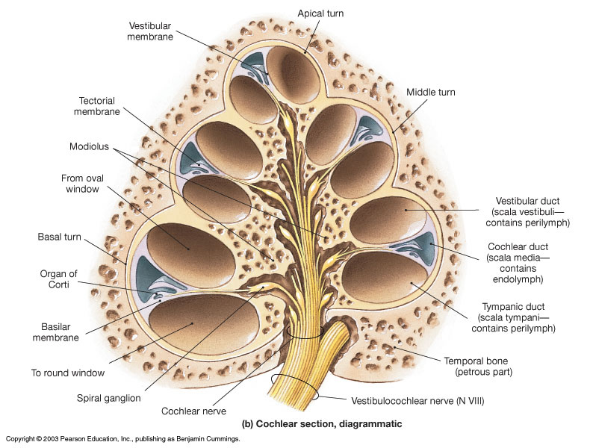
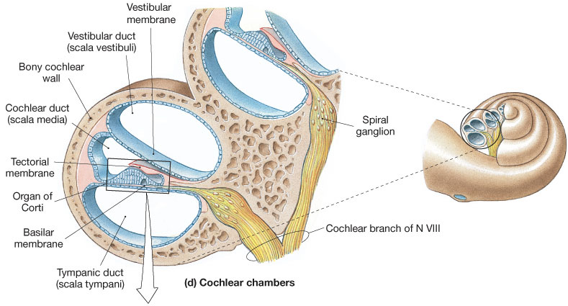
Sectional View of Cochlea
Showing arrangement of the:
3 Ducts
3 Membranes

Slide 6
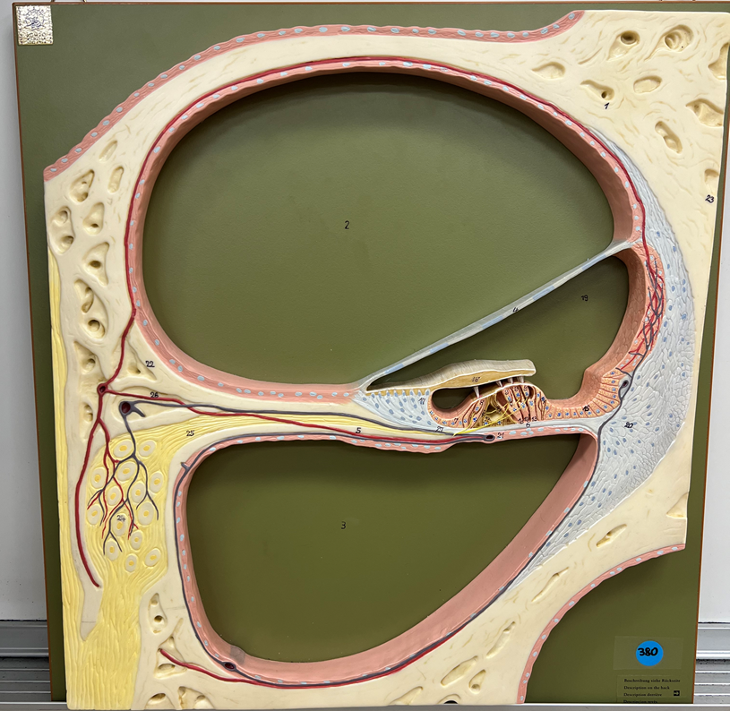

Slide 7
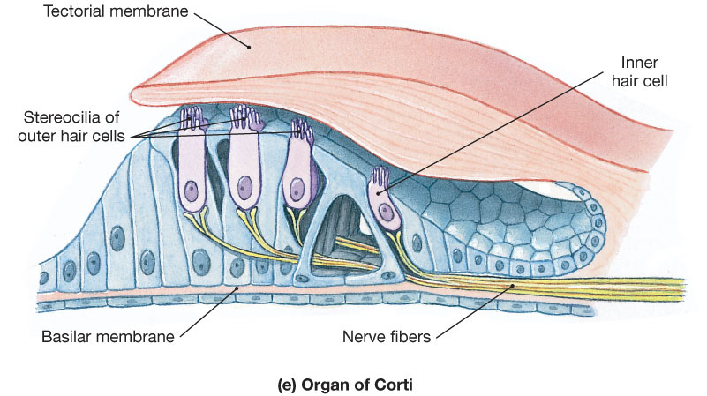
The Organ of Hearing
To Cochlear N.

Slide 8
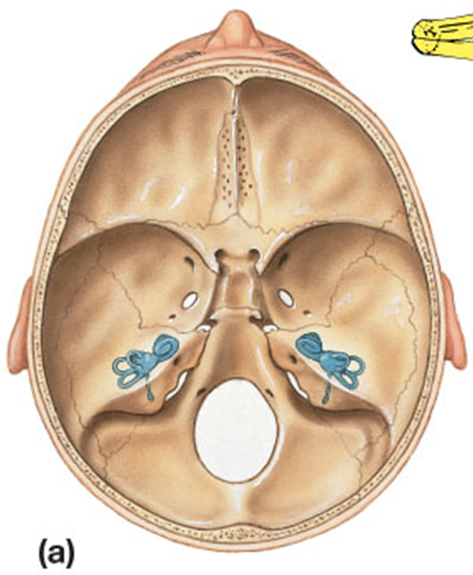
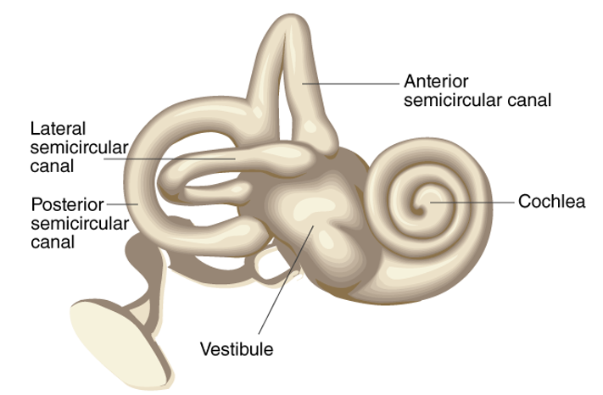
The Bony Labyrinth
of the Inner Ear
M
I
S

Slide 9
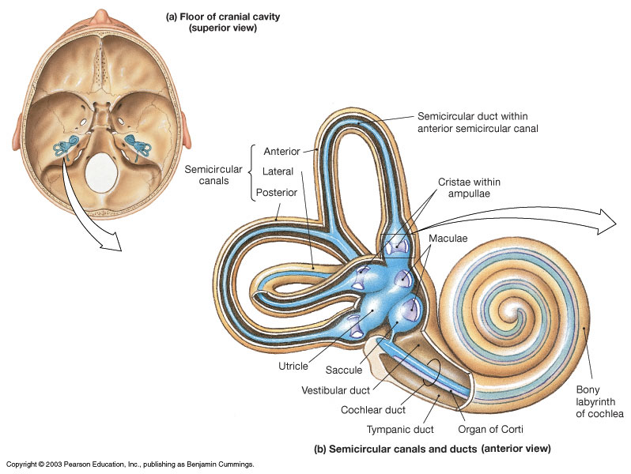
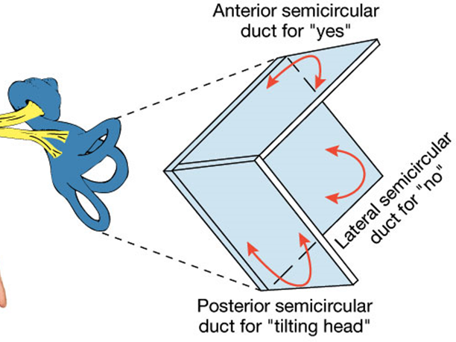
Semicircular Canals and Ducts
Maintain balance (equilibrium) by
detecting rotational head movements

Slide 10
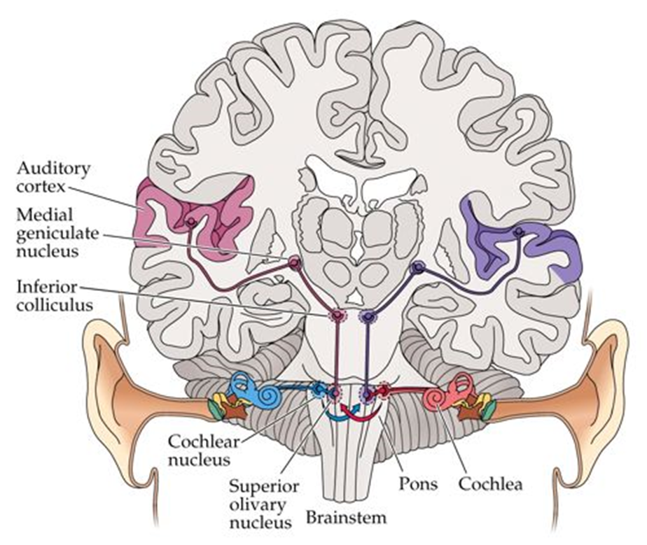
Ascending Auditory Pathways

Slide 11
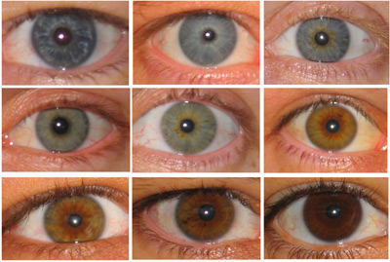
The Eyes
Q: What Makes Eyes Have Color?

Slide 12
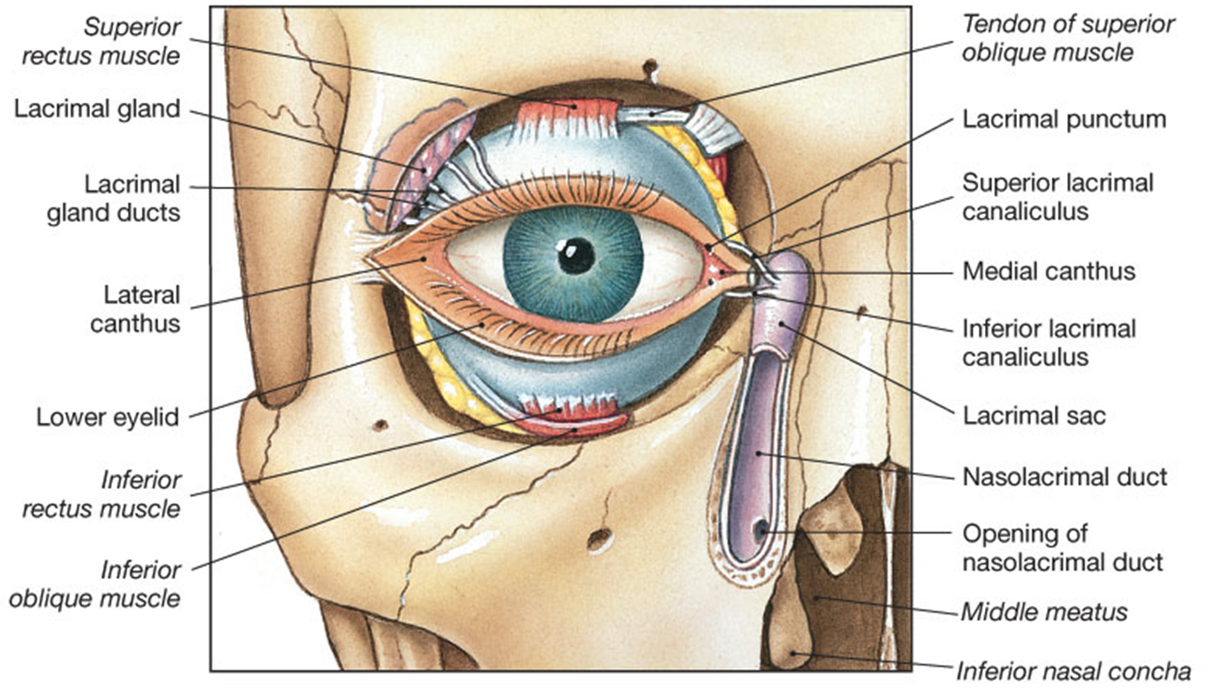
The Eye in the Orbit
With the Lacrimal Apparatus

Slide 13
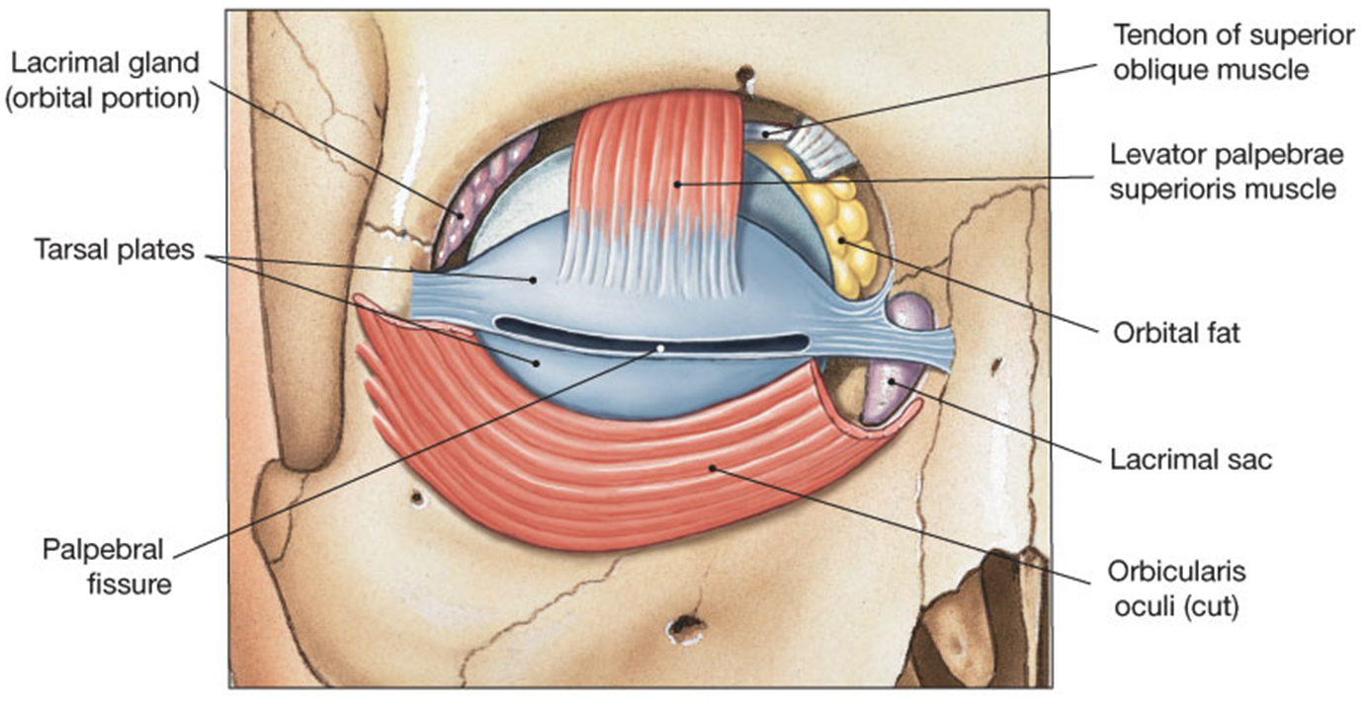
The Palpebrae Muscles
Trochlea

Slide 14
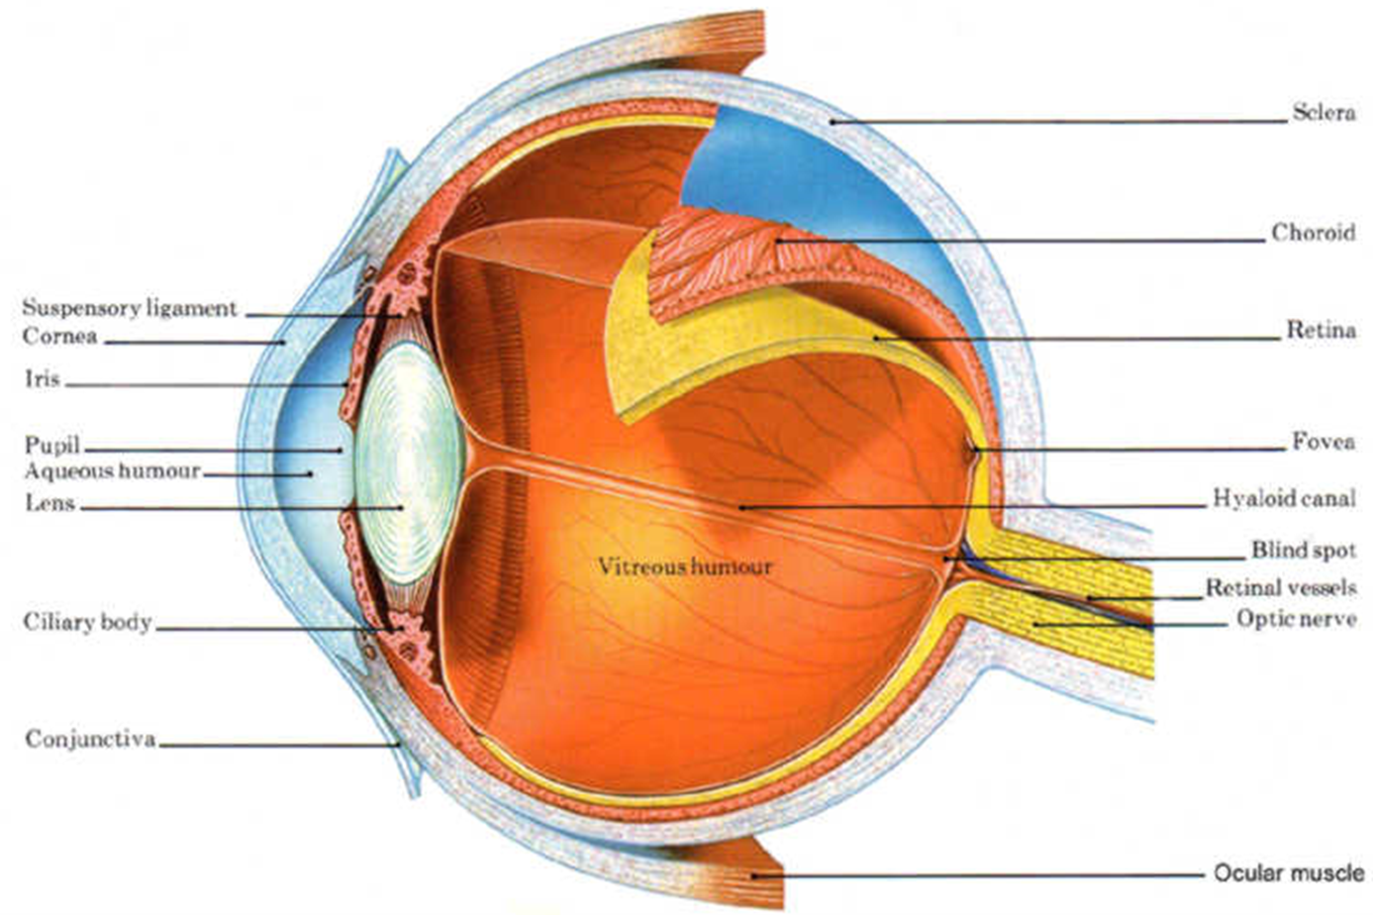
The Layers (Tunics) of the Eye

Slide 15
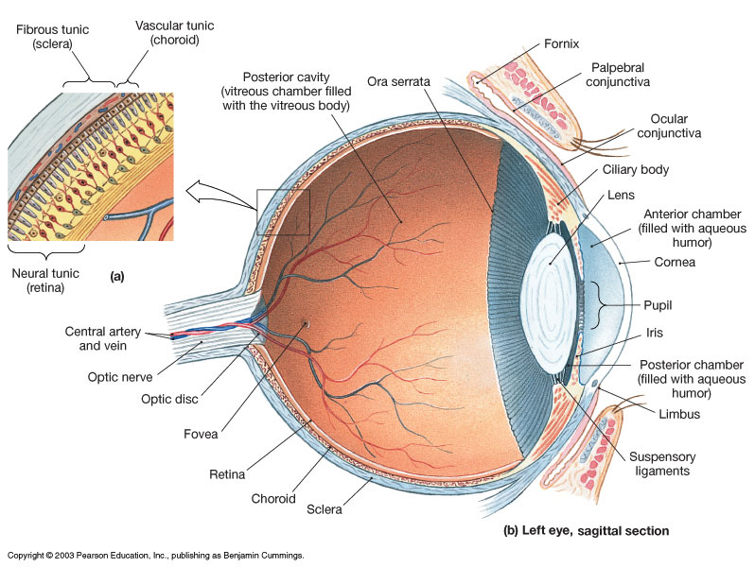

Slide 16
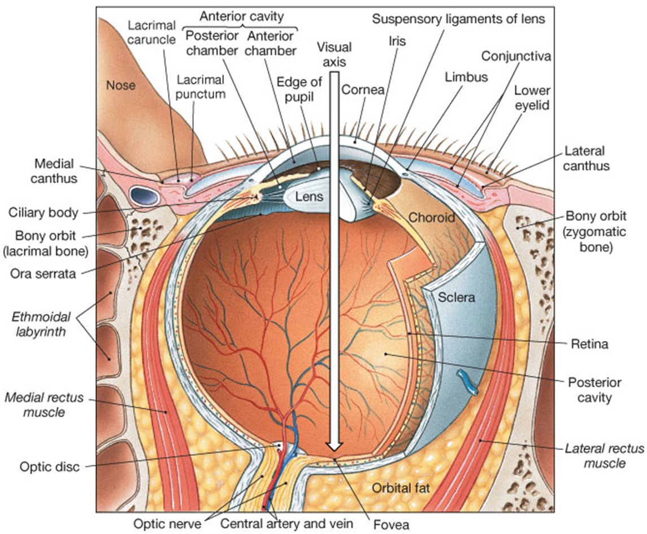

Slide 17
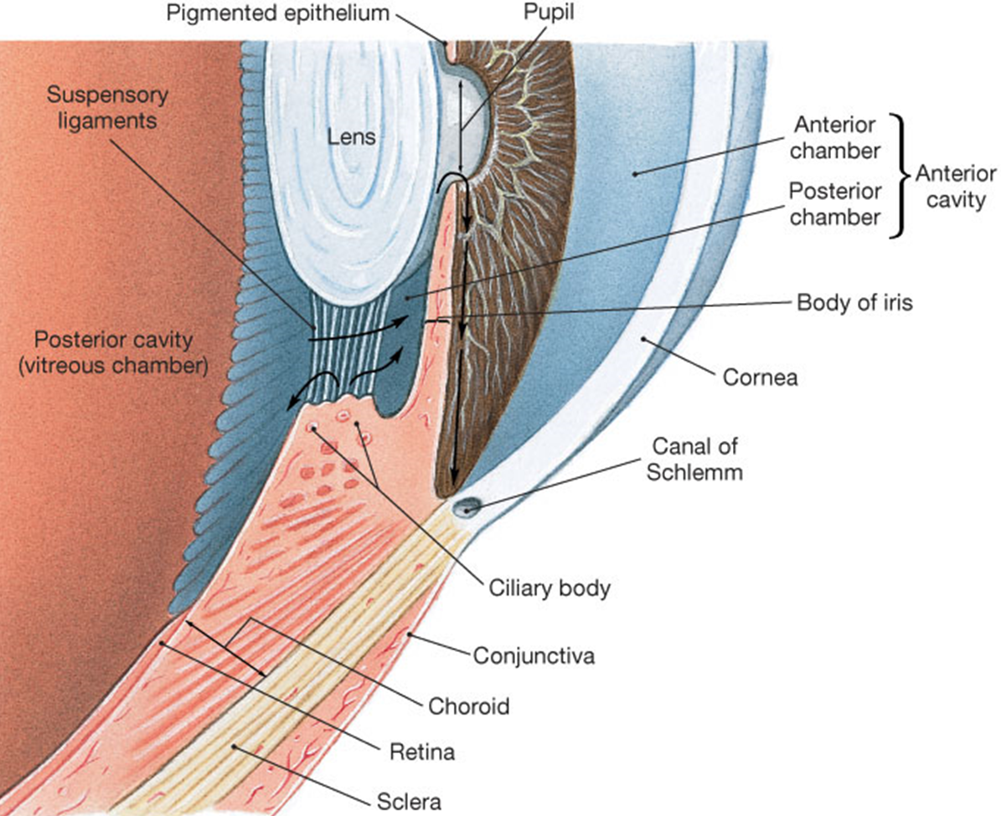
The Circulation of Aqueous Humor
within the Anterior Cavity of the Eye

Slide 18
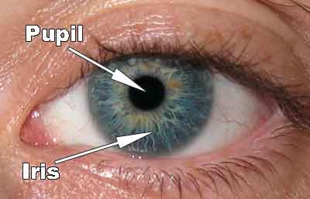
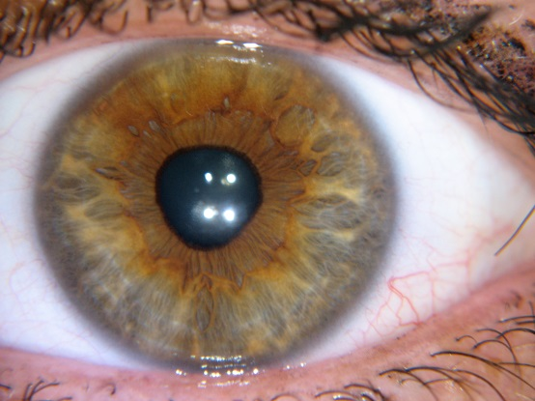
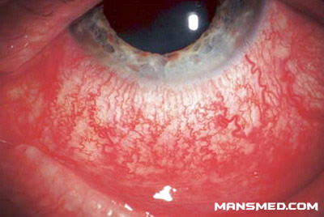
Conjunctiva - lines inside of eyelids and covers the sclera of the eye (= the whites of the eye). Made of non-keratinized stratified squamous and stratified columnar epithelium, + goblet cells.
It is vascular (has many tiny blood vessels),whereas the sclera is avascular.
sclera
Other cells in conjunctival epithelium include melanocytes, T and B cell lymphocytes.
Conjunctivitis – when the conjunctiva becomes inflamed, from injury or irritation, also known as ‘pinkeye’.

Slide 19
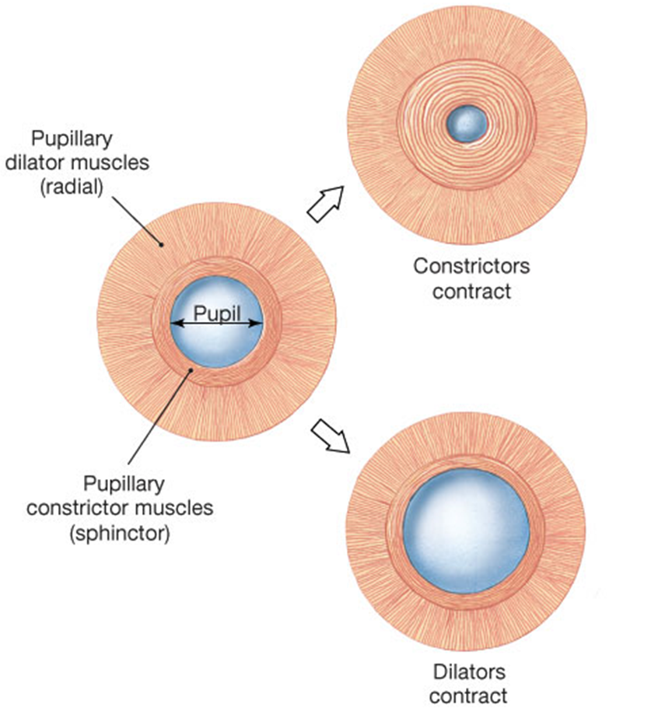
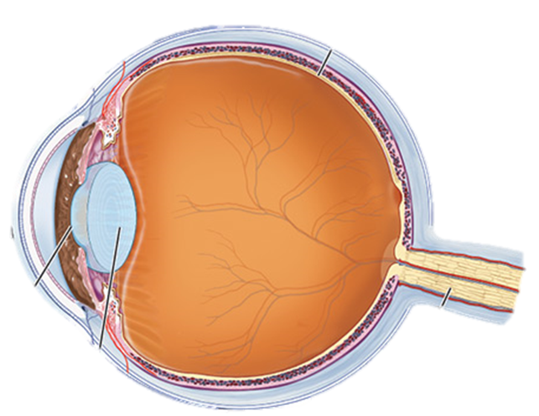
The Pupil and the Light Fixing Apparatus
Ciliary body
Retina
Iris
Fovea
centralis
Cornea
Pupil
Optic N.
Lens

Slide 20
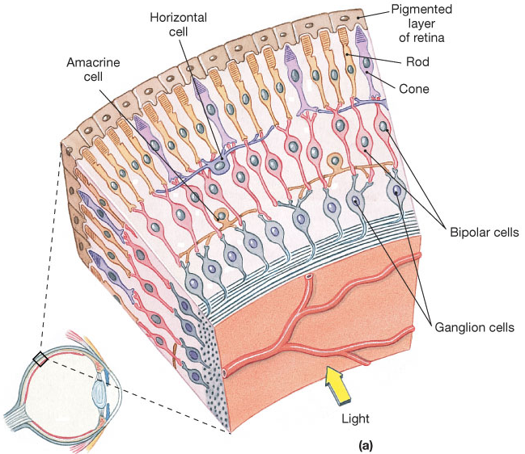
Layers of the Retina (Neural Tunic)

Slide 21
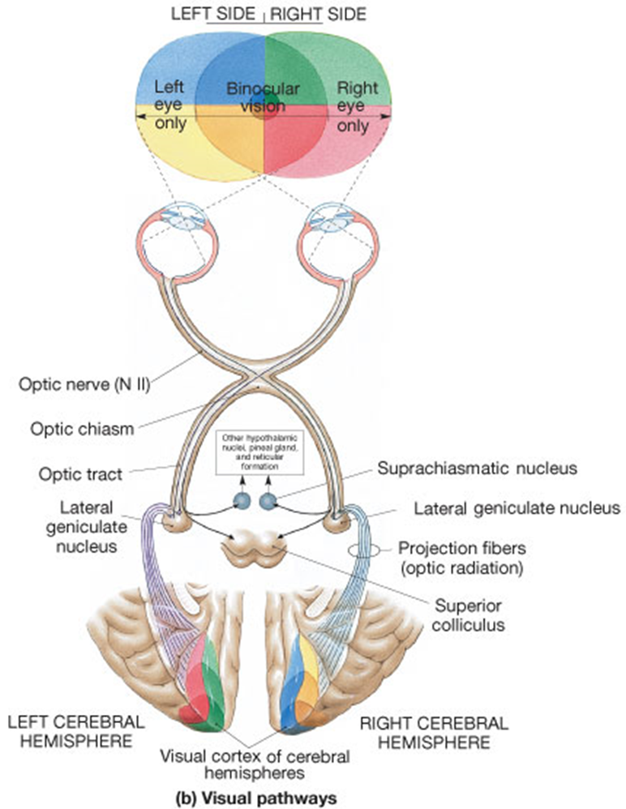
Visual Pathways

Slide 22
Vision
Visual Conditions
Myopia - near (short) sightedness. Results from light entering eye being focused in front of the fovea centralis of retina, rather than directly on it. Causes distant image to be out of focus. Commonly from the eyeball being too long, alters distance of the fovea onto which the light is being refracted (‘bent’ or focused).
Myopia often treated by concave corrective lenses (have a negative optical power).
Hyperopia - far (long) sightedness. Eyes do not have enough power to see close or nearby objects. Results from light entering eye being focused in behind the fovea centralis of retina, rather than directly on it.
Hyperopia treated with convex corrective lenses (have a positive optical power).

Slide 23
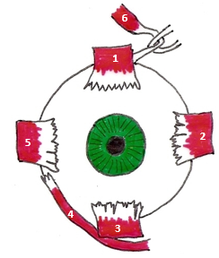
Presbyopia = associated with aging in which the eye exhibits a diminished ability to focus on near objects. Likely due to a decrease in elasticity of the lens and perhaps changes in the lens’s curvature.
Astigmatism - is caused by the shape of the cornea which prevents part of it from focusing light onto the retina. This results in a blurred area of the visual filed within an otherwise clear image.
These conditions are termed "refractive errors“ as they involve changes in the way light is ‘bent’ or focused as it enters the eye.

Slide 24
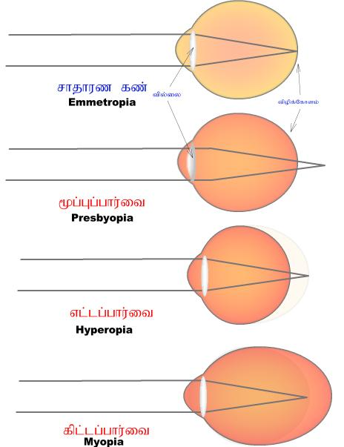
Normal Vision
Light (image) focused
on fovea of retina
lens shape
differs
eye shape same
Light focused
behind fovea
of the retina
Lens is
less flexible
Light focused
behind fovea
of the retina
Eyeball
too short
Light focused
in front of fovea
of the retina
Eyeball
too long

