Slide 1
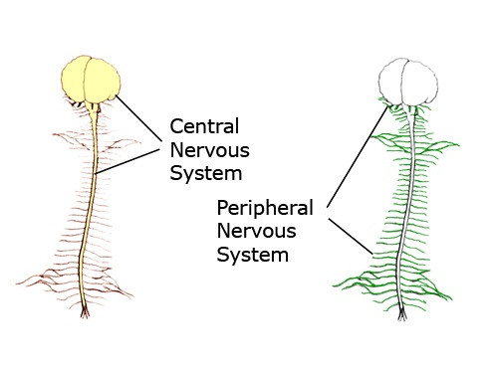
The Nervous System
The Central Nervous System (CNS) is composed of the Brain and Spinal cord
The Peripheral Nervous System (PNS) is composed of Ganglia and Nerves
Spotlight on the Peripheral Nervous System

Slide 2
Central Nervous System
Peripheral Nervous System
The PNS has 2 components:
The SNS and the ANS
Somatic Nervous System
(SNS)
Autonomic Nervous System
(ANS)
(has 2 divisions)
Voluntary*
Involuntary#
Effector Tissue is:
Skeletal Muscle
Only!
(2 divisions)
Parasympathetic
Sympathetic
Effector Tissues are:
1. Cardiac Muscle
2. Smooth Muscle
3. Glands
*Except for Reflexes
#Except for Biofeedback mechanisms

Slide 3
The Somatic Nervous System (SNS)
This one is simple and easy – so let it be!
CNS
PNS
One Somatic Motor Neuron
to a single effector tissue:
NT = ACh
Effector Tissue
Skeletal Muscle
Receptor = Nicotinic
This thing!
All that ever happens is that a Somatic Motor Neuron ‘fires’ a signal
to skeletal muscle fibers and then the muscle contracts!
If they do not send a signal, the muscle stays relaxed!
e.g., the musculocutaneous nerve sends a signal and presto, the biceps brachii contract!
Easy, huh?

Slide 4
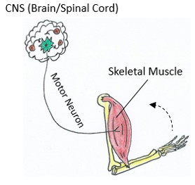
Summary Notes on SNS:
The Somatic Nervous System (SNS) is simple anatomically.
It is mostly under Voluntary control, meaning
we are consciously aware of body movements.
(The exception is reflex actions)
Here are the important concepts of SNS:
There is only 1 Somatic Motor Neuron.
It acts on 1 Effector Tissue only = Skeletal muscle.
Skeletal muscle contracts as a result of this innervation.
Skeletal muscle relaxes when there is no signal from somatic motor neurons.
We will not go into details about neurotransmitters and receptors, but…
At the neuromuscular junction for skeletal muscle, somatic motor neurons release ACh (acetylcholine) onto nicotinic receptors.

Slide 5
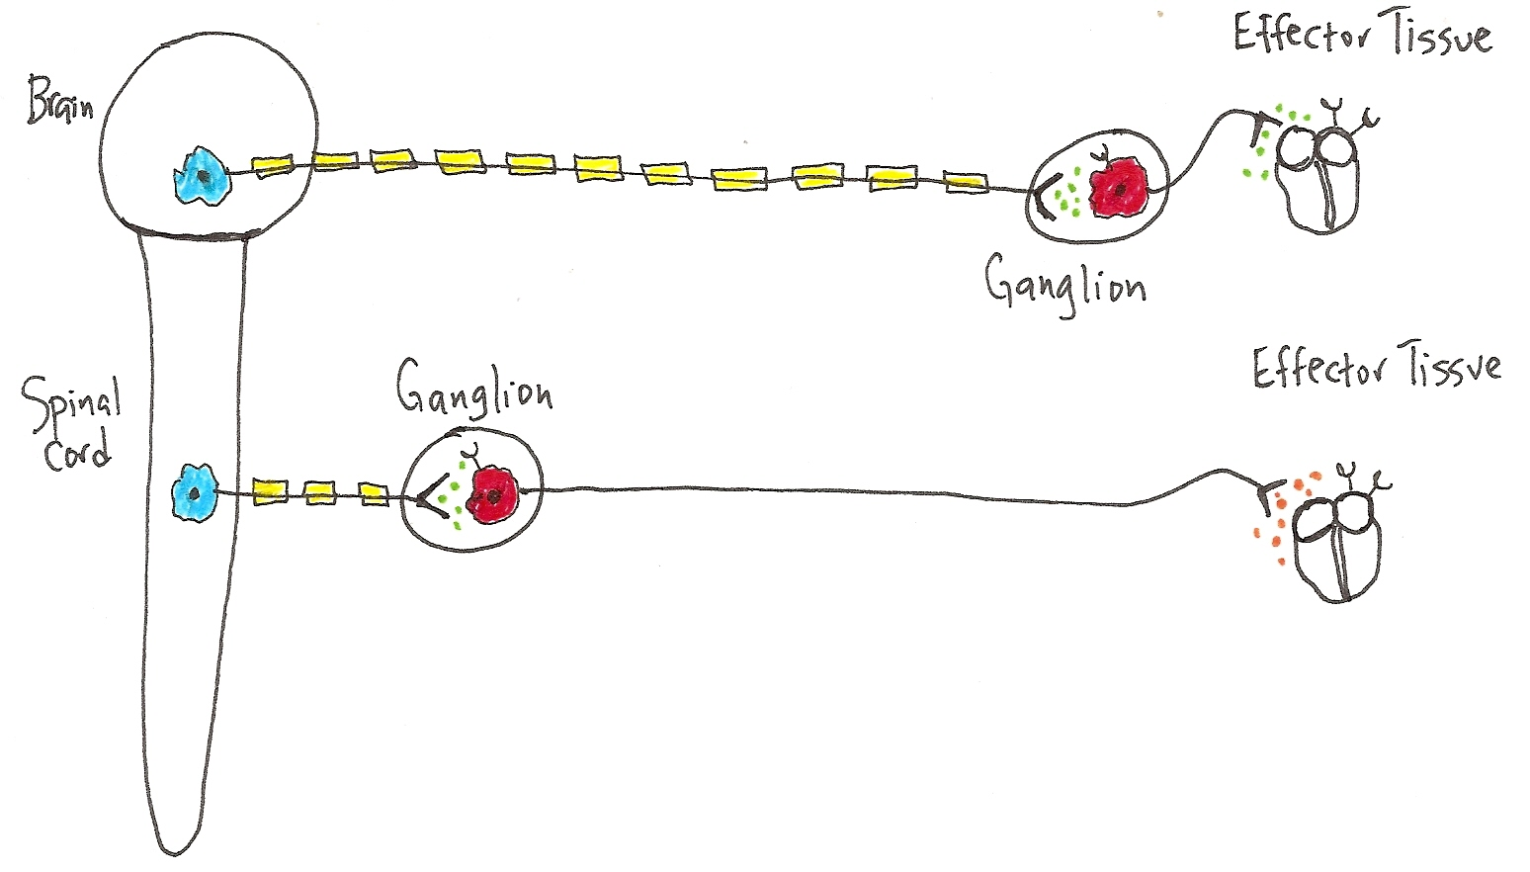
The Autonomic Nervous System
(the ANS is more complex than the SNS)
CNS
PNS
Tissue
Preganglionic Neurons
PARA
e.g., the Heart
(Causes decrease)
SYM
e.g., the Heart
(causes increases)
Postganglionic Neurons
In CNS: Preganglionic Neurons
Para = Craniosacral Origin*
Sym = Thoracolumbar Origin*
At Ganglion (in PNS):
Postganglionic
Nerve cell bodies
Effector Tissue (in PNS):
Cardiac Muscle
Smooth Muscle
Glands
*The term ‘origin’ means where in the CNS do these first ANS neurons come from.
Note that the same actions occur at the ganglion for both divisions, they are identical.
Here at the effector tissue is where the 2 divisions (Para and Sym) of the ANS differ.

Slide 6
ANS Overview Notes:
The Autonomic Nervous System (ANS) is complex.
It has 2 divisions: The Parasympathetic and the Sympathetic.
There are 3 basic effector tissues in the ANS for both divisions:  cardiac muscle,  smooth muscle, and  glandular tissue. Both divisions have the same effector tissues, but often the 2 divisions have antagonistic (opposing) effects.
The catch phrase for Para is: “Rest and Digest”. For Sym it’s: “Fight or Flight”. Keep those terms in mind as they help reveal what the actions are on effector tissue.
The ANS involves 2 motor (efferent) neurons in sequence. The 1st neuron is from the CNS to a ganglion (it’s called the preganglionic neuron) and the 2nd neuron is from the ganglion to the effector tissue (it’s called the postganglionic neuron).
A ganglion is a cluster of nerve cell bodies in the PNS. Right? : )
A nerve fiber is a single axon. Right? : )
In the detailed drawings, please notice how the ganglia in the Para division are close to the effector tissue, but in the Sym division they are close to the CNS. Also, notice the nerve fibers (axons) for the preganglionic neurons in the Para are very long and the nerve fibers for the postganglionic are very short. It is the opposite arrangement for the Sym division! What do you notice about axon myelination?

Slide 7
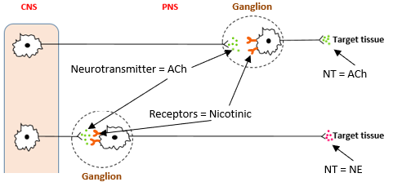
Summary Notes on ANS:
The Autonomic Nervous System (ANS) is more complex anatomically.
The ANS is mostly under Involuntary control, meaning
we are not consciously aware of these responses.
(The exception is biofeedback actions)
Here are the important concepts of ANS:
There are 2 Motor Neurons in the ANS:
  The preganglionic neuron
  The postganglionic neuron
Acts on 3 Effector Tissues:
  Cardia muscle – of the heart.
  Smooth muscle – of blood vessel walls, bronchioles, ducts, tracts and organs.
  Glands – of exocrine (sweat, salivary, etc.) and endocrine (hormones, etc.) glands.
There are 2 divisions of the ANS, the Parasympathetic and the Sympathetic
For the most part they oppose each other: Para is for resting and digesting, and Sym is for fast emergency responses to prepare the body for danger or excitement.

Slide 8
More ANS Notes:
In general, Para is for ‘housekeeping’ activities (“Rest & Digest”), storing needed things, relaxing, getting rid of things and doing some chores!
e.g., after lunch, as you decide to sit and read - Para is at work! Heart rate is low, saliva and G.I. tract activity are high, bronchiole (airways) diameter is small, no need for much air, everything is fine, there’s no hurry, you’ve got all day. Pupil diameter is small too, enabling that near focus to get all the fine details!
In general, Sym is for emergency situations (“Fight or Flight”)! You may have to fight or run – either way it takes a lot of energy.
e.g., imagine as you sit down to read, a big scary bug enters the room. Presto - immediately the Sym is at work. Heart rate skyrockets (to get more blood to body, and get you out of danger), your G.I. activity comes to a halt, and bronchioles diameter gets larger, as you need more air flow to either fight or run. More Sweat? Yes. Dry mouth? Yes. Pupil diameter becomes larger too, enabling distant focus so you can see an escape route! You are ready!!!
Note: The NT released (ACh) and receptors at the ganglion (Nicotinic) are the same in both divisions!
They are different at the Effector Tissue, where the Para releases ACh and the Sym releases NE.

Slide 9
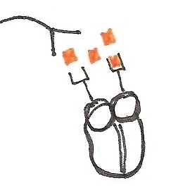
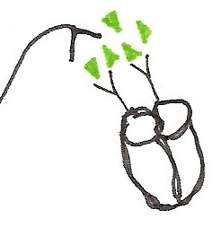
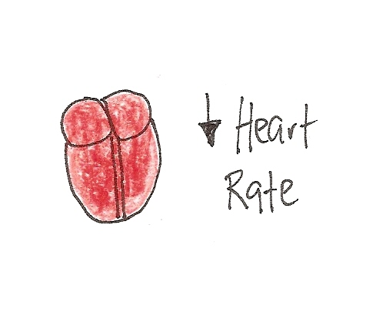
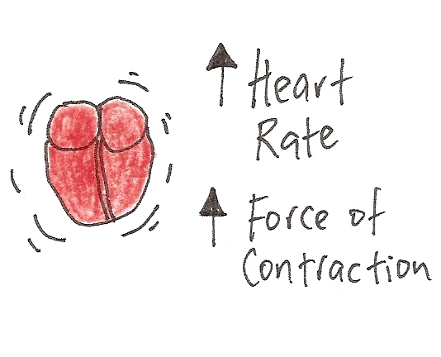
PARA
Now let’s compare how
the 2 –‘s of the ANS
Effect the Heart
SYM
. .
The neurotransmitter acetylcholine (ACh) is released from Postganglionic Parasympathetic neurons, that is, at the effector tissue!
The neurotransmitter norepinephrine (NE) is released from Postganglionic Sympathetic neurons, that is, at the effector tissue!
Effect?
Effect?
PARA = “Rest and Digest”
SYM = “Fight or Flight”

Slide 10
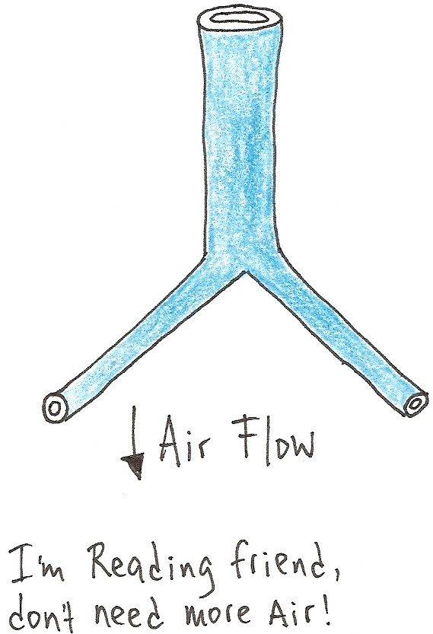
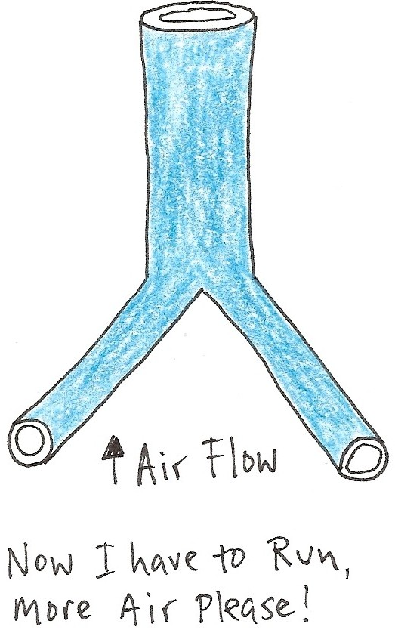
PARA
The
Lungs?
(Bronchioles)
SYM
Diameter of
Bronchioles
(constriction)
Diameter of
Bronchioles
(dilation)
Bronchioles are tiny tubes in the lungs that air flows through
What is the direct “effector tissue” for the bronchioles?
Remember, there are only 3 basic choices!

Slide 11
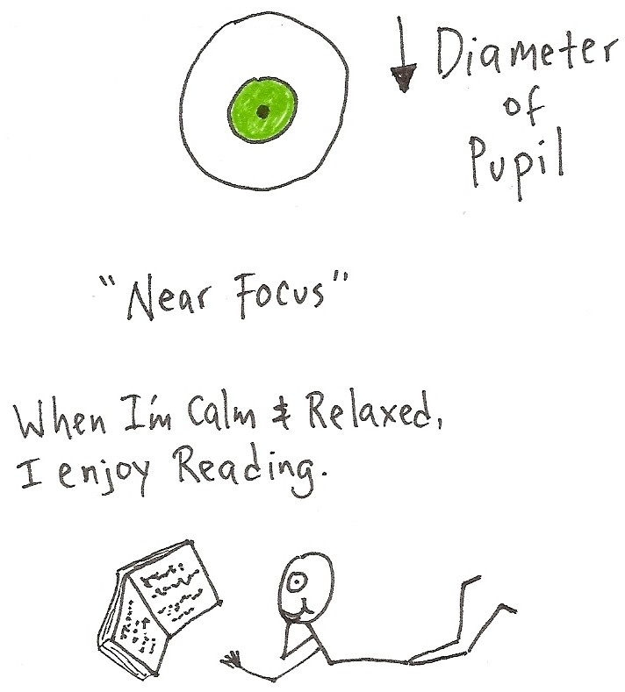
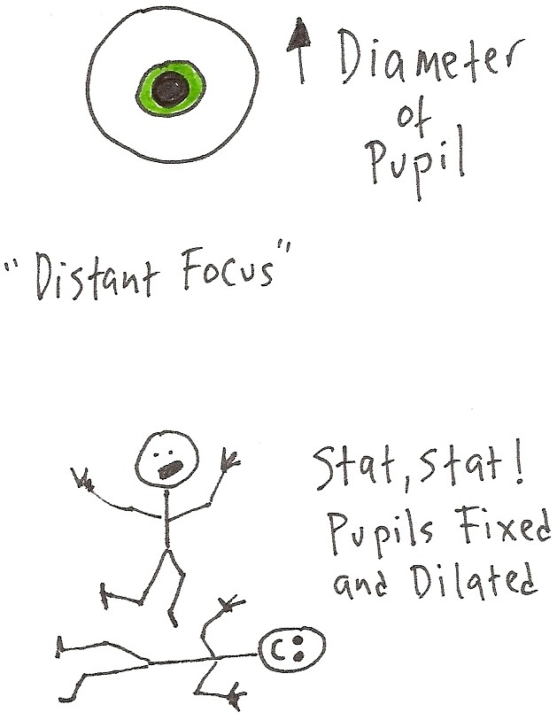

PARA
SYM
Vision?
(constriction)
(dilation)
Hmmm, coconut oil and butter are natural saturated fats with excellent medium chain fatty acids for human health.
Good thing I read …
Note: Similar effects to Sympathetic stimulation are found from being in Love – seriously.
The pupil is a hole in the center of the iris (colored part) of the eye. It has two sets of intrinsic ‘muscles’ that can change pupil diameter, which changes the amount of light allowed in to hit the retina and photoreceptors.

Slide 12
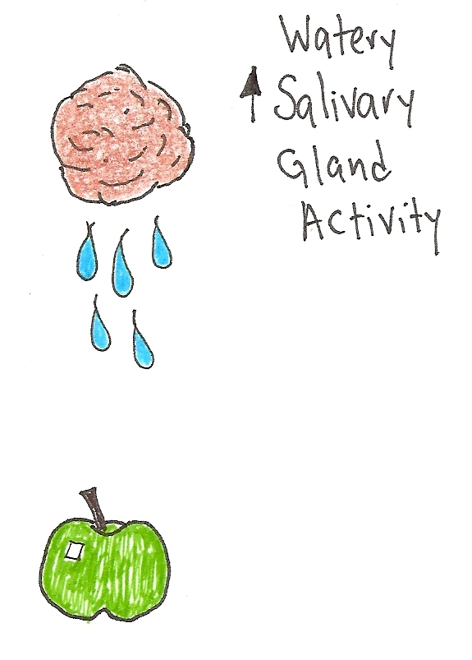
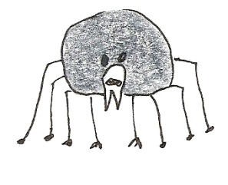

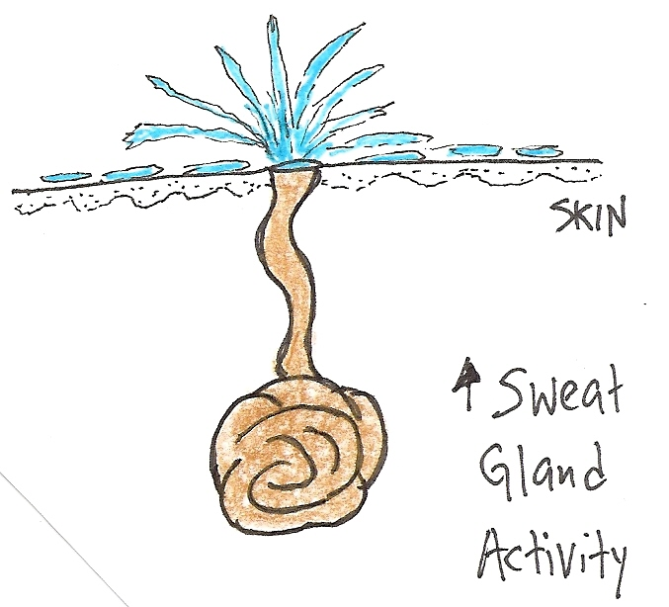
PARA
SYM
Saliva & Sweat?
“What a tangled web
we weave, when our
aim is to deceive!”
Yum, I can just
Imagine how nice
this will taste!
Make sure it’s Organic, salvesterols are good for you.
Note: Not telling the truth
will also make you sweat!

Slide 13
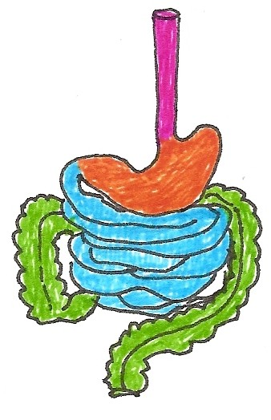
PARA
SYM
G.I. Tract
Alimentary Canal?
Rest and DIGEST
Emergency - no time to digest!
In G. I. Tract Motility
In G. I. Tract Motility
In G. I. Tract Secretions
In G. I. Tract Secretions

Slide 14
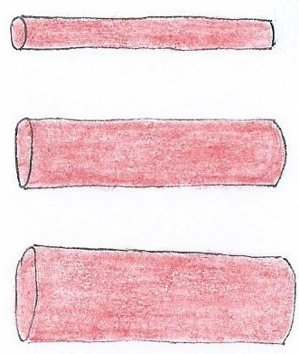
More ANS Notes:
Vascular Smooth Muscle (VSM) is around blood vessel walls and is predominantly controlled by the Sym division of ANS, causing vasoconstriction and vasodilation.
Vasoconstriction = increased BP
Blood Vessel Diameter
Controls Blood Flow and Pressure
Blood vessel
Vasodilation = decreased BP
Sympathetic postganglionic neurons release norepinephrine (NE) and:
a) if α (alpha) receptors present = vasoconstriction = ↓Flow, ↑ Blood Pressure
b) if β (beta) receptors present = vasodilation = ↑Flow, ↓ Blood Pressure
The rule of thumb is: The more Sym stimulation there is, the more constricted blood vessels become (except for blood vessels supplying skeletal muscle!). This is why your blood pressure goes up when you get scared or excited!!!

Slide 15
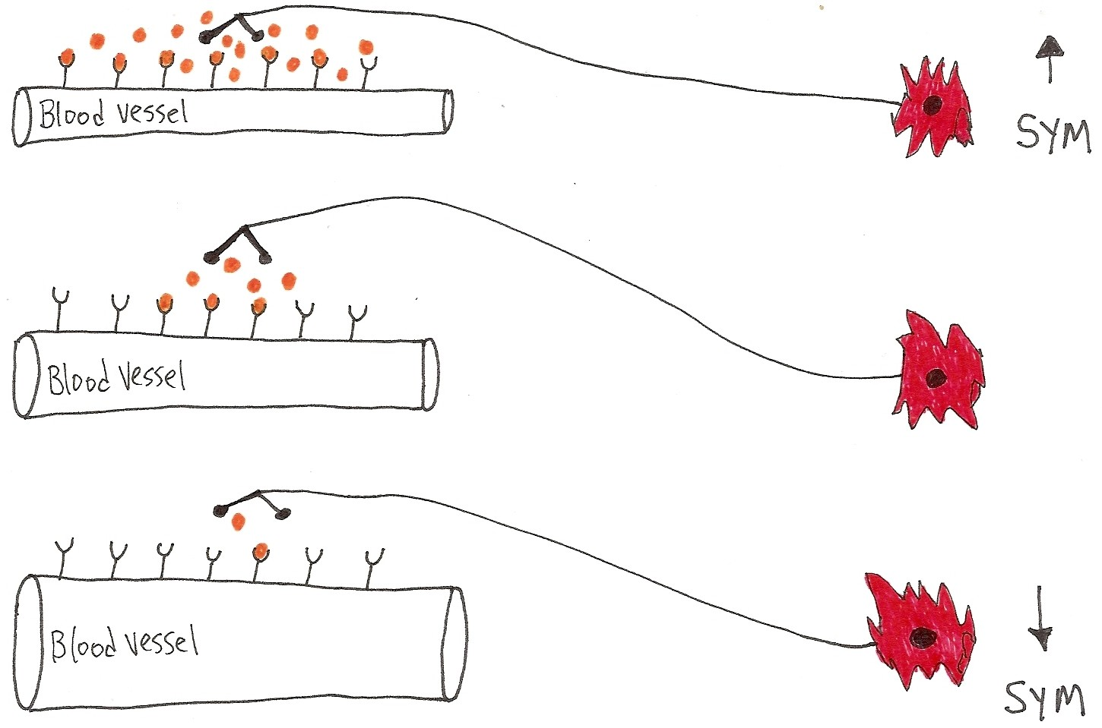
Blood Vessel Diameter: Mostly controlled by the SYM
(usually, more Sym innervation means more vessel constriction - if α’s receptors)
↓r -> ↑R -> ↑BP -> ↓flow
These are
the α receptors
and NE is binding
to them, big time!
Blood vessel at ‘rest’
Sympathetic Innervation
r = radius of blood vessel
R = peripheral resistance
BP = Blood pressure
These are the
same α receptors but
there is less NE and thus
it is not binding to
all of them!
↑r -> ↓R -> ↓BP ->↑flow
α’s = constriction; β’s = dilation. The vessel above must have which receptors? Alpha!

Slide 16
Please Note:
Skeletal muscle is controlled by the Somatic (soma = body) nervous system (SNS), it is not controlled by the Autonomic nervous system (ANS).
However, the SNS and the ANS do work together. The blood vessels supplying skeletal muscles have β receptors on them. When sympathetic postganglionic neurons release norepinephrine (NE), it binds to these β receptors, causing vasodilation of blood vessels supplying skeletal muscle – this results in an increase in blood flow to skeletal muscles - so you can run faster, swing your arms harder!
Makes sense, right?!
We will not go into details about neurotransmitters and receptors, but…
At the ganglion, all preganglionic neurons release ACh on to nicotinic receptors.
The postganglionic neurons for the Para division release ACh on to muscarinic receptors at the effector tissue. Effect is usually inhibitory.
The postganglionic neurons for the Sym division release NE on to alpha or beta receptors at the effector tissue. Effect is usually excitatory.

Slide 17
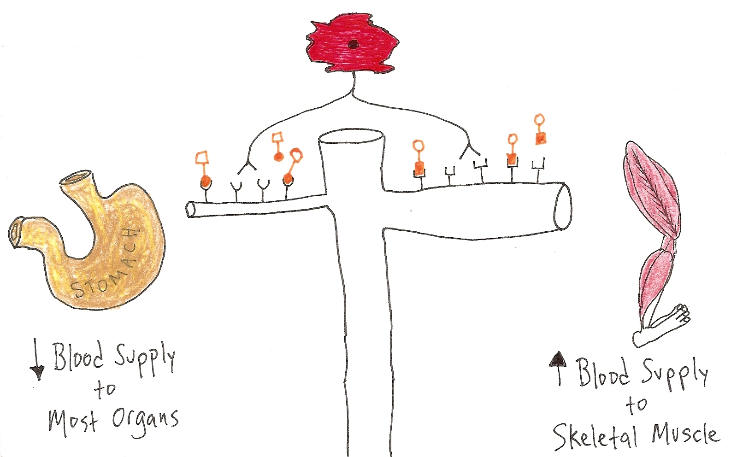
Diverting Blood Flow is an important strategy!
In times of Emergency, this is what the SYM division does!!!
Sympathetic postganglionic neuron
α R’s = Vasoconstriction*
β R’s = Vasodilation*
α = alpha receptors
β = beta receptors
b
l
o
o
d
v
e
s
Constriction
Dilation
*Shuts down the blood supply that is unnecessary when in danger.
*Opens up blood supply to skeletal muscle when in danger or exercising.
What’s the Effector Tissue for blood vessels?
Note: The ANS does not innervate Skeletal Muscle!

Slide 18
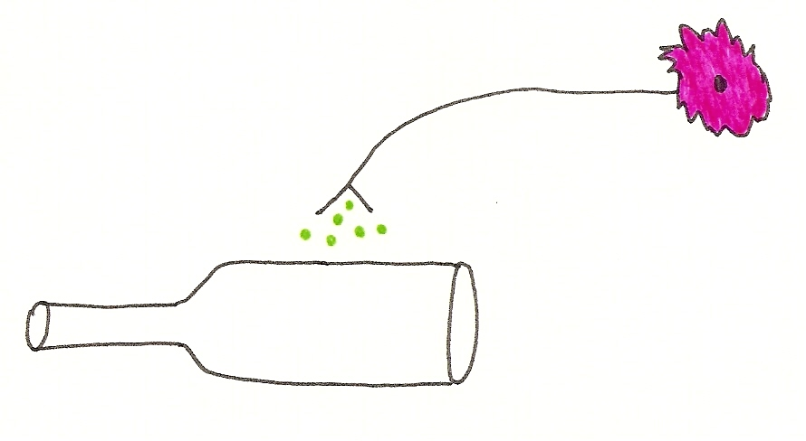

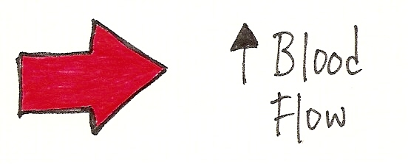

PARASYMPATHETIC
*The PARA division has no effect on blood vessels or blood flow, Except to erectile tissue!
Here it causes vasodilation which we know increases blood flow to a region.
Parasympathetic postganglionic neuron
PARA
to
Erectile tissue of
clitoris for females
vasodilation
blood vessels to erectile tissue
Yep –> Engorged and Tingly
PARA
vasodilation
to
Erectile tissue of
penis for males

Slide 19
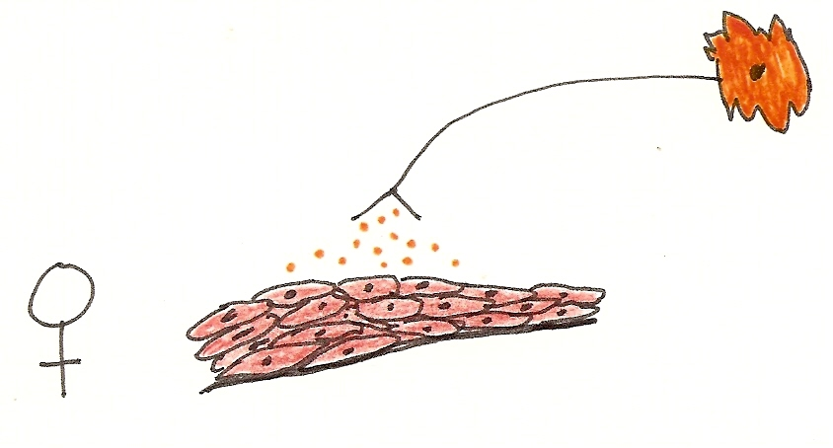
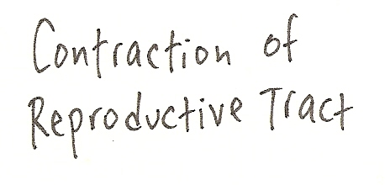
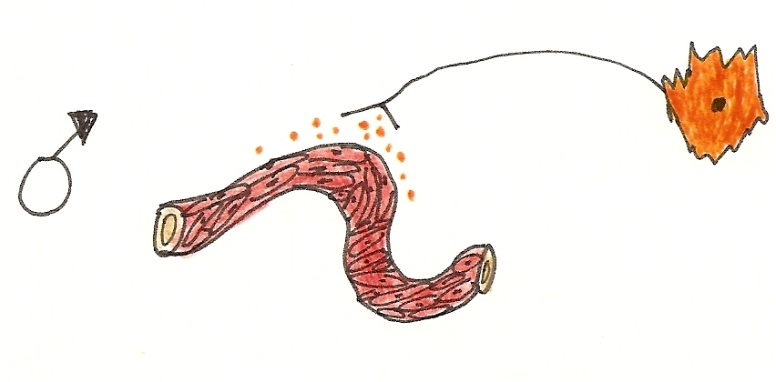
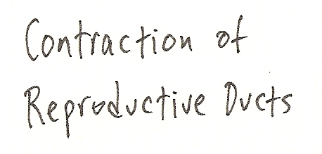
SYMPATHETIC
The SYM division acts on the tracts and ducts of the Reproductive System
Lining of Repro tract
SYM
Yep –> Ejection of Fluids
Lining of Repro duct
SYM
Q: What’s the Effector Tissue that lines these ducts? Only have 3 basic choices!

Slide 20
Notes:
To Summarize, in matters of Reproduction…
Para relaxes VSM* and increases blood flow to erectile tissue = the “point” factor.
Sym causes the smooth muscle of reproductive ducts to contract = the “shoot” factor.
*VSM = vascular smooth muscle (the muscle around blood vessels)
Lastly, the Anatomical Arrangement of two divisions is different and is indicative of their different actions.
The Para division is more Convergent, such that it often focuses on one thing at a time, like only one effector tissue, not 4 at once. Usually, the ganglion for this division is very close to or on the effector tissue, so it is a focused response, it is not wide-spread.
The Sym division is more Divergent, such that it can signal multiple tissues at once. With ganglion for the Sym division so close to the spinal cord, this allows the response to be wide-spread, branching out into many different directions at the same time (simultaneously).
Examine the drawing on the next slide illustrating this!

Slide 21
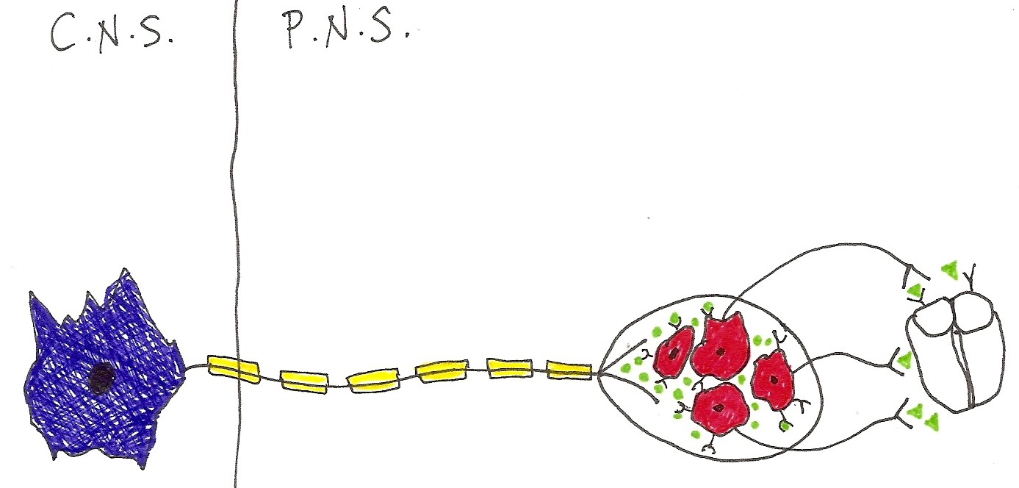
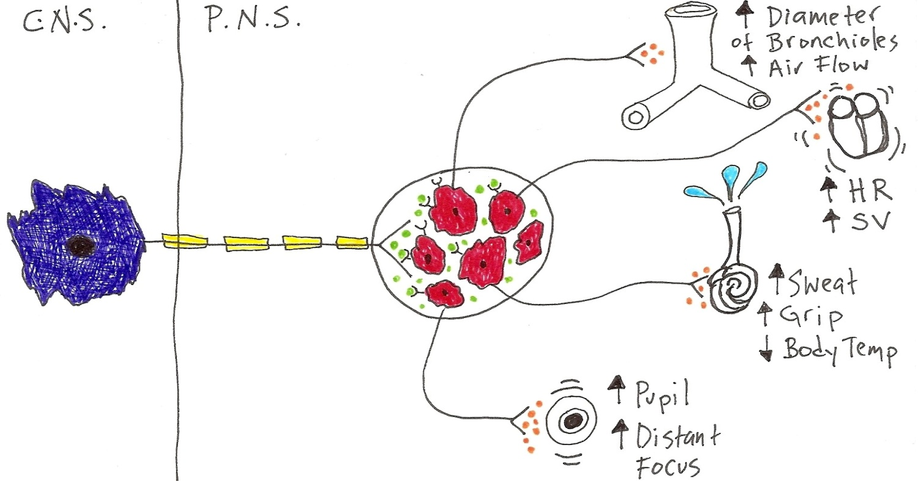
Anatomical Arrangement of ANS
Para
is
CONVERGENT
Often one effector tissue at a time
Ganglion
Effector
Tissue
Multiple effector tissues simultaneously
Sym
is
DIVERGENT
Ganglion
Effector
Tissue

Slide 22
Table of Actions of the 2 Divisions of the Autonomic Nervous System
Effector Tissue | Parasympathetic | Sympathetic
Iris (Eye Muscles) | Pupil Constriction (near focus) | Pupil Dilation (far focus)
Lacrimal Gland | Increases secretions (tears) | -------------
Sweat Glands | ------------- | Increases secretions (sweat)
Lung Bronchioles | Bronchial constriction (decreased air flow) | Bronchial dilation (increased air flow)
Heart | Decreases Heart Rate Decreases Force of Beat | Increases Heart Rate - β Increases Force of beat – β
Blood Vessels of the Body | ------------- | Vasoconstriction - α Vasodilation - β
Salivary Glands | Increases Watery Saliva | Reduces Watery Saliva
G. I. Tract Activity | Increases Motility Increases Secretions | Decreases Motility Decreases Secretions
Liver | Glycogen synthesis (increases Glucose Liver storage) | Glycogen breakdown (releases Glucose into Blood)
Bladder Wall | Contraction (for voiding urine) | -------------
Adrenal Medulla | ------------- | Epinephrine secreted into blood as a hormone
Erectile Tissue | Increases blood flow (vasodilation of blood vessels) | -------------
Reproductive Tract | ------------- | Stimulation of contraction (ejection of fluids)
-------- means no effect

