Slide 1
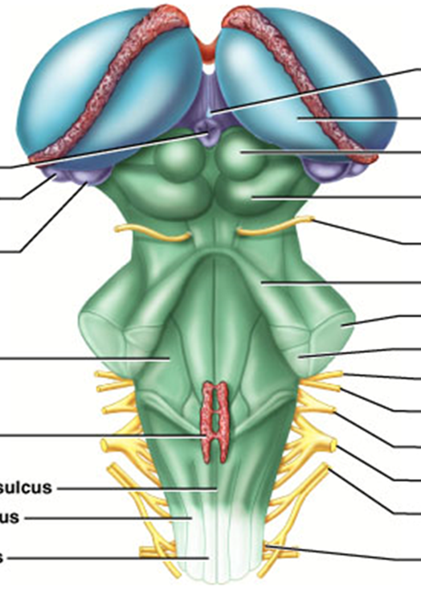
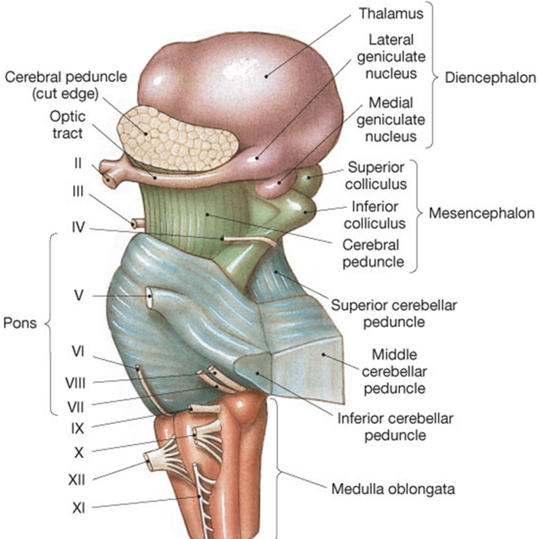
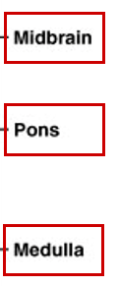
The Brain Stem
(Midbrain)
Posterior View Lateral View

Slide 2

Midbrain
Substantia nigra
= black substance
Corpora quadrigemina
= ‘four bodies’ (2 pairs)
Superior colliculi
=> nuclei that act in visual reflexes (vision).
Inferior colliculi
=> nuclei that act in auditory reflexes (sound).

Slide 3
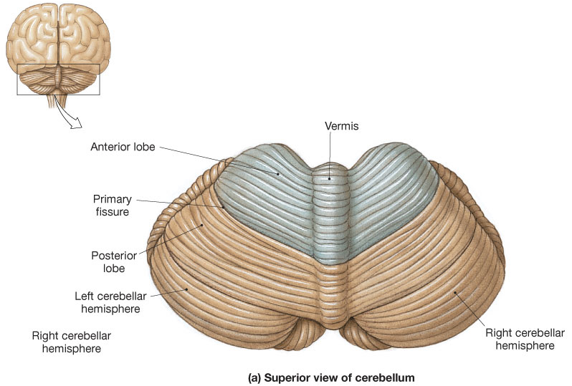

The Cerebellum – superior view
Located dorsal to the pons and medulla
Consists of two cerebellar hemispheres
Folia

Slide 4
Functions of Cerebellum
Located dorsal to the pons and medulla
1) Controls postural reflexes:
- coordinates rapid, automatic adjustments of
muscles in body to maintain equilibrium.
2) Produces skilled movements:-
- implements routines for fine tuned movements.
Refines learned routines until the action
becomes routine.

Slide 5
* Thick tracts connecting the cerebellum to the brain stem
Superior, Middle and Inferior Cerebellar Peduncles
* Fibers to and from the cerebellum are ipsilateral -
run to and from the same side of the body

Slide 6
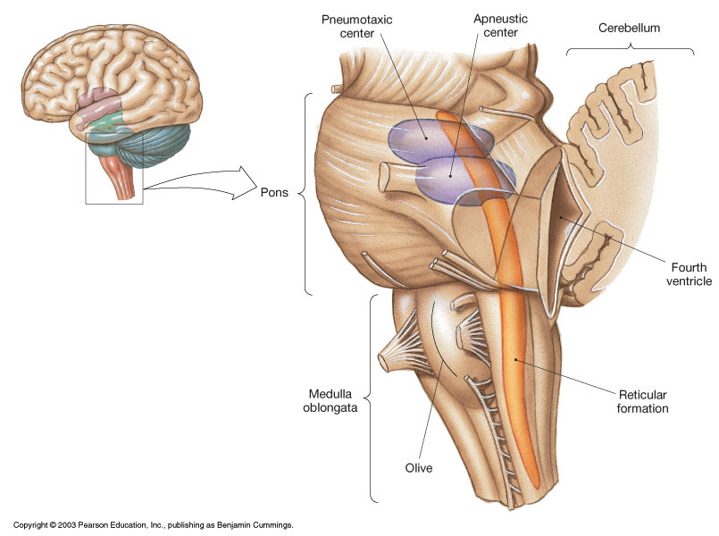
Pons
* Contains the pontine
respiratory centers.

* Contains the nuclei
of cranial nerves
V, VI, and VII

Slide 7
The Medulla contains:
Much of the reticular formation
Nuclei influence autonomic functions

Vital centers of the reticular formation:
1) Cardiac Control Center
2) Respiratory Control Center
3) Vasomotor Control Center
Also contains centers for hiccupping, sneezing,
swallowing, vomiting and coughing.

Slide 8
Protection of the Brain
The Skull
Cranial Meninges
Cerebrospinal Fluid
Blood-Brain Barrier

Slide 9
Cranial Meninges - 3-layer protective membrane
1. Dura Mater - Composed of two layers:
a) Periosteal (Endosteal) – outer layer attaches to bone.
b) Meningeal – inner layer, closer to brain.
(These two layers fused, except to enclose the dural sinuses)
Composed of dense irregular connective tissue.
2. Arachnoid Layer - ‘spider’ web-like layer.
Composed of loose/fibrous connective tissue.
3. Pia Mater - delicate, follows convolutions.
Composed of an outer collagen layer, & inner epithelial elastic and reticular fiber layer.

Slide 10
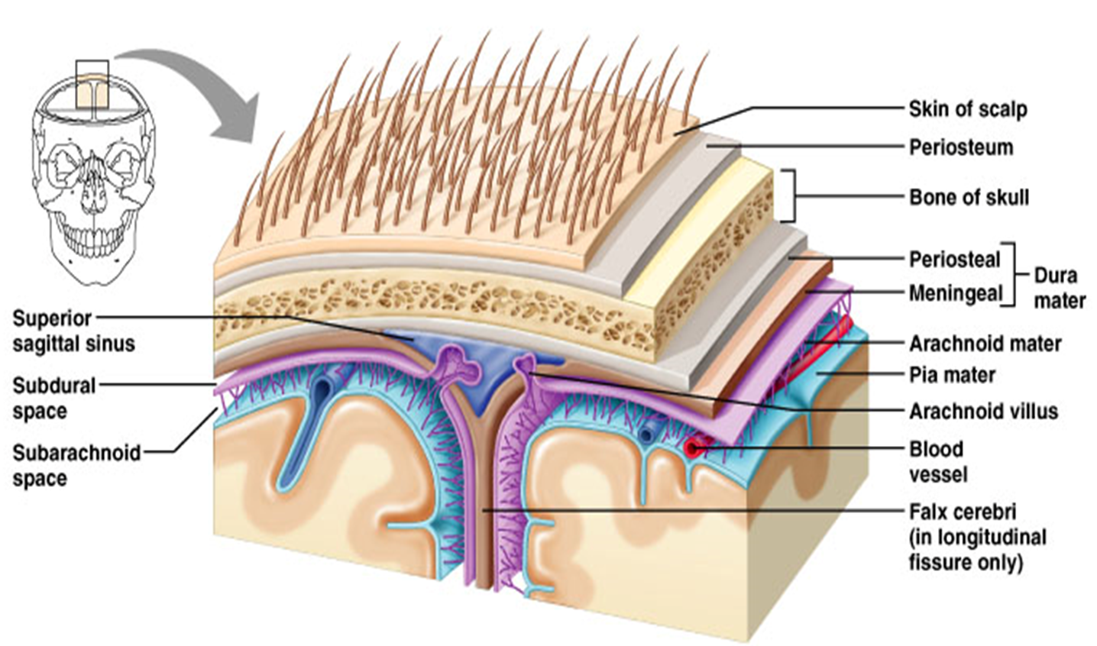

Slide 11
Cranial Meningeal Spaces
Epidural space
Potential space superior to dura.
Subdural space
Potential space between dura and arachnoid mater.
Subarachnoid space
Filled with CSF
Contains the blood vessels supplying brain.

Slide 12
The Sinuses = Large Veins (in cardiovascular system)

Slide 13
Cerebrospinal Fluid (CSF)
Roles of CSF:
1. Cushions and insulates delicate nervous tissue.
2. Gives Buoyancy to the brain (“floats” in CSF).
3. Exchange of gases (O₂ and CO₂), nutrients and
wastes.
* CSF formed in the choroid plexuses in ventricles of brain

Slide 14
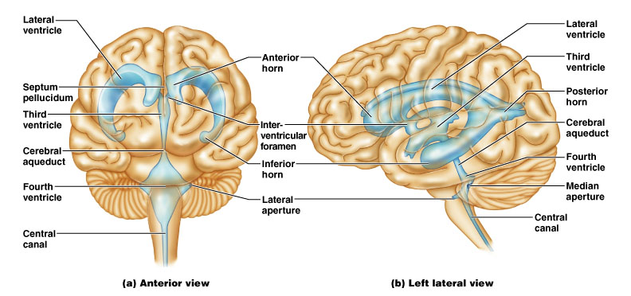
CSF Circulates in:
Chambers, Spaces, and the Central Canal.

Slide 15
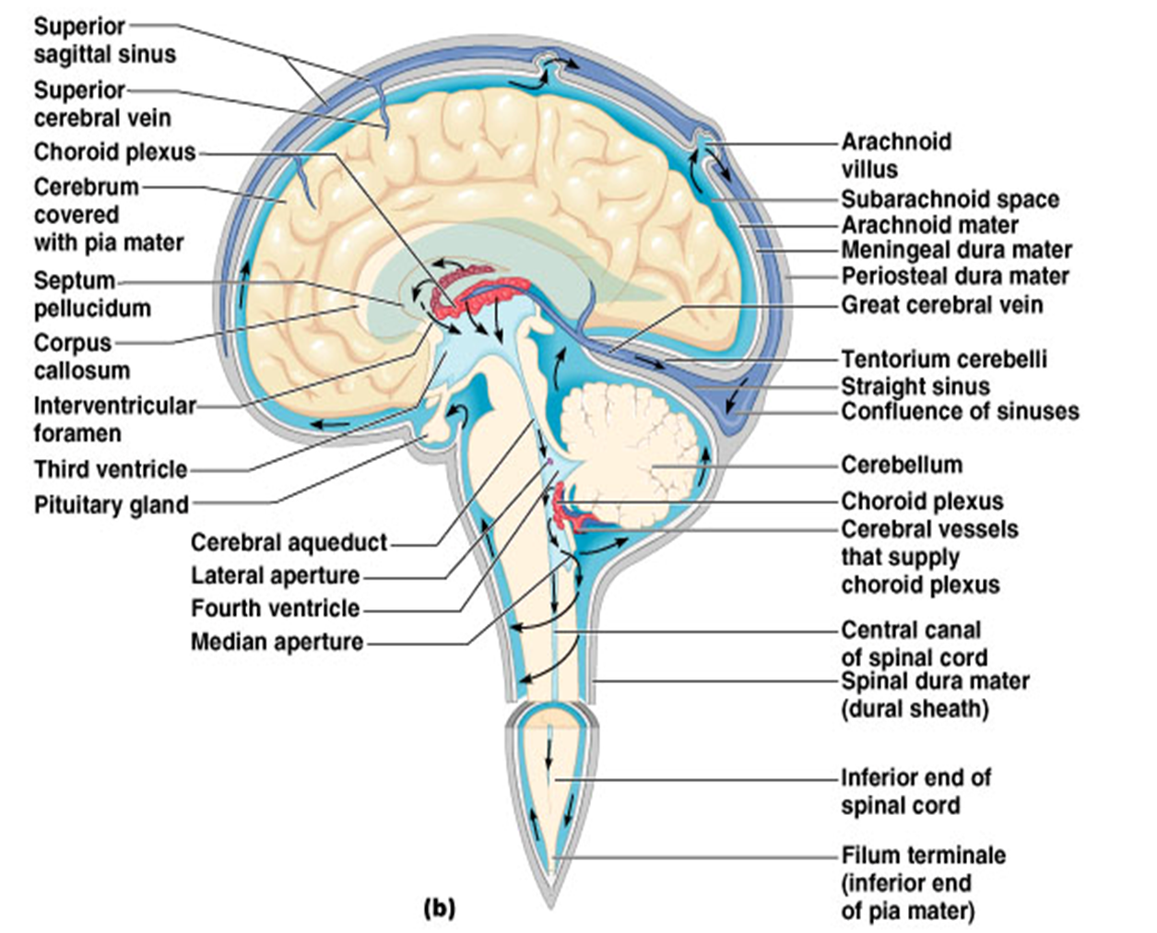

Slide 16
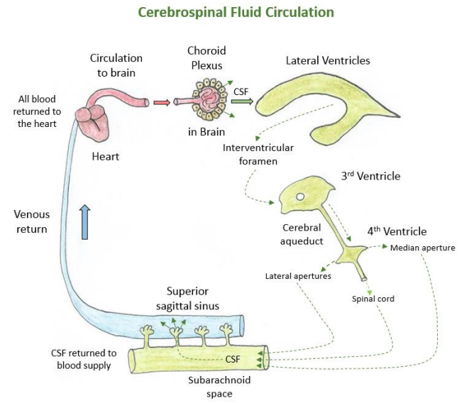
Arachnoid
villi

Slide 17
CSF Circulation

Slide 18
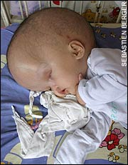
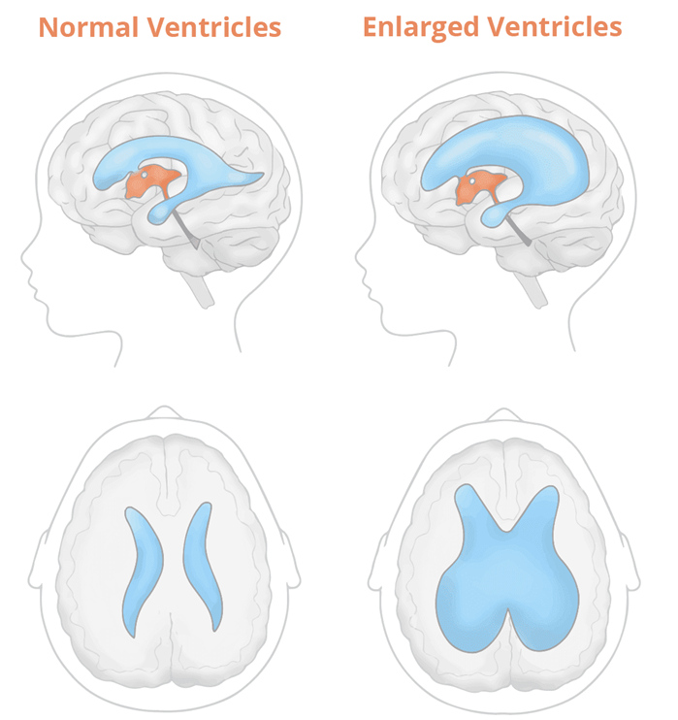
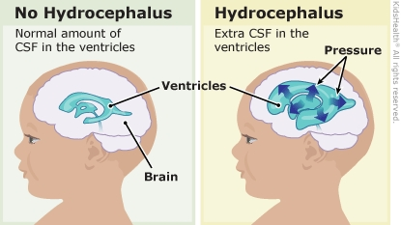
Hydrocephalus

Slide 19
Blood Brain Barrier (BBB)
A restrictive barrier around blood vessels in the brain (created by astrocytes).
Prevents most blood-borne toxins from entering the brain but not an absolute barrier.
Nutrients such as O₂, and glucose can pass. Plus CO₂, alcohol, nicotine, and anesthetics.
Dopamine? L-Dopa?

Slide 20
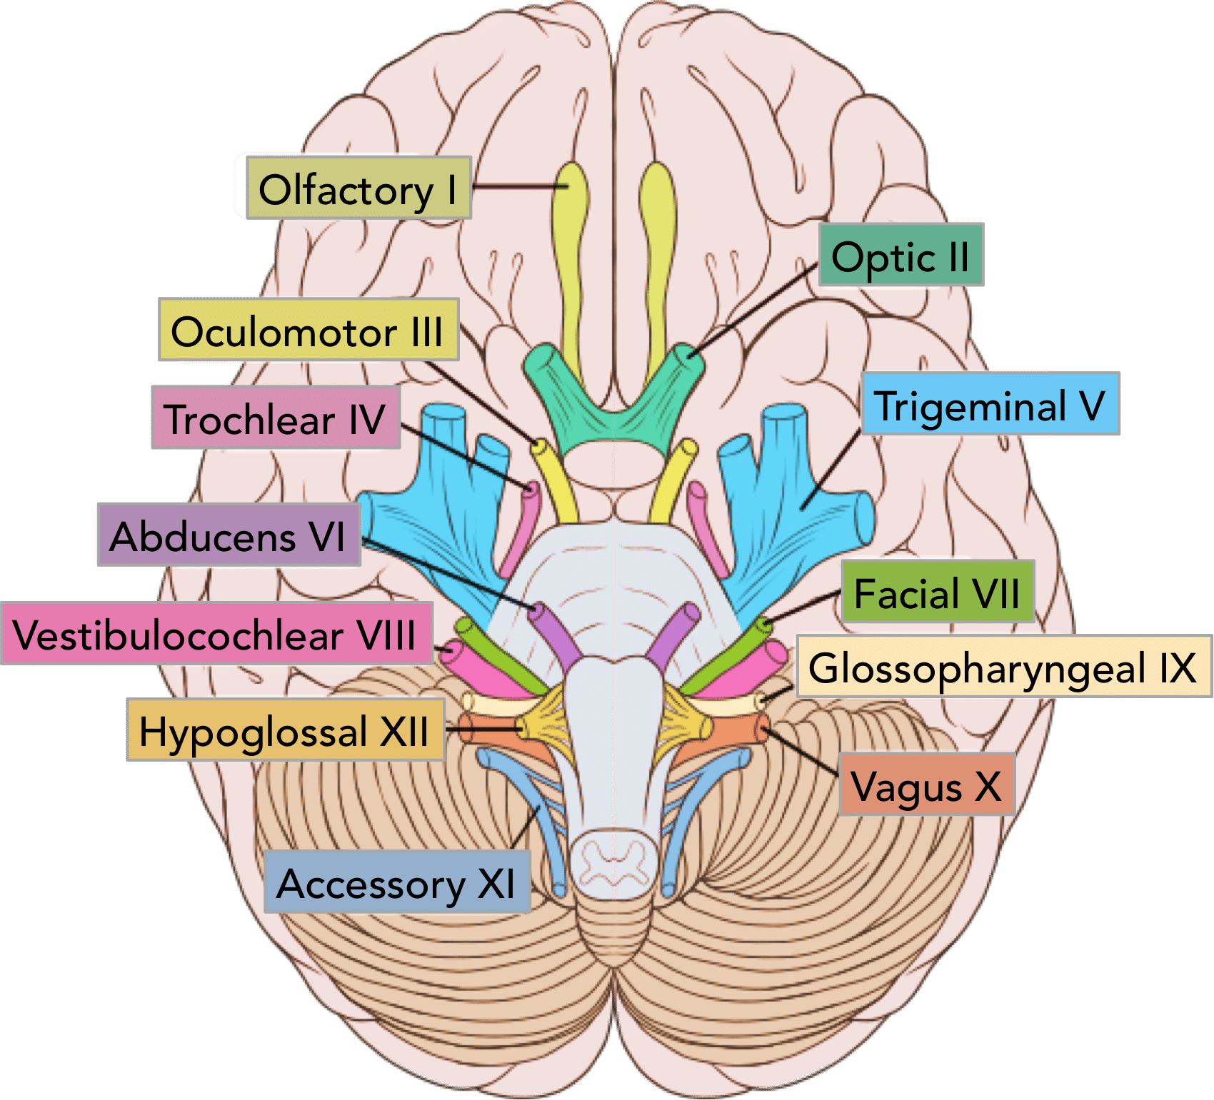
The 12 Pairs of Cranial Nerves
Descriptive Numeric Names

Slide 21
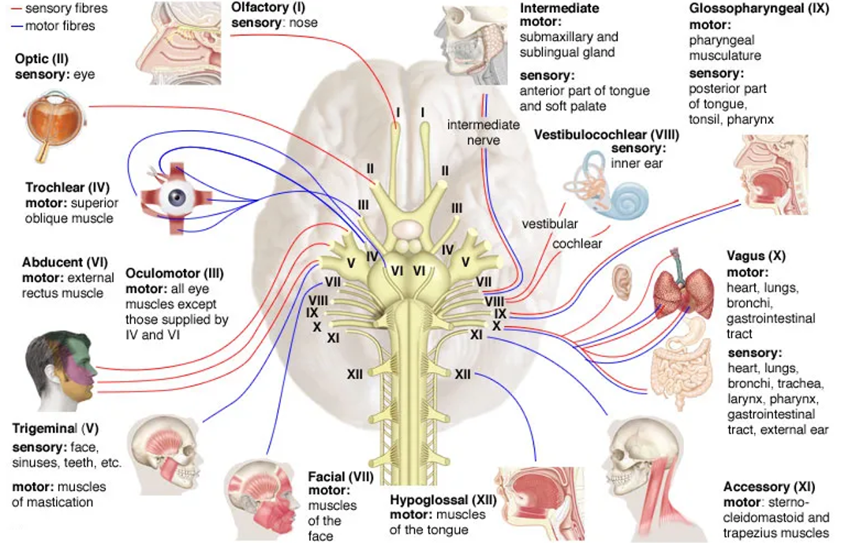

Slide 22
Cranial Nerves | Origins | Innervation | General Functions
Olfactory N. I (s) | Cerebrum, olfactory tract and bulb. | The nasal mucosa. | Detects and conveys sense of smell from the nose to the temporal lobe for perception of smells.
Optic N. I II (s) | Optic disc (posterior retina). Ganglion cells of retina, enters the skull via optic canal on way to optic chiasm. | Photoreceptors (Rods and Cones) of the Retina (neural tunic). | Transmits visual information from the eyes to the brain for perception.
Oculomotor N. III (m) | From midbrain of brainstem, exits skull and enters orbit via the superior orbital fissure. | 4 extrinsic ocular muscles; ciliary muscle, sphincter pupillae muscle. | For control of the movement of the eyeball. Also, for constriction of pupil (miosis), controls levator palpebrae superioris, and lens accommodation.
Trochlear N. IV (m) | From midbrain of brainstem, exits skull and enters the orbit via the superior orbital fissure. | The extrinsic superior oblique muscle of eye. | Controls 1 extrinsic eye muscle (the superior oblique), for an inferolateral rotation (down and out).
Trigeminal N. V (b) | Pons of brainstem. Ophthalmic N. via superior orbital fissure, Maxillary N. via foramen rotundum, and Mandibular N. via foramen ovale. | Muscels and tissues of the head, and face, sinuses, and teeth. | Sensations of forehead, orbits and nose; cheek, upper lip; lower lip, buccal and mandible. Muscles of mastication (chewing).
Abducens N. VI (m) | Pons of brainstem. Exits skull via the superior orbital fissure. | Lateral rectus extrinsic muscle of the eye. | Abducts the eyeball (looking laterally).

Slide 23
Cranial Nerves | Origins | Innervation | General Functions
Facial N. VII (b) | Pons of brainstem. Leaves brain via stylomastoid foramen. Part of the Parasympathetic division. | Facial muscles. Tastebuds, lacrimal and sublingual, submandibular salivary glands. | Muscles of facial expression. Taste for anterior two-thirds of tongue. Generates tears and saliva.
Vestibulocochlear N. VIII (s) | Pons and medulla oblongata of brainstem. | The inner ear, both the vestibular complex (including the utricle and saccule); and the cochlear for hearing. | Vestibular branch: Conveys signals to the vestibular complex which integrates the relative position of the head with other body parts to maintain balance (equilibrium). Cochlear branch: Sends sound info from the inner ear (cochlea) to the brain (auditory cortex temporal lobe).
Glossopharyngeal N. IX (b) | Leaves brain from medulla oblongata of brainstem via jugular foramen. Part of the Parasympathetic division. | Laryngeal and pharyngeal muscles for swallowing; parotid gland. Posterior one-third of tongue. Carotid bodies within the carotid sinus. | Acts to elevate larynx and pharynx when swallowing and dilates pharynx during swallowing and speech. Responsible for the ‘gag reflex’. Taste sensation posterior one-third of tongue. Detects dissolved gas levels in carotid bodies of carotid sinus.
Vagus N. X (b) | Leave brain from medulla oblongata of Brainstem, exits the skull via jugular foramen. Significant (75%) part of the Parasympathetic division. | Acts on the tongue, pharynx, laryngeal muscles that control the voice, the heart, and the gastrointestinal system. | Controls thoracic abdominal viscera laryngeal and pharyngeal muscles Sensation of epiglottis; thoracic and abdominal viscera, carotid body external acoustic meatus. Also has gag reflex.
Accessory N. XI (m) | From medulla oblongata of brainstem and from the spinal cord. Exits the skull via jugular foramen. | Laryngeal muscles, sternocleidomastoid, trapezius. Some small laryngeal muscles. | For head movements, such as rotation, flexion, lateral flexion, and extension of head. Plus, elevation of shoulders.
Hypoglossal N. XII (m) | From medulla oblongata of brainstem, exits brain via hypoglossal foramen. | Intrinsic and extrinsic tongue muscles. | Controls muscles of food mixing, swallowing and muscles of speech, and sound creations in mouth.

Slide 24
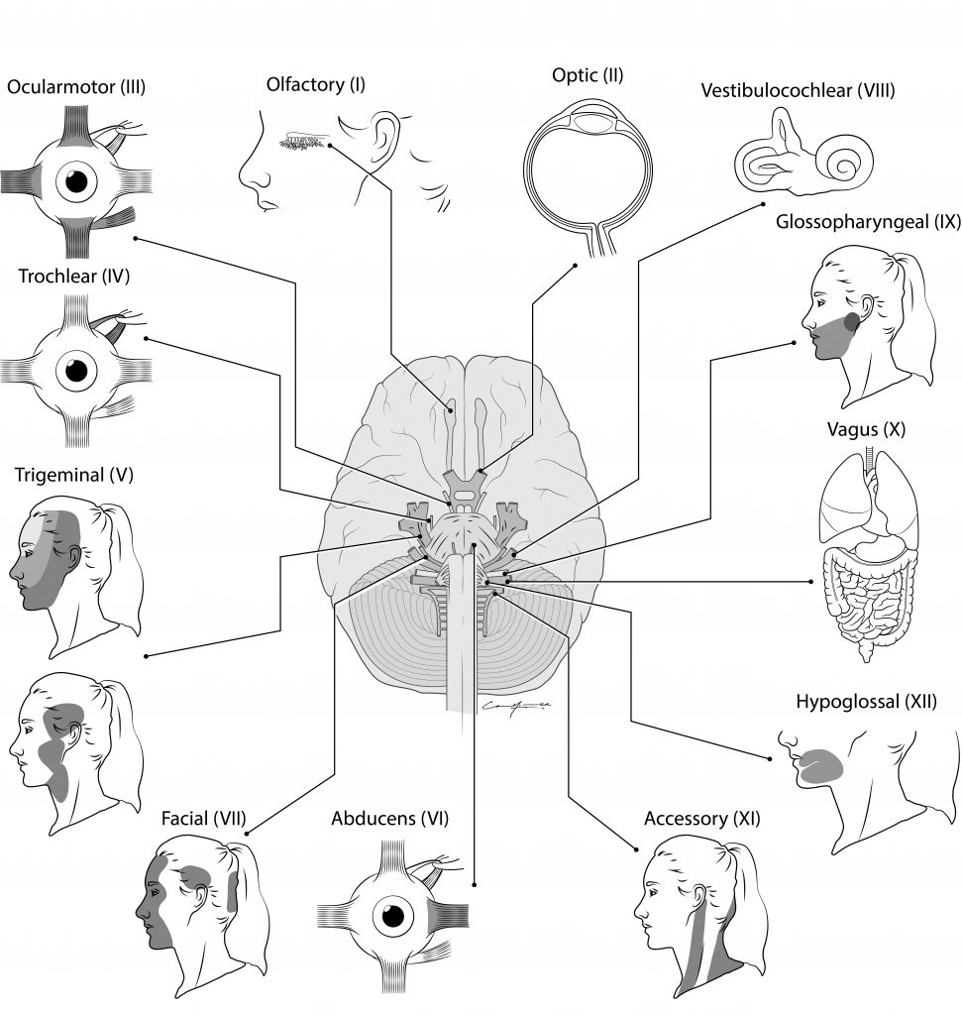
Testing the 12 Cranial Nerves

