Slide 1


Budget & Resource Development Subcommittee
September 11, 2024
TREY
research

Slide 2
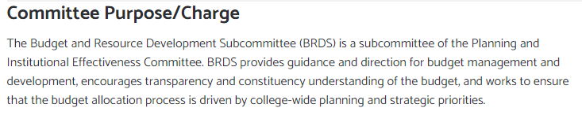

BRDS Committee Charge/Purpose

Slide 3
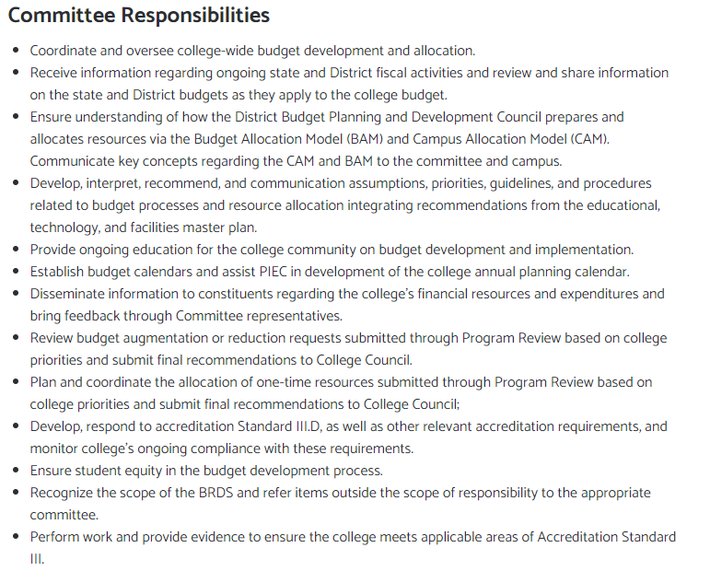
BRDS Committee Charge/Purpose

Slide 4
BRDS Committee Membership

Slide 5
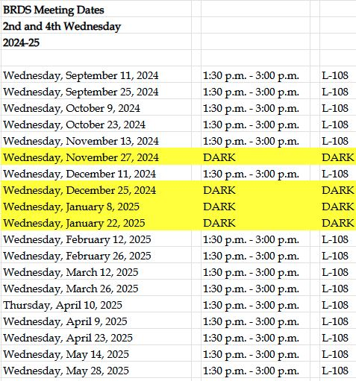
BRDS Committee Meeting Calendar

Slide 6
California Budget Update
Focus on stability in the context of a significant budget deficit
No major core reductions to programs or services
Draws on reserves and savings to balance budget
Maintains funding for key education priorities:
  Higher education compacts with the UC and CSU
  $18M for two projects to support Vision 2030 priorities

Slide 7
SDCCD Budget Update
Overview of SCFF
  Basic Allocation – Fixed amount based upon number and size of colleges and centers
  FTES Allocation – Revenue earned based upon 3-year average
  Supplemental Allocation – Revenue earned based upon headcount of AB450, Pell, California College Promise Grant
  Success Allocation – Revenue earned based upon 3-year average of success outcomes
Districts are funded on the greatest of their actual SCFF calculation, Hold Harmless, or Stability amount
  Stability – 1-year protection based on prior year SCFF calculation adjusted by current COLA
  Hold Harmless Protection – Minimum SCFF funding is a district’s 2017-18 apportionment funding adjusted by COLAs

Slide 8
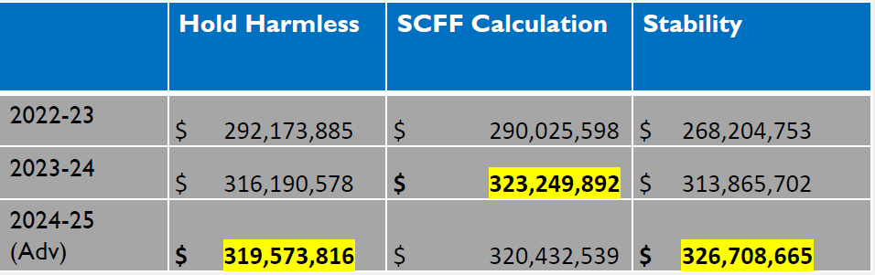
SDCCD Budget Update

Slide 9
SDCCD Budget Update
  PERS contribution rates increase from 26.68% to 27.05%
  Medical contributions are estimated to increase almost 7%
  Must prepare for State revenue volatility, deferrals, or deficits
  Unfunded FTES – 326 unfunded in FY24

Slide 10
2024-25 Adopted FTES & FTEF Targets

Slide 11
2024-25 Adopted Budget

Slide 12
Questions ?

