Slide 1
New Adjunct faculty welcome
FALL 2024

Slide 2
Agenda
Welcome – Wesley Lundburg, President and Michael Odu, Vice President of Instruction
Academic Senate – Pablo Martin, Academic Senate President
Flex – Allen Andersen, Flex Coordinator
Student Conduct & Academic Honesty – Adrian Gonzales, Vice President of Student Services
Jet Fuel Resource Center – Adrian Gonzales, Vice President of Student Services
Technology Services – Bill Pacheco, Multimedia Specialist
Census Rosters & Grade Reporting – Dana Stack, Admissions & Records Director
Faculty Evaluations – Ken Reinstein, Faculty Evaluations Coordinator
Academic & Career Pathways - Lisa Brewster, GUIDED PATHWAYS COORDINATOR
Academic Success Center – Donnie Tran, Academic Success Center Coordinator
mesa (Math Engineering Science Achievement) Program – Alex Hofler, MESA Director
Library Services – Mary Hart, librarian/chair
DSPS – Kandice Brandt, DSPS Counselor
Job Placement Services – Alex Ortega, Job Placement Coordinator
AFT – Kevin Petti, AFT Representative
Q&A/Closing

Slide 3
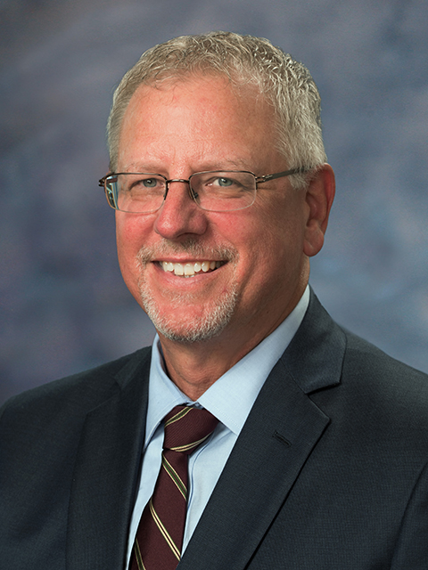
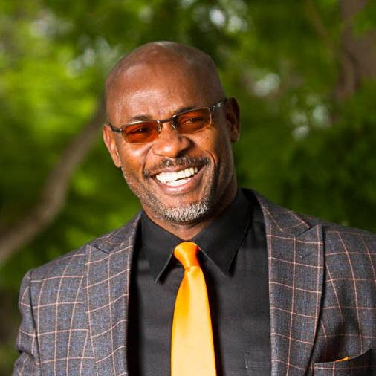
Welcome
P. Welsey Lundburg, PhD
President
wlundburg@sdccd.edu

Slide 4
Welcome
Michael Odu
Vice President of Instruction
modu@sdccd.edu
https://sdmiramar.edu/services/instruction-svcs

Slide 16
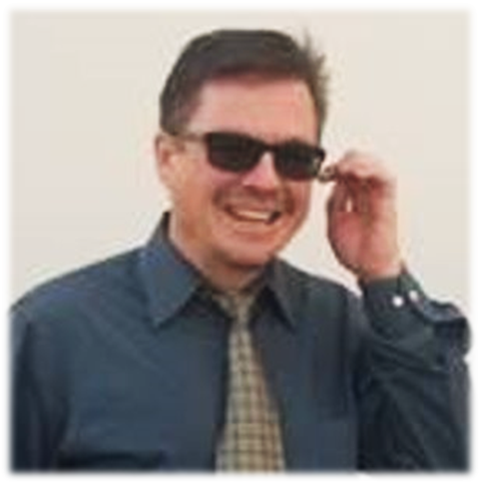
WHAT Is "Flex"?
Allen Andersen
Flex Coordinator
aanderse@sdccd.edu
Adjunct Orientation
(2 Hours!) Flex #25222
All faculty who teach class must complete
Instructional Improvement (Flex) hours. (Calculated by how many class hours they teach)
2 Hours
3 Hours
5 Hours
Once you complete your required hours, you have met your Flex obligation
Independent project proposals must be submitted by Nov. 4, 2024
Flex hours must be marked as complete by Noon, Dec 10, 2024
After Dec. 10, the District will dock paychecks for all uncompleted Flex hours.

Slide 17
WHAT Is "Flex"?
Allen Andersen
Flex Coordinator
aanderse@sdccd.edu
Question?
Adjunct Orientation
(2 Hours!) Flex #25222
Access your Flex Contract through your MySDCCD Portal:
College Faculty Dashboard
Faculty Quicklinks
Flex
(The Flex Handbook is here too!)
FLEX 2024
Register for workshops no later than the day of the activity.
Missed registering for a workshop that you attended?
Contact your Flex Coordinator, to be put on the roster retroactively.
Don't Forget: Go into your Flex Contract to confirm Completion/Attendance
(This is NOT Automatic.)

Slide 18
Student services
Cheryl Barnard
Dean of Student Affairs
cbarnard@sdccd.edu
Policy 5500 Violations
Plagiarism
Removal of a Disruptive Student
Students of Concern
Cheryl Barnard
Dean of Student Affairs
cbarnard@sdccd.edu
K1-210
x7313

Slide 19
Student services
Cheryl Barnard
Dean of Student Affairs
cbarnard@sdccd.edu
Board Policy 5500 Violations
BP 5500 - STUDENT RIGHTS, RESPONSIBILITIES, CAMPUS SAFETY AND ADMINISTRATIVE DUE PROCESS
This policy outlines the rights and responsibilities of all District Students.
It also outlines the District's commitment to a safe learning environment for all students

Slide 20
Student services
Cheryl Barnard
Dean of Student Affairs
cbarnard@sdccd.edu
What do I do when a student cheats or plagiarizes?
•If there is an incident of academic dishonesty, collect evidence. Meet with the student and share the evidence. If student accepts responsibility, faculty needs to determine appropriate academic sanction (lowering of grade, zero given on assignment/test, re-do work or re-take exam).
• Complete the Faculty Academic Sanction Form (found under employee resources). Send a copy to Department Chair, Dean of the School and Dean of Student Affairs.
• If incident involves more than one student and/or is severe in nature, consider referring the incident to the Dean of Student Affairs by submitting an Incident Report form (found under employee resources).

Slide 21
Student services
Cheryl Barnard
Dean of Student Affairs
cbarnard@sdccd.edu
What do I do when a student disrupts the classroom and discipline is required?
Fill out the Removal of Disruptive Student Form & provide to Dean of Student Affairs immediately. Prompt attention is given to these matters. The form is located on the Student Affairs website.
You may remove the student for up to 2 class sessions for classes that meet 2 times per week, and 1 class session for a class that meets once a week.
If the level of disruption is severe enough and there is a level of threat, call Police Dispatch at (619-388-6405)

Slide 22
Student services
Cheryl Barnard
Dean of Student Affairs
cbarnard@sdccd.edu
What do I do if I have a concern about a student's well-being?
The College has a Behavioral Intervention Team which meets twice a month
This inter-disciplinary team meets to review and respond to reports of student behavior that are concerning and at the present time do not meet the criteria for a student conduct violation or an immediate threat to the community (immediate threat call College Dispatch X6405)
Contact Student Affairs or complete form on the BIT Webpage
When in Doubt, Please Reach out!

Slide 23
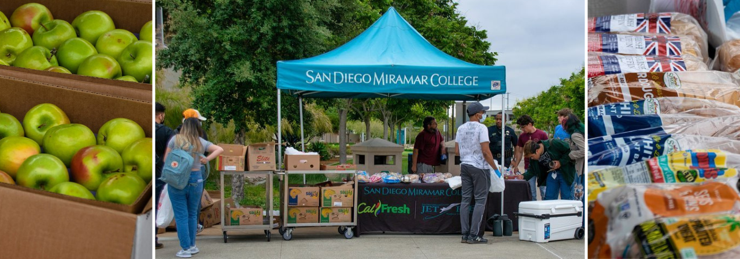
JEt Fuel Resource CenTer
Acting Basic Needs Coordinator
Margot Salgado
Msalgado@sdccd.edu
Food Assistance
•Mon-Tues Noon-3PM; Wed-Thurs 9AM-3PM
•Must be enrolled in at least one class at Miramar
•Students are allotted 1 visit per day
The Really, Really Free Farmer's Market
•9AM- While supplies last; In-front of K1 Building
•Fall dates: 8/21, 9/4, 9/18, 10/2, 10/16, 11/6, 11/20, 12/4 & 12/18
CalFresh Connection
•Stop by the Jet Fuel Pantry to be connected to Miramar's CalFresh liaison
•Students can also sign up through Feeding San Diego
•Referrals to external food pantries through the San Diego Food Bank
Resources also available for emergency funding, housing, transportation, clothing, hygiene items – please refer directly to Margot

Slide 24
Technology services
Instructional Computing Support
miramar.ics@sdccd.edu
(619) 388-7387
Website Services
mmweb@sdccd.edu
(619)388-7348
Multimedia Services
avmira@sdccd.edu
(619) 388-7317
Technology Services Director – Kurt Hill, khill@sdccd.edu
https://help.sdccd.edu for any campus technology assistance

Slide 25
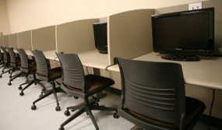
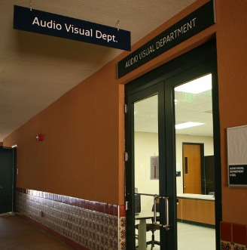
Technology Services Audio Visual
AV Services (L-111) Overview
Faculty/Staff Technology Training
Multimedia Services
Contact https://help.sdccd.edu for
technology-related issues or, for Media services,
contact avmira@sdccd.edu

Slide 26
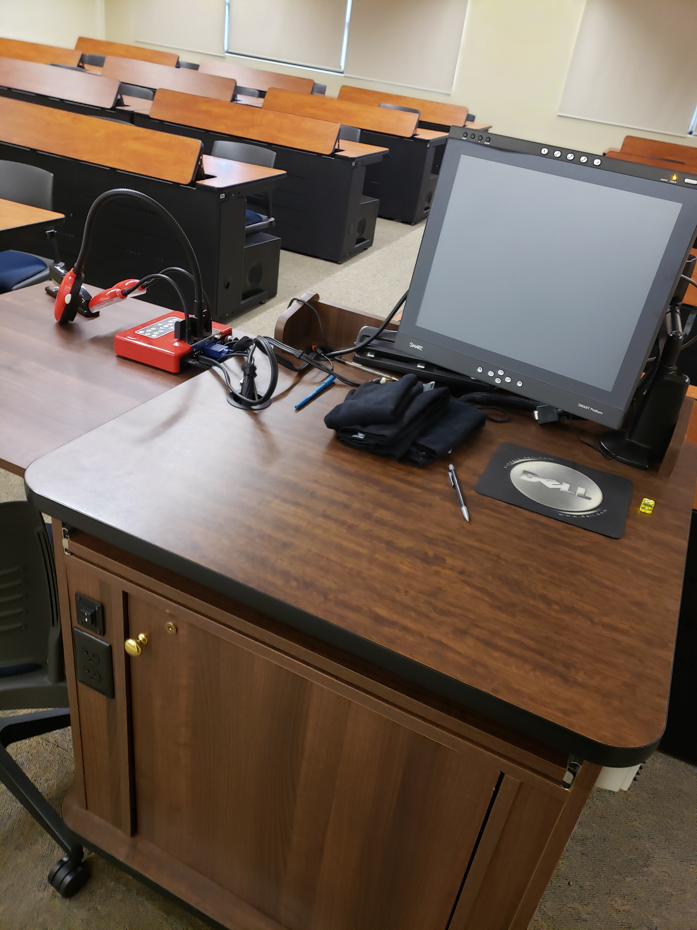
TECHNOLOGY SERVICES AUDIO VISUAL
Faculty/Staff Technology Training
Smart classroom faculty technology training
May be FLEX credit eligible
AV Technology training should be completed prior to using the classroom audiovisual equipment. Schedule a training appointment with us ASAP
Contact https://help.sdccd.edu for technology-related services or support, or, for media services, contact us directly at avmira@sdccd.edu

Slide 27
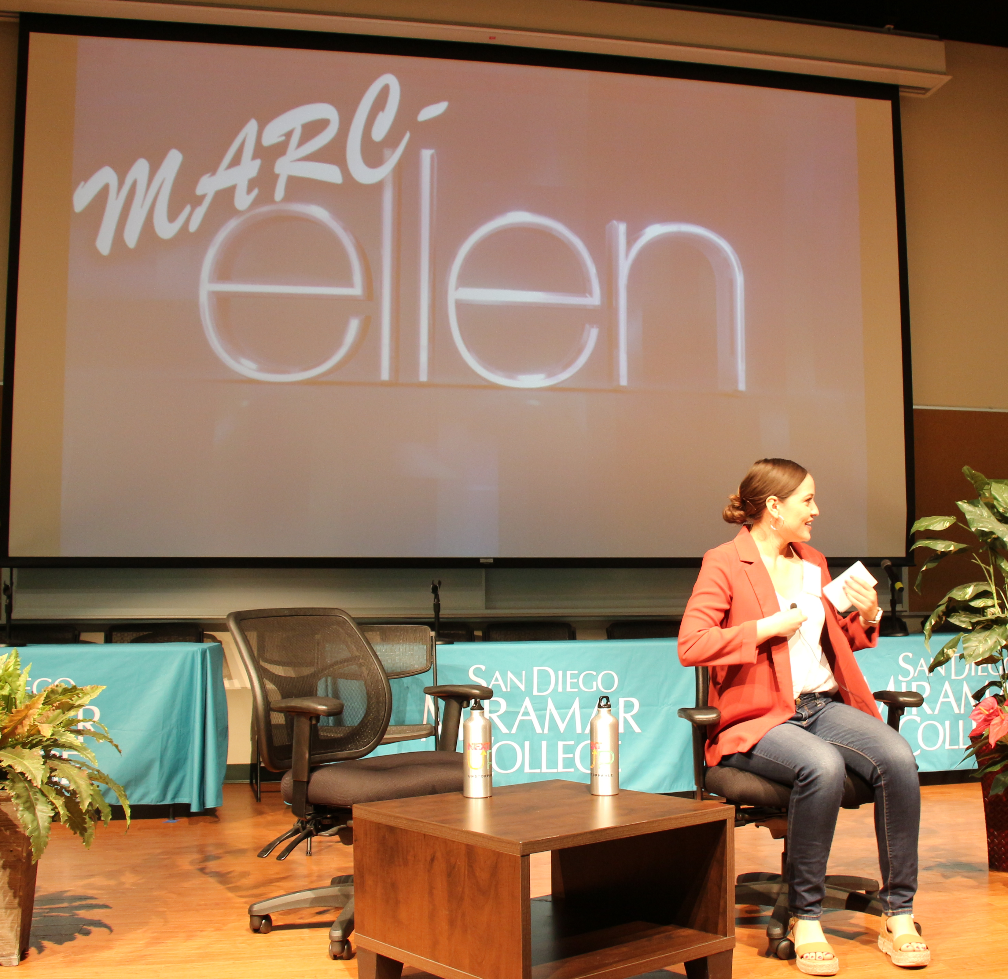
TECHNOLOGY SERVICES AUDIO VISUAL
Multimedia Services
Special Event Assistance
Equipment Checkout
Faculty Media Checkout
Audiovisual Production Services
Instructional Videos
Marketing Videos
Other production requests
Contact https://help.sdccd.edu for technology-related services or support, or for media services, contact us directly at avmira@sdccd.edu​

Slide 28
Student services
Dana Stack
Director, Admissions & Records
dstack@sdccd.edu
619-388-7579
OFFICIAL GRADE AND ATTENDANCE ROSTER
The Official Grade and Attendance Roster, located in Faculty Portal, is the permanent record of attendance for all students registered in regular college classes.
Important: Rosters are legal documents that may be subpoenaed by the court.
Whose responsibility is it to drop?
Faculty are required to clear rosters of inactive enrollment by the census date. The census date is the “snapshot” the State uses for funding purposes. It's calculated at approximately 20% of the class meetings.
Note: Faculty must submit drops no later than noon the day of census.
To comply with the Department of Veterans Affairs reporting requirements, faculty must report drops/withdrawals within 22 calendar days from the student's last known academic activity.

Slide 29
Student services
Dana Stack
Director, Admissions & Records
dstack@sdccd.edu
619-388-7579
OFFICIAL GRADE AND ATTENDANCE ROSTER
When are grades due?
The online grade sheet is available one week prior to the class end date. The deadline to submit grades is seven calendar days following the end of the session.
Having trouble navigating the system?
Check out the "Help and Support" link, located in the lower right corner of your Faculty Portal.
Need assistance? Please call or email me.

Slide 30
Faculty Evaluations
Ken Reinstein
Faculty Evaluations Coordinator
kreinste@sdccd.edu
Purpose: To assess effectiveness, encourage professional growth, help with making informed decisions
Timeline: Within first year, and at least once every six semesters
Process: Faculty peer/SME visits class at agreed-upon time; follows up with meeting to review observations and go over Faculty Evaluation appraisal form

Slide 31
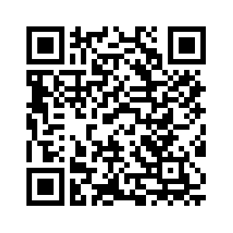
Faculty Evaluations
Ken Reinstein
Faculty Evaluations Coordinator
kreinste@sdccd.edu
Student evaluations: First semester and once every three semesters. Forms for evaluation will be sent to you either via campus mail or electronically
For more information: Go to AFTguild.org
Article XV (15.1.14) of the AFT guild CBA (Union Contract)
College Faculty Appraisal Guide
Miramar Faculty Evaluations page >>

Slide 32
Academic & Career Pathways

Slide 33
JOIN your ACP Canvas Shell

Slide 34
SAMPLE

Slide 35
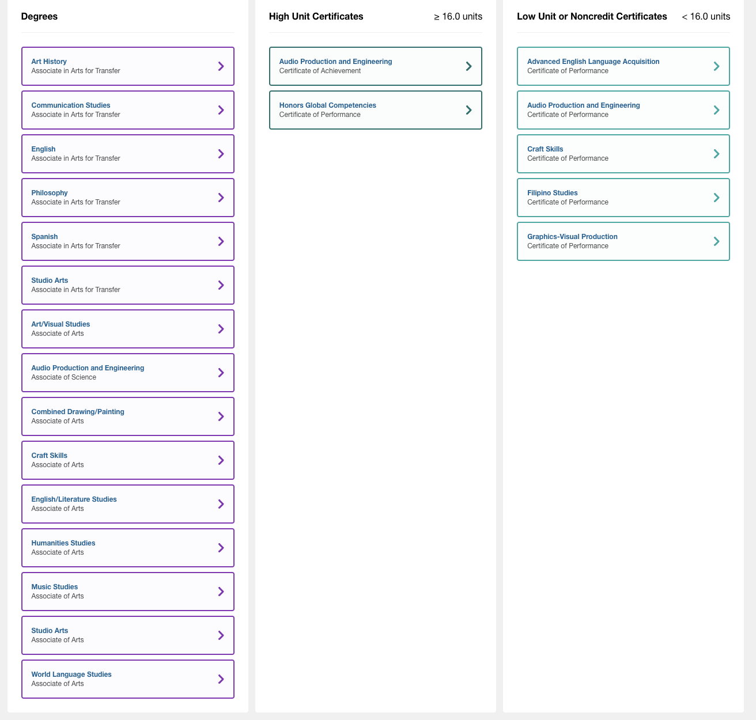
Program Maps
2 year maps for all degrees and certificates
PLEASE share with your classes

Slide 36
Canvas Shell
Please Share with Students

Slide 37
Canvas Shell

Slide 38
Campus resources

Slide 39
Academic success center (ASC)
Donnie Tran
ASC Faculty Coordinator
dtran@sdccd.edu
Francine McCorkell Instructional Support Supervisor fmccorke@sdccd.edu
ASC X(Twitter), FB, & IG Account: @MiramarASC
Location | Monday-Thursday | Friday
ASC (L-101) | 9 am-6 pm (space only) Tutoring: 10 am-6 pm | 9 am-6 pm (space only)
Math Lab (M-210) | 9 am-6 pm (space only) Tutoring: 10 am-6 pm | 9 am-1 pm (space only) Tutoring: 10 a.m.-1 pm
Writing Lab (H-103) | 10 am-5 pm (space and tutoring) | Closed
STEM Center (S6-110) | 10 am-6 pm (space and tutoring) | 9 am-3 pm (space only)
NetTutor & STAR-CA | Check availability in this Canvas course: https://sdccd.instructure.com/enroll/MEAEEJ (self-enrollment)
Assignment Drop-Off | https://sdccd.instructure.com/enroll/4MM7GL (self-enrollment)

Slide 40
Academic success center (ASC)
Donnie Tran
ASC Faculty Coordinator
dtran@sdccd.edu
Francine McCorkell Instructional Support Supervisor fmccorke@sdccd.edu
ASC X(Twitter), FB, & IG Account: @MiramarASC
Services for Students (Highlights)
One-on-one tutoring on a drop-in and by-appointment basis in English, math, biology, chemistry, physics, & other subjects
Individual, and group study spaces
Reserve rooms for workshops, and group study
Access to resources: Pay-for-print stations, scanners, computer lab, and anatomy models
Embedded Tutors in English and math X-courses & Career Education courses
Writing support for lab reports

Slide 41
ACADEMIC SUCCESS CENTER (ASC)
Donnie Tran
ASC Faculty Coordinator
dtran@sdccd.edu
Francine McCorkell Instructional Support Supervisor fmccorke@sdccd.edu
ASC X(Twitter), FB, & IG Account: @MiramarASC
MyWCO
All students will need to create an account to access tutoring services
Services for Faculty
Class Orientations at ASC – Bring your students for a tour to learn about all available services
Class Visits – Similar to an orientation, but an ASC representative will come to your classroom
Student Attendance at ASC – Include ASC visits in your syllabus
Embedded Tutors – Request if a tutor can be assigned to your course
Access to Learning Resources – Your students will have access to textbooks, manipulatives, and models. You can donate or loan materials to the ASC.
Office Hours – You can hold your office hours at the ASC. Just let Donnie know your days and times.

Slide 42
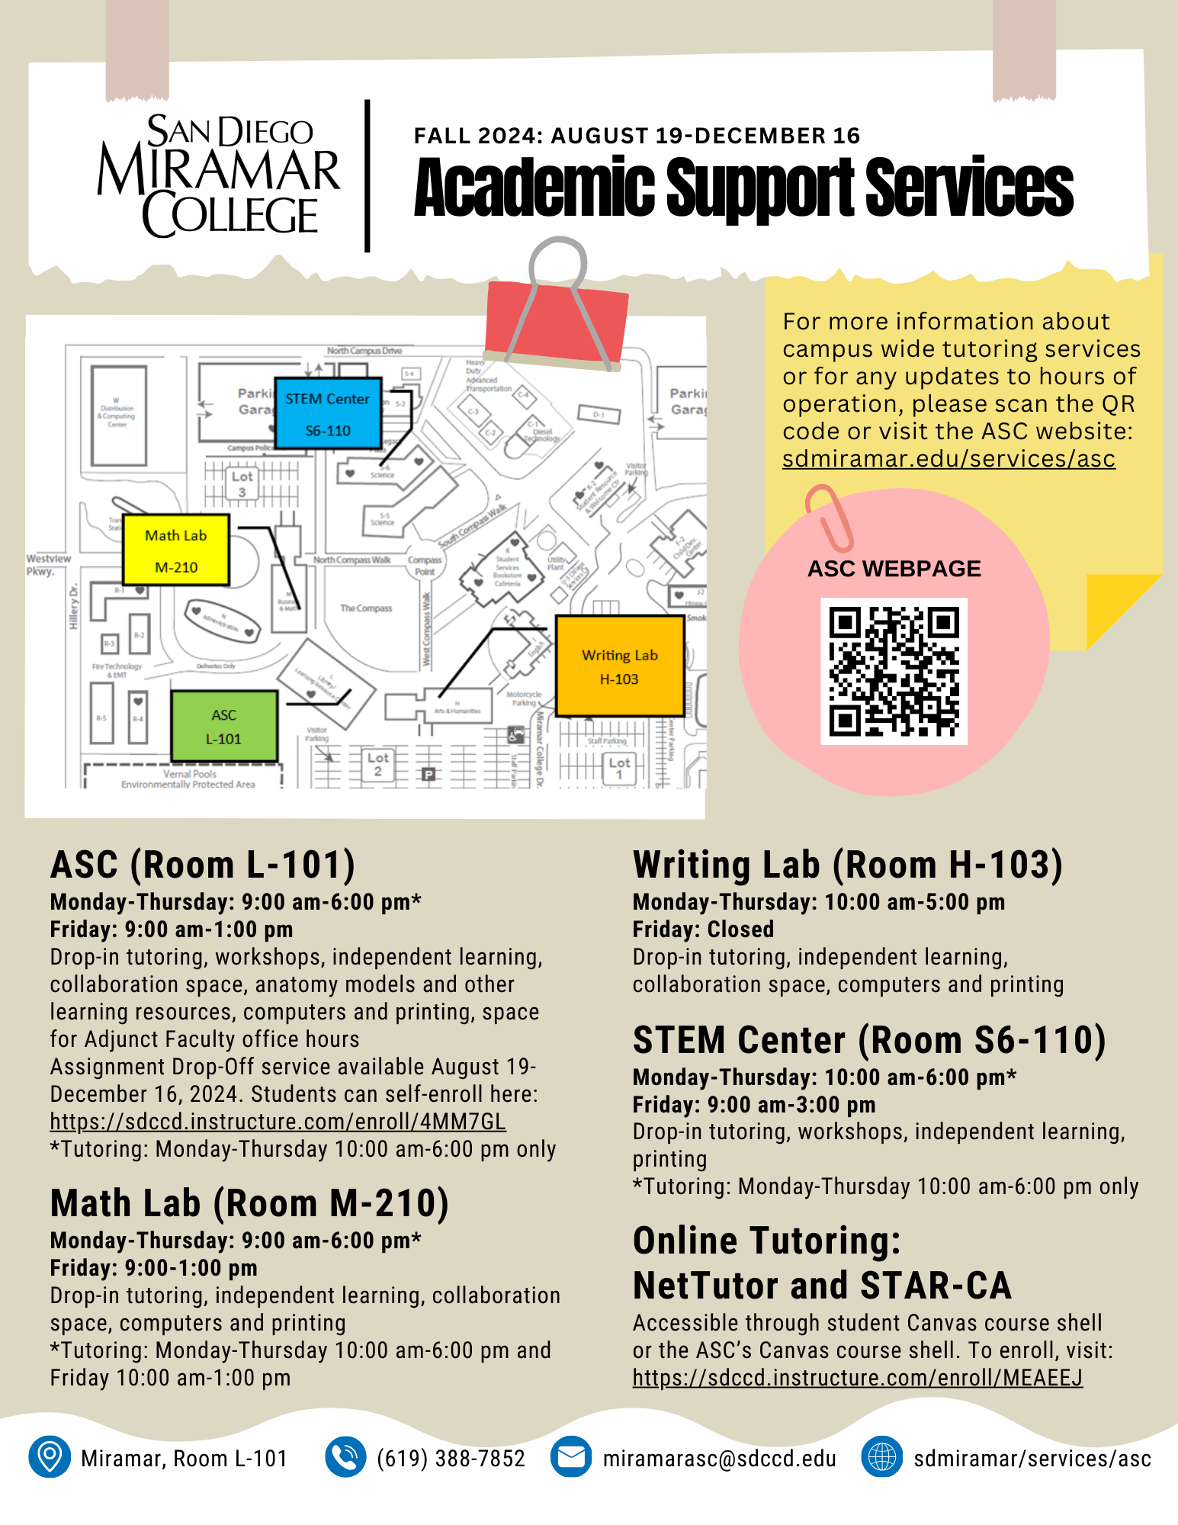
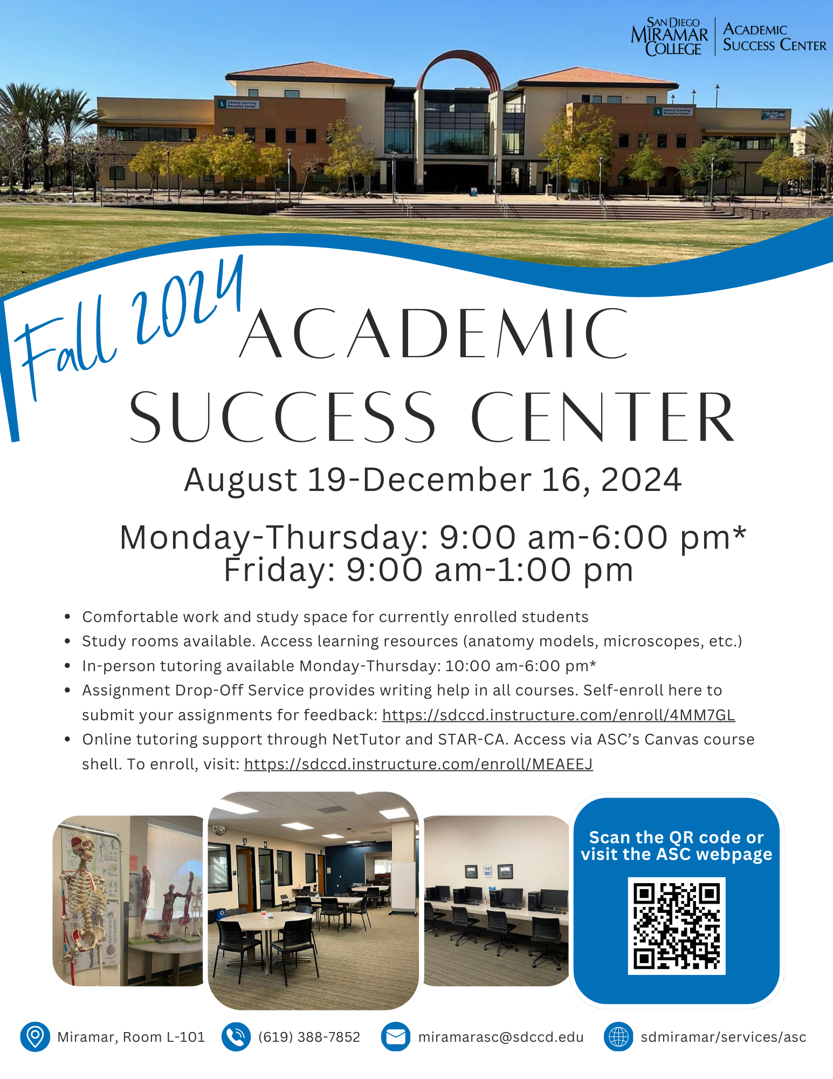
ACADEMIC SUCCESS CENTER (ASC)
Donnie Tran
ASC Faculty Coordinator
dtran@sdccd.edu
Francine McCorkell Instructional Support Supervisor fmccorke@sdccd.edu
ASC X(Twitter), FB, & IG Account: @MiramarASC

Slide 43
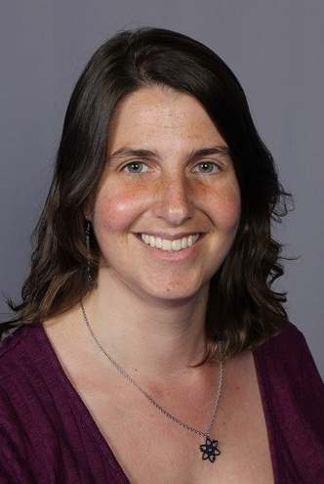
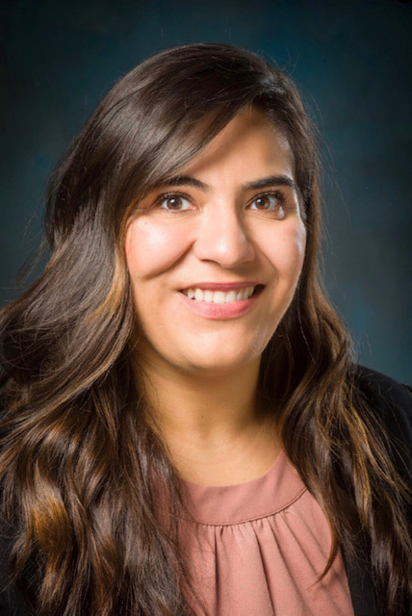
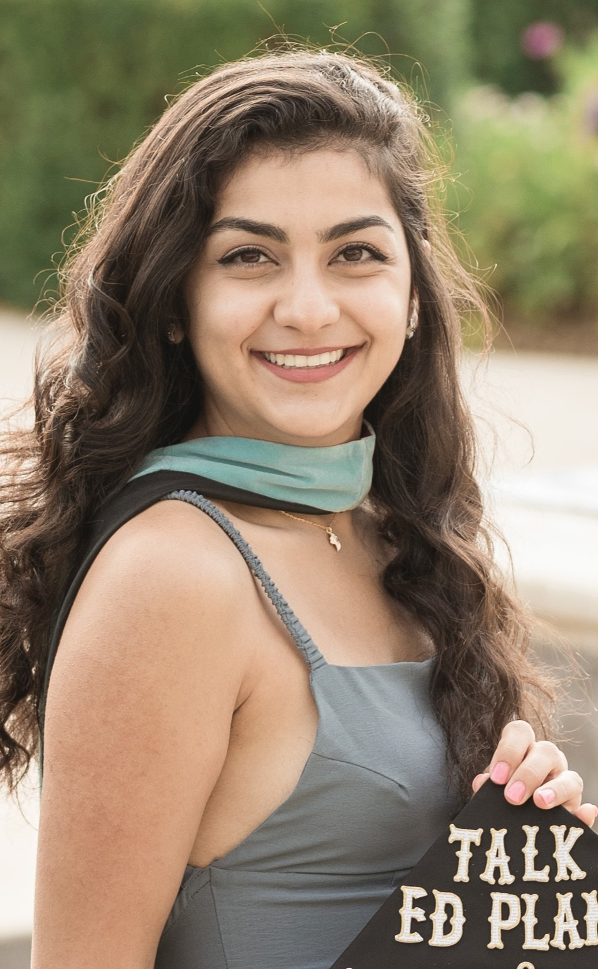
Miramar program
Director
Alex Hofler
Contact Us
Website
sdmiramar.edu/mesa
Email
MiramarMESA@sdccd.edu
Admin Assistant
Maribel Flores
Counselor
Rita Arabo

Slide 44
Miramar program
https://sdmiramar.edu/mesa
Mission:
Propel diversity and achievement in STEM by supporting economically and educationally disadvantaged STEM students in their journey to a bachelor's and beyond.

Slide 45
Miramar program
https://sdmiramar.edu/mesa
Over 50 Years of Fostering Success in STEM
1970: Founded at an Oakland High School
1973: Expanded into universities
1984: Expanded into middle schools
1993: Expanded into community colleges

Slide 46
Miramar program
https://sdmiramar.edu/mesa
Supportive Student Community
Small Cohort Events
Miramar STEM and San Diego MESA Events
Academic Support
Dedicated MESA Counselor
Regular Academic Check-ins
Calculator, Lab Coat, Goggle Loans
Transfer & Career Preparation
Transfer/Grad School Events
And more!

Slide 47
Miramar program
https://sdmiramar.edu/mesa
Must be in a Calc*-based STEM Major
*Major requires Math 150
Must Plan to Transfer
No Prior Bachelor's
Priority given to students with
Academic Considerations
First Gen, Foster Youth, Under-Performing High School, Etc.
Financial Considerations
Low-Income, Financial Need, Etc.

Slide 48
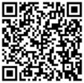
Miramar program
Share the Program
Website
sdmiramar.edu/mesa
Syllabus/Canvas Blurb

Slide 49
LIBRARY SERVICES
Mary Hart Librarian mhart@sdccd.edu
Library Services
http://sdmiramar.edu/library
Fall Session Library Service Hours
(Beginning January 29th)
Monday-Thursday from 9:00am to 6:00pm
Friday from 9:00am to 1:00pm
Closed Saturday and Sunday

Slide 50
LIBRARY SERVICES
Mary Hart Librarian mhart@sdccd.edu
Contact Info
For general library information, call 619-388-7310.
For research help during business hours, call the Reference Desk at
619-388-7611.
For additional research help options, see our Reference Assistance Page.
Important Documents
Library Orientation Request Form
Faculty Reserve Request Form
Collection Purchase Request Form
Lending Policy - Circulating Books
Lending Policy – Library Use Only (LUO) Reserve Books

Slide 51
LIBRARY SERVICES
Mary Hart Librarian mhart@sdccd.edu
Library Research: Tools & Assistance
OneSearch (find articles, books, videos, and more)
Articles & Databases
Multi-Subject Article & Reference Databases
Databases by Subject
A-Z Databases
A-Z Journals
eBook Collections
Open-Access Collections
Streaming Video Collections
Get Research Assistance from a Librarian
Research Guides

Slide 52
Presenter: Kandice Brandt
DSPS Counselor/Learning Disability Specialist
Website: www.sdmiramar.edu/dsps
General Email: Miradsps@sdccd.edu
Proctoring Email: MiramarDSPSProctor@sdccd.edu
Locations: K1-204, DSPS Counseling Office
L-102, High Tech Center
L-103, Test Proctoring Center
Program Coordinator: Kandice Brandt
X 7604
Kbrandt@sdccd.edu

Slide 53
DSPS authorizes academic accommodations for students with a variety of permanent and temporary disabilities.
Accommodations reduce disability impacts and allow access to facilities and instructional materials.
Accommodations provide opportunities for students to participate fully in our institution and to demonstrate their knowledge.

Slide 54
Students Apply for DSPS Services Online
https://mydsps.sdccd.edu/user/intake/
*link is on the DSPS website
Submit Verification of Disability
Learning Disability Testing (*under limited conditions)
One application to DSPS for all of SDCCD- distributes to each college the student selects.

Slide 55
Sharing Information about DSPS with your students
Recommended syllabus statement:
Students with disabilities who may need academic accommodations should contact me as soon as possible. You and I will work with the Disability Support Programs and Services (DSPS) department to identify your appropriate academic accommodations for this course. DSPS is located in the K1 Student Services building, room K1-204 and can be reached at (619) 388-7312 or by email at miradsps@sdccd.edu. To register or to learn more about their services, please visit their website at www.sdmiramar.edu/dsps.
Request a live or virtual class visit from a DSPS counselor
Share a video about DSPS services with your class
*Live or embed in your canvas shell!

Slide 56
MyDSPS Student and Faculty Portals
https://sdmiramar.edu/studentportal
https://sdmiramar.edu/facultyportal
Students Can:
Apply for DSPS Services
Request and view accommodation letters
Request Test Proctoring Appointments
Faculty Can:
View Accommodation Letters
Submit exams and testing parameters

Slide 57
DSPS Consultation Services for Faculty
Consultation on how, when, and the need to provide accommodations
Strategize with faculty about individualized methods/approaches to support a student’s learning
Guidance with inclusive teaching strategies
Student/Professor mediation
Provide training on disability topics at department meetings
Provide strategies for behavior management
Outreach-classroom visits and presentations
Technology training and the High Tech Center
Reinforce/reiterate agreements and/or recommendations you have provided to the student
Assist with identification of essential elements in a course and provide options for appropriate accommodations
Faculty Resources

Slide 58
Job placement services
Alex Ortega
Job Placement Coordinator
aortega001@sdccd.edu
619-388-7335
Focus on the immediate "In-Field" job opportunities
Build caseload of students looking for careers in their field of study
Work with faculty in confirming student aptitude
In collaboration with Miramar's Employer Relations Liaison, enhance and create talent pipelines for Miramar Students and Alumni

Slide 59
American federation of teachers (AFT)
Kevin Petti kpetti@sdccd.edu

Slide 60
AMERICAN FEDERATION OF TEACHERS (AFT)
Union Negotiated Adjunct Faculty Benefits
Pay for Office Hours
POA Job Security
Fully Paid Medical, Dental, and Vision Benefits
Unemployment Benefits
And much more!
For more info visit: aftguild.org/adjunct-issues-and-benefits

Slide 61
Q&A/Closing
Thank you for what you do for our students.
Have a great semester!
#makingtheinvisiblevisible
#buildingcommunity
#studentreadycollege

Slide 62
SCHOOL & Department Meetings
Please contact your Dean's Office or Department Chair for information on School and Department meetings

