Slide 1
Advanced Technological Education (ATE) National Science Foundation
Biotechnology program

Slide 2
Current Biotechnology Grant Funded Programs
Program | Brief Project Description | Grade Level | Duration | Students Reached
Biotech Career Jump Start | At least 30 hours per year to create STEM awareness and provides hands on experiences and career guidance. | 9-12 | 2020-2023 | 85
Amgen Biotech Experience (ABE) | Offers lab-based, classroom-based, and web-based investigations in biotechnology, and provides professional learning opportunities and resources to support high schools in the use of ABE materials. | 11-12 | 2005-2023 | ~75,000
Credit by Exam Articulation | Students who pass the exam can earn college credit for their high school biotechnology classes. Teachers of schools with an articulation agreement must be ABE-trained and offering Medical Interventions/Biotechnology. | 11-12 | 2004-2023 | 2495
Defense STEM Education Consortium (DSEC) | Serves underrepresented students by providing opportunities to gain hands-on experience, to move quickly through the pathway and opportunities for paid internships. | CC | 2021-2023 | 129
Supply Chain Experience (SCE) | 50 hours hands-on ‘real world’ biotechnology experience where products manufactured by participants will be used in the biotech classes and ABE high school kits. Includes resume building and career exploration. | CC | 2018-2023 | 140
Internships | 150 hour subsidized external industry internship. | CC | 2018-2023 | 35

Slide 3
ABE and Articulation Data
 | 2018-19 | 2019-20 | 2020-21 | 2021-22 | 2022-23
Schools served | 55 | 25 | 8 | 32 | 32
Teachers implementing Amgen Biotech Experience | 73 | 35 | 8 | 45 | 38
Students reached | 10263 | 3255 | 642 | 4168 | 5510
Articulating Schools | 16 | 21 | 19 | 20 | 21
Title I Articulating Schools | 8 | 10 | 8 | 8 | 9
Students tested | 616 | 607 | 675 | 596 | 753
*Teachers of schools with an articulation agreement must be ABE-trained

Slide 4
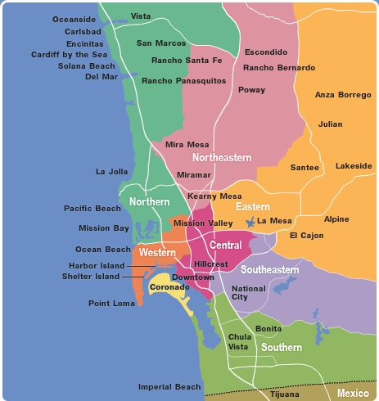
Map of Articulating Schools
Articulating High Schools
Mira Mesa High School
University City High School
Canyon Hills High School
Kearny High School
Clairemont High School
San Diego High School
Crawford High School
La Jolla High School
Point Loma High School
Rancho Bernardo High School
Westview High School
Castle Park High School
Sweetwater High School
Eastlake High School
Helix High School
Sage Creek High School
Mission Vista High School
Torah High Schools of San Diego
School for Entrepreneurship & Tech
Del Lago Academy

Slide 5
ATE Project Plan
Outcome: To create a direct pathway of students from high school to certification to employment.
Plans to address labor demand include:
Recruitment of first-generation and/or Hispanic high school students, who have passed the BIOL 131 Credit by Exam, into a college bridge program
Provide work-based learning experiences that promote acquisition of hands-on lab skills in the Applied Biotech courses and the Supply Chain Experience
Offer student pathways to earning college Biotechnology Certificate of Achievement Awards and/or the nationally recognized Biotechnician Assistant Certification (BACE).

