Slide 1
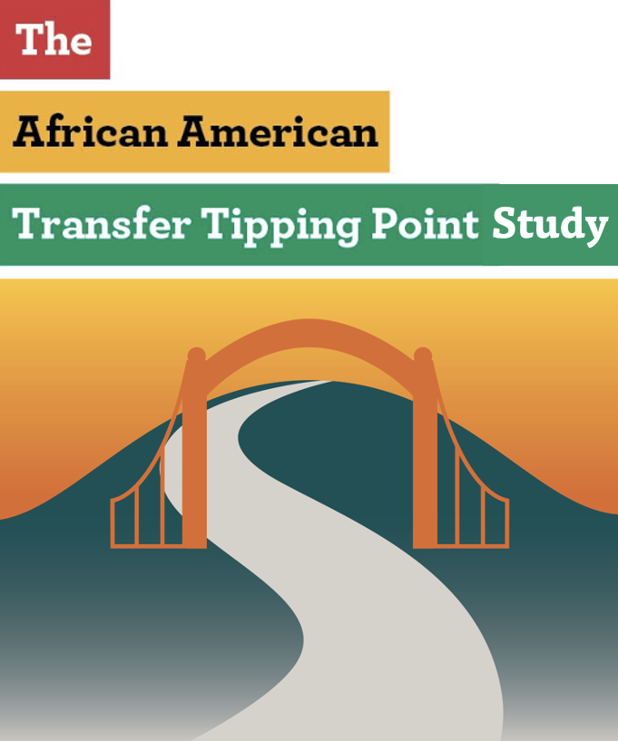
Identifying factors impacting transfer among African American/Black community college students
Dr. Darla M. Cooper
Dr. P. Marcell Gilmore
The RP Group
San Diego Miramar College
April 5, 2024
Notes:
50 minutes

Slide 2
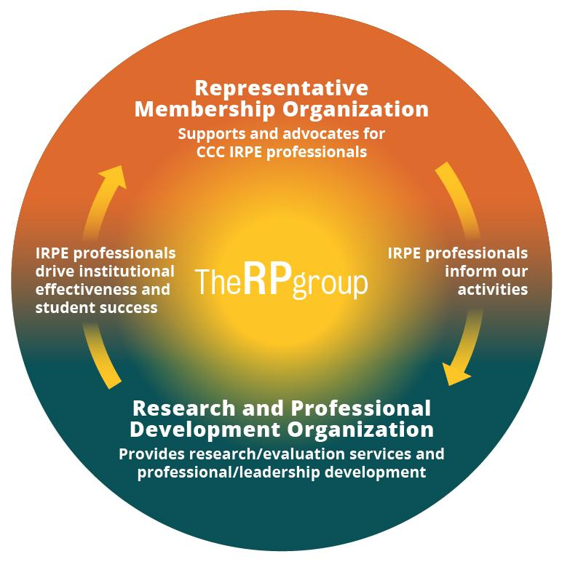
About The RP Group
Mission: As the representative organization for Institutional Research, Planning, and Effectiveness (IRPE) professionals in the California Community Colleges (CCC) system, The RP Group strengthens the ability of CCC to discover and undertake high-quality research, planning, and assessments that improve evidence-based decision-making, institutional effectiveness, and success for all students.
Services: Research, evaluation, planning, professional development, and technical assistance—designed and conducted by CCC practitioners
Organization: 501(c)3 with roots as membership organization
Notes:
Darla

Slide 3
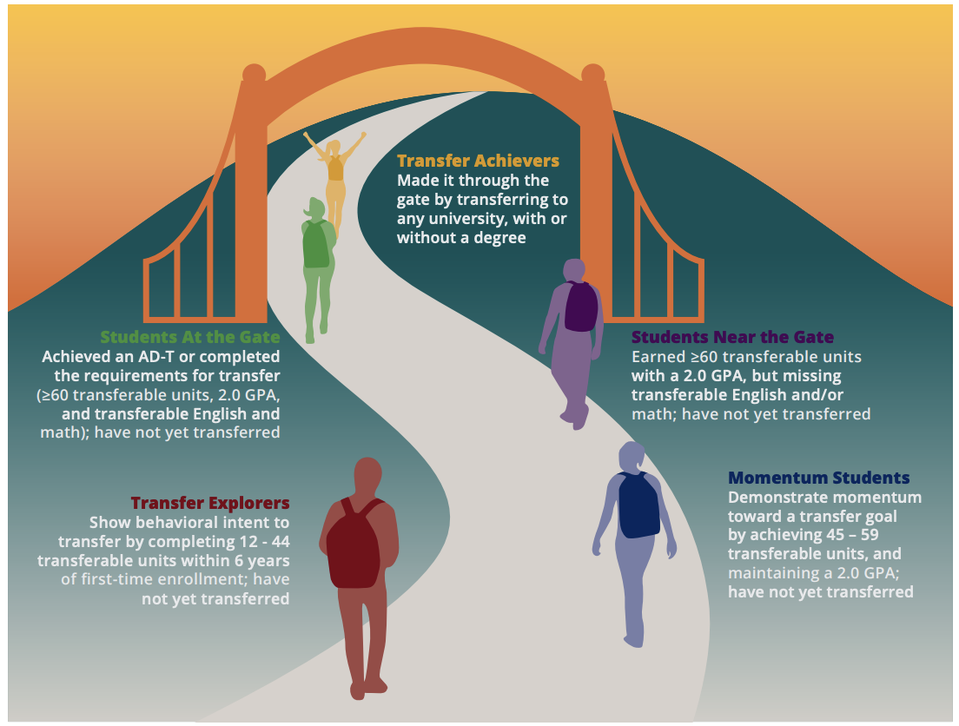
Through the Gate
Mapped California’s transfer landscape, identifying a continuum of milestones for the student transfer journey and quantifying how many students were “near” or “at” the transfer gate
When compared to White students, African American/Black students are 2.04 times more likely to transfer than remain near the gate. The problem is that they are less likely to make it “near the transfer gate.”
Notes:
Darla

Slide 4
The African American Transfer Tipping Point
Study made possible with generous funding from:
Notes:
Katie

Slide 5
GUIDING QUESTIONS
What factors contribute to students' likelihood of reaching the tipping point?
Which programs and practices are associated with greater persistence to and through the tipping point, and ultimately, the transfer gate?
Notes:
Katie

Slide 6
METHODS
Phase 1: Exploring student course-taking patterns
Phase 2: Interviews and focus groups with college practitioners and transfer-motivated students at colleges having higher success with transfer among African American students
Phase 3: A survey of African American/Black students across the CCC
Notes:
Katie

Slide 7
Phase 1 Population
Six first-time cohorts enrolled at a CCC between 2011 and 2016
Tracked for six years
Completed at least 12 transferable units with passing grades and had not yet enrolled in a university
69,242 African American/Black students and 778,977 non-African American/Black students
Notes:
Katie

Slide 8
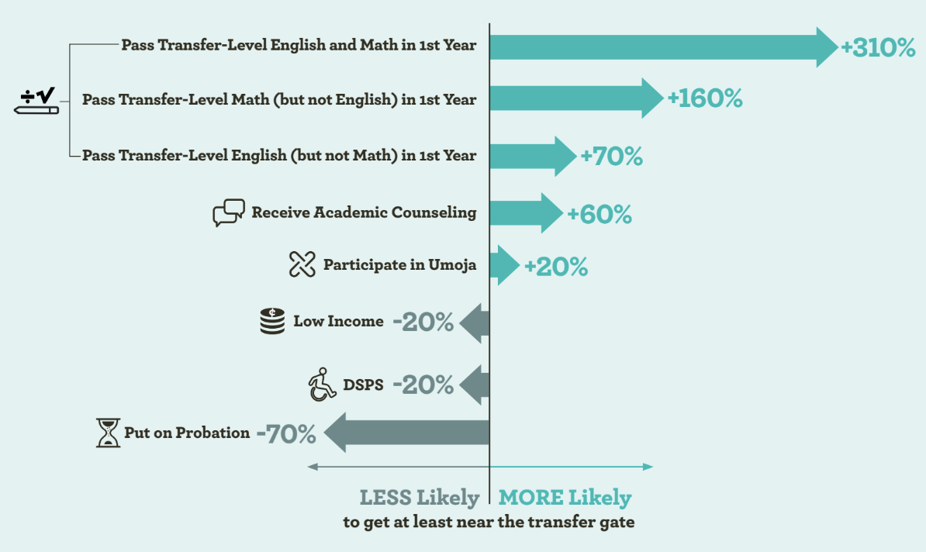
Phase 1 Results
Notes:
Katie

Slide 9
Phase 1 Results
….vs 110% for non-African American/ Black Students
41% of African American/Black students are put on probation vs 29% of non-African American/Black students
...
Notes:
Katie

Slide 10
Phase 2 Results:
From Interviews and Focus Groups
Passing Math and English: Faculty help students build their confidence as students, increase their mastery of key subjects and support their success
Academic Counseling: Students avoided general and Transfer Center counseling, as they did not feel heard, seen, valued, or respected and did not see themselves reflected
Umoja (Black Student Support Programs): Mandatory, dedicated, and proactive counseling offered by Umoja allows the time and space for counselors who reflect students’ backgrounds to build relationships with them
Academic Probation: Triggering nature of the word probation, Receiving a notice that they are on probation can be devastating, negatively impacted their financial aid eligibility
Notes:
Katie

Slide 11
Please join us at the workshops for faculty and classified professionals at 12:45pm.
We look forward to seeing you there!
Notes:
Katie

Slide 12
Find Out More….
Project Leads
Darla Cooper, EdD
Katie Brohawn, PhD
Project Team
Alyssa Nguyen, MA
Rogéair D. Purnell, PhD
Ashley Redix, PhD
Daisy Segovia, PhD
Kelley Karandjeff, EdM
Analytic Advisor
Terrence Willett, MS
Click on the QR Code to access the project webpage. Click on Resources tab to access briefs.
Notes:
https://rpgroup.org/All-Projects/ArticleType/ArticleView/ArticleID/269

Slide 13
Faculty Workshop
Notes:
Katie

Slide 14
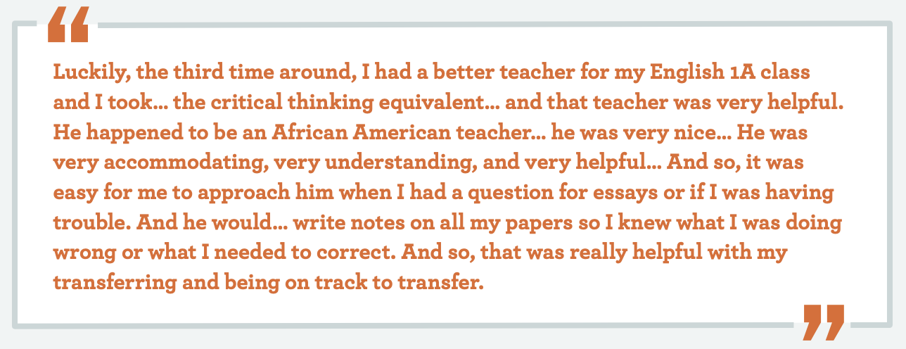
Why Instructional Faculty Matter
Faculty help students build their confidence as students, increase their mastery of key subjects, and support their success

Slide 15
Why Instructional Faculty Matter
Black student success is not the sole responsibility of Black faculty.

Slide 16
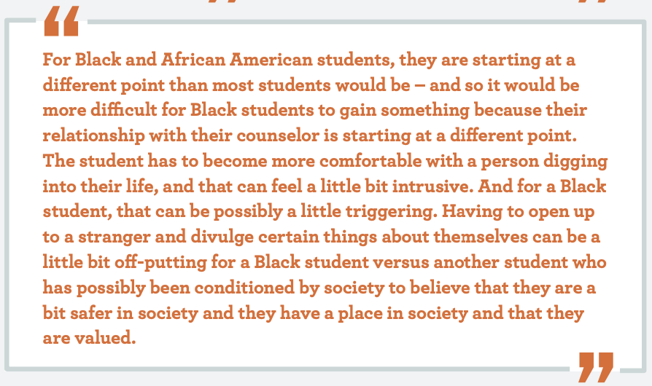
Why Counseling Matters
Students avoided general and Transfer Center counseling, as they were not heard, seen, valued, or respected and did not see themselves reflected
More likely to indicate benefiting more from academic counseling support from special population programs such as EOPS or Umoja

Slide 17
Discussion
What is the faculty’s role in supporting Black student success?

Slide 18
Classified Professionals Workshop
Notes:
Katie

Slide 19
Phase 2 Results:
From Interviews and Focus Groups
Passing Math and English: Faculty help students build their confidence as students, increase their mastery of key subjects and support their success
Academic Counseling: Students avoided general and Transfer Center counseling, as they did not feel heard, seen, valued, or respected and did not see themselves reflected
Umoja (Black Student Support Programs): Mandatory, dedicated, and proactive counseling offered by Umoja allows the time and space for counselors who reflect students’ backgrounds to build relationships with them
Academic Probation: Triggering nature of the word probation, Receiving a notice that they are on probation can be devastating, negatively impacted their financial aid eligibility
Notes:
The throughline is connection and belonging. That needs to happen regardless of position on campus.

Slide 20
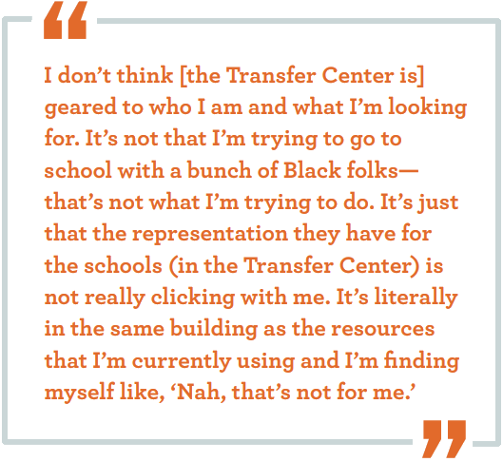
Why Classified Professionals Matter
What is a sense of belonging (SOB)?
A feeling or sensation of connectedness, the experience of mattering or feeling cared about, accepted, respected, valued by, and important to the group (e.g., campus community) or others on campus (e.g., faculty, peers, staff) (Strayhorn, 2019).

Slide 21
Why Classified Professionals Matter
Black student success is not the sole responsibility of Black employees.

Slide 22
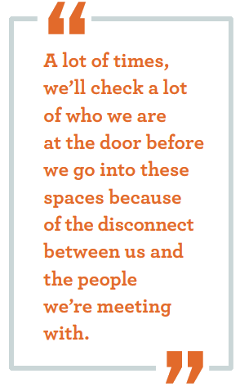
Why Classified Professionals Matter
The entire campus is responsible for creating a sense of belonging for Black students.

Slide 23
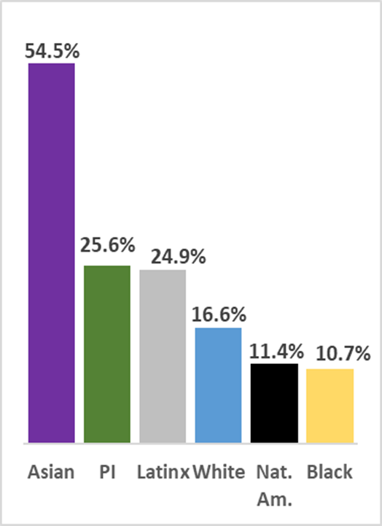
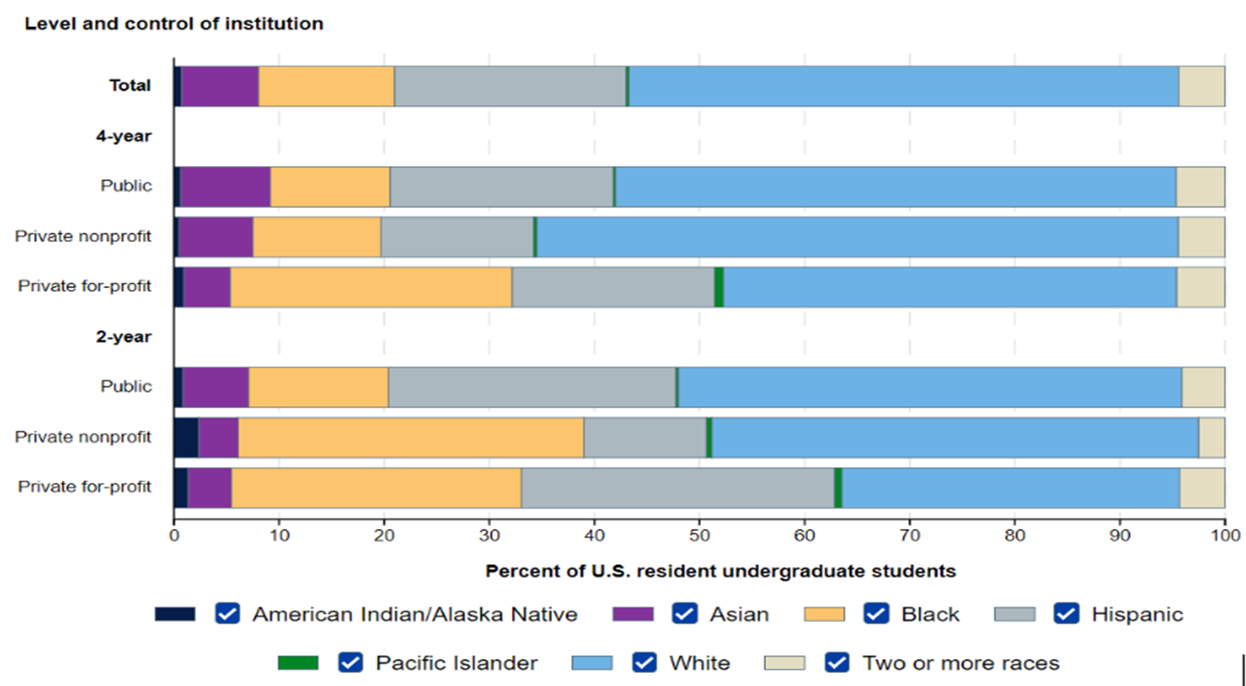
Why Classified Professionals Matter
Level of Institution
Total
4-year
Public
Private nonprofit
2-year
Public
Private nonprofit
Private for profit
Source: National Center for Education Statistics
Edsource June 15, 2021

Slide 24
Classified Professional Workshop Summary:
The entire campus is responsible for creating a sense of belonging and supporting the success of African American students.
Do classified professionals feel included in “big idea” initiatives on campus?
- Includes campus-wide areas of focus like accreditation, equity, Professional Development, SCFF, etc.
Practices used to support the success of African American students can be applied to all students.
Questions?
Notes:
The throughline is connection and belonging. That needs to happen regardless of position on campus.

