Slide 1
S.D. Miramar College Participatory Governance Academy Spring 2024

Slide 2
Participatory Governance Academy Agenda
The rationale and goals for this academy
Updates to and highlights from the College Governance Handbook
Before meetings (and hosting the first meeting)
During meetings (including guiding principles)
After meetings
Small group discussion: Committee mergers
Committee highlights and open floor/discussion

Slide 3
Rationale
This academy/workshop is the culmination of years of faculty, staff, and administrative efforts discussing ways to help Miramar's committees function at their best.
The two primary goals behind this work are to achieve:
optimally functioning committees
effective committee integration with, and communication to, the greater campus

Slide 4
Disclaimer
The presenters are not "experts" on committees, nor do we pretend to have the final word on their best practices!
We are hosting this workshop because we want to promote helpful, efficient, and transparent committee processes.
This is a space for discussion. You are invited to share your ideas, experiences, and best practices–and of course, ask questions!

Slide 5
Updates to and Highlights from the CGH
Please see the updates to the CGH from Fall 2023
Highlights:
Environmental Sustainability Subcommittee changed their charge to read, "Collect environmental sustainability data and research, and make recommendations to the Facilities, Health, and Safety Committee. Promote environmental stewardship and awareness on campus." The purpose of the change is to enable the ESC to take on a more visible role on campus promoting environmental stewardship and awareness.
Clarifications regarding membership during sabbaticals and breaks in service (such as those for adjunct faculty).
In addition to other, minor and technical changes, including those due to institutional reorganizations.

Slide 6
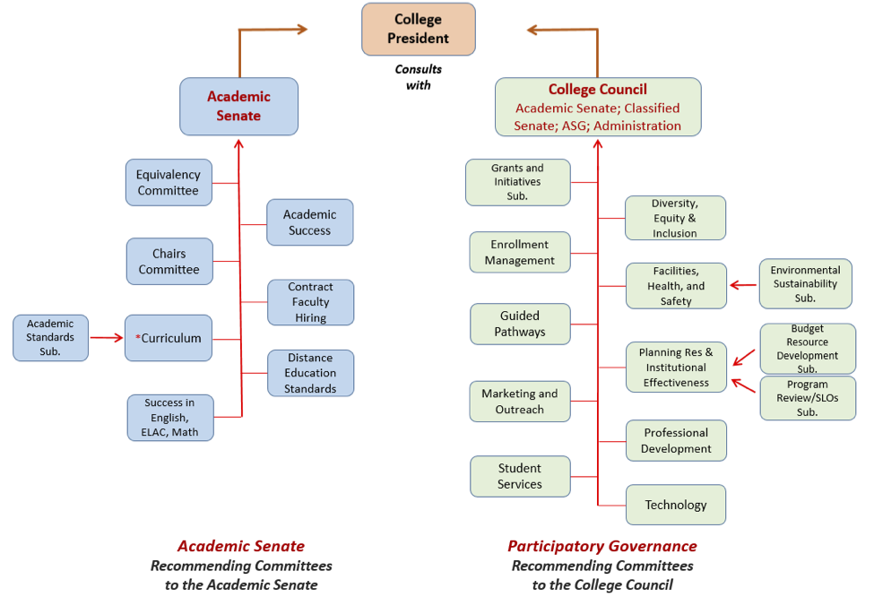
Updates to and Highlights from the CGH*
* Note that this graphic isn't entirely up to date, including the merging of some committees.

Slide 7
Before Meetings: The beginning of the semester
Prior to the first meeting (or during the first scheduled meeting of the year), confirm membership term lengths/dates by contacting committee chairs.
Share any changes with constituent leaders.
For faculty: updates can be shared via this form; interest can be collected via this form.
For classified: please contact your Senate President or Vice-President.
Please make sure committee webpages are up to date.
Calendar/create committee meeting events. Options include:
On the committee web page, create a new meeting page for each meeting of the semester or academic year (under “Content: Add Content: Committee Meeting) —this automatically sets a date on the Campus Calendar (see the Curriculum Committee).
In the Outlook Calendar, create an entry for each meeting.

Slide 8
Before Each Meeting
Ask committee members for agenda items well before the next meeting and consider asking them to review the agenda before it's finalized
Post the agenda and any documents relevant to the meeting
If using the Outlook Calendar, you can attach them there
If using the committee meeting webpage, upload the different documents to the appropriate location (i.e. under “Agenda” or “Associated Documents,” here’s an example)
Note that “Important Documents” on the committee webpage is different from “Associated Documents” on the subsidiary committee meeting webpages*
Some folx upload “DRAFT” minutes to the webpage, the calendar entry, or email them directly to committee members only–whichever approach you use, strive to be consistent
Notes:
* Regarding “Important Documents” vs. “Associated Documents”: For example, draft documents such as “Technology Plan” should be posted on the webpage for the committee meeting it will be discussed at. Once the plan is approved or adopted, it should then be attached as an “Important Document” to the main committee webpage.

Slide 9
If you are sending an email—consider these protocols

Slide 10
Before Each Meeting
3. Notify committee members at least 72 hours prior to the meeting (for meetings subject to the Brown Act, notify the campus body of the meeting via email and post the agenda at the physical location of the meeting 72 hours in advance)
Option 1: Email a link to the meeting webpage (which includes the time, location, agenda, and associated documents); if the draft minutes from the last meeting are not already uploaded there, attach them to the email
Option 2: Share the Outlook Calendar entry for the meeting and attach the draft minutes if necessary; consider adding a link to the meeting webpage
Option 3: Email the agenda, associated documents, and draft minutes as attachments (this can be cumbersome for members, especially if any documents are updated or added prior to the meeting)

Slide 11
Before Each Meeting
A Note on Meeting Modality Options
4. The Brown Act ensures the public has access to meetings. If your committee must follow the Brown Act, as of March 2023 we now choose to follow either AB 2449 or the “traditional Brown Act”:
If your committee opts to follow the AB 2449 guidelines, in short:
51% of members must be present in person.
Members can only miss two meetings a year due to “just cause.” More meetings can be missed due to "emergency circumstances.”
If your committee opts to follow the traditional Brown Act, in short:
All members can attend meetings remotely (aka via “teleconference”).
Folx must list a physical address that they will teleconference from.

Slide 12
Before Each Meeting
What are your thoughts on which approach works best regarding:
Using the Outlook Calendar or the committee webpage?
How to post/share minutes?

Slide 13
During Meetings
When conducting a meeting, committees should adhere to the Brown Act and Miramar’s College Governance Handbook*, follow Robert’s Rules of Order, and be collegial (see these links: “Guiding Principles for Committee Work,” the RRO “Cheat Sheet”, and the CGH)
Take attendance and establish quorum. Quorum is defined in RRO as 50% of the membership plus one.
Ensure someone is taking minutes (see “Guidelines for Writing Meeting Minutes” in “Guiding Principles for Committee Work” and consider using Zoom's AI to help with/draft the minutes)
Follow the agenda (see “Guiding Principles for Committee Work”)
Ensure full participation but limit unnecessary reiteration of points.
For lengthy discussions, summarize the main points (this also helps with preparing minutes).

Slide 14
During Meetings
Summarize arguments for and against an issue.
If an issue is contentious, have each side address the chair rather than each other.
Follow proper procedures for making and voting on motions (see “Guiding Principles for Committee Work”).
Specify the action items (i.e. what must be done after the meeting, including reports to constituents and/or parent committees). *
End on time (or take a vote to extend time if necessary).
Notes:
* Note: consider asking members to review the highlights, conclusions, as well as action items from the meeting to ensure everyone leaves "on the same page;" the College Council usually concludes their meetings by verbally identifying any items that need to be reported or acted on

Slide 15
During Meetings
At the first meeting of the year:
Review the committee charge as it is stated in Miramar’s CGH
If the committee wishes to make changes moving forward, they can do so via this process
Review the Chair and other committee members’ roles
Clarify who the voting members are and how proxies work
Clarify the role of Ex-Officio (aka resource) members and guests

Slide 16
After Meetings
Post approved minutes from the previous meeting to the committee meeting webpage
Share draft minutes with committee members ASAP (within 72 hours, if possible)*
This helps ensure their accuracy as folx are more likely to remember what transpired at the meeting
This is especially helpful when there are action items for members to complete
Note: While we don’t have to approve minutes in our meetings as per Robert’s Rules, we are required to post meeting minutes to the committee’s web page
Notes:
* Again, some folx upload “DRAFT” minutes to the committee webpage, share them via the calendar entry for the upcoming meeting, or email them directly to committee members. Choose an option and stick with it.

Slide 17
After Meetings
Each committee should determine the best way to share recommendations and make reports to the campus/constituents
Note: the College Council lists items to report and/or take action on and shares this with their membership immediately after each meeting. The Academic Senate highlights these items separately and includes sample ballots for constituents when necessary. Both bodies include these lists in their minutes as well (see an example here).
If the committee is a subcommittee or under the purview of another body (such as the Classified or Academic Senate), schedule reports with them as needed.
Other thoughts?

Slide 18
Small Group Discussion: Committee Mergers
Have you, in your role as committee chair or committee member, ever considered combining or merging your committee with another committee on campus?
What sort of guidance or support might you need to support this type of discussion?

Slide 19
Successes and Highlights from the Curriculum Committee

Slide 20
Final Discussion
How does your committee report information with its constituents and other committees that oversee or are related to yours?
As a member of the campus community, how would you like to hear reports from other committees?
What do you think about a college-wide practice of committees creating a one-page document summarizing all that your committee has accomplished during the month/semester/year?
Any other thoughts or questions?

