Slide 1
Miramar ASC & Library Team
Donnie Tran
Francine McCorkell
Reylyn Cabrera
Van Chau
Anh Thu Truong
Donna Sanmar
Cattleya Amezuca
Quy Nguyen
Pamela Phaymany

Slide 2
Fall 2023 Tutoring Services at Miramar College
Academic Success Center, Math Lab, STEM Center

Slide 3
Fall 2023 Tutoring Services at Miramar College
Academic Success Center (ASC) Room L-101, Southwest corner on the first floor of the LLRC
Math Lab Room M-210, second floor of the M-Building
Peer-Led Team Learning Program (PLTL) STEM Center, Room S6-110

Slide 5
Fall 2023 Tutoring Services at Miramar College
Academic Success Center (ASC) Room L-101, Southwest corner on the first floor of the LLRC
Math Lab Room M-210, second floor of the M-Building
Peer-Led Team Learning Program (PLTL) STEM Center, Room S6-110

Slide 6
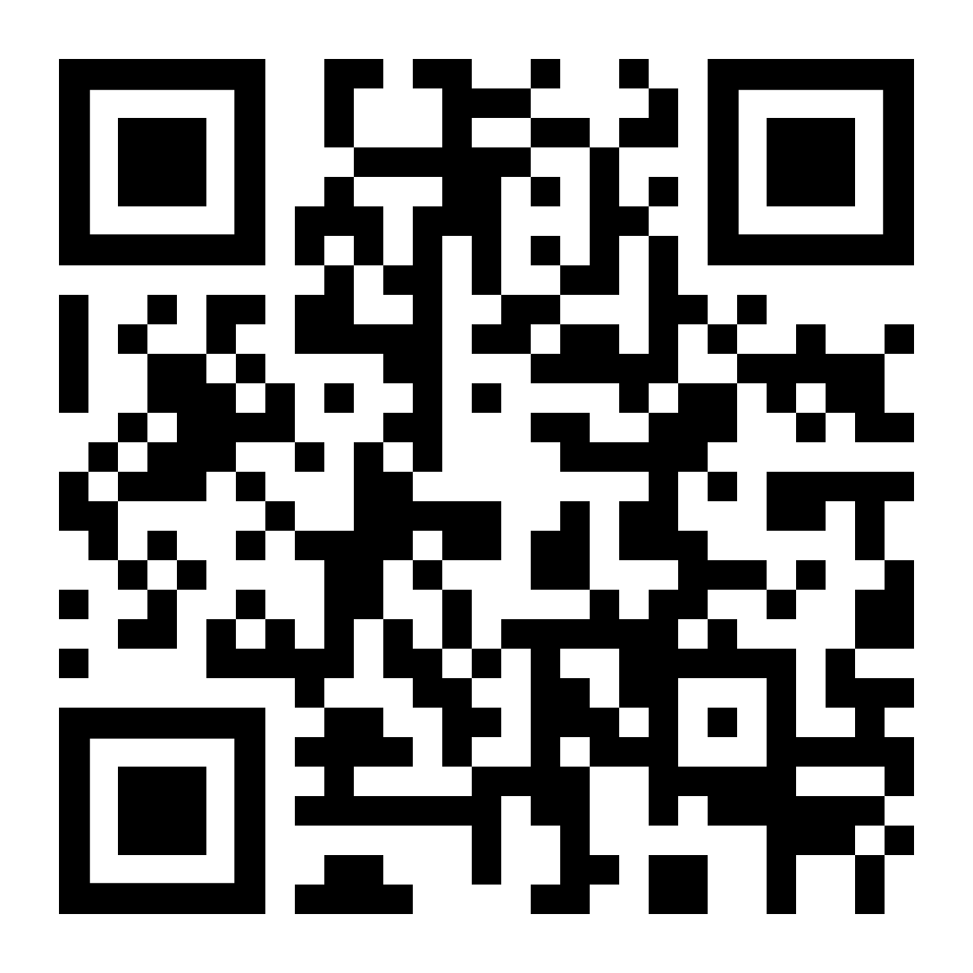
Visit the ASC webpage for any updates to our hours of operation and to learn more about tutorial services on campus.
Scan the QR code or
visit sdmiramar.edu/services/asc

Slide 7
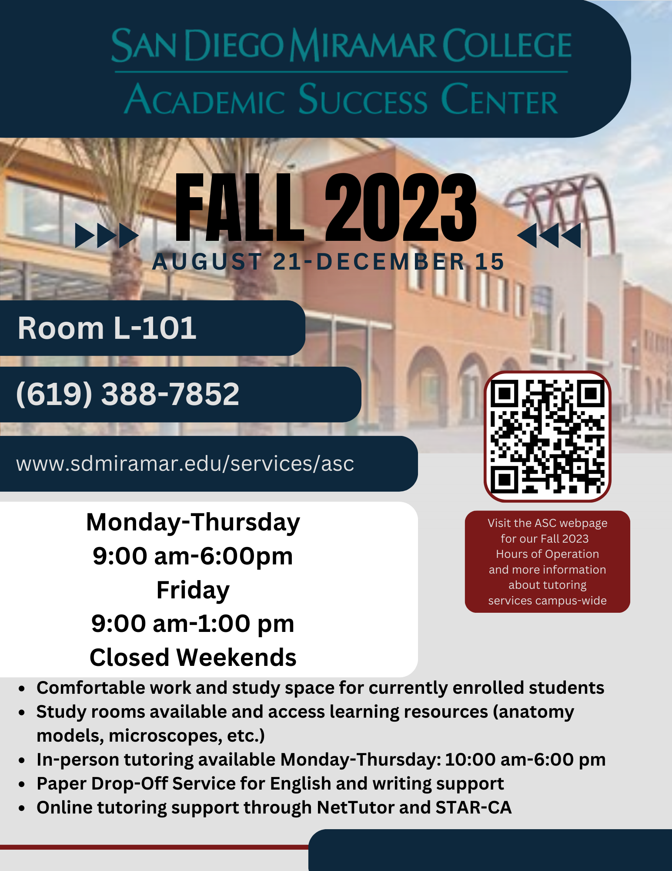
ASC Fall 2023
Hours of Operation
Monday-Thursday
9:00 am-6:00 pm
Friday 9:00 am-1:00 pm
Tutoring availability
Monday-Thursday
10:00-6:00 pm

Slide 8
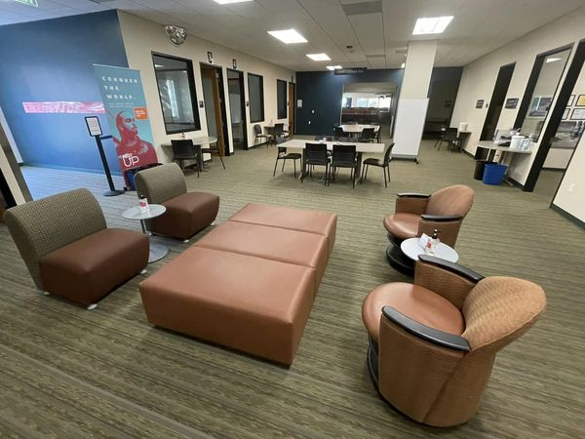
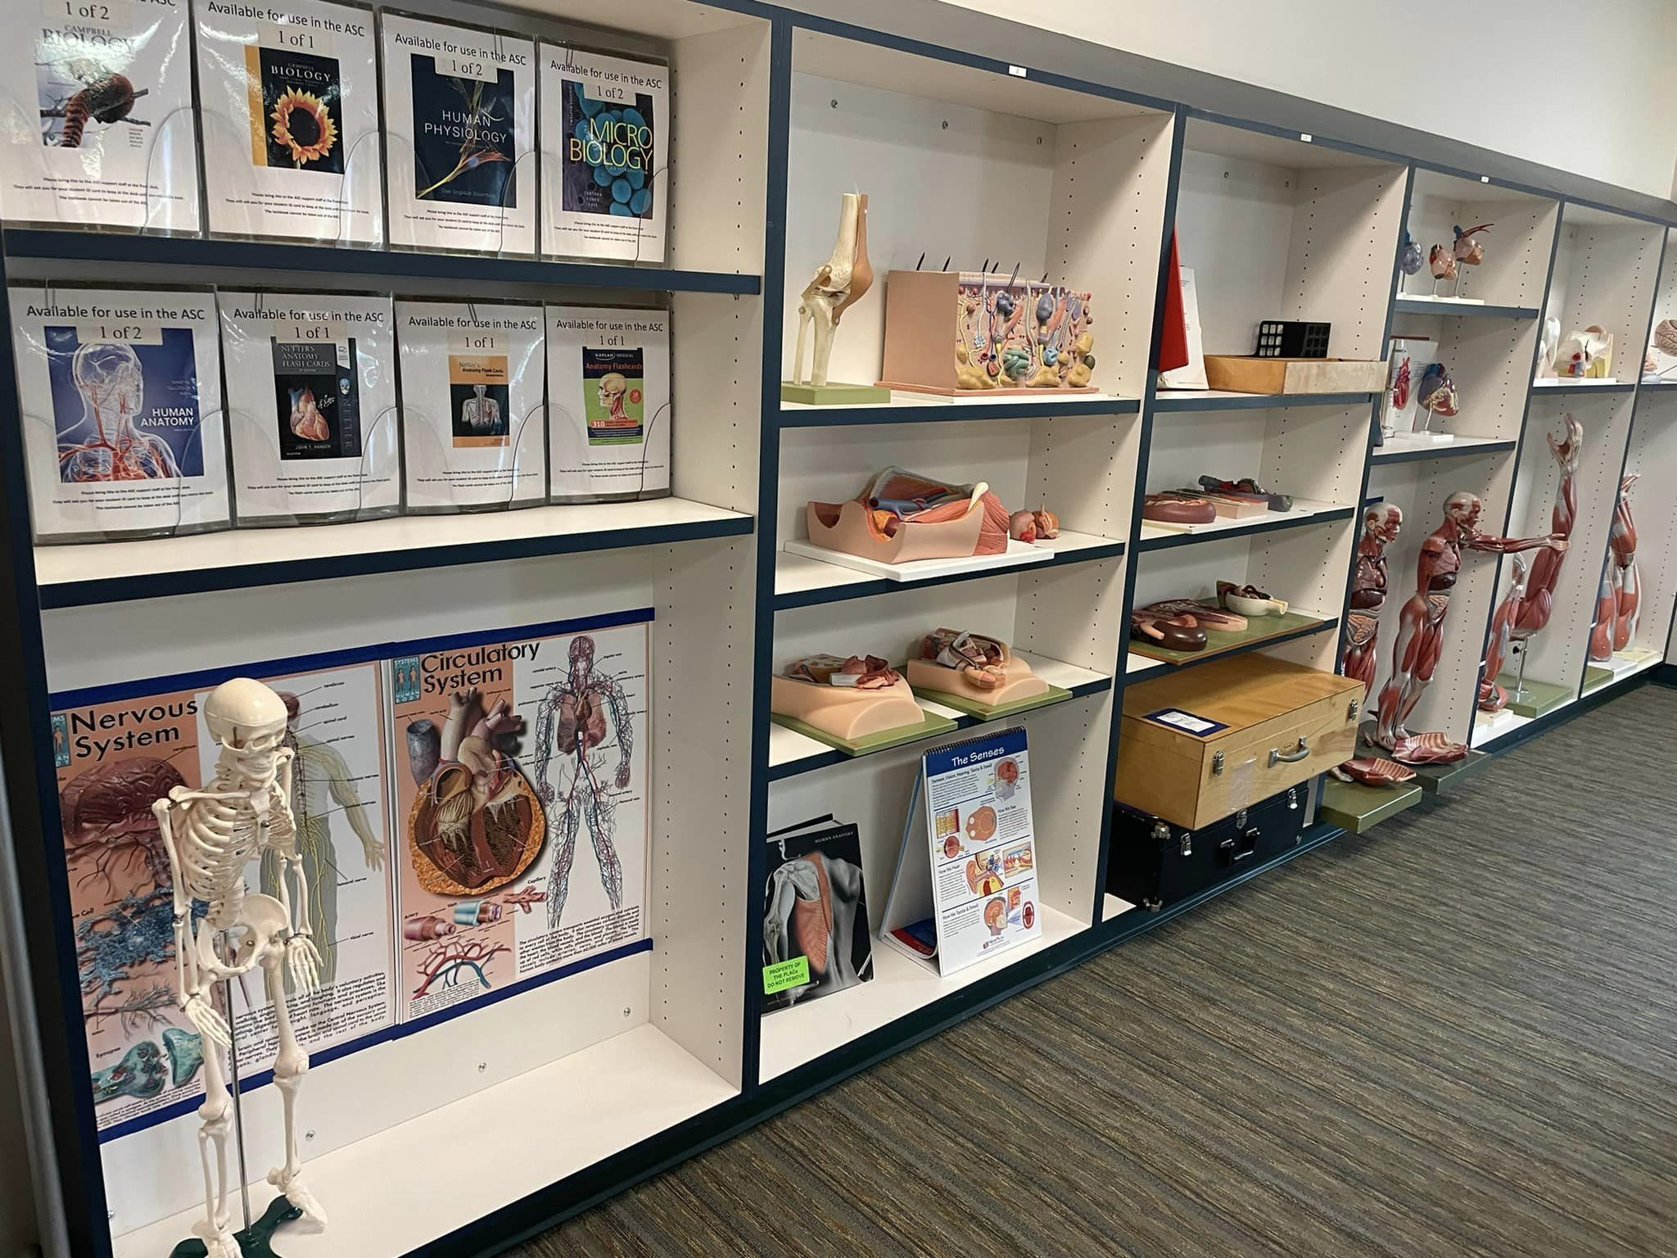
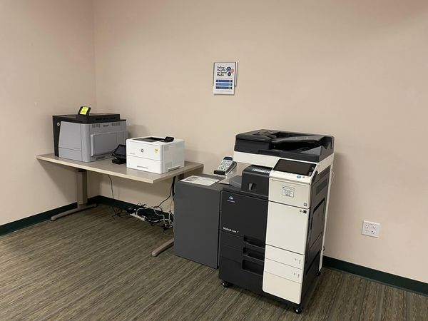
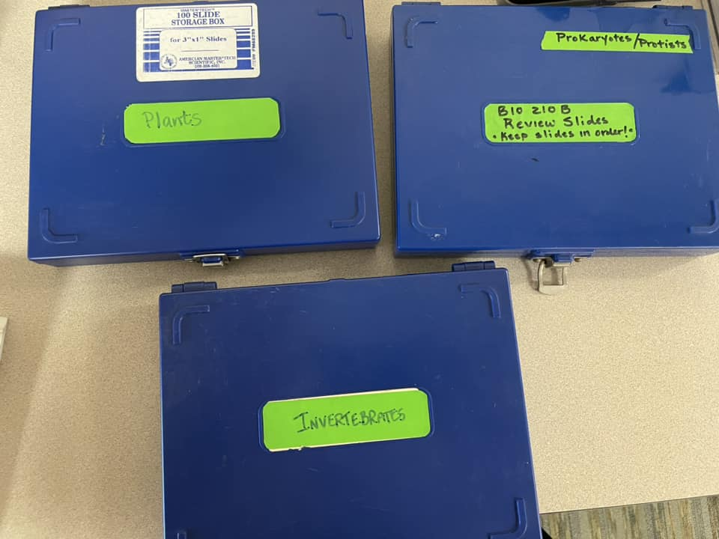
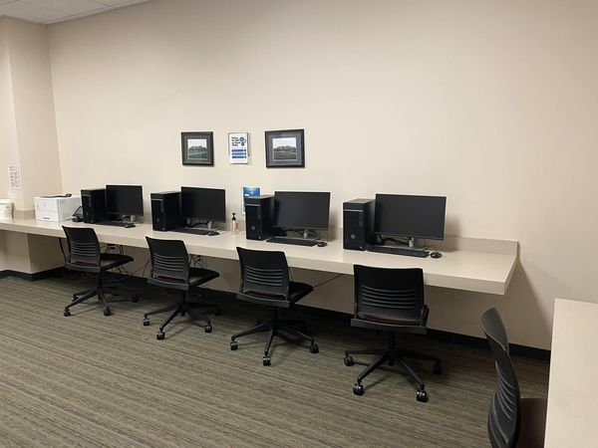
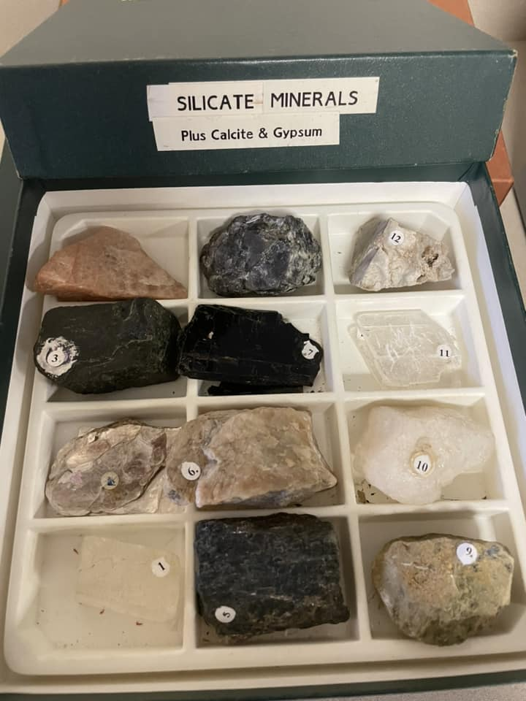
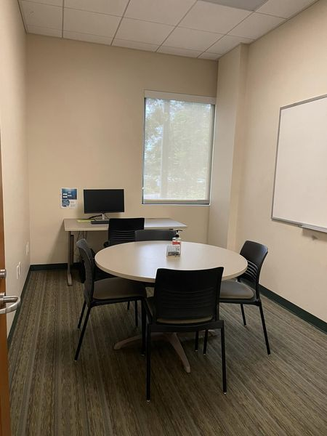
Comfortable work and study space with access to the asc’s resources

Slide 9
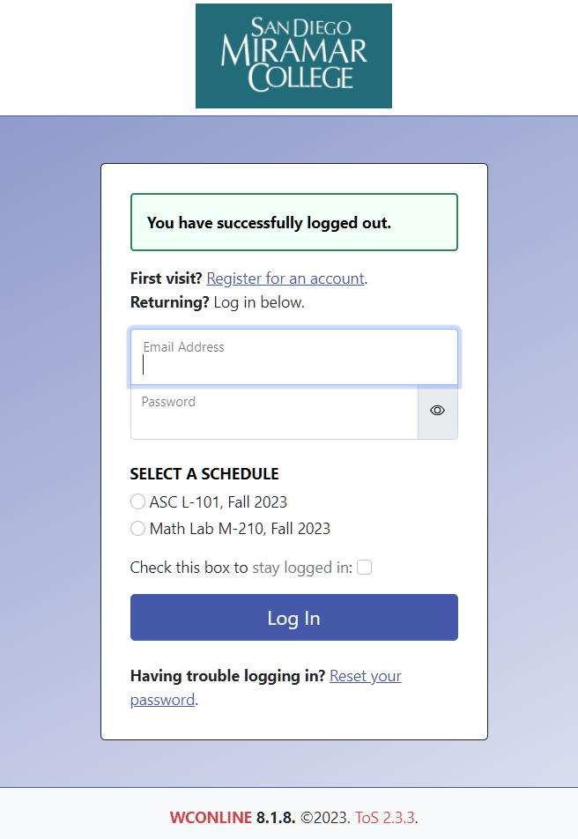
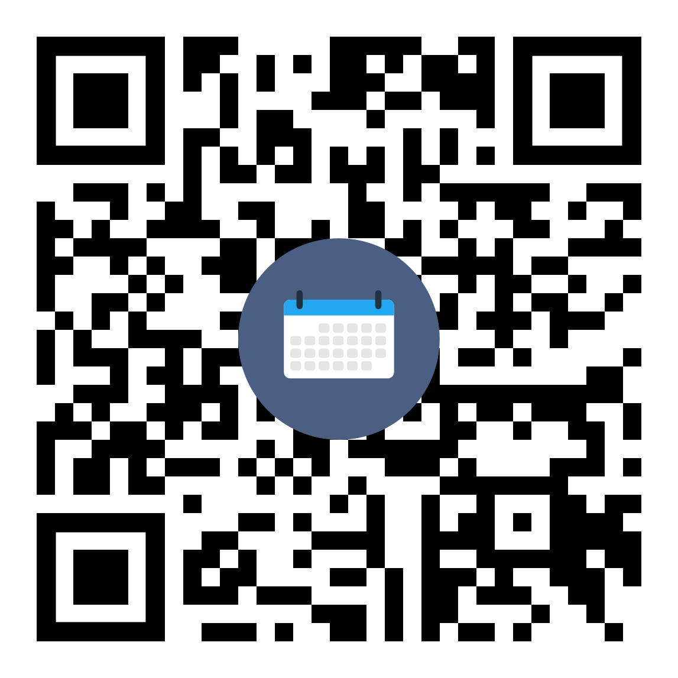
My WCOnline
sdmiramar.mywconline.com
Used District-wide for tutoring appointment scheduling and tracking student attendance
Student accounts use their college email address as the username
Default password is their 10-digit CSID
Students can self-schedule appointments (ASC only)
Students can also call or come in person and have an ASC representative assist them.

Slide 10
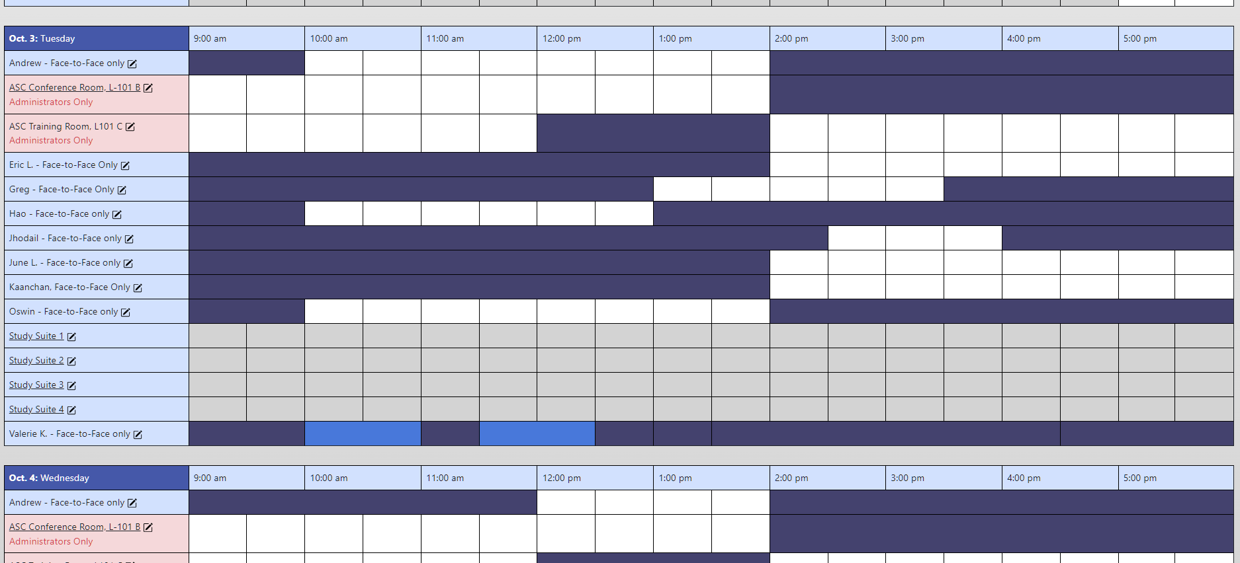
My WCOnline
sdmiramar.mywconline.com
ASC uses it to track student attendance and collect data.
Students log-in and log-out.
Students can view tutor/subject tutoring availability.
Students can self-schedule tutoring appointments.

Slide 11
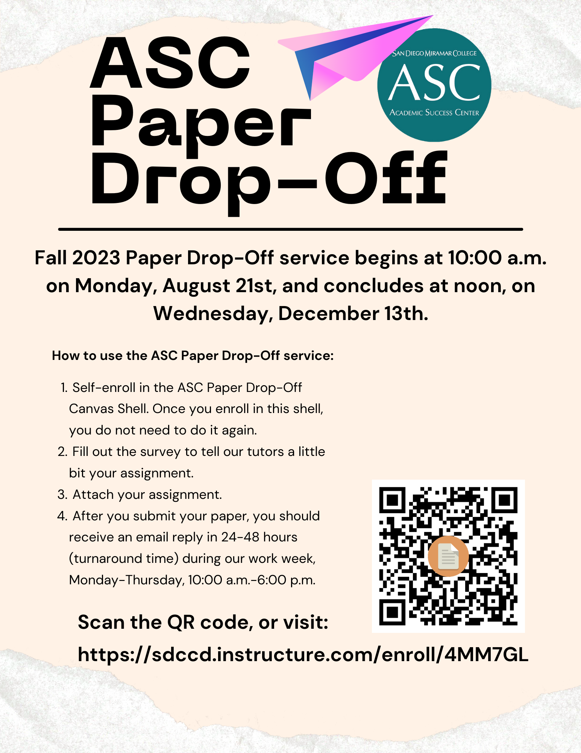
Virtual Tutoring Services

Slide 13
ASC Online Zoom Hub is currently on pause for Fall 2023
Online support available through STAR-CA and NetTutor

Slide 15
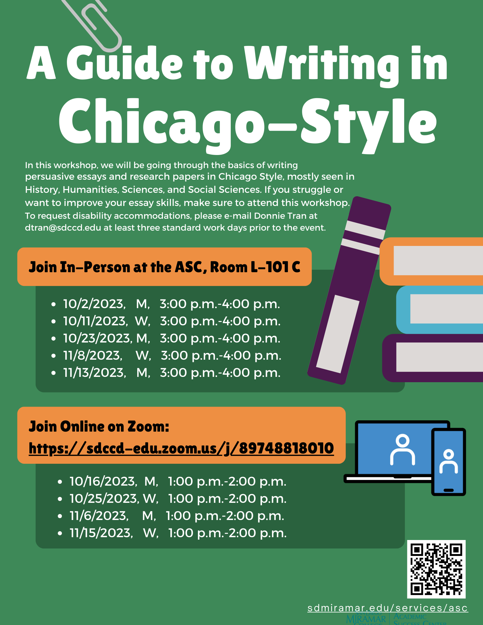

Slide 16
Fall 2023 Tutoring Services at Miramar College
Academic Success Center (ASC) Room L-101, Southwest corner on the first floor of the LLRC
Math Lab Room M-210, second floor of the M-Building
Peer-Led Team Learning Program (PLTL) STEM Center, Room S6-110

Slide 17
Math Lab Fall 2023
Hours of Operation
Monday-Thursday
9:00 am-6:00 pm
Friday
9:00 am-1:00 pm

Slide 18
My WCOnline
sdmiramar.mywconline.com
ASC/Math Lab uses it to track student attendance and collect data.
Students log-in and log-out.
Students can view tutor/subject tutoring availability.
No self-scheduling because Math Lab tutoring is walk-in basis only

Slide 19
Fall 2023 Tutoring Services at Miramar College
Academic Success Center (ASC) Room L-101, Southwest corner on the first floor of the LLRC
Math Lab Room M-210, second floor of the M-Building
Peer-Led Team Learning Program (PLTL) STEM Center, Room S6-110

Slide 20
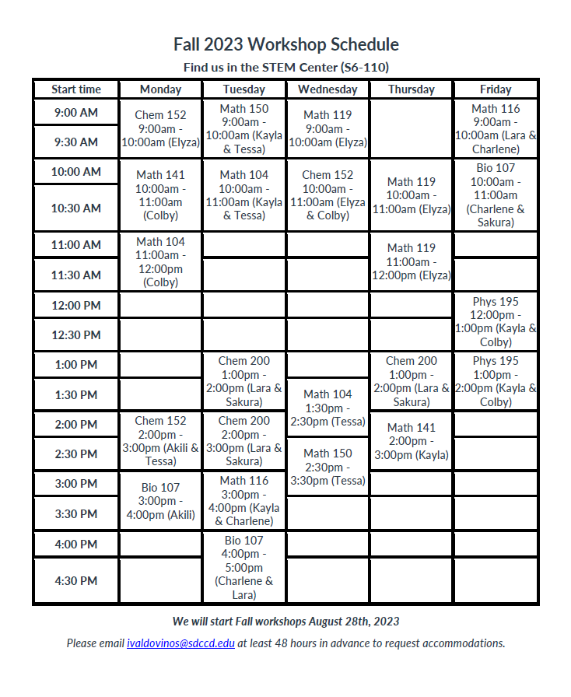
Peer-Led Team Learning (PLTL) Program
Located in the STEM Center, Room S6-110
Workshops only
Led by Peer Leaders who meet with instructors to cover the lessons each week.
Worksheets to help students practice and learn what is covered each week.
For more information, contact Ivan Valdovinos at ivaldovinos@sdccd.edu

Slide 21
Fall 2023 Library Services at Miramar College

Slide 22
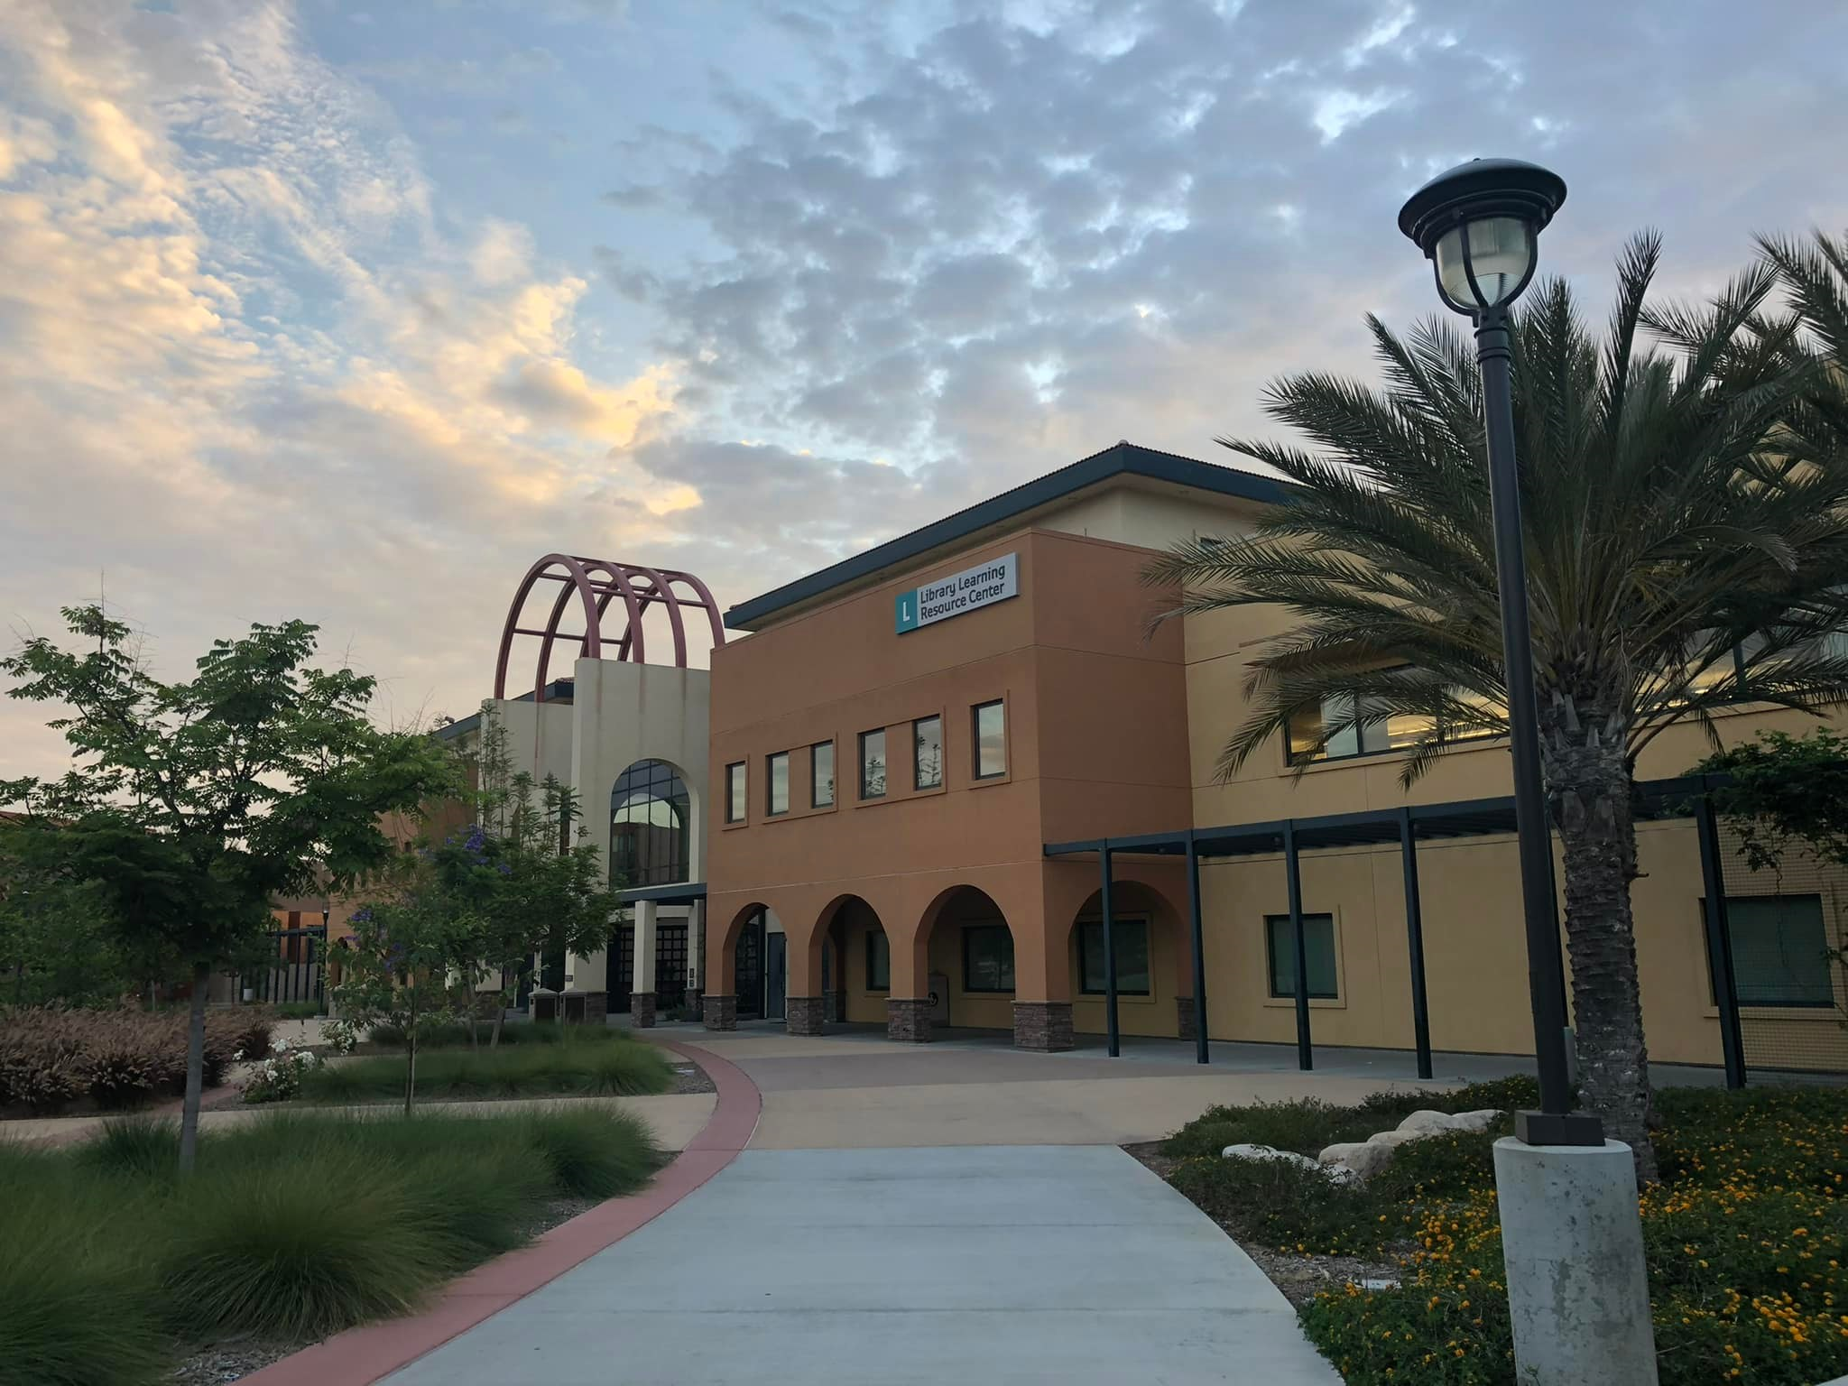
Miramar College Library
Room L-200, second floor of the LLRC
Hours of Operation
Monday-Thursday
9:00 am-6:00 pm
Friday 9:00 am-1:00 pm
Website:
sdmiramar.edu/services/library

