Slide 1
There are 2 types
of cells in the
Nervous System:
1) Neurons
Communication cell
2) Glial cells
Support cell
Ganglia

Slide 2
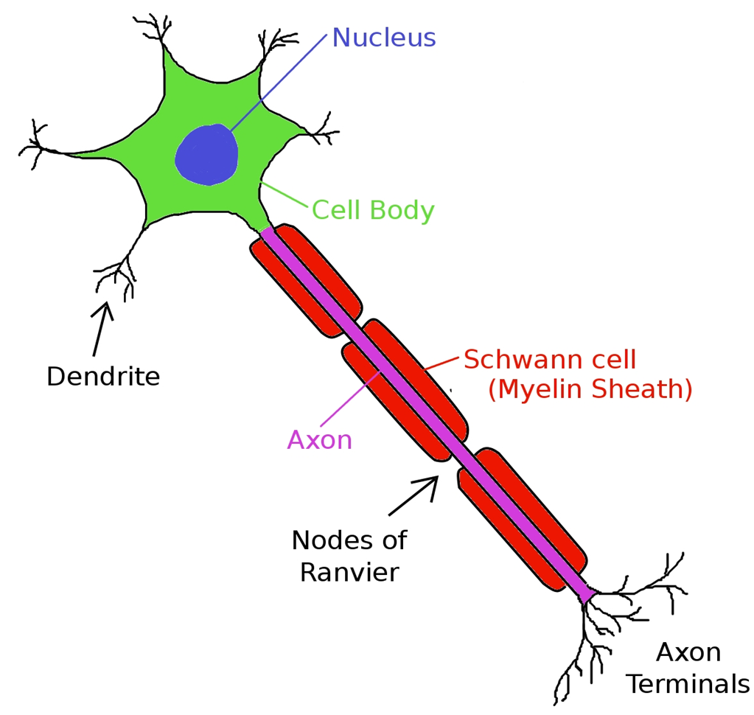
Incoming
Info.
Processing
Info.
Processes information
Typical
Motor
Neuron
Receives incoming info
Outgoming
Info.
Releases the signal

Slide 3
PNS
CNS
The Feedback Loop
Sensory Pathway
Receptors
(detect changes)
1. Sensory Neuron
Interneuron
(Integration)
(calculate what to do)
2. Interneuron
3. Motor Neuron
Motor Pathway
Effector
Tissue
(respond to change)

Slide 4
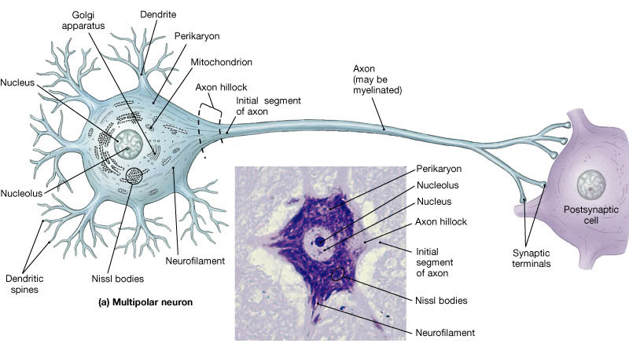
The Motor/Multipolar Neuron
Telodendria
Histology of a Neuron

Slide 5
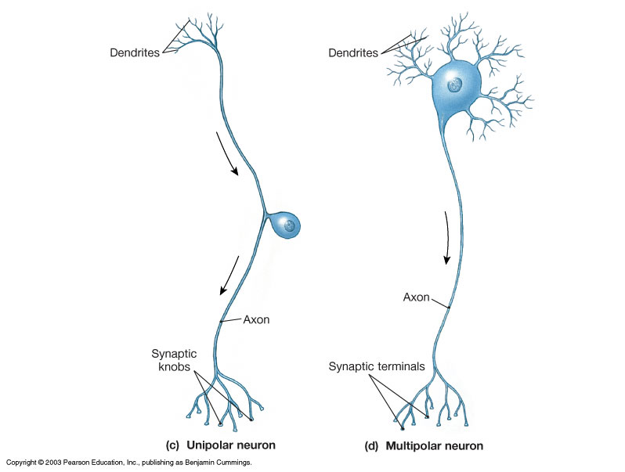
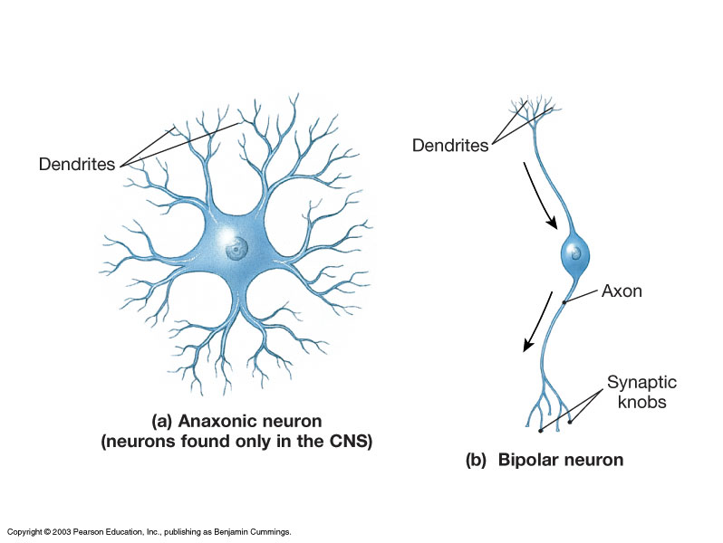
Important Anatomical Neurons
Anaxonic
Bipolar
Unipolar
Multipolar

Slide 6
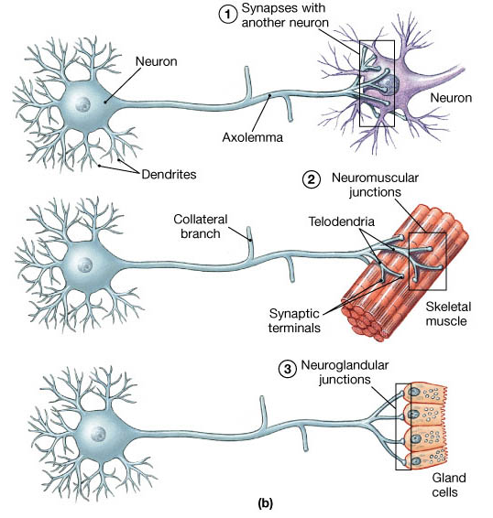
The 3 major types of Communications coming from Neurons

Slide 7
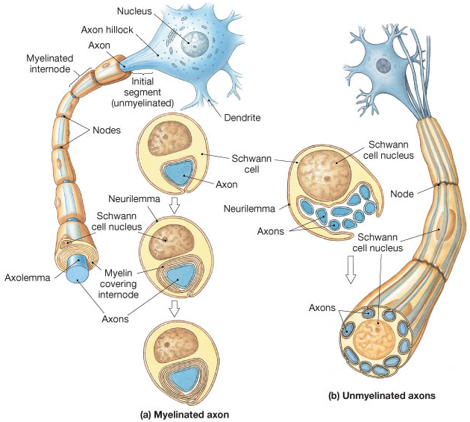
Axon Myelination

Slide 8
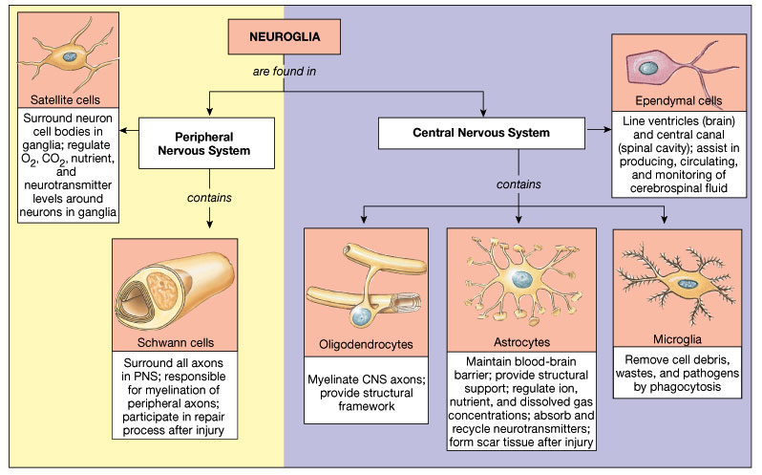
The Glial Cells
Glial Cells

Slide 9
Nervous System Terminology
Gray Matter – mostly nerve cell bodies.
White Matter – mostly myelinated axons.
Nerve fiber – a single axon of a neuron.
Nerve – a bundle of axons in the PNS.
Tract – a bundle of axons in the CNS.
Columns – are groups of tracts.
Ganglion – a cluster of nerve cell bodies in PNS.
Nucleus – gray matter in CNS with discrete boundaries
and common function.

Slide 10
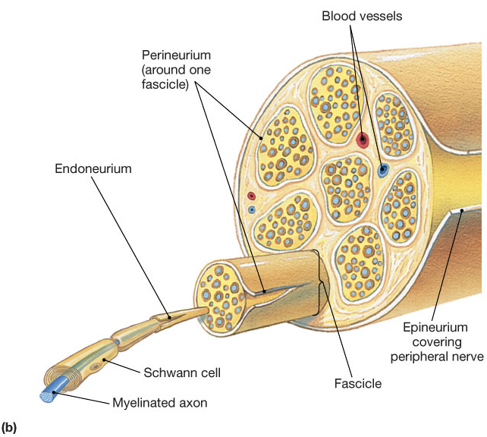
Anatomy
of a
Nerve
Neurolemma
Axolemma

Slide 11
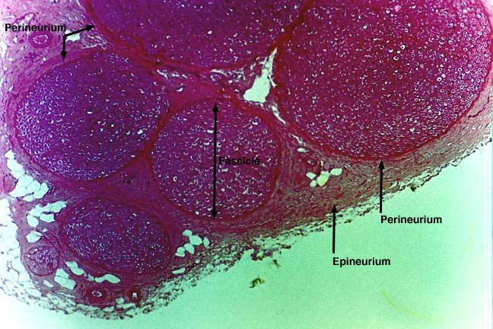
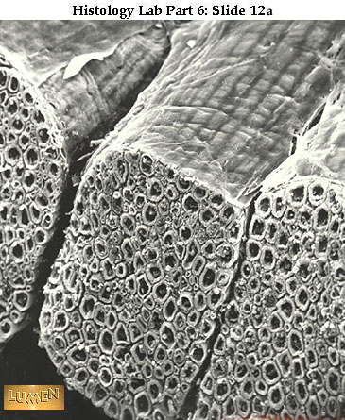
Histology
of
Nerves

Slide 12
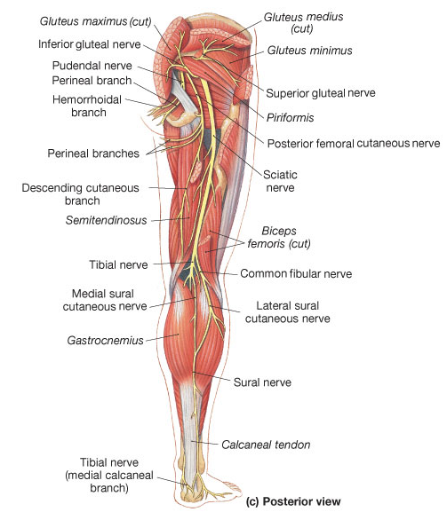
What Nerves look like on models

Slide 13
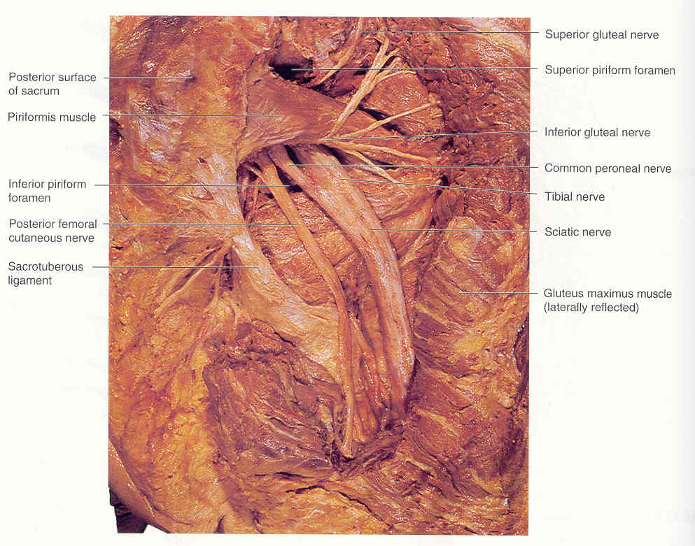
What Nerves look like on cadavers

Slide 14
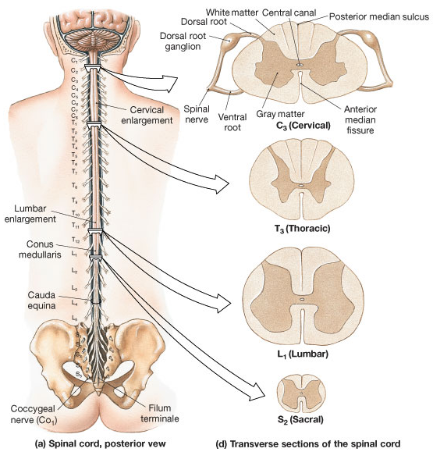
In the Spinal cord:
White matter = columns
Gray matter = horns
There are 31 pairs
of Spinal Nerves
8 Cervical (C₁-C₈)
12 Thoracic (T₁-T₁₂)
5 Lumbar (L₁-L₅)
5 Sacral (S₁-S₅)
1 Coccygeal (Co₁)

Slide 15
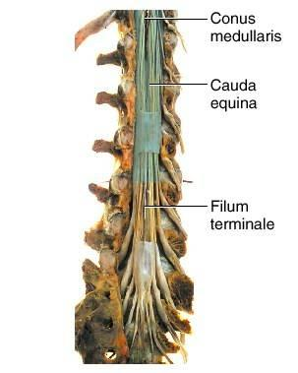
Anatomical Features of the Spinal Cord
Typically ~18 inches in length
Deep anterior median fissure
Shallow posterior median sulcus
Conus medullaris (= end of cord)
Cervical and lumbar enlargements

Slide 16
Filum Terminale extends to sacral vertebrae, joins coccygeal ligament, for length-wise stabilization.
Cauda Equina - extension of ventral
and dorsal roots (horses tail!).
Denticulate Ligament (extension of dura to pia mater) for lateral (side to side) stabilization.

Slide 17
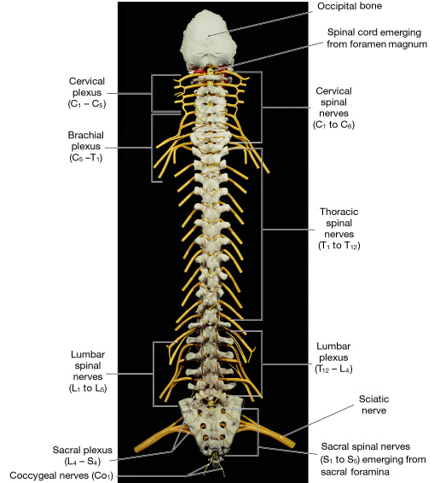
Spinal Plexus:
(in the Nervous System)
is a re-arrangement of
spinal nerves into
functional groups.
Cervical (C₁-C₅)
Brachial (C₅-T₁)
Lumbar (T₁₂-L₄ )
Sacral (L₄-S₄)

Slide 18
Cervical (C₁-C₅)
e.g. Phrenic n. (C₃-C₅)
Brachial (C₅-T₁)
e.g. Radial n. (C₅₋₈-T₁)
e.g. Ulnar n. (C₈-T₁)
e.g. Musculocutaneous n. (C₅-C₇)
e.g. Median n. (C₅₋₈-T₁)

Slide 19
Lumbar (T₁₂-L₄ )
e.g. Femoral n. (L₂-L₄)
e.g. Obturator n. (L₂-L₄)
Sacral (L₄-S₄)
e.g. Sciatic n. (L₄-S₃)
e.g. Tibial n. (L₄-S₃)

Slide 20
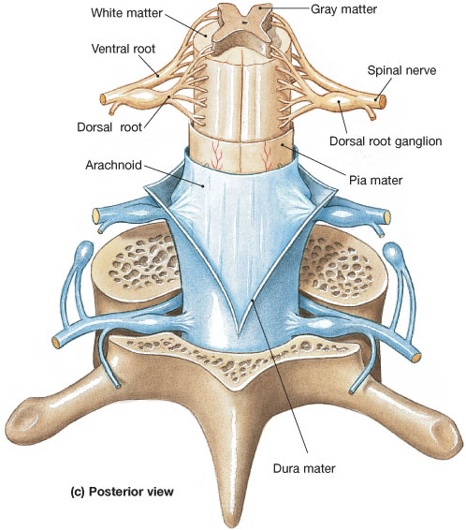
Spinal Meninges
- Dura Mater
Dense irregular CT +
Simple squamous
epithelium
- Arachnoid
Simple squamous
epithelium
- Pia Mater
Collagen and elastic fibers

Slide 21
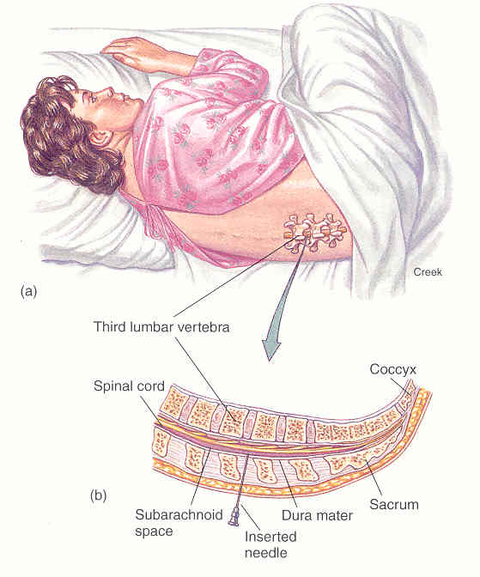
Lumbar Puncture

Slide 22
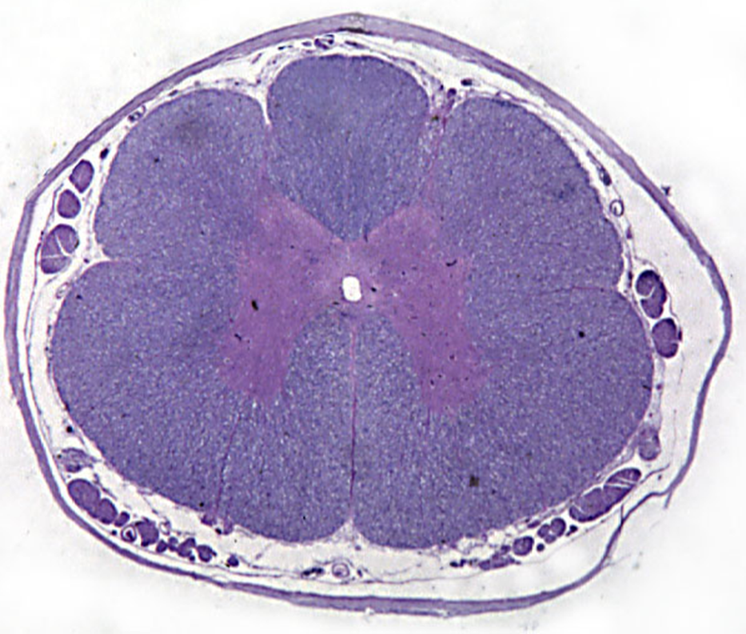
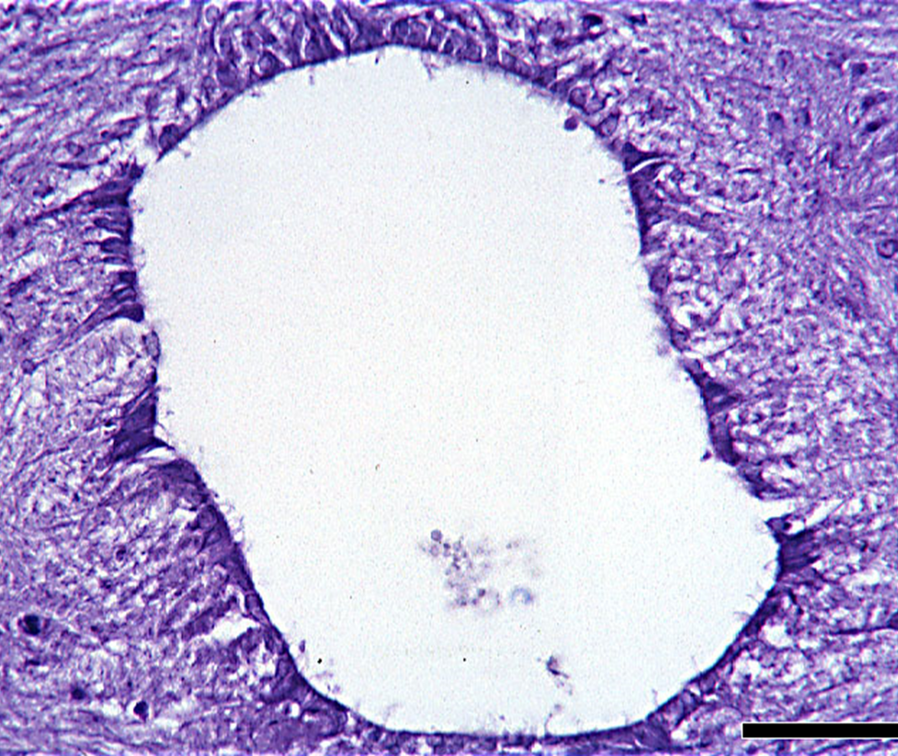
Cross Section of Spinal Cord Histology
Central Canal
filled with CSF lined
with ependymal cells
Now draw the x.s. of spinal cord

Slide 23
Spinal Cord Anatomy (x.s.)

Slide 24
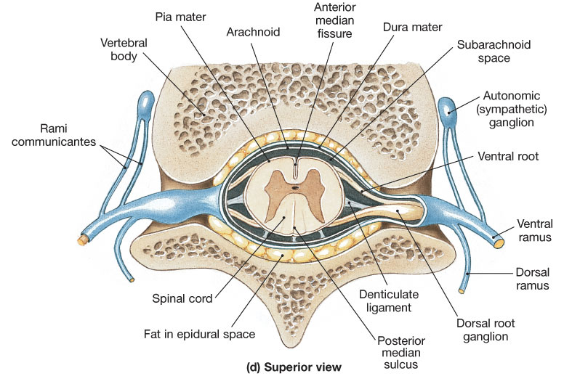

Slide 25
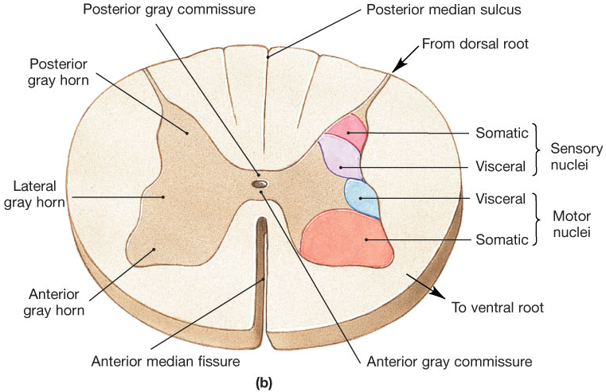
The Spinal Cord Nuclei

Slide 26
The Spinal Cord Nuclei
Posterior gray horns:
Somatic and Visceral Sensory nuclei.
Anterior gray horns:
Somatic Motor control.
Lateral gray horns:
Visceral Motor neurons.
Gray commissures
Axons of interneurons crossing and unmyelinated axons.

Slide 27
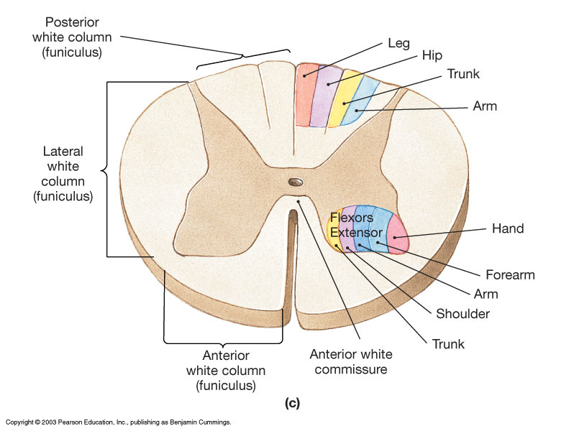
The Spinal Cord Nuclei

Slide 28
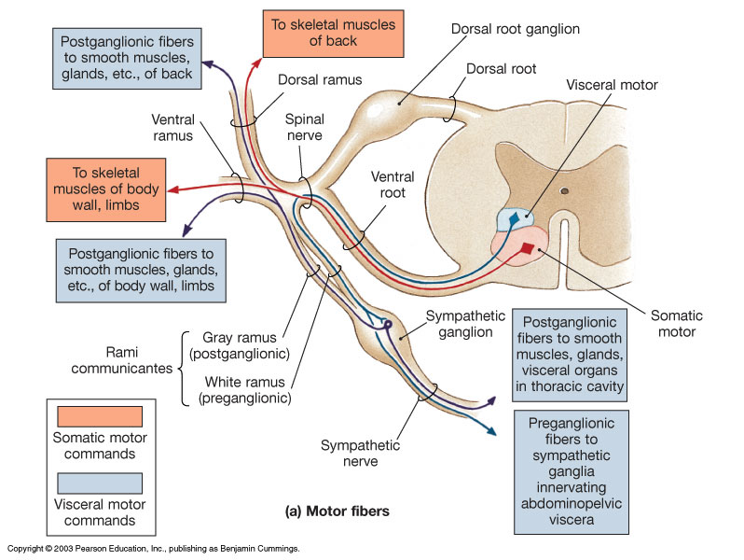
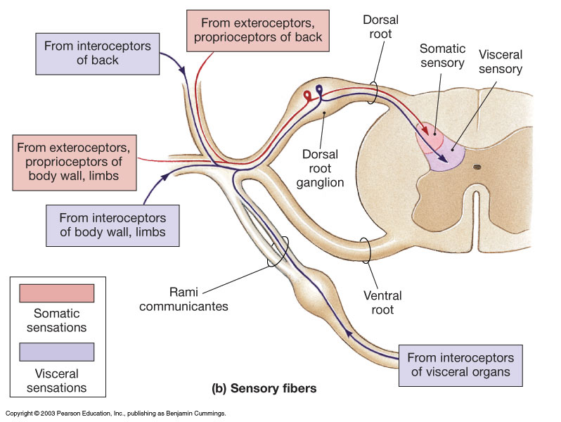
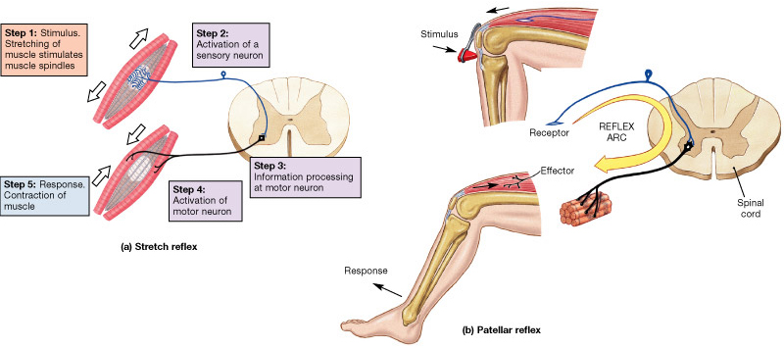
Spinal Pathways
Spinal
Reflexes

Slide 29
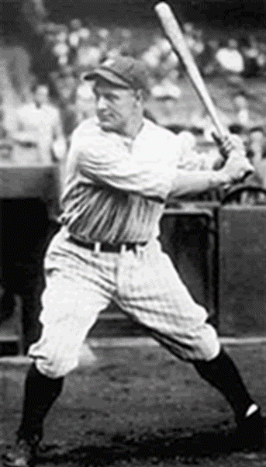
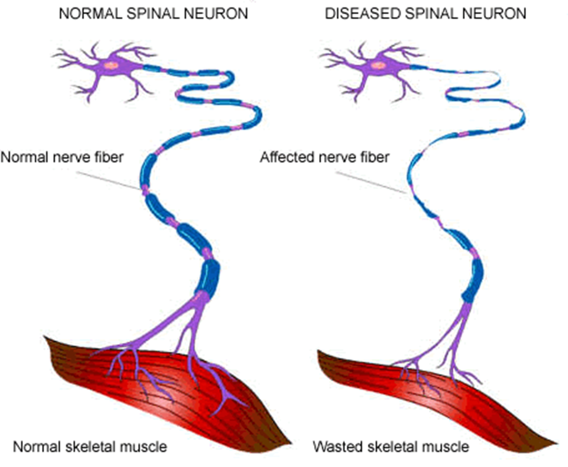
Lou Gehrig
Amyotropic
Lateral Sclerosis
(ALS)

