Slide 1
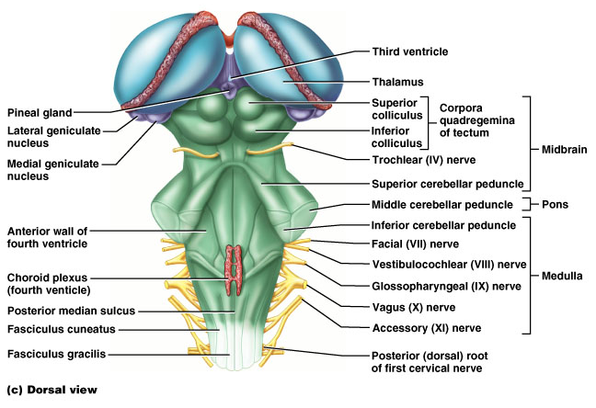
The Brain Stem

Slide 2
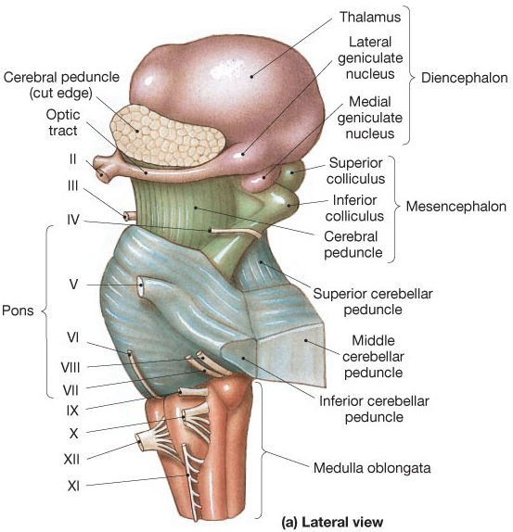
The Brain Stem
Midbrain,
Pons,
Medulla Oblongata

Slide 3

Midbrain
Corpora quadrigemina
= ‘four bodies’ (2 pairs)
Superior colliculi
=> nuclei that act in visual reflexes (vision).
Inferior colliculi
=> nuclei that act in auditory reflexes (sound).

Slide 4
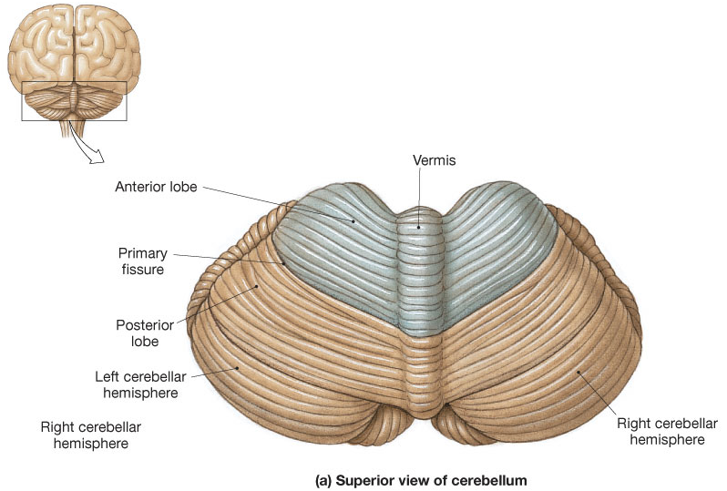

The Cerebellum – superior view
Located dorsal to the pons and medulla
Consists of two cerebellar hemispheres
Folia

Slide 5
Functions of Cerebellum
Located dorsal to the pons and medulla
1) Controls postural reflexes:
- coordinates rapid, automatic adjustments of
muscles in body to maintain equilibrium.
2) Produces skilled movements:-
- implements routines for fine tuned movements.
Refines learned routines until the action
becomes routine.

Slide 6
* Thick tracts connecting the cerebellum to the brain stem
* Superior, Middle and Inferior Cerebellar Peduncles
* Fibers to and from the cerebellum are ipsilateral -
run to and from the same side of the body

Slide 7
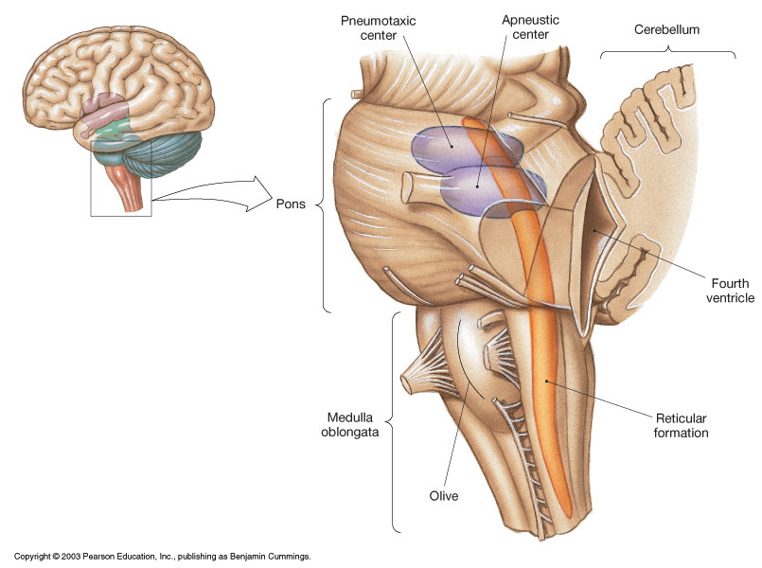
Pons
* Contains the pontine
respiratory centers.

* Contains the nuclei
of cranial nerves
V, VI, and VII

Slide 8
The Medulla contains:
Much of the reticular formation
Nuclei influence autonomic functions

Vital centers of the reticular formation:
1) Cardiac Control Center
2) Respiratory Control Center
3) Vasomotor Control Center
Also contains centers for hiccupping, sneezing,
swallowing, vomiting and coughing.

Slide 9
Protection of the Brain
The Skull
Cranial Meninges
Cerebrospinal Fluid
Blood-Brain Barrier

Slide 10
Cranial Meninges - 3 layer protective membrane
1. Dura Mater - Composed of two layers:
a) Periosteal (Endosteal) – outer layer attaches to bone.
b) Meningeal – inner layer, closer to brain.
(These two layers fused, except to enclose the dural sinuses)
Composed of dense irregular connective tissue.
2. Arachnoid Layer - ‘spider’ web-like layer.
Composed of loose/fibrous connective tissue.
3. Pia Mater - delicate, follows convolutions.
Composed of an outer collagen layer, & inner epithelial elastic and reticular fiber layer.

Slide 11
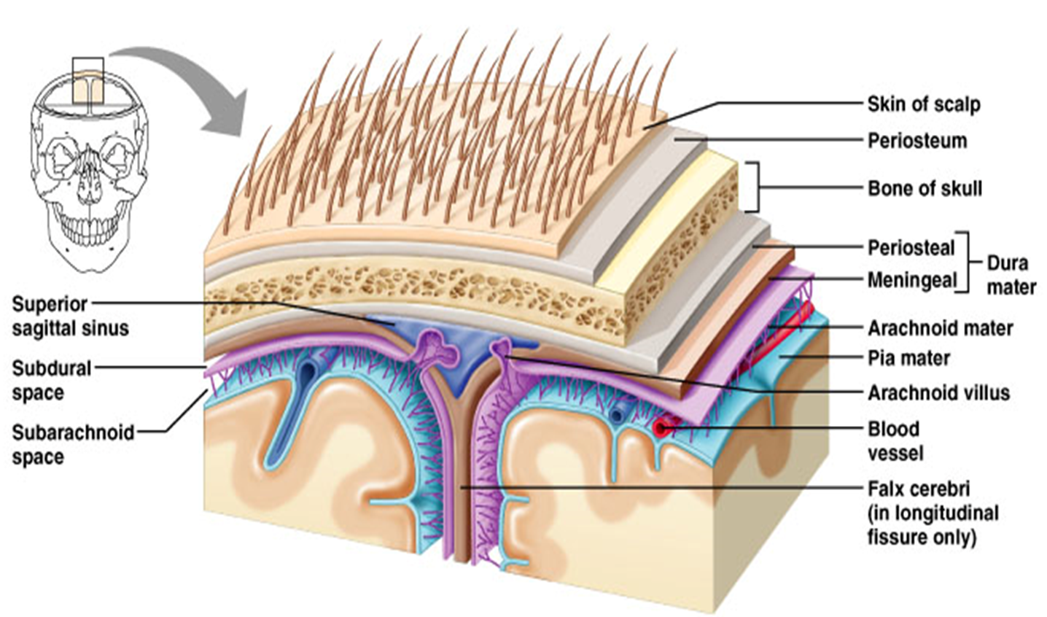

Slide 12
Cranial Meningeal Spaces
Epidural space
Potential space superior to dura.
Subdural space
Potential space between dura and arachnoid mater.
Subarachnoid space
Filled with CSF
Contains the blood vessels supplying brain.

Slide 13
The Sinuses

Slide 14
Cerebrospinal Fluid (CSF)
Roles of CSF:
1. Cushions and insulates delicate nervous tissue.
2. Gives Buoyancy to the brain (“floats” in CSF).
3. Exchange of gases (O₂ and CO₂), nutrients and
wastes.
* CSF formed in the choroid plexuses in ventricles of brain

Slide 15
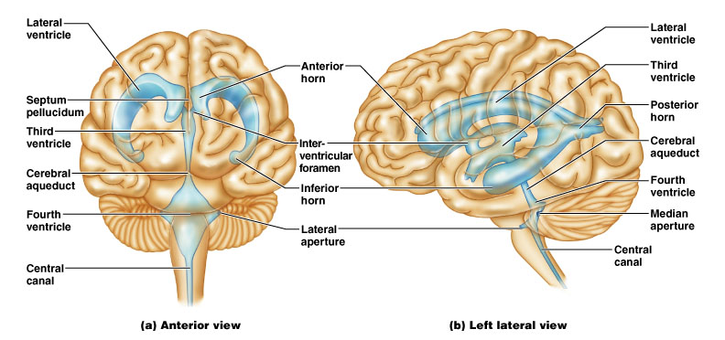
CSF Circulates in:
Chambers, Spaces, and the Central Canal.

Slide 16
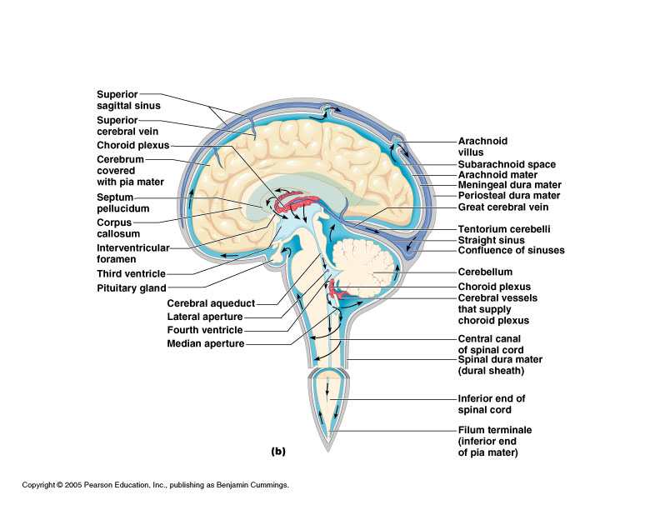

Slide 17
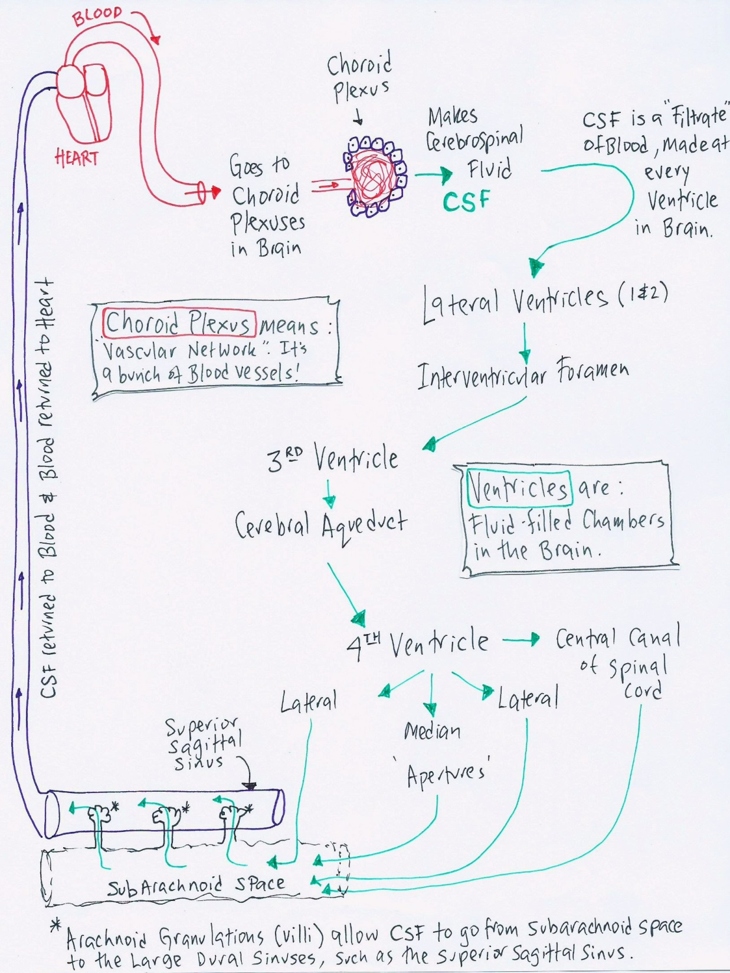

Slide 18
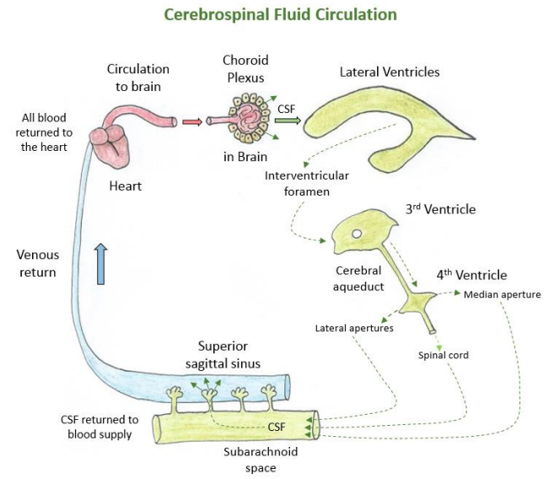

Slide 19
CSF Circulation

Slide 20
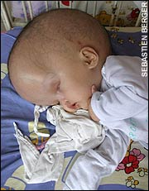

Slide 21
Blood Brain Barrier (BBB)
A restrictive barrier around blood vessels in the brain (created by astrocytes).
Prevents most blood-borne toxins from entering the brain but not an absolute barrier.
Nutrients such as O₂, and glucose can pass. Plus CO₂, alcohol, nicotine, and anesthetics.
Dopamine? L-Dopa?

