Slide 1

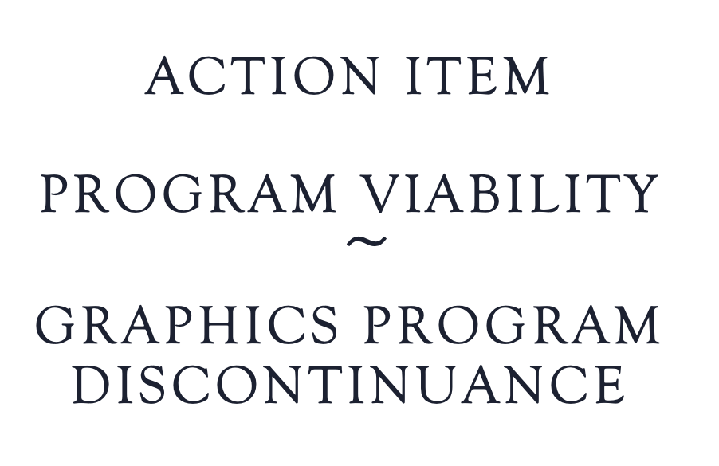
Action Item
Program Viability
$͠$
Graphics Program Discontinuance

Slide 2
Program viability
Discontinuance process
Request for Program Discontinuance forwarded to PROA subcommittee (Spring 2023) (VP & Dean)
PROA Subcommittee Approved request for formation of Program Discontinuance Workgroup (Spring 2023)
Program Viability/Discontinuance Workgroup - Graphics Program Discontinuance (1st Meeting 4/26/23)
College Informed 5/3/23
On Campus Public Forum 5/8/23
Program Viability/Discontinuance Workgroup Recommended Graphics Program Discontinuance (5/26/23)
Program Viability Workgroup Final Report & Recommendation for Graphics Program Discontinuance 8/9/23
PROA Subcommittee Supports the Program Viability Workgroup’s Recommendation 8/28/23
PIER Committee Approved the Recommendation for Graphics Program Discontinuance 9/1/23
Classified Senate Approved the Recommendation for Graphics Program Discontinuance 9/5/23
Associated Student Government Approved the Recommendation for Graphics Program Discontinuance 9/15
Academic Senate First Read 9/5 & 2nd Read & Approval for Graphics Program Discontinuance 9/19
Proposed College Council Review & Approval Date 9/26/23
Proposed Board Review & Approval Date 11/9/23

Slide 3
Program Viability Workgroup
  Michael Odu, Vice President of Instruction, Michael ODU
  Adrian Gonzales, Vice President of Student Services
  Brett Bell, Vice President of Administrative Services
  Lou Ascione, Dean of Liberal Arts
  Rex Heftmann, a faculty member who teaches at least one course in the Program
  Patti Manley, PIER Committee representative
  Catrina Gillus, Counseling Representative, who does not teach in the program.
  Pablo Martin, Academic Senate, who does not teach in the program.
  Darren Hall, Chairs’ Committee, who does not teach in the program.
  Alex Stiller-Shulman, Curriculum Committee, who does not teach in the program.
  Mara Palma Sanft, Miramar’s Articulation Officer
*It is noted that there is no AFT representation. Issues related to faculty are addressed in the Contract and Board Policy by the SDCCD Human Resources office.

Slide 4
Information considered
Articulation (Course & Certificate)
Career Information
Course & Program Data
Curriculum
Program Information & Background
Program Technology
Program Facilities

Slide 5

Action Item
Request for College Council Approval of the Graphics Program Discontinuance Recommendation.

